Slide 1
Rapid Development Projects
Mike Kirsch
NASA Engineering Safety Center

Slide 2
Presentation Objective
Capture Project Management Lessons Learned and Observations from the NESC’s Composite Crew Module project as well as other rapid design development activities.

Slide 3
Composite Crew Module Context
Geographically dispersed team across 4 time zones
Civil servants and contractors working side by side, no clear interfaces or organizational divisions
Competitive contractors on same team – collaborating (we all win, or we all lose)
Design and Manufacture full scale complex composite structure – typical duration ~ 5 years

Slide 4
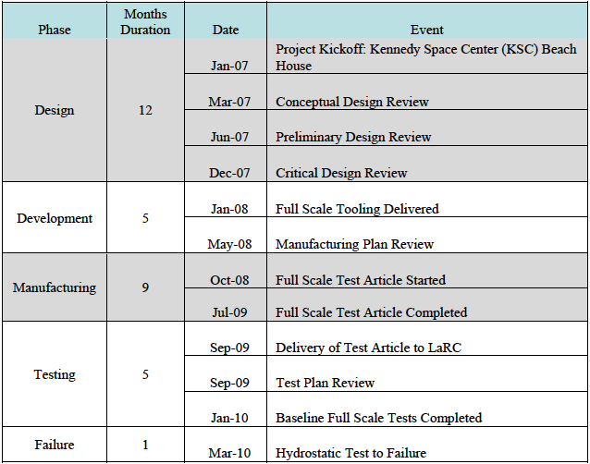
CCM timeline

Slide 5
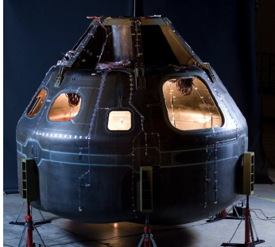
CCM

Slide 6
Project Management
The Project Manager must have practically full control.
  Authority to make team adjustments with minimal overhead
  Authority for make/buy decisions
  Authority to proactively buy down risk; ie; long lead procurements, overtime, double shift, etc.
  Authority to tailor processes (7120)
  Authority to be agile; leverage opportunity and mitigate risks
  Authority to say “good enough”
Thus the project manager must have top cover. On CCM I had the backing of my key stakeholders:
  NESC Director
  NASA Chief Engineer
  Associate Administrator
  Administrator
Stakeholders informed about every 2 weeks on project progress and products

Slide 7
Define a Clear Project Objective
Absolutely clear project objective:
  “provide members of the NASA family hands-on design, build, and test experience on a complex composite structure so that NASA would have the skills for future Exploration hardware projects by:”
    Deliver a full-scale composite crew module primary structure for test, quickly; approximately 18 months from project kick-off to delivery
      Specific, Measureable, Time constrained

Slide 8
NESC Alternate Heat Shield Carrier Structure
Develop and demonstrate an alternative heatshield carrier design with the goal of reducing the structural system mass by 25 percent, or approximately 800 lb.
  The sizing and material of the Avcoat system are not part of this assessment.
The alternate design would be intended for implementation on EM-1
  MPCV EM-1 DAC 1 ~ January 2013 - September 2013
  MPCV EM-1 DAC 2 ~ September 2013 – May 2014
  MPCV EM-1 Structures Design Review ~ July 2014
  MPCV Procurement for EM-1 Hardware starts ~ January 2015

Slide 9
Project Urgency
The Project Management Leadership team, and their leaders must maintain a sense of urgency
It is a race, but it is a marathon, not a sprint
Team Leaders must set and manage the pace to maintain momentum without burnout
Schedule is king once technical is good enough, lowest cost achieved by shortest schedule
  On technical, “better is enemy of good enough”
  Without guidance, engineers may “sharpen the pencil” to perfection

Slide 10
Independent Technical Reviews
Objective: Seek expert opinion on threats and opportunities
Any and all feedback was accepted, but no RIDs were dispositioned – open loop
Issues were collected and managed by PM team

Slide 11
Independent Technical Reviews were critical to synchronize the team
Independent Reviews were product focused – not decision gates
Independent Technical Reviews
  Concept Review – ordered raw material
  PDR – ordered tooling
  CDR – Fabrication of piece parts, Analysis and CAD converged
    Drawings were not a “constraint”
  MRR – Fabrication of assembly – 1 month of critical path drawings released
  TRR – Full scale test readiness – Instrumentation plan, test plan released
    Note: MLAS switched to ITR 1, ITR 2, etc to avoid pre-conceived notions about technical review content
Independent Technical reviews were performed with same group:
  Small team (15-20) of subject matter experts
The whole CCM team was collocated for two weeks with the first week dedicated to dry running review material, and second week dedicated to presenting.
  Much of the design converged during these two week blitz sessions

Slide 12
Team
Team recruited through Center Directors/Engineering Directors – “identify candidates”
Team members “interviewed” to assess agility
Parochial behaviors were squashed
Experts hired “LOE style” irrespective of company or center affiliation
  Statements of work were product based, but loosely
Team adjusted regularly based on threats and opportunities
  Not all members stayed with project
Every one on team doing “in-line” work – flat organization
Management approach
  Full timers are “pro-active”. They need to know critical path
  Part time are reactive ie; “what did I miss”. Part timers need to be given deadline on individual tasks

Slide 13
Colocations/Team building
CCM co-located the first 5 weeks of project
Home for 2 weeks
Then co-located again for 2 weeks
7 of first 9 weeks, were co-located.
Weeks 1 – 5 set expectations, generated relationships
Weeks 6 and 7, members reverted to parochial thinking/decision making (human nature – not by intent)
Weeks 8 and 9 re-established “project based” thinking
Co-located for 2 weeks every two months thereafter, mostly coincident with independent technical reviews.
  Bowling and Skeet shooting were used as social event

Slide 14
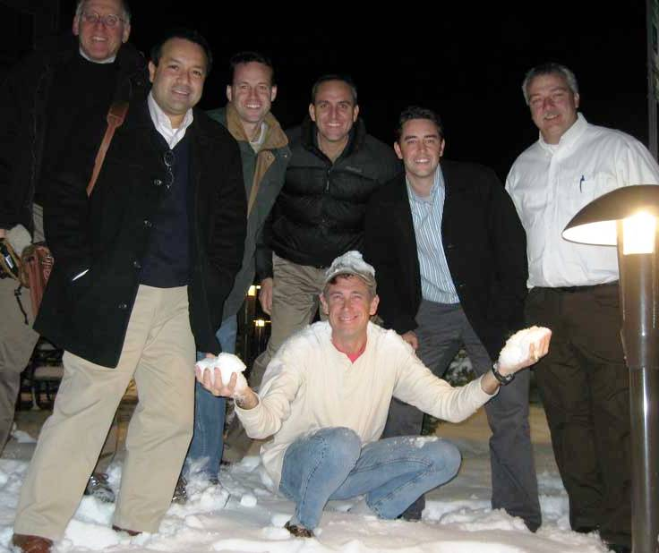
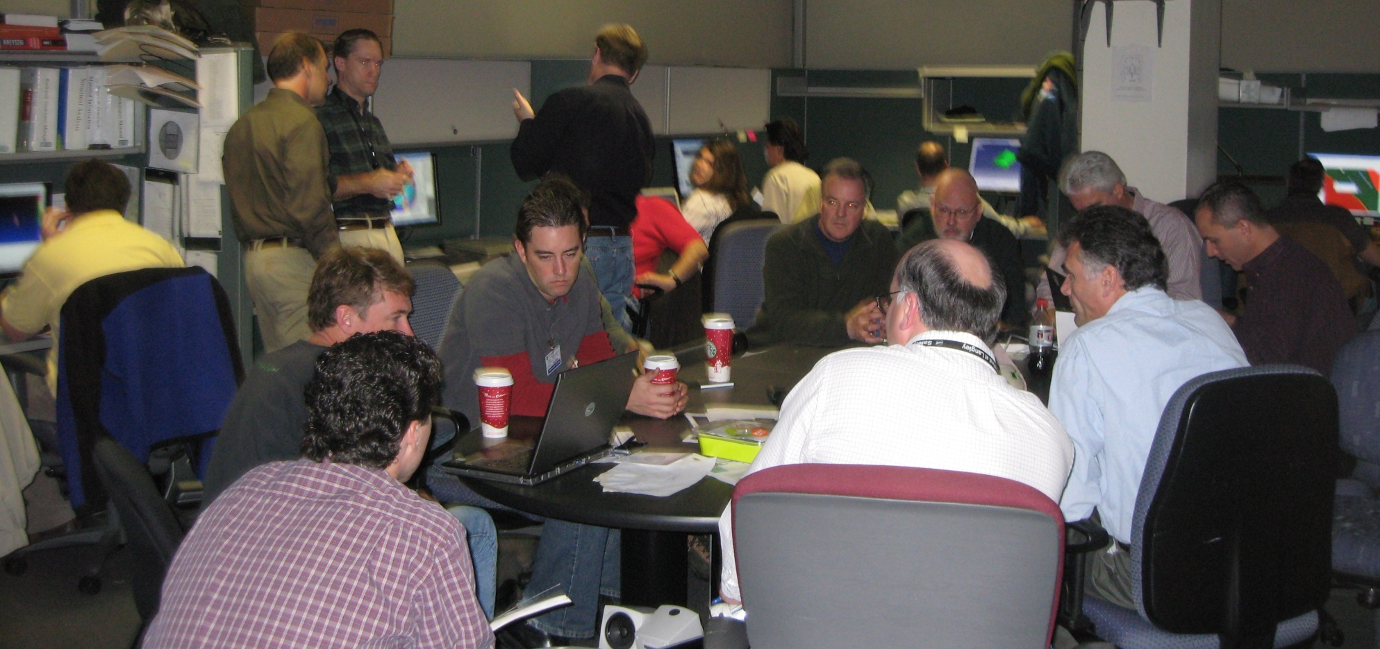
From Ralph Roe’s Safety Culture:
Principle #1 – Develop Relationships
Establish and build strong relationships across the team
  The tendency is to over work the technical and neglect the personal relationship side of the project
  Strong working relationships will allow the team to work through the difficult issues in an open, non-threatening environment

Slide 15
Communications
When Not “co-located””
  Tagup everyday at 8:30
  Team status/decision making M,W,F at 10:30
  Design/analysis sessions T,Th at 1:00
  Telecon/Webex nearly running 24/7
  Instant messaging very valuable throughout
  Instant desk top sharing analyst to analyst, CAD to analyst, etc.
  Mode: Manage as if everyone were in the same room “how would we solve this if we were sitting next to each other”
  Don’t wait for scheduled meeting to bring up issues
When co-located
  Emphasize project objective
  Start everyday with discussion of critical path and “late breaking news”
As PM, I always asked:
  “who’s using your result and do you know what they are going to do with it?”
  Then I would ask, “who are you waiting on, and do they know you are waiting on it, and do they know how you will use their result?”
In general, “Engineers will not integrate themselves”

Slide 16
Heat shield carrier (HSC)
Example - Daily Status
Project appears to be transitioning from multiple days between handoffs, to hours between handoffs
Coordination of the multiple spinning plates is critical!
Daily Status – Discuss what you’re waiting on, and who’s waiting on you.
Include discussion of ETA and ETD
Be cognizant of provider and receiver schedule constraints (leave, travel, etc)
Communication, Communication, Communication!
  Don’t assume others know what you want and don’t assume you know what they want – verify!
  Be a system engineer first, and a discipline engineer second!

Slide 17
HSC Example - Daily Status
What are you waiting on, and do they know?
  CAD
  Static Analysis
  Dynamic Analysis
  Manufacturing
  Test and Integration
  Thermal

Slide 18
Critical Path Management
Project schedule/critical path was “deliverable” centric – ie; products and “handoffs”
Project schedule was discussed no less than weekly.
Broad schedule covering total project at 2 weeks to month fidelity
Rolling daily fidelity for current week through next 3 weeks.
Always looking to “buy” schedule
  OT, second shift, outsource, make/buy
  Theme: fastest schedule results in lowest cost because burn rate is ~ steady
Always baseline “optimistic” durations – and hold/manage reserve at end.
  Never - ever criticize full time member for missing deadline
  Criticize for not informing stakeholder if deadline will be missed
Beware of part timers on critical path
THERE MUST BE A SENSE OF URGENCY!

Slide 19
Heat Shield Carrier
Daily Critical Path Example
2/7 - James sizes V5 with smeared orthogrid spacing based on tabletop engineering at LaRC
  Supplied to Jim
2/8 - Jim sketches Ti orthogrid in 2D – supplied to James
2/8 - James re-optimizes model to generate heights based on orthogrid spacing – supplied to Chris
2/8 - John provides Orion traceable CAD interface surfaces – supplied to Chris
2/8 - Brent generates CAD solution of compression pad to orthogrid interface
2/8 - John generates/updates CAD solution of truss/ring interface to orthogrid
2/12 - Chris Tolman generates CAD surfaces of selected orthogrid pattern and incorporates James’ new optimized orthogrid heights.
  Supplied to Eric, Greg,
2/14 - Chris generates Solid cad model and supplied to John and Brent
  First CAD based mass estimate
2/22 - Eric and Greg generate explicit finite element models using pattern, spacing and web heights from Chris/James and interface definitions from Brent and John
  Supplied to James for optimization
3/8 - John and Brent generate explicit solid CAD models using pattern spacing, web heights, etc from Chris/James.
  Supplied to team for evaluation, including alignment with emerging manufacturing assessment
2/27 - James optimizes orthogrid sizing
  Supplied to Marshall and Claude for dynamic analysis
  Supplied to CAD team for update
3/8 - Marshall and Claude evaluate dynamic response of explicit model
  Supplied to team for evaluation

Slide 20
Cost Management
Shortest schedule equals lowest cost
  KNOW the critical path (fastener lead times are a killer)
  Technically good enough to meet project objective
  THERE MUST BE A SENSE OF URGENCY
Original cost was team size x labor rate x duration + procurements + travel
Once underway Estimate At Complete (EAC) was management method
  EAC = Actual costs + ETC
  ETC = burn rate * remaining duration + other one time expenses
**If earned value is “Required”…**
  BCWP (EV) = Budget – ETC.
    Forward looking – rather than % complete
    Considers open risks and mitigations that may not be in schedule baseline
Be careful asking for cost variance!

Slide 21
Configuration Management
CCM used ICE/Windchill
CCM had a person dedicated to effective use of ICE/Windchill. PM held team accountable for following his expectations when using ICE.
  ICE project side for general file storage
  ICE product side for electronic review/approval of drawings, specs, models, etc.

Slide 22
Rapid Development Take Aways
Baseline Clear Project Objective
Emphasize critical path and product hand-offs
Maintain Urgency
Think system first, discipline second
Be agile – react quickly to threats and opportunities
Advocate Technical peer reviews (ITR)
Focus on relationships
Train next generation

