Slide 1


Model-Centric Engineering, Part 1:
An Introduction to Model-Based Systems Engineering
Presenter: Daniel L Dvorak
Copyright 2013 California Institute of Technology. U.S. Government sponsorship acknowledged.
Notes:
Welcome to “Model-Centric Engineering, Part 1: An Introduction to MBSE”. My name is Dan Dvorak (Animate), and I’ll be presenting this module.
This module is an introduction to what is commonly known as “Model-Based Systems Engineering”, or “M-B-S-E”, but the first part of the title --- “Systems Engineering with System Models” --- emphasizes that this is fundamentally about systems engineering, and that the focus will be on the role that a system model plays in the practice of systems engineering.

Slide 2
Audience, Prerequisites
Intended Audience:
Systems engineers and managers seeking to understand MBSE*: definition, motivations, claimed benefits, etc.
Prerequisites:
Systems engineering background
Non-Objectives:
Not SysML** training
Not tool training
* MBSE = Model-Based Systems Engineering
** SysML = Systems Modeling Language
Notes:
This training module is aimed at systems engineers and managers who want a basic introduction to model-based systems engineering.
We will look at industry definitions of MBSE, what’s motivating it, what’s the big idea, what a system model is and what benefits it can bring, and several other topics. This module assumes some familiarity with the concepts of systems engineering, and but you don’t have to be a practicing systems engineer to understand the main points.
This module will briefly introduce the Systems Modeling Language, commonly referred to as “SysML”, though not for the purpose of teaching the language, but rather for using it to illustrate some of the ideas in MBSE.

Slide 3

Model-Centric Engineering Series
Module 1 (~1¼ hours)
Systems Engineering with System Models
Primary Audience
Managers and systems engineers
Module 2 (~1½ hours)
Introduction to System Modeling
Systems engineers & discipline engineers
Module 3 (~3 hours)
Foundational Concepts for Building System Models
Model developers
(a subset of systems & discipline engineers)
Module 4 (~2½ hours)
Architecting the System Model
Project leadership
(ensure that the model provides value to project)
Notes:
This module is the first in a series of MBSE training modules, and its purpose is to an overview of how a more model-centric approach affects systems engineering.
(Animate) The second module introduces some basic ideas about how to build a good system model, and is targeted at systems engineers and discipline engineers.
(Animate) The third module goes into much more detail about how to represent a system design in terms of foundational concepts and relationships, yielding a well-organized system model that can be checked and analyzed. This module covers concepts such as mission, requirement, component, function, interface, characterization, and analysis --- and the relationships among those concepts.
(Animate) The fourth module covers more foundational concepts, though targeted at programmatics, so it covers concepts such as program, project, stakeholder, work package, process, and product --- and the relationships among those concepts as well as relationships to elements of the system design.

Slide 4
Acknowledgments
Contributors:
Todd Bayer, Daniel Dvorak, Sanford Friedenthal*,
J. Steve Jenkins, Chi Lin, Sanda Mandutianu
Other sources:
Europa Study systems engineering team
JPL Modeling Early Adopters community
Funding:
NASA Chief Engineer (Mike Ryschkewitsch)
  SEWG MBSE initiative (Joseph Smith, HQ)
JPL ESD Integrated Model-Centric Engineering (Chi Lin, JPL)
JPL Systems & Software Division (David Nichols, JPL)
* Affiliation: SAF Consulting
Notes:
Before we get started, I want to acknowledge the other contributors to this training module, namely, Todd Bayer, Sandy Friedenthal, Steve Jenkins, Chi Lin, and Sanda Mandutianu.
(Animate) This module also draws upon information from the Europa Study systems engineering team and the JPL Modeling Early Adopters community.
(Animate) Finally, funding for this training module was provided by the NASA Office of Chief Engineer, headed by Mike R, and by the MBSE initiative of the NASA Systems Engineering Working Group, headed by Joseph Smith. Funding also came from from the Integrated Model-Centric Engineering initiative at JPL – managed by Chi Lin, and from JPL’s Systems & Software Division, managed by David Nichols.

Slide 5
Outline
What is model-based systems engineering (MBSE)?
Systems engineering problems that MBSE addresses
The role of a system model and how it relates to other discipline models
Case study in MBSE
Comparison of MBSE to traditional SE
Management issues:
  Implications for projects, infusion strategy, lessons learned
Summary
Notes:
This module will begin with a couple formal definitions of MBSE and will address the common question “what’s the big idea behind MBSE?”
(Animate) We then look at some problem areas in the current practice of systems engineering that MBSE helps address,
(Animate) and then look at the concept of a system model and the role that it plays, including its relation to other discipline models such as mechanical and electrical models.
(Animate) Then, as a case study, we’ll look at a project that is applying MBSE in the formulation phase to see what systems engineering artifacts they have produced.
(Animate) That will be followed by a brief comparison of MBSE to more conventional SE, including observations from practitioners.
(Animate) And finally, we’ll examine some of the management issues involved in moving to a more model-centric approach. Along the way we’ll look at some myths about MBSE in order to correct some misconceptions.

Slide 6
Preview of Key Points
MBSE is SE. It formalizes part of SE; it doesn’t replace it.
MBSE helps enhance communication, manage complexity, and improve product quality
The “system model” plays an integrating role with respect to the various discipline models in a project
Effective models organize rich technical information, disclose inconsistencies, support analyses and verification, support automated generation of gate products, and preserve technical investments
Infusion of MBSE involves some learning curve and culture change, so plan for it
Notes:
Before we dive in, let’s preview a few key points that will emerge in this module.
(Click) First, it’s worth keeping in mind that MBSE is fundamentally about doing good systems engineering. It’s not a new religion and it doesn’t replace systems engineering.
(Click) Second, projects that have applied MBSE are seeing better communication within teams as well as to stakeholders, better management of complex designs, and improvement in the quality of products.
(Click) Third, we’ll see that the so-called “system model” plays an important role as an integrator of design information in exchanging information with the various discipline models such as mechanical and electrical models.
(Click) Fourth, we’ll see the ability of models to organize rich technical information and help disclose inconsistencies. Well-organized models support analysis, support verification, and support automated generation of gate products.
(Click) Finally, infusion of MBSE principles and practices involves some learning curve and culture change, so it’s best to plan for that

Slide 7
What is Model-Based Systems Engineering, and what’s the Big Idea?
Notes:
OK, let’s begin by addressing the obvious questions: What is model-based systems engineering, and what’s the Big Idea, anyway?

Slide 8
What is MBSE / MBE?
“Model-based systems engineering (MBSE) is the
formalized application of modeling to support system requirements, design, analysis, verification and validation activities beginning in the conceptual design phase and continuing throughout development and later life cycle phases.”
  INCOSE SE Vision 2020 (INCOSE-TP-2004-004-02, Sep 2007)
“Model-Based Engineering (MBE): An approach to engineering that uses models as an integral part of the technical baseline that includes the requirements, analysis, design, implementation, and verification of a capability, system, and/or product throughout the acquisition life cycle.”
  Final Report, Model-Based Engineering Subcommittee, NDIA, Feb. 2011
Notes:
Let’s start with a couple definitions. According to INCOSE, the International Council on Systems Engineering, MBSE is the “formalized application of modeling” to support the engineering activities that systems engineers always engage in, namely, requirements, design, analysis and verification & validation”. The definition goes on to say that MBSE begins early in the project life-cycle and continues into later phases.
(Animate) Continuing on to the second definition, the National Defense Industrial Association emphasizes that model-based engineering “uses models as an integral part of the technical baseline”. In short, both definitions emphasize the role of models in activities that span the project life-cycle.
In this module we’ll often use the phrase “system model”, rather than just “model”, to clarify that we’re focusing on a system-level description

Slide 9
Comparing Document-Based SE to MBSE
Document-based SE produces a variety of documents
  Difficult to …
    assess completeness and consistency of information spread across several documents
    perform traceability
    assess change impacts
MBSE produces a system model, held in a model repository
  Includes system specification, design, analysis and verification
  Provides a more complete, consistent and traceable system design
  Facilitates traceability and change impact assessments
Source: Sanford Friedenthal
Notes:
Now let’s compare the more traditional document-based systems engineering to MBSE.
(Animate)

Slide 10
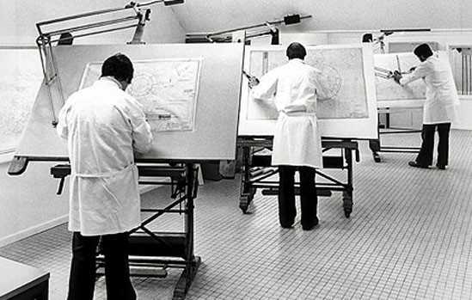
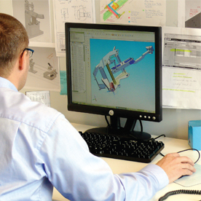
What’s the Big Idea of MBSE?
Add rigor and precision (enhance communication)
Help manage complexity
Electronic and mechanical CAD went through
similar transformations over the last 30 years
Notes:
So, what is the Big Idea of MBSE, anyway? Well the first idea (Animate) is to add rigor and precision to our systems engineering conversations and our work products. Miscommunication is one of the principle dangers in a project, whether it’s due to errors of interpretation or errors of omission, and that vulnerability to miscommunication increases as systems become more complex.
(Animate) The second idea is to help manage complexity in the increasingly ambitious systems that we build. As we proceed in this module, you’ll see how these ideas are put into practice, but let’s look at some recent history in engineering.
(Animate) Over the last 30 years, electrical and mechanical engineering went through a similar transformation, and the benefits were so overwhelming that today, all serious electrical and mechanical engineering is based on computer-aided design and modeling. Adopting a more model-based approach to systems engineering is expected to be as real and important as it was for mechanical and electrical engineering.
If you are wondering why systems engineering is late to this party, part of the answer is that there has been a lack of standards until recently, and another part is that systems engineering has been harder to formalize because of its breadth.

Slide 11
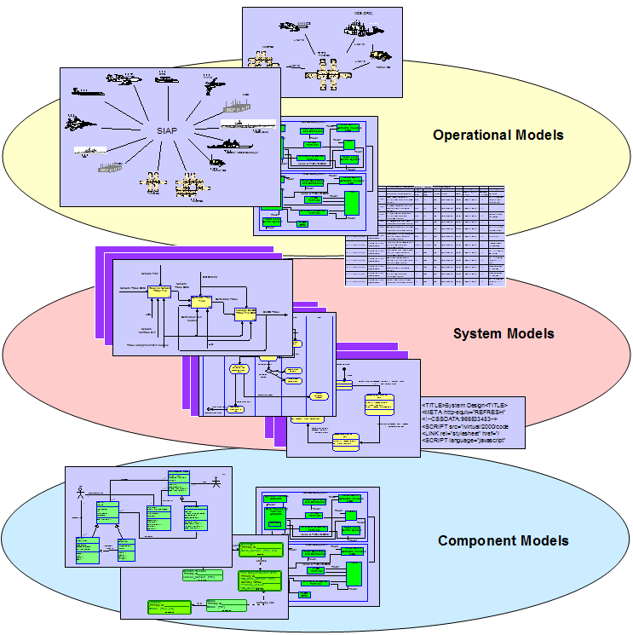
MBSE in two dimensions
Pre-Phase A
Phase A
Phase B
Phase C
Phase D
Phase E
Concept
Studies
Concept &
Technology Dev
Preliminary
Design
Final Design
& Fabrication
Assembly, Test
& Launch
Operations
& Sustainment
MBSE (and SE) …
Spans the engineering
life-cycle
Integrates with multiple engineering disciplines
System
Model
Vertical Integration
Subsystem
Models
Component
Models
11
Notes:
This chart visually emphasizes two dimensions that MBSE shares with SE. (Animate) First, MBSE applies across the project life-cycle, from concept studies in pre-Phase A to operations in Phase E. That’s the horizontal dimension, if you will. (Animate) Second, MBSE focuses on a system-level description, and of course that description must be consistent with the more detailed descriptions of subsystems and components. That’s the vertical dimension. (Animate) At the top of the vertical dimension is something called a “system model”, and that’s what we’ll explore next. Remember, the title of this module is “Systems Engineering with System Models”, so as we proceed, we’ll be talking about the role that a system model plays in a project.

Slide 12
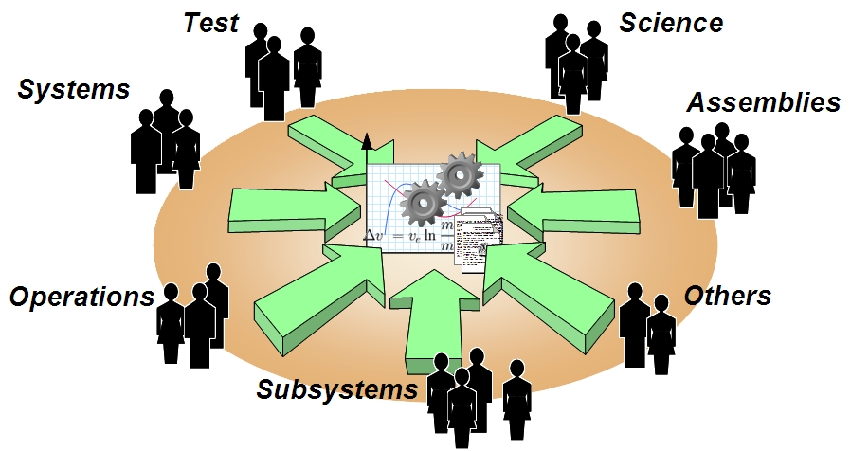
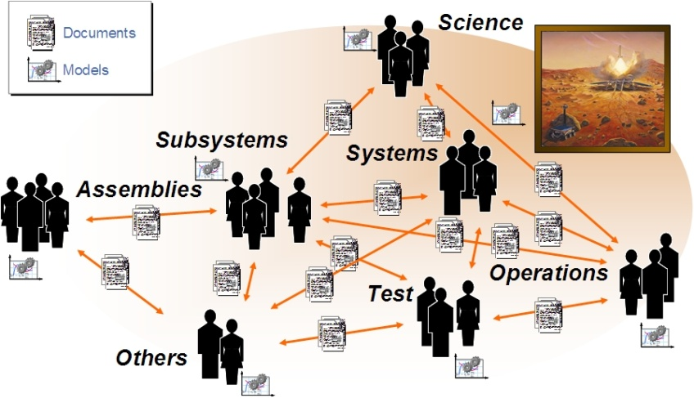
The “System Model”
Systems Engineering requires structural, behavioral, physics and simulation-based models representing the technical designs
Current practice tends to rely on standalone (discipline-specific) models
MBSE moves toward a shared system model. All disciplines, including discipline-specific models, “view” a consistent system model.
Today: Standalone models related through documents
Future: Shared system model with multiple views, and connected to discipline models
Notes:
Now, it has always been true that systems engineers work with models, including structural, behavioral, physics and simulation-based models to represent the technical designs, so what’s different here?
(Animate) Well, one difference is that current practice tends to rely on standalone models. These are often discipline-specific models --- such as mechanical, electrical, thermal, etcetera --- that are loosely integrated, and described in documents. Much of the formal communication among the different engineering teams takes place through a variety of documents that include human-readable text, diagrams, and spreadsheets. The challenges in this traditional approach are: (1) ensuring consistency among all the documented models, especially as the design evolves, and (2) just getting a system-level understanding of the technical baseline.
(Animate) What’s different in MBSE is the move toward a shared system model. I’ll say more about the system model in a few minutes, but it’s worth noting here that the system model is both human-readable and computer-readable, and therefore more easily checked in an automated way for completeness and consistency. The system model becomes a basis of communication --- at a system level --- not just for humans to understand the evolving baseline but also for integrating information across the various discipline-specific models.

Slide 13
Myths about MBSE (part 1)
Myth 1: MBSE is a new craze meant to displace traditional systems engineering
No. MBSE formalizes part of SE to improve precision and rigor. It doesn't displace or replace it.
Myth 2: MBSE is an additional SE activity
No. MBSE is systems engineering, just as ECAD is electrical engineering.
Myth 3: MBSE aims to eliminate documents
No. Documents are still important. What's different in MBSE is that some documents can be generated from an authoritative, integrated system model, and therefore be kept mutually consistent and up to date.
Notes:
Now, before we leave this section, it’s useful to note that there are some misconceptions about MBSE, so let’s take a look at three of them.
(Animate Myth 1) The first myth is that MBSE is some kind of new craze, or new “religion”, if you will, that aims to displace traditional systems engineering, and the short answer is “no”
(Animate). MBSE doesn’t displace traditional SE. What it does is formalize part of SE, and thereby improve precision and rigor.
(Animate Myth 2) Another myth is that MBSE is an additional SE activity, on top of what system engineers already do.
(Animate) The reality is that MBSE is pure technique; it is technique for doing systems engineering, just as Electrical CAD is a technique for doing electrical engineering. It’s not an additional activity.
(Animate Myth 3) A third myth is that MBSE aims to eliminate documents, and that’s understandable given that MBSE is often described as moving from a document-centric approach to a model-centric approach.
(Animate) However, documents are still important and even desirable. A well-structured document containing a thoughtful narrative can convey important facts and analyses in a way that directly addresses stakeholder concerns. What’s possible now, with MBSE, is to keep documents mutually consistent and up to date by generating documents using information in the system model.

Slide 14
What problems exist in systems engineering?
Source: “The Need for an Integrated Model-Centric Engineering Environment at JPL”, 24 Oct 2009, Todd Bayer (JPL IOM-3100-09-040)
Notes:
Moving on now, let’s look at some of the problems that have been identified in the practice of systems engineering, and later on we’ll see how MBSE addresses these problems.
(Animate) What you’ll see in the next few slides came from a 2009 study at JPL that examined several reports about systems engineering in order to understand the problem areas and establish some concrete goals for what to fix. The study was conducted by JPL’s initiative on Integrated Model-Centric Engineering, and five themes emerged.

Slide 15
Problems in Systems Engineering (1 of 5)
Mission complexity is growing
faster than our ability to manage it
?!
Complexity
Scope
Result: Increasing mission risk from inadequate specification & incomplete verification
Notes:
The first problem is that mission complexity is growing faster than our ability to manage it.
Missions have become increasingly ambitious, evolving from flyby reconnaissance to orbital studies to in-situ exploration, and that has been enabled by ever-increasing space-borne processing capability, with more and more flight system functionality implemented in software.
Unfortunately, single-viewpoint, natural language specifications are inadequate to capture and expose these system level interactions and characteristics, increasing the risk of unexpected system behaviors.
At the same time, the potential range of behaviors has become so large that it is impractical to fully test it: problems can no longer be reliably exposed by testing.
(Animate) The result of this situation is that inadequately-specified and incompletely-tested system level interactions are a major and growing risk factor for our missions.

Slide 16
Problems in Systems Engineering (2 of 5)
System design emerges from the pieces, not from an architecture
Result: Systems that are brittle, difficult to test, and complex and expensive to operate
Notes:
The next problem is that system design often emerges from the pieces rather than from an architecture.
Architectural principles are seldom articulated or used to drive the design, and that allows poorly understood or flawed requirements and assumptions to persist, resulting in weakened designs.
In general, weak architecture can lead to unmanageable interactions, stove-piped analyses, brittle fault protection, untestable aspects of design, and late discovery of design defects such as unexpected behaviors and unmet requirements.
Also, with so much of system behaviors managed by software, it’s crucial that systems engineers communicate effectively with software engineers, but textual representations are often ambiguous or incomplete.
(Animate) The result of all these issues is that we end up with systems that are brittle, difficult to test, and hard to operate. In fact, we end up with systems whose behavior must be ‘discovered’ – often in flight.

Slide 17
Problems in Systems Engineering (3 of 5)
Knowledge and investment are lost at project lifecycle phase boundaries
Phase n
Phase n+1
Result: Increasing development cost and risk of late discovery of design problems
Notes:
The third problem is that knowledge and investment are lost at project lifecycle boundaries.
For example, models used during the formulation phase of a project are abandoned and new ones created when implementation phase begins. Many examples exist, including trade models, cost models, power, telecom, and data transport models.
Essential attributes of design are not captured consistently in a readily accessible manner. For example, architectural principles, trade study assumptions and rationale, and system design, rationale, and narrative are only partially captured at best and are seldom readily accessible.
Training of engineers joining a project takes longer than necessary. In moving from pre-phase A to Phase A, and then on to Phases B, C and D, there is significant team expansion and turnover. Training people who were not around for previous phases is currently heavily dependent on getting key documents from, and having lengthy conversations with, key people. Because the system design is poorly captured, this essentially ensures that new team members will be discovering attributes of the design for years.
(Animate) The net result of all this is increasing development cost and late discovery of design problems.

Slide 18

Problems in Systems Engineering (4 of 5)
Knowledge and investment are lost between projects
Project A
Project B
Result: Increasing cost and risk; dampens potential for true product lines
Notes:
The fourth problem is that knowledge and investment are lost between projects.
Since system architectures and designs are not well-captured, re-using them on subsequent projects is difficult and seldom happens, except where the project team itself is ‘inherited’ by the next project.
There is currently no formal way to document and integrate the broad experience and knowledge of engineers across a project, to train new systems engineers who will need to absorb this broad knowledge quickly and deeply, and to make this available as a legacy to future projects in a manner that’s easily dissected and reapplied to new circumstances.
(Animate) The net result is an increase in cost and risk, compared to what could have been. Also, this problem reduces the potential for true product lines.

Slide 19
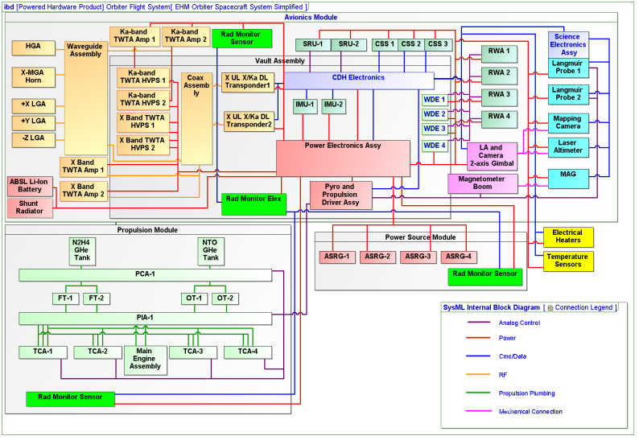
Problems in Systems Engineering (5 of 5)
Technical and programmatic sides of projects are poorly coupled
?
Result: Hampers effective project decision-making, increasing development risk
Notes:
The last problem area is that the technical side of a project is poorly coupled to the programmatic side.
The cost, schedule, scope, investment and risk implications of a given set of requirements, science objectives, components and functions is very difficult to determine. Very little coupling exists between the performance side (science, requirements, components, and functions) and the implementation side (implementation, investments, and risks).
Schedule and cost models rarely include mitigations/backup options for technical implementation risks. It is difficult to transfer information between tools and different discipline types.
Trade studies seldom fully incorporate programmatic considerations, but it’s important that systems engineers be knowledgeable about programmatic realities and the impact of engineering decisions on programmatics. However, existing tools don’t support such an integrated view.
(Animate) The net result is that this poor coupling hampers effective decision-making on both sides --- technical and programmatic --- and that increases development risk.

Slide 20
Industry-Identified Problems in SE*
Poor integration of models across the life cycle
  Hard to get coherent, checkable model of the whole system
  (at some level of abstraction)
Limited reuse of models between programs
  Paying for similar engineering work over and over
Variation in modeling maturity and integration across Engineering Disciplines (e.g., systems, software, mechanical , electrical, test, maintainability, safety, security)
  Mechanical/Electrical CAD/CAE fairly mature
  Systems/Software/Test fairly immature
* Source: NDIA Final Report, Model Based Engineering Subcommittee
Notes:
Before we leave this topic, it’s worth noting that the National Defense Industrial Association noted similar problems Systems Engineering.
For example, they too saw poor integration of models across the lifecycle, making it hard to get a coherent and checkable model of the whole system at some level of abstraction.
(Animate) They also noted the limited reuse of models between programs, which meant that sponsors end up paying for the similar engineering work over and over.
(Animate) They also noted that modeling maturity and integration varied across different engineering disciplines, with mechanical and electrical being fairly mature whereas systems and software and test were fairly immature.

Slide 21

Current State
Desired State
  Architecture and design captured in a formalized and repeatable system model
  Design reviews consist largely of model inspection & validation
  System model evolves from formulation through operations
  System test activities focus on model validation
  Models and modeling tools are integrated across life-cycle
  Behavioral, physical, cost and risk models are integrated, allowing for an integrated fully-informed approach to system optimization
Requirements
& Objectives
Configuration
Operations
Plan
Margin
Analysis
Cost
Model
“System Model”
Spreadsheets, viewgraphs, text documents, e-mails, meeting notes, etc.
System Model
Coupled models of structure, behavior, requirements, and equations. Single source of info. Checkable. Queryable.
Power
Model
Radiation
Model
Structural
Model
Thermal
Model
Notes:
So, let’s wrap up this topic by looking at where many organizations are today and where we would like to be. In sketching this picture, I’m going to oversimplify a bit to make a point.
In the Current State most organizations have a “system model” of sorts consisting of spreadsheets and view graphs and text documents and e-mails and meeting notes …
(Animate) … and this system model is loosely coupled to other models and plans through documents.
(Animate) Ideally, this rather weak notion of “system model” will give way to a much stronger notion in which models of structure, and behavior, and requirements, and equations are coupled so that the relations among these elements are explicit. Such a model would serve as a single source of information --- at a system level --- and would be checkable for various types of consistency and completeness, and queryable in the sense that the model can help answer certain types of questions.
(Animate) Looking into the future, we see a Desired State where several things are different.
(Animate) Architecture and design captured in a a formalized system model
(Animate) Design reviews consist largely of model inspection and validation, and examining key analyses that the model supports.
(Animate) The system model evolves across the lifecycle, from formulation through operations.
(Animate) System test activities focus a lot of attention on model validation, given the importance of an integrated, system model
(Animate) Models and modeling tools are integrated across the life-cycle, and finally …
(Animate) Different types of models --- behavioral, physical, cost and risk models are integrated, allowing for a more fully-informed approach to optimization.

Slide 22
How does MBSE address these problems?
Getting to the desired state builds upon …
  The concept of a formal system model, and
  A standard modeling language

Slide 23
What is a system model?
What role does it play?
Notes:
So let’s now examine a couple obvious questions: What is a system model, anyway? And what role does it play? The answers in this section are fairly simple. We’ll see more detail about a system model later in the case study.

Slide 24
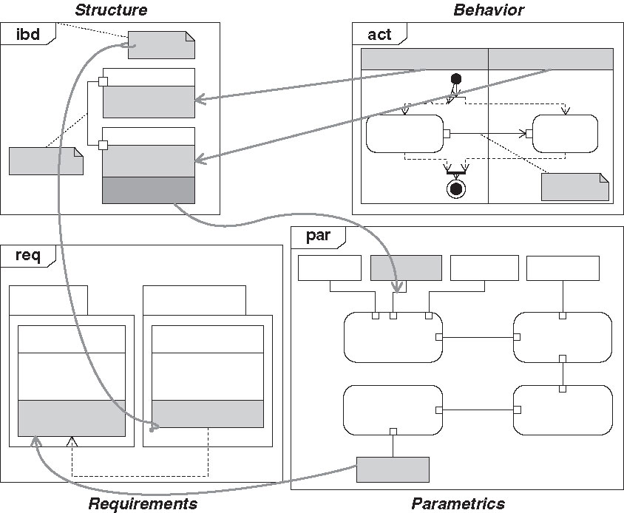
What is a System Model?
Structure
Behavior
A system model is an interconnected set of model elements that represent key system aspects including:
structure,
behavior,
requirements, and
parametrics
A system model represents logical relationships among requirements, design, analysis and verification elements
Requirements
Parametrics
(equations)
Notes:
A system model represents four aspects of system design --- structure, behavior, requirements and parametrics. Understand, of course, that these aspects of system design are not new. Systems engineers have always dealt with these aspects. What’s different here is that these aspects are captured in a single model, and in a way that they are coupled.
(Animate) For example, requirements are coupled to elements of the design that they specify, such as components and interfaces and functions. Likewise, equations used to analyze parts of the design are coupled to the parameters that characterize components and behaviors, or that are specified in requirements.
We’ll see more about this coupling shortly.

Slide 25
System Model as Integrator
The system model exchanges information with discipline models to form an authoritative, up-to-date source of information at a system level
Requirements
Repository
System Model
Analysis Models
Verification Models
U
(
s
)
G
(
s
)
∫
Req’ts Allocation &
Design Integration
Hardware Models
Software Models
S
SET
Q
R
CLR
Q
© Copyright Lockheed Martin Corporation All Rights Reserved
Notes:
The next idea to keep in mind is that a system model plays an integrating role in analysis and design and verification and operations.
As this diagram shows, the system models receives information from other discipline models and it supplies information to other discipline models.
For example, the mass properties of a spacecraft that come from a mechanical CAD model are kept up to date in the system model and supplied to other discipline models that need such information, such as attitude control analyses.
Similarly, performance requirements held in the system model are supplied to appropriate analyses to check if the design satisfies the requirements.

Slide 26
How a System Model Helps
A system model can be structured to answer specific questions
Using traditional methods:
Does every component trace to a requirement?
Have both sides of every interface been specified?
If this requirement changes, what is potentially affected?
What is the dry mass of the flight system?
Show power and energy used for mission scenario x
What is the mass rollup?
System
Model
Manual mapping from every powerpoint block diagram to DOORS.
Yes
No!
Manual mapping from every powerpoint block diagram to every ICD.
List of functions, components, interfaces and requirements
DOORS trace gives only a clue; critical info is in SE’s head.
Manual update of Excel file MEL + manual consistency check of equipment list against all PowerPoint block diagrams.
479 kg
Power and energy profile
Similar to ‘dry mass’ above, but also uses model of scenario
MEL
Same as ‘dry mass’ above.

Slide 27
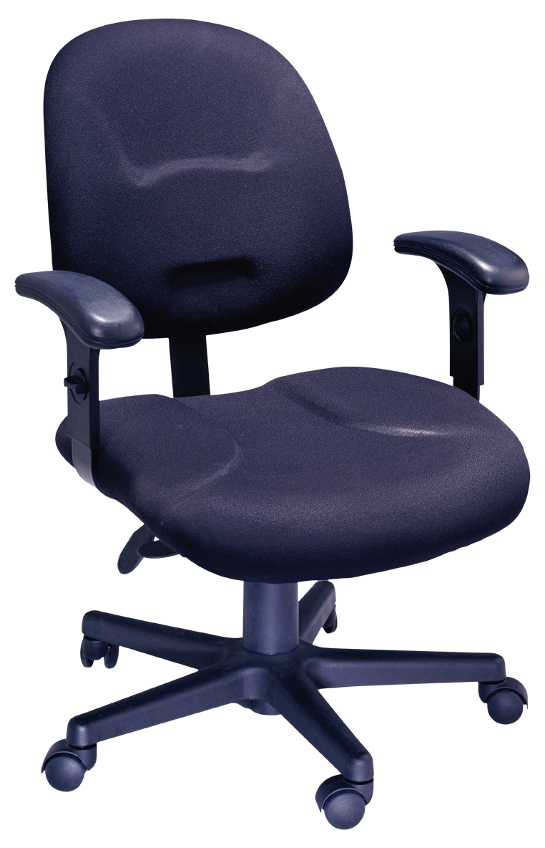
Effective Model vs. Effective Design
An effective model provides sufficient representation to answer the questions being posed (e.g. is it a good design?)
An effective design satisfies its requirements in a cost-effective way
An effective model shows a flawed design to be flawed
Example:
  A CAD model of a chair is a high-quality
  representation of the chair geometry
  … but it could be a poor design
    e.g. can’t handle the load
Source: Sanford Friedenthal
Notes:
It’s useful to make a distinction between an effective model and an effective design.
A model is “effective” if it can help answer the questions being posed. We model for a purpose, and that purpose includes answering questions such as: does the design satisfy the requirements? Does the design have adequate margin in all operational scenarios? Will fault management properly handle failure X?
(Animate) A simple example to make the distinction is a CAD model of a chair. It is certainly a high-quality representation of the chair geometry, …
… but it might be a poor design if it can’t handle the required load. An effective model will tell us.
(Animate) Bottom Line: a model is particularly helpful if it can show a flawed design to be flawed.

Slide 28
What is SysML?
Is SysML required for MBSE?

Slide 29
What is SysML? (1 of 3)
SysML™ = Systems Modeling Language
SysML is a general-purpose modeling language that supports the specification, design, analysis, and verification of systems that may include hardware, software, data, personnel, procedures and facilities.”
(Friedenthal, Moore & Steiner, A Practical Guide to SysML)
SysML is a visual modeling language that is both human- and computer understandable, and extensible.
“SysML is the new industry-standard language designed specifically to support modern systems engineering.”
(Bran Selic, Malina Software Corporation)
Notes:
SysML stands for “Systems Modeling Language”, which is a general-purpose modeling language designed to support systems engineers in what they do, namely, specification, design, analysis, and verification of systems. And the kinds of systems that SysML is designed for include hardware, software, data, personnel, procedures and facilities. As I said, it is very much a general-purpose modeling language.
(Animate) It’s important to know that SysML is a visual modeling language that has several types of diagrams. However, unlike diagrams that you might draw in PowerPoint, the information in a SysML diagram exists in a database, which means that it can be processed in various ways by computer programs, and we’ll say more about that later. The other important thing to know is that the language is extensible. For example, the language has a very general modeling element called a “block”, but that can be extended (or specialized, if you will) to be a Hardware Component, and that may be further specialized to be a Flight Hardware Component, which therefore has mass properties, and that might be further specialized to be a Star Tracker, which has additional properties.
(Animate) Finally, this last quote --- about SysML being an industry-standard language designed to support modern systems engineering --- simply points out that SysML is an industry standard, not a proprietary standard, and in fact it is currently supported by several commercial tools.

Slide 30
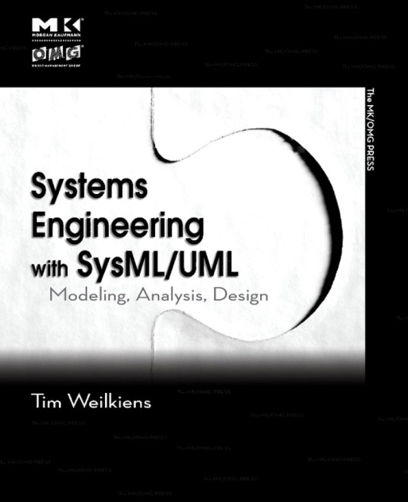
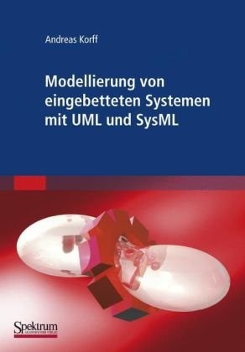
What is SysML? (2 of 3)
SysML is a subset of UML with extensions to support requirements for systems modeling
UML 2
SysML
16 diagrams
9 diagrams
42 extensions
software
modeling
system
modeling
Use of SysML facilitates systems-software communication within projects since UML is the de facto standard software modeling language
Title: “Modeling of embedded systems with UML and SysML” (translated from German)
Notes:
As a language, SysML is related to the UML, the Unified Modeling Language, that came from the world of software engineering in the 1990s. SysML is a subset of UML that has fewer diagram types, but also has numerous extensions specific to systems engineering.
(Animate) This kinship between SysML and UML --- that is, between systems engineering and software engineering --- is particularly useful for systems that include software, which is usually the case for the kinds of systems that NASA develops.
(Animate) By the way, the book shown in the lower left, with the title in German, was included to show that the use of SysML is not confined solely to the United States. In fact, the book shown on the next slide is also a German title.

Slide 31
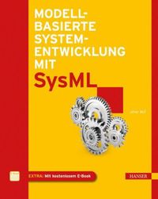
What is SysML? (3 of 3)
SysML is an OMG standard
The Object Management Group™ (OMG) is an international, open membership, not-for-profit computer industry consortium founded in 1989 that creates standards for for software used in government and corporate environments to enable interoperability.
http://www.omg.org/
Title: Model-based system development using SysML
(translated from German)
SysML History*:
2001: INCOSE Model Driven Systems Design workgroup
decides to customize UML for systems engineering
2001: INCOSE and OMG chartered the OMG Systems
Engineering Domain Special Interest Group
2004: The SysML Partners distributed their first open source
SysML specification drafts
2007: Version 1.0 language specification released by OMG
2012: Version 1.3 released by OMG
* http://en.wikipedia.org/wiki/Sysml
Notes:
Earlier, we saw a quote that SysML is an industry-standard language. More specifically, SysML is a standard of OMG, the Object Modeling Group.
(Animate) OMG is an international consortium that has developed specifications in various domains, including business process modeling, software modeling, system modeling, real-time middleware, and many more. Note that their purpose in developing standards is to enable interoperability, and that’s especially important for projects that involve multiple centers and multiple partners.
(Animate) Regarding SysML specifically, as this box shows, the history dates back to 2001 when INCOSE decided to customize UML for systems engineering, thereby building upon a modeling language that began evolving in the 1990s.

Slide 32
What can a SysML model represent?
Structure
Behavior
Structural composition
Interconnection
Classification
Function-based behavior
Message-based behavior
State-based behavior
Requirements
Relationships to other requirements, interfaces, components, analyses, and test cases
Constraints on physical and performance properties
Requirements
Parametrics
Note: The need to represent such aspects has always been part of systems engineering. SysML simply provides a formal language for doing so.
Adapted from Sanford Friedenthal
Notes:
What can a SysML model represent?
(Animate) Well, first, it can represent various aspects of structure, including composition (e.g., a star tracker is part of a spacecraft), interconnection (e.g., the solar panels are connected to the power control unit), and classification (an antenna is a type of flight hardware component).
(Animate) Next, a SysML model can represent behaviors in different ways. An example of function-based behavior is that a star tracker provides attitude information; an example of message-based behavior is that a fault monitor emits a message when it detects a problem; and an example of state-based behavior is that a radio transmitter transitions to an idle state upon receiving a certain command.
(Animate) Next, a SysML model can represent constraints on physical and performance properties. For example, it can represent the equation for calculating signal-to-noise ratio on a space link, given values for all the variables.
(Animate) Also, a SysML model can represent requirements and the relationships that they have to other model elements, such as other requirements, components, interfaces, analyses and test cases. For example, consider a requirement that specifies that a component must provide a particular kind of interface; that requirement is a model element, and it is explicitly related to the interface, which is another model element.
(Animate) In fact, there are many explicit relationships among model elements within a SysML model, as depicted by these lines, and that’s essential to helping maintain consistency among the four categories of information shown here.
(Animate) Finally, just to keep things in perspective, none of these categories of information are new with SysML. To the contrary, they have always been part of systems engineering. SysML simply provides a formal language for representing them, and SysML tools provide a way to help manage them.

Slide 33
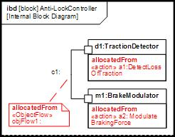
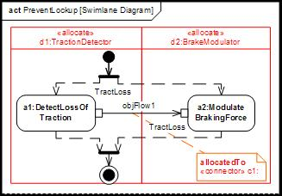
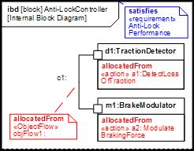
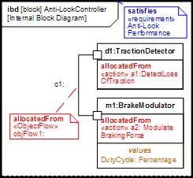
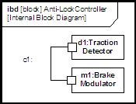
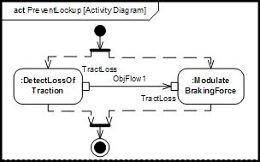
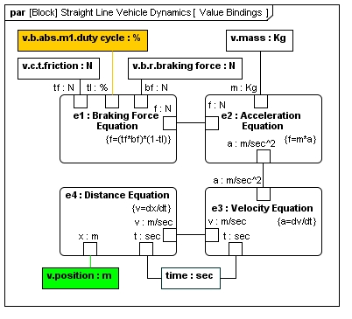
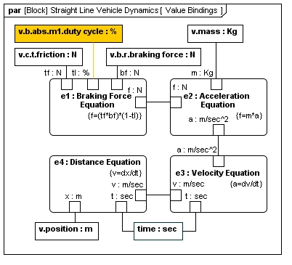
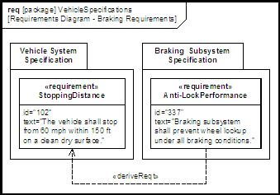
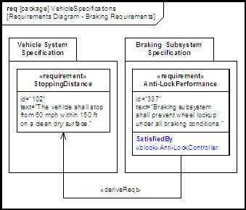
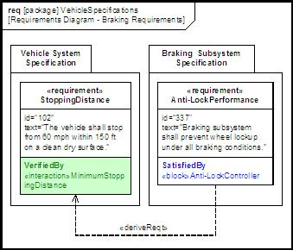
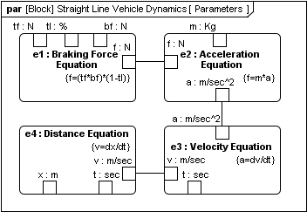
Four Pillars of SysML (and interrelations)
Structure
Behavior
allocate
value
binding
satisfy
Verify
Requirements
Parametrics
Notes:
At the beginning of this module I said that there would be a simple introduction to SysML, and most of it is on this one animated slide. The first thing to note is that a system model consists of model elements that represent key aspects of design, including structure, behavior, requirements and parametrics, each having their own diagrams. The example shown here is for an anti-lock brake controller for an automobile, and under Structure we see an internal block diagram showing that the controller has a Traction Detector and a Brake Modulator, and that they are connected together. Under Behavior, we see an activity diagram showing two actions, namely, Detect Loss of Traction and Modulate Braking Force. And as we continue, we’ll see the ways in which these diagrams are interrelated.
(Animate) For instance, we now see that each action has been allocated to a specific part of the controller (Animate), as shown in the red lines. Specifically, the action “Detect Loss of Traction” has been allocated to the Traction Detector, and “Modulate Braking Force” has been allocated to the Brake Modulator. Thus, we’re seeing the relations between a structural view and a behavioral view of a system.
Moving down to Requirements now, (Animate), we see that a requirement on Anti-Lock Performance is satisfied by the Anti-Lock Controller, or at least that’s the claim, so let’s see how that claim might be verified. Looking at the Brake Modulator (Animate), it has a value property called Duty Cycle, represented as a percentage. (Animate) The value of Duty Cycle is bound to the duty cycle parameter, which is an input to the Braking Force Equation in Parametrics. When all the inputs to all the equations have been supplied by other model elements (which are not shown here), then the equations can be solved (Animate), yielding an output for vehicle position, which is the same as stopping distance. That value can then be compared (Animate) to the required minimum stopping distance to verify whether the design satisfies the requirement.
Now, stepping back from the details, the kinds of connections shown on this slide exist in conventional systems engineering, of course, but the actual connections themselves are more manual and typically involve different tools for text documents, diagrams, and spreadsheets, and keeping all those artifacts mutually consistent requires discipline. What’s different in using SysML is that the relations among model elements exist in a database as part of the system model, and that database can be checked for various types of consistency and completeness. Later, we’ll say more about the kinds of processing that can be done on a system model.

Slide 34
What SysML is Not
Not intended to replace current investment in modeling in other engineering disciplines. (Nor could it.)
  Mechanical, electrical, thermal, telecom, navigation, attitude control, etc.
Not a methodology or a tool
  SysML is a language
  SysML is methodology-neutral and tool-independent
Not required for MBSE
  SysML is designed to support MBSE, but MBSE does not require SysML
“A standardized and robust modeling language is considered a critical enabler for MBSE. The Systems Modeling Language (OMG SysML™) is one such general purpose modeling language …”
A Practical Guide to SysML, 2012
This training module uses SysML to help explain MBSE,
but other system modeling languages could be used as well.
Notes:
In this section I’ve talked about what SysML is, but it’s worth mentioning 3 things that SysML is not.
(Animate) First, SysML is not intended to replace or subsume modeling in other engineering disciplines. Those disciplines --- such as mechanical, electrical, thermal, etc --- all have tools that are better suited for detailed modeling in their discipline. Modeling in SysML is intended to capture a more abstract, system-level of description.
(Animate) Second, SysML is not a methodology or a tool; it’s a language, and it is methodology-neutral and tool-independent.
(Animate) Third, although SysML is designed to support MBSE, MBSE does not require SysML.
(Animate) This quote from one of the SysML books makes the point that a standardized modeling language is an enabler for MBSE, and that SysML is one such modeling language.
(Animate) So, this training module uses SysML to help explain MBSE, but other modeling languages could be used as well.

Slide 35
Myths about MBSE (part 2)
Myth 4: MBSE is just about using SysML
No. SysML is a modeling language that can be used to describe systems, whereas MBSE is the application of modeling languages, methods, tools, and domain knowledge to analyze, specify, design, and verify systems.
Myth 5: There’s nothing really new in MBSE;
SE’s already create many kinds of models
Modeling is not new. What’s new is the existence of formal modeling languages for describing systems, and the role that a system model can play in integrating information from other models.
Myth 6: SysML tools are just new drawing tools, similar to the Visio™ and PowerPoint™ tools
No. Information in SysML diagrams is stored in a database and can be analyzed for consistency and completeness, and processed to generate reports. Data can be exchanged with other discipline models.

Slide 36
Making it Real:
A case study in MBSE
Examples are from the Europa study,
courtesy of Todd Bayer

Slide 37
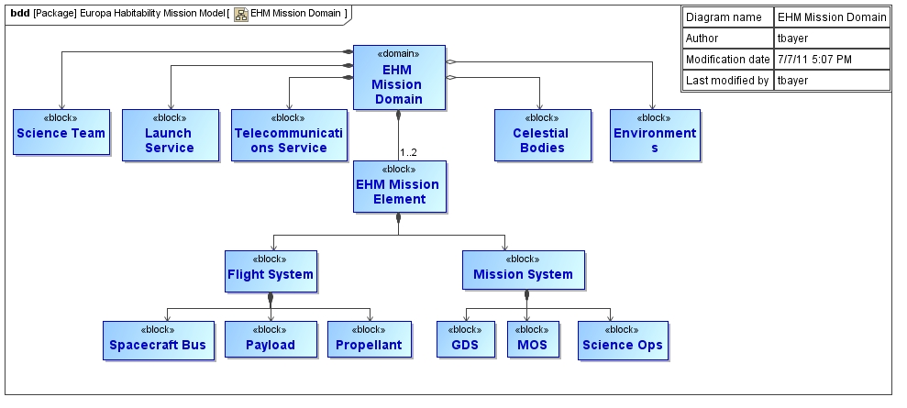
MBSE Case Study
Mission Domain
Top-level view: “front door” to more detailed views
Composite association
Reference association
Notes:
This simple block diagram in SysML is a structure diagram that shows the “Mission Domain” for the EHM mission, and that mission domain is composed of several elements, including the science team, launch service, telecommunications service, and mission elements. The mission element further decomposes into the Flight System and the Mission System. And as you can see, the Flight System is further decomposed, as is the Mission System. What’s useful about this kind of diagram is that it can serve as a top-level view or “front door” to the system model. Clicking on blocks in this diagram leads to more detailed views.

Slide 38

MBSE Case Study
Flight System Composition (a.k.a. System Block Diagram)
Internal block diagram (ibd) shows connections among elements
Authoritative statement of flight system composition
Mass & Power reports are produced directly from the underlying model
Notes:
This diagram --- sometimes referred to as a “System Block Diagram” --- is also a SysML diagram.
Visually, it looks very much like the kind of diagram that engineers have produced in PowerPoint or Visio, but in SysML, all these modeling elements --- and the connections among them --- are represented in a database.
As you can see in the Connection Legend in the lower right, different types of connections are shown in different colors, and that’s for the benefit of people reading the diagram. In the database, those connections are distinguished with different classifiers.
A key point, as I’ve said previously, is that such a model can be analyzed in various ways using algorithms that traverse the database, extracting what’s needed for the analysis.
Anyway, this block diagram is a kind of structure diagram in SysML that shows what is connected to what.

Slide 39
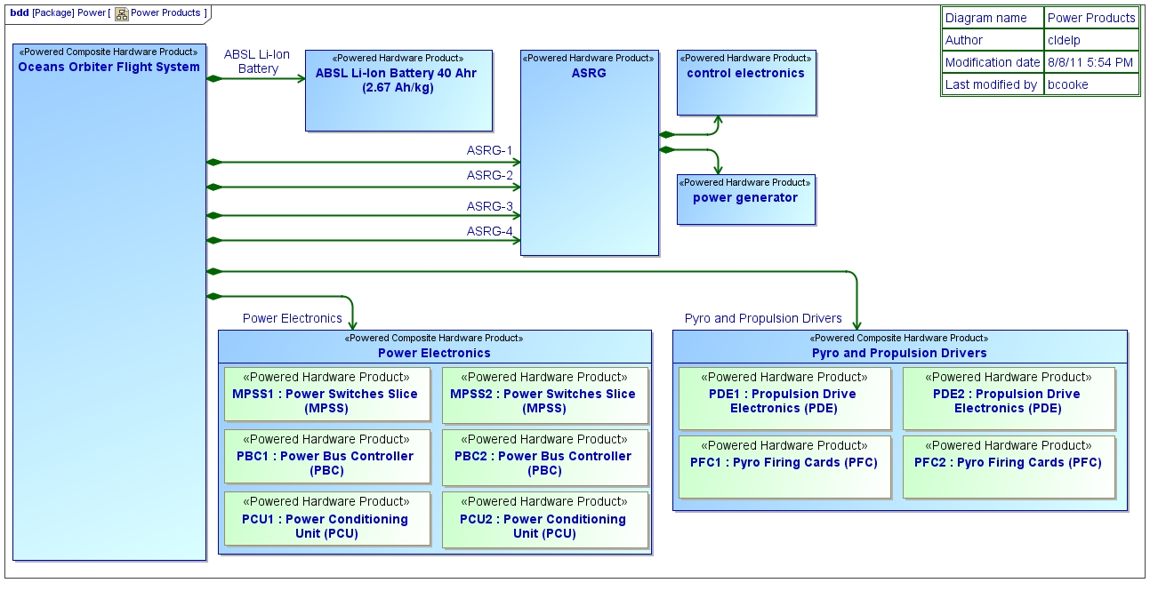
MBSE Case Study
Subsystem Deployment
This block diagram is a view of the flight system
showing only the powered elements
Notes:
In contrast to the previous diagram that showed components and connnections, this block diagram shows a couple levels of decomposition, but no connections. For example, the “Oceans Orbiter Flight System” block shown on the left is composed of a battery, an ASRG, power electronics, and pyro and propulsion drivers. Those last two are further decomposed into other products.
So, this block diagram is a kind of structure diagram in SysML that shows what is part of what.

Slide 40
  MBSE Case Study
  Equipment List and Mass Margin Report
Produced directly from the system model
Reports mass of payload, spacecraft, and propellant, and computes margin relative to launch vehicle capability
Legend:
  CBE: Current Best Estimate
  Cont: Contingency (percentage)
  MEV: Maximum expected value
Notes:
This slide shows a simple example of a report that can be generated from information in the system model. It shows the current best estimate of mass for different parts of the spacecraft, and the maximum expected value.
The report rolls up the total mass of the payload and the spacecraft and the propellant, and computes the margin relative to the launch vehicle capability.
It’s a simple example of a common view of the design that’s really important to some stakeholders. What’s important to keep in mind is that as long as the system model is kept up-to-date with mass information, this kind of report can be regenerated easily and frequently.

Slide 41
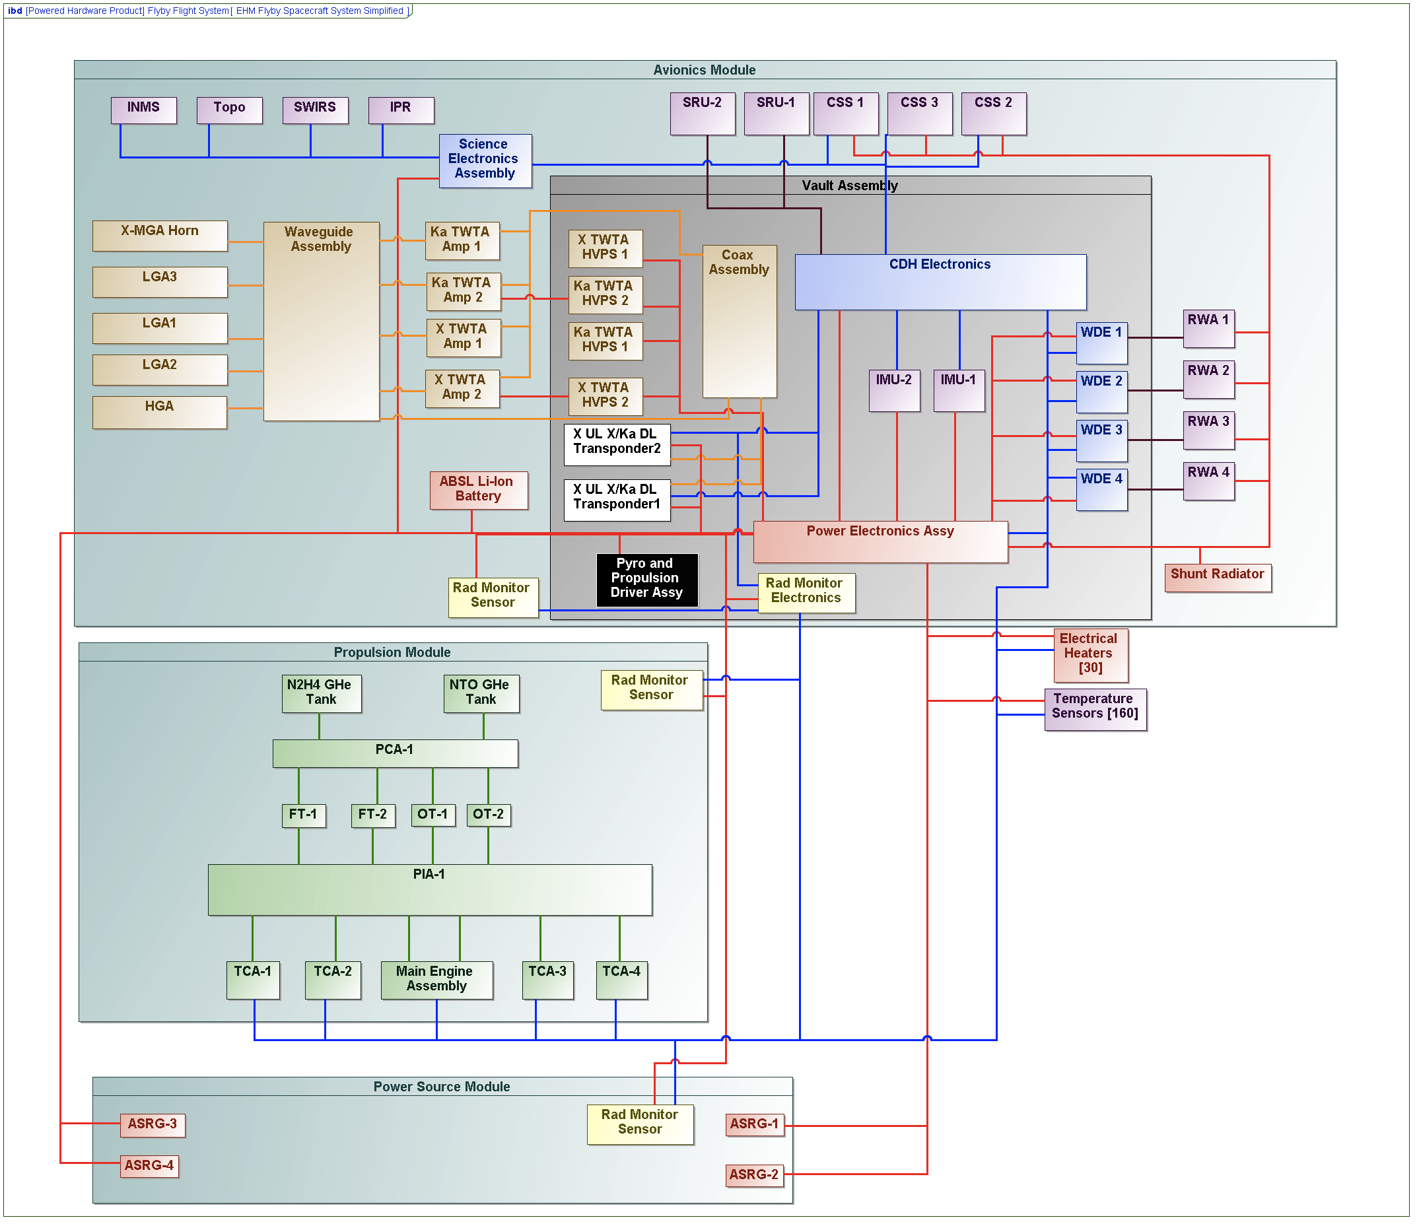
MBSE Case Study
Model-Generated Power Margin Analysis
The Europa Clipper System Model
Including component power
characterizations and
mission scenarios
Discipline Specific
Energy and Power
Margin Functions
in an accessible format
(e.g. Mathematica)
Mission Specific Energy
and Power Margin
Analysis Results
Energy Power Margin Analysis
Mathematica/Maple/Matlab
Key system metrics (such as power margin) are derived early in the mission lifecycle, using reliable analysis functions, produced rapidly with little effort.
Notes:
This slide shows an overview of how a power margin analysis is generated.
In simple terms, information in the system model about component power loads and mission scenarios is provided to an analysis program that computes how power and energy changes over the course of one orbit around Jupiter, which takes 7 Earth days.
The analysis program in this case was developed in Mathematica, but other mathematical tools could be used.

Slide 42
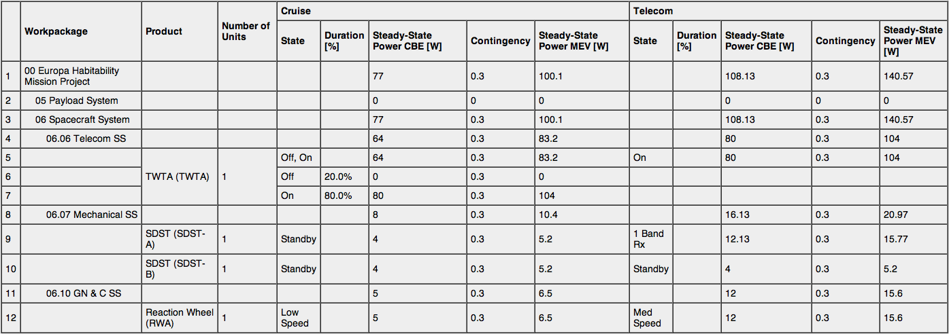
MBSE Case Study
Modeling Power Load Characterization
Associates a system-level power load characterization with a power load characterization of each component
Notes:
This chart shows the power modes of different spacecraft elements such as transponder, traveling wave tube, and reaction wheel.
The power modes are shown in a sequence diagram, and each such mode has an associated power draw in Watts, as shown in the grey-colored table.
This information will be used in the next step when we look at all the different segments of a 7-day orbit.

Slide 43
MBSE Case Study
Mission Scenario Modeling
Think of an orbit as a flower with petals
Define each piece of a flyby petal as a system level power mode.
Define the flyby scenario as a timeline in terms of the system level power modes.
Notes:
Now the next part of power margin analysis requires representing a mission scenario --- an orbit around Jupiter that flies past Europa --- as a sequence of system modes, each having its own details about energy production and power consumption.
(Animate) Each orbit around Jupiter takes 7 earth days, and that orbit can be thought of as the petals of a flower.
(Animate) Each petal represents a system level power mode.
(Animate) And as we see here on the right, the scenario starts at the top with a red petal for what’s called “near science”, and then an orange petal for “far science”, and then green petals for cruise and telecom, and so forth. With that, including the time duration for each petal, we now have enough information in the model to calculate the power margin analysis.

Slide 44
MBSE Case Study
Model-Generated Power Margin Analysis
7 day Petal Scenario
Battery SOC
Week 1
Week 2
Total Load + 40%
Power Generation
Power (W)
State of Charge (SOC)
CBE Total Load
Telecom
Payload
Timestep (hours)
Notes:
This slide shows the results of the analysis for two consecutive orbits.
Using the legend on the right, we see the green line showing periods of telecom activity.
We also see the red line showing power generation, which is fairly constant except during eclipse.
And the pink line shows battery state of charge, which declines sharply during eclipse and gradually builds back up to 100% before the next eclipse.
Although the power model used here is quite simple, it enables the project to do a margin analysis, and easily recalculate it as the design changes.

Slide 45
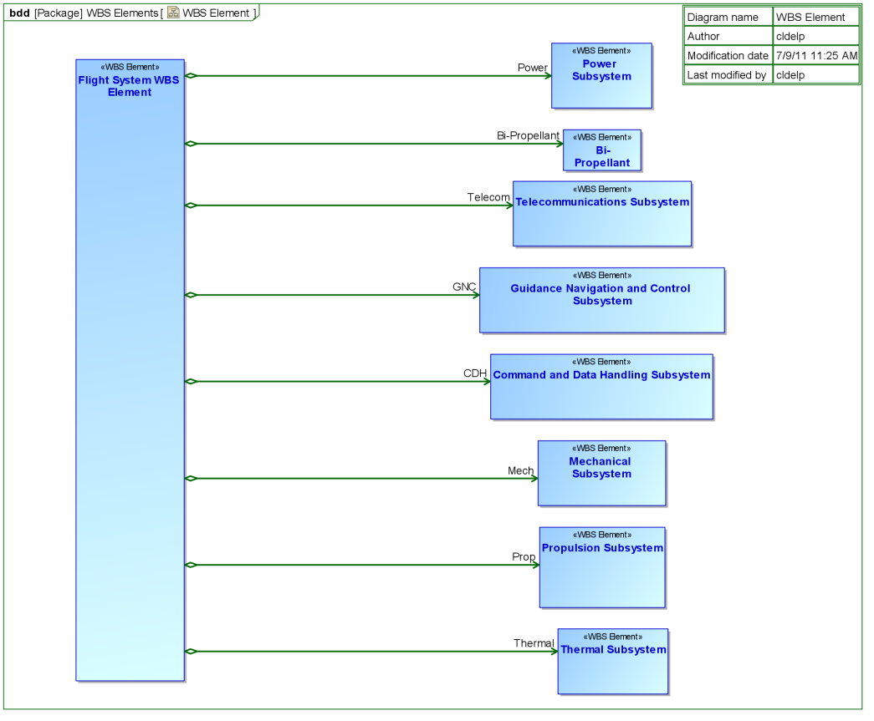
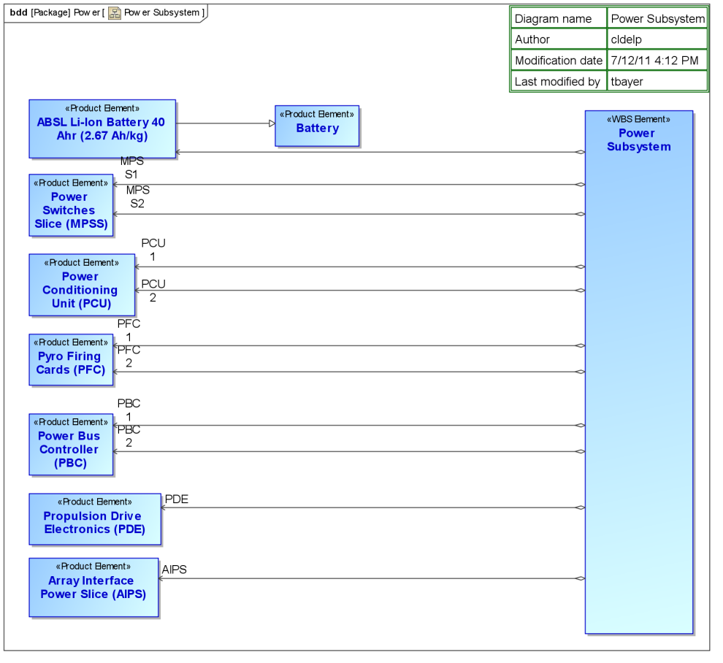
MBSE Case Study
Work Breakdown vs. Product Breakdown
Subsystems seldom delivered as integrated components
Better understood as aggregations of convenience, in this case aggregations of delivery responsibility
Work breakdown (WBS)
Example:
Flight system WBS element authorizes Power Subsystem WBS element.”
Product supplier
Example:
Power Subsystem WBS element supplies products: Battery, Power Switches, etc.

Slide 46
How does MBSE compare to traditional SE?
What’s happening in industry?

Slide 47
Modeling in Traditional Systems Engineering
“Models have been used as part of document-based systems engineering approach for many years, and include functional flow diagrams, behavior diagrams, schematic block diagrams, N² charts, performance simulations, and reliability models, to name a few.” *
“However, the use of models has generally been limited in scope to support specific types of analysis or selected aspects of system design. The individual models have not been integrated into a coherent model of the overall system.” *
* A Practical Guide to SysML. Friedenthal, Moore and Steiner.

Slide 48
MBSE: Consistency and Continuity
Transition to a rigorous system model helps ensure consistent modeling across disciplines and continuous access to this system model between system levels and across the life cycle
_{Past}
Specifications
Interface requirements
System design
Analysis & Trade-off
Test plans
_{Future}
Revision by GIT; Original Source: OMG SysML Tutorial (June 2008). Reprinted with permission. Copyright © 2006-2008 by Object Management Group.
Notes:
Focus on what MBSE brings to the table – don’t attack the “document” straw man

Slide 49
MBSE: What’s new about it?
Modeling is not new
  Flight projects have a strong legacy of modeling
  (structural, thermal, circuit design, mission design…)
  Systems Engineering uses models also, though typically limited in scope and duration. A set of requirements, an excel spreadsheet, and a PowerPoint drawing are all models.
What is new is …
  the availability of a formal modeling language which can describe systems, and
  the information engineering standards and tools which enable integration of a system model with existing discipline models.

Slide 50
What MBSE Practitioners Say (1 of 2)
It Enhances Communication
  A single, authoritative source of information keeps team on same page
  Standard documents are kept consistent and up-to-date
  More complete transmission of concepts & rationale from one phase to next
It Improves Productivity
  Less hunting for information.
  Time-consuming project documents/reports become trivial to generate
It Improves Quality
  Earlier detection of inconsistencies (‘escapes’) due to clearer semantics
  “One thing that I’ve found is that the process of modeling leads to ‘escape discovery’. …capturing the details leads to a greater understanding of the system and makes errors or potential problem areas ‘pop out’.”

Slide 51
What MBSE Practitioners Say (2 of 2)
It Supports Integration
  Provides consistent definition of system to integrate with discipline models, including cost models and science margin models
It Helps Manage Complexity
  Different views address the concerns of different stakeholders
It Enables Reuse of Institutional Knowledge
  MBSE enhances reuse of intellectual property
  (model elements embody hard-earned technical expertise)
It Attracts Early Career Talent
  MBSE forms a bridge from college education to institutional practices
  MBSE methods being taught to the current generation of engineering students
  New hires are prominent among the early adopters

Slide 52
What Boeing Says
Why MBSE now?
System definitions have moved from simple to highly integrated & complex
Customers’ drive to open architectures and increased affordability
Faster delivery of adaptable, interoperable systems
Measurable Benefits
  Comprehensive integrated architectures resulted in a significant reduction in interface definition changes after initial design
  Detailed functional architectures resulted in reductions of actual program test hours
  MBSE used for early identification of system performance impacts, resulting in a more effective network performance
  Potential design issues were identified early in the lifecycle
Source : Christi Gau Pagnanelli, Barbara Sheeley, Ronald Carson, The Boeing Company, “Model-Based Systems Engineering in an Integrated Environment”

Slide 53
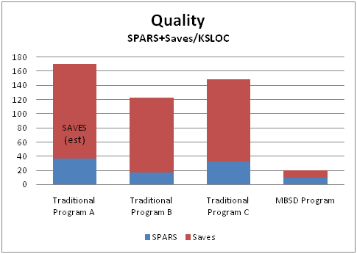
What Lockheed Says
Case Study from LM Aeronautics
Collected data from four real aerospace and defense programs at LM
Three programs used traditional approach; one software-intensive system used model-based
Measurable Benefits
  Quality: model-based approach had fewer defects per requirement
  Software Quality: model-based approach
  had far fewer defects per KSLOC
  Affordability: When normalized for system
  size, the model-based-produced system
  was developed at a significantly reduced
  cost
Source: Lenny Delligatti, Lockheed Martin Corp., “Model-Based Systems Engineering (MBSE) with SysML”

Slide 54
MBSE in Industry
  In a 2009 SysML survey, 45 companies participated:
No longer small pilot studies!
Actively used in most large companies in Aerospace, Defense, Automotive
MBSE is becoming part of day-to-day engineering practice
Space Systems: 23%
Aircraft: 20%
Defense: 20%
Automotive: 7%
Other: 30%
Project Duration
1 mo – 1 year: 20%
1 year – 3 years: 35%
> 3 years: 45%
Project Size
< 10 people: 28%
10 – 100: 40%
100 – 1000: 22%
> 1000 people: 10%
(Data Source: Robert Cloutier — http://www.omg.org/cgi-bin/doc?syseng/2009-12-04)

Slide 55
Why is MBSE Being Used?
Large majority (55.2%) cited the opportunity to improve Systems Engineering efforts as the reason for using modelling.
When asked what the primary purpose of the model was, the majority said it was specifically to improve the quality of requirements and design to reduce downstream defects

Slide 56
The Value of MBSE: From the SE Community
MBSE Improves Productivity
  Single system model is authoritative, unambiguous, and durable
    Less time spent looking for information
  System model promotes communication (single source of truth)
    Keeps whole team on the same page
  Documents and charts are generated from the model
    Reduces time “wasted” on making slides for gate reviews
  Standard analyses can be run frequently
  Gate transitions are more seamless:
    Formulation ➔ Implementation ➔ Ops
MBSE Improves Quality and Reduce Risk
  Industry-standard notation reduces misunderstanding
  System-level validation can be done early
  Model is analyzable, unlike powerpoint/visio, so it can support many kinds of checks (completeness, consistency, correctness)
  Documents kept up-to-date by generating them from the model

Slide 57
A Historical Perspective on SE and MBSE
Long ago, systems and subsystems were on equal footing
Over time, computers allowed pretty much all the domains − except systems − to build rigorous modeling capabilities.
  Systems is the last to get this rigor because it’s the broadest, most conceptual, and has by definition the full complexity of the system to deal with. So it’s the hardest one to get rigorous about.
SE has been at a disadvantage because of this
  Lacking this quantitative rigor, SE has had to rely too heavily on intuition, overemphasizing the Art and neglecting the Science
SE needs to claim the rigor of its domain to restore balance
  Otherwise our systems will continue to be assemblages of components whose performance and behavior must be discovered after assembly.
MBSE provides this rigor
Source: Todd Bayer (JPL)
Notes:
Way back when, no one had computers and everyone, systems and subsystems, were kind of on equal footing as far as what they could assert about the design. Over time, computers allowed pretty much all the domains - except systems - to build rigorous modeling capabilities which they could use to make strong assertions about their part of the design. But that state of affairs meant that the subsystems accreted most of the authority in discussing the design and design changes. They are able to drive the design to a place favorable for their subsystems because they can ‘prove’ why they need to do so. Systems is more or less a bystander to this discussion because about all they can do is put an experienced person at the table who can talk about the issue, but not contribute any authoritative, rigorous analysis to show why a different point in the overall design space is better for everyone. (Prof. Heinz Stoewer suggests that systems engineering is really concerned with two things: synthesis and control. This is probably a good way to think of what’s meant by rigor in this case).
MBSE is the thing which can provide this rigor to systems engineering. This would help restore the ‘balance of power’ between systems and subsystems. Systems will be able to have more impact on the design up front -- when it matters -- rather than be in the mode of trying to catch up and track all the changes after they’re made.
Systems is the last to get this rigor because it’s the broadest, most conceptual, and has by definition the full complexity of the system to deal with. So it’s the hardest one to get rigorous about.
Until Systems Engineering can speak rigorously about the system, the spacecraft we launch will continue to be not much more than collections of subsystems, patched together by systems engineers playing catch-up. This means that MBSE is not just good. We are convinced that for the future of Systems Engineering and of the systems we build, MBSE is essential and urgent.

Slide 58
Observed Benefits of MBSE (1 of 2)
Modern modeling languages have clearer semantics than common boxes-and-lines diagrams, reducing miscommunication
Consistent, single source of information keeps team on same page and reduces time spent getting answers
Earlier detection of inconsistencies because models can be analyzed with respect to calculations, policies, rules, patterns, etc.
Documents are kept up-to-date because they can be auto-generated from the system model

Slide 59
Observed Benefits of MBSE (2 of 2)
System model supports multiple views to address different stakeholder concerns, and all views refer to same model elements, so changes in an element appear on all views
Model-based simulation of state machines enables debugging and refinement of behavioral requirements
System model evolves across life-cycle and may guide similar future projects
System model helps to better manage complexity
Summary
Formal systems models offer these benefits because they introduce additional consistency and continuity, and because they are both human- and computer-understandable, and logically verifiable

Slide 60
Comparison Summary
MBSE does not replace traditional SE
Rather, MBSE formalizes part of SE
MBSE combines traditional methods and best practices with rigorous modeling techniques
Formal systems models offer these benefits because they introduce additional consistency and continuity, and because they are both human- and computer-understandable, and logically verifiable
Notes:
So let’s recap.
First, we’ve seen that MBSE formalizes part of SE; it doesn’t replace it.
Second, MBSE is still SE, and so traditional methods of analysis and verification still apply, and some of them are facilitated by having a rigorous model.
Third, we get these benefits because formal system models help expose inconsistencies, partly because they are human-understandable and partly because they are logically verifiable.

Slide 61
Management Issues
Implications for projects
Infusion challenges
Lessons learned

Slide 62
MBSE implications for projects
How does MBSE affect…
deliverables?
project schedule/milestones?
project organization?
processes (e.g. design, reviews, CM, model mgmt, methodology…)?
infrastructure?
metrics?

Slide 63

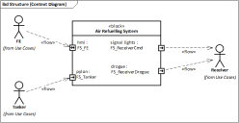
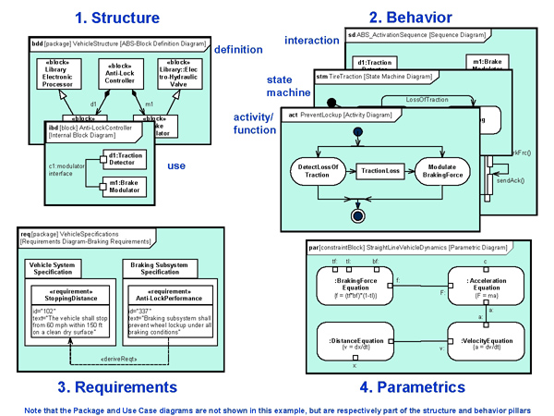
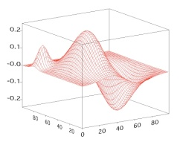

MBSE implications for projects (1 of 6)
How does MBSE affect deliverables?
Project still has to produce deliverables for each review
Some documents may be generated automatically from system model
  This ensures that design and documents
  are kept in sync
Reports
HTML
Web Pages
Model
Transformers
Simulation &
Analysis
Ex: Mathematica
System Model
Audits

Slide 64
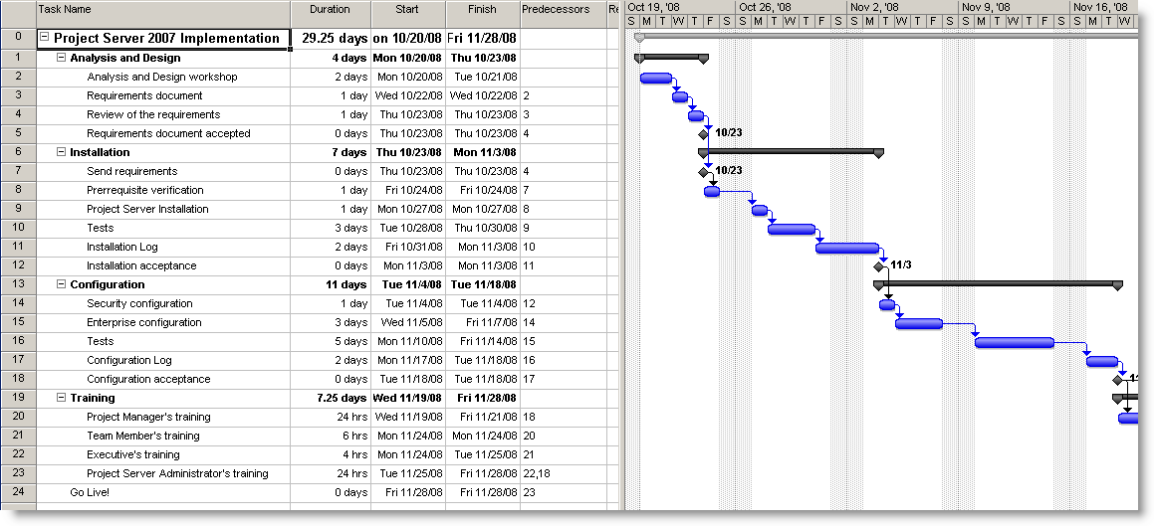
MBSE implications for projects (2 of 6)
How does MBSE affect project schedule?
Schedule time and resources to deploy infrastructure and train workforce
Model development becomes infused within the schedule since models are an integral part of the technical baseline

Slide 65
MBSE implications for projects (3 of 6)
How does MBSE affect project organization?
Everyone needs training, but not to the same depth
Different levels of training for different levels of modeling
EVERYONE
Understand and express concepts using SysML standard notation
SysML Models
MOST SEs including leadership
Collaborate and develop models with help from core team
Applies best practices, contributes to production models
CORE TEAM

Slide 66
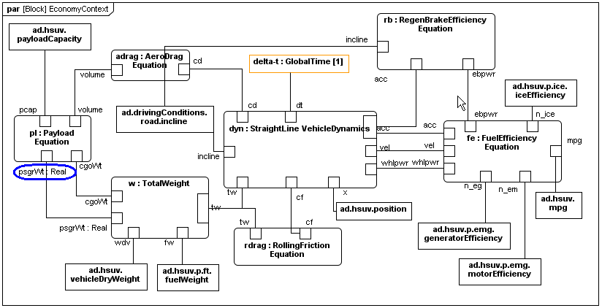

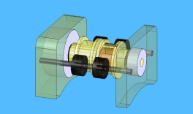
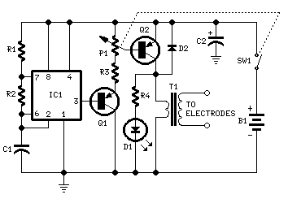
MBSE implications for projects (4 of 6)
Does MBSE affect reviews?
It can, but doesn’t have to
  Can still conduct conventional reviews
Generate views from the system model that address different stakeholders’ concerns
Leverage the model by
reviewing the model itself
  Reduces non-productive effort in preparing for a review
Reviewers
Models

Slide 67
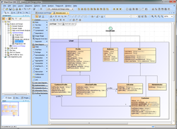
MBSE implications for projects (5 of 6)
How does MBSE affect infrastructure?
Need:
  System modeling tool(s)
  Training (in modeling and in tool usage)
  Standards (modeling style guide, model management)
  Methodology*
SysML Modeling Guide
IMCE Team
Version: 9/24/11
* See “Survey of Model-Based Systems Engineering (MBSE) Methodologies”, J. A. Estefan, 2008, INCOSE.
http://www.omgsysml.org/MBSE_Methodology_Survey_RevA.pdf

Slide 68
MBSE implications for projects (6 of 6)
How does MBSE affect metrics?
Easier to get data from models and update metrics
Example metrics
  Quality of design
    Mass margin, power margin, data margin, cost, …
  Progress of design and development effort
    Completeness of component specs, # use case scenarios, …
  Estimated effort to complete design and development
    Constructive Systems Engineering Cost Model (COSYSMO) gets inputs from system model (# requirements, # use cases, etc.)
  Others:
    Number of critical TBDs
    Stability of requirements and design changes over time
    Potential defect rates

Slide 69
Myths about MBSE (part 3)
Myth 7: All SE’s need to become expert modelers
No. You can establish a core modeling team to build the model. All SE’s should learn how to interpret the model.
Myth 8: If the model doesn’t execute, it has no value
  No. Just describing something in a formal modeling language immediately improves communication and understanding. A model is useful if it helps communicate the design or answer questions.

Slide 70
Management Issues:
Implications for projects
Infusion strategy
Lessons learned

Slide 71
Infusion: a multi-pronged approach
Educate and train an initial cadre of modelers
  Pair domain experts with early career hires
Build on grass-roots efforts
Work with strong advocates and advisors consisting of international and national experts
Establish an institutionally-supported modeling environment
  Define modeling standards, enable collaborative modeling effort, build a reusable model repository; provide support to system model developers
Identify and build applications
  Develop system models that have immediate benefits to project’s needs
  Put training into practice
  Modelers partner with project’s system engineers to get early buy in
  Use the initial application to validate the reusable modeling environment
Partner with industry, INCOSE, academia and OMG to learn, contribute and stay current
Source: Chi Lin, JPL

Slide 72


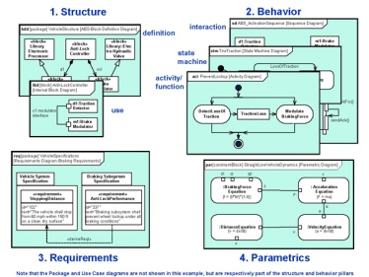
Integrated Model-Centric Engineering:
Ops Concept
Projects build models
Institution provides:
Modeling Development Infrastructure
CM Controlled
Integrated Tool/model environment
Use
Develop
System Model
Retrieve
Models with Use Cases
Engineering Data
distributed (project,,
Line, institution
Standards
Modeling template
Naming conv.
Modeling style guide
Data exchange
Repositories
Archive
Domain discipline models
(e.g., Modelica, STK, Simulink, NX )
Generate
Engineering Products
Analyze/ Tradeoffs/Validate/Reviews
e.g.,
Gate products for reviews
MEL/PEL
Requirements & tracing
State Transition Execution
Source: Chi Lin, JPL

Slide 73
Cultural Change Roadmap
Internalization
Institutionalization
7
6
Mechanisms to support sustaining the change
Adoption
Mechanisms to support wider rollout of change
5
COMMITMENT TO CHANGE
Initial Use
Mechanisms to support measured success in piloting
(i.e., initial operational environment )
4
Understanding
Mechanisms to assure understanding
(training, piloting)
3
Awareness
Mechanisms to promote awareness
(e.g., seminars, Modeling Early Adopter Group)
Contact
2
1
TIME
Adapted from “Out from Dependency: Thriving as an Insurgent in a Sometimes Hostile Environment”,
SuZ Garcia and Chuck Myers, SEPG Conference, 2001

Slide 74
Multi-Year Strategy: Capabilities
Setting Expectations: Such an effort takes time to achieve
Phase III: Integrating
Key Capabilities:
A fully operational modeling Infrastructure that enables integration of system models with domain discipline analytical models, simulation/visualization models to support:
  Design to cost
  Reviews
  Trade study…
A matured model-based development methodology with training support
A fully CM controlled operational model repositories that collaboratively managed by projects, lines and Institution
Phase II: Performing
Key Capabilities:
MBSE methodology that supports systems & software integration
Modeling framework that enables model/tools integration
Standard design views and viewpoints that support:
  capturing technical designs in formal models
  performing reviews based on formal models
Standard set of modeling tools are established and supported
CM-controlled repository populated with validated reusable models created from formulation to implementation
Degree of Maturity
Phase 1: Building
Continuous
Practice
Key Capabilities:
Cadre of trained MBSE modelers
Modeling infrastructure that facilitates collaborative modeling activities
Initial modeling standard
Modeling user’s guide
Initial CM-controlled model repository framework w/examples
Time
Source: Chi Lin, JPL

Slide 75
Myths about MBSE (part 4)
Myth 9: MBSE is an all-or-nothing commitment
No. MBSE is not a single thing that you adopt all at once and then deal with the consequences. You have a lot of latitude in choosing when and where to apply it, and bounding the risks in transition.
MBSE involves a cultural change; it can progress step by step.

Slide 76
Management Issues:
Implications for projects
Infusion strategy
Lessons learned

Slide 77
Lessons Learned from Europa Study (1 of 2)
Investment is crucial
  Europa study benefitted from years of local investment in tools, modeling environment, and training
Unity of leadership is essential
  Management must be willing to pay the startup costs and give time for the effort to pay dividends
Best way to start modeling is to hire people who already know how to do it
  Later infusions will benefit from an experienced pool of engineers
Team organization matters
  3-tiers: small set of core modelers, larger set of modeling-savvy SEs, within larger set of project personnel
Everyone needs training, but not to the same depth
Source: Todd Bayer (JPL)

Slide 78
Lessons Learned from Europa Study (2 of 2)
Best way to figure out how to apply MBSE: do it for real
  “Shadow pilots” would not have been as helpful
  Pressure to deliver real engineering products forces discovery and resolution of problems not likely encountered in a shadow
Keep the focus on project deliverables, and model only as far as you need to answer the questions
  This may need to be constantly reinforced
Description first, then analysis
  Just describing something in a formal model language immediately improves communication and understanding
Separate models from analyses
  Mass analysis program is independent of system details
Real examples are powerful
  Much more effective at conveying understanding and building support
Source: Todd Bayer (JPL)

Slide 79
Lessons Learned: Strategy
Young engineers are already attuned to system modeling
  the transition to MBSE is happening whether we help or not
  pair young engineers (modelers) with graybeards (subject matter experts)
Collaboration has been essential
(industry, other space agencies, academia)
Infusion can be gradual, both in time, and in project space
  benefits are evident even when systems modeling is used in a modest way on a single subsystem
  the simple act of creating a formalism is by itself a significant help in communication and understanding
Culture change does not follow a project life-cycle

Slide 80
Lessons Learned: Just Modeling Isn’t Enough
…we also have to agree on…
Ontology
  What concepts are important to us?
  What properties and relationships do those concepts have?
  How do we name concepts and properties?
Notation and exchange syntax
Tools and model repository
  How do I create models?
  Where can I store my models?
  Where can I find other models and relate to their content?
Model data access mechanisms
Model validation rules and constraints
Configuration management procedures
Relationships between engineering deliverables and model content
…we model to get work done…

Slide 81
Summary
Notes:
Let’s wrap up now with a few key points.

Slide 82
Audience Participation
What are your take-aways?

Slide 83
Take-Aways
MBSE is systems engineering, aided by a system model
  MBSE formalizes part of systems engineering
A system model …
  helps manage complexity and risk
  improves communication within a team and with stakeholders
  provides a consistent definition of the system that integrates information from discipline models
  supports analyses (if organized appropriately)
  helps couple technical design to programmatics
Need infrastructure:
  Tools, training, standards, methodology
Multi-pronged, evolutionary infusion strategy recommended
  Culture change takes time

Slide 84
For more information
MBSE Community of Practice on NEN
  https://nen.nasa.gov/web/se/mbse
These slides
  https://nen.nasa.gov/web/se/mbse/documents
OMG MBSE Wiki
  http://www.omgwiki.org/MBSE/doku.php
OMG SysML Official Site
  http://www.omgsysml.org/
NIMA: NASA Integrated Model-centric Architecture
  OCE initiative to leverage/coordinate four communities of practice: MBSE, Modeling & Simulation, CAD and PDLM
  https://nen.nasa.gov/web/se/nima

Slide 85
Outline of MBSE Training Module 2
Title: Introduction to System Modeling
System models
  Purpose, contents, types, integration
Good system models
  What makes a system model good?
SysML basics and customization
  Specializing SysML for flight projects: the IMCE ontologies
Methodologies and NASA systems engineering process
  Impact of MBSE and system modeling on NPR 7123
Summary

Slide 86
The End
Systems Engineering with System Models:
An Introduction to Model-Based Systems Engineering
Notes:
That brings us to the close of this training module. Thank you for your time.

Slide 87
Acronyms
FS: Flight System
IMCE: Integrated Model-Centric Engineering (JPL)
INCOSE: International Council on Systems Engineering
MBE: Model-Based Engineering
MBSE: Model-Based Systems Engineering
NDIA: National Defense Industrial Association
NEN: NASA Engineering Network
NICM: NASA Instrument Cost Model
NIMA: NASA Integrated Model-centric Architecture
OCE: Office of Chief Engineer
OMG: Object Management Group
SE: Systems Engineering
SEWG: Systems Engineering Working Group (NASA)
SysML™: Systems Modeling Language (OMG)
UML: Unified Modeling Language

