Slide 1

Model-Centric Engineering, Part 2:
Introduction to System Modeling
SEWG MBSE Training Module 2 https://nen.nasa.gov/web/se/mbse/documents
  Todd Bayer, Daniel Dvorak, Sanford Friedenthal,
  Steven Jenkins, Chi Lin, Sanda Mandutianu
Jet Propulsion Laboratory, California Institute of Technology
Copyright 2012 California Institute of Technology. U.S. Government sponsorship acknowledged.

Slide 2
Objective and Intended Audience
Objective:
Understand good practices in the development and use of system models
Intended Audience:
Systems engineers and discipline engineers (practitioners)
Prerequisites:
Systems engineering background
No SysML tool experience required
Non-Objectives:
Not SysML training
Not tool training
Not a sales job

Slide 3
Outline
Take-aways from Module 1: “Systems Engineering with System Models”
System Models
Good System Models
SysML Basics and Customization
Methodologies and NASA Systems Engineering Process
Summary

Slide 4
Acknowledgements
Funding:
  NASA SEWG MBSE initiative (Steve Kapurch, HQ)
  JPL ESD Integrated Model-Centric Engineering (Chi Lin, JPL)
  JPL Systems & Software Division (David Nichols, JPL)
Contributors:
  Todd Bayer, Daniel Dvorak, Sanford Friedenthal, Steven Jenkins, Chi Lin, Sanda Mandutianu
Other Sources:
  JEO/EHM modeling effort
  JPL Modeling Early Adopters (MEA)

Slide 5
Take-aways from “Systems Engineering with System Models”
MBSE is systems engineering … with models
  MBSE formalizes part of systems engineering
MBSE addresses SE problems of complexity, architecture, integration, reuse, and technical/programmatic coupling
A system model …
  integrates info from discipline models
  becomes part of the technical baseline
  serves team as single source of truth
Needed infrastructure …
  Tools, training, standards, methodology
Multi-pronged, evolutionary infusion strategy recommended
  Culture change takes time

Slide 6
System Models
What is a model?
What are some purposes for modeling?
What does a system model contain?
What are the different types of models?
How are the different types of models integrated into the overall engineering effort?

Slide 7
What is a Model?
A model is a representation of one or more concepts that may be realized in the physical world
A model is an abstraction that does not contain all the detail of the modeled entity
  The reason to abstract is to highlight parts of the world needed to understand and/or address a problem
Models are represented in many forms including graphical, mathematical, and logical

Slide 8
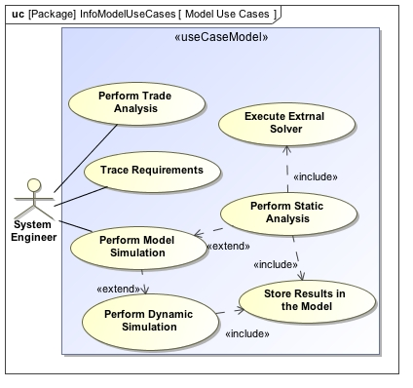
Some Purposes of Modeling
Characterize an existing system
Specify and design a new or modified
system
  Represent a system concept
  Specify and validate system requirements
  Synthesize system designs
  Specify component requirements
  Maintain requirements traceability
Evaluate a design
  Conduct system design trade-offs
  Analyze system performance requirements
  or other quality attributes
  Verify that the system design satisfies its
  requirements
  Assess the impact of requirements and design changes
Train users on how to operate or maintain a system
Shorten the time needed to get an accurate understanding of a system
Source: A Practical Guide to SysML: The Systems Modeling Language, by Friedenthal, Moore, and Steiner, 2008.

Slide 9
System Model Contents
A system model describes …
The problem the system is intended to address
  Requirements
  Use cases
Both hardware and software
The structure of the system
  The organization of components within the system
  The structure of the data flowing in and out of the system and its components
The behavior of the system
  State descriptions
  Sequence descriptions
  Algorithmic descriptions
Analyses of the system

Slide 10
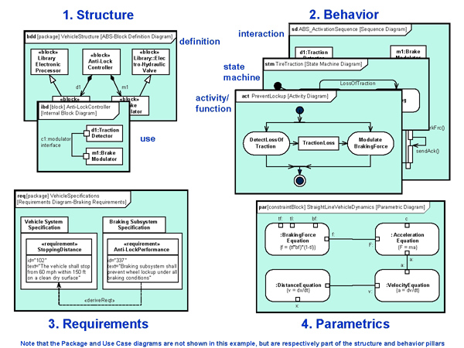
System Model and Other Discipline Models
Structural Model
Instrument Models
System Model
Coupled models of structure, behavior, requirements, and equations. Single source of truth. Checkable. Queryable.
“System Model”
Spreadsheets, viewgraphs, text documents, e-mails, meeting notes, etc.
Electrical
Model
Telecom Model
Thermal
Model
Software Model

Slide 11
What makes a System Model good?
Modeling notation expressive enough for the domain
Conveys the conventional domain wisdom
Semantics of model elements unambiguous
Model is complete
Can answer pertinent questions about the domain
Supports reasoning about the model and the design
Support reasoning about programmatics
Supports required analyses

Slide 12
How a System Model Helps
A well-structured system model can be analyzed to answer many questions
Does every component trace to a requirement?
Have both sides of every interface been specified?
What is the dry mass of the flight system?
What is the maximum load on power bus 3?
Is every terminal connected?
What is the mass rollup?
System Model
Yes
No!
479 kg
14.7 A
Yes
Mass Report

Slide 13
Is This A Model?
spacecraft
ground system
transmit telemetry
receive telemetry
telemetry packet
Sure, why not?

Slide 14
Is It A Good Model?
spacecraft
ground system
transmit telemetry
receive telemetry
telemetry packet
Not so much.
It is just boxes and lines with no clear meanings.

Slide 15
What’s Wrong With It?
spacecraft
ground system
transmit telemetry
receive telemetry
telemetry packet
Same symbol for different kinds of things
Same symbol for different kinds of relationships

Slide 16
Better?
spacecraft
ground system
transmit telemetry
receive telemetry
telemetry packet
Not much.
Essential distinctions are merely suggested.
They should be explicit.

Slide 17
Making Distinctions Explicit
Rather than merely hinting at distinctions with shapes or colors, we could devise a set of types or classes to be applied to model elements
The set of types is application-dependent
  Systems engineers talk about different things from chefs
  The distinctions are whatever matters for your application
  Is red wine a different type from white, or is is merely a property of wine?
    It depends on what you want to say about wine
What kinds of things do systems engineers talk about?
  Component, Interface, Function, Requirement, Work Package, Product, Process, Objective, Message, etc.
Let’s apply some classes to our model
For now, every element has
  one type, denoted like this: «type»
  one name, which identifies an individual of that type

Slide 18
Model With Typed Elements
«component»
spacecraft
«component»
ground system
«function»
transmit telemetry
«function»
receive telemetry
«message»
telemetry packet
Much better.

Slide 19
Answering Questions
What components are present?
«component»
spacecraft
«component»
ground system
«function»
transmit telemetry
«function»
receive telemetry
«message»
telemetry packet

Slide 20
Answering Questions
«component»
spacecraft
What functions are present?
«component»
ground system
«function»
transmit telemetry
«function»
receive telemetry
«message»
telemetry packet

Slide 21
Answering Questions
«component»
spacecraft
«component»
ground system
What messages are present?
«function»
transmit telemetry
«function»
receive telemetry
«message»
telemetry packet

Slide 22
Add Typed Relationships
«component»
spacecraft
«component»
ground system
«performs»
«function»
transmit telemetry
«function»
receive telemetry
«performs»
«sends»
«message»
telemetry packet
«receives»
Note that relationships are now directed.

Slide 23
More Questions and Answers
What component performs the function transmit telemetry?
«component»
spacecraft
«component»
ground system
«performs»
«function»
transmit telemetry
«function»
receive telemetry
«performs»
«sends»
«message»
telemetry packet
«receives»

Slide 24
More Questions and Answers
What functions does the component ground system perform?
«component»
spacecraft
«component»
ground system
«performs»
«function»
transmit telemetry
«function»
receive telemetry
«performs»
«sends»
«message»
telemetry packet
«receives»

Slide 25
More Questions and Answers
What messages does the function transmit telemetry send?
«component»
spacecraft
«component»
ground system
«performs»
«function»
transmit telemetry
«function»
receive telemetry
«performs»
«sends»
«message»
telemetry packet
«receives»

Slide 26
More Questions and Answers
What components perform a function that sends or receives the message telemetry packet?
«component»
spacecraft
«component»
ground system
«performs»
«function»
transmit telemetry
«function»
receive telemetry
«performs»
«sends»
«message»
telemetry packet
«receives»
Alternatively, what component designs may be affected if the definition of telemetry packet changes?

Slide 27
Reasoning About Models
We can use models to answer questions
The questions may be about the system itself
  What is it?
  How does it work?
  Is the performance adequate?
  What happens if something breaks?
The questions may be about the model
  Is it complete?
  Is it consistent?
  Does it support required analyses?
The questions may be about the design artifacts
  Are all required documents present?
  Does each document contain all required content?
We call answering these kinds of questions reasoning
  It doesn’t necessarily mean exotic, artificial intelligence

Slide 28
Reasoning About Completeness
What components perform no function?
«component»
spacecraft
«component»
ground system
«function»
transmit telemetry
«function»
receive telemetry
«performs»
«sends»
«message»
telemetry packet
«receives»

Slide 29
Reasoning About Completeness
What functions are not performed by any component?
«component»
spacecraft
«component»
ground system
«function»
transmit telemetry
«function»
receive telemetry
«performs»
«sends»
«message»
telemetry packet
«receives»

Slide 30
Reasoning About Completeness
What messages are received but not sent?
«component»
spacecraft
«component»
ground system
«performs»
«function»
transmit telemetry
«function»
receive telemetry
«performs»
«message»
telemetry packet
«receives»

Slide 31
Reasoning About Completeness
What messages are sent but not received?
«component»
spacecraft
«component»
ground system
«performs»
«function»
transmit telemetry
«function»
receive telemetry
«performs»
«sends»
«message»
telemetry packet

Slide 32
Reasoning About Consistency
Are there illegal or meaningless
relationships in the model?
«component»
spacecraft
«component»
ground system
«sends»
«sends»
«performs»
«function»
transmit telemetry
«function»
receive telemetry
«performs»
«sends»
«sends»
«message»
telemetry packet
«receives»

Slide 33
Reasoning About Design
«component»
spacecraft
m_{e}:
m_{a}: 130 kg
Each component has:
allocated mass (m_{a})
estimated mass (m_{e})
«contains»
«component»
telecom
m_{e}:
m_{a}: 35 kg
«component»
propulsion
m_{e}:
m_{a}: 80 kg
«component»
amplifier
m_{e}: 8 kg
m_{a}: 10 kg
«component»
antenna
m_{e}: 19 kg
m_{a}: 20 kg
«component»
tank
m_{e}: 38 kg
m_{a}: 44 kg
«component»
thruster
m_{e}: 30 kg
m_{a}: 29 kg
m_{e}: estimated mass
m_{a}: allocated mass

Slide 34
Reasoning About Design
«component»
spacecraft
m_{e}: 95 kg
m_{a}: 130 kg
Each component has:
allocated mass (m_{a})
estimated mass (m_{e})
«component»
spacecraft
m_{e}:
m_{a}: 130 kg
«contains»
Rule: Estimated mass m_{e} of any component with parts is the sum of m_{e} of its parts
«component»
telecom
m_{e}: 27 kg
m_{a}: 35 kg
«component»
telecom
m_{e}:
m_{a}: 35 kg
«component»
propulsion
m_{e}:
m_{a}: 80 kg
«component»
propulsion
m_{e}: 68 kg
m_{a}: 80 kg
«component»
amplifier
m_{e}: 8 kg
m_{a}: 10 kg
«component»
antenna
m_{e}: 19 kg
m_{a}: 20 kg
«component»
tank
m_{e}: 38 kg
m_{a}: 44 kg
«component»
thruster
m_{e}: 30 kg
m_{a}: 29 kg
m_{e}: estimated mass
m_{a}: allocated mass

Slide 35
Reasoning About Design
«component»
spacecraft
m_{e}: 95 kg
m_{a}: 130 kg
Each component has:
allocated mass (m_{a})
estimated mass (m_{e})
«component»
spacecraft
m_{e}:
m_{a}: 130 kg
«contains»
Rule: CBE mass m_{e} of any component with parts is the sum of m_{e} of its parts
«component»
telecom
m_{e}: 27 kg
m_{a}: 35 kg
«component»
telecom
m_{e}:
m_{a}: 35 kg
«component»
propulsion
m_{e}:
m_{a}: 80 kg
«component»
propulsion
m_{e}: 68 kg
m_{a}: 80 kg
Policy: m_{e} < m_{a} for every component
«component»
amplifier
m_{e}: 8 kg
m_{a}: 10 kg
«component»
antenna
m_{e}: 19 kg
m_{a}: 20 kg
✖
«component»
tank
m_{e}: 38 kg
m_{a}: 44 kg
«component»
thruster
m_{e}: 30 kg
m_{a}: 29 kg
m_{e}: estimated mass
m_{a}: allocated mass

Slide 36
Reasoning About Design
Is this OK?
«component»
spacecraft
«specifies»
«requirement»
observe
«contains»
«component»
telecom
«component»
propulsion
«refines»
«component»
amplifier
«component»
antenna
«requirement»
diameter
«specifies»
Probably not.
Requirements shouldn’t jump component levels.

Slide 37
Reasoning About Design
Is this OK?
«component»
spacecraft
«specifies»
«requirement»
downlink
«contains»
«component»
telecom
«component»
propulsion
«refines»
«component»
amplifier
«component»
antenna
«requirement»
diameter
«specifies»
Yes. This is a common pattern.

Slide 38
Reasoning About Design
Is this OK?
«component»
spacecraft
«specifies»
«requirement»
translate
«contains»
«component»
telecom
«component»
propulsion
«refines»
«component»
amplifier
«component»
antenna
«requirement»
diameter
«specifies»
No. Requirement refinement should be consistent with product decomposition.

Slide 39
Reasoning About Design
Is this OK?
«component»
spacecraft
«specifies»
«requirement»
radiate
«contains»
«component»
telecom
«component»
propulsion
«refines»
«component»
amplifier
«component»
antenna
«requirement»
diameter
«specifies»
Yes. Sometimes you refine
at the same level for clarity.

Slide 40
Relating Product and Work Breakdowns
What relationships join these structures?
«component»
spacecraft
«supplies»
«work package»
spacecraft
«contains»
«authorizes»
«component»
telecom
«supplies»
«work package»
telecom
«component»
propulsion
«work package»
propulsion
«supplies»

Slide 41
Relating Product and Work Breakdowns
What relationships join these structures?
«component»
spacecraft
«authorizes»
«work package»
spacecraft
«contains»
«authorizes»
«component»
telecom
«work package»
telecom
«component»
propulsion
«work package»
propulsion
Authorizes in this context means “is the customer for”.

Slide 42
A Good Model
Describes a system design clearly and transparently
  In particular, it shows a flawed design to be flawed
Communicates a system design effectively to an incompletely bounded audience
  In particular, it uses standard, well-defined vocabulary and notation
Lends itself to automated reasoning for
  validation in modeling domain (well-formedness, etc.)
  validation in engineering domain (performance, etc.)
  validation in programmatic domain (cost, schedule, etc.)
Lends itself to automated transformation into
  analysis specifications for discipline-specific tools
  documents or other information products
Narrows the risky and expensive gap between describing a design and analyzing it

Slide 43
SysML Basics & Customization
How modeling notations help produce good models
How the IMCE (Integrated Model Centric Initiative) ontologies help create and integrate domain models
Examples: modeling requirements, structural decomposition, analysis, work decomposition

Slide 44
What SysML is
What SysML is not
A general graphical modeling language for systems engineering
OMG SysML™ is an industry standard
SysML may be used to model complex systems including hardware, software, information, personnel, procedures, and facilities.
SysML provides standard graphical representations for modeling
  System requirements
  Behavior,
  Structure, and
  Parametrics
  which are used to integrate with other engineering models
SysML extends a subset of UML
NOT a methodology or a tool
  SysML is methodology- and tool-independent
NOT the same thing as MBSE
  SysML is an MBSE enabler, as a standard visual modeling language and lingua franca
NOT intended to replace current investments in modeling within other engineering disciplines. NOR could it.
  SysML models are intended to be used as integrators of other discipline models, thus enabling integrated model-centric engineering

Slide 45
SysML - A Graphical Language for Representing Systems Models
SysML
Diagram
Behavior
Diagram
Requirement
Diagram
Structure
Diagram
Activity
Diagram
Sequence
Diagram
State
Machine
Diagram
Use Case
Diagram
Block
Definition
Diagram
Internal
Block
Diagram
Parametric
Diagram
Package
Diagram
Same as UML
Modification of UML
Not in UML

Slide 46
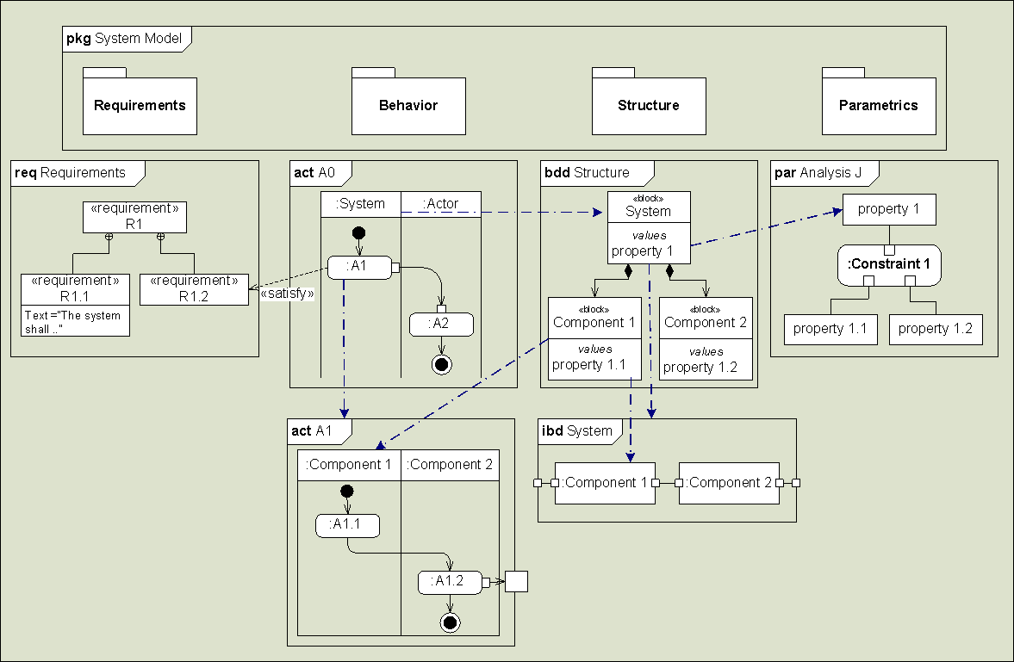
SysML Synopsis

Slide 47
Domain Specific Language
SysML is a language that supports the practice of model-based systems engineering
SysML is very general. It has no vocabulary specific to spacecraft or its engineering disciplines
However, the language can be extended by defining new concepts, packaged in a profile
The new concepts, and the grammar for using them in well-formed statements, is an ontology
SysML tools can be customized for spacecraft engineering by defining ontologies and packaging them in profiles

Slide 48

What is an Ontology?
(animated)
An ontology describes concepts and relationships for a domain of interest
Concepts have relationships to each other
Ontologies specify legal sentences
Some concepts form a type hierarchy
Concepts have properties
  e.g., mass
Ontologies have rules
  e.g., a function is performed by exactly one component
Requirement
specifies
Function
performs
Component
presents
Interface
1
deploys
PhysicalComponent
Mission
executes
Project
mass
pursues
FlightHwComponent
Objective
An ontology is an agreement on usage, rather than a dictionary or a taxonomy
Legend
Antenna
Main Engine
Solar Panels
Concept
relationship
Reflector
Feedhorn
a type of
Notes:
----- Meeting Notes (9/15/11 11:38) -----
speak about models
ontologies describe sysml model or domain models

Slide 49
JPL IMCE Ontology Organization
Foundation Ontologies
Base, Mission, Project,
Quantities-Units-Dimensions-Values,
Analysis, Artifact
Fundamental terms use in all projects, disciplines, and applications
uses
Discipline Ontologies
Mechanical
Electrical
Thermal
Propulsion
ACS, Physics, …
Discipline-specific terms specified and owned by cognizant organizations
uses
Focus is integration and interoperation
uses
Kinds of items that are modeled in a project
Application Ontologies
Star Tracker, Sun Sensor, Reaction Wheel, Thruster, Antenna, …
Focus is reuse
Notes:
The purpose of the discipline ontology category is to provide experts in the line organizations the opportunity to define the discipline-specific property definitions that will be used across multiple application ontologies.
The mechanical discipline ontology, for example, will define parameters to specify mass properties. These definitions will be used by mechanical application ontologies (e.g., boom, strut, backshell, etc.) and also by other application ontologies (e.g., propulsion, avionics, AACS, etc.)
The distinction between discipline and application is that discipline ontologies (mostly) define groups of related properties, and application ontologies (mostly) define things by refining foundation concepts and applying discipline properties.

Slide 50
System model ⬅➔ Discipline models
Structural Model
Operations Plan
System Model
Coupled models of structure, behavior, requirements, and equations. Single source of truth. Checkable. Queryable.
“System Model”
Spreadsheets, viewgraphs, text documents, e-mails, meeting notes, etc.
Power Model
Mass Roll-up
Exchange of information is governed by Electrical ontology, e.g., Board, Channel, EndCircuit, Interface.1553, Interface.Power28V, …
Thermal Model
Radiation Model
Notes:
----- Meeting Notes (9/15/11 11:38) -----
stop at the system model

Slide 51
The preceding slides have shown basic aspects of SysML and how to extend the language for NASA projects
The following slides show examples of models that use concepts from the IMCE ontologies

Slide 52
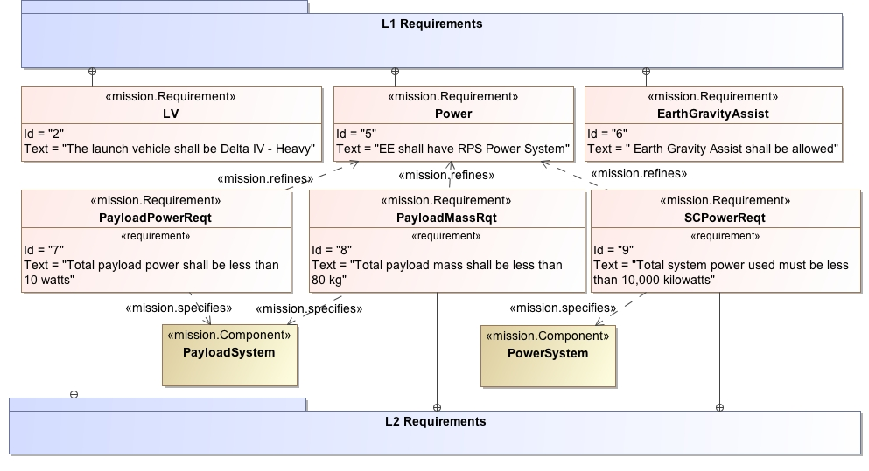
Modeling Requirements
Notes:
Example of an IMCE ontology – Mission ontology
"Requirements”
Could be anything - some criterion demonstrated by test, could be flight rule, could be "I require that camera is on."
In the opposite direction, describing design processes, handling processes, all the way up to policy.
It is not the purpose of the ontologies to capture every meaning for the word "requirement".
To the contrary, the purpose is to define precisely what we mean by "requirement".
Our meaning, roughly, is a formal specification of a component, function, interface, interface junction, or process.
The use case for requirements so defined is a statement of work to be incorporated into an agreement with a supplier.
----- Meeting Notes (9/15/11 11:38) -----
not legible
reqs look different
comments on L1 on the refinement arrow

Slide 53
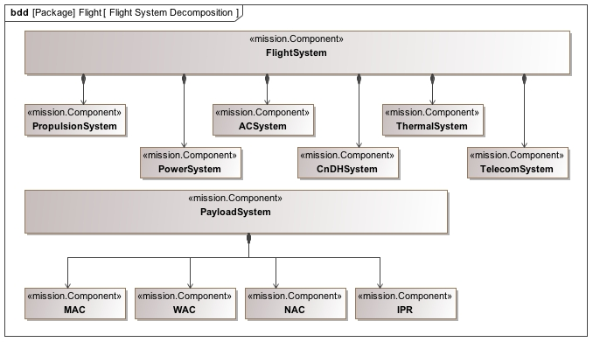
Modeling Structure Decomposition

Slide 54
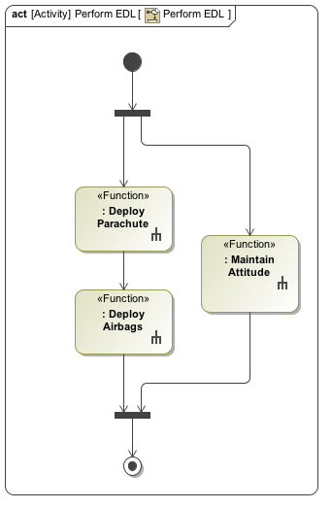
Modeling Behavior
Simplified activity showing entry, descent and landing
Rake symbol indicates that actions are further decomposed
Activity diagrams can show much more detail such as input, output, execution semantics

Slide 55
Modeling Analysis of Requirements
A model can explain how 2 or more requirements are related in the context of supporting analyses
«Requirement»
Downlink data rate
analyzes
refines
refines
«Analysis»
Link Margin
«Requirement»
Spacecraft EIRP
«Requirement»
Ground G/T
explains
explains

Slide 56
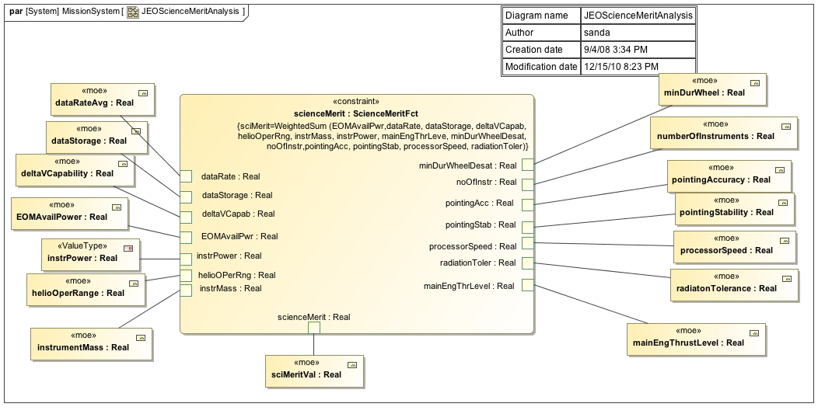
Modeling Analysis - Science Mission Margin Model
Model of 14 parameters that affect the value of science to be acquired

Slide 57
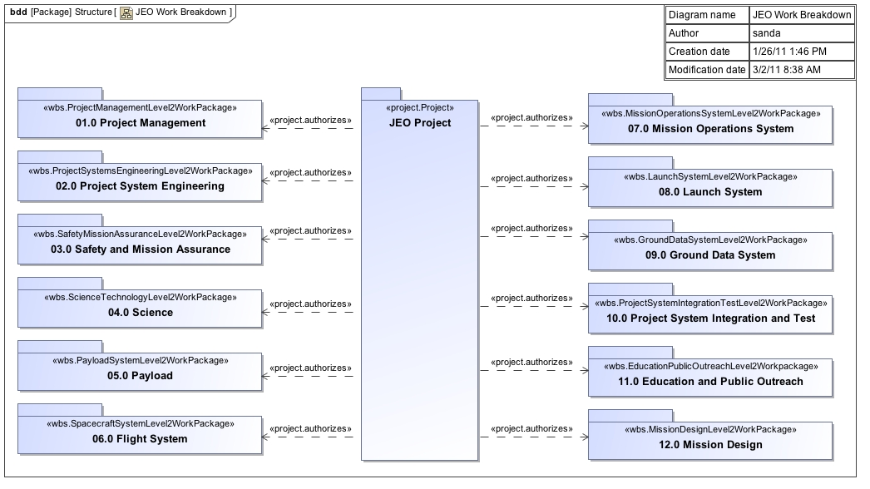
Modeling WBS
The pattern: project authorizes work package

Slide 58
Customizing SysML with Ontologies
Identify concepts and relationships in the domain
Create a SysML extension, called a profile, to represent the domain-specific terminology, such as
  Mission, Analysis, Project – generic SE domain
  Priority, Task, Deadline – real-time domain
A profile represents an ontology of the domain
  Concepts: Mission, Objective
  Relationships: Mission pursues Objective
The result – a domain specific modeling language

Slide 59
Methodologies and NASA Systems Engineering Process
How is system modeling addressed as part of the systems engineering process?
Summarize an example MBSE Process / Method
Describe impact of MBSE and System Modeling on NASA SE Process (NPR 7123.1A) and typical Gate Products

Slide 60
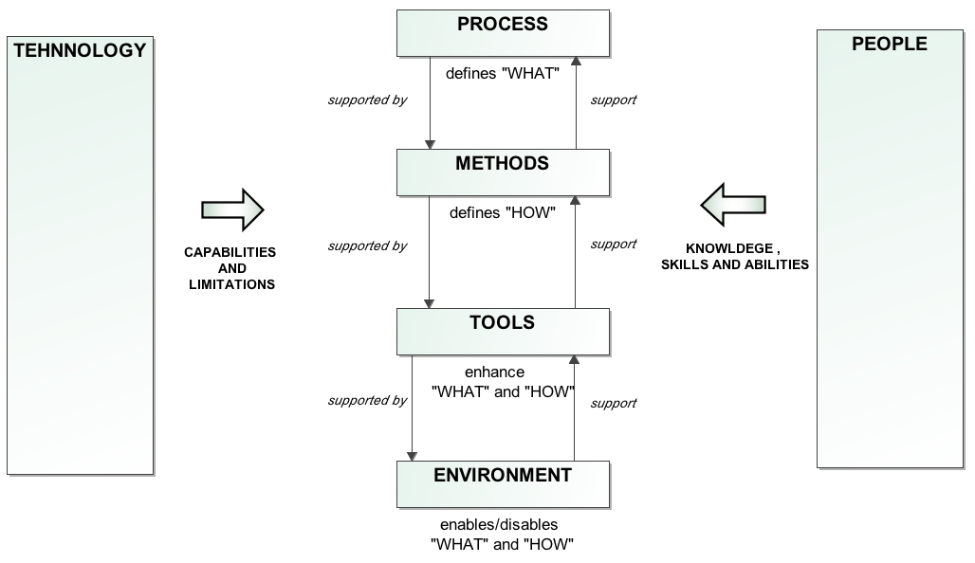
What is a Methodology?
Methodology
A methodology is a collection of related methods, processes, and tools.
Source: Jeff Estefan, Survey of Model-Based Systems Engineering (MBSE) Methodologies, INCOSE, 2008
Notes:
• A process is a logical sequence of tasks performed to achieve a
particular objective. A process defines the “WHAT” is to be done,
without specifying the “HOW” each task is to be performed.
• A method consists of techniques for performing a task, the
“HOW” of each task. The terms “method,” “technique,” practice,”
and “procedure” can be used interchangeably in this context.
• Attributes:
• Thought patterns/processes
• Knowledge base
• Rules and heuristics
• Structure and order
• Notation
• A tool is an instrument that, when applied to a particular method,
can enhance the efficiency of a task. Thus, methods help bridge
the gap between process and tools. The purpose of the tool
should be to facilitate the accomplishment of the “HOWs.”
• A methodology can be defined as a collection of related
methods, processes, and tools.

Slide 61
Methodologies – A Survey
Systems Engineering
  NASA Procedural Requirements (NPR) Systems Engineering Processes and Requirements
    SE Engine
Modeling
  INCOSE OOSEM/SysML (Object Oriented Systems Engineering methodology)
  IBM Telelogic Harmony-SE
  IBM Rational Unified Process-Systems Engineering (RUP-SE) for Model-Driven System Design (MDSD)
  Vitech MBSE
  JPL State Analysis
  Object Process Methodology (OPM)
Source: Jeff Estefan, Survey of Model-Based Systems Engineering (MBSE) Methodologies, INCOSE, 2008

Slide 62
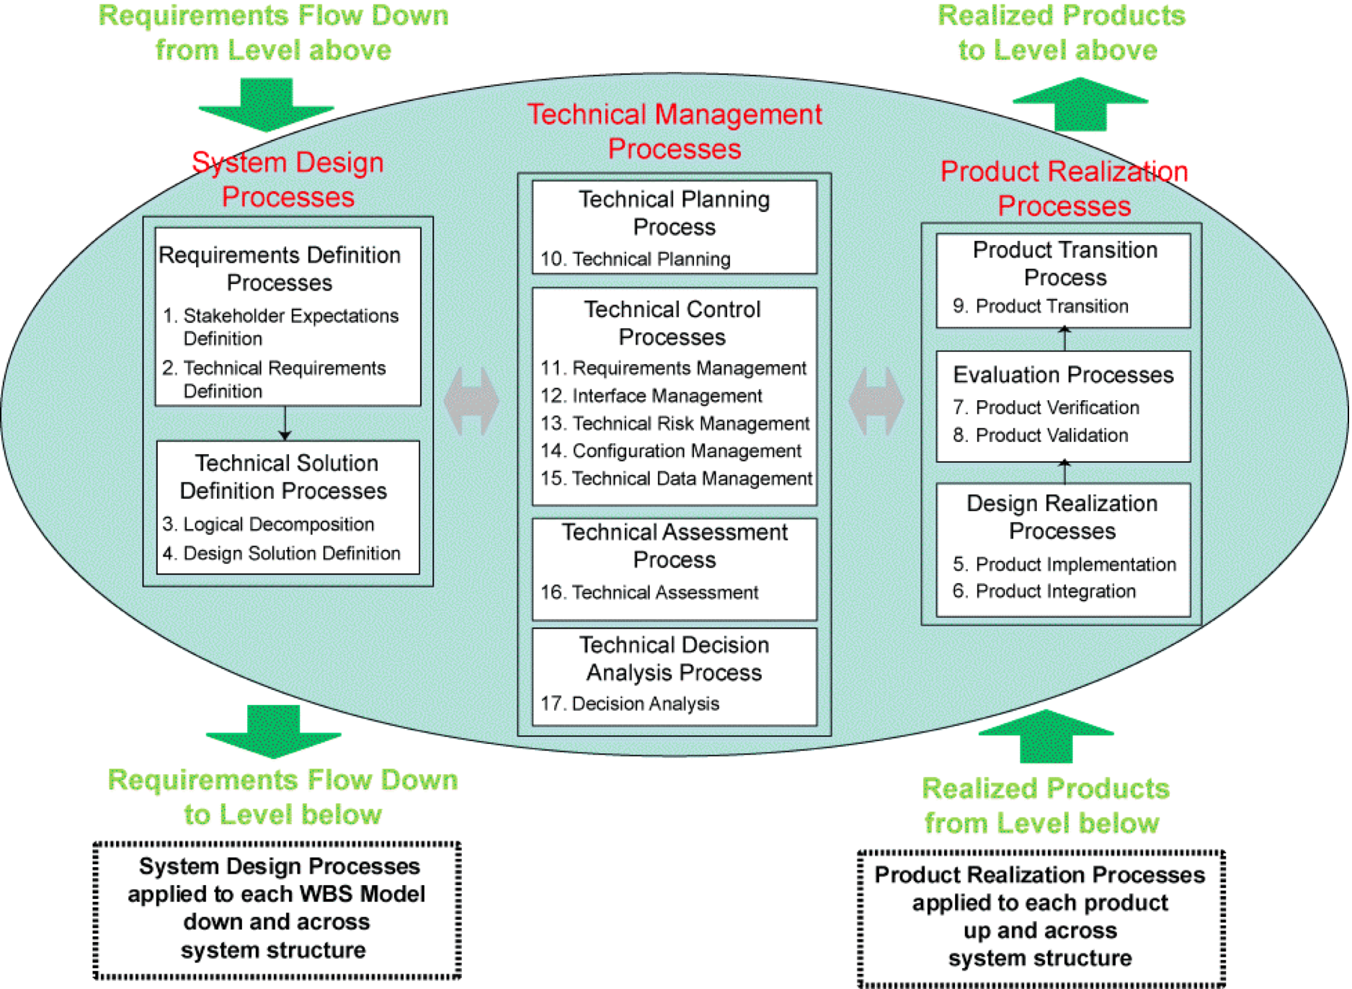
NPR 7123.1A: NASA Systems Engineering Processes and Requirements
NPR 7123 specifies 17 SE processes
Core set of common agency-level technical processes and requirements needed to define, develop, realize, and integrate system products created and acquired for NASA
The set of common processes may be supplemented and tailored to achieve specific project requirements.
Notes:
System Design Processes
Stakeholder Expectations Definition Process
Technical Requirements Definition Process
Logical Decomposition Process
Design Solution Definition Process
Product Realization Processes
Product Implementation Process
Product Integration Process
Product Verification Process
Product Validation Process
Product Transition Process
Technical Management Processes
Technical Planning Process
Requirements Management Process
Interface Management Process
Technical Risk Management Process
Configuration Management Process
Technical Data Management Process
Technical Assessment Process
Decision Analysis Process

Slide 63
NPR 7123 Example – Technical Requirements Definition Process Flow Diagram
NPR-defined process does not change
Notes:
Purpose
Transform the baselined stakeholder expectations into unique, quantitative, and measurable technical requirements expressed as “shall” statements
Inputs and sources
Baselined set of stakeholder expectations
Baselined Concept of Operation
Measures of effectiveness
Outputs and destinations
Set of validated technical requirements
Set of MOPs that when met will satisfy the MOEs to which a set is related (to Logical Decomposition and Technical Data Management Processes)
A set of critical technical performance measures (TPMs)
Activities
Analyze the scope of the technical problem
System functions under design control
Expected interaction among system functions (data flows, human responses, and behaviors)
External physical and functional interfaces (mechanical, electrical, thermal, data, procedural( with other systems
Required capacities of system products
Timing of events, states, models, and functions related to operational scenarios
Emerging or maturing technologies necessary to make requirements
Define constraints affecting the design of the system or products

Slide 64
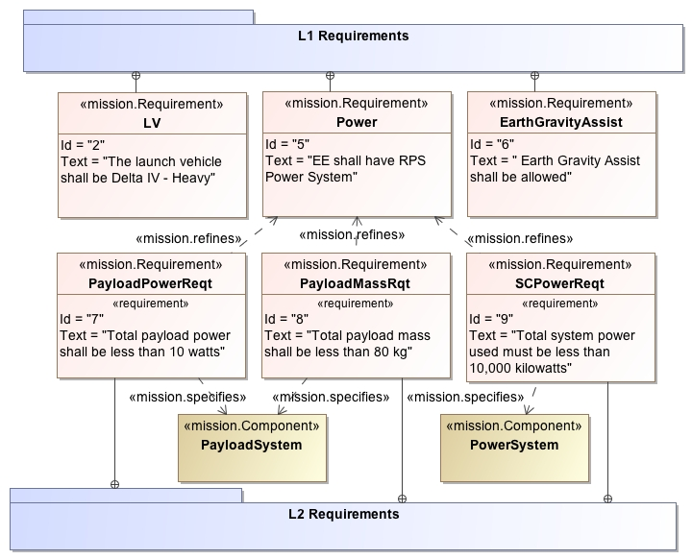
Technical Requirements Model
Package of level 1 requirements
Requirement refines another requirement
Requirement specifies a component
Package of level 2 requirements

Slide 65
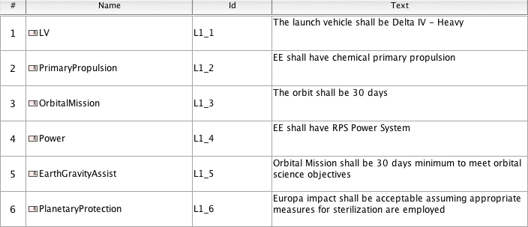
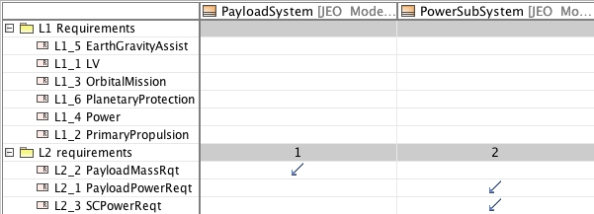
Requirements and Requirement Allocation Model
Requirements list
Allocation of requirements to components

Slide 66
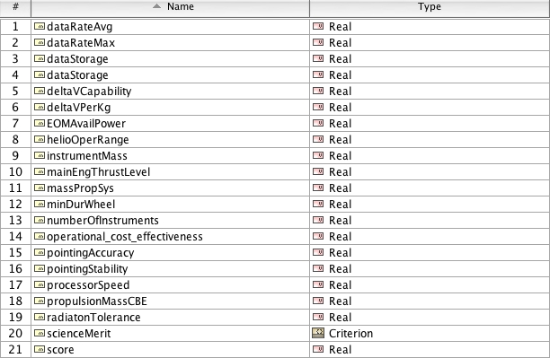
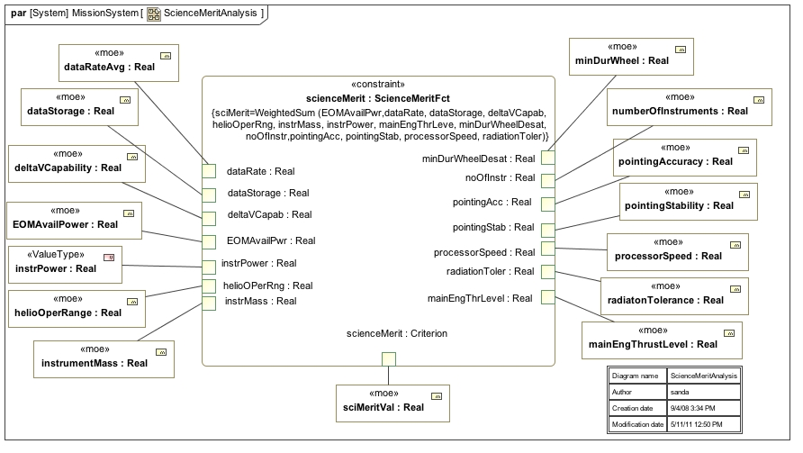
Modeling the Measures of Effectiveness Gate Product
“science merit” is shown as a function of 14 parameters

Slide 67
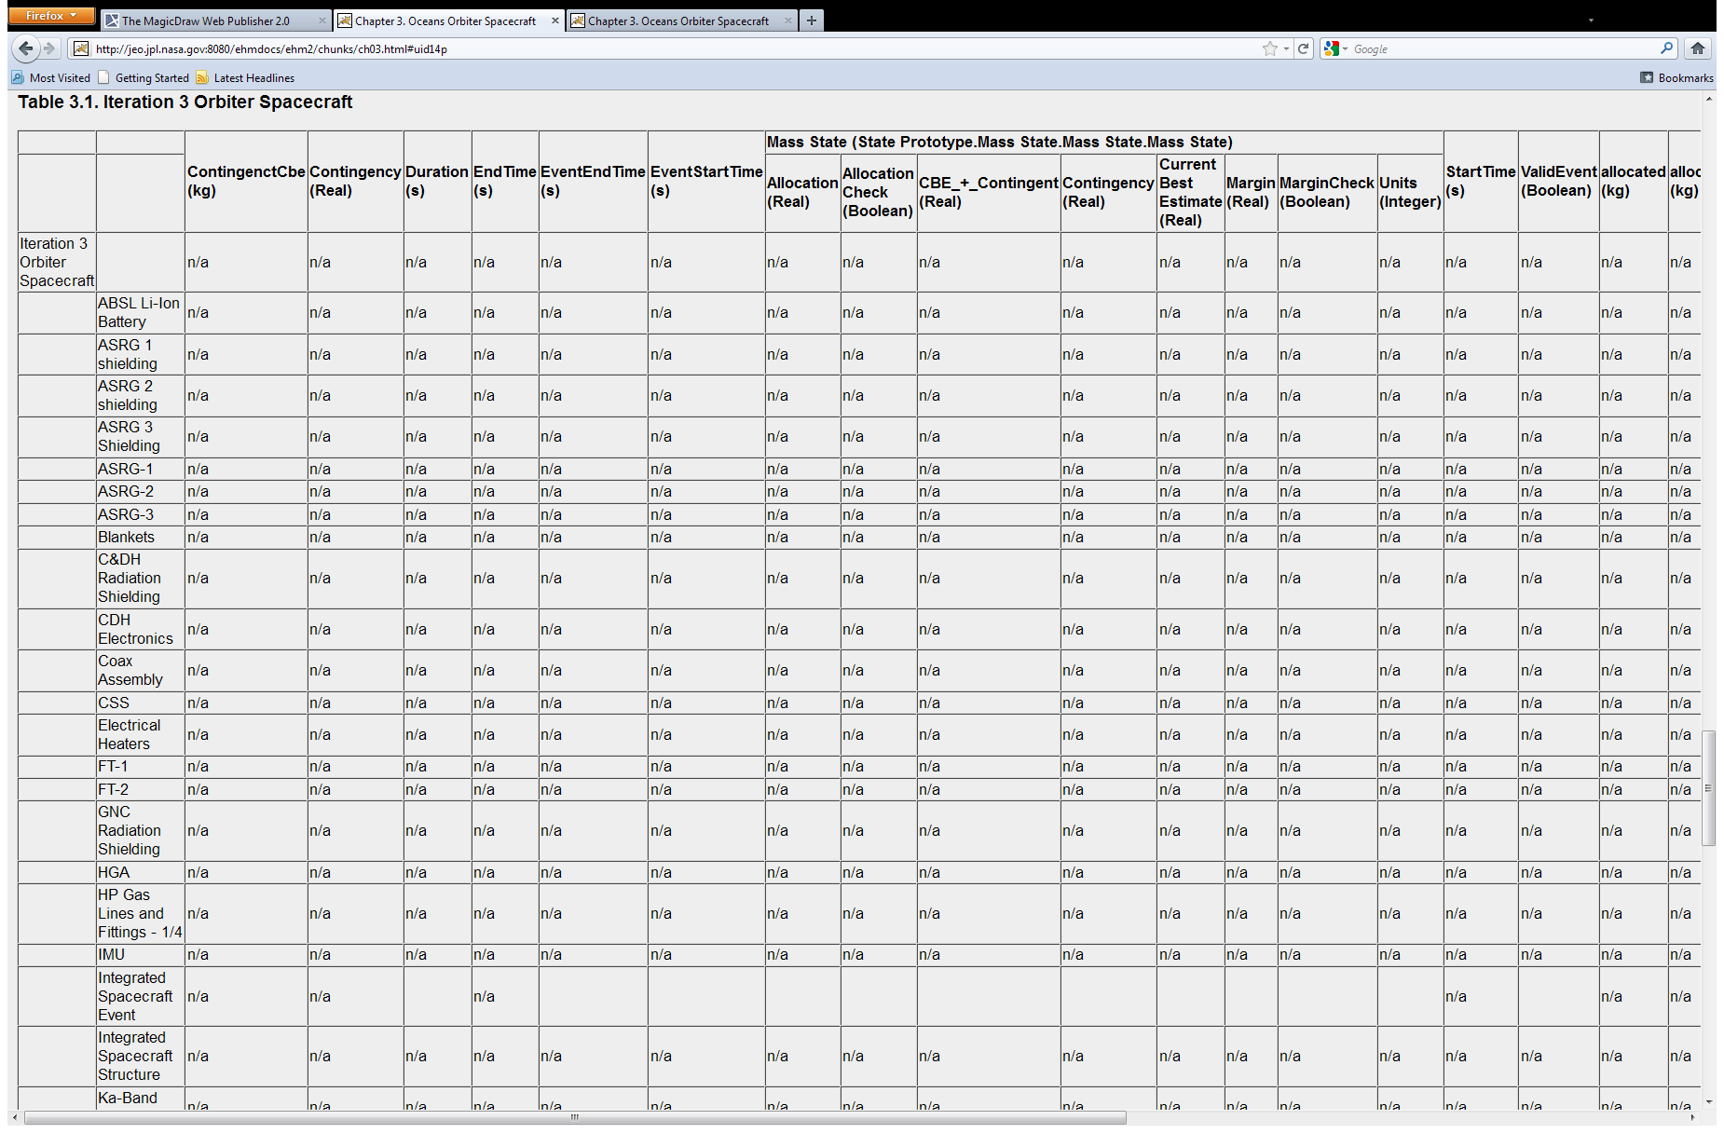
Equipment List and Mass Margin
Mass report generated from model

Slide 68
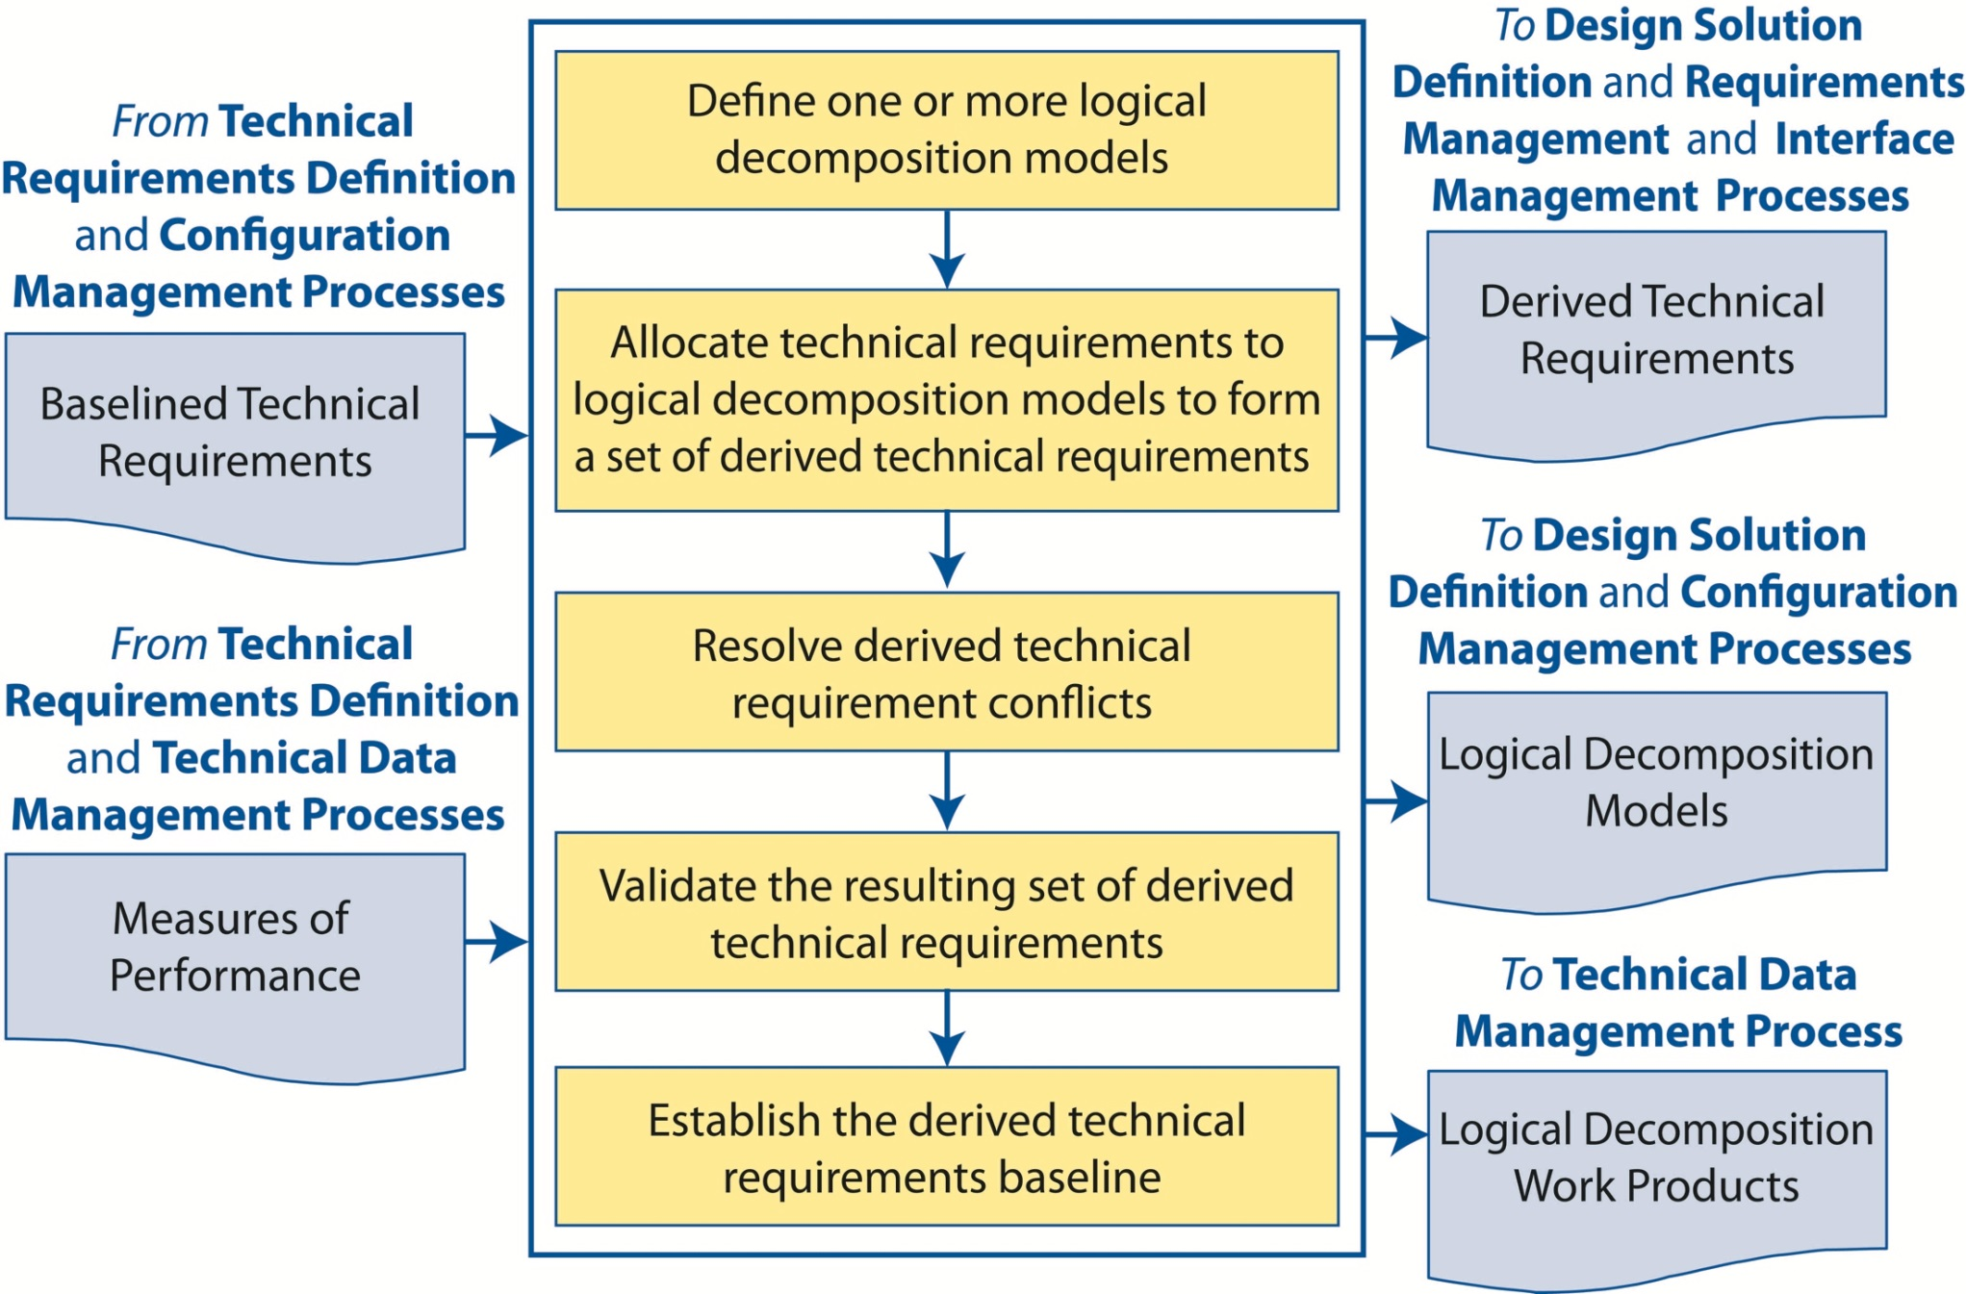
NPR 7123 Example – Logical Decomposition Process Flow Diagram
NPR-defined process does not change
Notes:
Purpose
Improve understanding of the defined technical requirements (functional, behavioral, and temporal)
Transform requirements into a set of logical decomposition models and their associated set of derived technical requirements (input to the design solution definition process)
Inputs and Sources
The baseline set of validated requirements
The defined MOPs
Outputs and Destinations
Set of validated derived requirements
Set of logical decomposition models
Logical decomposition work products
Activities (for the WBS model in the system structure)
Define one/more logical decomposition models based on the requirements
Allocate requirements to the logical decomposition models to form a set of derived requirements
Resolve derived technical “design-to” requirements
Validate that the resulting set of derived requirements have
Bidirectional traceability
Assumptions and decision rationales consistent with the source set of technical requirements
Establish the derived technical requirements baseline.

Slide 69
Flight System Logical Decomposition Model
Decomposition by whole-part relationships

Slide 70
Work Breakdown Structure Model
Decomposition by work packages

Slide 71
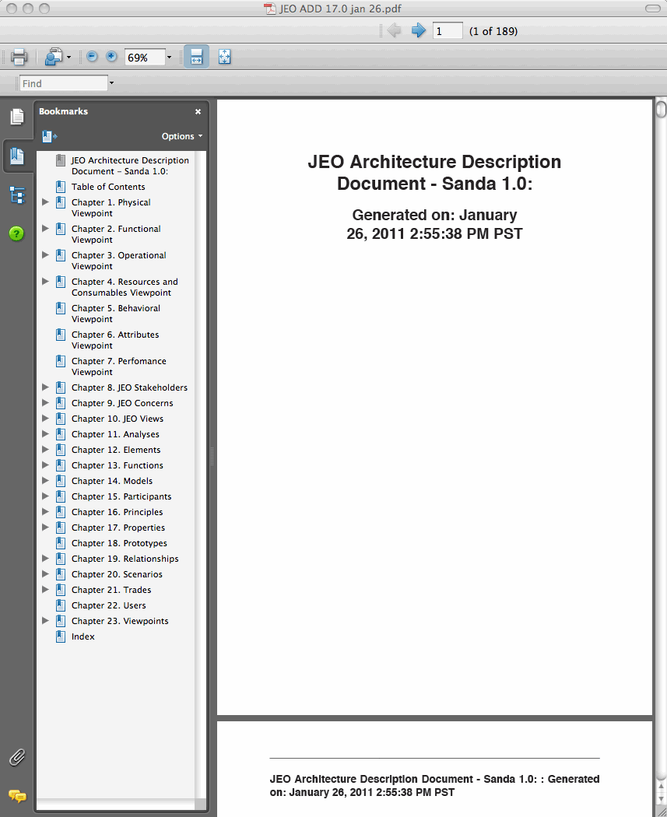
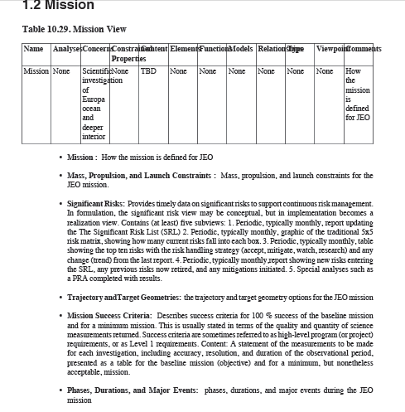
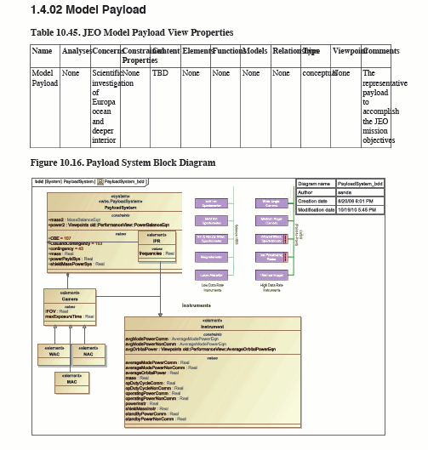
Automatically Generated Architecture Description Document
Includes the logical decomposition models

Slide 72
Summary: Methodology and NPR 7123
A methodology is a collection of related methods, processes, and tools.
NPR 7123 defines NASA’s 17 SE processes
MBSE does not change those processes, but it formalizes the methods and adds modeling tools
MBSE helps ensure consistency among gate products generated from a system model

Slide 73
Summary of Training Module
A system model is both descriptive and analytical
A system model integrates information from many discipline models
A good model has unambiguous semantics
A good model narrows the risky and expensive gap between describing a design and analyzing it
SysML, as a language, can be extended with profiles for domain-specific languages
MBSE doesn’t change NASA’s SE processes

