Slide 1

Foundational Concepts for Building System Models
SEWG MBSE Training Module 3 https://nen.nasa.gov/web/se/mbse/documents
  Todd Bayer, Daniel Dvorak, Sanford Friedenthal,
  Steven Jenkins, Chi Lin, Sanda Mandutianu
Jet Propulsion Laboratory, California Institute of Technology
Copyright 2012 California Institute of Technology. U.S. Government sponsorship acknowledged.

Slide 2
Objective and Intended Audience
Objectives:
Understand how systems engineering concepts are expressed in the JPL Foundation profiles of SysML
  Note: SysML representations are not entirely mature; subject to change
Understand how automated analysis enhances design integrity
Intended Audience:
Systems engineers, especially model developers
Prerequisites:
Systems engineering background
Basic SysML knowledge assumed
MBSE Module 2: Introduction to System Modeling
Non-Objectives:
Not SysML training or tool training

Slide 3
Acknowledgements
Funding:
  NASA SEWG MBSE Initiative (Joseph Smith)
  JPL ESD Integrated Model-Centric Engineering (Chi Lin)
  JPL Formulation & Systems Engineering Division (David Nichols)
Contributors (in alphabetical order):
  Todd Bayer, Daniel Dvorak, Sanford Friedenthal, Steven Jenkins, Chi Lin, Sanda Mandutianu
Other Sources:
  JPL Europa pre-project modeling efforts
  JPL Modeling Early Adopters (MEA)

Slide 4
Outline
Takeaways from MBSE training modules 1 and 2
Extending SysML with ontologies
  The role of OWL vs. SysML
  Reasoning on models
The systems engineering ontologies
  Mission concepts: mission, objective, requirement, component, …
  Analysis concepts: analysis, characterization
  Project concepts: program, project, work package, product, process, …
Analysis/reasoning on models (examples)
Overview of the modeling tool environment and its integration with CM, Requirements Management, Analysis, and a Query Generation tool such as one supported by SPARQL
Relationship of model to NASA SE lifecycle and gate products Summary

Slide 5
Takeaways from Module 1 “Systems Engineering with Models”
MBSE is systems engineering … with models
  MBSE formalizes part of systems engineering
MBSE addresses SE problems of complexity, architecture, integration, reuse, and technical/programmatic coupling
A system model …
  integrates info from discipline models
  becomes part of the technical baseline
  serves team as single source of authoritative information
Needed infrastructure …
  Tools, training, standards, methodology
Multi-pronged, evolutionary infusion strategy recommended
  Culture change takes time

Slide 6
Takeaways from Module 2: “Introduction to Modeling”
A system model is both descriptive and analytical
A system model integrates information from many discipline models
A good model has unambiguous semantics
A good model narrows the risky and expensive gap between describing a design and analyzing it
SysML, as a language, can be extended with profiles for domain-specific languages
MBSE doesn’t change NASA’s SE processes
  Doesn’t change what is done, but can change how it is done

Slide 7
Extending SysML for systems engineering
The role of OWL and SysML

Slide 8

Extending SysML
“SysML is a general-purpose systems modeling language intended to support a wide range of domain-specific applications such as the modeling of automotive or aerospace systems. SysML has been designed to enable extensions that support these specialized domains. An example may be a customization of SysML for the automotive domain that includes specific automotive concepts …”
              Chapter 14, A Practical Guide to SysML
              Friedenthal, Moore and Steiner
SysML permits user-defined extensions called stereotypes
Stereotypes extend existing SysML concepts with additional properties and constraints
Stereotypes are grouped into special packages called profiles
The new concepts, and the grammar for using them in well-formed constructions, can be represented in an ontology

Slide 9

What is an Ontology?
An ontology describes concepts and relationships for a domain of interest
Concepts have relationships to each other
Ontologies specify legal sentences
Some concepts form a type hierarchy
Concepts have properties
  e.g., mass
Ontologies have rules
  e.g., a function is performed by exactly one component
Requirement
specifies
Function
performs
Component
presents
Interface
1
deploys
HwComponent
Mission
executes
Project
pursues
FlightHwComponent
mass
Objective
An ontology is an agreement on usage, rather than a dictionary or a taxonomy
Legend
Antenna
Main Engine
Solar Panel
Concept
relationship
Reflector
Feedhorn
a type of
Notes:
----- Meeting Notes (9/15/11 11:38) -----
speak about models
ontologies describe sysml model or domain models

Slide 10
Motivations for Ontology
Organization / Structure
Provides guidance to systems engineers, no need to ‘reinvent the wheel’
A well-organized ontology pays benefits on every project
Communication / Reuse / Collaboration
Consistent meaning and usage across programs, projects, organizations and tools promotes communication
Automation
Well-structured models can be checked automatically for various types of completeness, consistency, and conformance to specifications
Integration
Well-defined concepts facilitate data exchange among multiple tools
Notes:
(1)
Formally represent knowledge in our domains of interest:
Space flight in general
Systems engineering in general
Fundamental phenomena underlying the above: physics, chemistry, economics, etc.
Convey the knowledge in a stable and durable manner
Independent of programs, projects, organizations and representation tools
Customize and/or adapt the modeling and analysis tools to reason about systems
(2)
Communication
Consistent terminology with well-defined meaning
A systems engineering ontology can capture the meaning of the concepts in a form independent of interpretation by subject matter experts
The ontology could also to be used to integrate information from the systems used in the design
Integrate representations from multiple systems engineering languages and tools
Automated reasoning can be used to check design properties such as consistency and conformance with specifications
Example: check that a collection of requirements are consistent
The language may be sufficiently expressive but there is no formal semantics
Not to replace SysML, UML, and engineering tools, but incorporate them into an integrated framework

Slide 11
Systems Engineering Ontologies
Kinds of items that are modeled in a project
Application Ontologies
Flight System, Sun Sensor, Reaction Wheel, Thruster, Antenna, …
Focus is reuse
uses
Discipline Ontologies
Mechanical
Electrical
Thermal
Propulsion
ACS, Physics, …
Discipline-specific terms specified and owned by cognizant organizations
uses
Focus is integration and interoperation
uses
Scope of this Module
Foundation Ontologies
Base, Mission, Analysis, Project,
Quantities-Units-Dimensions-Values
Fundamental terms use in all projects, disciplines, and applications
Notes:
The purpose of the discipline ontology category is to provide experts in the line organizations the opportunity to define the discipline-specific property definitions that will be used across multiple application ontologies.
The mechanical discipline ontology, for example, will define parameters to specify mass properties. These definitions will be used by mechanical application ontologies (e.g., boom, strut, backshell, etc.) and also by other application ontologies (e.g., propulsion, avionics, AACS, etc.)
The distinction between discipline and application is that discipline ontologies (mostly) define groups of related properties, and application ontologies (mostly) define things by refining foundation concepts and applying discipline properties.

Slide 12
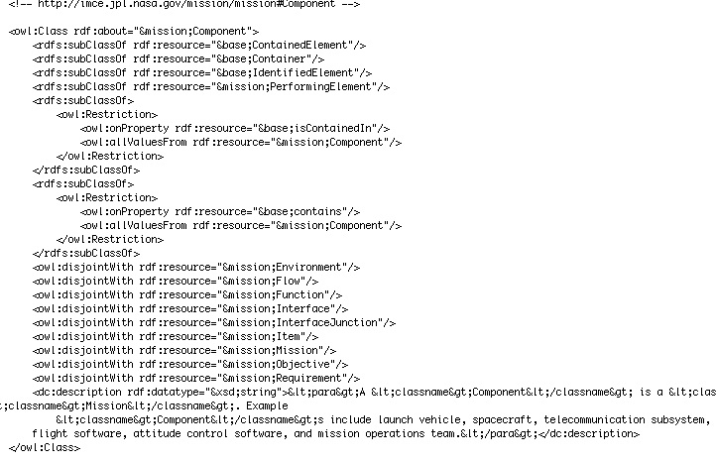
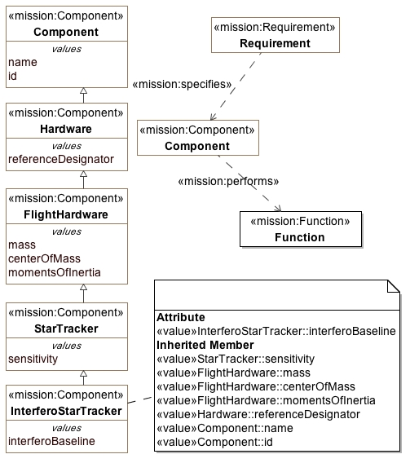
Representing Ontologies using OWL and SysML
OWL is a language for expressing ontologies using a logical formalism
SysML is a graphical modeling language for representing systems engineering concepts
Component has performs relationship with Function
Hardware specializes Component
FlightHardware specializes Hardware
FlightHardware has mass property
StarTracker specializes FlightHardware
OWL
SysML
graphical
rigorously
formal
Logical Automatic Processing
Ad-hoc Automatic Processing
MBSE approach leverages both OWL and SysML
Notes:
The ontology constrains the intended usage of the terms in ontology so that the ontology forms a vocabulary and axioms that can be used to express the knowledge and that can be used for sharing knowledge between different systems.
The specification is formal (like a program is formally written in a programming language), so that the ontology can be processed by a computer.

Slide 13
OWL and SysML: Complementary Modeling Languages
OWL
The Web Ontology Language (OWL) is a W3C standard
OWL is a Description Logic (DL) language for ontologies
  Statements, axioms, assertions, etc.
  Can express a formal ontology
Supports automated reasoning: check model consistency, well-formedness
Take-away:
OWL provides knowledge formalism
SysML
The Systems Modeling Language (SysML) is an OMG standard
SysML is a graphical modeling language for the SE domain
  Requirements, structure, behavior, parametrics
  Extension mechanisms to express a domain ontology
Supports some automatic reasoning
Take-away:
SysML provides graphical expressiveness
Notes:
Distinguish among 3 things:
Domain-specific vocabulary
Formalism (formal semantics)
Expressiveness
By using OWL we can check both the rigor of our concepts as well as well formedness of a model
Slide:
OWL provides formalisms which enables: rigorous checking of ontology concepts and ultimately the user models in SysML mapped backed to OWL
SysML gives expressiveness and an extension mechanism to apply a domain-specific vocabulary
Together, we constrain how a SysML profile is used to fully leverage the formalism

Slide 14
IMCE Vision for OWL/SysML Integration
SysML modeling tool
OWL editor
(e.g., Protégé)
OWL statements
Model
Transformation
Profile
edit ontology
convert ontology to SysML profile
OWL Reasoners
Check consistency and satisfiability. Compute entailments.
edit system model
SPARQL queries
Custom Analysis
OWL statements
Model
Transformation
System model
run integrity checks
convert SysML model to OWL
This is one example of how OWL and SysML tools might be used in MBSE

Slide 15
English ➔ OWL ➔ SysML Profile ➔ Usage
(animated)
English: “Component performs Function”
OWL (RDF)
<owl:Class rdf:about="&mission;Function">
<rdfs:subClassOf rdf:resource="&base;IdentifiedElement"/>
<rdfs:subClassOf rdf:resource="&mission;SpecifiedElement"/>
</owl:Class>
<owl:Class rdf:about="&mission;Component">
<rdfs:subClassOf rdf:resource="&base;ContainedElement"/>
<rdfs:subClassOf rdf:resource="&base;Container"/>
<rdfs:subClassOf rdf:resource="&base;IdentifiedElement"/>
<rdfs:subClassOf rdf:resource="&mission;PerformingElement"/>
</rdfs:subClassOf>
</owl:Class>
<owl:ObjectProperty rdf:about="&mission;performs">
<rdf:type rdf:resource="&owl;AsymmetricProperty"/>
<rdf:type rdf:resource="&owl;InverseFunctionalProperty"/>
<rdf:type rdf:resource="&owl;IrreflexiveProperty"/>
<rdfs:range rdf:resource="&mission;Function"/>
<rdfs:domain rdf:resource="&mission;PerformingElement"/>
</owl:ObjectProperty>
pkg [Profile] Component performs Function
SysML
profile
«stereotype»
mission:Component
«stereotype»
mission:performs
«stereotype»
mission:Function
bdd [Package] Component performs Function
«mission:Component»
Orbiter Spacecraft
«mission:performs»
«mission:Function»
Transmit Science Data
Usage

Slide 16
Simple Reasoning Examples
(animated)
Type | Given this input * | A reasoner concludes …
Consistency | “has mass” is a functional property. Curiosity is a HardwareComponent. Curiosity has mass 850 kg. Curiosity has mass 900 kg. | Inconsistent: At least two facts are mutually contradictory.
Satisfiability | Work Package and Organization are disjoint concepts. Every Project is both a Work Package and an Organization. | Unsatisfiable: no Project can exists that satisfies all rules.
Rules Entailment | Every Spacecraft is a Component. Every Orbiter is a Spacecraft. | Every Orbiter is a Component. (Therefore, all Component rules and Spacecraft rules apply to every Orbiter.)
Facts Entailment | Every Spacecraft is a Component. MSL Rover (an individual, not a class) is a Spacecraft. | MSL Rover is a Component.
Examples given in “equivalent” natural language, not OWL.
Purpose is to show kinds of problems for which reasoning is useful, not to demonstrate the mechanics.
Notes:
These examples are given in “equivalent” natural language, not OWL. The purpose is to show the kinds of problems for which reasoning is useful, not to demonstrate the mechanics.
Entailment ~ inference
Reasoning – deriving facts that are not expressed in ontology explicitly
All the formalisms were created with the outlook of automatic processing but due to their properties such as decidability or computational complexity or even due to the level of formality it is not always possible.
Description logics are created with the focus on tractable reasoning. A few examples of tasks required from reasoner are as follows.
Satisfiability of a concept - determine whether a description of the concept is not contradictory, i.e., whether an individual can exist that would be instance of the concept.
Subsumption of concepts - determine whether concept C subsumes concept D, i.e., whether description of C is more general than the description of D.
Consistency of ABox with respect to TBox - determine whether individuals in ABox do not violate descriptions and axioms described by TBox.
Check an individual - check whether the individual is an instance of a concept
Retrieval of individuals - find all individuals that are instances of a concept
Realization of an individual - find all concepts which the individual belongs to, especially the most specific ones

Slide 17
Ontology Hygiene Example
explains and validates are object properties (relations)
validates is a subproperty of explains, meaning
  (x validates y) implies
  (x explains y)
  or, validation is a kind of explanation, but not vice-versa
inverse of explains is isExplainedBy
inverse of validates is isValidatedBy
isValidatedBy should be a subproperty of isExplainedBy
Fragment from a system model
Analysis
explains
Anything
validates
Validation
Fragment from ontology
inverse of
explains
isExplainedBy
subproperty of
subproperty of?
inverse of
validates
isValidatedBy

Slide 18
SPARQL Query Example
This example illustrates an audit in SPARQL for previous example
Literally it says “If p₁ and p₂ are distinct properties such that p₁ is a subproperty of p₂, and p₁⁻¹ and p₂⁻¹ exist, then report whether p₁⁻¹ is a subproperty of p₂⁻¹”
Most important features to note: it’s short and fast
A collection of similar queries can form the basis of a continuous validation suite for ontology and model development
select distinct ?p1 ?p2 ?inverse_ok
where {
?p1 rdfs:subPropertyOf ?p2 .
?p1 owl:inverseOf ?p1_inverse .
?p2 owl:inverseOf ?p2_inverse .
bind (exists { ?p1_inverse rdfs:subPropertyOf ?p2_inverse } as ?inverse_ok)
filter (?p1 != ?p2)
}
Notes:
SPARQL Protocol and RDF Query Language
RDF query language (query language for databases)
W3C standard
Unambiguous queries
Prefix foaf: http://xmlns.com/foaf/0.1/
SELECT ?name ?email?
WHERE {
?person a foaf:Person
?person foaf:name ?name
?person foaf:mbox ?email
}

Slide 19
Overview of systems Engineering Ontologies

Slide 20
Introduction
The purpose of the Systems Engineering Ontologies is to encompass key concepts and associate vocabulary for modeling systems in the space system domain
The emphasis in this training module is on the ontology concepts and how they appear in SysML models
Examples are given representing a fanciful mission to the extrasolar planet Kepler-16b
Notes:
Specification compliant: does not distinguish unambiguously between concepts such as a mission, a science objective, an engineering product, or a work package
Set of classifiers: Used to make these distinctions organized into Ontologies
Every concept (Component, Function, Interface, Requirement, etc.) will be characterized by a set of properties defined by its type (contains, specifies, executes, etc.)

Slide 21
Systems Engineering Ontologies Organization
Scope of this module
Foundation Ontologies
Mission, Project, Analysis,
Quantities-Units-Dimensions-Values,
Artifact
Fundamental terms use in all projects, disciplines, and applications
uses
Discipline Ontologies
Mechanical
Electrical
Thermal
Propulsion
ACS, Physics, …
Discipline-specific terms specified and owned by cognizant organizations
uses
Focus is integration and interoperation
uses
Kinds of items modeled in a project
Application Ontologies
Star Tracker, Sun Sensor, Reaction Wheel, Thruster, Antenna, …
Focus is reuse
Notes:
The purpose of the discipline ontology category is to provide experts in the line organizations the opportunity to define the discipline-specific property definitions that will be used across multiple application ontologies.
The mechanical discipline ontology, for example, will define parameters to specify mass properties. These definitions will be used by mechanical application ontologies (e.g., boom, strut, backshell, etc.) and also by other application ontologies (e.g., propulsion, avionics, AACS, etc.)
The distinction between discipline and application is that discipline ontologies (mostly) define groups of related properties, and application ontologies (mostly) define things by refining foundation concepts and applying discipline properties.

Slide 22
Some Foundation Concepts Examples
Concept | Definition | Examples
Component | Performs one or more functions and presents zero or more interfaces that define its connections | launch vehicle, spacecraft, telecom subsystem, flight software, attitude control software, and mission operations team
Interface | A set of mechanical, electrical, signal, or other properties that describe some aspect of a component's connection to or interaction with another component | spacecraft to launch vehicle, launch vehicle to spacecraft, battery terminals
Function | An operation or an activity performed by a Component in the context of executing a Mission | search for life on Mars, insert into Martian orbit, send instrument telemetry
Requirement | An assertion about a Component, Function, or Interface that must be true for every acceptable realization of that element | The spacecraft bus main structure shall be aluminum. The spacecraft shall provide 300 W to instruments.
Work Package | Discrete unit of project authority, cost, schedule, and activity; a node in the project Work Breakdown Structure | Project Systems Engineering, Spacecraft System, Spacecraft Product Assurance

Slide 23
Partial Map of Foundation Ontology Concepts
(animated)
Concern
represents
Stakeholder
Process
executes
Program
represents
authorizes
produces
Project
supplies
Mission
pursues
Objective
Product
specifies
produces
analyzes
deploys
Analysis
Requirement
Interface
specifies
presents
WorkPackage
supplies
Component
Function
performs
characterizes
invokes
Characterization
influences
contains
characterizes
Environment
Legend
Think in terms of statements:
“Requirement specifies Component”
“Component performs Function”
“WorkPackage supplies Component”
Mission ontology
Project ontology
Analysis ontology
relationship
a kind of
Notes:
----- Meeting Notes (9/15/11 11:38) -----
speak about models
ontologies describe sysml model or domain models

Slide 24
The Mission Ontology
Missions and Objectives
Physical Structure
Interfaces
Behavior and Functions
Specification by Requirements
Environment

Slide 25
Mission Ontology Scope (partial)
Mission Ontology defines concepts for describing missions in terms of:
  Objectives,
  Constituent components,
  Functions those components perform
  Requirements that specify them
Mission
pursues
Objective
specifies
deploys
aggregates
Requirement
Interface
joins
Junction
specifies
presents
refines
emits,
ingests
traverses
Component
performs
Function
Requirements refinement
Flow
Item
contains
invokes
System
breakdown
Functional
decomposition
sends, receives
induces
influences
MaterialItem
Message
Environment

Slide 26
Objective
An Objective represents a specific interest that one or more stakeholders have in the successful execution of a mission
Objectives differ from Requirements:
  they are not the result of negotiated agreement between customer and supplier
  they need not be mutually consistent
  a Mission pursues but need not completely achieve all its Objectives
Objectives can be aggregated
Objective
aggregates
Notes:
Examples:
Characterize the extent of the Europan ocean and its relation to the deeper interior
Determine if life ever arose on Mars
Aggregation is in fact a compositional relationship with a more specialized meaning.

Slide 27
Mission pursues Objective
pursues
Missions pursue scientific and technical objectives
  A Mission can pursue multiple Objectives
  An Objective can be pursued by more than one Mission
Objective
Mission

Slide 28
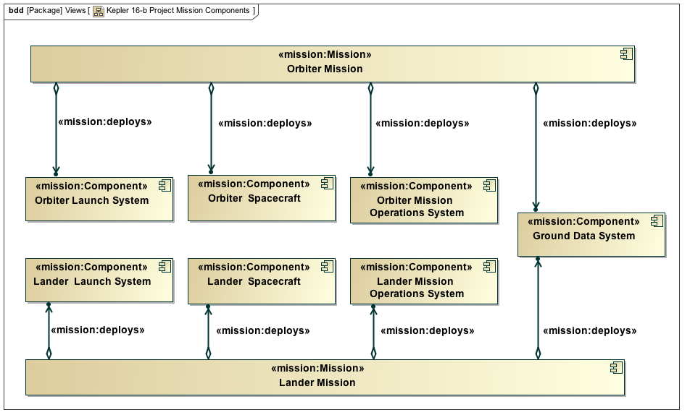
Mission deploys Component
deploys
A Mission pursues Objectives by
deploying a set of assets, i.e., Components
Component
Mission

Slide 29
Component Containment (System Breakdown)
A Component may contain other Components
  Physical encapsulation
  Physical assembly
  Functional performer decomposition
Component
contains

Slide 30
Component presents Interface
An Interface identifies a set of mechanical, electrical, signal, or other properties that describe some aspect of a component's connection to or interaction with another component.
  An interface is a specification, not a thing
  It appears as a typed port
Component
presents
Interface
Mission:Interface is used to type a port
Notes:
In fact, a common pattern is that an InterfaceJunction at one level of abstraction is represented at a lower level of abstraction by an InterfaceJunction-Interface-Component-Interface-InterfaceJunction string, the Component here representing the physical realization.
We say an Item or Flow traverses an InterfaceJunction to indicate that the properties of the InterfaceJunction are pertinent to the sends/receives or emits/ingests operations for that Item or Flow. In that sense, the InterfaceJunction is a proxy for the conduit of exchange.

Slide 31
Junction joins Interface
A Junction indicates that a pair of Interfaces may be connected
  A declaration, not a physical entity
High level of abstraction
  Avoid commitment to a particular implementation
  Common pattern: a Junction at one level of abstraction is represented at a more detailed level by an actual component (e.g., a physical cable or harness).
Interface
joins
Junction
Notes:
In fact, a common pattern is that an Junction at one level of abstraction is represented at a lower level of abstraction by an Junction-Interface-Component-Interface-Junction string, the Component here representing the physical realization.
We say an Item or Flow traverses an Junction to indicate that the properties of the Junction are pertinent to the sends/receives or emits/ingests operations for that Item or Flow. In that sense, the Junction is a proxy for the conduit of exchange.

Slide 32
More Interfaces and Junctions
Defines input and output interfaces for
command, telemetry, and science data
Defines specialized interfaces for
spacecraft
and ground system

Slide 33
Spacecraft and Ground System Interfaces
Shows command, telemetry and science interfaces as ports on spacecraft and ground system, using the defined types, e.g., “Command In”

Slide 34
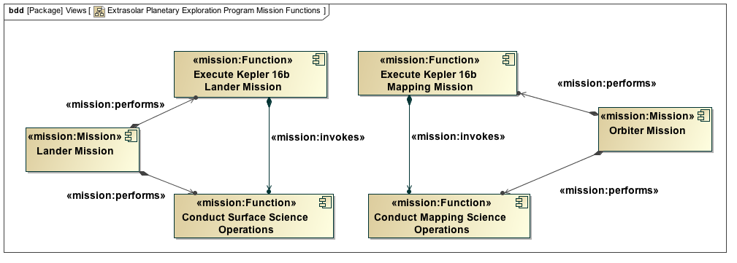
Mission performs Function
A Mission performs one or more Functions
A Function represents an intent to change the state of the world
A Function may invoke another Function
invokes
Mission
performs
Function
Notes:
In fact, a common pattern is that an Junction at one level of abstraction is represented at a lower level of abstraction by an Junction-Interface-Component-Interface-Junction string, the Component here representing the physical realization.
We say an Item or Flow traverses an Junction to indicate that the properties of the Junction are pertinent to the sends/receives or emits/ingests operations for that Item or Flow. In that sense, the Junction is a proxy for the conduit of exchange.

Slide 35
{Mission, Component} performs Function
Every Component performs
one or more Functions
Mission
performs
deploys
Function
performs
invokes
Component
<<mission:Function>>
<<mission:Function>>
Notes:
In fact, a common pattern is that an Junction at one level of abstraction is represented at a lower level of abstraction by an Junction-Interface-Component-Interface-Junction string, the Component here representing the physical realization.
We say an Item or Flow traverses an Junction to indicate that the properties of the InterfaceJunction are pertinent to the sends/receives or emits/ingests operations for that Item or Flow. In that sense, the InterfaceJunction is a proxy for the conduit of exchange.

Slide 36
{Item, Flow} traverses Junction
Junction
A Function may interact by sending and receiving Items
An Item is a discrete quantity of matter or information
  A Message is a discrete unit of information
A Flow is an exchange of matter or energy
  Without natural boundaries
An Item or Flow traverses a Junction
An Interface transfersIn or transfersOut an Item or Flow
traverses
traverses
Item
Flow
MaterialItem
Message
transfersOut
transfersIn
traverses

Slide 37
Function sends Message; Message traverses Junction
Component
presents
Interface
joins
Junction
Embedded IBD shows Science Data Downlink as a connector
performs
traverses
Function
sends
Message
representation of sends/receives TBD

Slide 38
Connectors are Junction Occurrences
Internal Block Diagram shows actual, not merely possible, connections and traversals

Slide 39
Requirement
A Requirement is an assertion that must be true of every acceptable realization of an entity
Requirements are traditionally grouped in ad-hoc categories (functional, performance, etc.)
  Without semantic rigor, not very useful
Every Requirement specifies at most one entity
  Component
  The performs relationship between Component and Function
  The presents relationship between Component and Interface
A Requirement always binds a Component (directly or transitively)
A lower-level Requirement refines a higher-level Requirement

Slide 40
Program-Level Functional Requirements
Mission
performs
Function
specifies
Requirement

Slide 41
Requirement specifies ….
interface requirement
functional requirement

Slide 42
Function invokes Function; Requirement refines Requirement
K16-b Mapping Downlink Requirement Specification
Mission or
Component
performs
Function
specifies
invokes
Requirement
refines

Slide 43
Environment
An Environment stands for a set of properties that may affect Components performing one or more Functions
An Environment influences zero or more Components
A Component induces zero or more Environments
Component
influences
induces
Environment

Slide 44
Kepler 16-b Environments
Component
influences
induces
Environment

Slide 45
The Analysis Ontology
Foundation Ontologies
Mission, Project, Analysis,
Quantities-Units-Dimensions-Values,
Artifact
Analysis
Characterization

Slide 46
The Analysis Profile Scope
The Analysis Ontology defines general concepts and relationships for analyses such as trade studies, cost estimates, etc.
The Analysis Profile defines classes and properties that describe characterization and analysis of model elements.
One of the key principles of Analysis is to separate identity from description
  We don’t necessarily say a spacecraft has “a mass”
  We might say it is characterized by one or more mass property characterizations
    e.g., as estimated, as measured, with contingency, etc.
  These characterizations represent choice about description

Slide 47
Characterization
Characterization is a central concept in a pattern that seeks to separate identity from description
A Characterization is a general entity that characterizes some other entity
Example specializations:
  Nominal
  Parametric
Characterization
characterizes
(an entity)
Note: The Characterization owns the relationship, not the entity.
Thus, a Characterization can be added without having ‘write’ access to the entity.
Notes:
Suppose we have a spacecraft model element (with applied stereotype «mission:Component»). We may wish to attach a value for the spacecraft's mass. The simplest approach would involve adding a value property called mass to the spacecraft. Upon reflection, however, we may find that this approach suffers from a number of deficiencies. The first is that a single mass value is rarely sufficient for practical systems engineering. A single spacecraft may have an as-designed mass, an an-analyzed mass, an as-measured mass, etc. Furthermore it may have an as-designed mass at Preliminary Design Review, another at Critical Design Review, etc. Creating a separate property for each mass characterization would be cumbersome at best. A second deficiency is that only the owner of a SysML Block can add a property. A reliability engineer, for example, cannot add a reliability estimate to a spacecraft model element without owning it.
For these reasons, we introduce the concept of Characterization. A Characterization is a general entity that characterizes some other entity. In the Analysis Profile we do not specialize Characterization, but typical usage would involve specializations for varied purposes. Some example specializations might be:
Nominal Characterizations are used to group arbitrary model elements into categories. For example, a nominal characterization called Jupiter could be used to relate multiple Environments (e.g., gravitational, radiation, etc.) to a single planet. Nominal characterizations for mission phases or life cycle milestones (PDR, CDR, etc.) can describe the evolution of a model over time. The distinctions between as-designed, as-analyzed, as-measured, etc., can be conveyed with nominal characterizations.
Parametric Characterizations are used to attach values to an element. For example, a Mass Properties Characterization could define mass, center of mass, and moments of inertia. This Characterization, in turn, could be characterized by one or more nominal characterizations that indicate greater specificity. One of the more important aspects of discipline-specific profiles will be to define parametric characterizations unique to each discipline.
Over time, it will become important for JPL to define, at Laboratory level and multiple levels below, standard nominal and parametric characterizations that anchor computations producing standard analysis products. A mass margin report application, for example, would use characterizations to locate a product breakdown structure corresponding to a particular life cycle milestone and to extract the specific parameter values comprising the columns of the report.
We say A Characterization is a general entity that characterizes some other entity (of any time). A Characterization can also characterize a relationship between to model elements. For example, we might use Characterizations between, say, nominal and off-nominal instances of the performs relationship between a Component and its Functions.

Slide 48
Example Nominal Characterizations
Useful for grouping elements

Slide 49
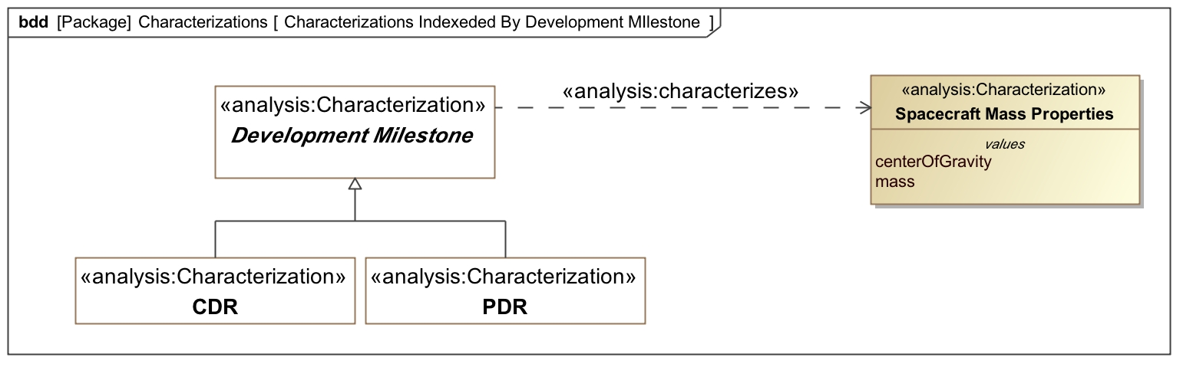
Characterizations By Milestone

Slide 50
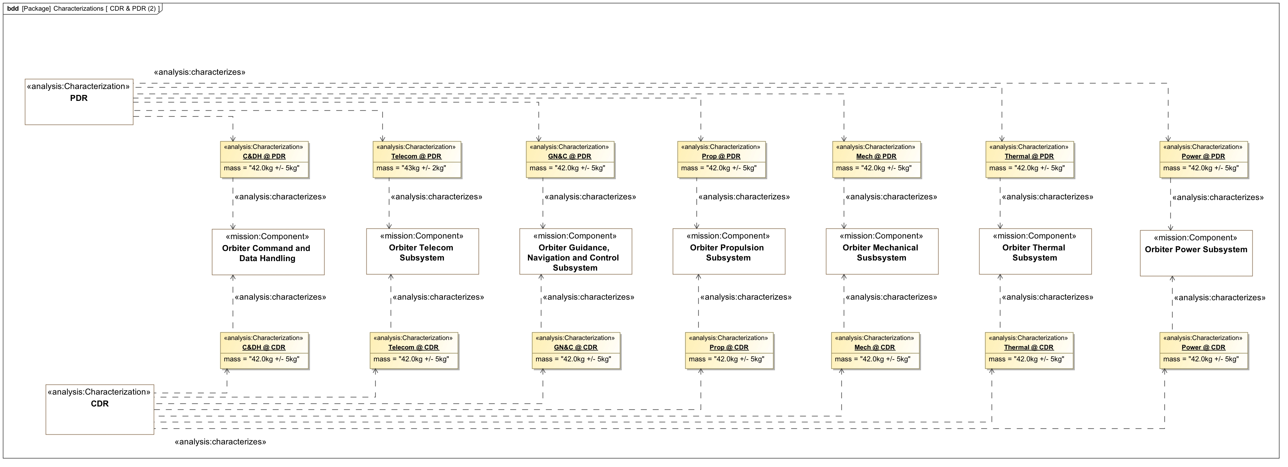
Characterizations (CDR & PDR)

Slide 51
Analysis
An Analysis is a Characterization that provides an explanatory bridge between two sets of model elements
The Analysis denotes the result, not the process
characterizes
Characterization
anything
analyzes
explains
anything
Analysis
anything
Notes:
Suppose we have a spacecraft model element (with applied stereotype «mission:Component»). We may wish to attach a value for the spacecraft's mass. The simplest approach would involve adding a value property called mass to the spacecraft. Upon reflection, however, we may find that this approach suffers from a number of deficiencies. The first is that a single mass value is rarely sufficient for practical systems engineering. A single spacecraft may have an as-designed mass, an an-analyzed mass, an as-measured mass, etc. Furthermore it may have an as-designed mass at Preliminary Design Review, another at Critical Design Review, etc. Creating a separate property for each mass characterization would be cumbersome at best. A second deficiency is that only the owner of a SysML Block can add a property. A reliability engineer, for example, cannot add a reliability estimate to a spacecraft model element without owning it.
For these reasons, we introduce the concept of Characterization. A Characterization is a general entity that characterizes some other entity. In the Analysis Profile we do not specialize Characterization, but typical usage would involve specializations for varied purposes. Some example specializations might be:
Nominal Characterizations are used to group arbitrary model elements into categories. For example, a nominal characterization called Jupiter could be used to relate multiple Environments (e.g., gravitational, radiation, etc.) to a single planet. Nominal characterizations for mission phases or life cycle milestones (PDR, CDR, etc.) can describe the evolution of a model over time. The distinctions between as-designed, as-analyzed, as-measured, etc., can be conveyed with nominal characterizations.
Parametric Characterizations are used to attach values to an element. For example, a Mass Properties Characterization could define mass, center of mass, and moments of inertia. This Characterization, in turn, could be characterized by one or more nominal characterizations that indicate greater specificity. One of the more important aspects of discipline-specific profiles will be to define parametric characterizations unique to each discipline.
Over time, it will become important for JPL to define, at Laboratory level and multiple levels below, standard nominal and parametric characterizations that anchor computations producing standard analysis products. A mass margin report application, for example, would use characterizations to locate a product breakdown structure corresponding to a particular life cycle milestone and to extract the specific parameter values comprising the columns of the report.
We say A Characterization is a general entity that characterizes some other entity (of any time). A Characterization can also characterize a relationship between to model elements. For example, we might use Characterizations between, say, nominal and off-nominal instances of the performs relationship between a Component and its Functions.

Slide 52
Downlink Analysis – Requirement Refinement
analyzes
Requirement
Analysis expresses the reciprocity between EIRP and G/T
Analysis
explains
refines

