Slide 1
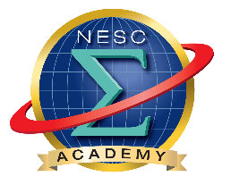

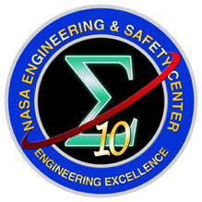
NESC Academy Webcast
Moving Cross Town or Cross the Solar System, Putting the Pieces Together
Launch Vehicle Mission Flow and Model Based Systems Engineering (MBSE)
Neil Dennehy, NESC
Jessica Knizhnik, GSFC
October 7th, 2016
Moderated by Jon Holladay
NASA Technical Fellow for Systems Engineering
NASA Engineering & Safety Center (NESC)

Slide 2

NASA MBSE Pathfinder Webinar Series
Where the Art and Science of SE Come Together
Rendezvous & Capture Systems
Neil Dennehy
NASA Technical Fellow for GN&C
NASA Rendezvous & Capture Systems Capability Leadership Team
7 October 2016

Slide 3
Presentation Outline
Team
Introduction to Rendezvous & Capture (RV&C)
Early History of Rendezvous
Examples of on-going and future RV&C missions
“Integrated Systems” aspects of RV&C
Some RV&C System Capability Stretch Goals
Some initiatives needed
Summary

Slide 4
NASA Rendezvous & Capture
System Capability Leadership Team (SCLT)
Team Leadership:
Team Membership:
Name | Organization
Neil Dennehy | NESC/GNC/Lead
Heather Hinkel/Scott Cryan (JSC) | RV&C SCLT Deputy
Dawn Schiable | OCE Advisor
Stephanie Stilson | Advisor
Name | Organization
Kalmanje Krishnakumar | ARC
Gary Pease | GRC
Keith DeWeese | GSFC
TBD | GSFC
Bo Naasz | HEOMD Rep
Erik Bailey | JPL
George Chen | JPL
Rudra Mukherjee | JPL
Pete Waydo | JPL
Greg Lange | JSC
James Lewis | JSC
Pete Spehar | JSC
Glenn Hines | LaRC
TBD | LaRC
Tom Bryan | MSFC
Ricky Howard | MSFC
Supporting Discipline Level CLTs:
Name | Discipline CLT
Oscar Gonzalez | Avionics
Dan Murri | Flight Mechanics
Mike Dube | Mechanical Systems*
Curt Larsen | Loads & Dynamics
Aron Wolf | GN&C
Jon Holladay | Systems Engineering
Mike Aguilar | Software
Upendra Singh | Sensors & Instruments (new)
* Brandon Robertson, Mechanical Systems TDT Deputy,
contributed significantly to this presentation
4

Slide 5
RV&C System Capability Definitions
Rendezvous & Capture - Process of bringing a spacecraft and another space-based object (manmade or natural body) together
  Rendezvous - Intentionally bringing two resident space objects close together at a specified location & time
  Capture – Mating of two spacecraft or a spacecraft and a space-based object.
    Grapple, Docking, Berthing, Small Body Touch & Go, Small Body Descent and Landing
  Note: In the original TCAT framework Rendezvous & Capture came under the higher-level category of “Arrival Transportation” defined as: Operations or experimental mode of transportation (vehicles) used to slow approach, connect to an object or set down on a surface.

Slide 6
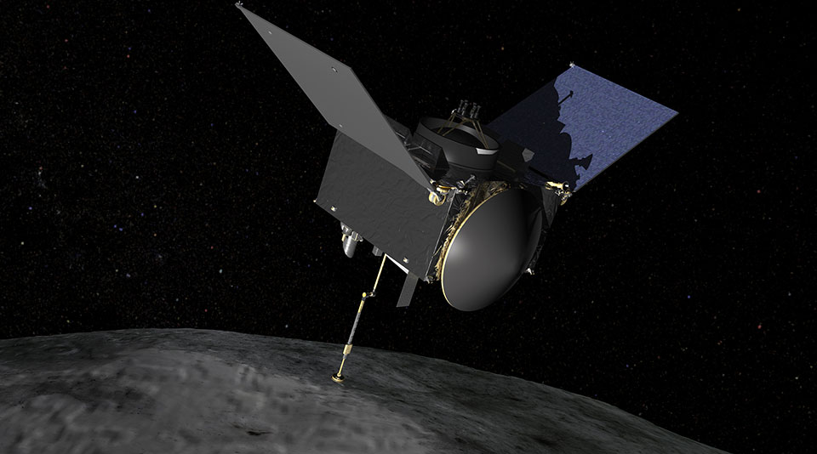
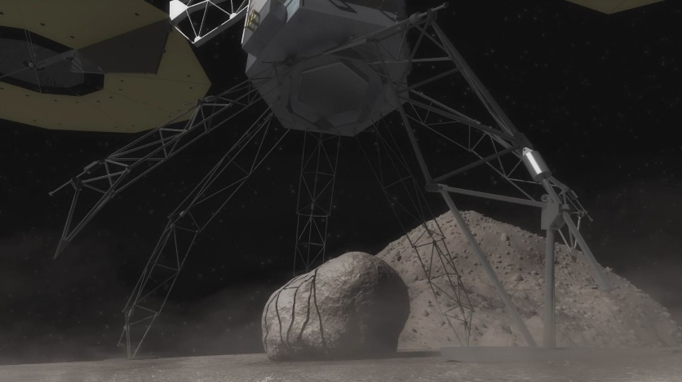
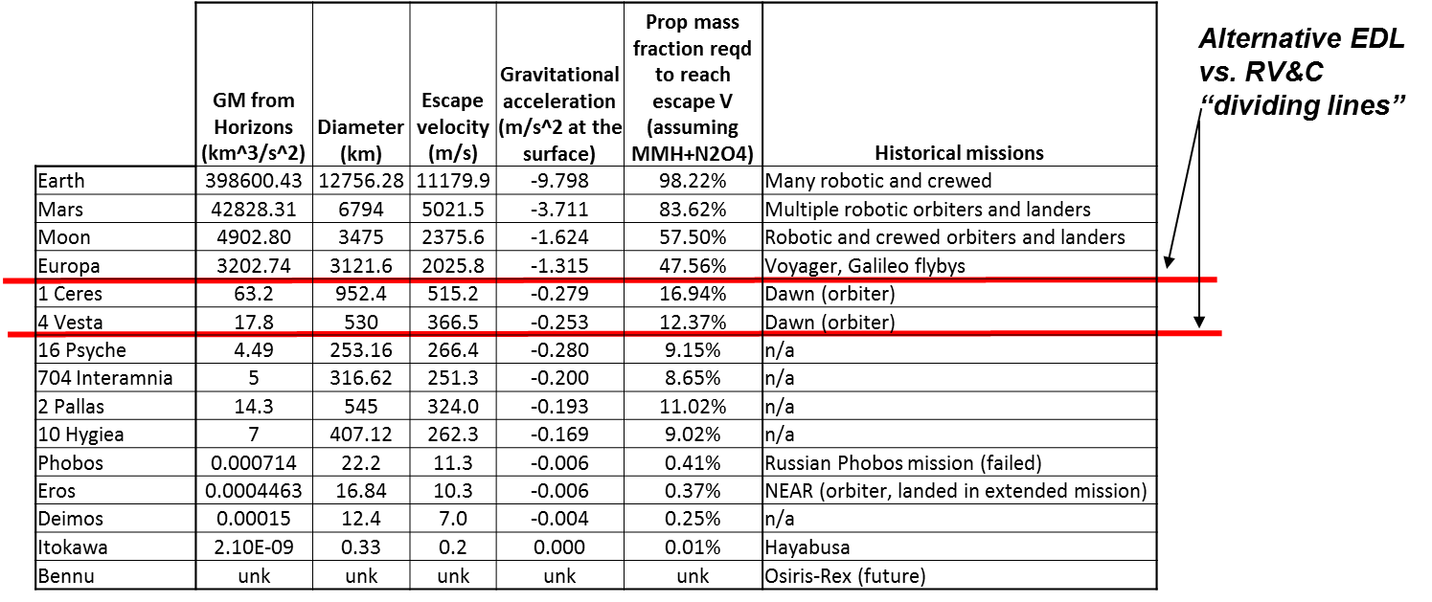
Introduction of RV&C Terms
Capture – Mating of two spacecraft or a spacecraft and a space-based object
Small Body Touch and Go - Momentary short duration intentional contact, without attachment, to a space-based object. Primarily performed to gather/collect small body surface material, typically with a sampling mechanism Examples: OSIRIS-REx Asteroid Sample Return Mission
Small Body Descent & Landing – When a spacecraft approaches, then descends and lands on a low-gravity well small body . Examples: Asteroid Redirect Mission, Robotic Segment
Image from HH
Can establish dividing line between target bodies where EDL system capability applies versus where RV&C system capability applies

Slide 7
“Classes” of RV&C Missions
RV&C Missions happen in MANY different locations
  Earth Reliant – ISS Visiting Vehicles, Satellite Servicing, Active Debris Removal
  Proving Ground - Asteroid Redirect Mission, Cislunar Transit Habitat, Small Body/Low Gravity Field
  Earth Independent – Planetary Rendezvous, Sample Return missions
RV&C Mission Types:
  Crewed vehicle – many timeline and operational constraints
  Robotic vehicle – onboard processing requirements, unconstrained timeline, long operating times
RV&C Target Types:
  Cooperative: contains known features to enable RPOD (reflectors, transponder, docking target)
  Non-cooperative: no features to enable AR&D, could have unknown/uncontrolled attitude
RV&C Destination Type:
  Vehicle – possibly known vehicle model and spin rate, may have mechanism to allow “capture”
  Celestial Body- known or unknown model and spin rate
Mission Type
Target Type
Destination
Crewed
Cooperative
Vehicle
Robotic
Planetary Moon
Celestial
Body
Non-cooperative
Large Asteroid
Example Missions
Crewed, cooperative, vehicle (Blue)
ARCM
Robotic, coop and Non-coop, vehicle (Orange)
Satellite Servicing
Robotic, Non-cooperative, Celestial Body(Purple)
ARRM, OSIRIS-REx

Slide 8

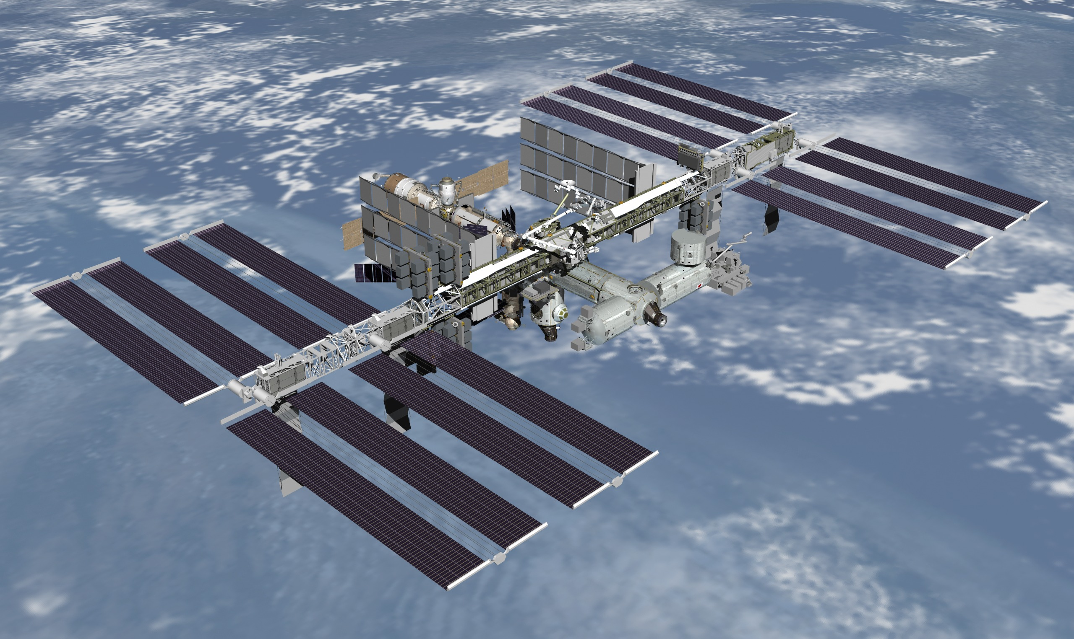

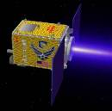
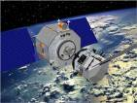
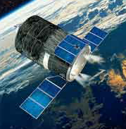
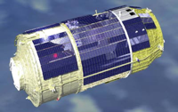

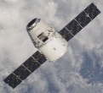
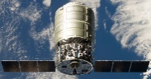
Near Earth Rendezvous & Capture Timeline (1995 – Today)
1995 1998 2003 2005 2007 2009 2010 2013 today
Soyuz and Progress to Mir and ISS
1986-today
Shuttle to Mir
1995-1998
Shuttle to ISS
1998 to 2011
AR&D DTOs
XSS-10
7/2009 – 7/2011
Jan 2003
Experimental Satellite System
XSS-11
4/2005 – 6/2006
Orbital Express
6/2001 to Launch
DART
O. E.
4/2005
3/2007 – 6/2007
ARPK
ARPK
ARPK
ATV
3/2008 – 2/2015
ETS-VII
HTV
1997- 2002
9/2009 - today
ETDP and SOMD AR&D Ground Testing
2005 - 2009
HRVDM
SM4
KEY
2004 - 2005
Dragon
Ground Activities
Flight Missions
5/2009
12/2010 - today
Cygnus
9/2013 - today
Orion & SSCO ground
2011 - today

Slide 9
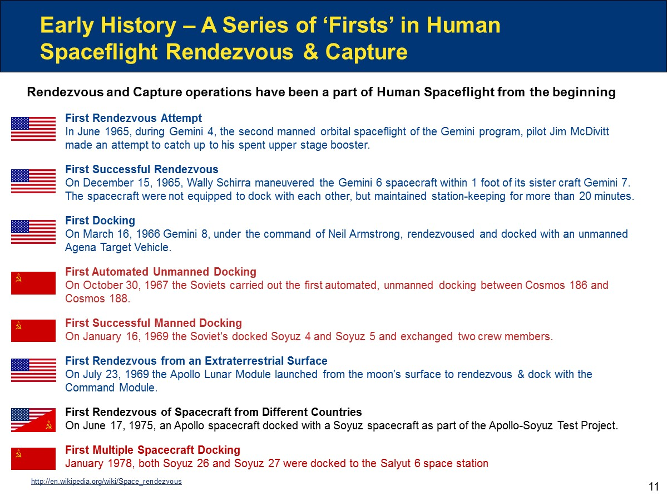

Slide 10
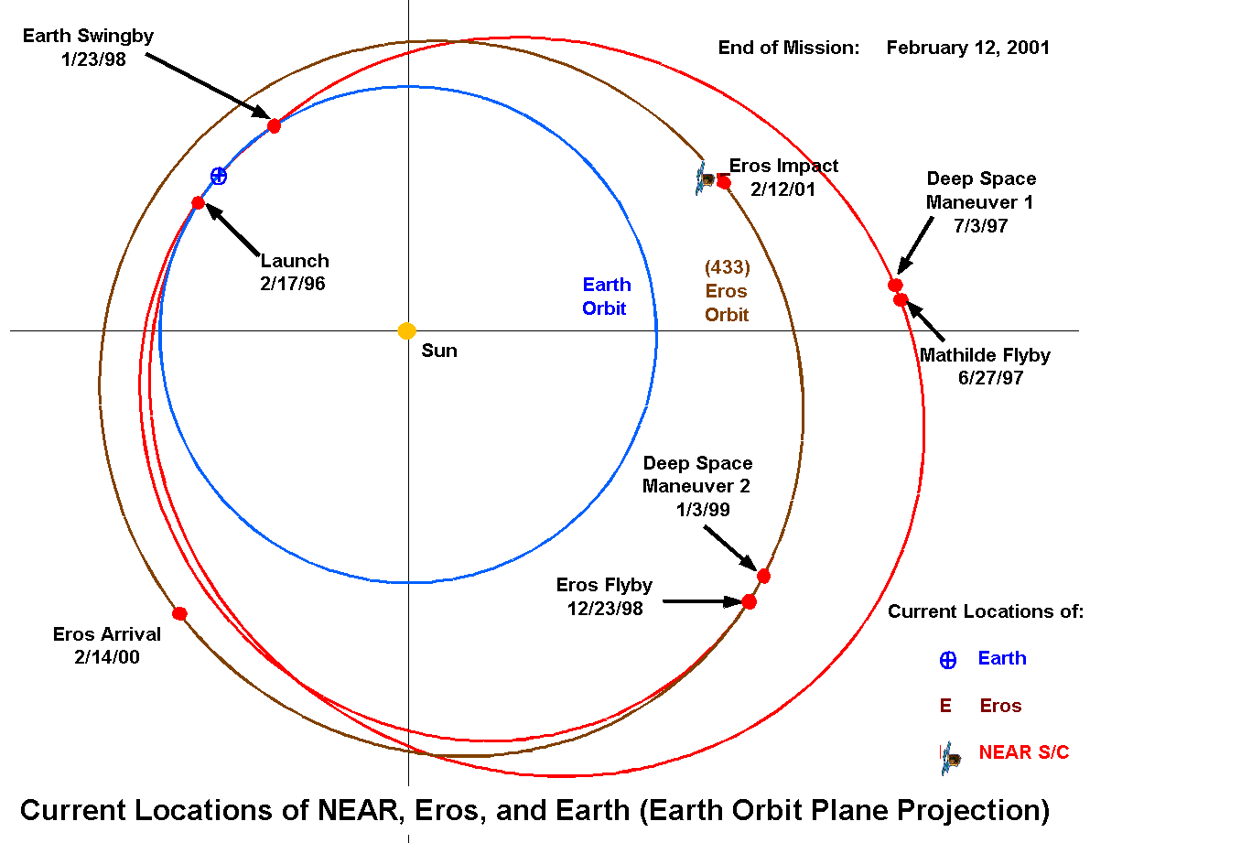
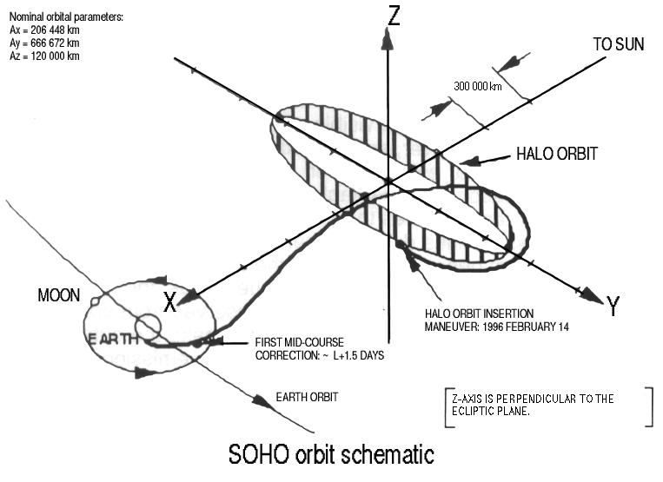
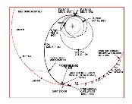
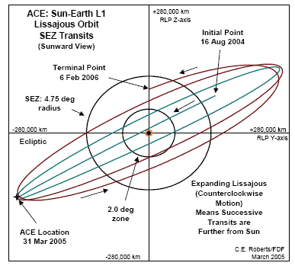
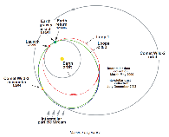
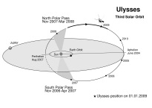
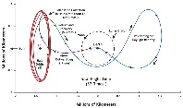
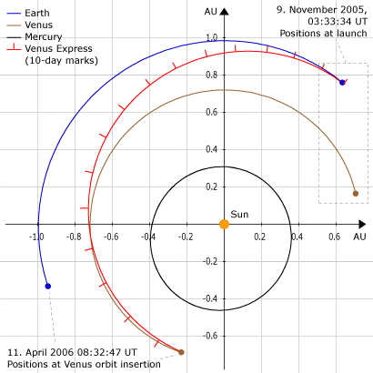
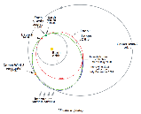
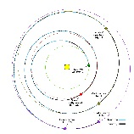
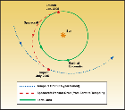
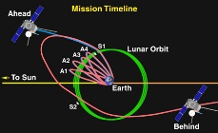
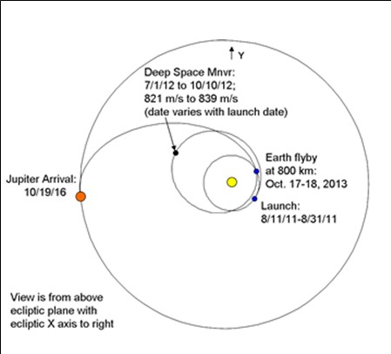
Deep Space Rendezvous Timeline
Sun Mercury Venus Moon Mars Jupiter Saturn Comets/Asteroids Solar Sys Pluto
1994
1995
1996
1997
1998
1999
2000
2001
2002
2003
2004
2005
2006
2007
2008
2009
2010
2011
2012
2013
2014
2015
Ulysses
Voyager 1&2
Pioneer 10
SOHO
Mars
Pathfinder
Mars
Global Surveyor
Galileo
NEAR
Lunar
Prospector
Cassini
ACE
Nozomi
MCO
Deep
Space 1
Stardust
Genesis
Smart 1
Mars
Express
Mars
Exploration Rovers
MINERVA
MESSENGER
Rosetta
Deep Impact
Venus Express
MRO
Stereo A&B
New
Horizons
Chang’e 1
Selene
Phoenix
Mars
Lander
Dawn
Chandrayaan 1
LRO
Kepler
Akatsuki
IKAROS
Chang’e 3
GRAIL
MSL
Juno
LADEE
Mars
Orbiter
Chang’e 3
Maven
MASCOT
Legend: NASA ESA/Europe Japan China
Recent Russian data not available
Dashed lines represent travel time prior to active science

Slide 11
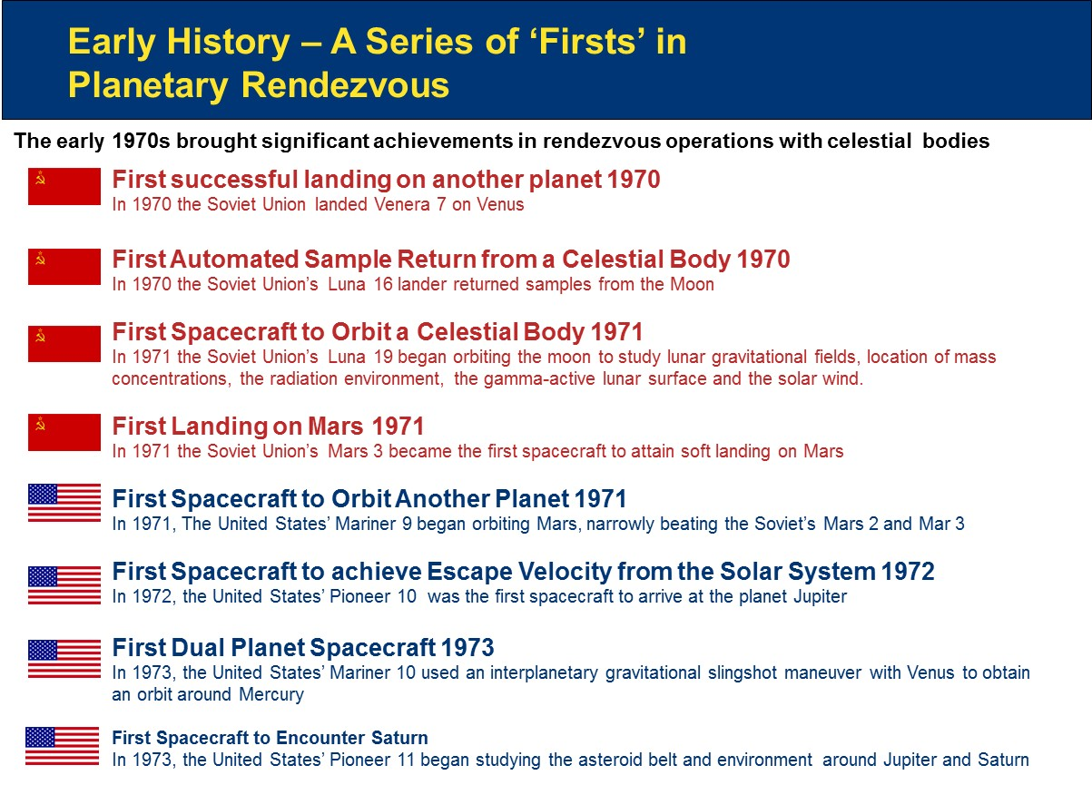

Slide 12
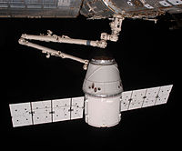
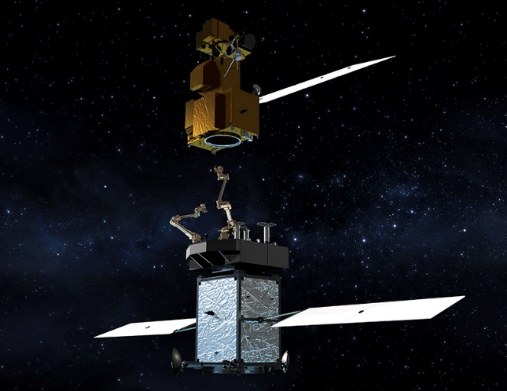
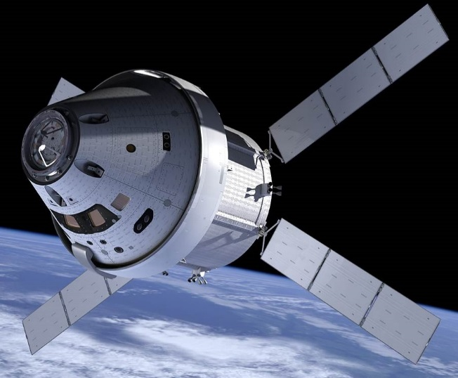
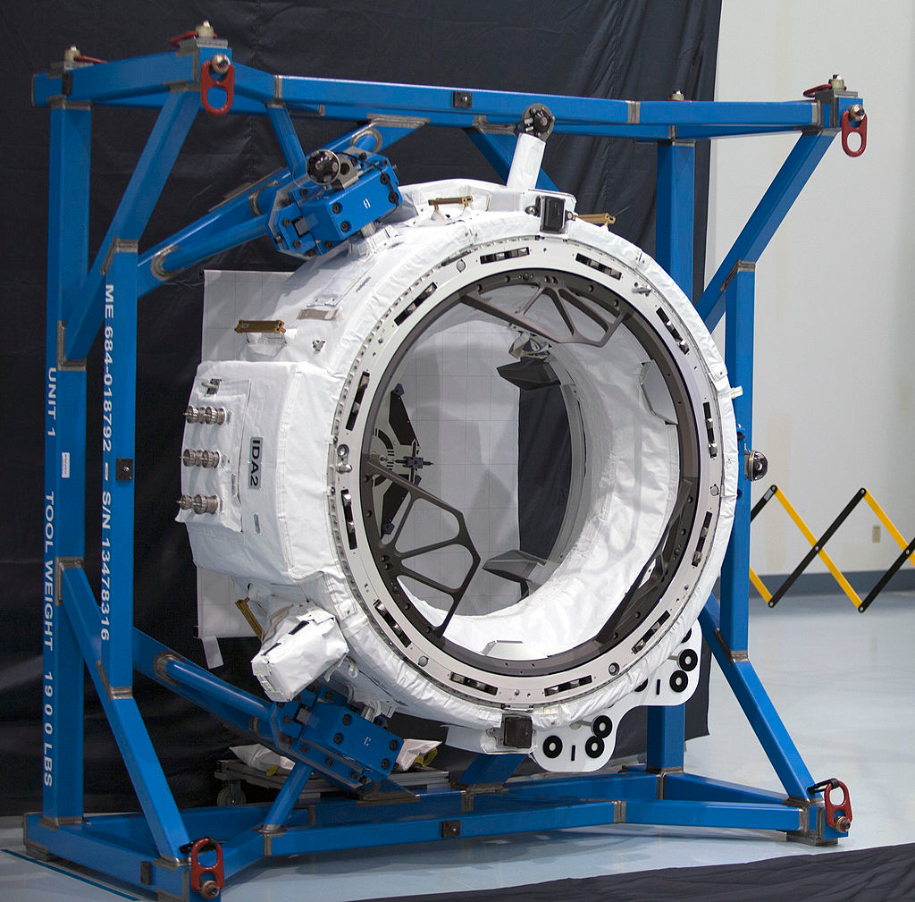
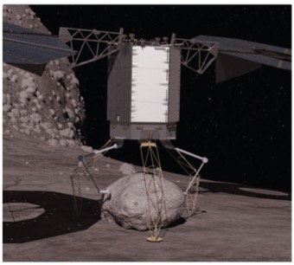
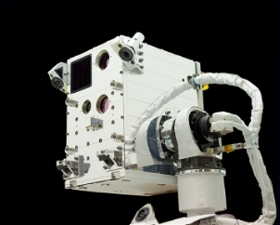
Multiple RV&C Related Operational and Development Activities On-Going
New Frontiers OSIRIS-Rex Asteroid Sample Return Mission Poised for September Launch
Restore-L Spacecraft Servicing Technology Demonstration Mission
SpaceX Cargo Resupply
International Docking Adapter
Converting ISS APAS/PMA to NDSB1
Orion
Asteroid Robotic Redirect Mission (ARRM)
Raven (ISS)

Slide 13
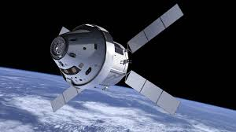
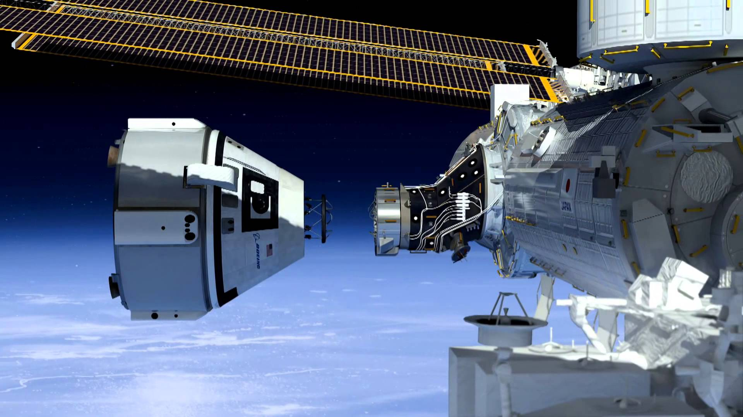
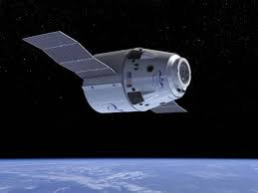
New Generation of Spacecraft Coming Online Soon
Currently have an unprecedented level of spacecraft system development at NASA
NASA
Orion MPCV
(EM-1 in 2018)
SpaceX
Dragon2
Boeing
CTS-100

Slide 14
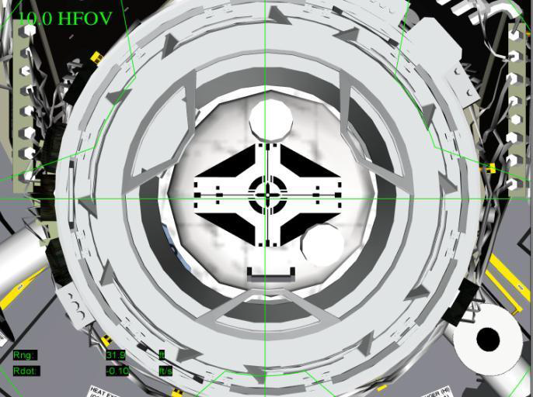
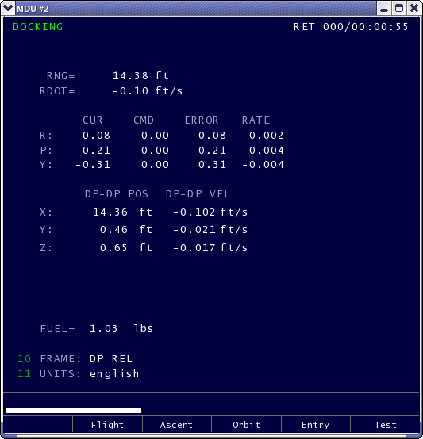
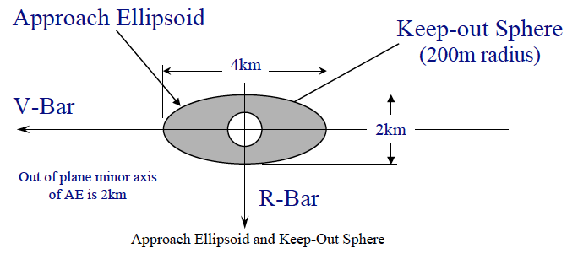
Rendezvous, Proximity Operations and Docking Represent Driving Spacecraft Piloting Challenges
From Stephens, Vox, Bilimoria, Mueller, Brazzel, Spehar, “Orion Handling Qualities During ISS Proximity Operations and Docking”
Engineering display of Orion docking camera view
Engineering PFD showing docking rates and offsets
From ISS to COTS Interface Requirements Doc SSP_50808
RV&C Systems Engineering analyses will need to be done to trade automated tasks versus crew performed tasks

Slide 15
RV&C System Capability Achieved Through
Discipline-level ‘Building Block’ Products & Services
NASA’s RV&C
System Capability
Systems Engineering Discipline
Loads & Dynamics Discipline
Software Discipline
Avionics Discipline
Autonomous Mission Management
GN&C Discipline
Robotics
Discipline
Sensors & Instruments Discipline
Mechanical
Systems Discipline
Flight Mechanics Discipline
RV&C Systems Engineering and Systems Integration of multiple
discipline-specific subsystems is critical to mission success

Slide 16
RV&C System Capability Achieved Through Discipline-level ‘Building Block’ Capabilities
Systems Engineering Discipline
  Requirements definition
  Concept of Operations (CONOPS)
  Architectural development & evaluation
  Trade Study methods & tools
  Fault Tolerance
  Integration
  Overall System V&V
Mechanical Systems Discipline
  Design of Capture Mechanisms for: Docking, Berthing, Grappling, Sampling
Guidance, Navigation, and Control (GN&C)
  GN&C subsystem architecture and design for RV&C missions
  Relative Navigation Sensors & Algorithms
  Closed-loop flight control
Flight Mechanics Discipline
  Trajectory optimization
  End-to-End Performance Evaluations
Software Discipline
  Flight software (FSW) design & development
  FSW V&V
  Image processing software
Loads & Dynamics Discipline
  Docking loads analysis
  Landing loads analysis
Sensor & Instruments Discipline
  Sensor detector technology
Robotics Discipline
  Mechanisms
  Path planning
Avionics Discipline
  Avionics architectures
  Flight processors
  Dedicated image processors for OpNav functions

Slide 17
Analysis of Selected NASA DRMs Reveals RV&C as Commonly Needed System Capability

Slide 18
Some Postulated RV&C Capability Stretch Goals to Drive Out Technology Needs
As a way to focus RV&C strategic planning, and to aid in identifying critical technologies needed for future missions, some candidate stretch goals for NASA RV&C system capabilities are:
  Science Mission Stretch Goal:
    Capability for autonomous rendezvous, proximity operations, and scientific interactions (e.g. sampling) with unknown, uncharacterized and uncooperative natural body targets of interest at deep space distances without reliance on Earth support
  Human Spaceflight Mission Goals:
    Capability for autonomous in-space assembly of crewed vehicles, power and propulsion modules, long term habitats, multi-purpose space platforms in cislunar and deep space regimes
Overarching theme: Building System Capabilities to Enable
NASA RV&C Missions Anytime/Anywhere in Solar System

Slide 19
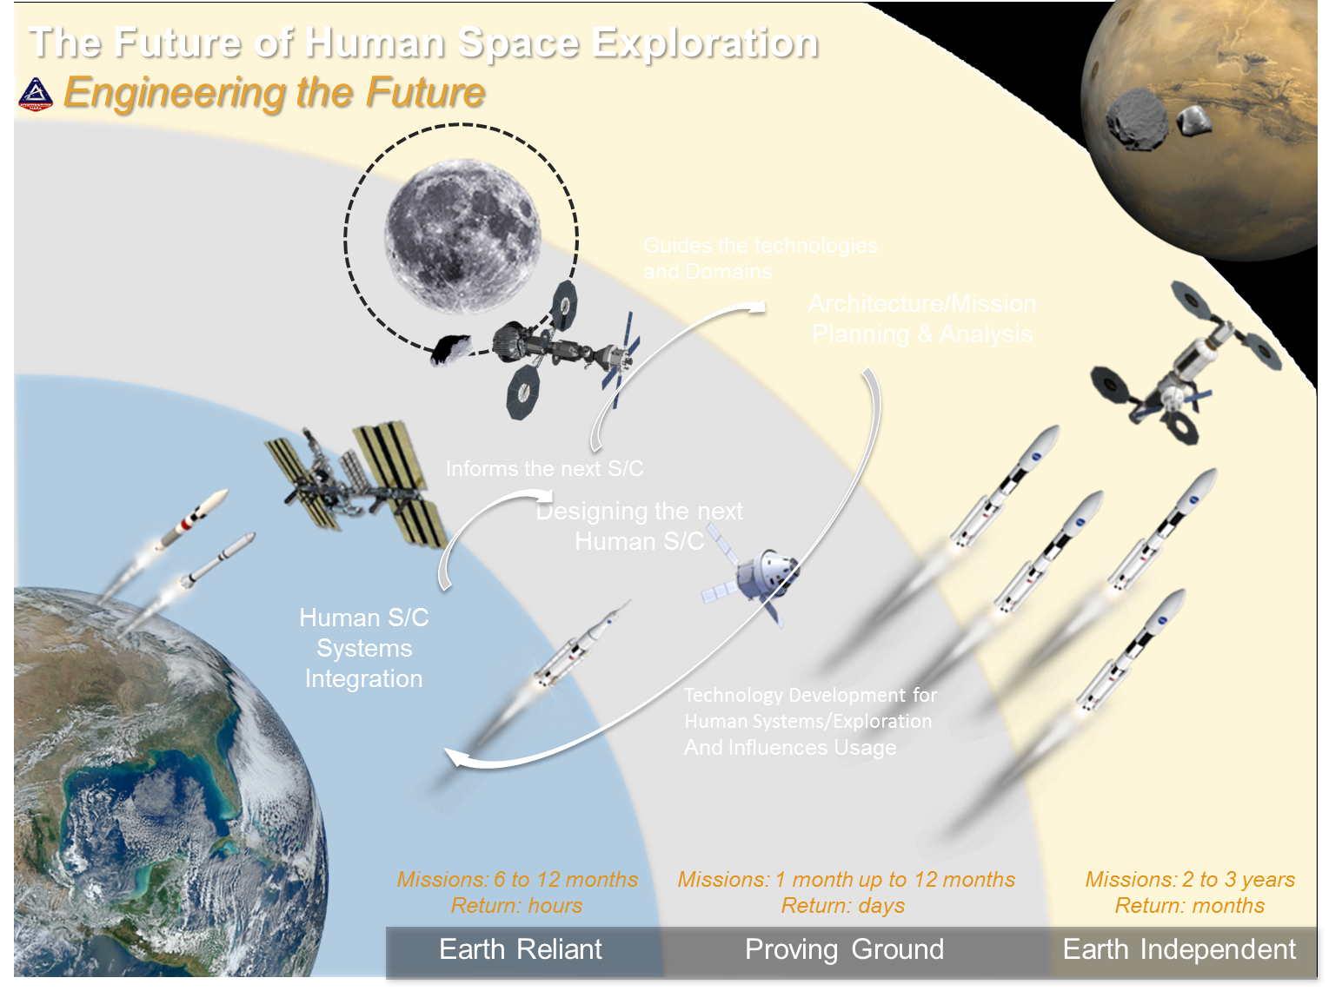

Slide 20
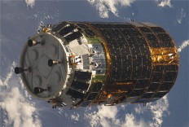
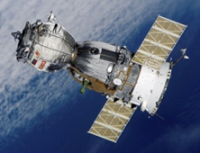
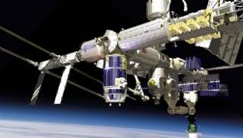
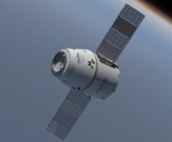
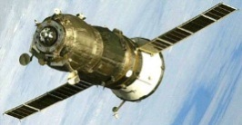
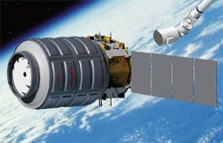
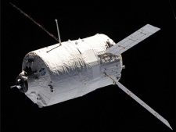
Lessons Learned from ISS Rendezvous Can Inform Our Future Cislunar Proving Ground Plans
Capture - CBM
ISS
Docking – Docking Port
HTV
(Vehicle) (ISS)
Soyuz
(ISS) (Vehicle)
RVS Reflector
- PROX
Dragon
Kurs
(TORU)
Progress
DragonEye/ (HHL)
Thermal imager
- CUCU
Cygnus
ATV
VVT VDM
- TGM
(Kurs-P Kurs-A)
TriDAR Reflector
- PROX
PROX: HTV Proximity Communication System
CUCU: COTS UHF Communications Unit
VDM: Videometer
VVT: Visual Video Target
TGM: Telegoniometer
There are currently 6 visiting vehicles operated each with unique
  approach/departure techniques
  navigation equipment and communications equipment, etc.
There are some issues identified such as reflector interferences, function-duplicated equipment and specific operations to each visiting vehicle
Need to leverage our ISS RV&C lessons learned for our future missions in the Cis-Lunar Proving Ground

Slide 21
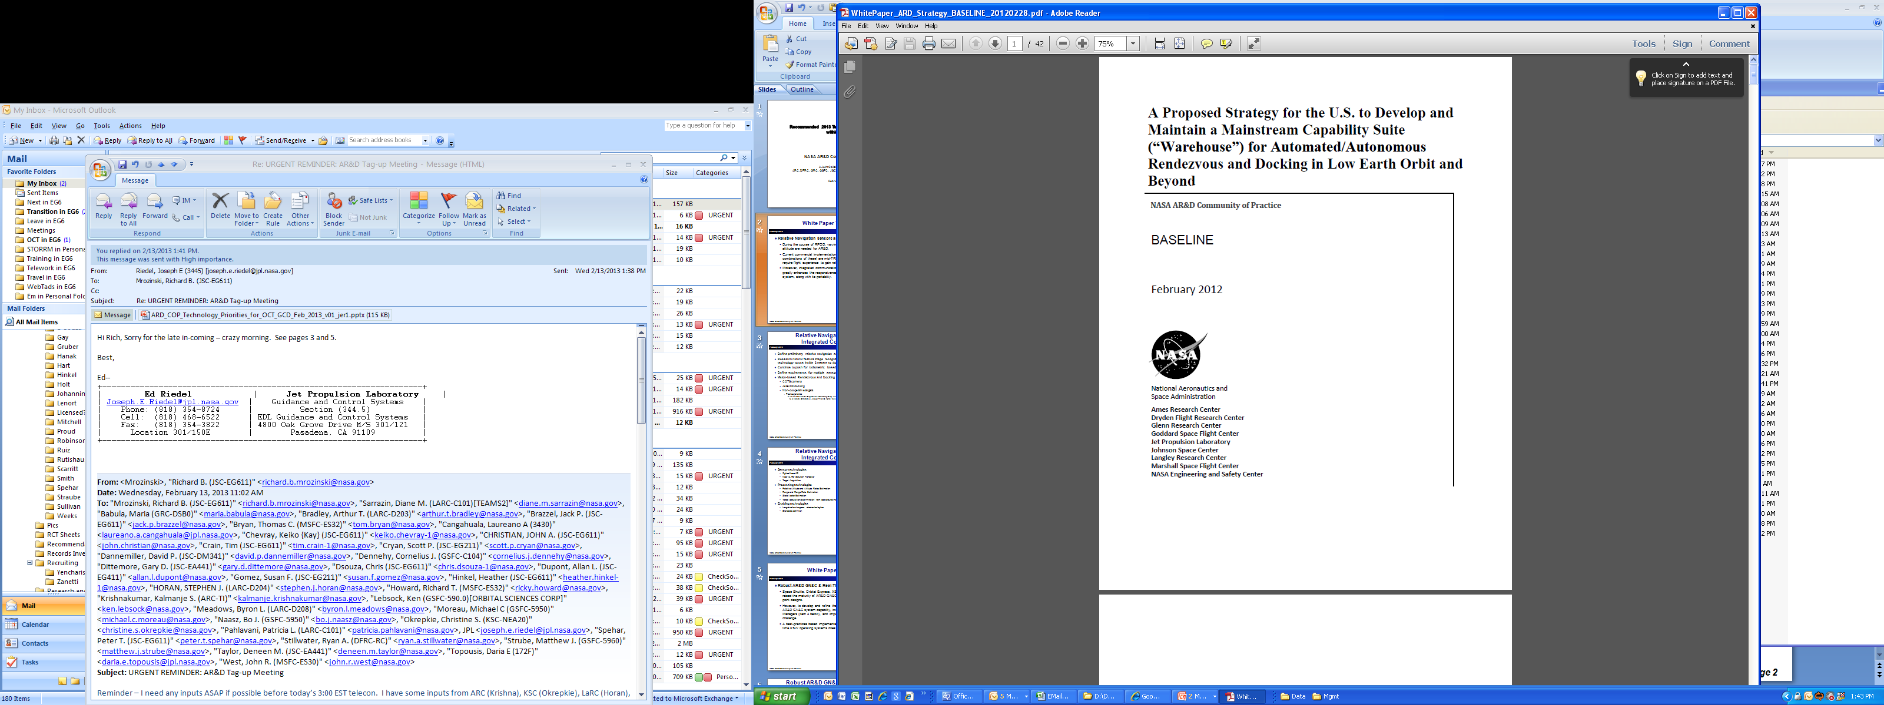
“Warehouse” Concept for Re-Usable RV&C Commodities
NASA AR&D CoP’s White Paper issued in February 2012 proposed a “warehouse” strategy to break the unaffordable “new mission – clean sheet of paper to design” syndrome

Slide 22
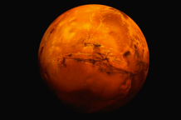



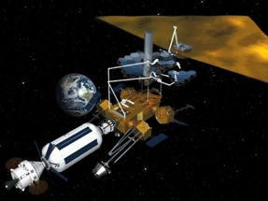








RV&C system-level capabilities enable multiple NASA missions
Journey to Mars
Human Exploration
Asteroid Redirection
On-orbit Assembly
Commercial Enterprise
Infrastructure Inspection and Maintenance
Observatory Servicing
Government
Fleet Management
RV&C System Capability
Planetary Defense
Propellant Depot
Note: this graphic adapted from original Ben Reed Restore-L chart
Orbital Debris Mitigation
NASA Internal – Do not distribute

Slide 23

Needed Initiatives Going Forward
Technology developments
Relative navigation sensors are RV&C #1 technology priority
Autonomy for Mars and Deep Space architectures
Flight demos critically needed for system level testing
Docking standard developments
  Develop a standard docking interface to enable exploration collaboration and interoperability between partners using different spacecraft
Current: Pressurized Mating Adapter
International Docking Adapter
Future: Two IDSS Compatible Ports on ISS

Slide 24
Summary
RV&C system-level capabilities enable multiple NASA missions, for both HEOMD and SMD
RV&C Systems Engineering and Systems Integration of multiple discipline-specific subsystems will be critical to mission success
Relative navigation sensors are RV&C #1 technology priority
Autonomy will be for Mars and Deep Space architectures
International Standards for RV&C (e.g. docking interfaces) Will Promote Interoperability

Slide 25
Model Based Sounding Rocket Overview
Team Members:
Edward Amatucci (GSFC), Nathaniel Barley (DoD), Kevin Bonanne (JPL), Rebecca Deschamp (SSC), Jessica Knizhnik (GSFC), David Kotsifakis (GSFC-WFF), Geethesh Kukkala (DoD), Denise McGarity (GSFC), Ted Mills (HQ), Damon Ollison (DoD) and Allen Wong (DoD)
With Input From:
Tyesia Alexander (DoD), Randy Brackins (MSFC), Tracee Gilbert (DoD), Brian Hall (GSFC-WFF), Giovanni Rosanova (GSFC-WFF), Carolina Restrepo (JSC), Scott Schwinger (GSFC), Philomena Zimmerman (DoD) and the NASA Sounding Rocket Operations Contract

Slide 26
Agenda
Goals and Objectives
Project Approach
Model Showcase
Value and Findings
Next Steps

Slide 27









Future State of System Modeling
Future: Information is in a system model that includes specification, design, analysis, and verification information and can be viewed from many different perspectives.
Today: Stand-alone models related through non-linked documents.
Future: Shared system model with multiple views, and connected to discipline models.
Test
Science
Systems
Assemblies
Operations
Others
Adapted from “Systems Engineering with Models: An Introduction,” Todd Bayer, et al. JPL
Subsystems

Slide 28
Goals and Objectives
Evaluate and characterize the benefits of adopting a model centric approach to flight system development at NASA
Develop Measures of Success to compare project performance (technical, and programmatic) between the heritage document centric approach vs a cross discipline model centric approach
Shadow existing sounding rocket project(s) with model centric tools and methods
Mature system level models to a point of critical path use on upcoming project(s)
Establish a framework for the future implementation of a model centric approach to current and future NASA projects
Create and maintain a trained and capable workforce for the future implementation of model based tools and methods

Slide 29

Why Sounding Rockets?
Data is abundant
  Sounding Rockets quickly process through a mission lifecycle
    Multiple full missions can utilize the model centric approach within a short period of time
  Sounding Rockets are a heritage program with a large catalog of data
    Allows for comparison against multiple document centric missions
Sounding Rockets are well understood with fewer complex parts
  Focus is on understanding and implementing MBE, not on design and technology development
The Sounding Rocket Project Lifecycle flow mirrors the NPR 7120 flow
Systems Engineering Sub Phases
Pre-MIC Mission Planning
Reqs Definition Conceptual Design
Flight Systems and GSE Design and Analysis Detailed Design Phase/Mission Planning
Flight HW and GSE Fab
I&T Environmental Testing
HW Assembly Pre-Launch Ops
Post-Launch Operations and Analysis
Meeting/
Activity
Mission Initiation Conference
Reqs Defnition Meeting
PDR
(optional)
Pre-Integration Review
MRR
FRR
(optional)
Lessons
Learned Review
Attitude
Data
to PI
Design
Review
Launch
MCR

Slide 30





Project Scope

Slide 31
Approach
Phase 1:
Baseline
1E: Create System Model
Phase 2:
Quantify
Phase 3:
Evaluate
3E: Implement MBE in Parallel to Documentation
Phase 4:
Test
4E: Validate MBE approach on a Sounding Rocket Mission
Phase 5:
Integrate
5E: Integrate MBE onto multiple Sounding Rocket Missions
2E: Link Physics Models to System Model
1P: Define Current Program Lifecycle Process and Relevant Metrics
2P: Benchmark Program Lifecycle Process
3P: Measure Program Lifecycle Process after MBE Implementation
4P: Measure Program Lifecycle Process after MBE Implementation
5P: Measure Program Lifecycle Process after MBE Implementation
2E: Evaluate Model Utility and Edit As Appropriate
2P: Identify Areas for MBE Integration
3P: Evaluate MBE Process Utility and Edit As Appropriate
4P: Evaluate MBE Process Utility and Edit As Appropriate
5P: Evaluate MBE Process Utility and Edit As Appropriate
Release Model Iteration 1
Release Model Iteration 2
Release Model Iteration 3
Release Model Iteration 4
Release Model Iteration 5
Capture Lessons Learned Throughout

Slide 32


MUSIC Sounding Rocket
TM
TM Wet
Exp Section
Motor Adapter
ACS
Skirt
Nosecone
Recovery
Milliner 46.011 was the 1st flight of the Multi User Suborbital Instrument Carrier (MUSIC) level mission
Provided NASA Applied Engineering and Technology Directorate (AETD) engineering personnel experience in
  Developing sounding rocket technology
  Conducting systems engineering processes
  Testing NASA AETD experiments
Includes
  Standard payload carrier with predefined mechanical, telemetry, power and attitude control capabilities
  Sealed section carries AETD experiments/instruments
  Wet section carries West Virginia University's Undergraduate Student Instrument Project (USIP)
Experiment Data Time

Slide 33
Engineering Model Goals, Objectives and Deliverables
GOAL:
  To create an interconnected system model of the Multiple User Suborbital Instrument Carrier (MUSIC) sounding rocket project based off of the information presented during MUSIC’s Design Review (DR)
ADDITIONAL OBJECTIVES:
  Link individual models to each other to create interconnected system model
  Identify useful physics based models to link to system model
  Identify views useful to the customer
  Identify missing linkages through model analysis
DELIVERABLES:
  Requirements Model
    Three levels of abstraction
  Concept of Operations (ConOps) Model
    Two levels of abstraction
  Architecture Model
    Three levels of abstraction
  Data Import and Export
    Review Documentation

Slide 34
Document and Model Comparison
171 subsections identified in the MUSIC DR package. Of those, about 7% were not planned on being modeled (Experiment, Safety,…).
At mid-September 2016, Team 4 has modeled (or placeholder exists for) over 90% of the documents.
      Requirements were modeled, some down to the part level (as well as analysis level).
      Main item missing was Risk – usually it is downloaded from NSROC database and concerns addressed between RDM and DR.
Advantage of Model Based DR
Advantage of Document Based DR
One data source, when modeled and linked correctly;
Same information can be displayed, but now data is linked across disciplines;
May help communications outside of NSROC
Does not require any learning curve;
Current practice

Slide 35
Program Model Goals and Objectives
Model Sounding Rocket Program Office operations to include:
  Mission lifecycle process
  Program domain architecture
Identify methods for measuring SRPO
  Cost
  Schedule
  Risk
  Technical performance
Identify critical interactions

Slide 36
Measurement Methodology
Items requiring programmatic measurement:
Labor Hours
Schedule Capacity
Success Rate
Complexity
Heritage Level
Mission Cadence
Sounding Rocket Resourcing Cycle
Allocated Budget
Labor Hours
Mission Cadence
Success Rate
Schedule Capacity
Labor hours are at rate that is contractually determined, and labor hours available for assigned projects is part of the sum hours available determined by level of effort allocated budget.
Success rate can vary with complexity of a project, and can determine if the project is appropriate for a level of effort program.
Independent Variables:
Allocated Budget
Success Rate*
Dependent Variables:
Labor Hours
Schedule Capacity
Mission Cadence#
*Success Rate is a moderator, not necessarily a direct factor
#Mission Cadence, or mission ‘capability’, is the desired output of the program.
Resourcing Cycle Influencers
Complexity
Heritage Level
Success Rate

Slide 37
Immediate Value and Innovations
Created an accurate model of requirements, concept of operations and architecture
Held a Technical Interchange Meeting with the Sounding Rocket Program Office
Using MBSE to identify problems with document-based approach for Sounding Rocket Program
  Inconsistencies and missing information in the documentation were found and discussed with SRPO
Developed glossary for the sounding rocket parts
  Frequently found many names to describe the same thing
Defined the interfaces between experiments and rocket
  Not thoroughly defined in the documentation
  Enables easier communication between experimenters and sounding rocket engineers
Created a generic sounding rocket model that can serve as an example for other programs and projects having multiple configuration options
  Multiple options for payload sections, launch vehicle sections, and experiment interfaces
Conducted model review with experienced Systems Engineers

Slide 38
Sounding Rocket Project and Program Findings
MUSIC Findings
  Modeling rigor allows for documentation of implied information
    Missing activities identified
    Hidden requirements revealed
    Missing document pages found
    Structure to include physical and functional breakdowns
    Interface between experiments and rocket is not thoroughly defined
    The Sounding Rocket Program frequently uses many names to describe the same thing
    Requirements don’t completely track with test plan
SRPO Findings
  Re-examination of current processes
    Analysis tools
    Potential for information import from discipline models (i.e.: part libraries)
  A template for designing and trading during the early stages of development might be useful to SRPO
  The SRPO could likely benefit the most from using MBSE to define interfaces between NSROC and
    The Experimenter
    The Range
    Safety
    The SRPO

Slide 39
Next Steps
Phase 1:
Baseline
Phase 2:
Quantify
Phase 3:
Evaluate
3E: Implement MBE in Parallel to Documentation
Phase 4:
Test
4E: Validate MBE approach on a Sounding Rocket Mission
Phase 5:
Integrate
5E: Integrate MBE onto multiple Sounding Rocket Missions
2E: Link Physics Models to System Model
1P: Define Current Program Lifecycle Process and Relevant Metrics
2P: Benchmark Program Lifecycle Process
3P: Measure Program Lifecycle Process after MBE Implementation
4P: Measure Program Lifecycle Process after MBE Implementation
5P: Measure Program Lifecycle Process after MBE Implementation
2E: Evaluate Model Utility and Edit As Appropriate
2P: Identify Areas for MBE Integration
3P: Evaluate MBE Process Utility and Edit As Appropriate
4P: Evaluate MBE Process Utility and Edit As Appropriate
5P: Evaluate MBE Process Utility and Edit As Appropriate
1E: Create System Model
Release Model Iteration 1
Release Model Iteration 2
Release Model Iteration 3
Release Model Iteration 4
Release Model Iteration 5
Capture Lessons Learned Throughout

Slide 40
Questions?
Upcoming Systems Engineering Webcasts
10/28 SE Tech Topic: NASA MBSE Pathfinder, Lessons Learned Harvest
Overview/Explanation of NASA/OCE Cloud: 20-30 min (A. West)
MBSE Response, MBSE Implementation Take-Aways: 30 min (K. Weiland)

