Slide 1
Joe Pellicciotti joseph.w.pellicciotti@nasa.gov
Welcome…
An Overview of Fastener Requirements in the new NASA-STD-5020

Slide 2
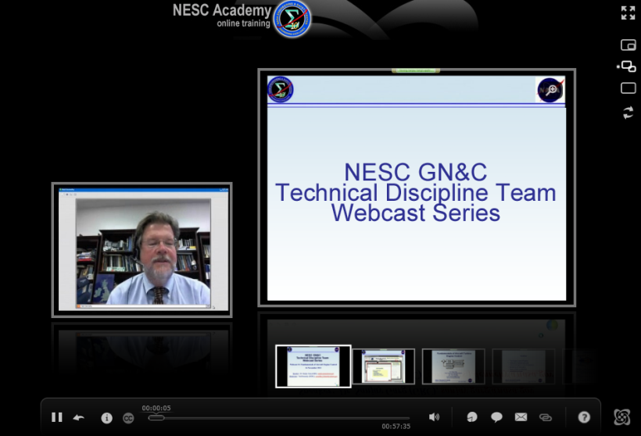



SLaMS Webcast
Series

Slide 3
An Overview of the New
NASA-STD-5020
Requirements for Threaded Fastening Systems in Spaceflight Hardware
Rob Wingate, NASA Marshall Space Flight Center
rob.wingate@nasa.gov
April 26, 2012
Notes:
3-day, 5-half-day, 5-half-day, 4-day,
8:00 - 5:00 8:00 - 1:00 8:00 - 4:30
8:45-9:45, 2 12:05 - 1:00, 2

Slide 4
Acknowledgements
Thanks to Tom Sarafin (Instar Engineering and Consulting, Inc.), who helped prepare the original charts upon which this presentation is based
Thanks to Andy Hissam (MSFC) for providing torque-tension data
Thanks to Dan McGuinness (GSFC) for use of charts he prepared for FEMCI

Slide 5
Why a New Standard for Threaded Fastening Systems?
“Lack of understanding [of fastened joints], inconsistency of procedures, and a lack of engineering rigor have led to millions of dollars in lost missions, lost hardware, and wasted time.”
—Chris Hansen, ISS Chief Engineer (2007)
STS-80 (1996): Small screw with no locking feature backed out and jammed a gear in external airlock, preventing the astronauts from opening the hatch and performing the EVA part of the mission.
ISS Flight 12A: Galled fastener almost caused loss of mission, and efforts to remove the bolt injured a crew member.
Multi-Purpose Logistics Module (MPLM): Hundreds of fasteners too short to engage locking feature, not detected during installation.
Space Shuttle Ku Band Antenna: After several missions, 2 of 4 main attachment bolts were discovered to be too short to engage locking features or provide adequate strength; required risky repair on launch pad.
Countless arguments over how to perform fastener stress analysis.
Many, many, more issues with fasteners have been encountered on other projects…

Slide 6
Review of Skylab Threaded Fastener Failures
Percentage breakdown by cause of 80 fastener issues
35 years later and similar problems are still being experienced
NASA-CR-151541, Investigation of Threaded Fastener Structural Integrity, 1977.

Slide 7
More Reasons for the New Standard
As of December 9, 2011, NSTS 08307A, Space Shuttle Criteria for Preloaded Bolts is “retired,” with status now listed as “withdrawn” on the NASA Standards web site
NASA-STD-5020 is intended to replace NSTS 08307 as the standard for threaded fastening system analysis on all NASA projects
  Includes significant changes in analysis methodology
  Supporting justification provided in appendices
And goes beyond NSTS 08307 by addressing …
  design considerations such as locking features, design preac, and material selection
  verification and quality assurance
  responsibilities of the hardware developer
Be aware that some projects are still under contract to use NSTS 08307 even though it is no longer active

Slide 8
The Threaded Fastening System Standard Development
Sponsored by the NESC through the Mechanical Systems Technical Discipline Team
4-year development effort started in 2007
Multi-organization development team
  Multi-NASA center
  Industry participation
  Academia participation
Supported by test and analysis efforts
Multiple iterations to achieve final content
Extensive technical review

Slide 9
Support Testing
Several test efforts were conducted at various locations to support requirements development and provide rationale
GSFC:
  Ultimate, yield and pure shear strength, with and without preload
  Torque-tension testing (Orion)
MSFC: Shear-tension interaction (NASA/TM—2012–217454, Aerospace Threaded Fastener Strength in Combined Shear and Tension Loading)
JSC: Statistical studies of torque-tension relationship
Boeing: Adhesive-based secondary locking features, particularly use of Loctite for space-flight hardware (NASA/CR-2012-217760, Process Sensitivity, Performance, and Direct Verification Testing of Adhesive Locking Features)
Oakland University: Fastener fatigue

Slide 10
NASA-STD-5020 Contents Overview
Scope
Applicable Documents
Acronyms and Definitions
General Requirements
Design Requirements
Criteria for Analysis of Threaded Fastening Systems
Quality Assurance
Appendix A. Explanation and Justification of Fastener Analysis Criteria
Appendix B. Best Practices for Locking Features
Appendix C. Justification for the Low-Risk Fatigue Classification
Appendix D. References

Slide 11
4. General Requirements
Contains top-level requirements consistent with existing standards:
  Adequate structural strength
  Adequate structural life
  Adequate joint separation factor of safety
  Incorporation of locking features
What is new:
  Guidance on selection of fitting factors
  Low risk approach for fatigue life (limited applicability)
  Specification of joint separation factors of safety based on consequences of separation
  Clarification of the number of locking features required
  Requirement for a “Fastening System Control Plan”
The requirements and criteria specified in Sections 5 – 7 are for the purpose of ensuring the Section 4 requirements are met.

Slide 12
4. General Requirements:
Fracture Control and Fatigue Life
All threaded fastening systems shall withstand the service life and service environment without fracture or fatigue failure.
Verification may be by fatigue analysis, crack-growth analysis per NASA-STD-5019, or fatigue testing.
Alternatively, with approval of the responsible Technical Authority, fasteners shown to be low risk for fatigue failure may be acceptable without analysis or testing.
  If this approach is adopted, most A-286 fasteners (within certain load limitations) would be considered low risk if they
    have UNJ, UNR, or MJ threads;
    and are used in joints containing no non-metallic clamped materials;
    and satisfy the separation criteria.
  Section 4.2 provides a detailed definition of a low-risk fastener (based on fastener fatigue testing).
The requirement for fastening systems to have sufficient life is not necessarily a requirement to perform fracture or fatigue analysis.

Slide 13
Fastener Life Requirements Are Not New or Unique
Service life requirements for NASA spacecraft structures exist in NASA-STD-5001A, Structural Design and Test Factors of Safety for Spaceflight Hardware
Fastener fatigue and fracture requirements existed previously in NSTS 08307:
  As one of three basic requirements, “The bolt must have adequate fracture and fatigue life.”
  “All preloaded bolts must be assessed for fatigue life.”
  “Bolts used in hardware that is under fracture control must meet fracture control requirements in accordance with their hardware’s fracture control plan.”
Verification of these requirements for fasteners has not always been rigorously enforced

Slide 14
4. General Requirements: Joint Separation (Gapping)
Mechanical joints using threaded fastening system hardware shall withstand the design separation load in conjunction with applicable maximum or minimum temperatures without separation
Design separation load = (limit load) x (separation factor of safety) x (fitting factor*)
Separation factors of safety depend on whether the joint is separation critical, which applies to a joint that fails to function as required when separated (e.g., a joint that must maintain a seal in a pressurized system):
  1.0 for joints that are not separation critical
  1.2 for separation-critical joints if separation could not credibly lead to loss of life, bodily harm, or catastrophic structural failure
  1.4 for all other separation-critical joints
Key point: Joints that are not separation critical do not require a separation factor of safety greater than 1.0.
*NASA-STD-5020 does not specify fitting factors; it provides guidance for selecting them.

Slide 15
Joint Separation Factor of Safety Contradiction
FAQ: Do you know that the NASA-STD-5020 joint separation factors of safety do not agree with NASA-STD-5001A?
This discrepancy was intentional
  It is the opinion of the NASA-STD-5020 team that the newer requirements are appropriate
  An effort will be made to remove fastener requirements, as appropriate, from the other NASA standards as they come up for periodic review
    Other standards that may need revision are NASA-STD-5012, Strength and Life Assessment Requirements for Liquid Fueled Space Propulsion System Engines, and NASA-STD-5017, Design and Development Requirements for Mechanisms
Even though NASA-STD-5020 is released, do not change fastening system requirements on existing projects without prior approval from the project/program

Slide 16
4. General Requirements: Locking Features
Regardless of the magnitude of preload, each threaded fastening system in spaceflight hardware shall incorporate a minimum of one locking feature that does not depend upon preload to function.
Locking features shall be verifiable during or after installation.
  Acceptable methods of verification for different types of locking features appear in section 7.6.
A mechanical locking feature, such as safety wire, shall be used on any bolt subject to rotation in operation (bolt serves as an axis of rotation between moving parts).
Liquid locking compounds and other adhesives are acceptable locking features if adequately verified, e.g., by torque measurement on witness coupons that are representative of and processed with the hardware being verified.

Slide 17
4. General Requirements: Fastening System Control Plan
Each hardware developer shall submit a Fastening System Control Plan (FSCP) to the Technical Authority at the Preliminary Requirements Review (PRR) or equivalent Project milestone review that …
  Shows how the requirements in this Standard are to be satisfied.
  Includes any organization-specific requirements and criteria for design, analysis, fastener installation, and verification.
  Captures or refers to organization-specific processes for ensuring quality and integrity.
Any tailoring of NASA-STD-5020 should be documented in the FSCP.
There are two reasons for inclusion of this requirement:
The FSCP allows hardware developers to demonstrate that they understand the potential pitfalls associated with threaded fasteners and know how to avoid them.
The FSCP gives developers more ownership and responsibility for ensuring threaded fastening systems are dependable.

Slide 18
5. Design Requirements
Section 5 requirements pertain to …
Materials (defers to NASA-STD-6016, Standard Materials and Processes Requirements for Spacecraft)
Configuration control of lubricants, coatings, sealants, and locking features
Avoiding dimensional interference through
  compatibility of thread forms
  control of dimensions and tolerances
  selection of fastener grip and length
  use of washers and chamfered bolt holes
Control of installation methods and parameters that affect preload

Slide 19
6. Analysis Criteria
6.1 Nominal, Maximum, and Minimum Preloads
Requires that the nominal nut factor (or other factor relating preload to the parameter being controlled during installation) be substantiated by test
But allows use of either test-derived variation or assumed variation
6.2 Strength Under Ultimate Design Loads
6.2.1 Ultimate-Strength Analysis for Tensile Loading
6.2.2 Ultimate-Strength Analysis for Shear Loading
6.2.3 Ultimate-Strength Analysis for Interaction of Tension, Shear, and Bending
6.3 Strength Under Yield Design Loads
6.4 Friction as a Load Path for Shear Loading: Joint-Slip Analysis
6.5 Joint Separation Analysis

Slide 20
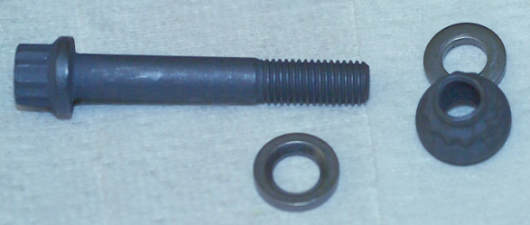
Case Study: Nominal, Maximum, and Minimum Preloads Based on Torque-Tension Data
Case study bolted joint:
  Not separation critical
  Fastening hardware re-use is allowed
The fastening system:
  Bolt: ¼-28 UNJ, Double Hex Head, A-286, 200 ksi
  Nut: ¼-28 UNJ, Double Hex Nut, Self-locking, A-286, 200 ksi
  Washer: Countersunk Washer, Alloy 718, High Bearing, Passivated
  Lubricant: Dry film lubricant as received on bolt and nut
NASA-STD-5020 guidance:
  Nominal initial preload shall be substantiated by torque-tension tests of a minimum of six sets of the fastening system hardware
  At least three tests (installation and removal) should be performed on each of the six sets
  May determine preload variation using test data statistics

Slide 21
Torque-Tension Testing
Running torque (prevailing torque, locking torque) of self-locking nut
Bolt 1, Cycle 1

Slide 22
Torque-Tension Testing
Bolt 1, Cycle 1
Bolt 1, Cycle 2

Slide 23
Torque-Tension Testing
Bolt 1, Cycle 1
Bolt 1, Cycle 3
Bolt 1, Cycle 2

Slide 24
Torque-Tension Testing, 2 bolts, 3 cycles ea.
Bolt 1, 3 cycles
Bolt 2, 3 cycles

Slide 25
Torque-Tension Testing, 3 bolts, 3 cycles ea.
Bolt 1, 3 cycles
Bolt 2, 3 cycles
Bolt 3, 3 cycles

Slide 26
Torque-Tension Testing, 4 bolts, 3 cycles ea.
Bolt 1, 3 cycles
Bolt 2, 3 cycles
Bolt 3, 3 cycles
Bolt 4, 3 cycles

Slide 27
Torque-Tension Testing, 5 bolts, 3 cycles ea.
Bolt 1, 3 cycles
Bolt 2, 3 cycles
Bolt 3, 3 cycles
Bolt 4, 3 cycles
Bolt 5, 3 cycles

Slide 28
Torque-Tension Testing, 6 bolts, 3 cycles ea.
Bolt 1, 3 cycles
Bolt 2, 3 cycles
Bolt 3, 3 cycles
Bolt 4, 3 cycles
Bolt 5, 3 cycles
Bolt 6, 3 cycles

Slide 29
Preload Variation Concepts
@ 60 in-lb
Measured range: 1543 – 2800 lb
(-29% to +30% from avg)
Coeff. Var. = 15.8%
@ 78 in-lb
Measured range: 2130 – 4080 lb
(-32% to +30% from avg)
Coeff. Var. = 19.1%

Slide 30
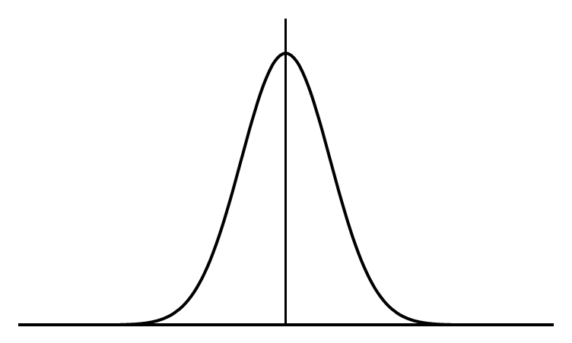
Preload Variation Concepts
Preload is approximately normally distributed at any torque
2-sided tolerance interval to contain 90% of the population with 95% confidence
(P_{pi-max})
95th Percentile Preload
Nominal Preload
(P_{pi-nom})
5th Percentile Preload
(P_{pi-min})

Slide 31
Preload Variation In Practice
Visual estimate of region where nominal preloads approach target preload
P_{ty-allow}
Yield Allowable
Consider preload variation @ 75 in-lb
Target Nominal Preload
e.g., (0.65) x (P_{ty-allow})
Tests should probably have been run to higher preload
CAUTION: preload data for statistics does not exist for all test bolts above this torque

Slide 32
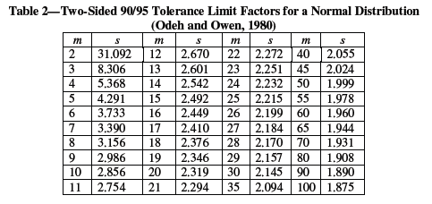
90/95 Tolerance Interval for Preload Variation @ 75 in-lb
90/95 Tolerance Limits = P_{pi-nom} ± s ∗ σ_{pi}
P_{pi-nom} = mean preload at 75 in-lb from the 18 torque-tension curves
s = a factor taken from NASA-STD-5020, Appendix A.2, Table 2 corresponding to the number of data points in the sample
σ_{pi} = standard deviation of the sample of 18 preload values at 75 in-lb
Preload Variation: Γ_{90/95} = (s ∗ σ_{pi})/P_{pi-nom}

Slide 33
90/95 Tolerance Interval for Preload Variation @ 75 in-lb
P_{ty-allow}
@ 75 in-lb:
Mean preload = 2953 lb
Std Dev = 558 lb
Γ_{90/95} = 0.449
4279 lb
P_{pi-nom}
2953 lb
1626 lb

Slide 34
Including the Torque Range from the Drawing
(method per NASA-STD-5020)
Example: 75 ± 4 in-lb
P_{ty-allow}
P_{pi-max}
(79/75) ∗ 4279 lb = 4507 lb
P_{pi-min}
(71/75) ∗ 1626 lb = 1539 lb

Slide 35
Including the Torque Range from the Drawing
(alternative method)
Example: 75 ± 4 in-lb
P_{ty-allow}
P_{pi-max}
4703 lb
P_{pi-min}
1557 lb

Slide 36
Adjusting for Running Torque
Preload is greater at any torque if adjusted for running torque
Adjusted for running torque
CAUTION: if adjusting preload data for running torque, make sure to not double book the adjustment in the analysis
Bolt 1, Cycle 1

Slide 37
Nut Factor Relationship
Consider nut factor @ any torque
Bolt 1, Cycle 1
P = T/(K·D)
1
K·D

Slide 38
Nut Factor Variation
(@ given torque on different curves)
Consider nut factor @ 75 in-lb
K = 0.081 (Bolt 1, Cycle 1)
K = 0.099 (Bolt 1, Cycle 2)
K = 0.114 (Bolt 1, Cycle 3)

Slide 39
Nut Factor Statistics
_{m}
P_{pi-nom} =
1
Σ
m
P_{pi-j}
_{j=1}
_{m}
1
Σ
T
=
m
Consider nut factor @ any torque
_{j=1}
K_{j} D
_{m}
T
Σ
1
=
mD
_{j=1}
K_{j}
CAUTION: statistics are on the reciprocal of the nut factor

Slide 40
Analysis Criteria Continued
Key Differences Between NASA-STD-5020 and NSTS 08307
Ultimate strength analysis, tension
NSTS 08307
NASA-STD-5020
Requires calculation of a margin of safety (MS) two ways, one based on total bolt load when including preload and one based solely on applied load. The lower MS applies.
MS calculated by comparing the predicted fastener load to the allowable fastener load.
Requires determination of whether rupture can occur before separation and calculation of the MS accordingly:
Rupture before separation: Account for preload
Separation before rupture: Ignore preload
MS calculated in a way that indicates how much the applied load can increase before the criteria are not satisfied.
Purpose: Encourage better understanding of the joint behavior; simplify and make the MS more meaningful.

Slide 41
Key Differences Between NASA-STD-5020 and NSTS 08307
Margin of Safety for Ultimate Tensile Strength: Separation Before Rupture
Margin of safety per NSTS 08307 method 1
Separation
Rupture
Allowable ultimate load, P_{tu-allow}
Bolt load at ultimate design load
Margin of safety per NASA-STD-5020 and per NSTS 08307 method 2
Maximum preload
45˚ slope
Bolt Tensile Load
Ultimate design load
Applied Tensile Load
Separation load
Allowable applied ultimate load = P_{tu-allow}

Slide 42
Key Differences Between NASA-STD-5020 and NSTS 08307
Margin of Safety for Ultimate Tensile Strength: Rupture Before Separation
Margin of safety per NSTS 08307 Method 1
Allowable ultimate load, P_{tu-allow}
Rupture
Bolt load (ultimate)
Margin of safety per NSTS 08307 Method 2
Maximum preload
45˚ slope
Margin of safety per NASA-STD-5020
Bolt Tensile Load
Ultimate design load
Applied Tensile Load, P_{t}
Allowable applied load, P′_{tu}

Slide 43
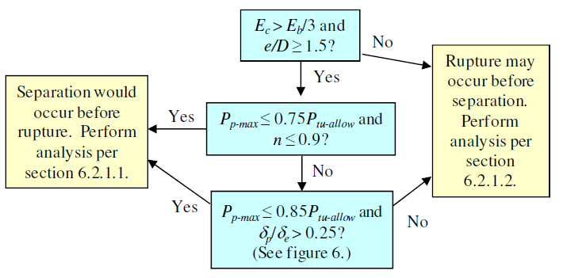
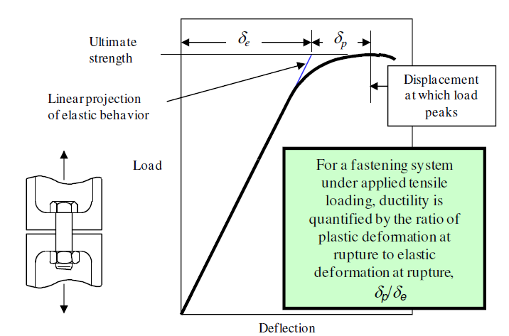
Separation Before Rupture?
(quick-look method)
Appendix Section A.5 provides a quick-look method for determination of joint separation before rupture as an alternative to detailed joint analysis or testing
Figure 5
Figure 6
E_{c} = lowest elastic modulus of clamped parts (excluding washers)
E_{b} = bolt material elastic modulus
e = minimum edge distance
δ_{p} = plastic deformation of the joint at rupture
δ_{e} = elastic deformation of the joint at rupture

Slide 44
Key Differences Between NASA-STD-5020 and NSTS 08307
Ultimate strength analysis, shear and tension-shear interaction
NSTS 08307
NASA-STD-5020
Requires interaction of preload with shear, thus offering incentive to decrease preload.
Analysis based on applied loads only; preload omitted from the assessment.
Justification: Tests conducted at NASA Goddard and NASA Marshall showed that preload does not reduce the strength of a joint under shear or combined tension/shear loading.
Failure criterion for interaction—with traditional exponents of 3 for shear and 2 for tension—applies regardless of whether threads are in the shear plane.
Failure criteria differ for threads in shear plane vs. threads not in shear plane. Both criteria are more conservative than NSTS 08307 (exponents are lower than 3 and 2).
Justification: Tests of A-286 bolts conducted at NASA Marshall showed the NSTS 08307 failure criterion to be unconservative. The NASA-STD-5020 criteria provide a good match with test data.

Slide 45
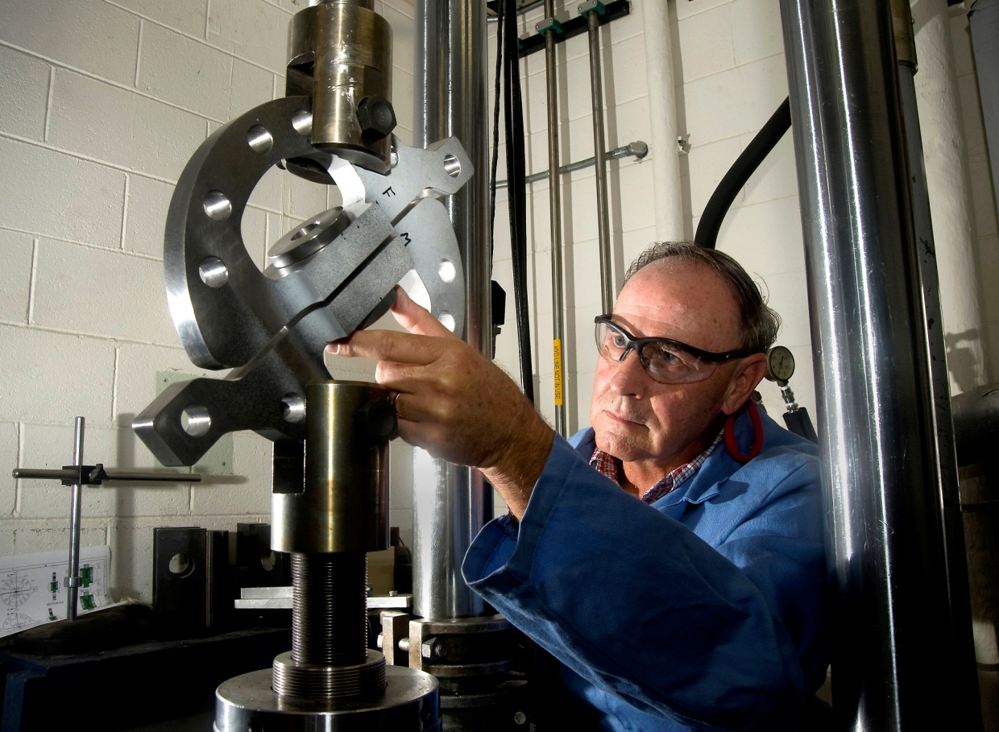
Shear/Tension Interaction Testing
Reference: NASA/TM—2012–217454, Aerospace Threaded Fastener Strength in Combined Shear and Tension Loading

Slide 46
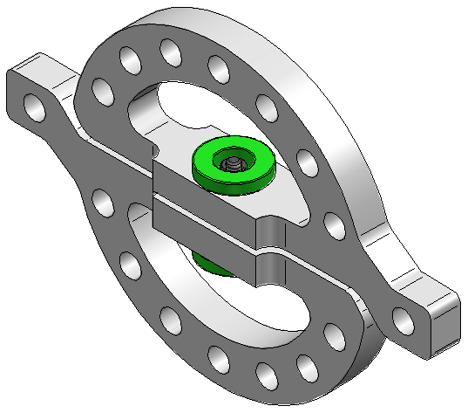
Shear-Tension Interaction Test Concept
A re-usable, variable position test fixture installed into a load frame to create combined tension and shear loadings
Load
Bolt tension-only load orientation
46 bolts tested
Variables:
  Shear-tension load ratio (via fixture orientation)
  Location of shear plane (thru body or threads)
  Preload (with and without)
Test Bolt
Fixture concept:
Brian Steeve (MSFC)
Load

Slide 47
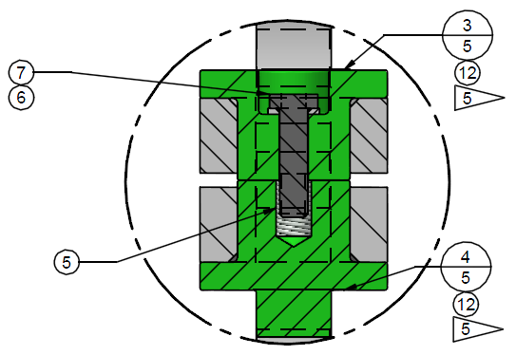
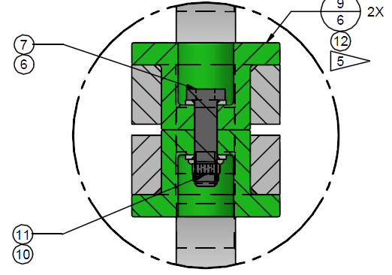
Test Concept Con’t
Bolt/Insert Combination
NAS1956C14 / NAS1395C6L
Bolt/Nut Combination
NAS1956C14 / NAS1805-6

Slide 48
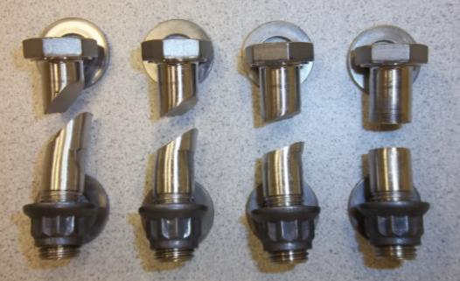
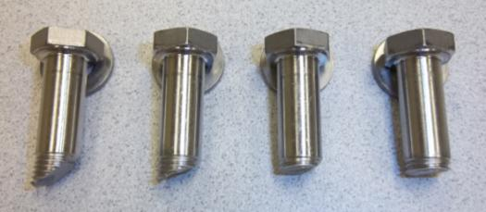
Shear/Tension Interaction Test Photos
22.5° 45° 67.5° 90°
Shear Plane in Body
22.5° 45° 67.5° 90°
Shear Plane in Threads

Slide 49
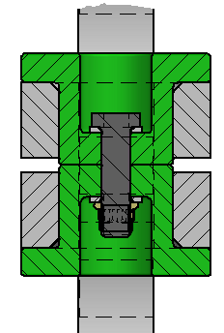
Shear/Tension Interaction Results
Preload does not affect results
Shear Plane in the Full Diameter Body

Slide 50
Shear/Tension Interaction Through the Body
R_{s}³ + R_{t}² = 1
(Allowables set equal to average breaking loads)
Failures occur inside the interaction envelope

Slide 51
Shear/Tension Interaction Through the Body
R_{s}² + R_{t}² = 1
Better fit, but failures still occur inside the interaction envelope

Slide 52

Shear/Tension Interaction Through the Body
R_{s}^{2.5} + R_{t}^{1.5} = 1
See also the guidance that bending interaction does NOT always need to be included

Slide 53
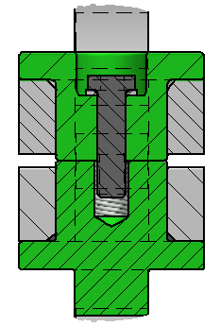
Shear/Tension Interaction Through the Threads
Preload does not affect results
Shear Plane in the Threads

Slide 54
Shear/Tension Interaction Through the Threads
R_{s}^{1.2} + R_{t}² = 1
(Note, the exponents are different than for shear plane through the body)

Slide 55
Key Differences Between NASA-STD-5020 and NSTS 08307
Yield strength analysis, tension
NSTS 08307
NASA-STD-5020
Requires a positive MS for fastener yielding.
Requires a positive MS for yielding only if yielding is detrimental. Guidance is provided for recognizing whether fastener yielding is detrimental.
Detrimental yielding is defined as yielding that adversely affects fit, form, function, or integrity of the structure.
Justification: In many cases, fastener yielding is not detrimental. In such cases, requiring a positive MS for yield is overly penalizing.

Slide 56
Key Differences Between NASA-STD-5020 and NSTS 08307
Joint separation analysis
NSTS 08307
NASA-STD-5020
Requires calculation of a separation margin of safety based either on nonlinear methods or on linear theory using calculated bolt stiffness and joint stiffness (stiffness of clamped parts).
Requires that the design separation load not exceed the minimum preload.
Justification: (1) simplification and (2) appropriate conservatism. The NSTS 08307 linear approach is unconservative for separation when using traditional methods of calculating joint stiffness, which were derived to conservatively calculate the total tensile load in a preloaded bolt.
Separation (a.k.a. gapping) is defined as the state of no compressive load between mating parts local to the fastener. For a joint designed to maintain a seal, it is further defined as any condition that enables a liquid or gas to penetrate the seal at an unacceptable rate.

Slide 57
Key Differences Between NASA-STD-5020 and NSTS 08307
Joint separation (gapping) criterion is more conservative
Slope based on traditional methods intended to conservatively estimate bolt load given uncertain actual behavior
Minimum Preload, P_{p-min}
Calculated separation load based on traditional methods (unconservative)
45˚ slope
Bolt Tensile Load, P_{tb}
Allowable load for separation = P_{p-min} (conservative), per NASA-STD-5020
Applied Tensile Load, P_{t}
Given uncertainty in the true separation load, analysis per NASA-STD-5020 is based on the assumption that separation occurs at an applied load equal to minimum preload.

Slide 58
Key Differences Between NASA-STD-5020 and NSTS 08307
Joint-slip Analysis
NSTS 08307
NASA-STD-5020
Slip analysis not addressed. NASA historically has not allowed analysis to take advantage of or count on friction.
Allows use of friction in yield-strength analysis, alignment analysis, and fatigue or fracture analysis. Requires positive margins of safety for ultimate design loads without reliance on friction.
The coefficient of friction for joint-slip analysis shall be no greater than 0.2 for cleaned, uncoated metal surfaces and 0.1 otherwise unless a higher value is substantiated by test.
The purpose of allowing reliance on friction in the above-noted analyses is to encourage good design practice. Fastened shear joints subject to cyclic shear loads are most dependable if the load is transferred either by (a) shear pins or other such devices, (b) fasteners in close-tolerance match-drilled and reamed holes, or (c) friction.

Slide 59
7. Quality Assurance
Section 7 requirements pertain to …
As-built documentation
Training of people installing fasteners
Installation tools and instruments
Inspection
Verification of locking features
Procurement, inspection, and storage of fastening system hardware

Slide 60
The Appendices
Appendix A: Explanation and Justification of Fastener Analysis Criteria
Appendix B: Best Practices for Locking Features
  Mechanical Locking Features
  Prevailing Torque Locking Features
  Adhesive Locking Features
  Free Spinning Locking Features
Appendix C: Justification for the Low-Risk Fatigue Classification
Appendix D: References

Slide 61
Summary
If embraced by spaceflight-hardware developers, NASA-STD-5020 should help programs avoid costly problems and mission failures associated with threaded fasteners.
Please contact the NESC Mechanical Systems Team of any errors or omissions in NASA-STD-5020.

Slide 62
Thank you for
attending…
Metal Fatigue Part 1
May 22nd, 1PM ET
Mr. Raymond Patin

