Slide 1
SPHERES National Lab Facility
Jose Benavides
NASA Ames Research Center
July 16, 2014

Slide 2
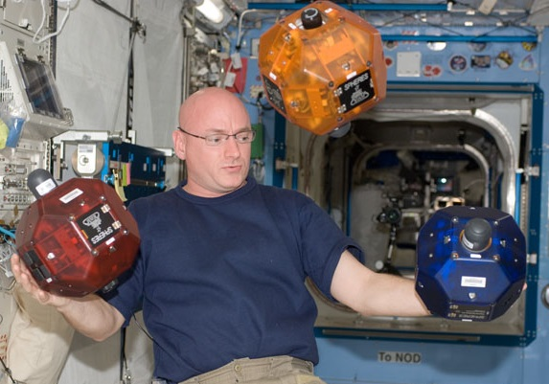
Synchronized Position Hold Engage Reorient Experimental Satellites - SPHERES
  A Facility of the ISS National Laboratory with three IVA nano-satellites designed and delivered by MIT to research estimation, control, and autonomy algorithms
  Installed on ISS in 2006
  Managed by ARC since Fall 2010
  By working aboard ISS under crew supervision, it provides a risk tolerant Testbed Environment for Distributed Satellite & Free-flying Control Algorithms
    Formation flight,
    Docking,
    Close proximity operations
  If anything goes wrong, reset and try again!
  The satellites can be reused
    Replenishable consumables
    Multiple test sessions assigned per year
Scott Kelly working with SPHERES in the Kibo lab
SPHERES ISS National Lab Facility
Program Executive: Jason Crusan (HQ)
Program Manager: Andres Martinez (ARC / R)
Chief Engineer: Jose Benavides (ARC / TI)
Operations Lead: Aric Katterhagen (ARC / PX)
  If you can’t bring the space environment to the laboratory, take the laboratory to space!
Notes:
gear towards audience,
- "go find dog" example
- free flyer inspection
- "mow the lawn"
CMG, gyros
autonmous inspection operations
- damage inpsection, characterizatin
- automnumiz inspection

Slide 3
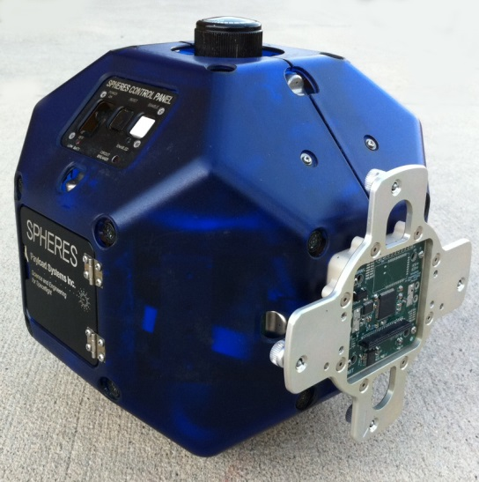
SPHERES Platform Capabilities
Sensors
Accelerometers, Gyroscopes, Ultrasonic ranging
Smartphone Camera
Actuator
CO2 Propulsion, 0.2N of force possible
C&DH
115kbps downlink to laptop
Real-time interface to laptop Matlab runtime
400kbps real-time downlink to Mission Operations Center
Expansion Port
Provides an interface for integration with additional technologies
Well documented ICD
Currently used by several Payloads
Diameter | 8.3 in (0.2 m)
Mass | 7.8 lb (3.5 kg)
Thrust (single thruster) | <1 oz (0.2 N)
CO₂ Capacity | 6 oz (170g)

Slide 4
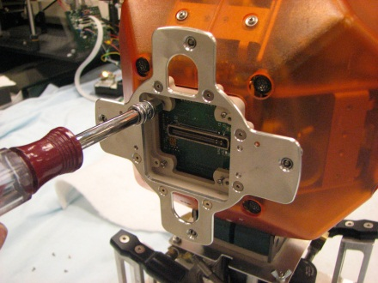
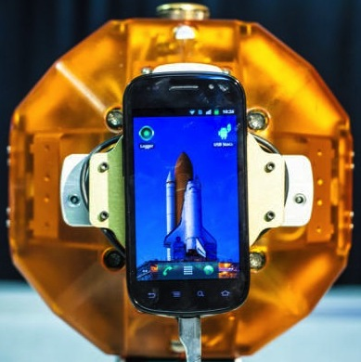
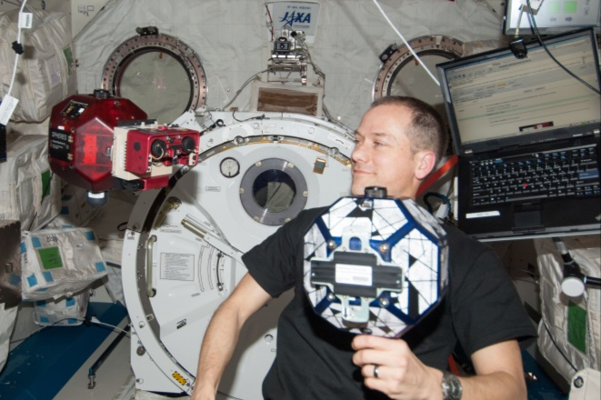
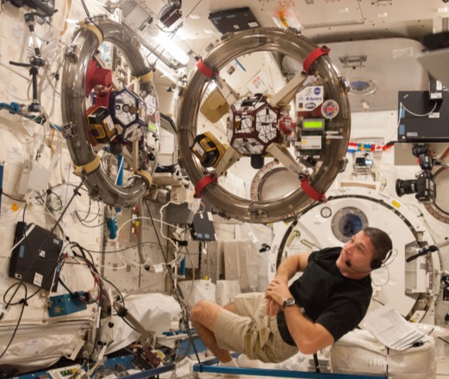
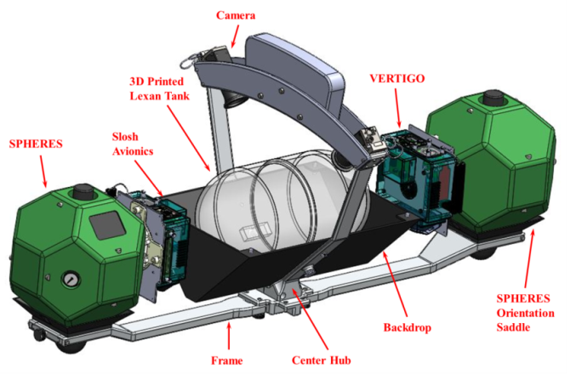
SPHERES Nat Lab Facility
3 SPHERES
Expansion Port Enabled
Smartphone
Vision Based Navigation
Electro-magnetic Actuation
(RINGS)
Fluid SLOSH

Slide 5
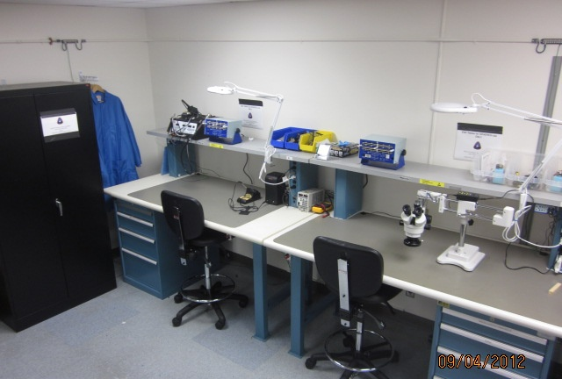
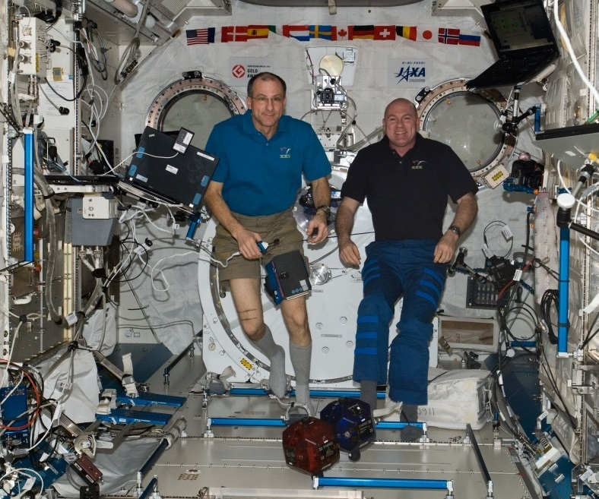
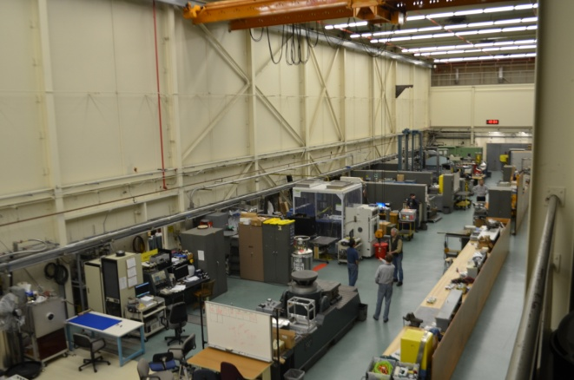
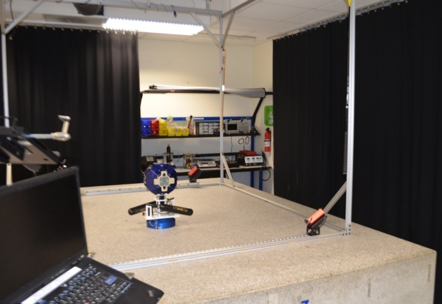
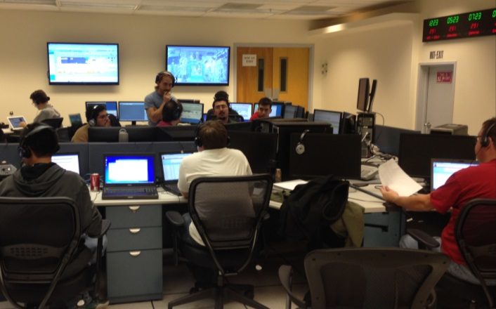
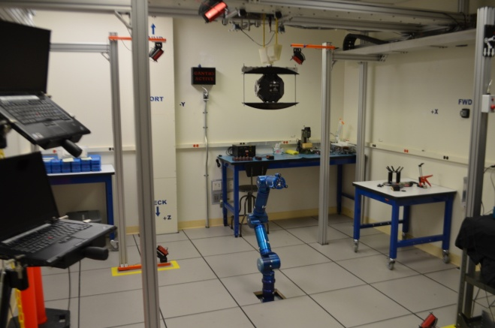
SPHERES Facility Labs
  Flight Lab
  Engineering Evaluation Lab (EEL)
  International Space Station
  Granite Lab
  Mission Operations Center
  Micro Gravity Test Facility (MGTF) Lab: Cradle/Gimbal and Robotic ARM

Slide 6
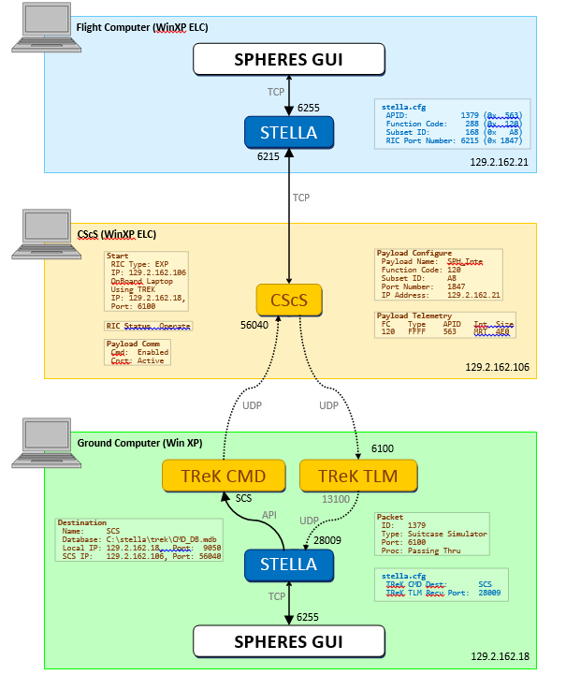
MGTF Lab Configured for SPHERES GUI C&DH
  Emulate space-to-ground end-to-end communication
  Collect real-time telemetry
  Send commands
  Matlab integration

Slide 7
Guest Scientist Program (GSP)
Technical Aspects
Download GSP from Sourceforge, including simulator
Dev and Test your software on the simulator
Test in Ames SPHERES Lab
Deliver Software and planning products to SPHERES Operations
Conduct test session aboard ISS
Operational Planning Aspects
Deliver proposed investigation – one pager
SPHERES initiates request to schedule ISS Test Session
Generate all planning items required by ISS (e.g. Test Plan, )

Slide 8
SPHERES Simulator Capabilities
Simulator Features
ISS-validated dynamics model
Matlab/Simulink & C programming environment
Full embedded architecture fidelity
  Same C-code developed for Simulator can be re-compiled for SPHERES hardware un-modified
Integration with Simulink 3D Animation toolbox
Cross-platform compatibility (Windows/Mac OS X)
Publicly Available :
  http://sourceforge.net/projects/issspheres/

Slide 9
Research & Benefits of SPHERES
Demonstrated key close-proximity formation flight, rendezvous and docking maneuvers, fault diagnosis and recovery
Supported human telerobotic operation and control investigations
Conducted experimental evaluation of algorithms and sensing for autonomous docking, Satellite servicing, Re-supply, Upgrade of space systems
Crew-based teleoperation and time-delayed ground control experiments for future crew-assistant robots.
Evaluation of COTS technologies such as smartphones for rapid prototyping and deployment in space environments.
Lessons learned on ISS have significant impact on ground robotics, mapping, localization, and sensing in 3D.
Developed a platform to demonstrate and validate metrology, control, autonomy, and artificial intelligence algorithms for distributed satellite systems (DSS)
Evaluation of Autonomous Inspection operations, damage inspection & characterization
Over 80 Test Sessions (400+ hrs. of Facility Console activities involving crew), 62 Crew training sessions (Over 100 hrs.).
One of the most used and popular ISS National Lab Facilities
NASA – MIT SSL – UMD SPPL – DARPA – NRL – AFS – FIT
Notes:
autonmous inspection operations
- damage inpsection, characterizatin
- automnumiz inspection

Slide 10
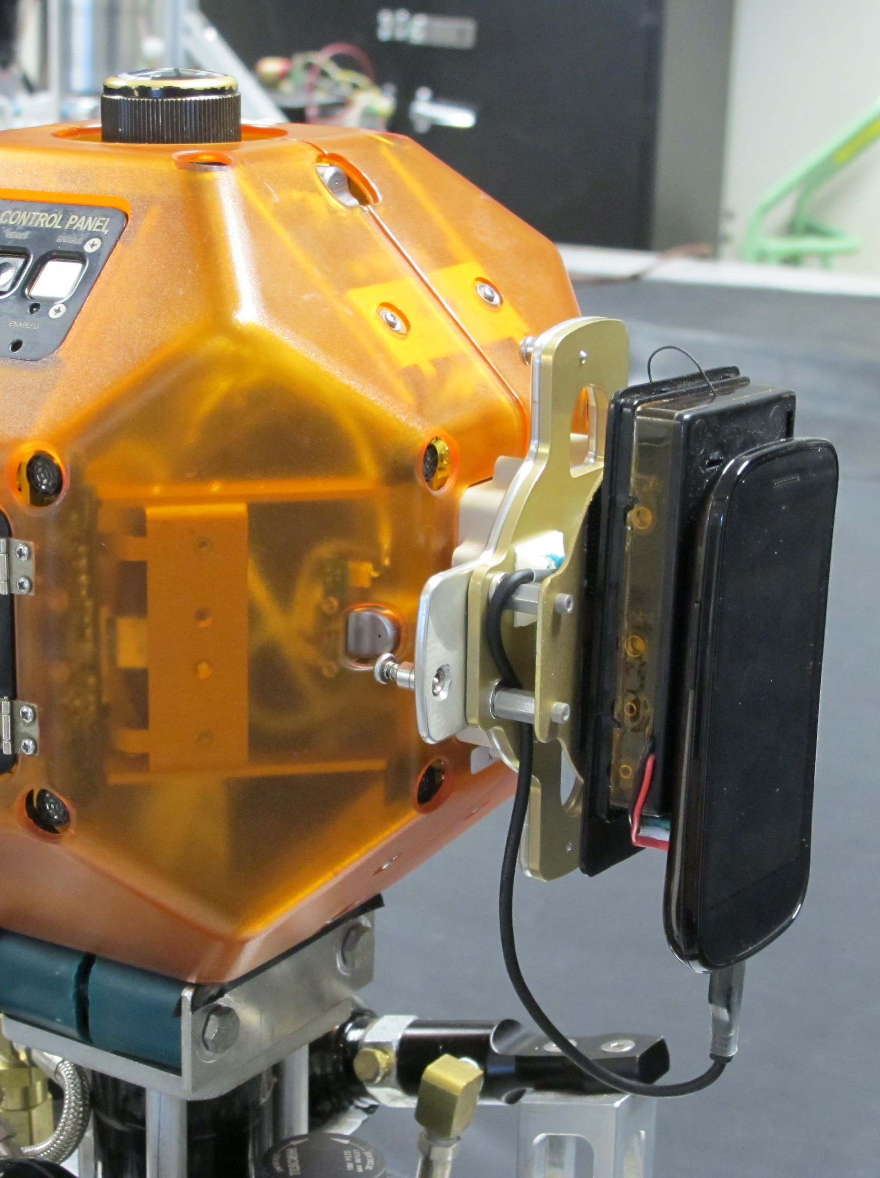
Smartphone Overview
Smartphone
  Converts SPHERES from satellite test-bed to free-flying robot
Demonstrate use cases
  Environmental surveys
  Mobile camera inspections
Technology development & risk reduction
  Ground/crew control & communication paths
  Control modes (supervisory vs. manual)
  User interfaces
  Wi-Fi localization
  Vision based navigation
Team Lead: Chris Provencher
Notes:
20,000 items tracked.
6,000 lost
ivitoray
mobel cam work
enviromental servayes.
telerobitc sensor platform
sph replacment
autonomous operations

Slide 11
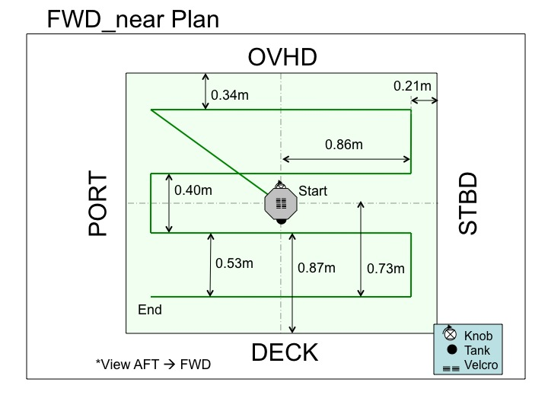
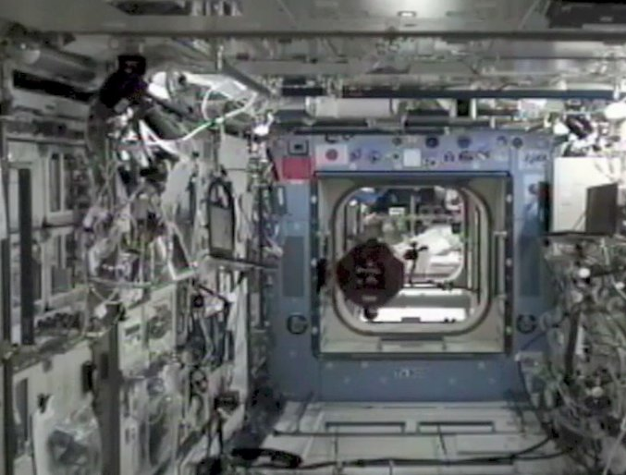
Ground Control Test (Dec 12, 2012)
Space Station Free-Flying IVA Survey
  Demonstrate video survey within ISS (Kibo Laboratory module)
  Smart SPHERES remotely operated by ISS Mission Control (Houston)
  Manual control (discrete commanding) and supervisory control (command sequences)
Kibo Laboratory on ISS

Slide 12
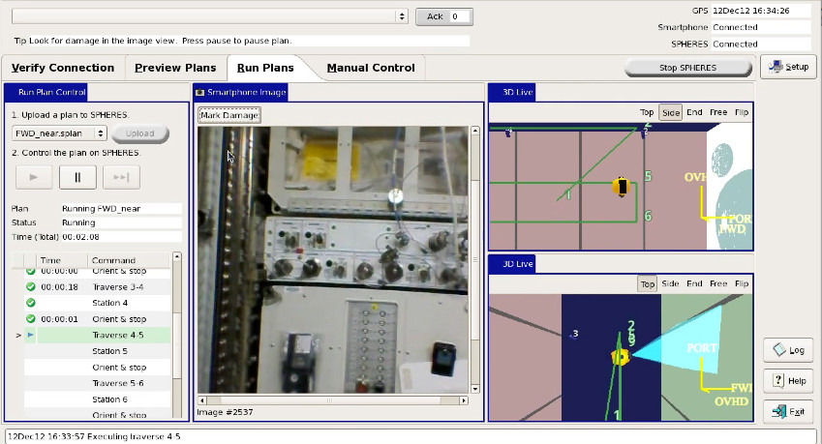
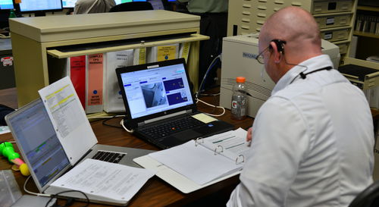
Remote Ops from MCC-Houston
Robot operator in
“PLUTO” Multi-Purpose Support Room

Slide 13
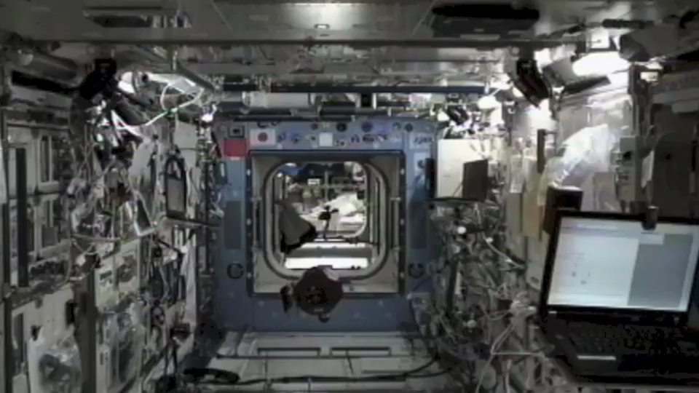
IVA Survey
December 12, 2012
Crew: Kevin Ford, Expedition 33 Commander
2x speed

Slide 14
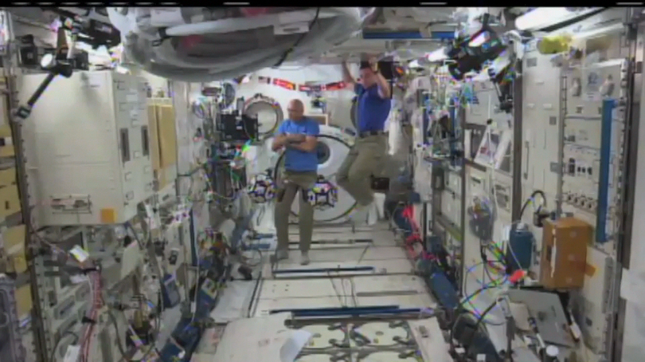
Inspection
September 5, 2013
Crew: Luca Parmitano and Chris Cassidy
4x speed

Slide 15
“Plus Orbits” Translation
Position data logged by smartphone (from SPHERES beacon system)
Blue = target waypoints
Red = measured path

Slide 16
Plus Orbits Orientation
Red = target waypoints
Blue = measured path
Blue lines = orientation of smartphone camera

Slide 17
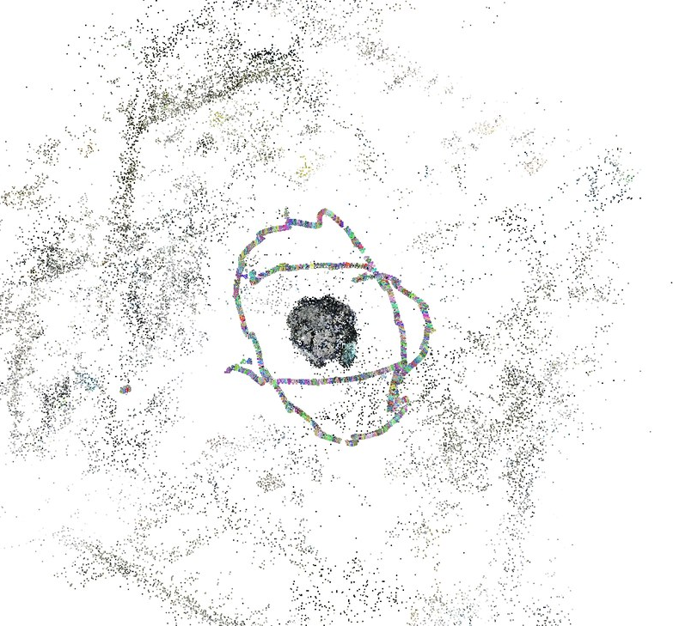
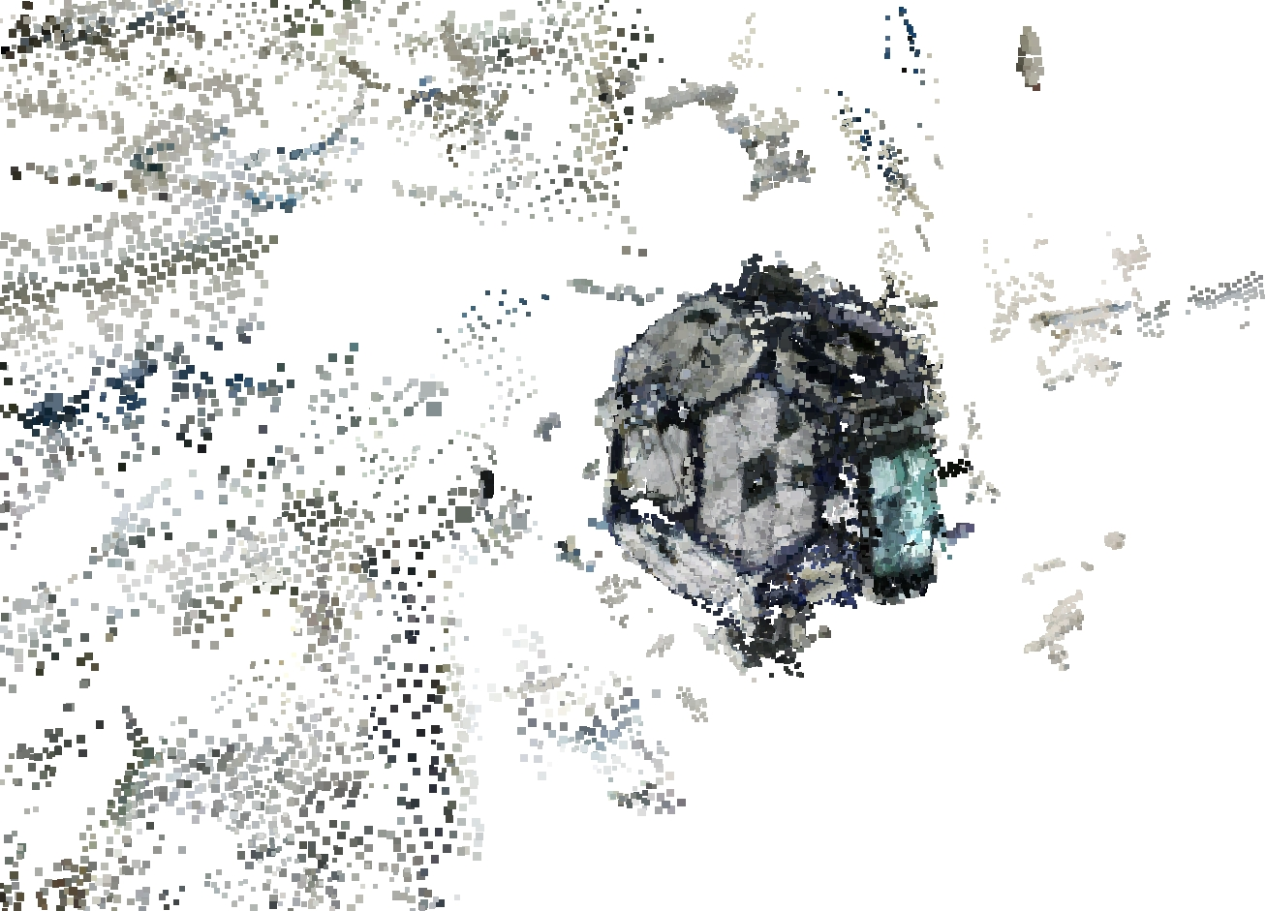
Inspection Coverage
Image-based 3D reconstruction
  Reconstructed using only camera images
  Shows position of camera for each image taken
  Shows inspection coverage

Slide 18
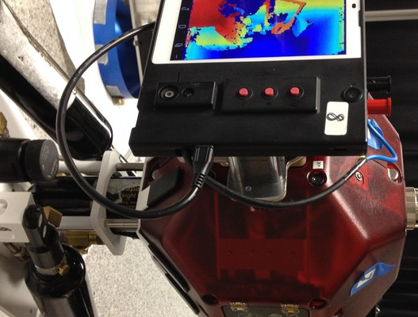
New Smartphone
Modified Google “Project Tango” prototype smartphone
(scheduled for delivery to ISS on Orbital-2)

Slide 19
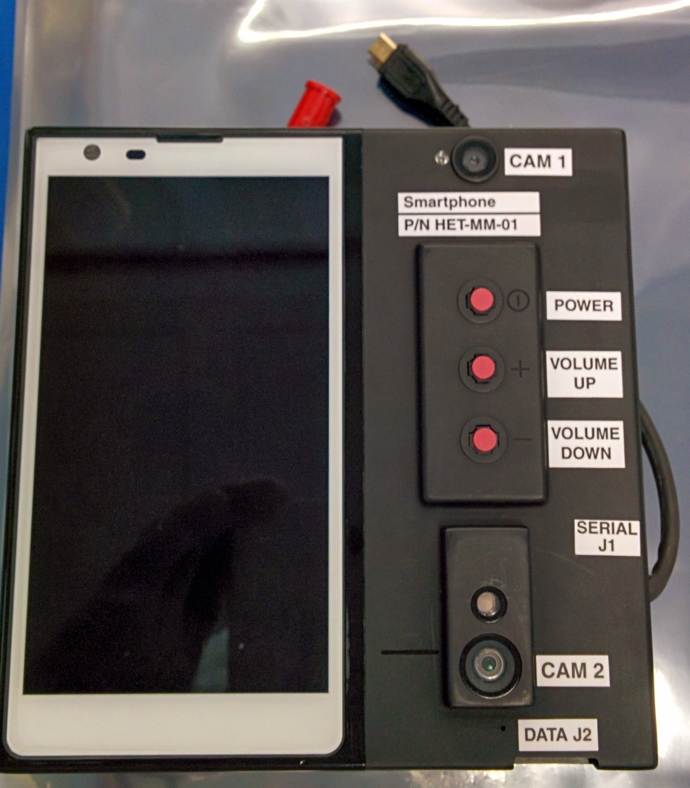
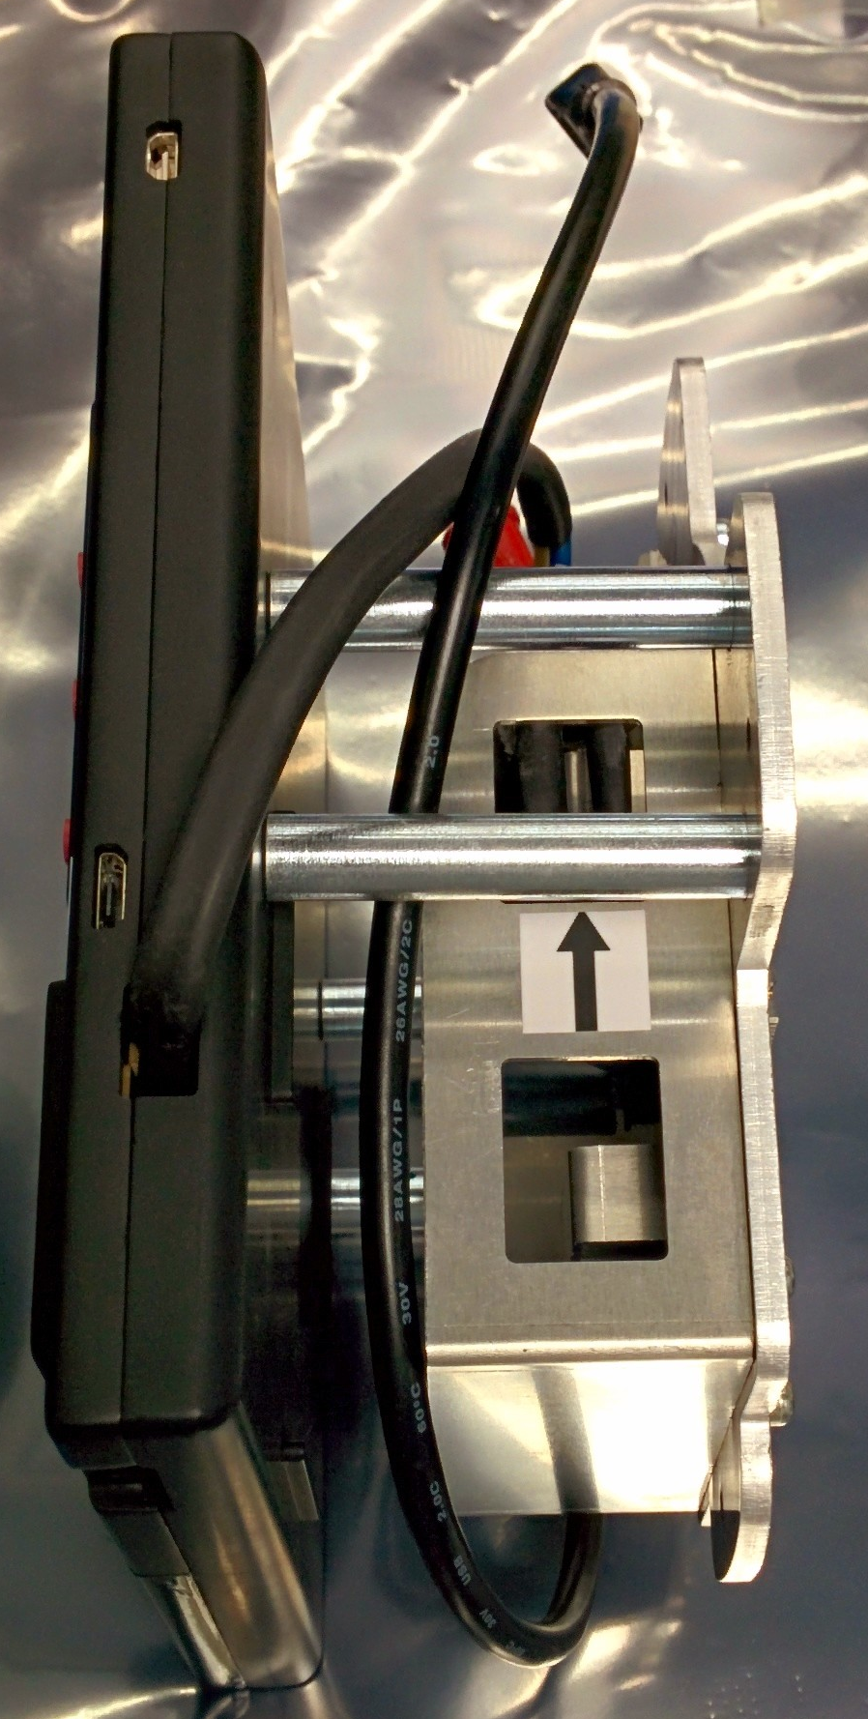
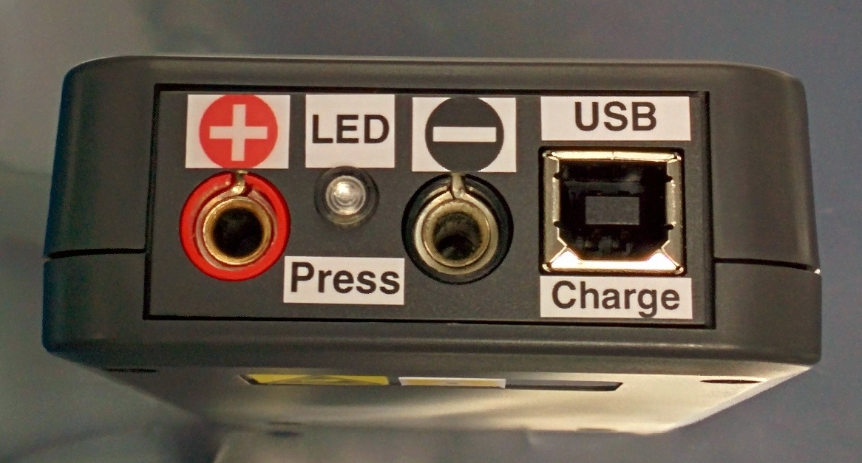
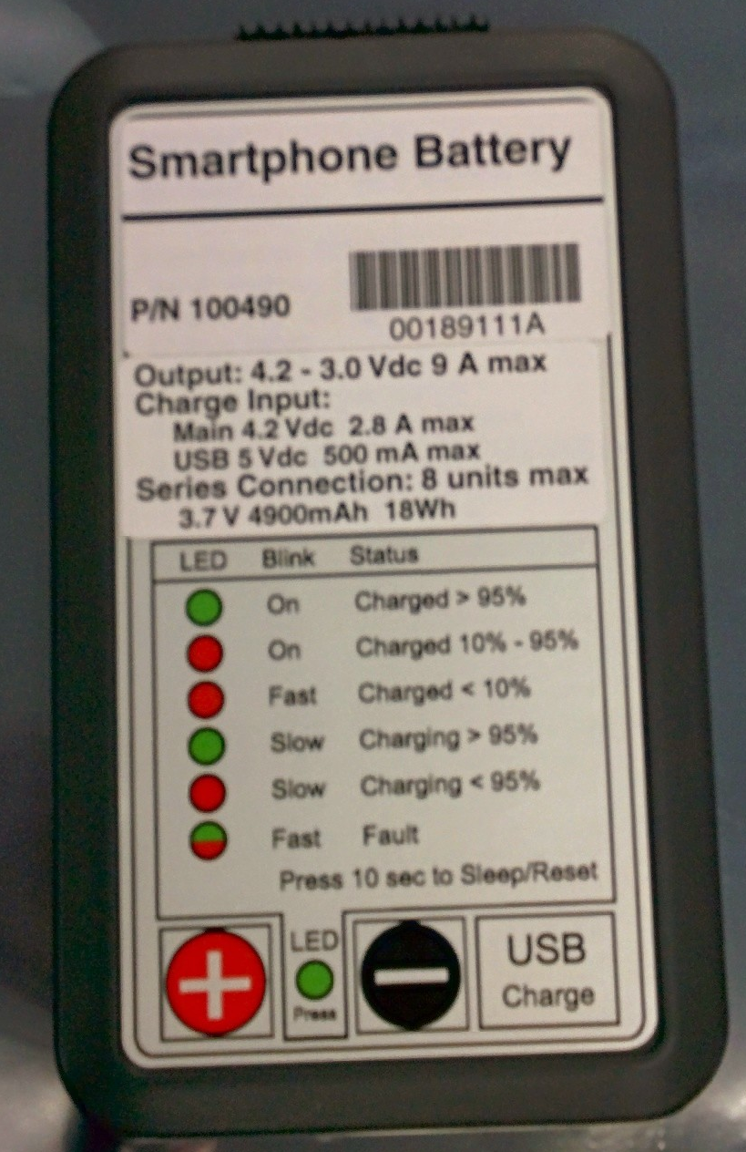
Smartphone flight unit

Slide 20
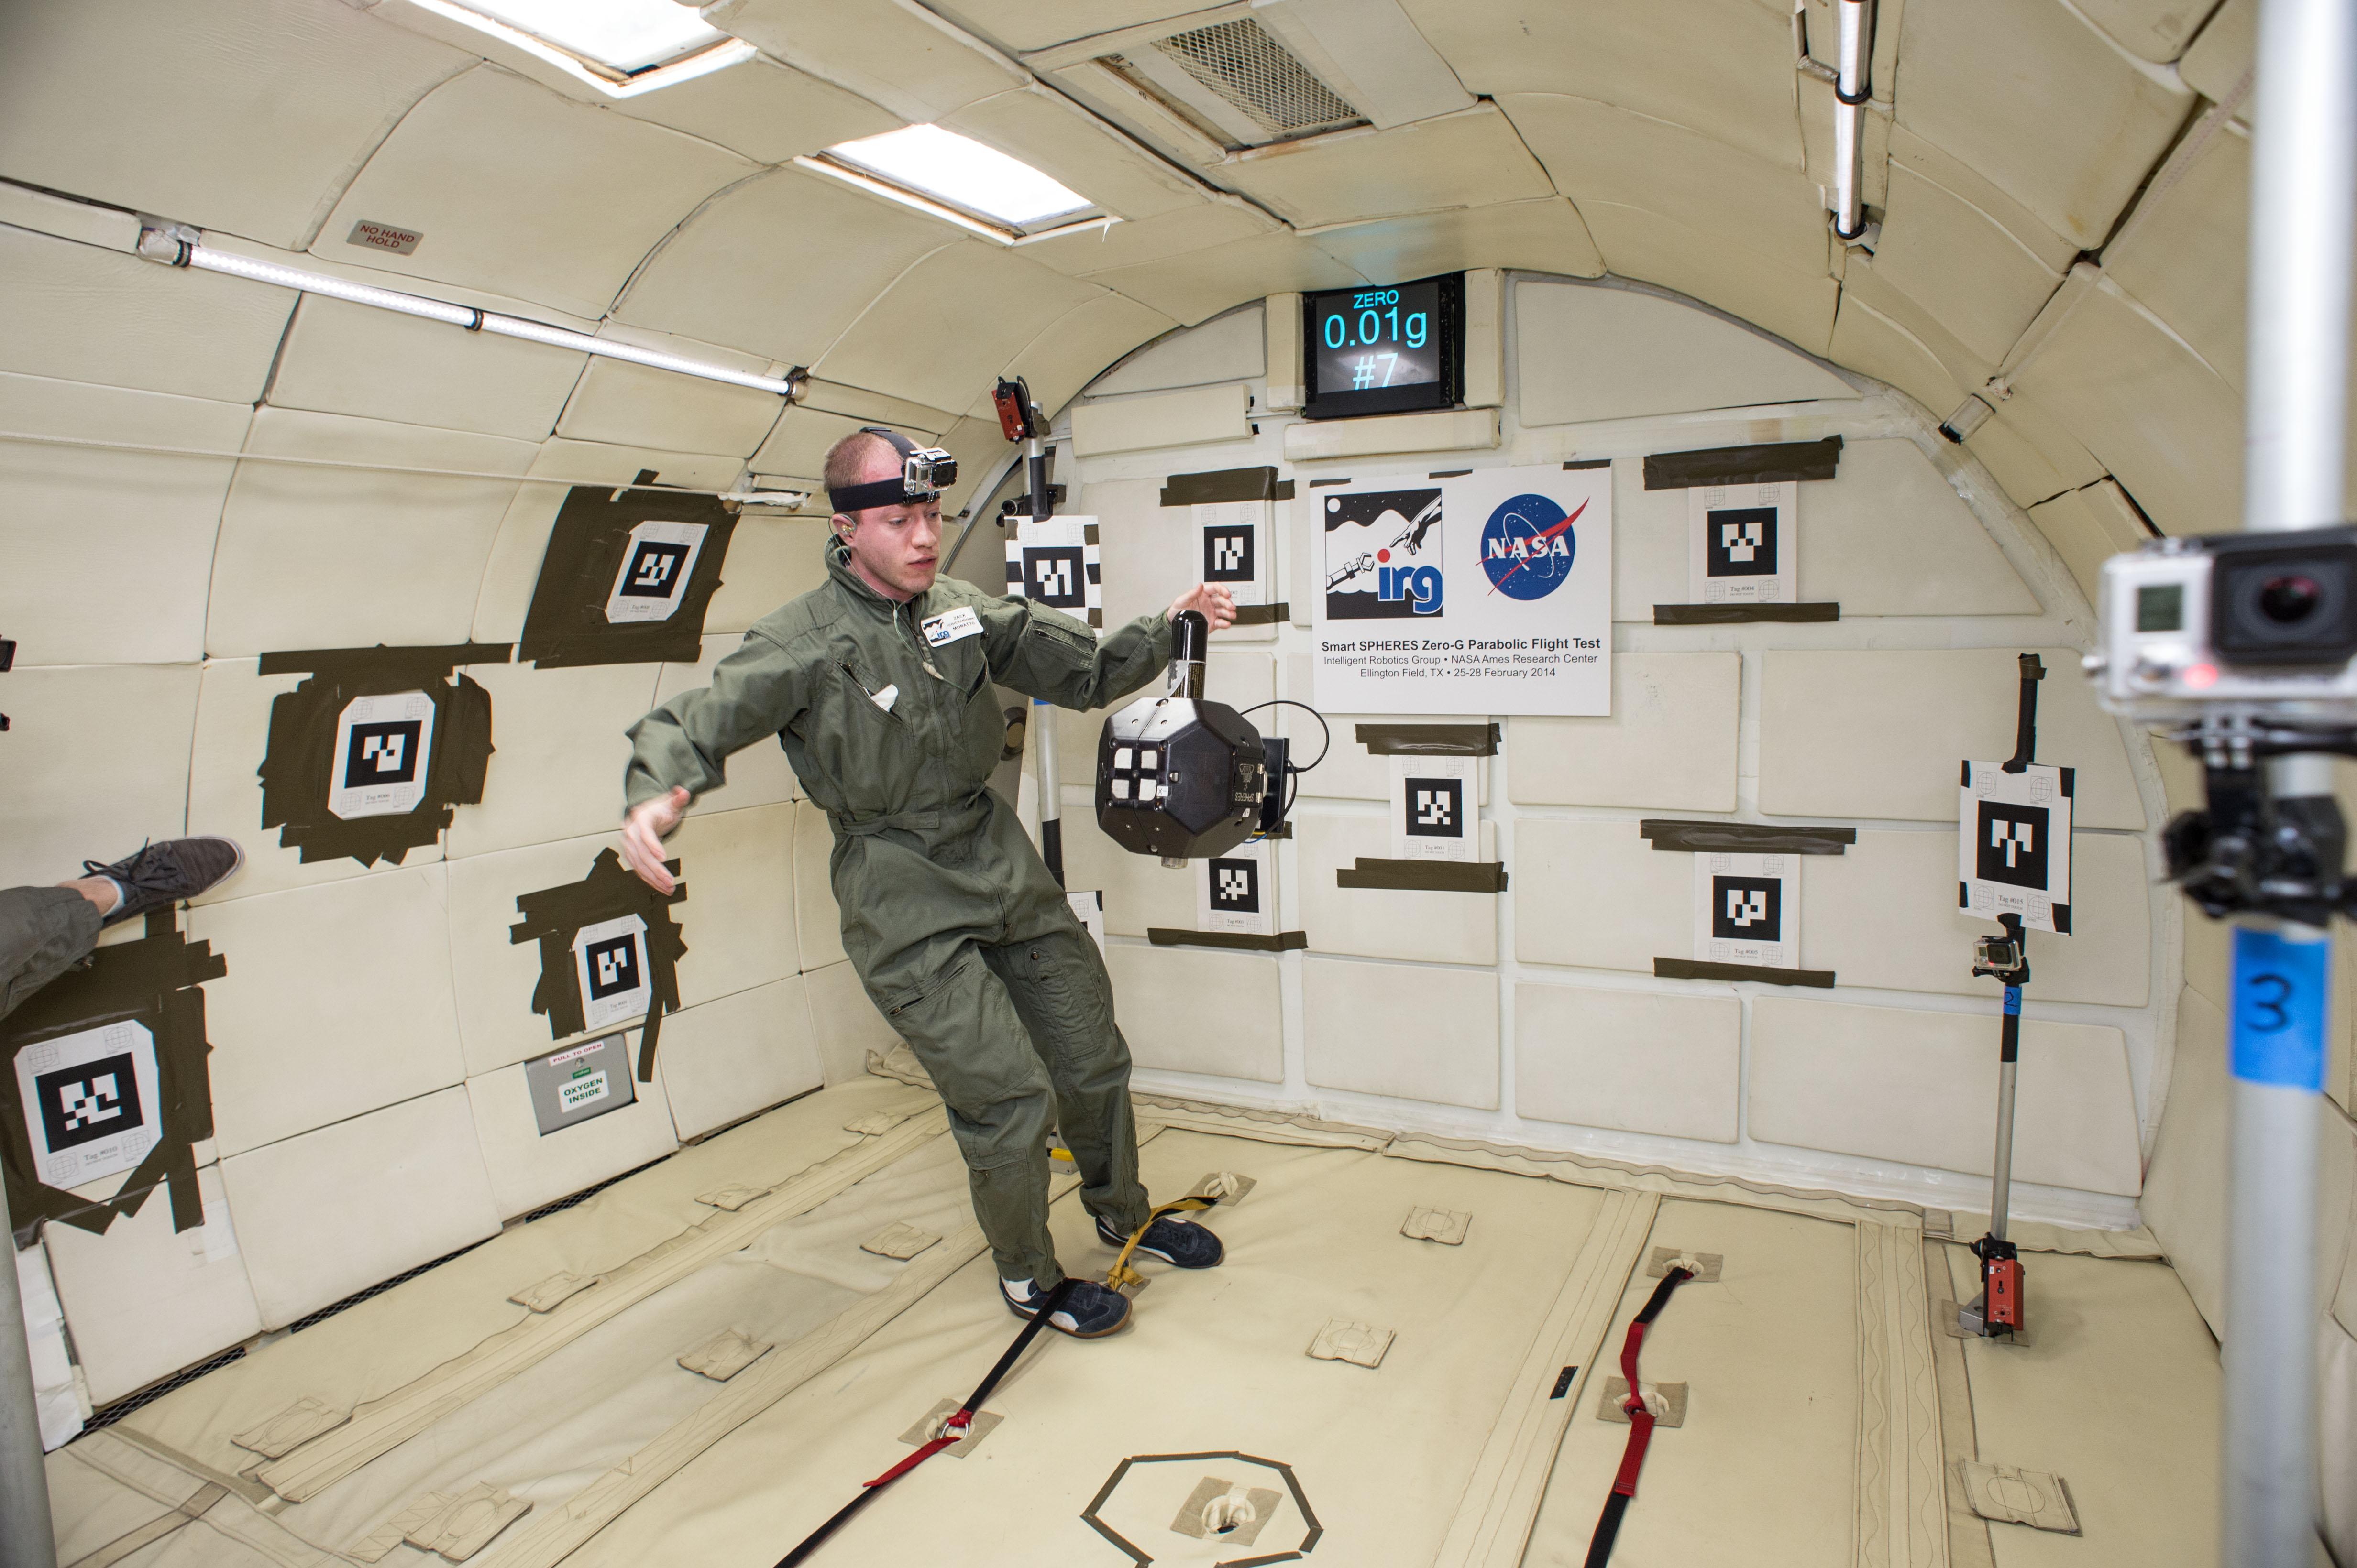
Smartphone parabolic flight test

Slide 21
Smartphone-MM Localization

Slide 22
Smartphone Mapping Activity

Slide 23
Smartphone ISS Nav Demo
First run remains in SPHERES beacon volume
Subsequent runs to Node 2 and US Lab
Limited to 20 mins of actual runs (data downlink constraints)

Slide 24
Points of Contact
Andres Martinez, Program Manager NASA Ames Research Center (650) 604-0530 andres.martinez@nasa.gov | Jose Benavides, Chief Engineer NASA Ames Research Center (650) 604-4401 jose.v.benavides@nasa.gov
Aric Katterhagen, Operations Lead NASA Ames Research Center (650) 604-6689 aric.katterhagen@nasa.gov
http://www.nasa.gov/spheres

Slide 25
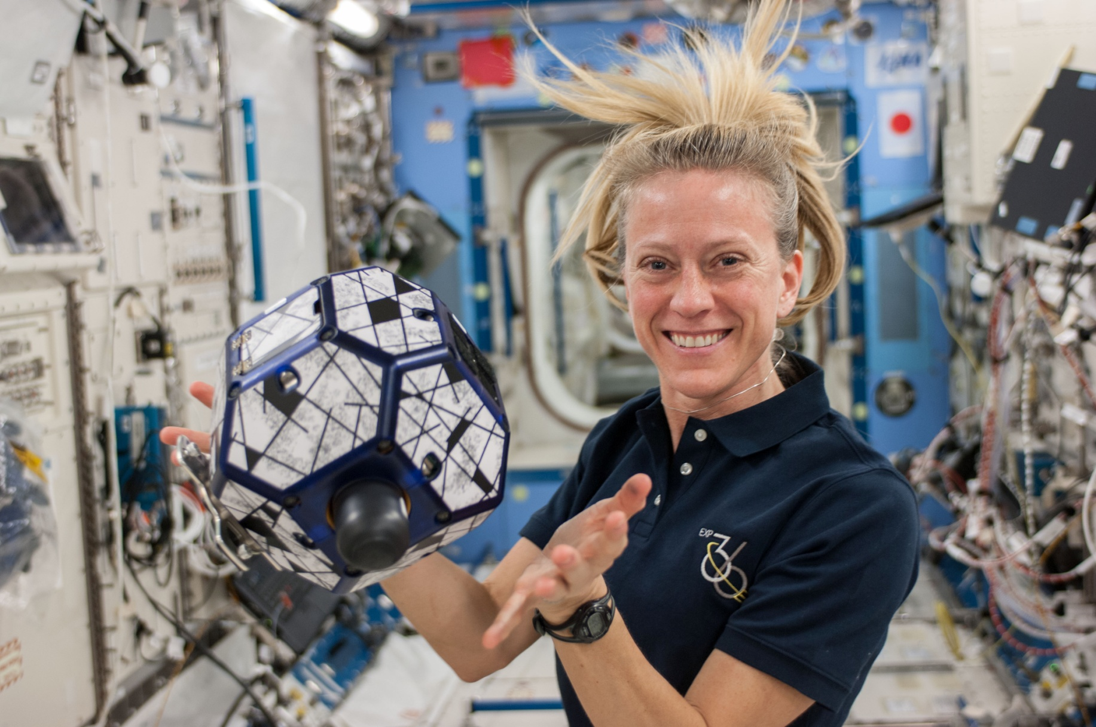
Questions?
NASA – MIT SSL – UMD SPPL – DARPA – NRL – AFS – FIT

Slide 26

END
http://www.nasa.gov/spheres

