Slide 1
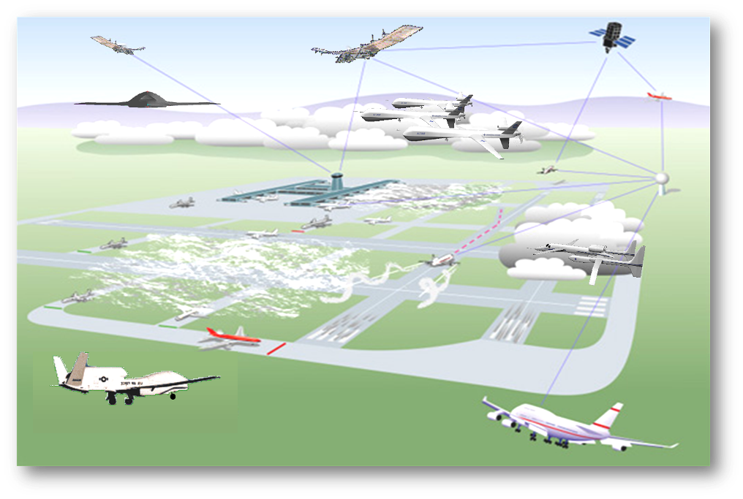
Human Factors of Remotely Piloted Aircraft Systems: Lessons from Incident Reports
Alan Hobbs, Ph.D.
San Jose State University Research Foundation
Human Systems Integration Division
NASA Ames Research Center

Slide 2
Outline
Introduction
Overview of RPAS human factors
RPAS critical incident study
Next steps

Slide 3
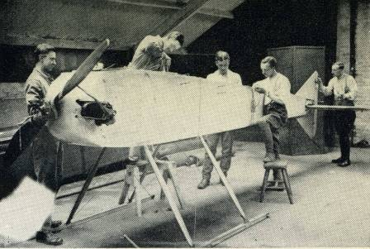
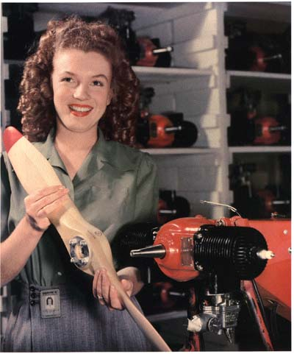
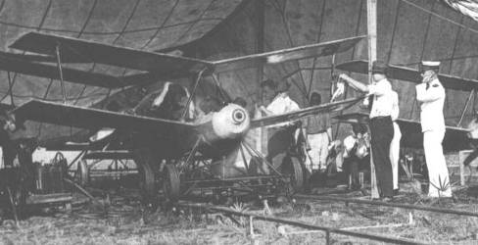
Archibald Low’s radio-controlled aircraft, 1917
Kettering Bug, 1918
Denny Radioplane, 1945
Notes:
Norma Jeane Dougherty

Slide 4
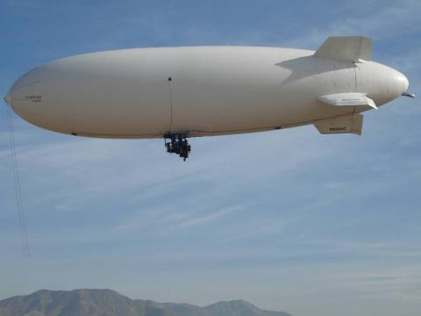
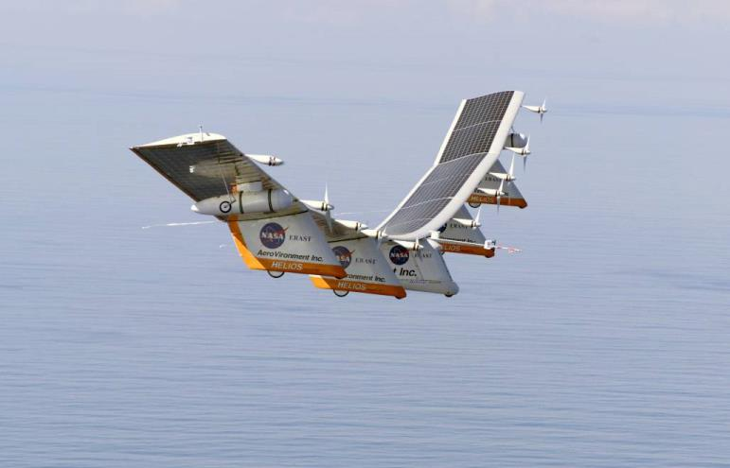
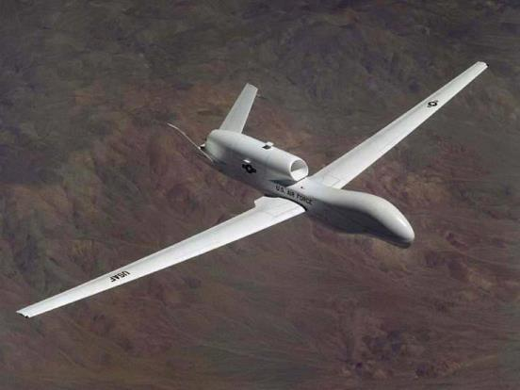
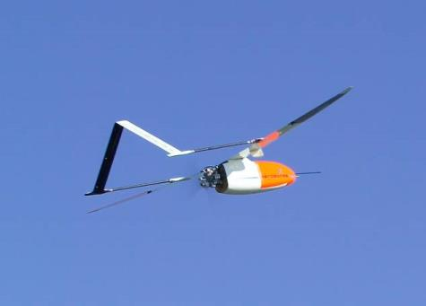
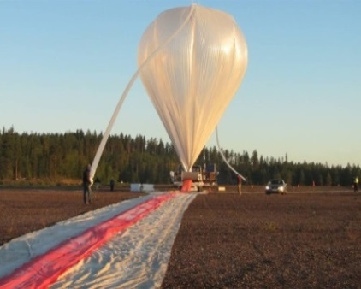
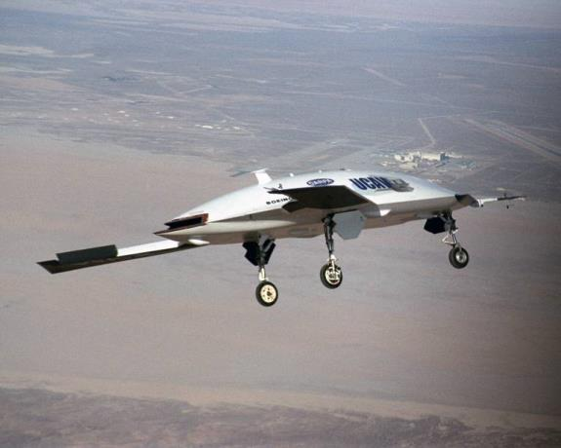
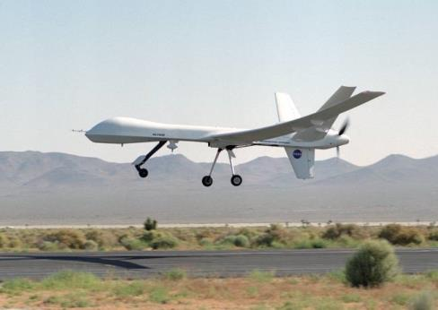
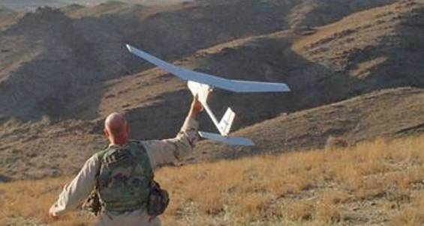
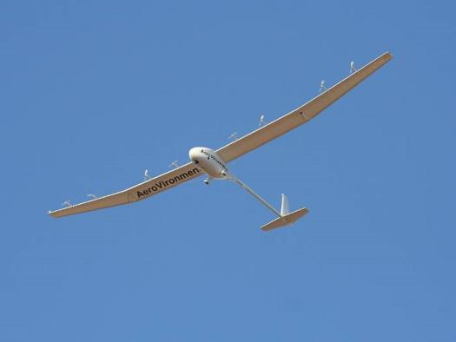
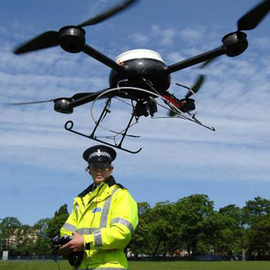
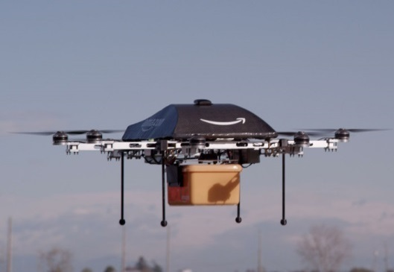
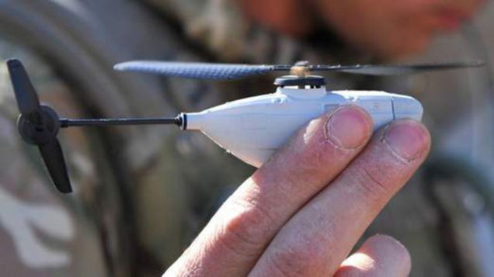
Notes:
Unmanned, remotely-piloted, UAV terminology. Will say RPS, but some people use “GCS”

Slide 5
Civilian Uses of RPAS
Advertising
Agriculture
Building inspections
Cattle herding
Construction site survey
Customs & border protection
Disaster response
Environmental sensing & research
Filmmaking
Firefighting
Land surveying & mapping
Mineral exploration
News reporting
Parcel delivery
Police
Powerline, pipeline, & rail track inspections
Real estate photography
Search & rescue
Ship inspections
Telecommunications relay
Traffic monitoring
Wildlife monitoring

Slide 6
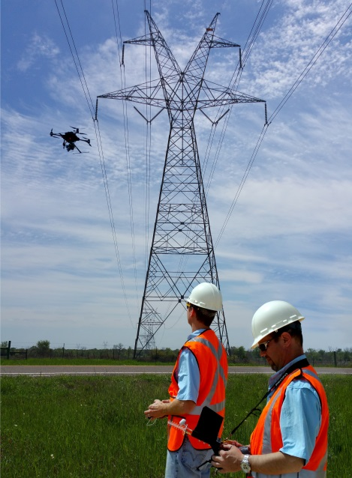

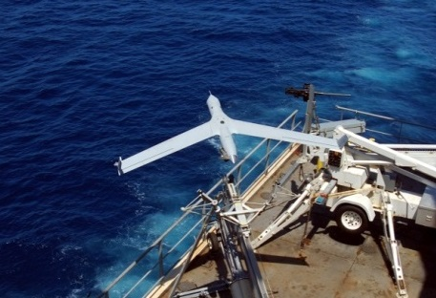
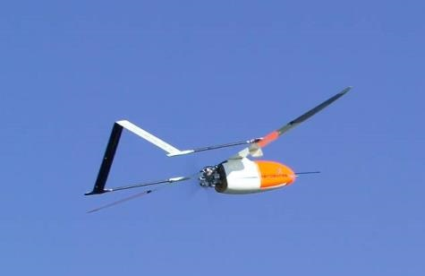
Three Types of RPAS Operations
All classes of civil airspace
Low level line-of-sight
Low level beyond-line-of-sight

Slide 7
Three Types of RPAS Operations
All classes of civil airspace
Low level line-of-sight
Low level beyond-line-of sight

Slide 8
Three Types of RPAS Operations
FAA Assumptions
Instrument Flight Rules
Controlled by a remote pilot
Not autonomous
Complies with ATC instructions
All classes of civil airspace
Low level line-of-sight
Low level beyond-line-of sight

Slide 9
Accident Record
Army accident rates¹:
  Unmanned aircraft: 49 per 100,000 hours
  Manned aircraft: 4 per 100,000 hours
USAF hull-loss rates²:
  MQ-9: 4 per 100,000 hours flown
  Manned aircraft: 0.4 per 100,000 hours flown
Small civilian RPA hull-loss rate:
  ~ 300 per 100,000 flight hours
1. Prather, C. (2013). Online report of Army aircraft mishaps. Flightfax, 26. Retrieved from www.safety.army.mil
2. United States Air Force. (2015). Q-9 flight mishap history. Retrieved from http://www.afsec.af.mil

Slide 10
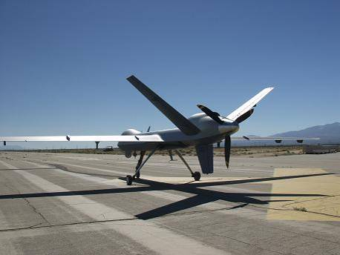
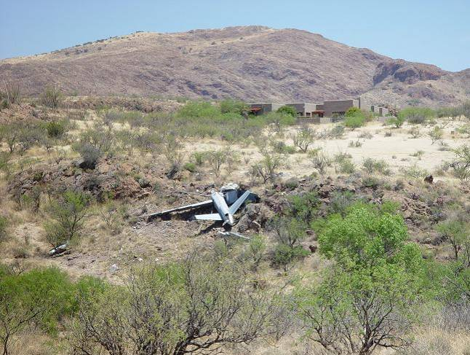
Predator B Accident at Nogales
Source: NTSB

Slide 11
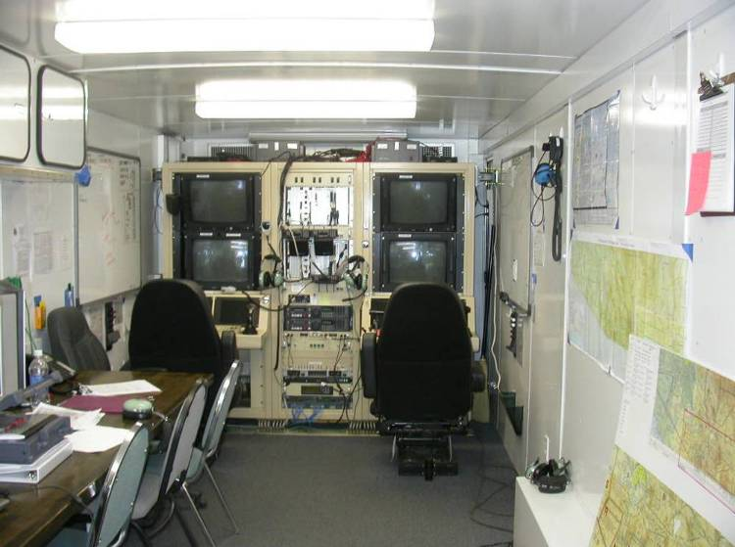
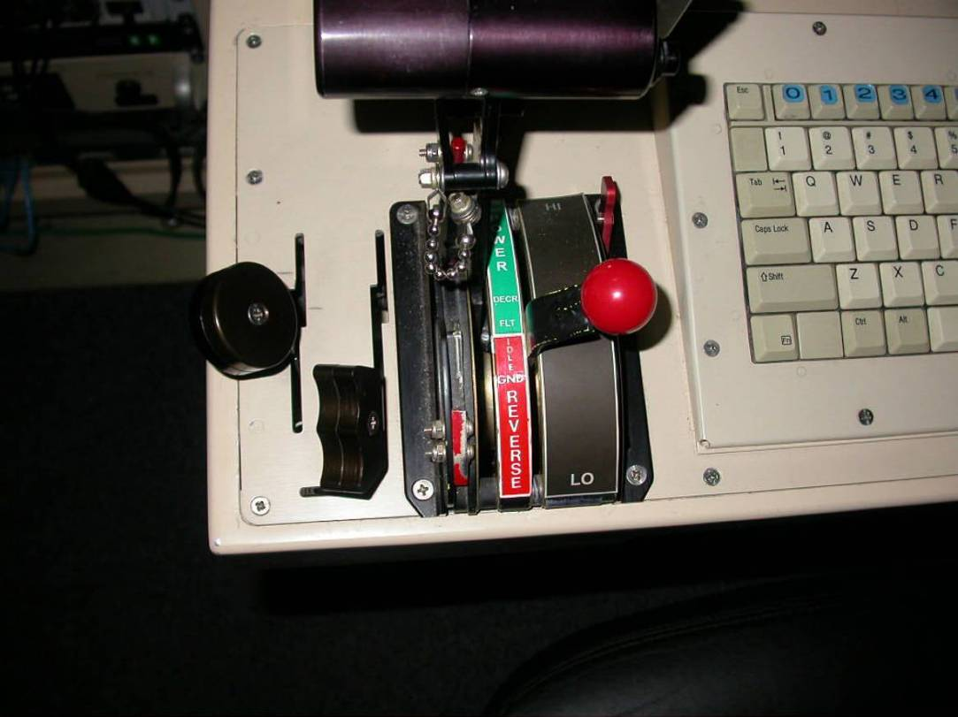
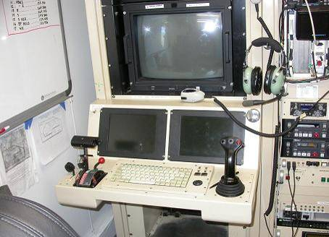
Predator B Accident at Nogales
Source: NTSB

Slide 12
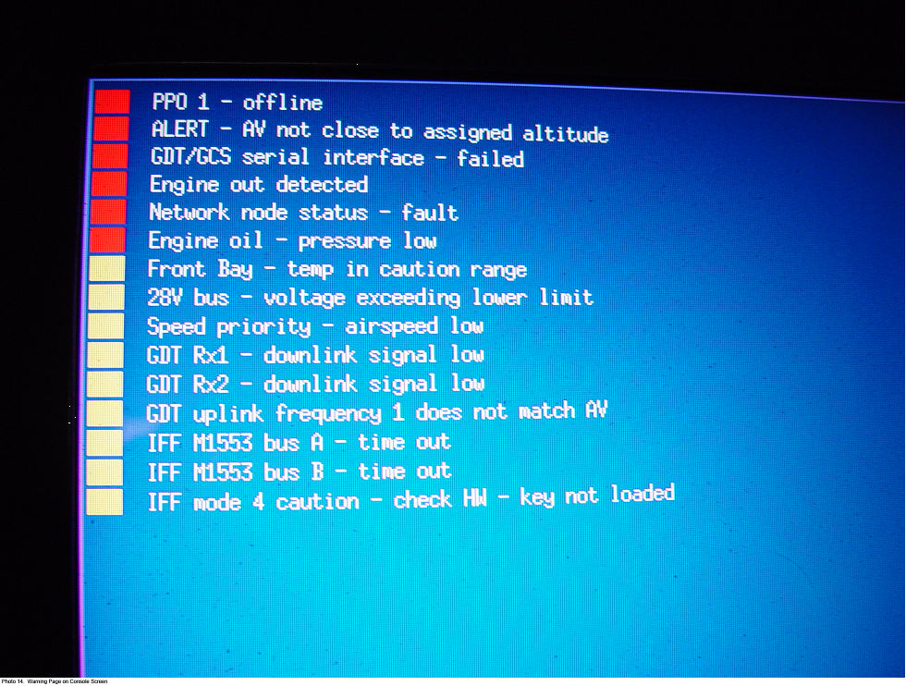
Predator B Accident at Nogales
Source: NTSB

Slide 13
Overview of RPAS Human Factors
1. Reduced sensory cues
2. Teleoperation via radio link
3. Remote pilot station
4. In-flight transfer of control
5. Flight termination

Slide 14
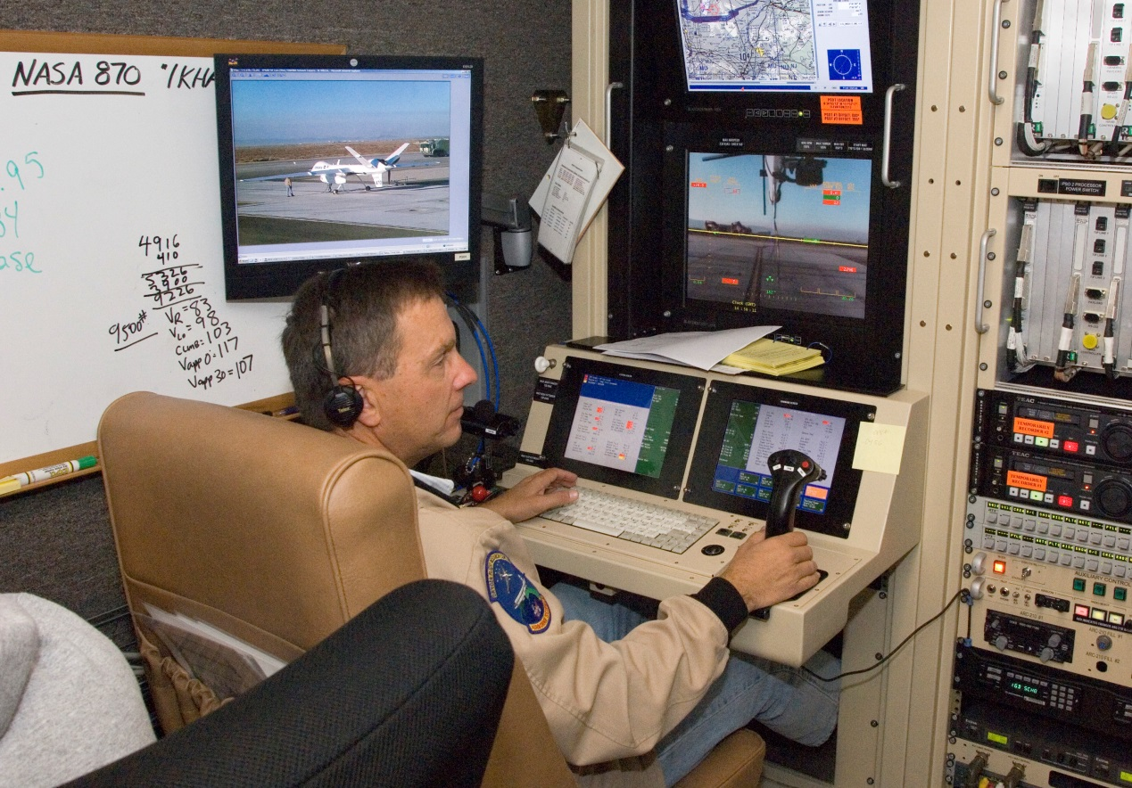
1. Reduced Sensory Cues
Lack of natural cues (e.g. visual, auditory, haptic)
“Soda straw” view from on-board camera
No “see and avoid”
Notes:
Loss of natural sensing, thought experiment, under a hood, no sound, no vibration, no smell, no haptic feedback, no vestibular sensations.
Detect and Avoid.

Slide 15
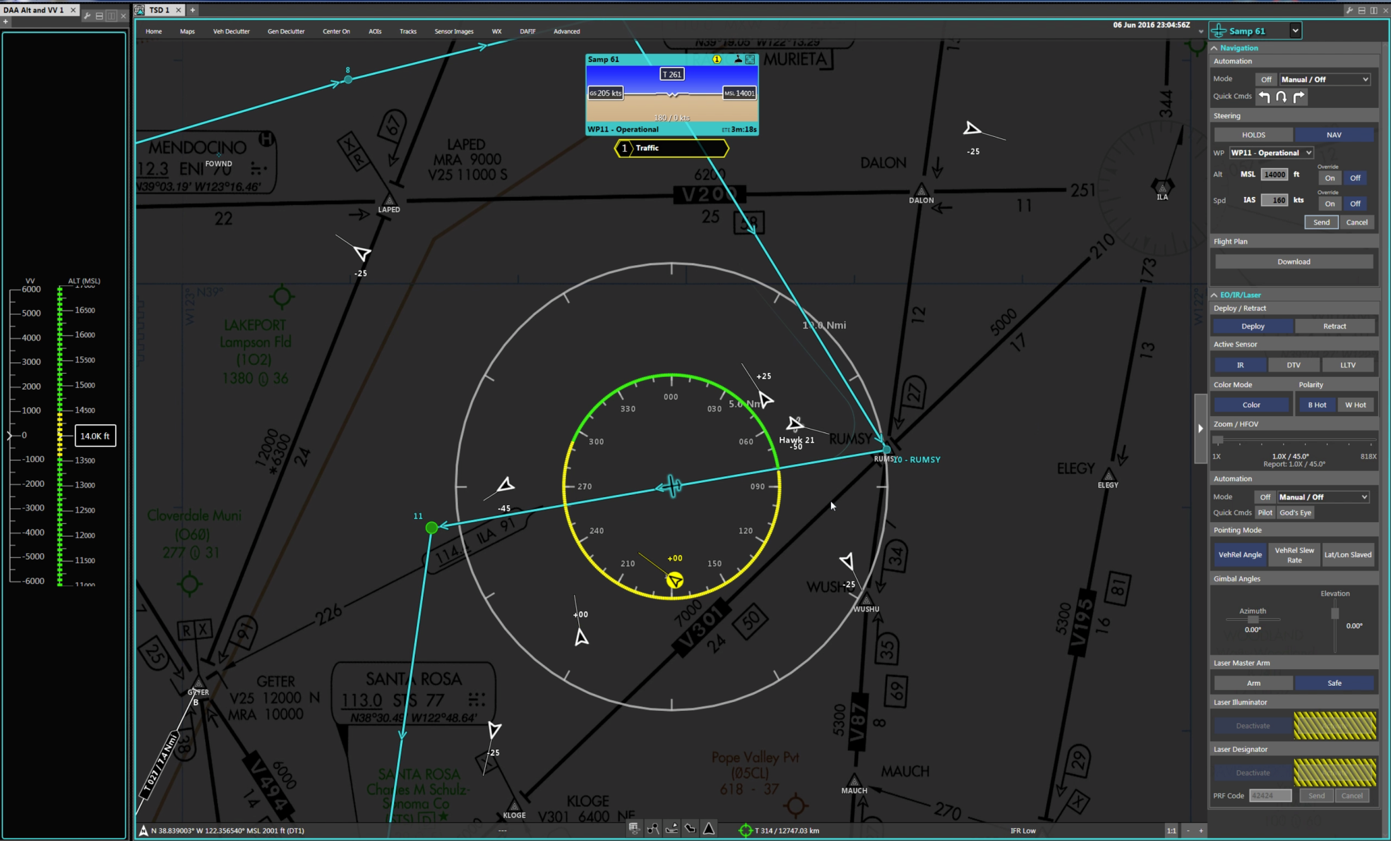
Detect and Avoid Display

Slide 16
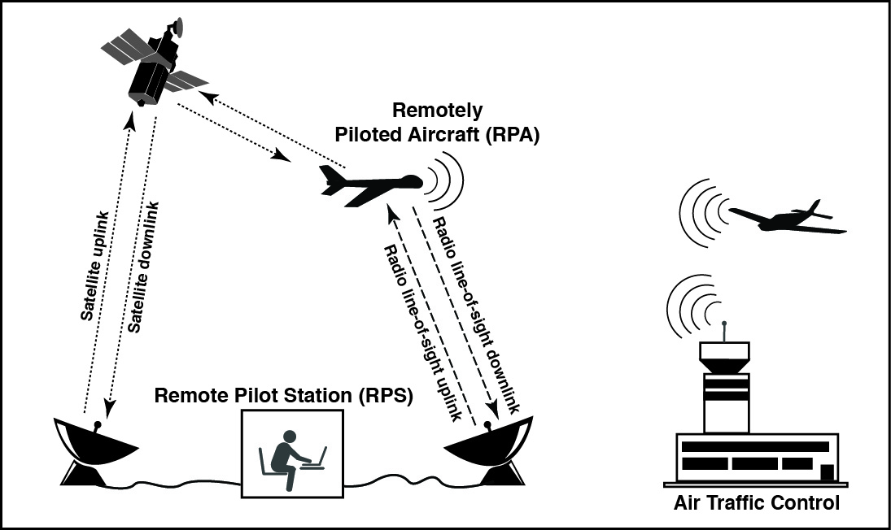
2. Teleoperation Via Radio Link
Loss of link
Latencies
Link management
Lost link procedures
Notes:
Teleoperation in medicine, mining, rail transport. Link management is a critical pilot task, awareness of signal strength, geographic limits. Transponder squawk code, 7400?
Requires on-board automation, supervisory control. Last message anxiety. Pilot of a conventional aircraft cannot inadvertently disconnect cockpit from rest of aircraft.
Pilot can be located anywhere.

Slide 17
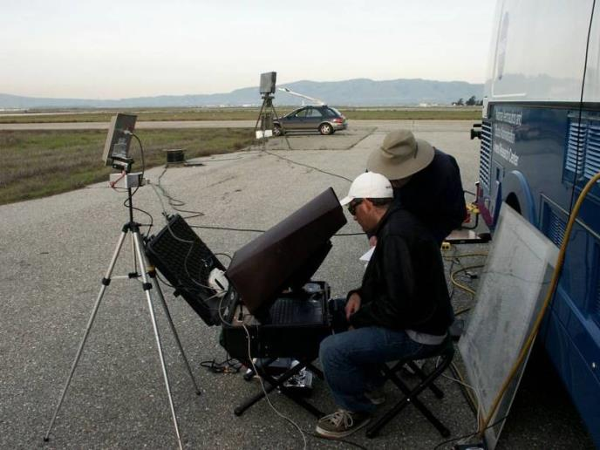
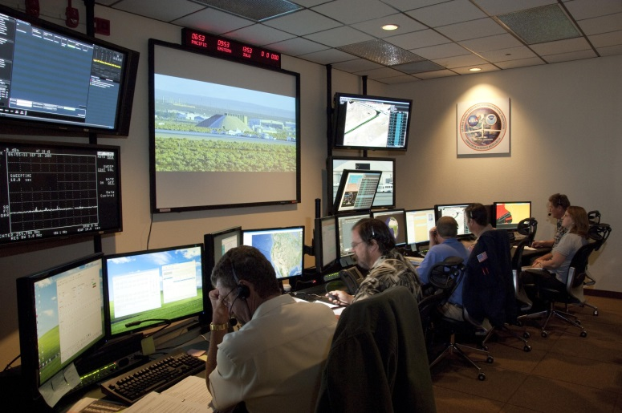
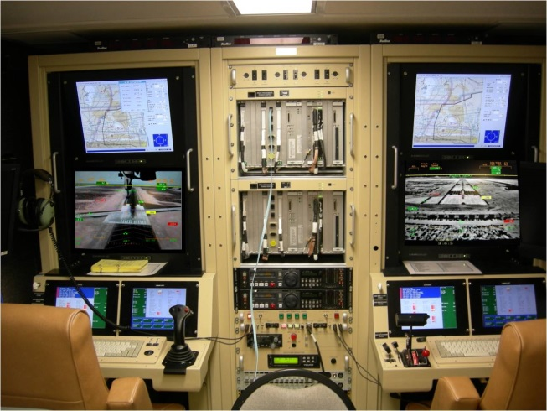
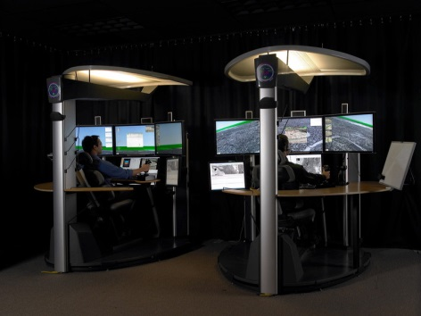
3. Remote Pilot Station (RPS)

Slide 18
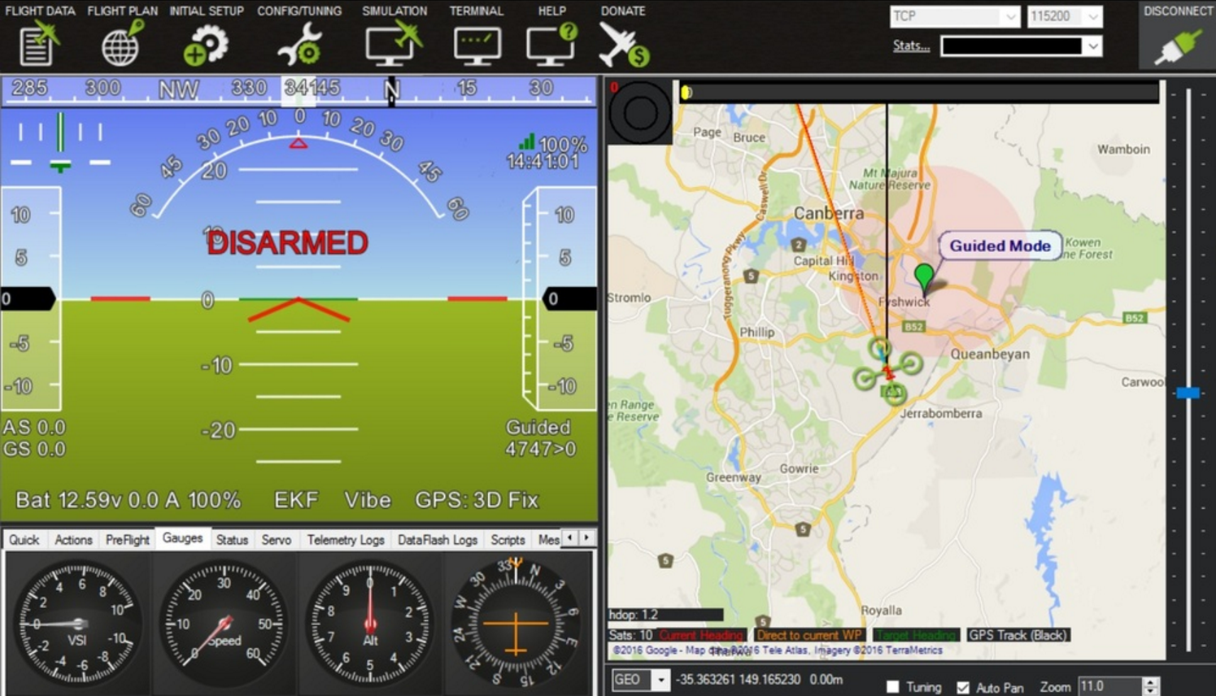
Laptop Pilot Station

Slide 19
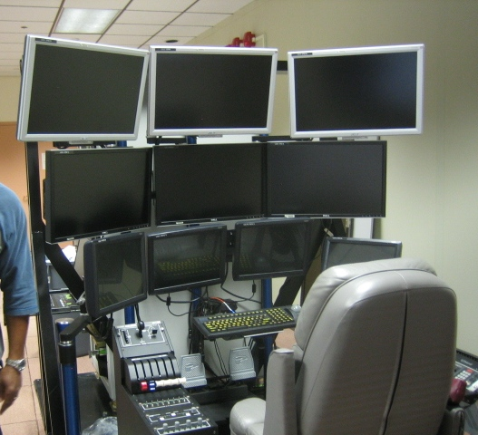
RPS Interfaces
Physical ergonomics
  Unreachable controls
  Difficult-to-read fonts and colors
  Critical controls placed next to non-critical controls
  Proliferation of displays
Cognitive ergonomics
  Complicated menu structures
  Inadequate feedback
  Reliance on text displays
  Multi-function controls
Notes:
From a cockpit to a control station? Will return to the need for design guidance later. Foveal bottleneck

Slide 20
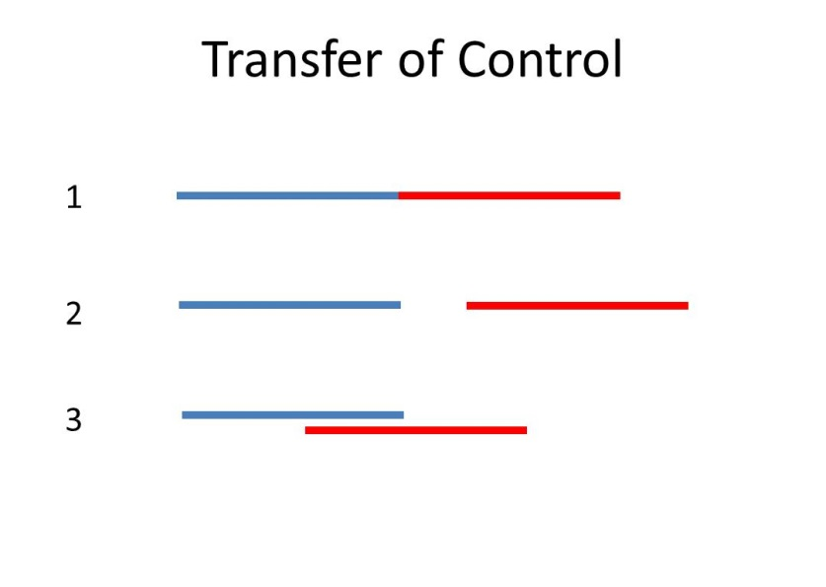
4. In-flight Transfer of Control
Handovers at same console
Control frequency changes
Transfers between consoles in same RPS
Transfers between RPS
Notes:
Control transfers are known periods of risk in other settings. Long duration flights will involve numerous handovers, increase exposure to risk.
Ensuring receiving RPS is configured same as giving. Confirming control. Communication between pilots?
Seamless, break before you make, make before you break.

Slide 21
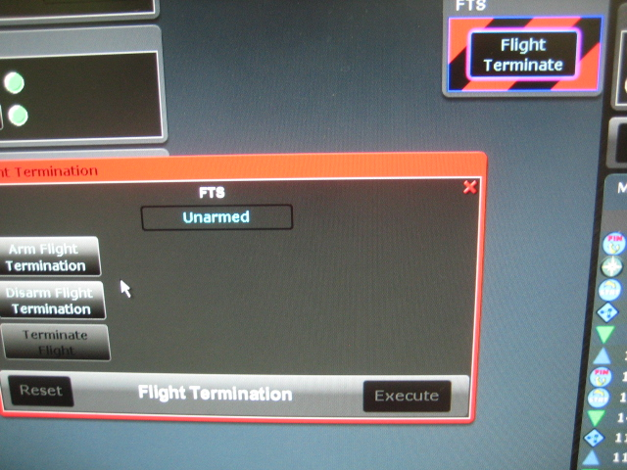
5. Flight Termination
Notes:
“Manned mindset”. Over 280 emergency landing sites were identified for NASA’s Ikhana wildfire monitoring missions in 2007.
Aerodynamic termination, parachute, controlled impact
Database information vs real-time info? Safe locations may not stay that way. Use cell phone data?

Slide 22
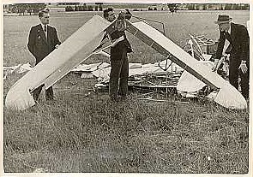

RPAS Critical Incident Study:
Rationale
“Tombstone safety” in the 20th century
Lack of data on minor RPAS events
Major accident 1
Minor accidents 10
Reportable incidents 30
Minor events 600
Notes:
Cannot beta test on community. In conventional aviation accidents, tombstone was for pilots or occupants, with RPAS operators are not at risk.
Refer to ASRS.

Slide 23
RPAS Critical Incident Study: Goals
Examine the feasibility of a method to collect the operational experiences of RPAS pilots
Provide independent and complementary data to supplement NASA simulations and flight tests
Notes:
Paul Fitts and Richard Jones 1947. Reports of “pilot error:” led to improvements I cockpit design.

Slide 24
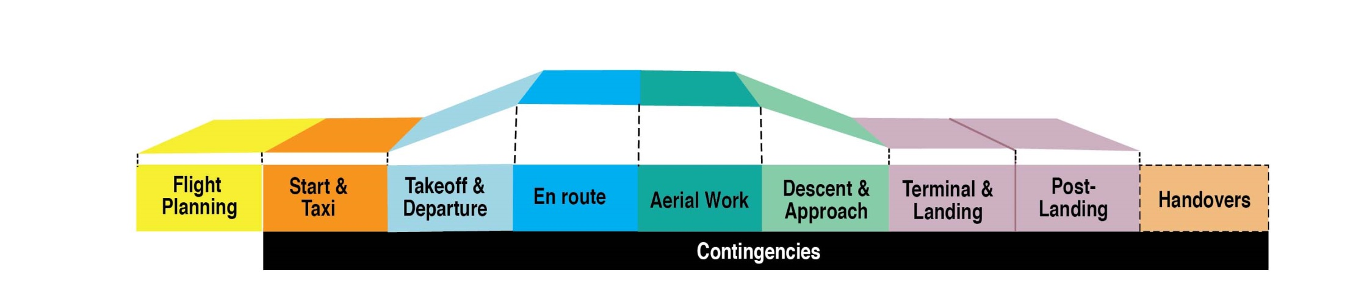
RPAS Critical Incident Study: Approach
Focus groups with 2-3 pilots at a time
Participants asked to recall events experienced while operating a remotely piloted aircraft
  A hazardous situation or error
  The rectification of a hazardous situation or error
Only reports that can be made public
Notes:
Participant identities remain confidential

Slide 25
Preliminary Results
23 participants
90 incidents described
Weight classes of the remotely piloted aircraft:
Aircraft max takeoff weight # of reports
Less than 400 lbs 17
2000-15,000 lbs 60
Greater than 15,000 lbs 13

Slide 26
Problems Mentioned in Reports

Slide 27
Example: Lost Link
“We were flying really far out … about 90 kilometers from the antenna. But I passed some random mountain peak for about one second and the aircraft went into emergency mode. Luckily I had the correct emergency mode programmed. If I didn't, I could've lost the aircraft.”
RPAS pilot report
Notes:
Also multiple lost links, example of severed power line.

Slide 28
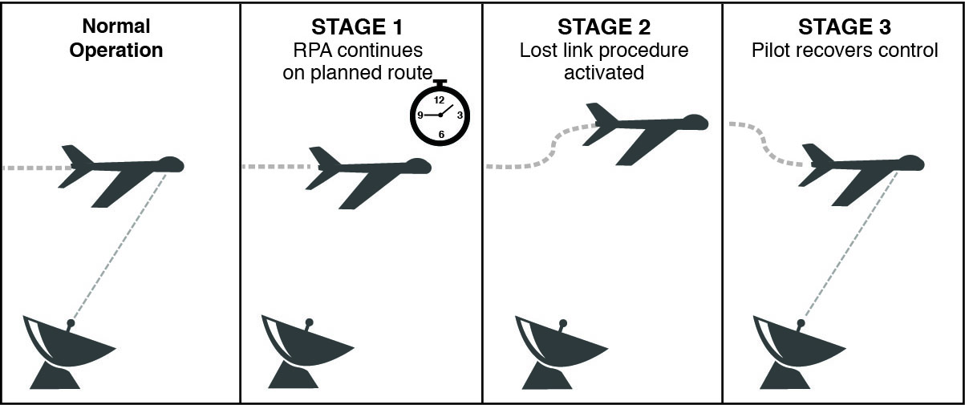
Stages of Lost Link
Notes:
What does ATC need to know? RPA Squawks 7400? Need to know what stage of lost link, and when the RPA will transition to next stage?

Slide 29
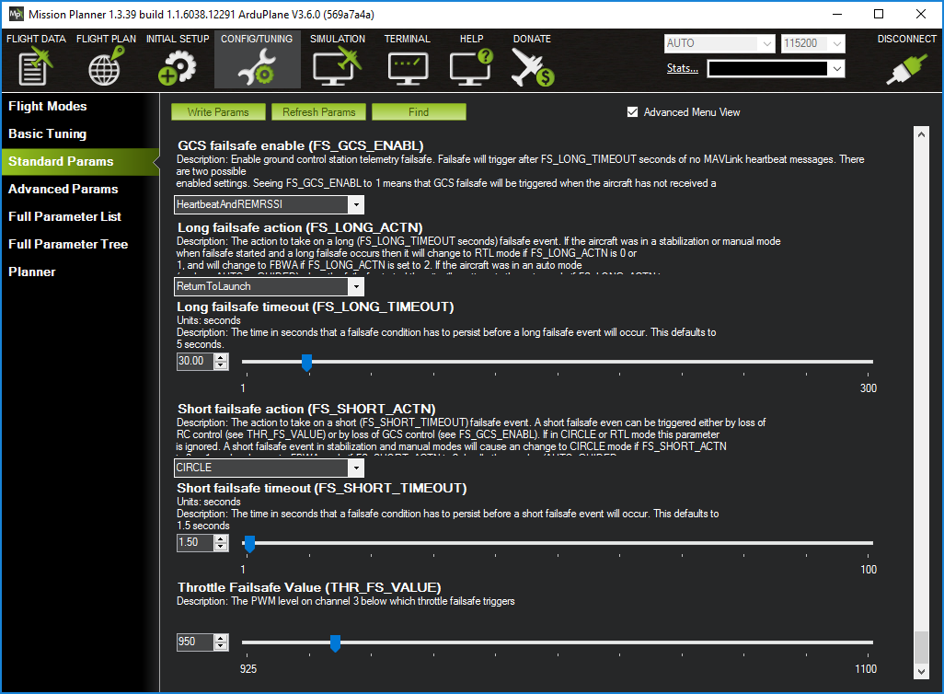

Slide 30
Example: Lost Link Timer
“The airplane … made many turnarounds due to it being out of link then … it would reacquire and … return on mission. This affected fuel burn. [So I] set time-out feature just short of the actual mission duration.”
  RPAS pilot report
Notes:
Timer settings can give ATC certainty by preventing a nuisance lost link maneuver. Or when entering areas with uncertain coverage.

Slide 31
Example: Lack of Sensory Information
“We fly based on digital gauges. We don't hear or feel anything, like RPM changes …. The aircraft is supposed to level off, at say, 5,000 ft … As opposed to a real aircraft [where] you can feel the airplane leveling off, I couldn't determine if it was still climbing until I noticed it was 300 ft past its command altitude.”
RPAS pilot report
Notes:
System and state awareness, error detection and recovery, How does it affect threat and error management? Detecting unexpected aircraft behavior?
Possible that non-digital cues are especially helpful for TEM? E.g. aircraft turning wrong direction, acft flying upside down.

Slide 32
Stale Lost Link
Pilot awareness of lost link mission
Lost link mission needs regular updating
Lost link mission can be a form of “automation surprise”

Slide 33
Example: Stale Lost Link
“At the beginning of the flight, the lost link procedure was valid, but the procedure was not updated later in the flight. At one point, had the lost link procedure been activated, it would’ve had the aircraft fly through terrain in an attempt to reach the next waypoint. However, the aircraft didn’t lose link and the error was caught in the handover to the next set of operators.”
RPAS pilot report

Slide 34
Example: Voice Latency
“There is a delay between clicking the press-to-talk and talking. This is very difficult to manage when in very busy airspace, and listening for a gap to talk. Sometimes by the time we press the talk button, with the satellite delay, the gap is gone and we step on other aircraft.”
RPAS pilot report
Notes:
Have been studies of ATC voice latency, but few studies in which pilot voice is delayed WRT other pilots.
Voice relay also means that in event of lost link, voice comms will also fail.

Slide 35
Controls and Displays
Some RPS interfaces appear to be particularly error-productive
Shared payload and flight controls
Keyboard and consumer interfaces
Notes:
Interface had a button for a parachute, but no parachute fitted, so used for payload control. (gas sampler)
Rapid keyboard presses can lead to skill based errors.

Slide 36
Example Narrative: Keyboards
“… an operator placed his manual on top of [the keyboard]. Accidently, this activated the GUI. Then more pressure was applied through handling the manual, on the space bar. As a result, it highlighted and armed, through several steps, the flight termination button. Luckily, the operator saw the countdown and caught it in time to deactivate this command.”
RPAS pilot report
Notes:
Rapid keyboard presses can lead to skill based errors.

Slide 37
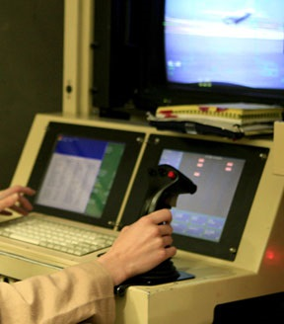
Example: Data Entry Errors and Slips
“I went to put the gear down, but instead I turned the SAS [Stability Augmentation System] off using the red emergency button. The aircraft went into a 20-degree bank and 5-degrees nose down. I was able to recover the airplane. I had developed muscle memory with the activation of the SAS disengagement button.”
RPAS pilot report

Slide 38
Accessibility of RPS
Maintenance
Corrective
Preventative
Fault isolation
Remove & replace
Test & inspect
Software updates
Time replacement
Repair
“In manned aircraft it is clear who is in command, but with UAS operations, there are multiple people who have a sense of responsibility for the aircraft. So when there is something that needs attention many people run to the GCS [Ground Control Station].”
RPAS pilot report
Notes:
Accessibility: “Clown Car Effect”
“People come and go, opening and closing doors and holding casual conversations. Ringing telephones, whispered remarks, and other disturbances can interrupt critical operations - such as approach and landing maneuvers that demand silence and concentration.” (Merlin, 2013, p.132).

Slide 39
Example: Mode Error during Control Station Transfer
“During preflight, handover checks were being done … we had the aircraft engine at idle with the parking brake set, but when the radio handover switched to XXX, he didn’t have the parking brake set and the power was set at 80% …. The result was the engine revving up, and the aircraft jumping its chocks.”
RPAS pilot report
Notes:
Automation surprise: “I … put the airplane into a holding pattern. …The aircraft turned in the opposite direction than what I wanted it to do. To correct the situation, I over-rode the aircraft. I had the aircraft go into the hold again and the aircraft did it again.”

Slide 40
Example: Unintended Transfer
“I was preparing to take control of the aircraft from [another pilot station]. The transmitters from my GCS were accidently left on. When I slewed the directional antenna to get the picture of the aircraft (the down link info), this automatically gave me control of the aircraft. I was not intending to take control of the aircraft at this time.”
RPAS pilot report

Slide 41
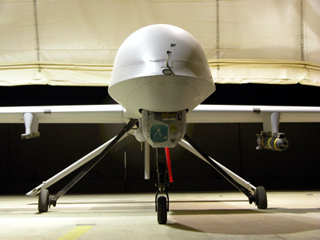
Example: Camera View Illusion
“Depending on how I do the landing …. [the moveable sensor camera] …will be used to make sure that we clear the turns. But sometimes, the sensor operator will move the camera, which will make it look like I’m turning but I’m actually not turning. So I have to concentrate and make sure I don’t respond to that erroneous camera view.”
RPAS pilot report

Slide 42
Next Steps
Continuing to collect RPAS incidents
Results are being used to inform design guidelines for RPAS control stations
Incident reports are helping to identify under-examined topics

Slide 43
Applying the Lessons to RPS Guidelines
(4) Properties
of the interface
(3) Control requirements
(2) Display requirements
System performance requirements
(1) Task descriptions
(5) General human factors principles
Notes:
NASA UAS in NAS Project. Develop guidelines in collaboration with standards organization.
Did not try to duplicate existing cockpit guidelines, focus on issues not covered by existing guidelines or standards.
Civil: FAA, EASA, Mil Standards, GAMA. RPAS-specific from NATO, Under Secretary of Defense.

Slide 44
Applying the Lessons to RPS Guidelines
Examples
(4) Properties
of the interface
(3) Control requirements
(2) Display requirements
System performance requirements
(1) Task descriptions
(5) General human factors principles
  “Two distinct and dissimilar actions of the RPAS crew should be required to initiate the flight termination command.”
“The RPS should enable the pilot to set the duration of a link outage that must occur before a lost link response is triggered.”
“Payload controls should be separate from controls with safety-of-flight functions.”
“The RPS should alert the pilot when the RPA encounters significant air turbulence.”
“The RPS should enable the pilot to maintain awareness of link strength.”
Notes:
What will be the RPAS equivalent of the “Basic T” flight instruments?

Slide 45
Under-examined Topics
1. Reduced sensory cues
  How does reduced sensory information affect threat & error management?
2. Teleoperation via radio link
  What does ATC need to know about link interruptions?
  How much voice delay is tolerable for pilot communications?
  How do humans positively contribute to highly-automated, teleoperated systems?
3. Remote pilot station
  How does the accessibility of the RPS change team dynamics?
  What maintenance tasks should be permitted while an RPS is controlling an aircraft?
4. In-flight transfer of control
  What are best practices for control transfers?
  What design features are needed to support control transfers?
5. Flight termination
  What information is needed to support flight termination decision making?

Slide 46
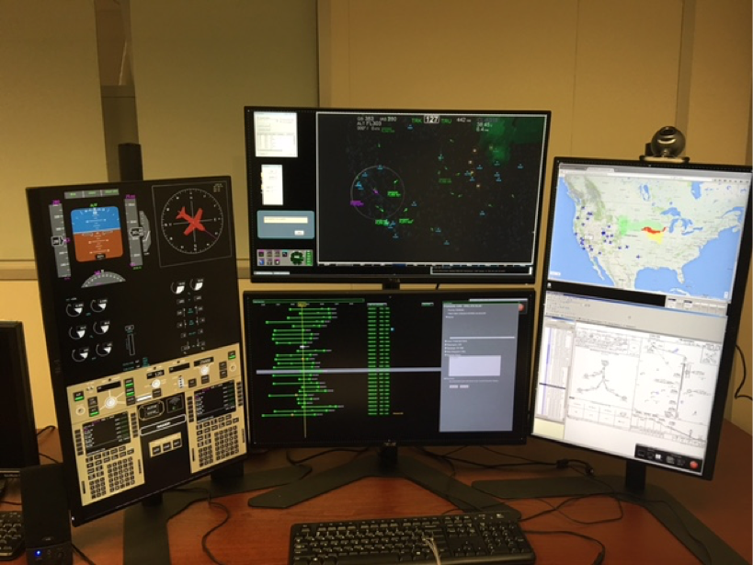
A Final Thought
Will there be a convergence between conventional aircraft and RPAS?
Notes:
Pilot incapacitation

Slide 47
References
Hobbs, A., & Lyall, B. (2016). Human factors guidelines for remotely piloted aircraft system (RPAS) remote pilot stations (RPS). Contractor report prepared for NASA UAS in the NAS Project. http://human-factors.arc.nasa.gov/
Hobbs, A., & Lyall, B. (2016). Human factors guidelines for unmanned aircraft systems.
Ergonomics in Design, 24, 23-28.
Hobbs, A. (In press). Remotely piloted aircraft systems. In S. Landry (Ed.). Handbook of
Aviation Human Factors. London: Taylor & Francis.
Hobbs, A. (2010). Unmanned aircraft systems. In E. Salas & D. Maurino (Eds.). Human factors in aviation, 2nd edition (505-531). San Diego: Elsevier.

