Slide 1
Space Environment Simulation
Part 4

Slide 2


Part 4 Roadmap
Test Purposes and
Industry Practices
Test Types
Test Levels
Test Margins
Unit
Testing
Thermal Cycling
Thermal Vacuum
Unit Test Requirements
Development Testing
Subsystem Testing
Spacecraft Level Testing Objectives
Test Temperatures
Spacecraft Thermal Balance
Math Model Correlation
Space Environment Simulation
Test Planning
Lessons Learned
Testing Checklist

Slide 3
Introduction
This lesson will focus on thermal test facilities and how the space environment is simulated.

Slide 4
Overview
Thermal vacuum chambers and associated ground support equipment (GSE) used to simulate the space environment will be described.
Tips will be offered on key things to look for to ensure readiness to proceed with a thermal vacuum test.

Slide 5
Space Environment Simulation
Testing performed in specialized vacuum chambers.
  Liquid nitrogen cooled shroud provides good approximation of deep space environment.
      Shroud at 77 K introduces less than 1% error compared to space at 4 K.
  Smaller cryopanels sometimes used for local cooling.
Test article powered on to bring units to expected operational temperatures and gradients.
Notes:
Thermal testing performed in specialized thermal vacuum chambers.
Nitrogen-cooled cold shroud typically nested just inside pressure vessel wall to provide cold radiative boundary for test article.
Liquid nitrogen cooled shroud provides good approximation for deep space environment.
Chamber wall at 77 K introduces less than 1% error compared to space at 4 K for room temperature spacecraft.
Smaller cryopanels sometimes used for local radiative cooling.
Test article powered on to bring units to expected operational temperatures and show possible thermal gradients.
Dedicated test phases are planned to:
Drive spacecraft regions to temperature levels (thermal vacuum test).
Simulate on-orbit energy balances (thermal balance test).

Slide 6
Space Environment Simulation (cont.)
Several approaches available to simulate orbital solar and planetary heat fluxes.
  Infrared (IR) flux from chamber cold shroud run at gaseous nitrogen temperatures.
  IR flux from heated panels or radiant heat lamps.
  Solar spectrum flux from xenon lamps.
  Electrical resistance heaters attached to vehicle surfaces.
    Heaters placed on all sides of vehicle can be used to drive all locations of vehicle or simulate different hot cases (sun angles).

Slide 7
Thermal Vacuum Chambers
TV chambers and associated equipment are used to simulate the space environment.
Every chamber is different, so one must be aware of the capabilities and limitations of the test facility.
    Will the test article and test support equipment fit in the chamber?
    Can chamber provide desired wall temperature?
    Can vibration and contamination requirements be met?
    Are there sufficient feed-throughs for electrical and fluid connections?

Slide 8
Thermal Vacuum Chambers (cont.)
Chambers may achieve vacuum with cryo-pumps or diffusion pumps.
Most chambers have shrouds on the interior of the vacuum vessel that provide boundary temperatures for test.
  Flooded with Liquid Nitrogen (LN₂, approximately 80-90 K)
  Controlled with Gaseous Nitrogen (GN₂, approximately 170-375 K)
  Liquid Helium (20-30 K)

Slide 9
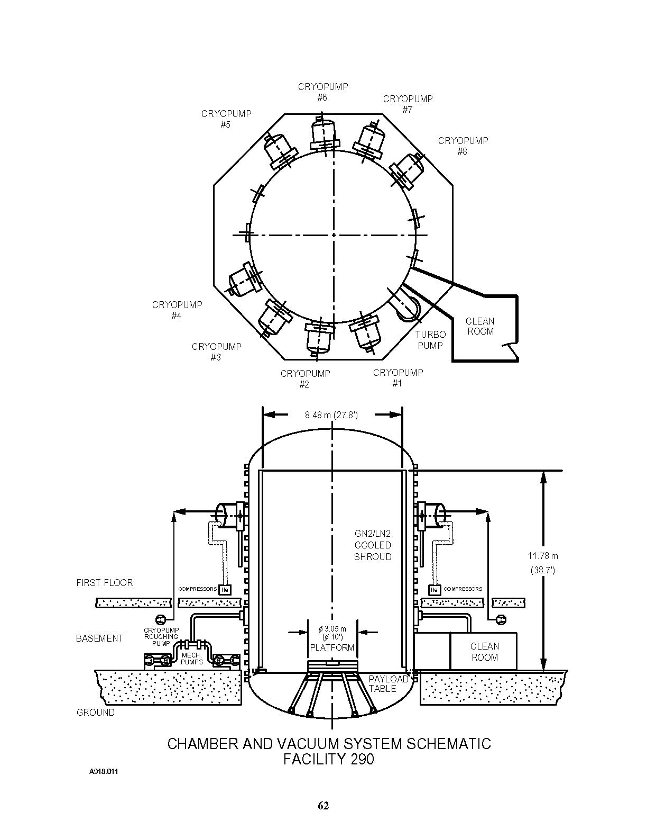
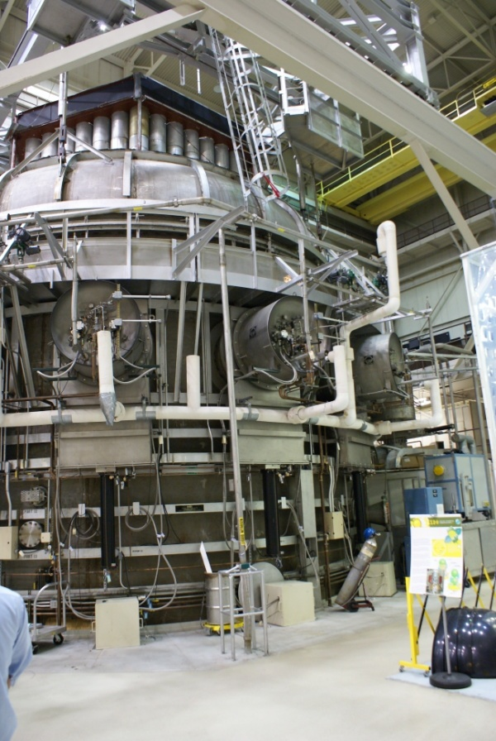
Example - Thermal Vacuum Chamber
SES Chamber at NASA/GSFC
Cryopumps (8)
Turbo
Pump
Clean
Room
8.48 m
GN₂ or LN₂ Cooled Shroud
Compressor
11.8 m
First floor
Basement
Mechanical
Pumps
Clean room
Table

Slide 10
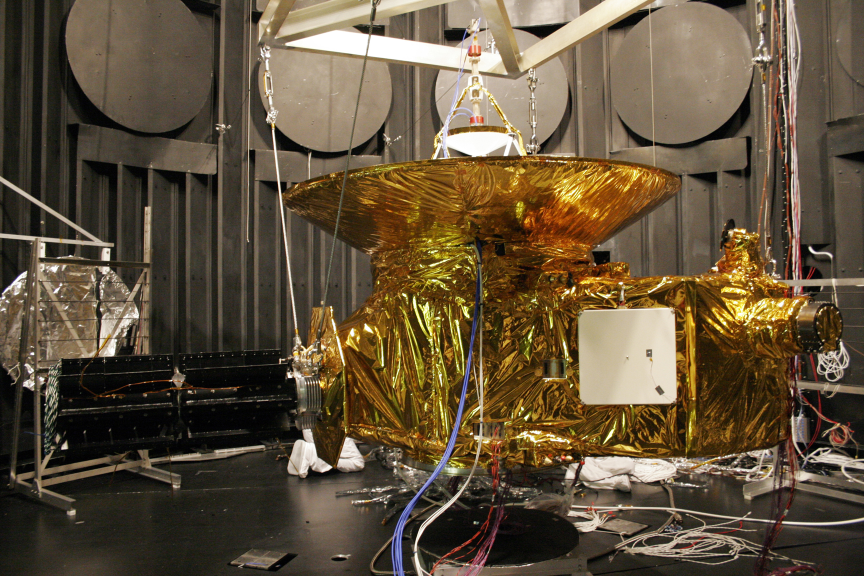
Interior of Test Chamber

Slide 11
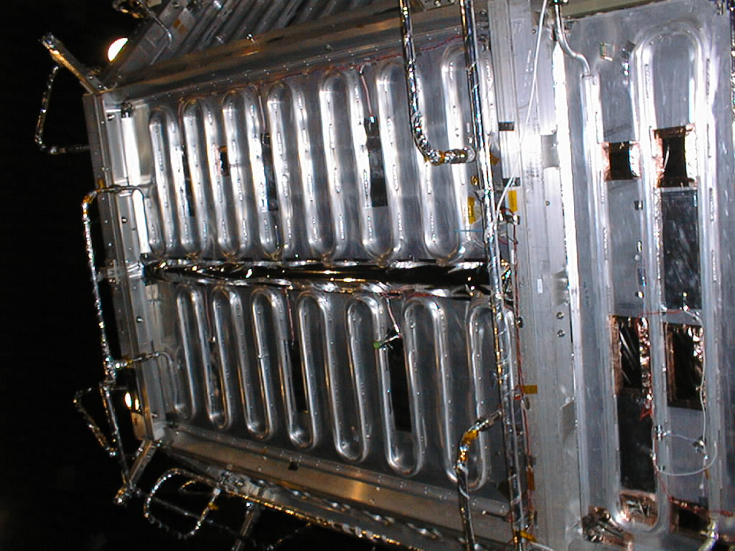
Cryopanels
Back of cryopanel showing plumbing
Cryopanels are plates that provide
local radiative sinks for radiators,
apertures, etc.
Typically high emittance (ε) on side
facing hardware.
Temperature Regimes:
  GN₂ approximately 130-375 K
  LN₂ approximately 80-90 K
  Helium approximately 20-30 K
  Pumped fluid loop/chiller approximately 200-450K

Slide 12
Cryopanels (cont.)
For Thermal Vacuum tests, the temperatures of the cryopanels may be colder than the flight environment to aid in reaching qualification temperatures.
For Thermal Balance tests, the temperature of the cryopanel is set to approximate the net energy flow from/to the critical area.

Slide 13
Cryopanels (cont.)
Gaseous nitrogen cryopanels require a Thermal Conditioning Unit (TCU) to control temperatures.
  A back-up TCU is required.
  Ice plugs can form and block the coolant line.
  Temperature sensors are required on inlets, outlets and multiple panel locations.
  Multiple cryopanels may be “chained” on the same TCU, but temperature control may be difficult.

Slide 14
Cryopanels (cont.)
Cryopanels are long lead-time items.
If liquid nitrogen control is needed for one part of the test and gaseous nitrogen for another, design to accommodate a “switchable” supply.
Many helium Cryopanels have a black-painted open-face honeycomb surface to enhance emissivity at low temperatures.

Slide 15
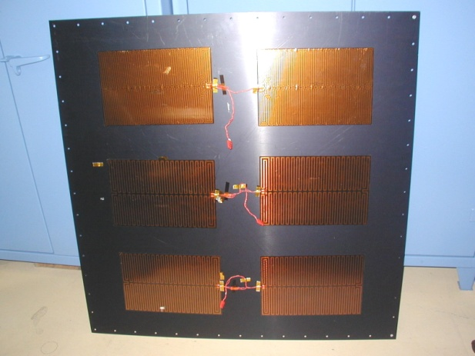
Heated Plates
Heated plates provide a radiative sink for components.
They are different from cryopanels since they contain no working fluid.
Plate is cooled by radiation to chamber shroud and the heater used to raise plate to desired temperature.

Slide 16
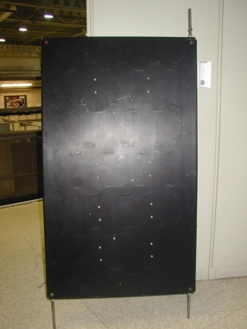
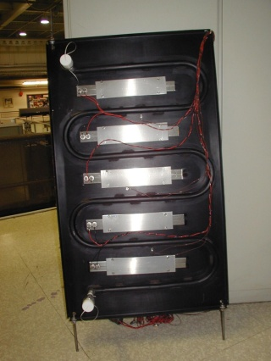
The “Tweens”
What do you do when you need temperatures between liquid and gaseous nitrogen?
Utilize heaters on LN₂ Cryopanels.
  Requires a flux-controlled heater and a device to regulate the liquid nitrogen flow.
  It can be difficult to control to exact temperatures with this method.
Cryopanel with Heaters

Slide 17
The “Tweens” (cont.)
A heater plate mounted on a cold plate can improve stability.
The heater power available and the coupling between the heater plate/cold plate must be sufficient to achieve temperature goals.
Heater Plate (high ε)
LN₂ Cold Plate
Isolation Mounting

Slide 18
The Bounce Back Effect
No surface is a perfect absorber like deep space.
The net energy transferred to a cryopanel or chamber shroud is a function of the separation distance, temperatures, and surface properties.
The net effect is that the cryopanel’s temperature has to be colder than the flight sink temperature to accurately simulate the flight condition.
α₂e₁
α₂ρ₁ρ₂e₁
α₂ρ²₁ρ²₂e₁
α₂ρ₁e₂
α₂ρ₂ρ²₁e₂
α₂ρ²₂ρ³₁e₂
Surface 2
e₁
ρ₂e₁
ρ₁ρ²₂e₁
ρ₂ρ²₁e₂
e₂
ρ₁e₂
ρ²₁ρ²₂e₂
ρ₁ρ₂e₁
ρ²₁ρ²₂e₁
ρ₁ρ₂e₂
α₁ρ²₁ρ³₂e₁
Surface 1
α₁ρ₂e₁
α₁ρ₁ρ²₂e₁
α₁ρ₁ρ₂e₂
α₁ρ²₁ρ²₂e₂
e = emitted flux α = absorptivity ρ = reflectivity
Notes:
No surface is a perfect absorber like space is for a spacecraft on orbit.
The amount of energy transferred to a cryopanel, heater plate, or the chamber is a function of the separation distance, temperatures, and surface properties.
The net effect is that the cryopanel’s temperature has to be colder than the flight sink temperature to accurately simulate the flight condition

Slide 19
Energy Transferred to a Cryopanel
q = σF₁₋₂ (T₁^{4 –} T₂⁴)
F₁₋₂ = (1/ε₂ +1/ε₁ − 1)⁻¹
Where:
q - energy flow from radiator surface to cryopanel
F ₁₋₂ – gray body form factor
ε - emissivity
σ - Stefan Boltzmann Constant
T - temperature (in absolute temperature)

Slide 20
Energy Transferred Per Unit Area From a Flat Radiator Plate to a Cryopanel (both ε=0.85)
Radiator Temp (K)

Slide 21
Fraction of Energy Transferred by a Radiator Plate to a Cryopanel (both ε=0.85)
Radiator Temp (K)
21

Slide 22



Lamps and Heated Rods
Lamps - Used to simulate solar flux or to warm surfaces. The spectral intensity and wavelength distribution of lamps should match solar inputs on the spacecraft.
Heated Rods - Thin cylindrical rods with heating elements within them that are used to simulate flux input using IR heating. Often referred to as Cal-rods, which is registered trademark of Wattco, Inc. May have a reflector to focus energy.

Slide 23
Solar Simulation
Solar beam approximates real sun, but is not perfect.
  Measure/map beam intensity and uniformity.
  Measure beam spectral content and adjust absorptance in analysis as appropriate.
  Measure divergence angle.
Beware of chamber reflections.

Slide 24
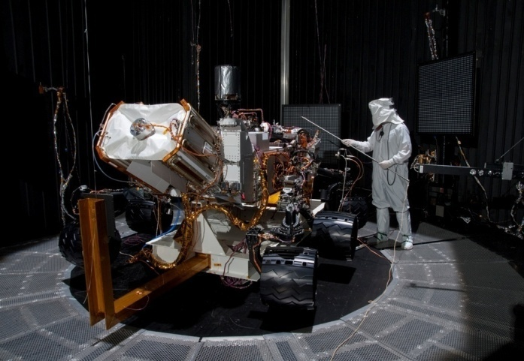
Technician Mapping Simulated Solar Flux

Slide 25
Comparison of radiative simulation methods
Method
Description
Advantages
Disadvantages
Solar Simulation
Solar wavelength lamps simulating solar heating
Minimal test equipment
Accurate simulation of sun
Not sized for large vehicles
Lamps provide parallel
fluxes only
Few facilities available
Expensive
IR Heater Lamps
Non-solar wavelength lamps positioned near spacecraft
Many separately
controlled lamps
Good flexibility
Non-solar input
Lamp zone interferences
Calorimeters needed to verify flux
IR Heater Plates
Plates of known temperature positioned near spacecraft
Environment known
accurately
Good control
Non-solar input
Blocks view to cold wall
Custom fabricated
Contact Heaters
Test heaters placed directly on spacecraft surfaces
Minimal test equipment
Good for appendages, booms and external hardware
Test blankets are required
Surfaces need cleaning

Slide 26
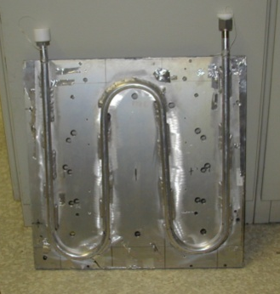
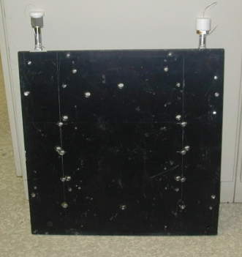
Cold Plates
Cold Plates are similar to Cryopanels except that they provide conductive (not radiative) sinks for components.
These can be cooled by liquid or gaseous nitrogen, or a pumped chiller loop.
A cold plate is thicker than a cryopanel, has bolting patterns on it, and may have a low emissivity finish.

Slide 27
Test Heater Considerations
Heater element
Control sensor or thermostat
Monitor sensor(s)
Power supply & controller
Stability requirements
Redundancy requirements

Slide 28
Why Do We Need Test Heaters?
Flux controlled:
  To simulate environmental fluxes.
  To facilitate parametric studies.
  To replace power of components not present in the test.
  To protect hardware and aid with transitions.

Slide 29
Why Do We Need Test Heaters? (cont.)
Temperature controlled:
  To protect flight and test hardware.
  To keep hardware at qualification temperatures.
  To control temperature of GSE (heater plates).
  To speed-up transitions from cold to hot plateaus.

Slide 30
Why Do We Need Test Heaters? (cont.)
Guard or “Zero Q”:
  To minimize non-flight conductive heat transfer from the spacecraft through test cables, mounting interfaces, etc.

Slide 31
The Zero Q Method
HEAT FLOW
For cabling:
  A heater is attached to the cable two feet from the spacecraft.
  One temperature sensor is placed on the spacecraft at the connector and a second on the cable at the connector.
  A controller adjusts the heater to minimize the temperature difference between the sensors.
  There will be no heat flow if zero temperature difference is achieved.

Slide 32
The Zero Q Method
HEAT FLOW
For mounting interfaces:
  Conductive isolators are used between the article under test and the mount.
  A heater is placed on the mount.
  Two temperature sensors spanning the interface are used to control the heater.

Slide 33
Control Sensors
Must be compatible with controller system.
Must operate in desired temperature regime.
Must produce response needed (i.e. temperature sensitivity).

Slide 34
Control Sensors (cont.)
Diodes
Thermocouples
Thermistors
Platinum Resistance Thermometer
Germanium Resistance Thermometer (0.05-10K)
Ruthenium Oxide Thermometer (0.05-30 K)
Resistance Temperature Detectors (RTD)

Slide 35
Test Blankets Frequently Required
Protect test facility hardware.
Block test article view to support structure.
Wrap test cables and fiber optics to minimize heat leaks from test article.
Minimize gradients or heater power in test.
Reflect energy to other locations.
Achieve close-out between different thermal zones.

Slide 36
MLI Close-Outs
Ensure that radiator only sees cryopanel environment.
Method of attaching to hardware must be considered.
Inner layer low or high emissivity depending on application.
Must be grounded and vented.
MLI Closeout
Cryopanel
Hardware
Radiator

Slide 37
Coolers
Thermoelectric Coolers (TECs) offer active cooling and precise controllability.
  Used primarily for “spot cooling” of a single component.
Mechanical Coolers are used to cool cold plates and to “recycle” cryogen in a closed loop cryopanel system.
  Particularly beneficial for programs using expensive helium coolant.

Slide 38
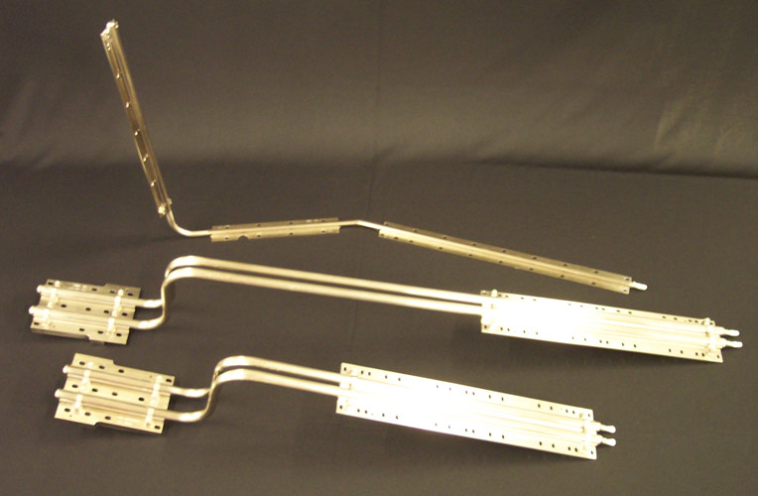
Test Articles with Heat Pipes
Heat pipes must be level to work
in gravity environment.
  Design spacecraft with testing
  in mind such that all pipes can
  be level during test.
Working fluid effects leveling requirements.
  Typically <0.1 inch along entire pipe for ammonia systems.
Leveling devices may be needed to adjust tilt.
Reflux mode of operation may be sufficient where leveling is not practical.
Notes:
Heat pipes must be level to work
in gravity environment.
Design spacecraft with testing
in mind such that all pipes can
be level when spacecraft is in test orientation.
Working fluid effects leveling requirements.
Typically 0.1” for ammonia systems.
Leveling devices may be needed to adjust tilt.
Reflux mode of operation may be sufficient where leveling is not practical.

Slide 39
Test Thermal Control Strategy
For Thermal Balance, the heat flows and heat transfer mechanisms should be the same for test and flight.
  Test heaters may be used to simulate fluxes that can not be imposed using cryopanels or the chamber.

Slide 40
Test Thermal Control Strategy (cont.)
For Thermal Vacuum, units just need to reach specified temperatures under vacuum.
  Any combination of cryopanels, heater plates, test heaters, etc. that produce the desired temperatures can be used.
  Use of test heaters to protect the hardware and elevate payload temperatures make for a safer, easier and faster test.

Slide 41
Test Thermal Control Strategy (cont.)
Redundancy and contingency planning must be implemented to determine the course of action if test facility or flight equipment fails.
  This information is critical in determining the redundancy required in the test set-up.

Slide 42
Contamination Monitoring and Control
Some test articles are contamination sensitive.
A number of techniques are available to measure and control contaminants.
Chamber shrouds often kept colder than test article at all times such that contaminants stick to cold wall rather than test article.
  May be augmented with Cold Finger or Scavenger Plate.

Slide 43
Contamination Monitoring and Control (cont.)
Quartz Crystal Microbalance cooled by TEC or cryogenic fluid can be used to measure contaminant outgas rate in real time.
Residual Gas Analyzer (RGA), Fourier Transform Infrared Spectrometer (FTIR), or Gas Chromatography/Mass Spectrometry (GC/MS) may be used to identify specific contaminants.
Aluminum coated witness mirrors can be placed in chamber for post-test UV reflectivity measurements.

Slide 44
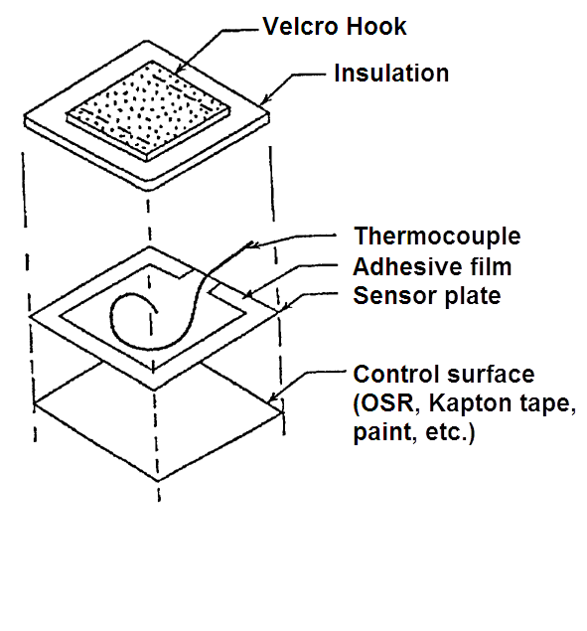
Heat Flux Calorimeter
Calorimeters sometimes needed to measure radiant flux.
A surface with known optical properties faces the flux source(s) and is radiatively and conductively isolated from everything else.
The equilibrium temperature of this surface provides a measure of the total incident flux.

Slide 45
Configuration Issues
Test hardware in chamber:
  Lamp arrays must be positioned and supported.
  Cables usually require blankets and guard heaters.
  Test stand effects must be minimized.
    Often insulated with a single layer of aluminized Mylar and/or heated.

Slide 46
Configuration Issues (cont.)
“Test like you fly” is ideal, but…
  Solar arrays, antennas and booms are often too large or can’t be adequately supported.
    Must compensate for effects of missing components during thermal balances.
  Most propellants are not loaded due to safety concerns.
  Flight batteries may not be used so that their narrow allowable temperature range does not limit testing of other components.

Slide 47
Configuration Issues (cont.)
Contamination Control :
  Ground support equipment design must allow for heating to bake-out temperatures and safe return to ambient.
  Especially important for cryogenic or optical systems.

Slide 48
Thermal Vacuum Test Walk-Around Checklist
Flight hardware should not interfere with test hardware.
  All radiators have unobstructed view to chamber wall or cryopanel.
  Thermal blankets completely closed out (no gaps).
Ensure that test equipment such as cables, test stands and chamber pressure vessel walls have not become part of the test.
  Verify that blankets, guard heaters, non-reflecting surface finishes (approved for vacuum environments), etc, have been used to mitigate effects.

Slide 49
Thermal Vacuum Test Walk-Around Checklist (cont.)
Ensure non-flight heat leaks have either been mitigated or accounted for in the thermal analysis.
Ensure that pre-test analyses are complete, including thermal balance predictions.
Verify that a well documented final test procedure is available.

Slide 50
Thermal Vacuum Test Walk-Around Checklist (cont.)
Test temperature goals, limits and acceptable tolerances are defined.
Thermal zones have been defined and methods of control and monitoring have been implemented, with significant margin applied when sizing test heaters.
Alarm and alert temperature limits clearly set.
A clear definition of thermal stability is provided.
Temperature sensor operation has been verified.

Slide 51
Thermal Vacuum Test Walk-Around Checklist (cont.)
Ensure that safety precautions have been taken.
  Procedures for power loss and data acquisition loss.
  Temperature limits are defined and alarmed.
  Procedure and equipment in place to ensure adequate oxygen levels achieved before human ingress if chamber had been purged with nitrogen.

Slide 52
Thermal Vacuum Test Walk-Around Checklist (cont.)
Verify that GSE heaters and sensors are functioning and hooked up correctly.
Verify that cold plates/cryopanels are plumbed correctly and have been leak checked.
Verify that cold plates, quartz crystal microbalances, residual gas analyzers are positioned properly and are functioning.
Take photos during build-up and prior to chamber closure for reference during the test.

Slide 53
Concluding Remarks for Part 4
Large vacuum chambers with internal cold wall used to simulate space flight conditions.
Radiative and conductive cold plates, radiant lamps, heaters and insulation used to simulate boundary conditions, eliminate non-flight-like heat leaks, and minimize impact of test GSE on spacecraft.
Thorough testing at unit and subsystem level minimizes risk that failures will crop up during spacecraft level testing on the critical path.

Slide 54
Conclusion of Part 4

