Slide 1
Test Planning, Lessons Learned and
Testing Checklist
Part 5

Slide 2


Part 5 Roadmap
Test Purposes and
Industry Practices
Test Types
Test Levels
Test Margins
Unit
Testing
Thermal Cycling
Thermal Vacuum
Unit Test Requirements
Development Testing
Subsystem Testing
Spacecraft Level Testing Objectives
Test Temperatures
Spacecraft Thermal Balance
Math Model Correlation
Space Environment Simulation
Test Planning
Lessons Learned
Testing Checklist

Slide 3
Introduction
This lesson will introduce the critical items which must be addressed in the test planning process and offer a lesson learned from a past test campaign.

Slide 4
Overview
Initial test planning considerations will be identified.
The contents of a good test plan and procedure will be discussed.
Lessons learned from thermal balance testing of a science instrument and the Mars Exploration Rover will be described.
A check list of things to look for prior to the start of testing will be offered.

Slide 5
Initial Planning Considerations
Specific subsystem requirements.
Test profile with proposed schedule (including chamber breaks).
Chamber(s) that can be used.
Configuration for thermal balance and thermal vacuum tests.

Slide 6
Initial Planning Considerations (cont.)
Cryopanels, heater plates, cold plates, etc. needed.
Battery – flight or spare?
Solar arrays – are they going to be present?
Special chamber feed-through requirements.
Purge requirements.

Slide 7
Initial Planning Considerations (cont.)
Cleanliness level requirements.
Type, number and location of contamination monitors.
Special data acquisition requirements.
Hazardous materials or special safety concerns (like volatile cryogens).
An action item list needs to be generated to track progress.

Slide 8
Initial Planning Considerations (cont.)
Test instrumentation needs to be determined early.
Test hardware installation activities must be incorporated in the integration schedule.
How the harness is routed and whether or not the test hardware will be removed after testing needs to be addressed.

Slide 9
The Test Plan/Procedure
The test plan and test procedure are the most important documents for the thermal engineer.
  Sometimes combined into a single document.
  Test Plan provides an overview and roadmap of the test.
  Test Procedure supplies detailed step by step instructions.
Accurate and complete documentation is a necessity!
Test Plan and Procedure should provide all the information necessary to safely and effectively conduct a thermal test.

Slide 10
The Test Plan/Procedure Contents
Test objectives.
Description of test item, configuration & set-up.
Test facility description.
Ground support equipment listing (including cables).
Listing of instrumentation (flight/test thermal sensors, flight/test heaters, QCMs, etc. ).

Slide 11
The Test Plan/Procedure Contents (cont.)
Description of pretest activities (facility and test equipment bake-out, GSE hardware checkout, ambient functional checkout).
Description of thermal test (pump down, bake-out, cool down, thermal balance).
Success criteria (cycling, limits, stability).
Diagram of test profile.
Test schedule.

Slide 12
The Test Plan/Procedure Contents (cont.)
Responsibilities.
Safety (hazardous materials, crane operations, emergency procedures, weather conditions).
Test personnel and reporting chain (personnel, contact info, responsibilities).
Definition of meetings (test readiness review, test coordination meetings, post test critique).

Slide 13
The Test Plan/Procedure Contents (cont.)
Verification (data reduction, failure reporting, etc.).
Documentation (procedure, quality assurance, test logs, test report).
Test tolerances (pressure, temperature, humidity, stability).

Slide 14
The Test Plan/Procedure Contents(cont.)
Figures showing:
  Test configuration.
  Flight hardware.
  Location of all heaters and temperature sensors.

Slide 15
The Test Plan/Procedure Contents(cont.)
Tables capturing:
    Red/yellow temperature limits for both operational and non-operational conditions.
    Heater settings.
    Shroud/cryopanel/coldplate settings.
    Predicted temperatures for all units in test.
    Temperature sensor/heater/thermostat information.

Slide 16
The Test Report
A great deal of important data is gathered during thermal testing.
A formal report is required to capture and interpret the results for future reference.

Slide 17
Example – Test Report Outline
Executive Summary
Introduction
  Scope of Report
  Test Scope and Objectives
  Thermal Design and Test Requirements
Test Overview and Summary
  Test Timeline
  Flight Hardware System Power States
  Summary
Test Configuration
  Flight Hardware System Configuration
  Support Hardware
  Facility

Slide 18
Example – Test Report Outline (cont.)
Instrumentation
  Test Instrumentation
  Temperature Transducers
  Heaters
  Flight
  Temperature Transducers
  Heaters
  Thermostats
  Power Supplies
  Calorimeters
  Quartz Lamps
  TQCMs
  Solar/IR Mapping

Slide 19
Example – Test Report Outline (cont.)
Test Matrix and Significant Events
  Phase 1 (Configuration #1)
  Phase 2 (Configuration #2)
  In-Air (Pre-Launch Configuration)
Results (Engineering Subsystems)
Results (Payload Instruments)
Flight Transducer and Thermocouple Correlation
Spacecraft Thermal Model Correlation
Design Modifications
  Design Deficiency Description
  Post-Test Design Changes
  Design Verification Matrix
  Problem Failure Reports (PFRs)
  Inputs to the Flight Hardware Operations Team

Slide 20
Example – Test Report Outline (cont.)
Lessons Learned
Conclusions and Recommendations
References
Appendices
Test Log Excerpts
Thermocouple, Heater, Flight Transducer and Blanket Tables
Thermocouple/Flight Transducer/Heater Location Figures
Temperature Plots
Flight Transducer Correlation
Thermal Design Validation
Facility Anomalies

Slide 21
Testing Lessons Learned

Slide 22
Lesson Learned:
Retest after significant thermal design modification
Background
  A science instrument was developed for an externally mounted location on a host spacecraft.
  Instrument thermal balance test revealed that it was running much colder than predicted.
  Closed off a primary radiator with MLI blankets.
  Did not retest to verify the design change.

Slide 23
Flight Temperature Problem Ensued
Problem
  On orbit, instrument temperature was 25 - 30°C hotter than predicted, within a few degrees of qualification temperature.
Analysis revealed
  Erroneous secondary reflected environmental heat loads.
  Improperly correlated model: conduction paths and view factors.
  Analysis also suggested that thermal blankets were compressed.

Slide 24
Problem Resolution and Lessons Learned
Solution
  Shaded instrument with spacecraft solar arrays.
  Turned instrument off in hottest orbits.
Lessons learned
  Thermal model correlation activities should be checked for:
    Unrealistic model changes.
    Model errors without explanations.
  Changes to heat rejection surfaces and path design must be retested for verification.

Slide 25
Lesson Learned:
Test may not capture worst case condition⁹
The Mars Exploration Rover (MER) is a JPL mission to land two roving science vehicles on Mars.
Two Rovers Launched in 2003 on separate Delta II class vehicles.
Each Flight System consisted of:
  A cruise stage and entry, descent and landing system.
  A rover.
  Five science instruments.
Both Rovers safely landed on the Martian surface and operated successfully.
  Thermal design performance has met all functional requirements.

Slide 26
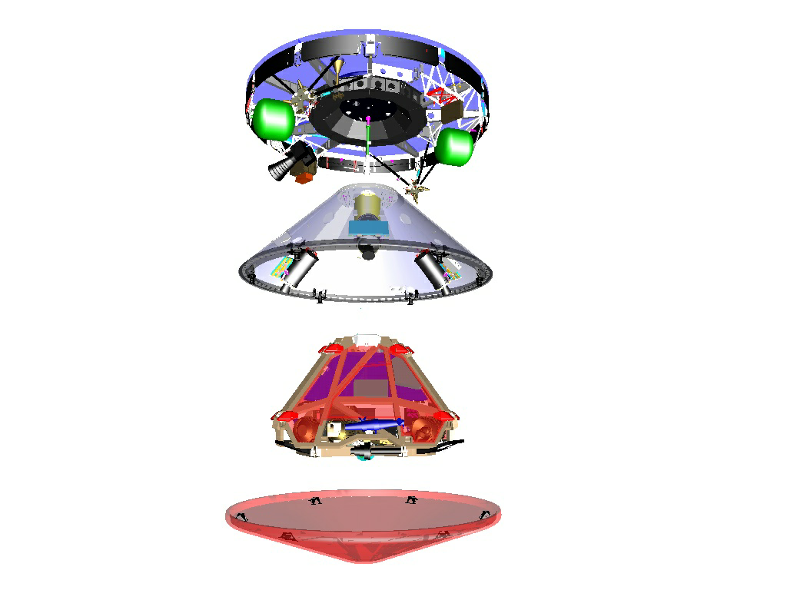
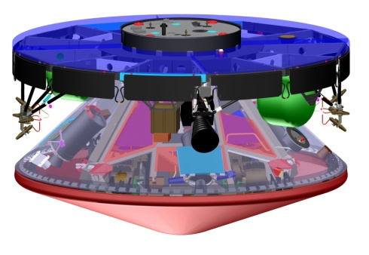
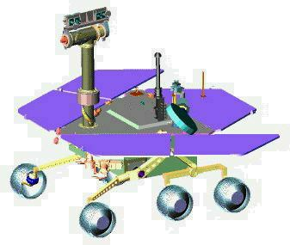
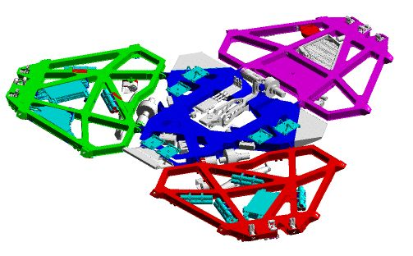
MER Spacecraft Configuration
Cruise Stage
Backshell
Rover
1.7 m
2.65 m
Heat Shield
Lander

Slide 27
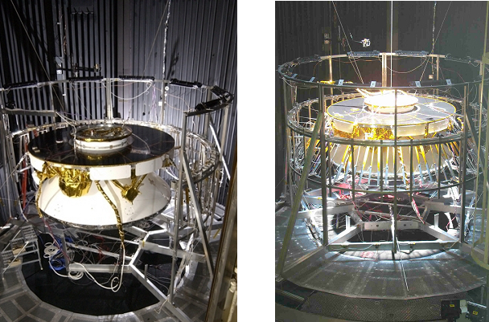
MER Solar Thermal Vacuum Test
Sufficient test data collected to allow thermal math model correlation.

Slide 28
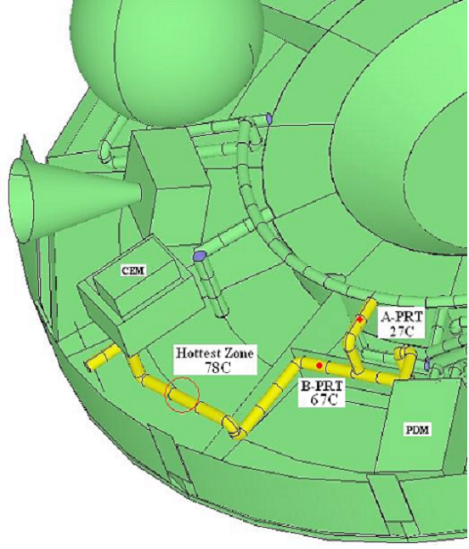
Flight Trajectory Correction Maneuver Surprise
Propellant line heater controlled by a computer based on temperatures measured by two Platinum Resistance Thermometers (PRTs).
Flight data indicated propellant line A-PRT at 27ºC while B-PRT rose to 62ºC during 3 hour thruster firing.
A-PRT is on an active flow leg & B-PRT is on a stagnant leg from fill valve.
During firing, propellant from tanks flows past A PRT, cooling it and keeping heaters “on”.
Stagnant line segment overheated because it wasn’t cooled by propellant flow.

Slide 29
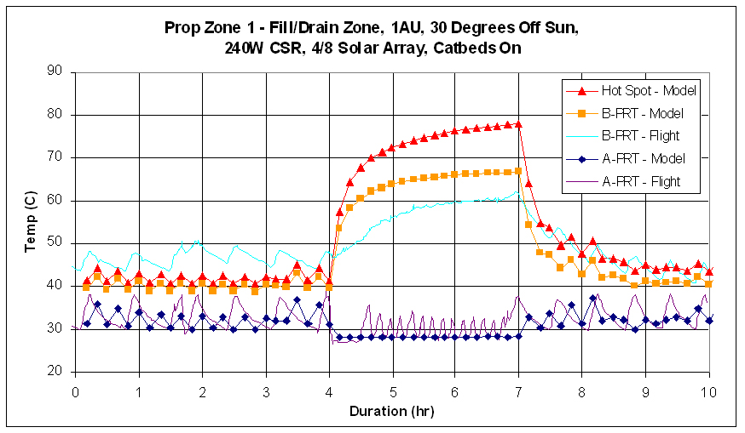
Trajectory Correction Maneuver Surprise (cont)

Slide 30
Corrective Action
  Uploaded a lower heater “off” set point which was below the temperature of the propellant tank.
  Propellant flowing through active portion of line would then ensure heater was off instead of keeping it on.

Slide 31
Lessons Learned
  Lack of propellant flow through lines during system thermal test can result in worst cases being missed.
    Impractical to use a referee fluid without risk to flight hardware.
  End-to-end functionality approach for design verification & validation can reduce residual risk.
    Walk through all operational & non-operational scenarios for propellant line thermal design.
    If practical, design test to capture worst case scenario.
    Conduct analysis to adjust for any test deficiencies.
  Design flexibility, such as software controlled heaters, can provide effective resolutions to in-flight surprises.

Slide 32
Testing Checklist

Slide 33
Test Article Handling/Installation
Good housekeeping for all flight hardware areas.
Handling and storage procedures should be in place for flight hardware.
Special procedure should be defined for electrostatic discharge sensitive equipment.
Proper contamination-control instructions shall be established.
Requirements for electric grounding of test articles and test sets should be defined.

Slide 34
Test Article Handling/Installation (cont.)
Test cables should have end-to-end continuity checks.
Test equipment should have readily retrievable maintenance and repair records.
Connector pins should be visually inspected prior to mating and after demating.
Component mounting requirements should be specified for interface filler and bolt torque.
Test recording and measuring equipment and instrumentation should be clearly described on an interface diagram.

Slide 35
Test Instrumentation/Data
Test-temperature limits and acceptable tolerances shall be clearly defined.
Allowable test-temperature transition rates shall be defined.
A clear definition of thermal stabilization (steady state) shall be established.
Location of all temperature sensors and heaters (if applicable) shall be shown in pictures or sketches.
Control-temperature sensors and primary backups shall be defined.
A continuity check and response to temperature stimulus (where accessible) shall be performed on all temperature sensors prior to test start.

Slide 36
Test Instrumentation/Data (con’t.)
Alarm setting shall be defined to give proper warning of temperature limits (plus tolerances) being exceeded.
Audible alarms must not be left in "Silence Alarm" mode when heat exchangers are operating correctly. There shall be a signal to alert test personnel to manually reset the alarms.
Use fuses with test heaters to prevent an overpower condition.
Heaters should be powered at a low level and response verified by control temperature sensor.
Manual data: Types of data required and recording intervals shall be defined. Data sheets shall be provided with samples in the test procedure.

Slide 37
Test Instrumentation/Data (con’t.)
Automated data: Adequate consoles with data monitors should be available, including a dedicated one for the customer. One set of all hardcopy results should be supplied to customer.
Instrument test cables should be wrapped with low-emittance surface material to minimize heat loss from the test article.
Test-temperature-sensor locations should compliment and sometimes duplicate flight-sensor locations. Test sensors should be located so as to be meaningful when comparing to nodal computer models.
Test sensors should be covered with thermal material similar to the surface to which they are attached. Lead wires should have low-emittance finish.

Slide 38
Test Instrumentation/Data (con’t.)
When instrumenting a propellant line, run the sensor lead wire along the line for approximately 12 inches before exiting low-ε overwrap.
Heaters used within the test article must be compatible with the slip-ring current capability for spinning tests. The number of thermal signatures that may be obtained are also limited by the slip-ring capability.
When running a thermal-balance test where long heater lead-lengths are present, make certain that the voltage drop in the lines has been accounted for in setting the thermal dissipation. Also account for the heater-resistance change as function of temperature.

Slide 39
Test Operations
Use test-facility requirements checklist prior to test.
Pictorial timeline showing test phases and temperature transition should exist in procedures.
Corona phenomena must be considered with proper safeguards.
Automated test procedures should be validated prior to test start.

Slide 40
Test Operations (cont.)
Back-up power should be available.
Performance measurements to be taken before, during, and after test should be defined.
Personnel required during test should be clearly defined.

Slide 41
Component Thermal Vacuum Test
Environmental test conditions and tolerances should be defined and should comply with the equipment specification.
Pass/fail criteria should be specified.
Test hazards and cautions shall be identified in the procedure at appropriate locations.
A process for handling test discrepancies should be established.
There should be regular test reviews while test is in progress.

Slide 42
Component Thermal Vacuum Test (cont.)
Quality Assurance (QA) and Engineering should review data prior to breaking configuration.
A test log-book should be used.
A defined process should exist for test-shift overlaps.
Independent Quality Assurance monitoring of flight-hardware activities.
Test personnel should be reasonably knowledgeable in thermal aspects of test.

Slide 43
System Thermal Vacuum Test
Contamination monitoring and measuring instrumentation should be strategically placed.
Test instrumentation should have current calibration and alignment data.
Heat-flux calorimeters should be calibrated in-situ.
Photographs should be taken of test article before and after installation in chamber.
Power should be filtered and regulated.
Safety procedures must be in effect in case of power outage or failure of the real-time data-acquisition system.

Slide 44
System Thermal Vacuum Test (con’t)
Hydraulic lines and fluid-containing valves and components should be closely inspected before and after the test.
Test heaters should be fused.
Make periodic visual checks through port holes if possible.
Assure that man-hole covers are bolted down prior to chamber closure.
Critical test instrumentation and hardware should be redundant.
Non-flight structure (i .e., spin fixture , spot-lamp supports, test hardware, etc.) should be hidden from spacecraft view with liquid nitrogen shrouding or low emittance wraps.

Slide 45
System Thermal Vacuum Test (con’t)
Reflections, even off black surfaces, should be accounted for when making predictions.
For solar thermal vacuum tests, use small black-plate and silver-Teflon radiometers to measure reflected solar energy where none is expected to occur.
Test hardware in the chamber that is above the test article should be sufficiently out of the solar beam to insure no shadowing or reflections.
Minimize the presence of warm test fixtures or peripheral equipment surfaces.

Slide 46
System Thermal Vacuum Test (con’t)
Note the effective background temperature of the chamber.
Use a small black-plate radiometer to measure the local effective background temperature.
Make the stress group aware of the environmental condition to which heater plates will be exposed.
The test article should be isolated from the support fixture by a thermal isolator. A blocking heater should be placed on the fixture side of the interface to control the losses from the test article.

Slide 47
System Thermal Vacuum Test (con’t)
Make certain that all materials used as last minute fixes (i.e., aluminum tape, Teflon, aluminum foil, paint, etc.) are space approved and also approved for your individual program. Also, material used should be compatible with expected temperature extremes (dental cement, epoxy, mylar, Teflon etc.).
Do not use aluminum foil or aluminum tape on thermal isolation brackets used to conductively isolate components. The conduction of the foil or tape is too high and may short out the isolation bracket. Instead, use aluminized Kapton tape, with the aluminum side out, as the primary thermal control surface where it is not feasible to coat the part with vapor deposited aluminum.

Slide 48
System Thermal Vacuum Test (con’t)
Perform a clearance check, at ambient conditions, around the periphery of all moving interfaces.
Thermal surfaces on both the test article and test-chamber hardware should be cleaned prior to raising the end bell.
Also, prior to raising the end bell, have a walk-around inspection of the test article, fixture, and chamber to (1) insure, as an example, the louver covers, Earth-sensor covers, sun-sensor covers, etc., have been removed and (2) last-minute thermal provisions have been implemented (do not assume that the above items have been done just because you have an understanding with the responsible manufacturing and test-facility engineer).
When end bell has been raised, run a complete data scan to ensure that all instrumentation is working properly.

Slide 49
Thermal Vacuum Chambers
Whenever diffusion pumps (DPs) are utilized, system interlocks and/or manual-control safety procedures shall be implemented, to include:
Automatic anti-oil migration and back-streaming controls.
Automatic DP oil high-temperature thermostat.
Prevention of roughing and high vacuum valve being open simultaneously.
Prevention of high vacuum valve being opened until roughing pressure is below a predetermined level.
Prevention of high vacuum valve being opened unless DP foreline valve is open.
Prevention of DP heaters being energized when DP foreline pressure is above a predetermined level.
Prevention of high vacuum valve being opened when DP heaters are off.

Slide 50
Thermal Vacuum Chambers (cont.)
Whenever a predetermined chamber pressure limit is exceeded:
An interlock should close the high vacuum valve.
An interlock should turn off power to corona-sensitive test articles.
An interlock shall prevent cooling medium from being introduced until a predetermined chamber pressure is achieved.
Independent pumping systems and valved systems are recommended. Whenever pumps performing multiple serial functions and/or valveless (semi-valveless) systems are utilized, interlocks or manual control with appropriate safety notes should be implemented to prevent out-of-sequence operations.

Slide 51
Concluding Remarks
Thermal needs of the article under test must be thoroughly understood in order to identify chamber and GSE requirements.
The test plan provides an overview of the test while the test procedure provides detailed step by step instructions.
Re-test should be considered if substantial thermal design changes are made.
Test readiness should be thoroughly assessed prior to closing the chamber door.

Slide 52
Conclusion of Part 5

Slide 53
Acknowledgements
Special acknowledgement is given to John Welch of The Aerospace Corporation and Carol Mosier of NASA/Goddard Space Flight Center for contributing material that forms the core of this class.
This author is grateful to the NESC Passive Thermal Technical Discipline Team for their contributions and technical review of this lesson.

Slide 54
References/Credits
Mil Std 1540E, “Test Requirements for Launch, Upper-stage, and Space Vehicles,” September 6, 2006 (same as SMC-S-016 dated June 13, 2008).
Mil Hdbk 340A, “Test Requirements for Launch, Upper-stage, and Space Vehicles,” April 1999.
GSFC-STD-7000, “General Environmental Verification Standard (GEVS),” April 2005.
GSFC-STD-1000E, “Rules for the Design, Development, Verification, and Operation of Flight Systems,” July 13, 2009.
G. Siebes, et.al., “Thermal Margins for Flight Electronics Review and Assessment,” Proceedings of the Thermal and Fluids Analysis Workshop, August 2012.

Slide 55
References/Credits (Cont.)
6) R. Stark , “Thermal Testing of Spacecraft,” September 7, 1971, Aerospace Corp. Report TOR-0172(2441-01)-4.
7) D. Gluck, “Space Vehicle Thermal Testing: Environmental Related Design and Analysis, Requirements and Practice,” September 27, 1987, Aerospace Corp. Report TOR-0086A(2902-08)-1.
8) J. Welch, “Assessment of the Mil-Std-1540 Thermal Uncertainty Margin used in Spacecraft Thermal Control,” Aerospace Corp. Report TOR-2009(1465)-8897.
9) G. Tsuyuki, et.al., “Summary of Mars Exploration Rover System Level Thermal Tests & Lessons Learned During Mission Operations,” Spacecraft Thermal Control Technology Workshop, March 11, 2004, El Segundo, CA.

