Slide 1
Fundamentals of EMC
Time Domain vs.
Frequency Domain
John McCloskey
NASA/GSFC Chief EMC Engineer
Code 565
Building 23, room E203
301-286-5498
John.C.McCloskey@nasa.gov

Slide 2
Full Demo/Tutorial Video
Video of full demonstration/tutorial on NESC Academy website
  “Effects of Rise/Fall Times on Signal Spectra”
  Link on GSFC EMC Working Group XSPACES SITE:
    https://xspaces.gsfc.nasa.gov/display/EMCWG/Home

Slide 3
Purpose of Demo/Tutorial
Demonstrate the relationship between time domain and frequency domain representations of signals
In particular, demonstrate the relationship between rise/fall times of digital clock-type signals and their associated spectra
Fast rise/fall times can produce significant high frequency content out to 1000th harmonic and beyond
  Common cause of radiated emissions that can interfere with on-board receivers
  Can be reduced by limiting rise/fall times

Slide 4
Topics
Sinusoid: Time Domain vs. Frequency Domain
Fourier series expansions of:
  Square wave
  Rectangular pulse train
  Trapezoidal waveform
Comparison to measured results for these waveforms
Observations

Slide 5
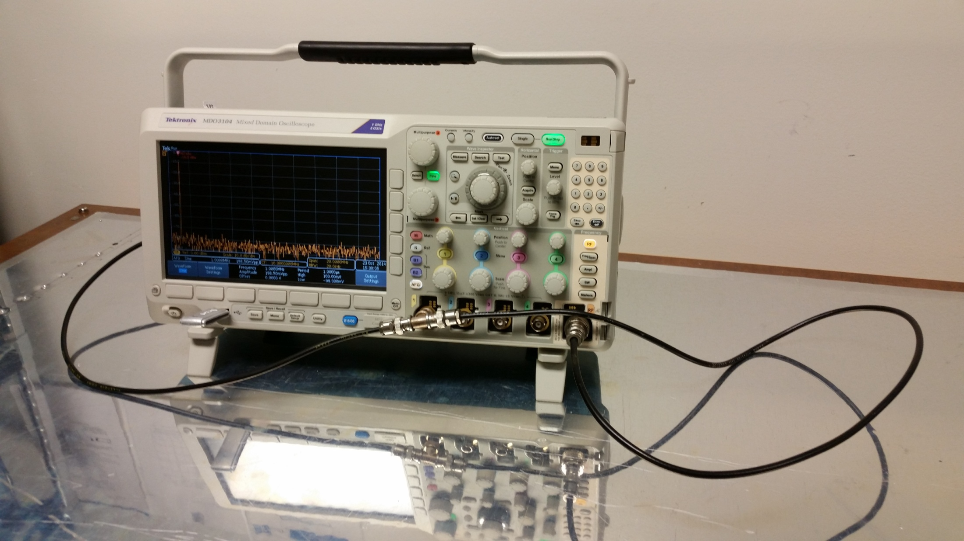
Demo 4: Time Domain vs. Frequency Domain

Slide 6
Demo 4: Time Domain vs. Frequency Domain (cont.)
Equipment
  Tektronix MDO3104 oscilloscope (built-in signal generator)
  2 RG-58 coax cables
  T connector
  BNC-N adaptor
Setup
  AFG: 1 MHz sine, square, pulse with 300 ns width (30% duty cycle)

Slide 7
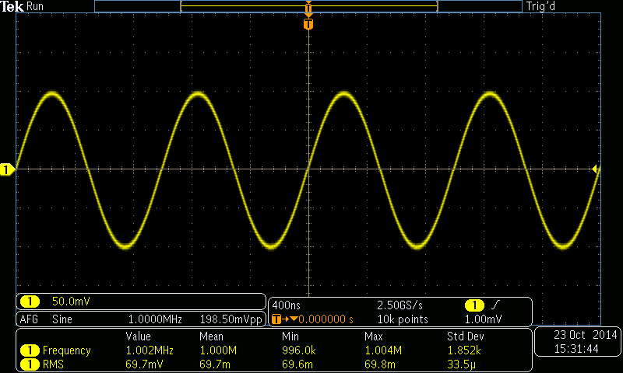
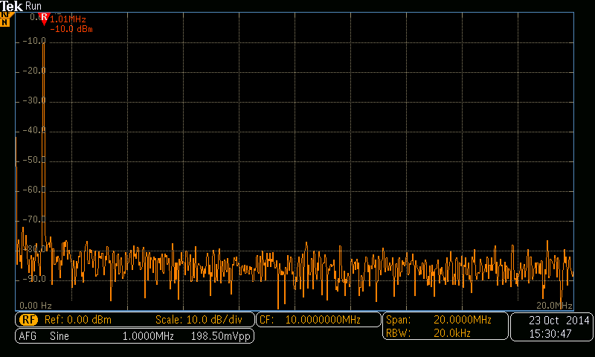
Demo 4: Time Domain vs. Frequency Domain (cont.)

Slide 8
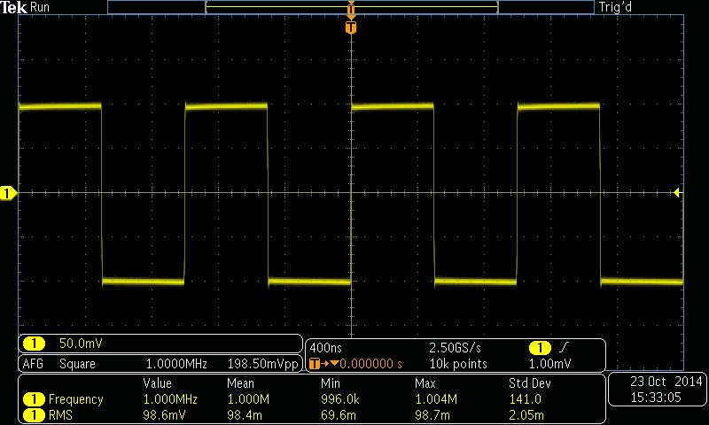
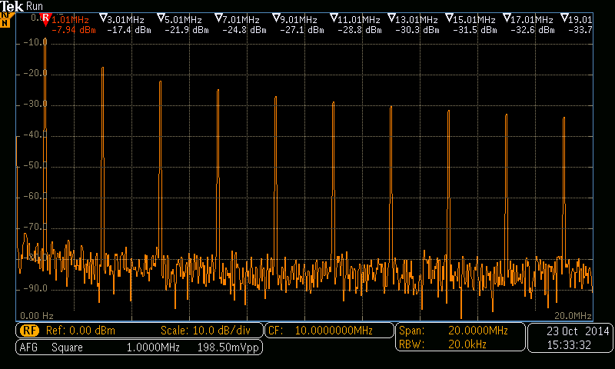
Demo 4: Time Domain vs. Frequency Domain (cont.)

Slide 9
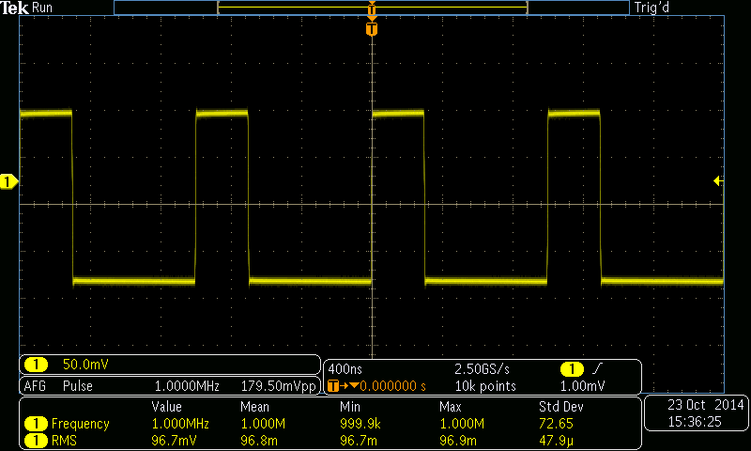
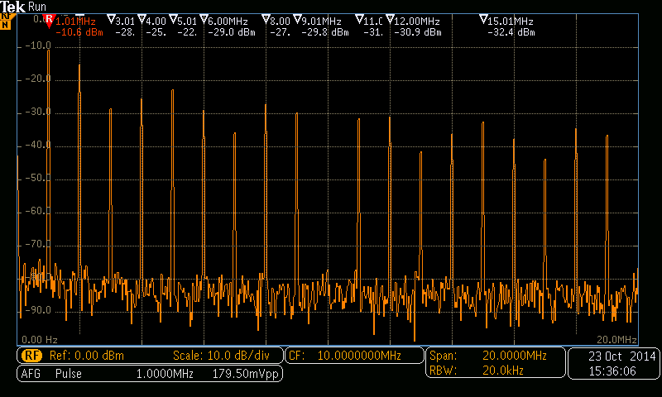
Demo 4: Time Domain vs. Frequency Domain (cont.)

Slide 10
Sinusoid: Time Domain vs. Frequency Domain
TIME DOMAIN
FREQUENCY DOMAIN
A
Amplitude
f
Frequency

Slide 11
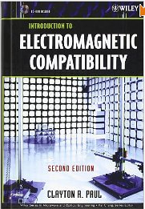
Fourier Series Expansion of Signal Waveforms
Recommended reading for an in-depth look at Fourier series expansions of signal waveforms:
  Clayton Paul, “Introduction to Electromagnetic Compatibility,” sections 3.1 and 3.2

Slide 12
Fourier Series Expansion of Square Wave
Odd harmonics only

Slide 13
Fourier Series Expansion of Rectangular Pulse Train
Even harmonics included
NOTE: For 50% duty cycle (τ/T = 0.5), this equation reduces to that for the square wave on the previous slide.
sin(x)/x
(next slide)

Slide 14
Response and Envelope of sin(x)/x
Response of |sin(x)/x|:
0 for x = nπ
1/x for x = (n+1)π/2
Envelope of |sin(x)/x|:
1 for x < 1
1/x for x > 1
Lines meet at x = 1

Slide 15
Envelope of Rectangular Pulse Train Spectrum
DC offset
Low frequency “plateau”
Harmonic response
0 dB/decade
-20 dB/decade
etc…
f₁
f₂
f₃
f₄
f₅
f
PULSE WIDTH

Slide 16
Fourier Series Expansion of Trapezoidal Waveform
A
τ
NOTE: τ_{r} and τ_{f} are generally measured between 10% and 90% of the minimum and maximum values of the waveform.
τ_{r}
τ_{f}
T
Assume τ_{r} = τ_{f} :
Additional sin(x)/x term due to rise/fall time

Slide 17
Envelope of Trapezoidal Waveform Spectrum
DC offset
Low frequency “plateau”
Harmonic response
(pulse width)
Harmonic response
(rise/fall time)
0 dB/decade
-20 dB/decade
-40 dB/decade
etc…
f₁
f₂
f₃
f₄
f₅
f
PULSE WIDTH
RISE/FALL TIME

Slide 18
Envelope of Trapezoidal Waveform Spectrum
Slower rise/fall times provide additional roll-off of higher order harmonics
0 dB/decade
-20 dB/decade
-40 dB/decade
f
PULSE WIDTH
RISE/FALL TIME

Slide 19
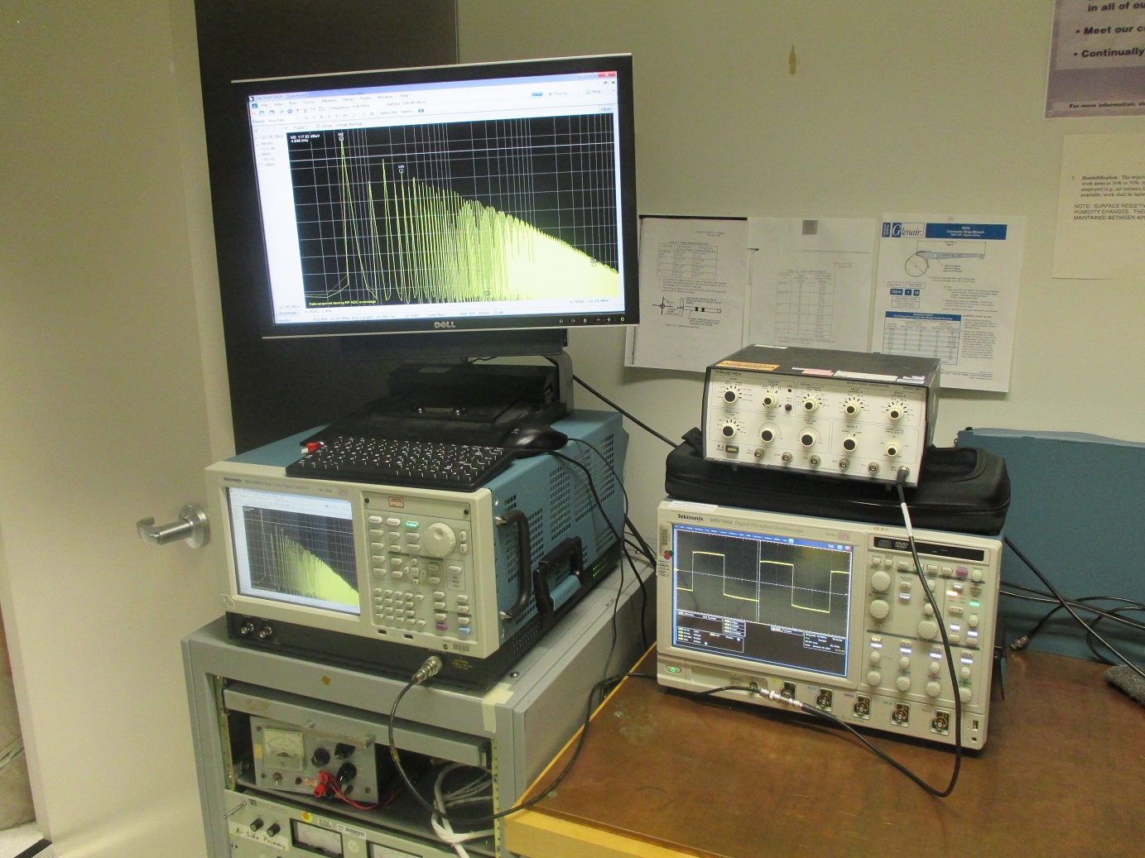
Time Domain vs. Frequency Domain Test Setup
WAVETEK 801 pulse generator
TEKTRONIX RSA5103A spectrum analyzer
(50 Ω input)
TEKTRONIX DPO7054 oscilloscope
(1 MΩ input)

Slide 20
Applied Waveform
A
τ
τ_{r}
τ_{f}
T
A = 1 V
T = 200 µs
(f₀ = 5 kHz)
τ, τ_{r} , & τ_{f} varied as indicated on following slides

Slide 21
τ = 100 µs (τ/T = 50%); τ_{r} = τ_{f} = 40 ns
2A(τ/T) = 1 V
= 120 dBµV

Slide 22
τ = 100 µs (τ/T = 50%); τ_{r} = τ_{f} = 360 ns
2A(τ/T) = 1 V
= 120 dBµV

Slide 23
τ = 100 µs (τ/T = 50%); τ_{r} = τ_{f} = 3.6 µs
2A(τ/T) = 1 V
= 120 dBµV

Slide 24
τ = 100 µs (τ/T = 50%); τ_{r} = τ_{f} = 10 µs
2A(τ/T) = 1 V
= 120 dBµV

Slide 25
τ = 80 µs (τ/T = 40%); τ_{r} = τ_{f} = 40 ns
2A(τ/T) = 0.8 V
= 118 dBµV

Slide 26
τ = 80 µs (τ/T = 40%); τ_{r} = τ_{f} = 360 ns
2A(τ/T) = 0.8 V
= 118 dBµV

Slide 27
τ = 80 µs (τ/T = 40%); τ_{r} = τ_{f} = 3.3 µs
2A(τ/T) = 0.8 V
= 118 dBµV

Slide 28
τ = 80 µs (τ/T = 40%); τ_{r} = τ_{f} = 10 µs
2A(τ/T) = 0.8 V
= 118 dBµV

Slide 29
τ = 10 µs (τ/T = 5%); τ_{r} = τ_{f} = 40 ns
2A(τ/T) = 0.1 V
= 100 dBµV

Slide 30
τ = 10 µs (τ/T = 5%); τ_{r} = τ_{f} = 350 ns
2A(τ/T) = 0.1 V
= 100 dBµV

Slide 31
τ = 10 µs (τ/T = 5%); τ_{r} = τ_{f} = 2 µs
2A(τ/T) = 0.1 V
= 100 dBµV

Slide 32
τ = 2 µs (τ/T = 1%); τ_{r} = τ_{f} = 20 ns
2A(τ/T) = 0.02 V
= 86 dBµV

Slide 33
τ = 2 µs (τ/T = 1%); τ_{r} = τ_{f} = 160 ns
2A(τ/T) = 0.02 V
= 86 dBµV

Slide 34
τ = 2 µs (τ/T = 1%); τ_{r} = τ_{f} = 400 ns
2A(τ/T) = 0.02 V
= 86 dBµV

Slide 35
τ = 100 ns (τ/T = 0.05%); τ_{r} = τ_{f} = 8 ns
2A(τ/T) = 0.001 V
= 60 dBµV

Slide 36
Observations (1 of 2)
Measured spectra show good agreement with expected values
  “3-line” envelope provides simple, accurate, and powerful analytical tool for correlating signal spectra to trapezoidal waveforms
Even harmonics
  Reduced, but not zero, amplitude for 50% duty cycle
  Varying amplitude for other than 50% duty cycle
  Must be considered as potentially significant contributors to spectrum
Low frequency plateau scales with duty cycle
  Spectrum for low duty cycle waveforms gives artificial indication of low amplitude
  First “knee” frequency may be quite high, producing relatively flat spectrum for many harmonics (100s or 1000s in these examples)
  Low duty cycle waveforms should be observed in time domain (oscilloscope) as well as frequency domain (spectrum analyzer)

Slide 37
Observations (2 of 2)
Signal spectra significantly more determined by rise/fall times than by fundamental frequency of waveform
Uncontrolled rise/fall times can produce significant frequency content out to 1000th harmonic and beyond
  Common cause of radiated emissions
  5 MHz clock can easily produce harmonics out to 5 GHz and beyond
  Potential interference to S-band receiver (~2 GHz), GPS (~1.5 GHz), etc.
Controlling rise/fall times can significantly limit high frequency content at source
LIMIT THOSE RISE/FALL TIMES!!!

