Slide 1
Fundamentals of EMC
Transmission Lines
John McCloskey
NASA/GSFC Chief EMC Engineer
Code 565
Building 23, room E203
301-286-5498
John.C.McCloskey@nasa.gov

Slide 2
Topics
Introduction
Transmission Line Parameters
  Velocity of propagation
  Relative permeability and relative permittivity
  Inductance, capacitance, characteristic impedance
  Propagation constant
  2-wire transmission line parameters
  Coaxial transmission line parameters
Demonstrations
  Impedance measurements
  Standing waves
  Unmatched vs. matched termination

Slide 3
Introduction
Finite speed of electromagnetic waves means that it takes a time for signal to travel down a cable
When the voltage and/or current on a line changes in a time interval comparable to the time it takes for the signal to travel down the wire:
  Length becomes significant
  Signal must be considered a wave propagating down line
  Voilà, you have a transmission line
Rule of thumb:
  Treat cable, wire, or PCB trace as transmission line if length > λ/10 for highest frequency of interest
  Must consider harmonics (rise/fall time), not just fundamental
  Applies to digital as well as analog signals
Fundamental
wavelength
λ
Frequency content
τ_{r}
τ_{f}
0 dB/decade
-20 dB/decade
τ
Amplitude
-40 dB/decade
T = 1/f
Z_{L}
f
PULSE WIDTH
RISE/FALL TIME

Slide 4
Permeability, Permittivity, Velocity of Propagation
Relative permeability and relative permittivity
Velocity of propagation
µ_{r} = relative permeability
= 1 for non-magnetic materials
ε_{r} = relative permittivity (dielectric constant)
~ 2 for Teflon
= approx. 0.6c - 0.7c typical
= approx. 2 x 10⁸ m/s
= approx. 20 cm/ns
f (MHz) | λ (m)
2 | 100
20 | 10
200 | 1
2000 | 0.1

Slide 5
Propagation Constant and Characteristic Impedance
V_{S}
( γ, Z₀ )
+ z
+ z = direction of propagation
Z₀ = characteristic impedance
γ = propagation constant = α + jβ
α = attenuation constant
β = phase constant (a.k.a. wavenumber)

Slide 6
Inductance and Capacitance
Inductance
Capacitance
+Q
I
V
I
-Q

Slide 7
Characteristic Impedance & Propagation Constant
R
L
V(z)
V(z + Δz)
I(z)
I(z + Δz)
R = series resistance per unit length (Ω/m)
L = series inductance per unit length (H/m)
G = shunt conductance per unit length (Ω⁻¹/m)
C = shunt capacitance per unit length (F/m)
G
C
Series voltage drop:
Kirchoff’s Current Law:

Slide 8
Characteristic Impedance & Propagation Constant (cont.)
WAVE EQUATIONS

Slide 9
Characteristic Impedance & Propagation Constant (cont.)
GENERAL SOLUTIONS
γ = propagation constant = α + jβ
α = attenuation constant
β = phase constant (a.k.a. wavenumber)

Slide 10
Characteristic Impedance & Propagation Constant (cont.)
V_{S}
+ z

Slide 11
Characteristic Impedance & Propagation Constant (cont.)
V_{S}
+ z

Slide 12
Characteristic Impedance & Propagation Constant (cont.)
Recall:
Characteristic impedance of lossy transmission line
Characteristic impedance of lossless transmission line (R → 0 and G → 0):

Slide 13
2-Wire Transmission Line Parameters
a
a
D
Inductance per unit length:
Capacitance per unit length:
D/2a dependence
μ_{r} = 1 for non-magnetic materials

Slide 14
2-Wire Transmission Line Parameters (cont.)
a
a
D
D/2a dependence
No dependence on length

Slide 15
Coaxial Transmission Line Parameters
a
b
Inductance per unit length (H/m):
Capacitance per unit length (F/m):
(typ.)

Slide 16
Coaxial Transmission Line Parameters (cont.)
a
b
Characteristic impedance (Ω):
(typ.)
Typical values:
50 Ω, 75 Ω

Slide 17
Input Impedance
I_{i}
l
Z_{S}
I_{L}
V_{S}
Z_{i}
V_{i}
( γ, Z₀ )
Z_{L}
V_{L}
z
z’ = l - z
Z₀ = characteristic impedance
Z_{S} = source impedance
Z_{L} = load (termination) impedance
γ = propagation constant = α + jβ
l = length of line
z = distance from beginning of line
z' = distance from end of line

Slide 18
Input Impedance (cont.)
I_{i}
l
Z_{S}
I_{L}
V_{S}
Z_{i}
V_{i}
( γ, Z₀ )
Z_{L}
V_{L}
z
z’ = l - z
INPUT IMPEDANCE OF LOSSY TRANSMISSION LINE
INPUT IMPEDANCE OF LOSSLESS TRANSMISSION LINE:

Slide 19
Input Impedance (cont.)
I_{i}
l
Z_{S}
I_{L}
V_{S}
Z_{i}
V_{i}
( γ, Z₀ )
Z_{L}
V_{L}
z
z’ = l - z
For electrically short cables (l < 0.1λ):
  Short-circuit termination (Z_{L} = 0):
  Open-circuit termination (Z_{L} = ∞):

Slide 20
Input Impedance (cont.)
I_{i}
l
Z_{S}
I_{L}
V_{S}
Z_{i}
V_{i}
( γ, Z₀ )
Z_{L}
V_{L}
z
z’ = l - z
For electrically long cables (l > 0.1λ):
  Characteristic impedance:
  l = λ/4:
  l = λ/2:
Short circuit termination measures as open-circuit
Open-circuit termination measures as short-circuit
Measured impedance equals load impedance

Slide 21
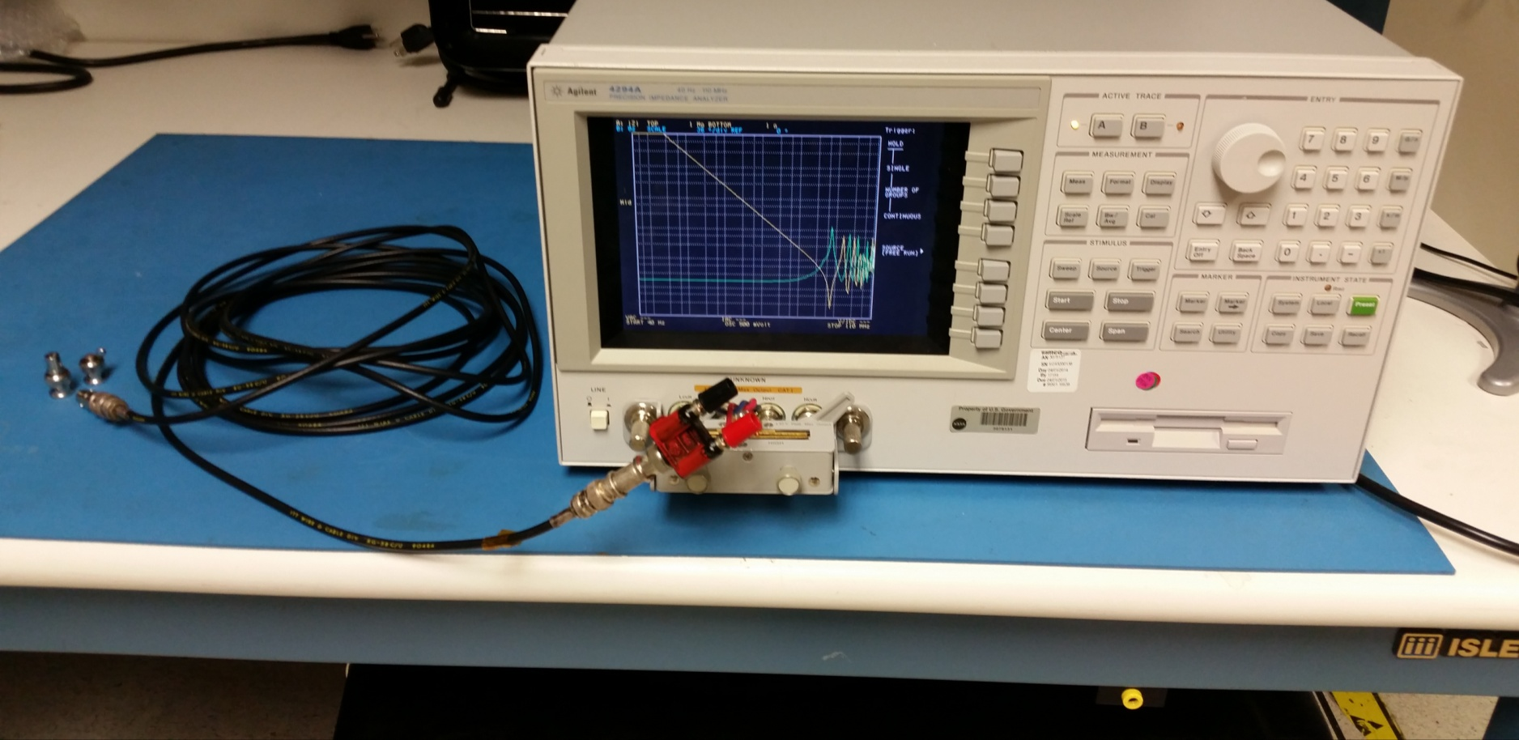
Demo 5a: Transmission Line Impedance Measurements
I_{i}
l
Z_{S}
I_{L}
V_{S}
Z_{i}
V_{i}
( γ, Z₀ )
Z_{L}
V_{L}
z
z’ = l - z

Slide 22
Demo 5a: Transmission Line Impedance Measurements (cont.)
Equipment
  Agilent 4294A impedance analyzer
  RG-58 coax
  2 BNC barrel adaptors
  1 banana-BNC adaptor w/short twisted pair to connect banana adaptor to analyzer
  Short termination, 50 ohm termination

Slide 23
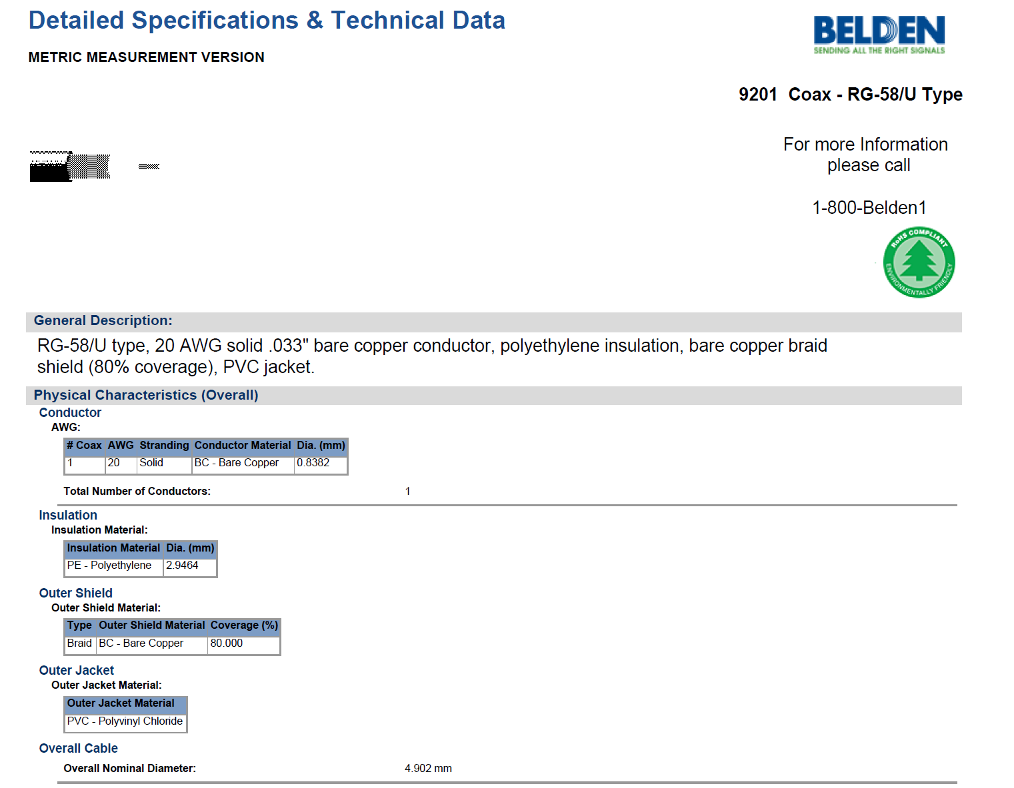
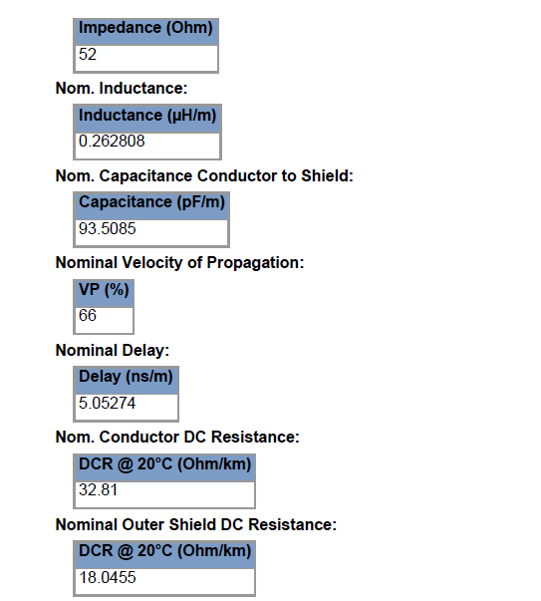
Demo 5a: Transmission Line Impedance Measurements (cont.)

Slide 24
Demo 5a: Transmission Line Impedance Measurements (cont.)
AIR
CABLE
μ_{r} = 1
ε_{r} = 2-3
(typical)
For 6.2 m cable:
6.2 m = λ/4 at ~ 8 MHz
6.2 m = λ/2 at ~16 MHz

Slide 25
Demo 5a: Transmission Line Impedance Measurements (cont.)
L = Z_{160 kHz}/10⁶
2.1 μH
340 nH/m
Z measured at ~160 kHz (1 MHz / 2π)
gives value of L in μH
Z = jωL = j2πfL
R
λ/4
λ/2

Slide 26
Demo 5a: Transmission Line Impedance Measurements (cont.)
Z = 1/jωC = 1/j2πfC
C = (1/Z_{160 kHz})*10⁻⁶
1/Z measured at ~160 kHz (1 MHz / 2π)
gives value of C in μF
640 pF
100 pF/m
R
λ/4
λ/2

Slide 27
Demo 5a: Transmission Line Impedance Measurements (cont.)
Impedance where curves meet
= Z₀ (50 Ω)
R
λ/4
λ/2

Slide 28
Reflection Coefficients
l
Z_{S}
V_{S}
( γ, Z₀ )
Z_{L}
z
z' = l - z

Slide 29
Voltage Standing Wave Ratio (VSWR)
l
Z_{S}
V_{S}
( γ, Z₀ )
Z_{L}
z
z' = l - z

Slide 30
Voltage Standing Wave Ratio (VSWR)
l
Z_{S}
V_{S}
( γ, Z₀ )
Z_{L}
z
z' = l - z

Slide 31
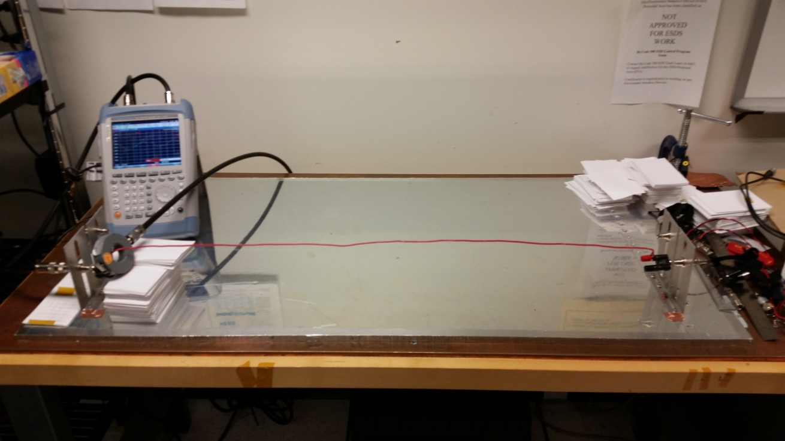
Demo 5b: Transmission Line Standing Waves

Slide 32
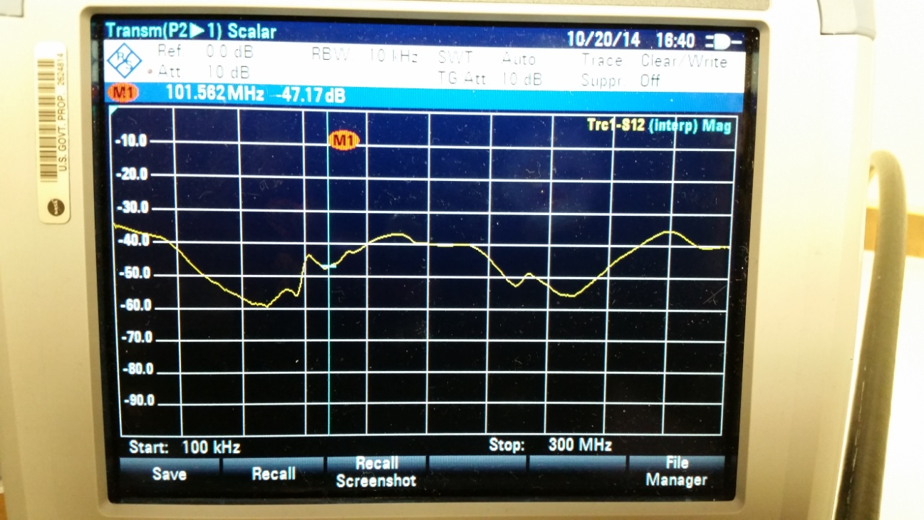
Demo 5b: Transmission Line Standing Waves
Equipment
  R&S FSH4 spectrum/network analyzer
  Fixture with single wire
  Current probe
  2 large coax cables with N connectors
  N-BNC adaptor

Slide 33
Why Must Transmission Lines Be Terminated?
Maximum energy (power) transfer to load
Can (should) also be terminated at source end
Minimize reflections
  Maintain signal integrity
  Minimize radiated emissions
Fundamental
wavelength
τ_{r}
τ_{f}
λ
τ
V = IZ, P = IV
Z_{L} < Z₀: Can’t get full V across load, some P reflected
Z_{L} > Z₀: Can’t get full I through load, some P reflected
Z_{L} = Z₀: all power to load, no reflection
T = 1/f
Z_{s}
Z_{L}
REFLECTIONS = RINGING = COMPROMISED SIGNAL INTEGRITY
= POSSIBLE RADIATED EMISSIONS

Slide 34
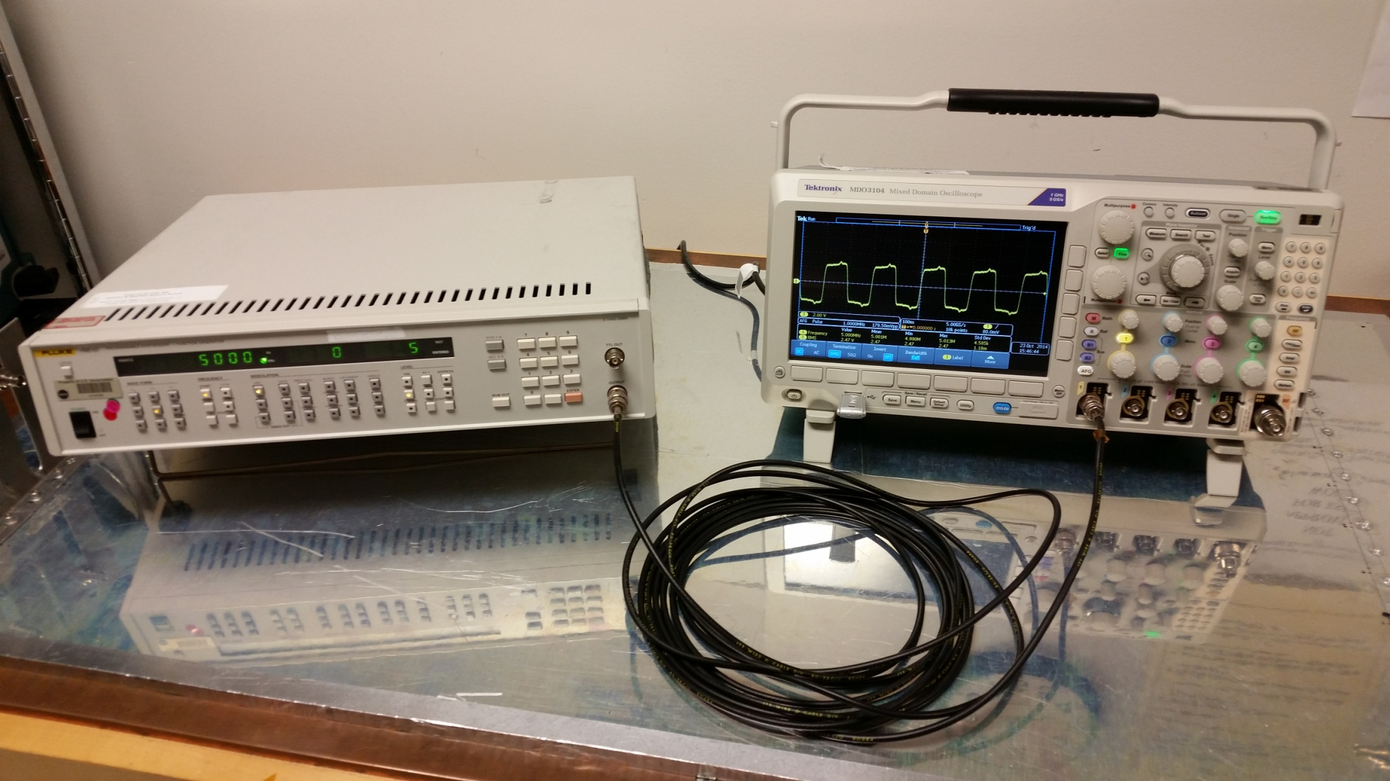
Demo 5c: Unmatched vs. Matched Termination

Slide 35
Demo 5c: Unmatched vs. Matched Termination (cont.)
Equipment
  Tektronix MDO3104 oscilloscope (built-in signal generator)
  Fluke PM5193 function generator
  RG-58 coax cable
Setup
  Pulse, 5 Vp-p, 15 MHz and 30 MHz

Slide 36
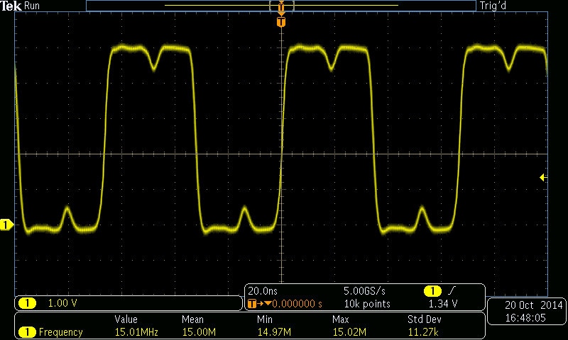
Demo 5c: Unmatched vs. Matched Termination (cont.)
COULD PRODUCE FALSE TRIGGER
15 MHz, 1 MΩ termination

Slide 37
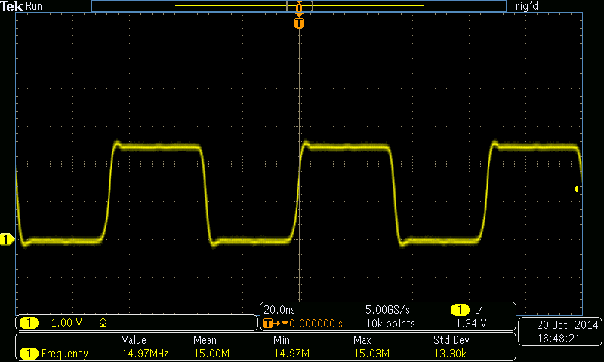
Demo 5c: Unmatched vs. Matched Termination (cont.)
15 MHz, 50 Ω termination

Slide 38
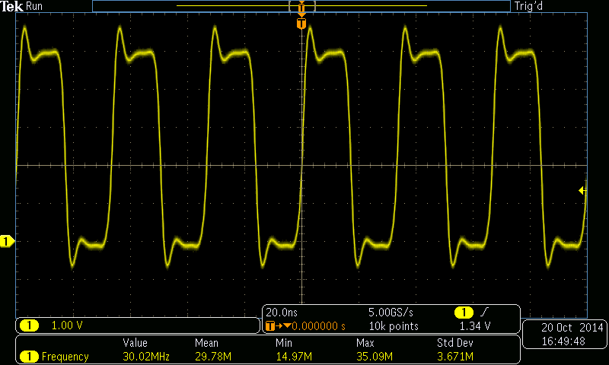
Demo 5c: Unmatched vs. Matched Termination (cont.)
30 MHz, 1 MΩ termination

Slide 39
Demo 5c: Unmatched vs. Matched Termination (cont.)
30 MHz, 50 Ω termination

