Slide 1
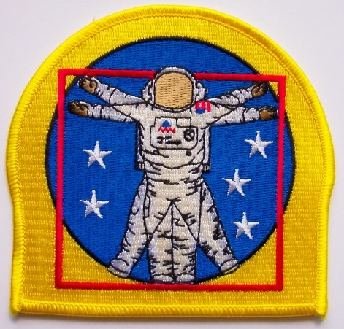
EVA Physiology & Medical Considerations Working in the Suit
Scott Parazynski, MD
“US Spacesuit Knowledge Capture Series”
24 January 2012
www.parazynski.com

Slide 2
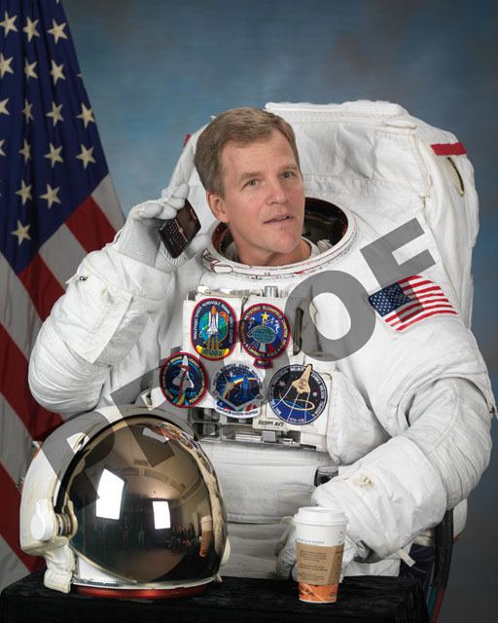

Notes:
MARS - 7/5/2001
Frosty white water ice clouds and swirling orange dust storms above a vivid rusty landscape reveal Mars as a dynamic planet in this sharpest view ever obtained by an Earth-based telescope. The Earth-orbiting Hubble telescope snapped this picture on June 26, 2001, when Mars was approximately 43 million miles (68 million km) from Earth -- its closest approach to our planet since 1988. Hubble can see details as small as 10 miles (16 km) across. Especially striking is the large amount of seasonal dust storm activity seen in this image. One large storm system is churning high above the northern polar cap [top of image], and a smaller dust storm cloud can be seen nearby. Another large duststorm is spilling out of the giant Hellas impact basin in the Southern Hemisphere [lower right].

Slide 3
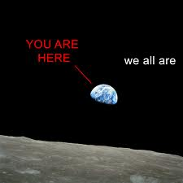
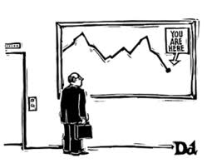
“US Spacesuit Knowledge Capture Series”
1. “EVA Physiology & Medical Considerations Working in a Suit” --- Tuesday, January 24, 2012
2. “Real-time EVA Troubleshooting” ---
Thursday, February 16, 2012
3. “TPS Inspection & Repair” ---
Thursday, February 23, 2012
4. “EVA Skills Training” ---
Tuesday, March 6, 2012
www.parazynski.com

Slide 4

Sir, you’re no Jack Kennedy Admiral Stockdale!

Slide 5
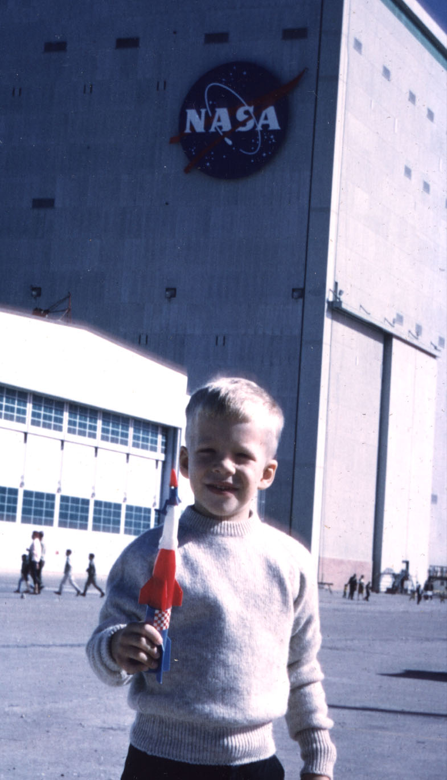
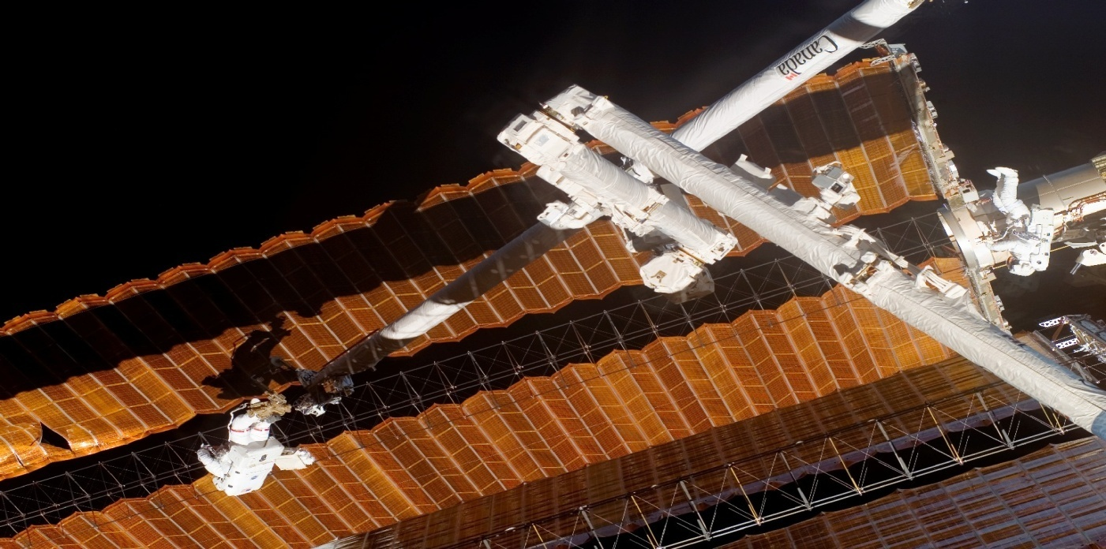

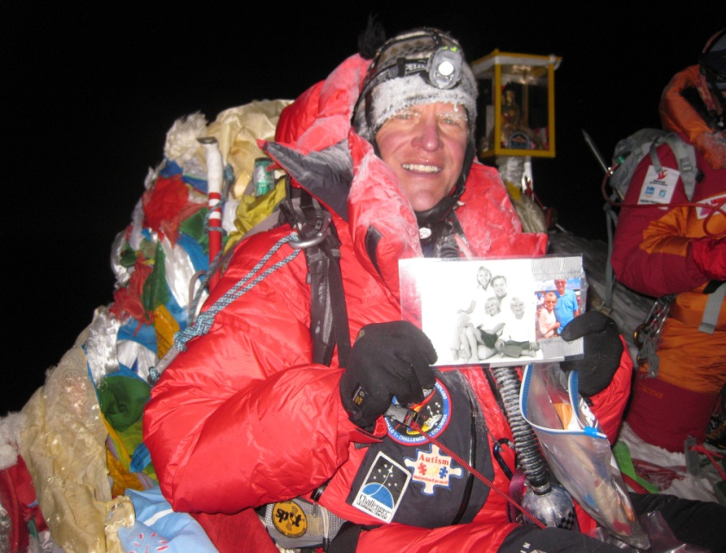
“Parazynski” is like “Smith” or “Doe” in Poland…

Slide 6
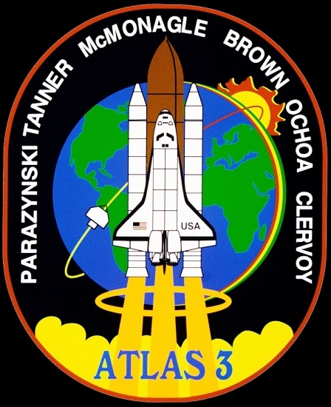


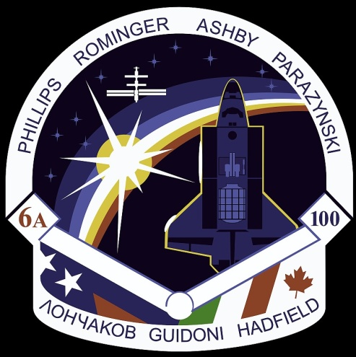


Slide 7
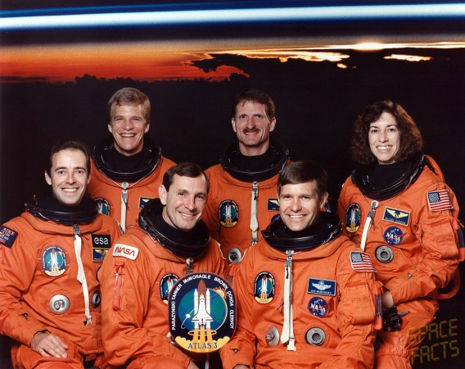
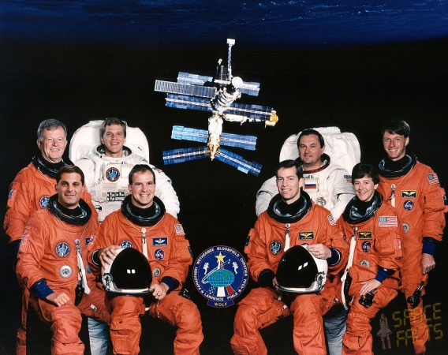
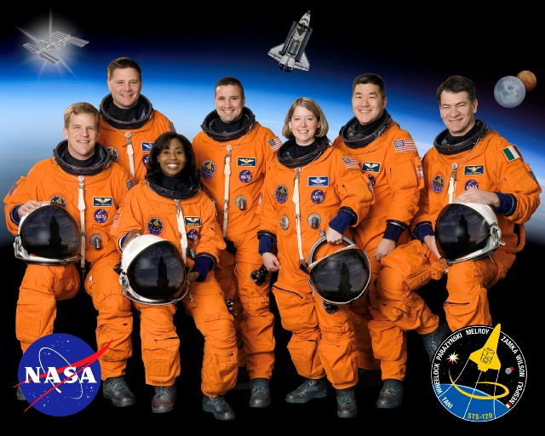
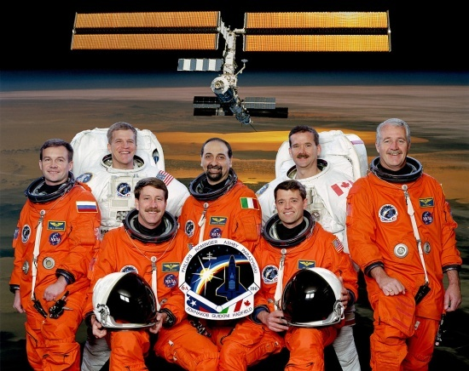
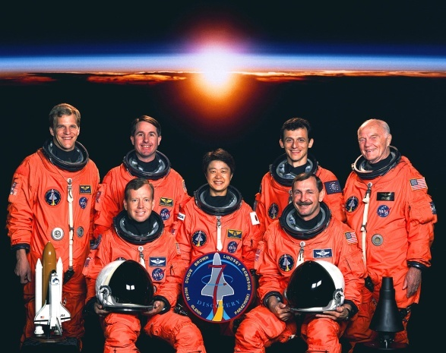

Slide 8
Human Complexity
Strength
Height
Fast vs. Slow Twitch
Weight
Visual Acuity
Mechanical Aptitude
HUMANS ARE EVEN MORE COMPLEX THAN THE SPACECRAFT YOU’RE BUILDING
Underlying Medical Conditions
Native Language
Susceptibility
to SAS
Arm Reach
Cultural Differences
G-Tolerance
Pain (Discomfort) Tolerance
Handedness
Auditory Acuity
Situational Awareness
Gender
Reaction Time (Scan Pattern)
Operational Background
Depth of Knowledge
(Preparedness)
Endurance
Verbal Clarity & Fluency
www.parazynski.com

Slide 9
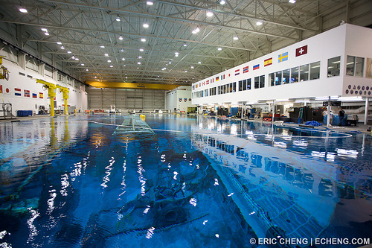
Lessons Learned on the Job
“EVA Cadre” selected to do the majority of development testing
Led to acceptance of some hardware and tasks that could not be accomplished by a broad cross section of the Astronaut Corps
Once recognized as an issue, crew consensus testing became actively more inclusive
www.parazynski.com

Slide 10
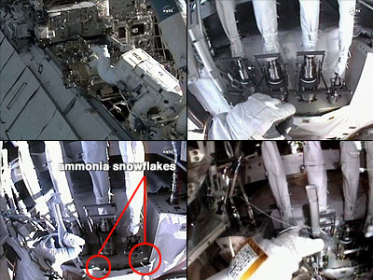
Fluid “Quick Disconnects”
www.parazynski.com

Slide 11
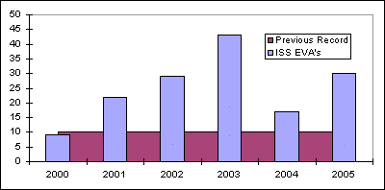
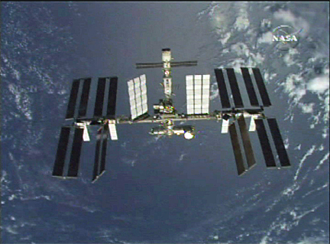
Wall of EVA: Summit Success
ISS “Wall of EVA”: not enough qualified crew for the volume of work ahead
Developed the “EVA Skills Training Program”
  Defined “Gold Standards” of EVA performance
  Gave trainees additional time to work towards these goals
  Ultimately a huge success: ISS assembly complete, many maintenance successes by ISS crews
www.parazynski.com

Slide 12
Human-Centered Design
Crew Evaluators Should Include:
  Broad Range of Anthropometrics
  Matching Skill & Experience Levels of Anticipated Crews
Early Crew Input:
  Saves Time Pre-Flight
  Saves $$$
  Increases On-Orbit Efficiency
  Enhances Maintenance Capability On-Orbit
Requirements & Design Phase w/Experienced Crew Input
Test & Validation w/Experienced Crew Input
Procedure & Ops Concept Development w/Experienced Crew Involvement
Successful Flight Operations & Maintenance in Concert w/Crew
www.parazynski.com

Slide 13
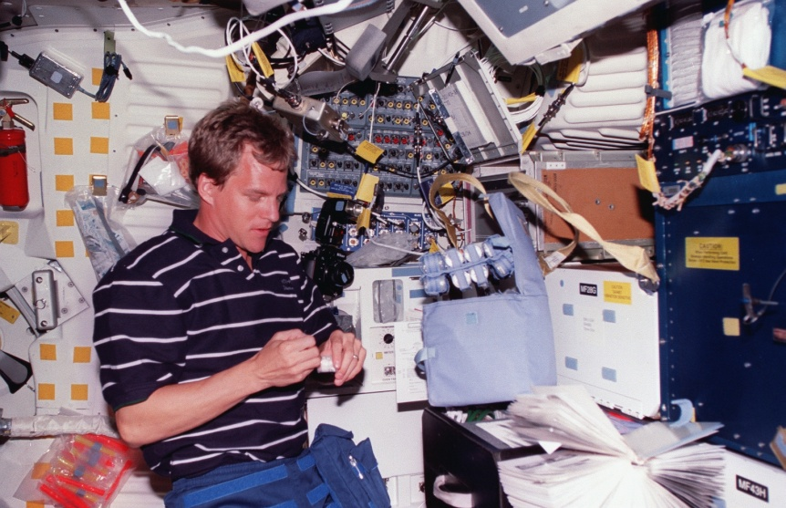
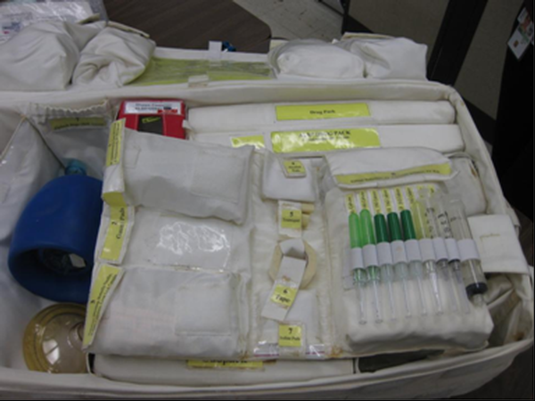
Space Medicine 101
Wide Variability in Adaptation to 0-G
  Motion Sickness
  Fluid Shifts
  Back Pain
Med Kit Contents & Exercise: Based on Probabilistic Risk Assessments
Return to 1-G Physically More Challenging
  Neurovestibular
  Musculoskeletal
  Cardiovascular
www.parazynski.com

Slide 14
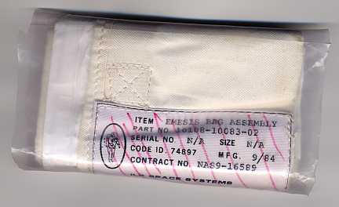
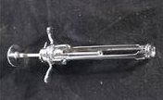
Space Adaptation Syndrome
SAS, a.k.a. Space Motion Sickness
Generally Limited to First 1-2 Days On-Orbit
Otoliths “Unweighted”
Preemptive Meds Helpful (Phen-Dex)
Avoid Rapid Head Motions on Arrival
Treat with Intramuscular Phenergan at Bedtime
www.parazynski.com

Slide 15
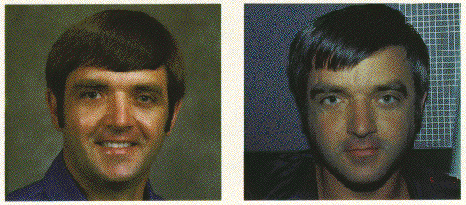
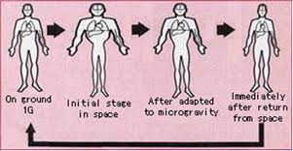
Fluid Shifts
No Gravity → No Hydrostatic Gradient
  Puffy Faces
  Runny Noses
  Mild Headaches
  “Bird Legs”
  SAS?
Return to 1-G:
  Orthostatic Intolerance
  G-suit, Fluid Loading
www.parazynski.com

Slide 16
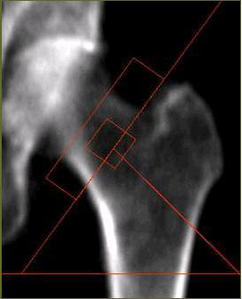
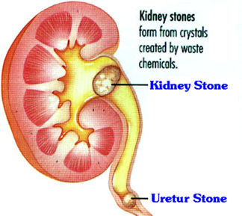
Musculoskeletal & Kidney
“Antigravity” Muscles & Bones Respond to Loading History
Without Loading in Space → Atrophy
Also Leads to:
  Ca++ kidney stones
  Premature Osteoporosis
  Secondary Injuries
www.parazynski.com

Slide 17
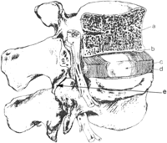
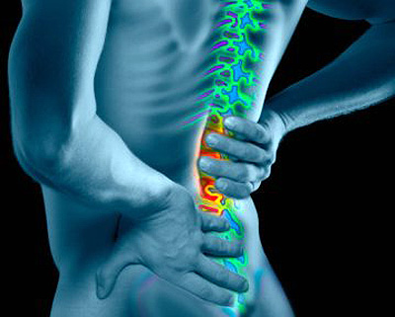
Back Pain
Unloading Results in Intervertebral Disc Swelling
Low Back Pain On- Orbit is Very Common
Sleeping in Fetal Position Often Helpful
May Predispose Astronauts to Disc Disease Later in Life
www.parazynski.com

Slide 18
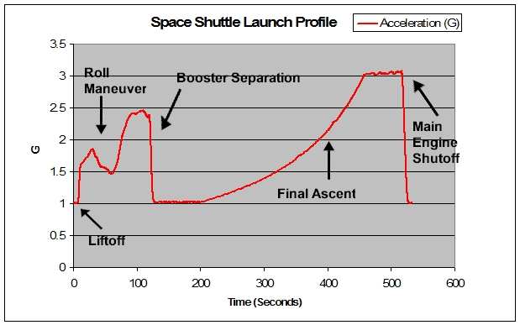






Other Aeromed Considerations
Accleration (“G’s”):
  Many CSF Vehicles >> Shuttle Accelerations
Non-Gov. Crew:
  Older, Younger?
  Less Medical Screening
  More Underlying Illness?
Urinary Retention
Infections, ↓Immune f(n)
Respiratory & Eye Irritation
Visual Acuity
www.parazynski.com

Slide 19
Engineering for Success
Human Diversity & Complexity: must take into account for safe & efficient spacecraft design, development, test and flight operations
Early Crew Involvement: pays huge dividends in all phases of development & operations
Human Physiology and Medical Issues: are fairly well understood & should be factored into spacecraft architecture (systems, provisioning)
www.parazynski.com

Slide 20
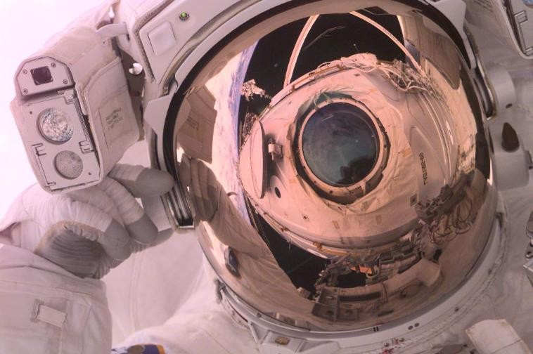

Slide 21
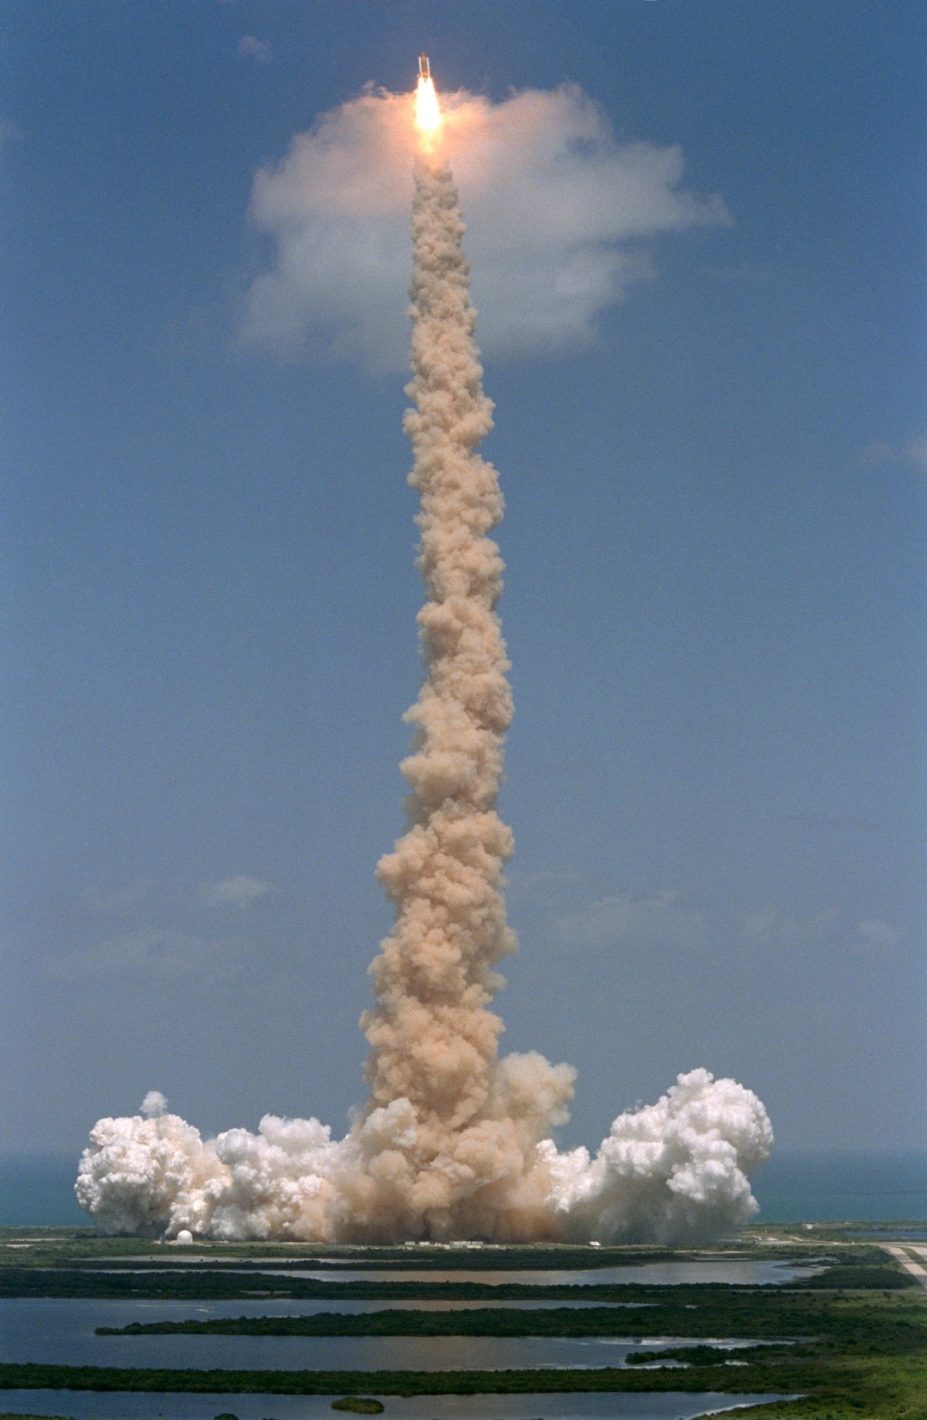
EVA: The Final Frontier
EVA Work Environment
Suit and Systems
EVA Training
EVA Physiology
EVA Risks
EVA Injury
Injury Prevention & Rx
The Future of Space Exploration: BEO EVA

Slide 22
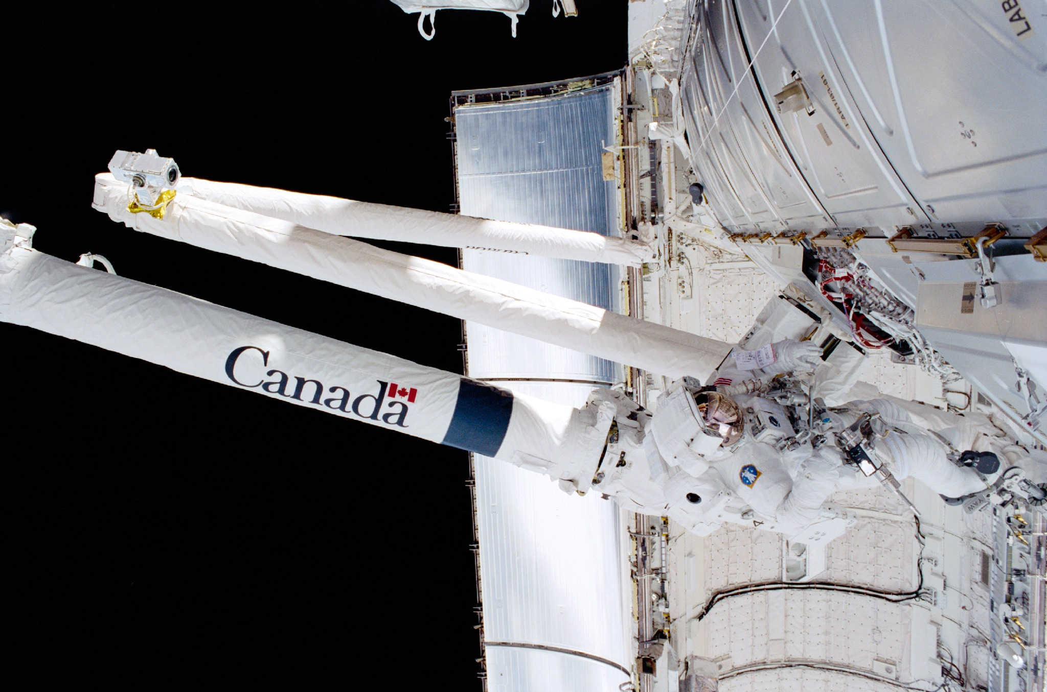
EVA Work Environment
Temperatures: ~-200º F to +300º F
(orbital night/orbital day variation)
External Pressure: Vacuum (~10⁻⁸)
Suit Pressure: 4.3 psia (100% O₂)
Orbiting Earth at ~17,500 mph

Slide 23
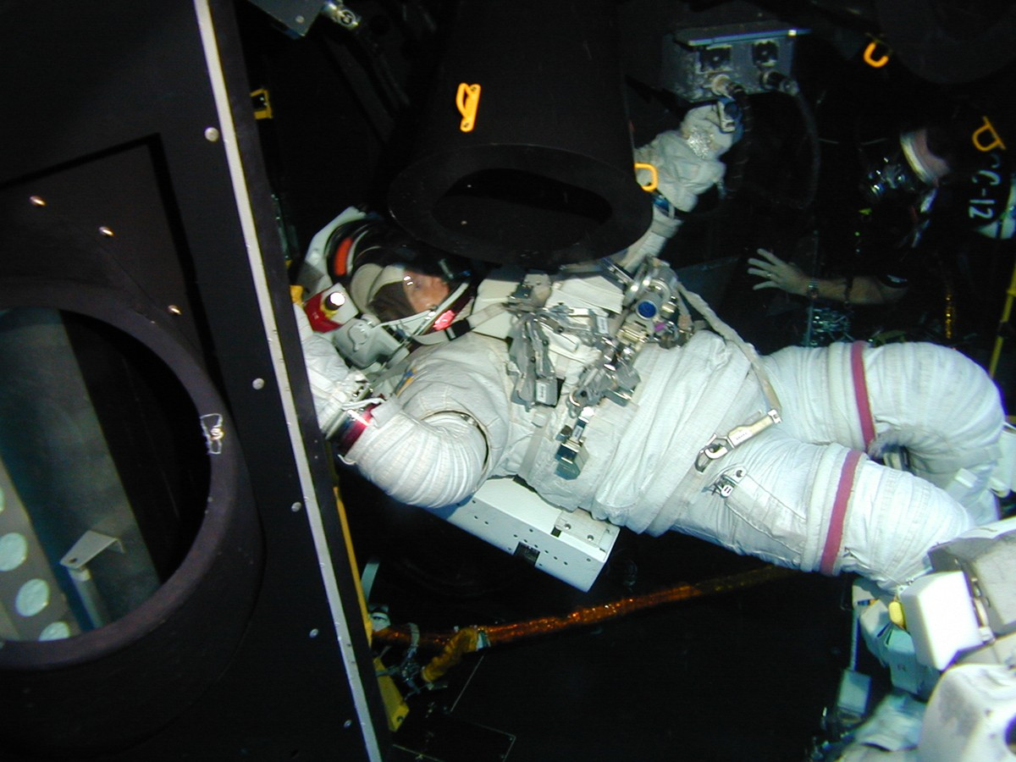
EVA Job Description
6-8 hour spacewalks the norm
Often very confining workspaces
Physically demanding: upper body strength and endurance
Work often requires great precision/tactility/dexterity
Best view in the Universe!

Slide 24
EMU Work Envelope
Notes:
Working within the nominal EMU envelope is preferred for NBL and on orbit activities. Working above the upper limit of the work envelope increases the risk of shoulder injury.

Slide 25
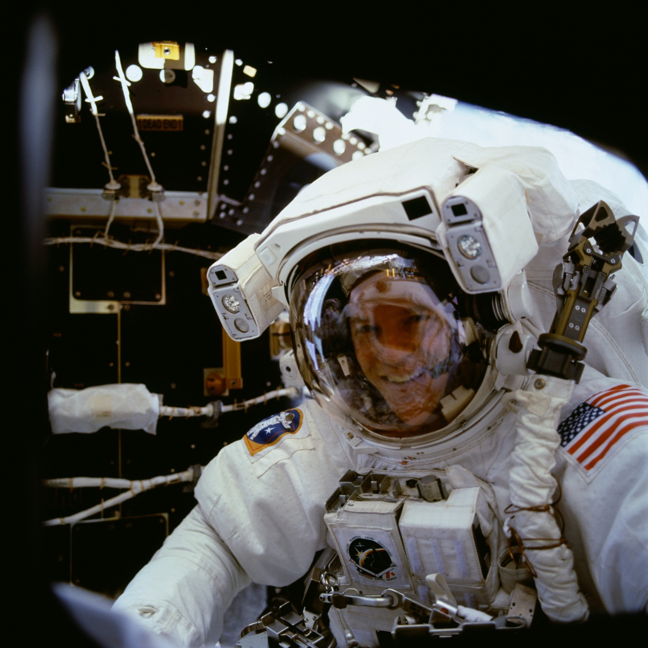
Extravehicular Mobility Unit
Protection from vacuum, temperature extremes, orbital debris
Communications with crew, MCC
Active cooling/passive heating
Biomedical monitoring (ECG, passive dosimetry)
Video monitoring
Tool platform/storage
Drinking water (no food)
Oxygen delivery (with b/u)
CO2 scrubbing
EMU “health monitoring”
Propulsion (“Simplified Aid for EVA Rescue”)
EMU: a personal spacecraft

Slide 26
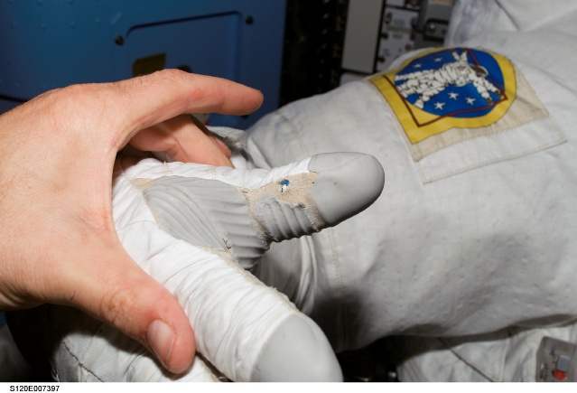

Slide 27
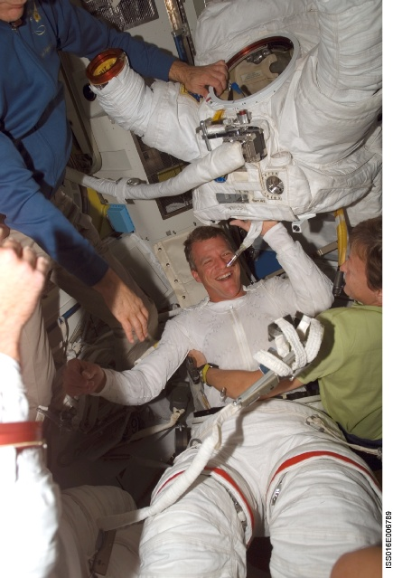

Slide 28
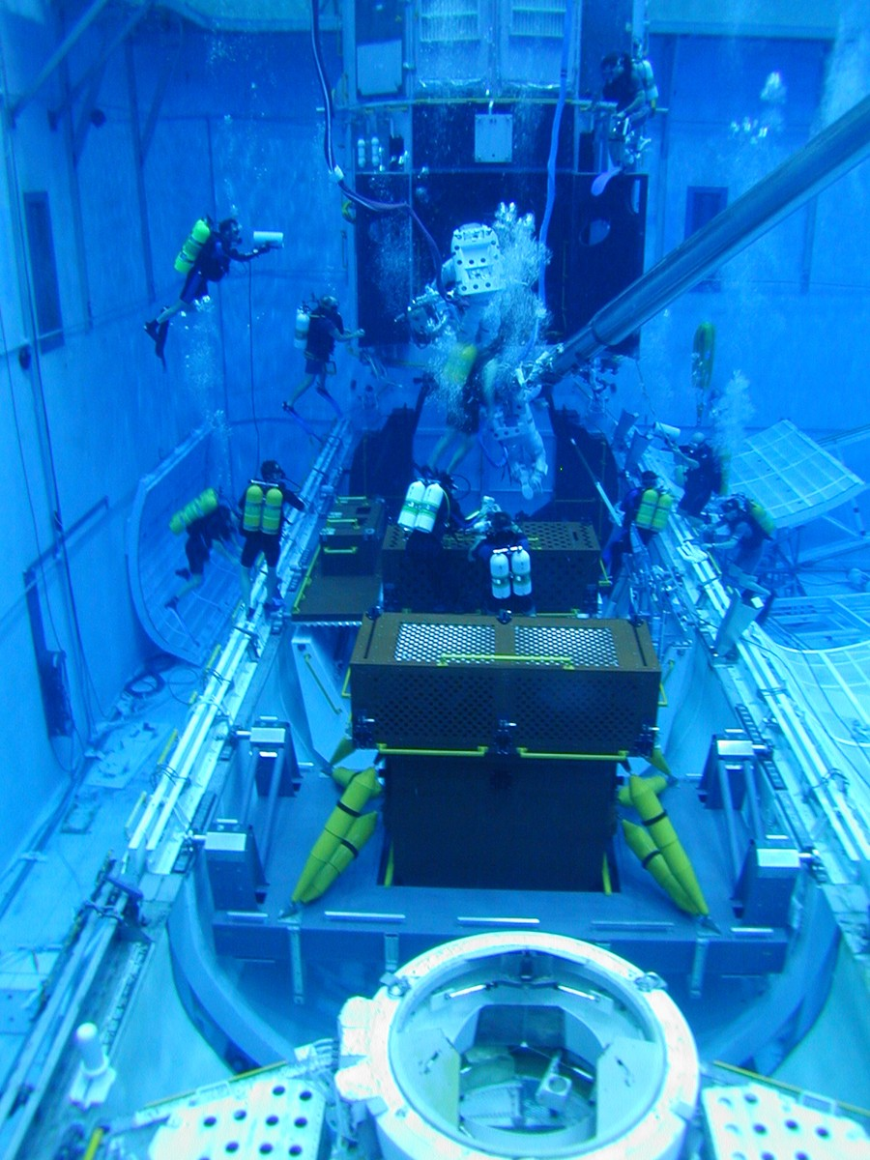
EVA Training Environments
Neutral buoyancy facilities
  Choreograph timelines
  Integrate EVA-robotics
  0-G analog (water drag a major difference)
  Nitrox used to increase bottom time
Virtual Reality Lab
Air Bearing Floor
Vacuum Chambers
EMU Systems Simulations
Integrated Simulations with Mission Control
The Gym!

Slide 29
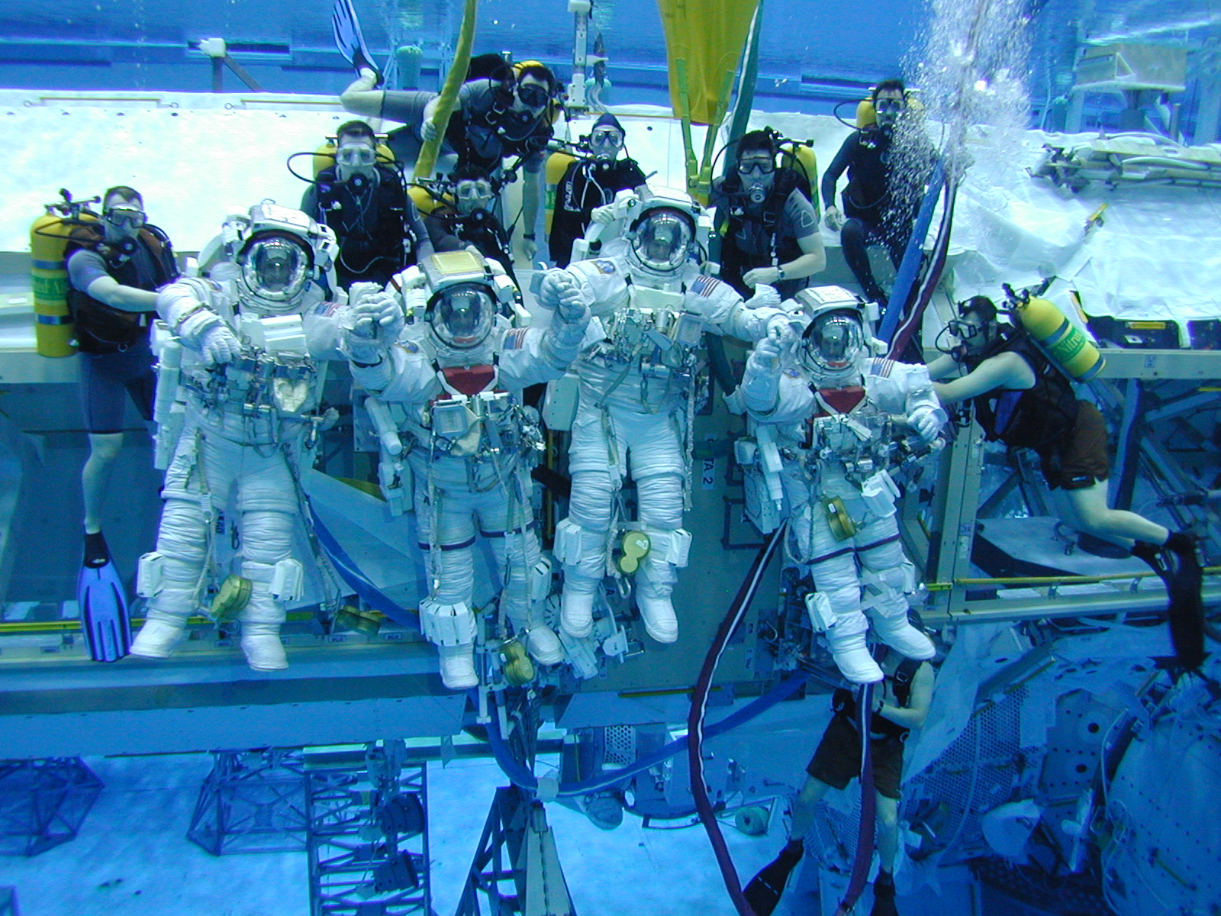

Slide 30
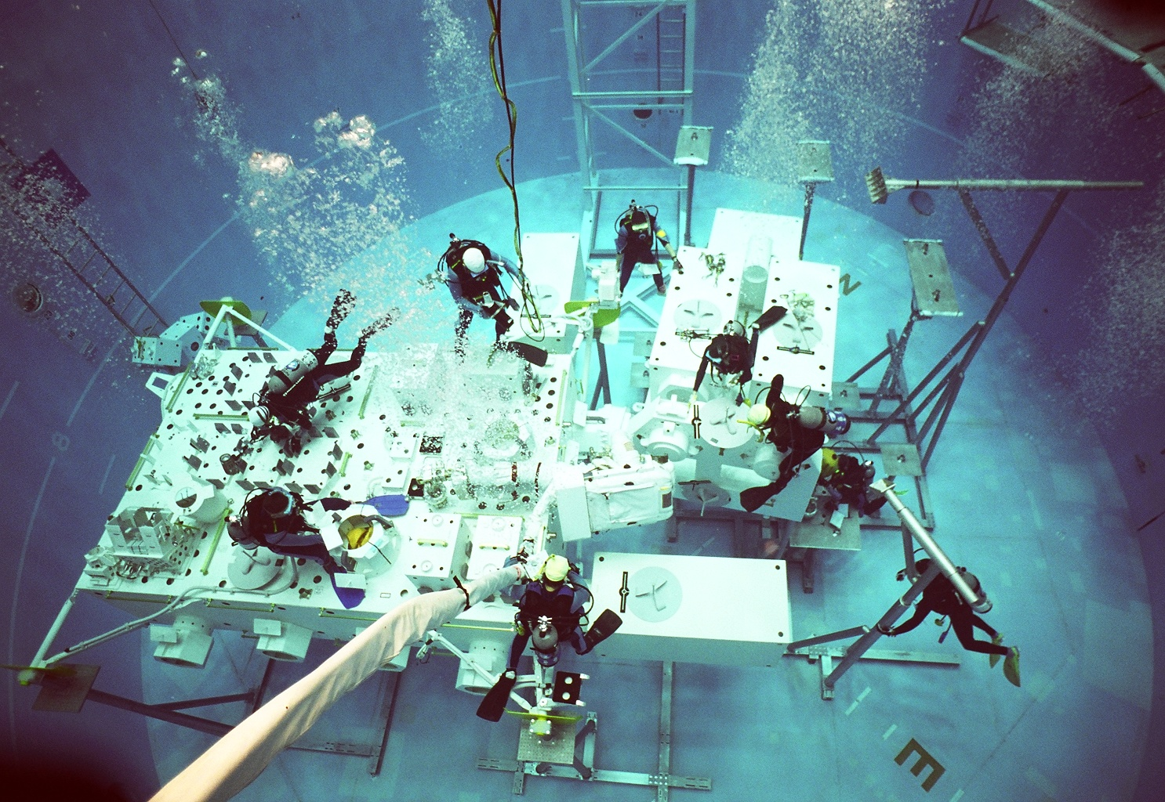
Weightless Environment Test System (WETS)
Tsukuba, Japan

Slide 31
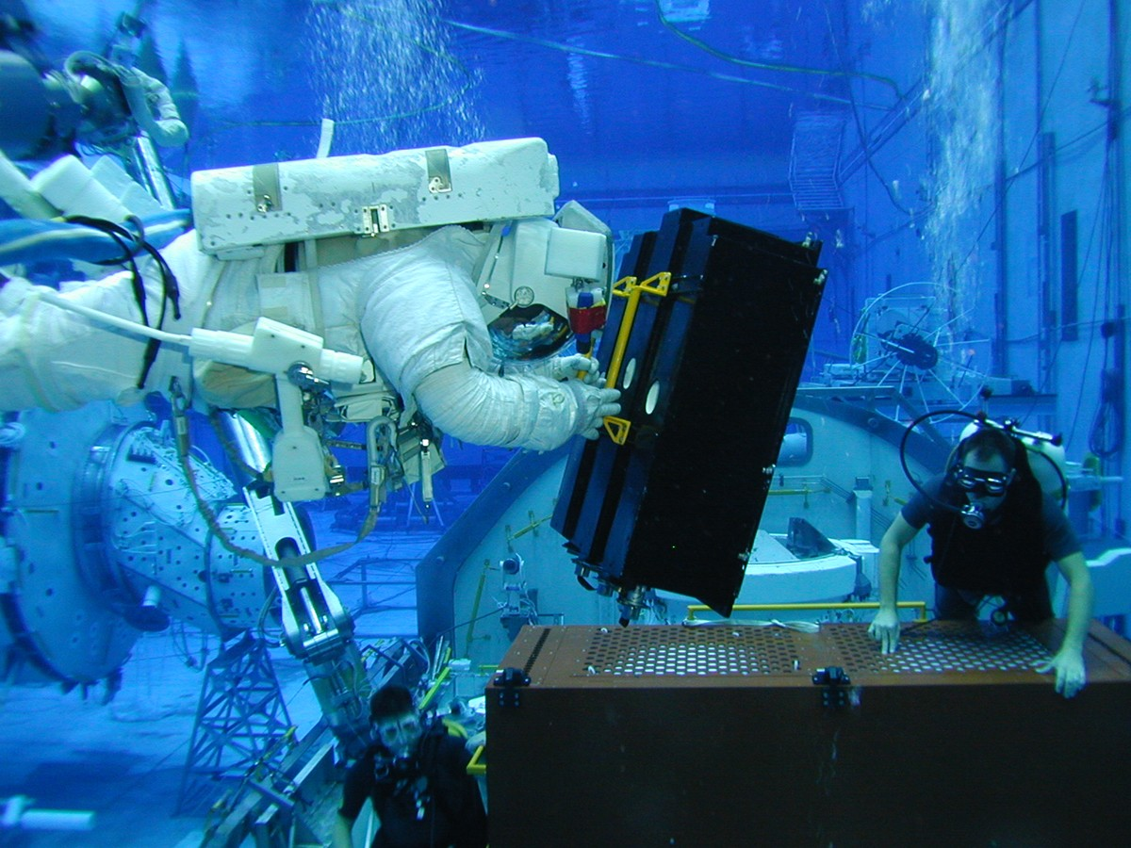
Mass Handling: difficult to train on Earth --- water drag, buoyancy effects

Slide 32
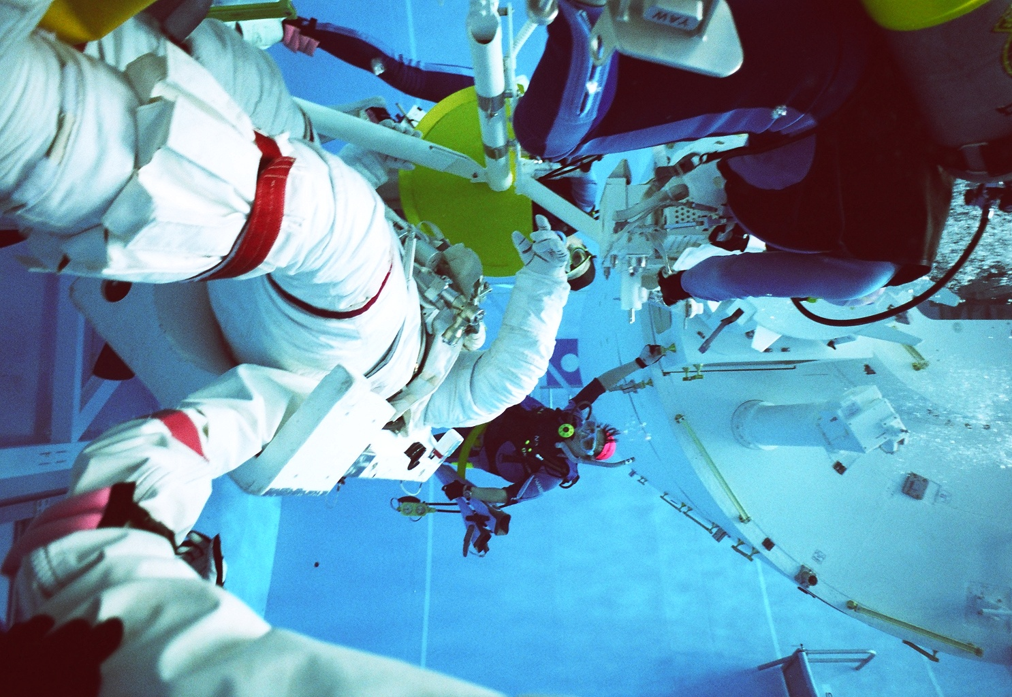
Unusual Training Attitudes: risk of shoulder injuries --- simple bruises to rotator cuff tears; barotrauma; orthostatic intolerance; disorientation

Slide 33
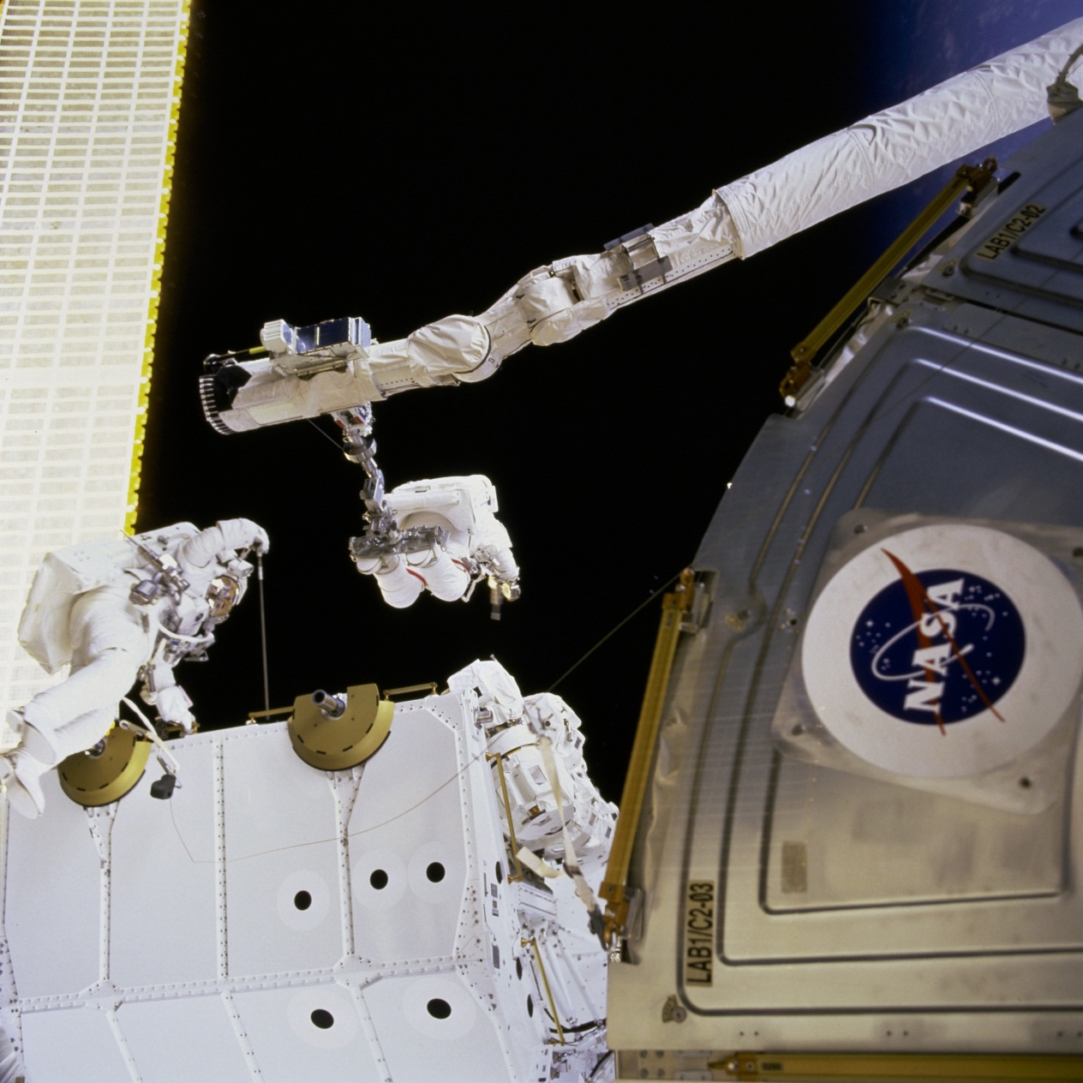
EVA Physiology:
Pressure changes with similarity to diving → risk of DCS and barotrauma (during both real and simulated EVA)
EVA preparations: 4 hour in-suit prebreathe on 100% oxygen, “campout,” or exercise prebreathe protocol
Incidence of DCS in space << diving DCS

Slide 34
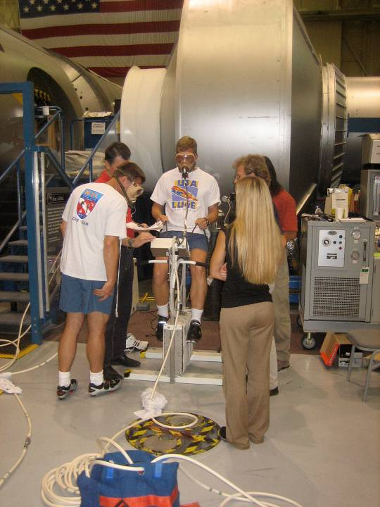

Slide 35
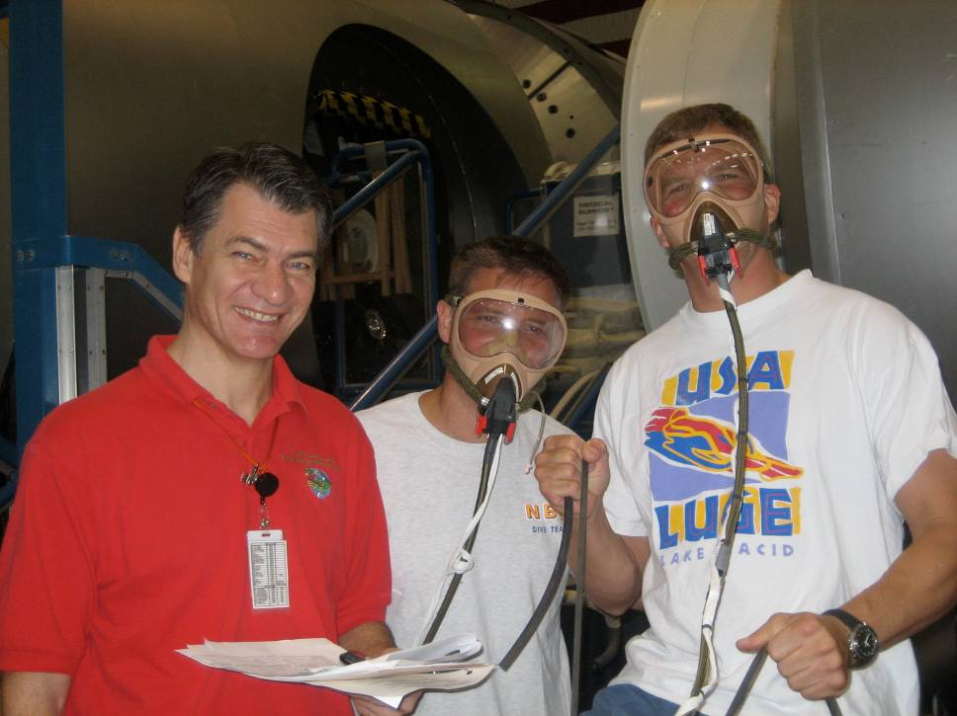

Slide 36
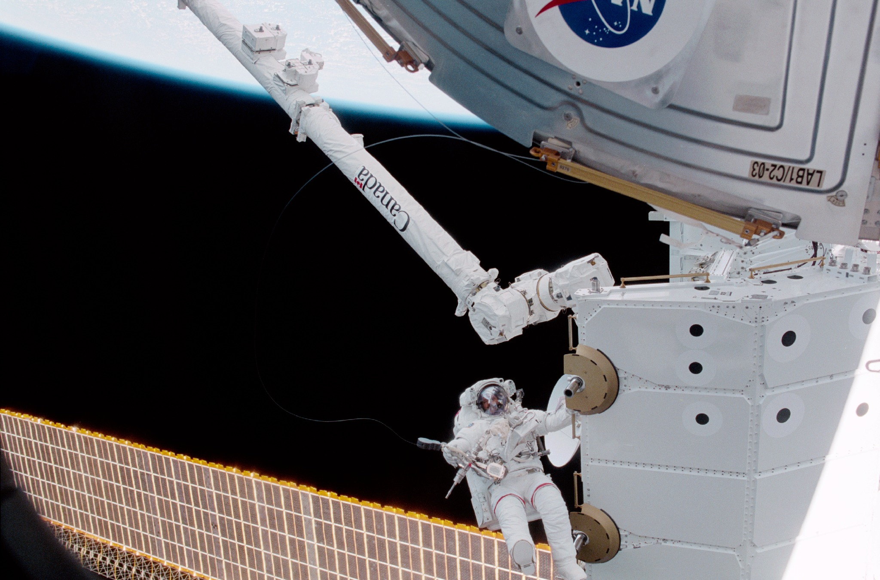
EVA Risks:
Decompression Sickness
Orbital Debris/suit leak
Fire in 100% Oxygen
Radiation Exposure
Frostbite/Superficial Burn
Separation from vehicle
Dehydration/low glucose

Slide 37
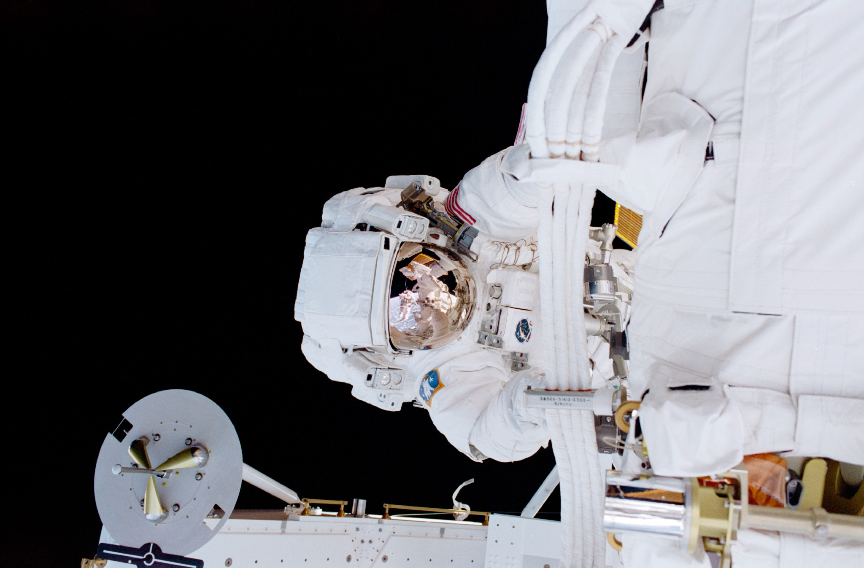
EVA Injuries:
Nerve Compression; Foot Pain, other hot spots
Shoulder Injuries:
  Rotator Cuff Tears
  Superior Labral Tear from Anterior to Posterior (SLAP)
  Tendonitis/Bursitis
Fingernail Delamination
Eye Irritation
Barotrauma
Orthostatic Intolerance
DCS (Type 1 and Type 2)

Slide 38
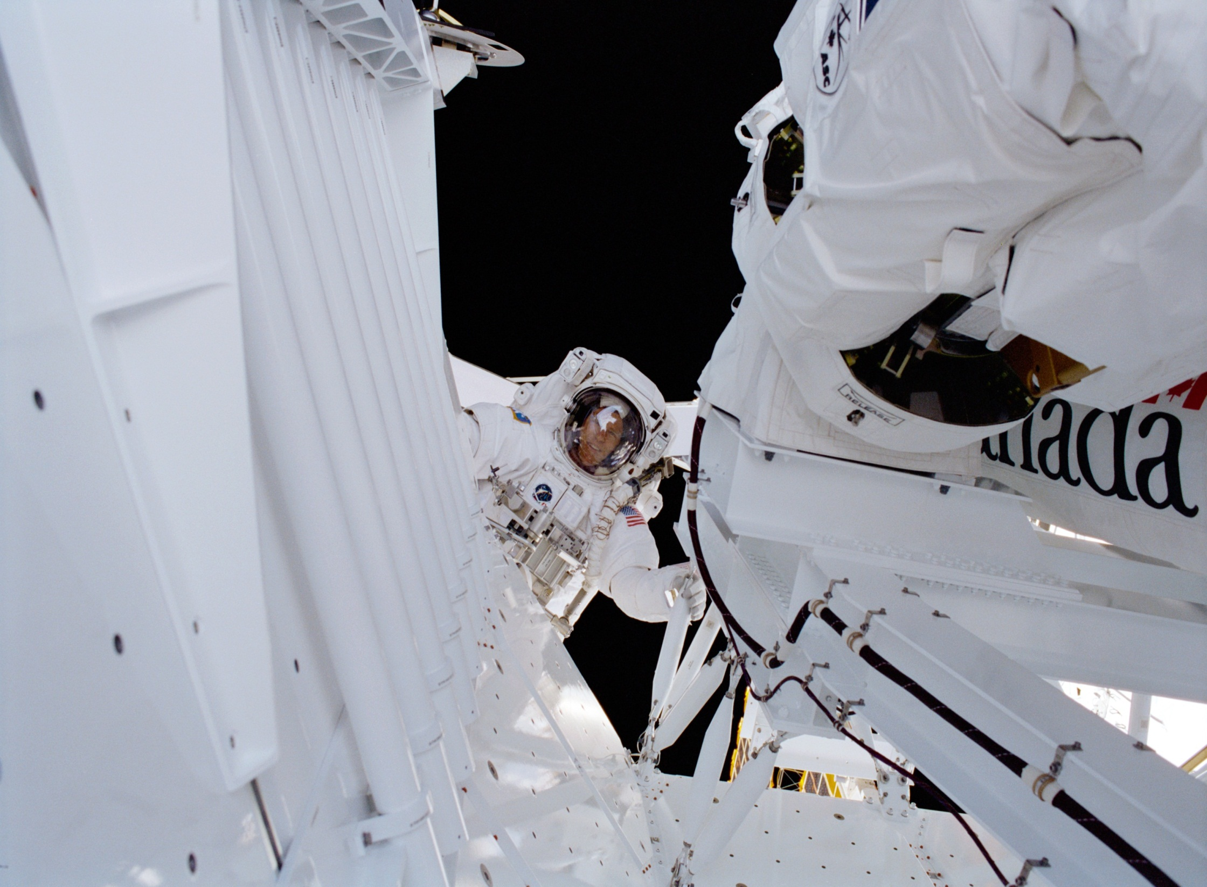
Injury Prevention/Rx:
Optimum Suit Fit
Preflight Conditioning
Avoiding Prolonged Inverted Ops (pool)
Proper Fingernail Care (trim, keep dry); Custom Gloves; Glue
Knowledge of and Working within the Work Envelope of the Planar Hard Upper Torso (HUT)
Prebreathe, Bends Treatment Adapter for DCS

Slide 39
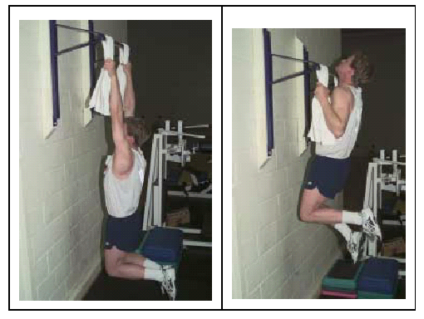
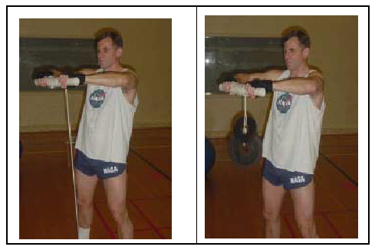
Strength & Conditioning
Key element to flight preparation
Injury prevention
Development of strength and endurance --- especially important for forearm, wrist and hand intrinsics
Strength and Conditioning coaches work directly with crew; mandatory for EVA crewmembers to exercise 3x/week
Also important: flexibility and aerobic capacity

Slide 40
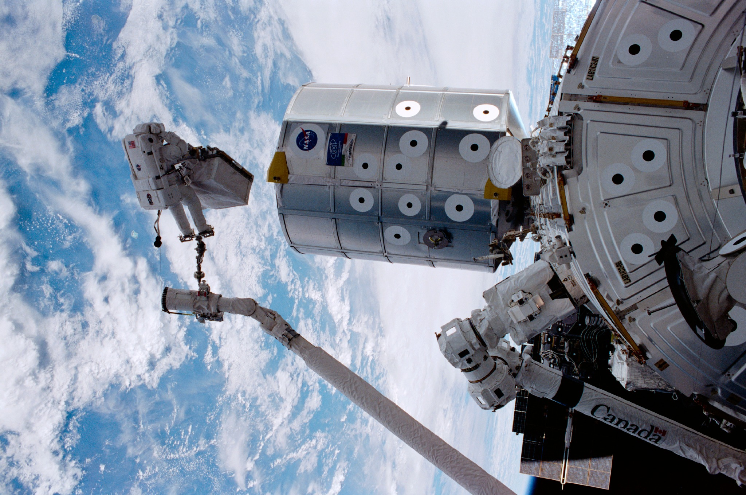

Slide 41

Miscellaneous:
Astronauts are physically very active; some have preexisting orthopedic injuries; some get hurt before flight (softball!)
Size and strength an asset because of physical nature of the job; difficult to scale gloves to smaller sizes
Flying after diving is often required; special tables for Nitrox have been developed for our use
Russian “Orlan” suit used on ISS --- 5.7 psia

Slide 42


Slide 43

Implications for BEO
Planetary EVA ≠ LEO EVA ≠ Asteroid EVA
Planetary EVA Considerations:
  Center of Mass
  Ground Reaction Force
  Dust
Asteroid EVA Considerations:
  “Microgravity Geology”
  Newton’s Laws
Need to ↓ ops overhead

Slide 44

QUESTIONS/DISCUSSION
Contact Info:
Cell: 713-894-4039
Email: parazynski@gmail.com
LinkedIn: www.linkedin.com/in/parazynski
Twitter: twitter.com/#!/SPOTScott
www.parazynski.com

Slide 45
QUESTIONS/DISCUSSION
Contact Info:
LinkedIn: www.linkedin.com/in/parazynski
Twitter: twitter.com/#!/SPOTScott
www.parazynski.com

