Slide 2

Bridge Natural Frequencies

Slide 3


NASA Engineering & Safety Center (NESC) Academy Online
Dynamic Concepts, Inc.
Huntsville, Alabama

Slide 4
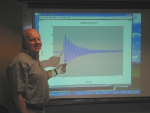
Tom Irvine
Email: tirvine@dynamic-concepts.com
Phone: (256) 922-9888

Slide 5
Why should NASA engineers study bridge vibration?
Bridge oscillations are driven by wind.
Launch vehicles must withstand wind gusts during roll-out, prelaunch & ascent
Good cross-training!

Slide 6
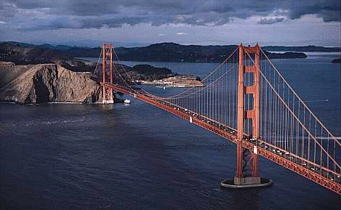
Golden Gate Bridge
Steel Suspension Bridge
Total Length = 8980 ft
Completed 1937

Slide 7
Excitation Sources
In addition to traffic loading, the Golden Gate Bridge must withstand the following environments:
    Earthquakes, primarily originating on the San Andreas
    and Hayward faults
    Winds of up to 70 miles per hour
    Strong ocean currents
The Golden Gate Bridge has performed well in all earthquakes to date, including the 1989 Loma Prieta Earthquake.
Several phases of seismic retrofitting have been performed since the initial construction.
Note that current Caltrans standards require bridges to withstand an equivalent static earthquake force (EQ) of 2.0 G.

Slide 8
Golden Gate Bridge Natural Frequencies
Mode Type | Period (sec) | Natural Frequency (Hz)
Transverse | 18.2 | 0.055
Vertical | 10.9 | 0.092
Longitudinal | 3.81 | 0.262
Torsional | 4.43 | 0.226

Slide 9
Galloping Gertie

Slide 10
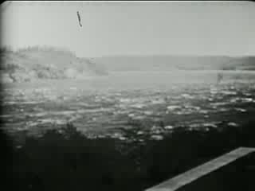

Slide 11
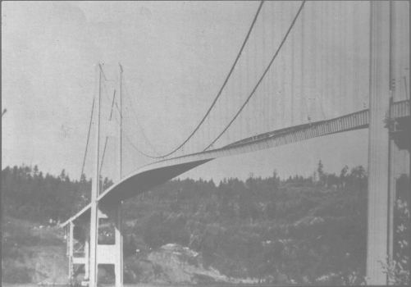
Tacoma Narrows Bridge
Torsional vibration mode at 0.2 Hz.
The two halves vibration 180° out-of-phase.

Slide 12
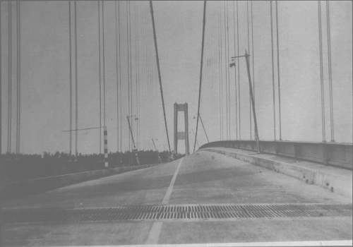
Tacoma Narrows Bridge
Torsional vibration mode.

Slide 13
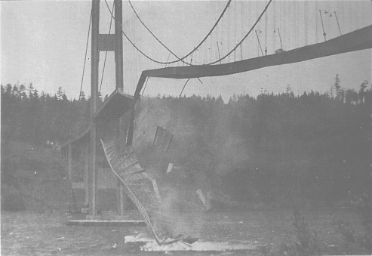
Tacoma Narrows Bridge Collapse

Slide 14
Tacoma Narrows Bridge Events
Strong winds caused the bridge to collapse on November 7, 1940.
Initially, 35 mile per hour winds excited the bridge's transverse vibration mode, with an amplitude of 1.5 feet. This motion lasted 3 hours.
The wind then increased to 42 miles per hour.
In addition, a support cable at mid-span snapped, resulting in an unbalanced loading condition.
The bridge response thus changed to a 0.2 Hz torsional vibration mode, with an amplitude up to 28 feet (336 inch).
What was the resulting peak acceleration in G?

Slide 15
Tacoma Narrows Bridge Acceleration
What was the resulting peak acceleration in G?
Again, the bridge response thus changed to a 0.2 Hz torsional vibration mode, with an amplitude up to 28 feet (336 inch).
This was a sinusoidal motion.
We will cover sine vibration in earnest in a future unit.
In the mean time……
Displacement * ω^2 = Acceleration
ω = 2π f
0.5 ( 336 in peak-to-peak ) * [ 2π 0.2 Hz ]^2 ( 1 G / 386 in/sec^2 ) = 0.69 G

Slide 16
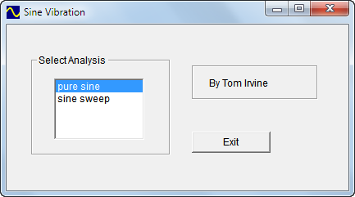
Program: sine.exe

Slide 17
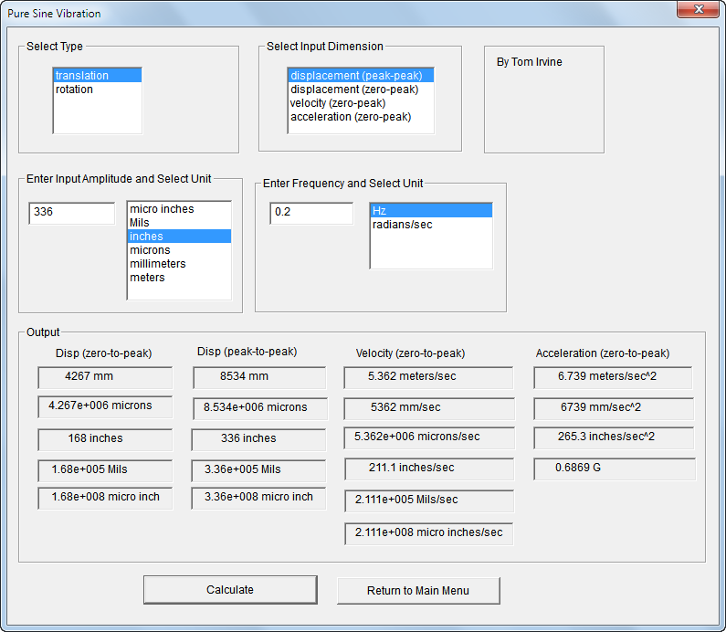

Slide 18
Candidate Failure Modes
The fundamental weakness of the Tacoma Narrows Bridge was its extreme flexibility, both vertically and in torsion.
This weakness was due to the shallowness of the stiffening girders and the narrowness of the roadway, relative to its span length.
Also, the solid girder plates blocked the wind.
Engineers still debate the exact cause of its collapse.
Three theories are:
Random turbulence
Periodic vortex shedding
Aerodynamic instability (negative damping)
Aerodynamic instability is the best explanation.

Slide 19
Random Turbulence
An early theory was that the wind pressure simply excited the natural frequencies of the bridge.
This condition is called "resonance."
The problem with this theory is that resonance is a very precise phenomenon, requiring the driving force frequency to be at, or near, one of the system's natural frequencies in order to produce large oscillations.
The turbulent wind pressure, however, would have varied randomly with time.
Thus, turbulence would seem unlikely to have driven the observed steady oscillation of the bridge.

Slide 20
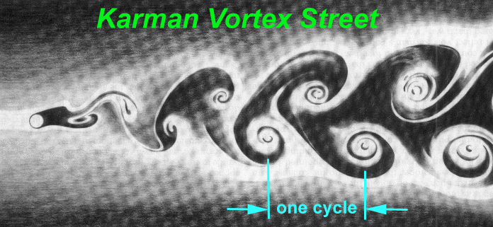
Theodore von Karman, a famous aeronautical engineer, was convinced that vortex shedding drove the bridge oscillations.
A diagram of vortex shedding around a spherical body is shown in the above figure.
Von Karman showed that blunt bodies such as bridge decks could also shed periodic vortices in their wakes.

Slide 21
Vortex Shedding
A problem with this theory is that the natural vortex shedding frequency was calculated to be 0.84 Hz. This frequency is also called the "Strouhal frequency." (calculation given on next slide)
The torsional mode frequency, however, was 0.2 Hz. This frequency was observed by Professor F. B. Farquharson, who witnessed the collapse of the bridge.
The calculated vortex shedding frequency was about four times higher than the torsional frequency. It was thus too high to have excited the torsional mode frequency.
In addition to "von Karman" vortex shedding, a flutter-like pattern of vortices may have formed at a frequency coincident with the torsional oscillation mode.
Whether these flutter vortices were a cause or an effect of the twisting motion is unclear

Slide 22
Strouhal Frequency
Variables
fs = Strouhal Frequency
(or Vortex Shedding Frequency)
S = Strouhal number
U = free stream velocity
D = diameter
Formula
fs = S U/D

Slide 23
Strouhal Frequency,
Tacoma Narrows Bridge
The Strouhal number for the bridge cross-section is S = 0.11 according to:
K. Billah and R. Scanlan, "Resonance, Tacoma Narrows
Bridge Failure, and Undergraduate Physics, Textbooks;"
American Journal of Physics, 1991.
Furthermore, the characteristic dimension is the girder height 8 ft.
The Strouhal frequency for a 42 mph (61.6 ft/sec) wind is thus
fs = (0.11) (61.1 ft/sec) / ( 8 ft)
fs = 0.84 Hz
Bonus Exercise: repeat using program strouhal.exe

Slide 24
Aerodynamic instability
Aerodynamic instability is a self-excited vibration
In this case, the alternating force that sustains the motion is created or controlled by the motion itself
The alternating force disappears when the motion disappears
This phenomenon is also modeled as free vibration with negative damping
Airfoil flutter and transmission line galloping are related examples of this instability

Slide 25
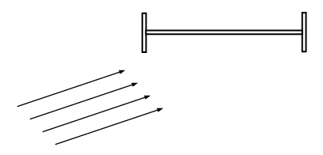
Span at initial
rest position
Wind
Assume that the wind direction was not perfectly horizontal, perhaps striking the bridge span from below
Thus, the bridge is initially at an angle-of-attack with respect to the wind.
Aerodynamic lift is generated because the pressure below the span is greater than the pressure above.

Slide 26
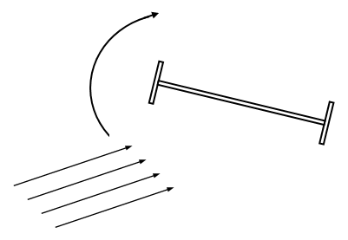
Span rotates clockwise
Wind
The lift force effectively places a torque, or moment, on the bridge
The span then begins to twist clockwise
The span has rotational stiffness
Elastic strain energy builds up as the span rotates

Slide 27
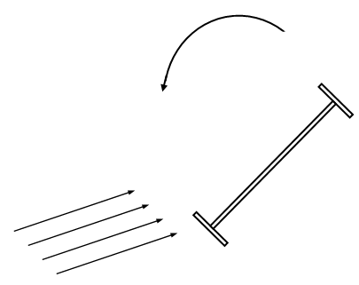
Span rotates
counter-clockwise
Wind
Eventually, the stiffness moment overcomes the moment from the lift force
The span then reverses its course, now rotating counter-clockwise
The span's angular momentum will not allow it to simply return to its initial rest position however.
The reason is that there is little or no energy dissipation mechanism
The span overshoots its initial rest position

Slide 28
Repetitive Cycles
Once again, strain energy builds up in the span material.
Eventually, the stiffness moment exceeds the moment from the wind's lift force.
The span thus reverse course, now rotating clockwise.
Again, it overshoots its rest position.
The cycle of oscillation begins anew, except that the span now has rotational velocity as it passes through the original rest position.
The cycles of oscillation continue in a repetitive manner.

Slide 29
Failure Modes
Eventually, one of two failure modes occurs.
One possibility is that the span experiences fatigue failure due to an excessive number of stress reversals.
The other is that the angular displacement increases in an unstable manner until the material is stressed beyond its yield point, and then beyond its ultimate stress limit
Note aerodynamic instability oscillation is not a resonant oscillation since the wind does not have a forcing frequency at, or near, the bridge's torsional mode frequency.
Some physics and engineering textbooks mistakenly cite the Tacoma Narrows Bridge as an example of resonance.

Slide 30
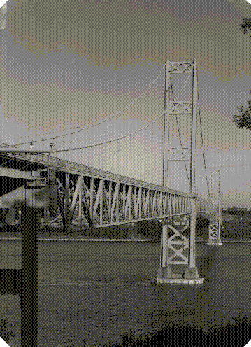
A new Tacoma Narrows Bridge was built in 1950.
The second bridge has truss-girders which allows the winds to pass through.
It also has increased torsional stiffness because it is thicker and wider.
Wind tunnel testing was performed to verify the design of the new bridge prior to its construction.
A similar adjacent bridge was completed in 2007 to allow increased traffic flow.

Slide 31
Modern Bridge Design
Bridges designed and built after 1940 no longer have vibration problems due to:
Computer-aided design
Finite element analysis
Modal testing
Wind tunnel testing
“Lessons learned” from previous designs
Right?

Slide 32
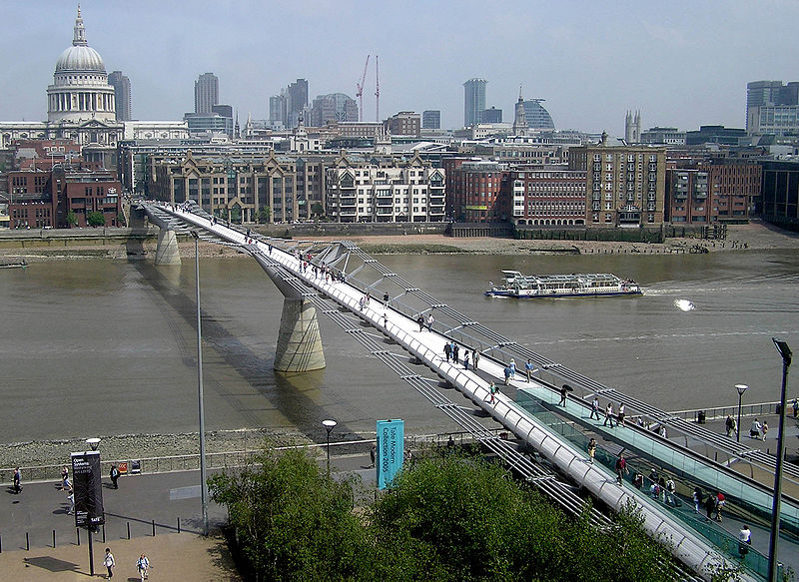
Millennium Bridge, London
Pedestrian bridge opened on June 10, 2000 Experienced significant lateral vibration.

Slide 33
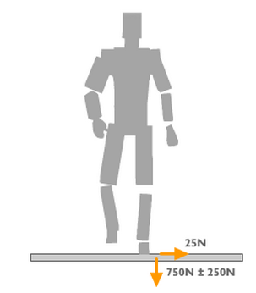
Footfall Excitation
Pedestrians exerted a lateral excitation.
Synchronous Lateral Excitation.
The natural sway motion of people walking caused small sideways oscillations in the bridge
Pedestrians being to sway in step, increasing the amplitude of the bridge oscillations and continually reinforcing the effect
Special case of forced vibration resonance

Slide 34
Millennium Bridge Retrofit
Video pictures showed the following oscillations:
  south span, 50 mm at 0.8 Hz
  center span, 75 mm at 1 Hz
Both stiffness and damping were too low.
Retrofit:
37 fluid-viscous dampers (energy dissipating) to control
horizontal movement
52 tuned mass dampers (inertial) to control vertical movement

Slide 35
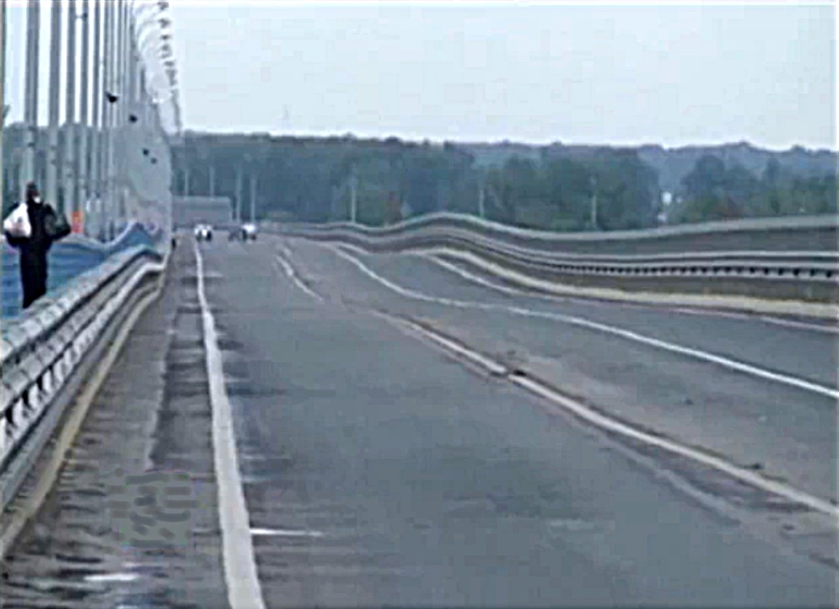
Volgograd Bridge, Russia
Authorities closed the bridge to all motor traffic on May 20, 2010, due to strong
oscillations driven by gale-force winds, with speeds up to 18 meters/second.
The bending frequency was 0.46 Hz.

Slide 36
Program Summary
Programs
sine.exe
strouhal.exe
Homework
View videos of the Volgograd Bridge on YouTube

