Slide 1



NESC Academy Webcast
Learning from Doing - Model Based Systems Engineering Pathfinder Lessons Harvest and Next Steps
Adam West, HQ - OCE
Dr. Karen Weiland, GRC
October 28th, 2016
Moderated by Jon Holladay
NASA Technical Fellow for Systems Engineering
NASA Engineering & Safety Center (NESC)

Slide 2


Office of the Chief Engineer
Magic Draw® Cloud Provisioning Pilot Project(s)
Webcast Presentation
Adam West
October 28, 2016

Slide 3
Core Team – Agency Wide and Interdisciplinary
Adam West Program Executive, HQ
    Paul Gill Program Manager, MSFC
Ken White MagicDraw Integration, MSFC
Amber Wright Usage Monitoring, MSFC
Ian Sturken OCIO Web Services Office Mgr
Darryl Smith NASA Shared Service Center (NSSC)
Glenn Campbell Planning and Integration, HQ

Slide 4
Origin and Operation
Driving Factors
  On going Engineering Management Board (EMB) request
    License optimization through consolidation
      Over subscription due to fear of denial of service
    Collaboration
  Enabling Capabilities
    NASA Shared Services Center (NSSC) Blanket Purchase Agreement
    HQ Office of the Chief Information Officer (OCIO) WESTPrime contract provides agency wide Cloud availability
    OCIO establishes Web Services Office (WSO) providing focal point for Cloud transition and optimization
  Technical Capability Leadership finding
    Action 5A: Software Capability- Establish a software library by consolidating purchase/lease of common tools across disciplines and the Agency into NASA-wide token tool, to include use of cloud
Introduction of the cloud facilitated easier path

Slide 5
Pilots
Followed step-wise incremental process building on experience and back-filling as we moved forward
Pilot 1.0
Establish software tool license key manager server capability in the NASA “cloud” environment
Pilot 2.0
Follow on activity to further build confidence and knowledge of cloud utility
Pilot 2.5
Demonstrate the potential for enhanced engineering collaboration by multiple NASA centers (using a Teamwork server) within the cloud
This first of kind “proof of concept” successfully confirmed the ability to provision a software tool and the ability to share models across NASA centers within the cloud environment
Results confirmed the potential for significant cost savings to NASA.
Identified and resolved the difficulties of agency wide firewall access and basic functionality
Fortified the collaboration and partnerships between OCE and OCIO
Published White Paper, “Magic Draw Amazon Cloud
Building user acceptance of cloud model – “spreading the word”
Partnered with System Engineering Tech Fellow – to host desired assessment for EVVA model
Organizational usage (Departments, Center)
Establish software usage monitoring capability as to build business case for cloud operations
Individual usage
Accomplishments:
Successfully deployed usage monitoring capability- waiver approved
User acceptance lead to pilot 2.5
Additive Manufacturing and Re-Tooling Engineering
Campaign / Component Integration
Sounding Rocket Mission Flow/Shadowing
Partner with Software Tech Fellow – to use NESC assessment models GSDO, GAILA
Findings and accomplishments:
Partnered with Systems Engineering Tech Fellow – perform desired assessments through cloud provisioning of the following MBSE Pathfinder major focus areas:
Complex Mission Campaigns
Hosted ~ 40 unique users using 22 licenses with no denial of service
Incorporated LauchPad authentication√
Developed and tested NAMS process for access to cloud tools √
Identifies appropriate usage report format / attributes for chargeback models as to right size software procurements (individual, shared licenses types)

Slide 6
Pilot 2.5 MD Cloud Content
Products | No. of Floating License
MagicDraw 18.0 FR Enterprise Edition | 22
MagicDraw 18.3 FR Teamwork Server | 10⁺ Connections
Syndeia 2.0 Base Product for MagicDraw | 2
Requirements Modeler | 22
Cameo ParaMagic | 16
Cameo Collaborator 18.0 LTR, | 1 – 5 Connections
SysML | 22
Cameo Simulation Toolkit Plugin 18.3 | 2
Altair (Software Usage Monitoring: Software Asset Optimization) | 5
Project Merge | 2

Slide 7
Additional Capability (in- work)
Center Products | Description
Windchill | Syndeia feature that allows access to Windchill parts data
CREO | Syndeia feature that allows access to CREO system details.
MySQL | Dashboard access to MySQL database.
Sharepoint | Application that is used to share various kinds of data.

Slide 8

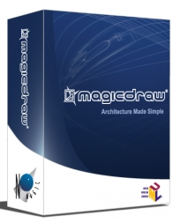

Basic Cloud Architecture
(with Cameo Collaborator)
Software tool license
Windchill
CREO
License Key Server
Magic Draw SW
Plugins
Usage Monitoring tool
MySQL
Teamwork Server
Model storage
Model sharing
Role based model access
User access
Magic Draw client
Cameo Collaborator Server (w/SAO)
Usage output:
Center-Organization-Individual

Slide 9
License Usage - Concurrent Users

Slide 10
Inter-Center Collaboration Enabled in Secure Operating Environment
Firewall
Center firewall policies are varied from center to center
Center access obtained through OCIO’s help in CR process for connectivity- defining allowed ports
Usage monitoring tool
Critical in establishing business case - establishing optimization of license type and associated plug-ins
Configurable – general dash boards
SAO does not support native Launch Pad / ICAM integration; waiver approved by OCIO to use LDAP
Data to be provided to community via NASA Engineering Network System Engineering CoP
NAMS process
Security layer - restricts access to the cloud to those that have a valid need and funding source
Three approvers required (Center Systems Engineering POC, Center funding POC, MagicDraw gatekeeper)
Timely user access (generally <1 day)
Development and testing complete at participating centers
Launch Pad Authentication
MagicDraw access managed initially using internal capability – manually inputting user names and passwords
Authentication is now seamless
Integration with Launch Pad available for FY 17

Slide 11
FY 17 Planned Activities
  Ongoing – support of the MBSE pathfinder
    OCE will*:
      Cover cloud maintenance costs
      Provide license key server
      Cameo Collaborator server
      Teamwork server
        Centers are free to keep their own but must pay for it themselves
      Usage monitoring capability
      Provide 10 enterprise edition MD licenses plus pilot 2.5 plug-ins
  Integrate Access Launchpad for user authentication
  Transition MagicDraw from the Development to Production environment
  Incorporate an inactivity time-out provision for better license utilization
* At no cost to the users

Slide 12
FY 17 Planned Activities
  Coordinate instantiation of MagicDraw licenses from Center to Cloud provisioning providing greater tool access for the community and improved collaboration
    Asking centers to help build out the capability using their licenses
      Upgrade and contribute their licenses and associated plug-ins
        Initial ratio of 3 to 1 to minimize potential of denial of service
        May increase to 4+ once usage is better understood
  Identify future Magic Draw gatekeeper to administer capability
  OCE/OCIO will continue to assess the progress and utilization of cloud provisioning and work with CLT’s to formulate future potential provisioning SW tool candidates

Slide 13
Learning from Doing - MBSE Pathfinder Lessons Harvest and Next Steps
Karen Weiland
HQ OCE Detail-in-Place
NESC Webinar / October 28, 2016

Slide 14

Agenda
MBSE Pathfinder 2016 overview
Individual team highlights
Knowledge capture summary
Recommended next steps
Future follow-on plans and schedule
Impact and summary

Slide 15

Why MBSE?
Technical Integration
Systems Management
Risk
By automating Systems Management we could improve quality early and throughout the life-cycle and balance the focus on Technical Integration.
MBSE could further allow better technical analysis and evaluation of the integrated System(s) to better understand and balance our risk response.
Since 2013, the NESC has utilized MBSE on over a half-dozen assessments to the benefit of NASA Programs and Projects.

Slide 16
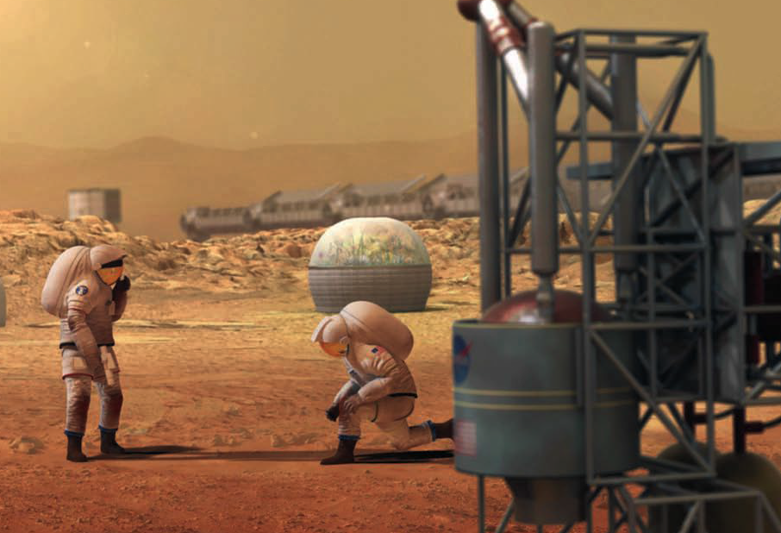
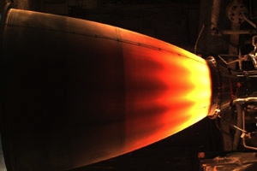
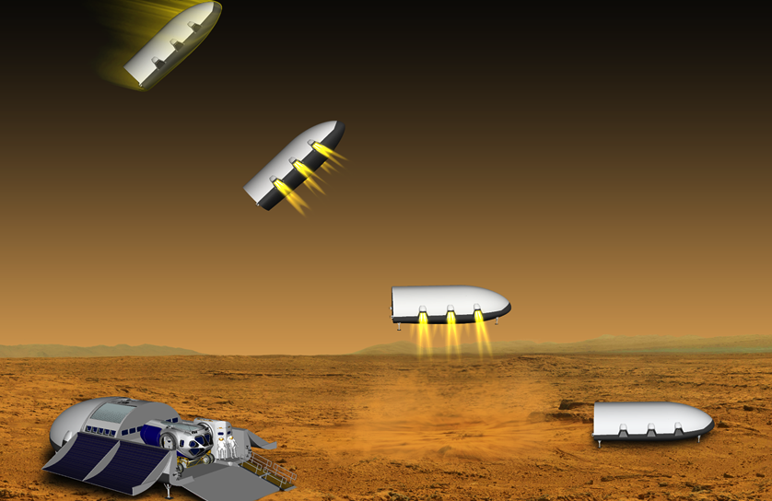
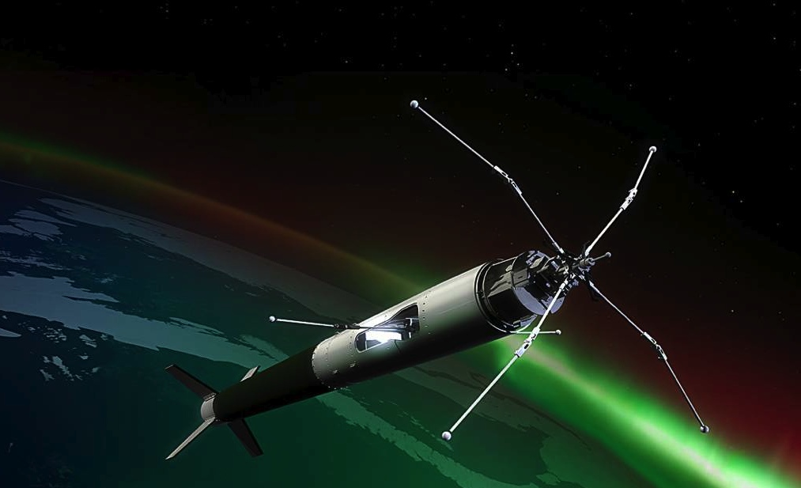
NASA MBSE Pathfinder
Informing next steps in Systems Engineering…
Architecture/DRM
Mars Colony ISRU
Team 1
Advanced Manufacturing
LOX/Methane Engine
Team 2
Exploration Class Element / Lander
Team 3
Sounding Rocket Mission Flow/Shadow
Team 4

Slide 17
MBSE Pathfinder Overview
Goals
  Application to complex NASA missions
  Multi-center collaboration / alignment
  Issue and Opportunity Capture
Background
  Numerous efforts at various Centers
  Several Center Workshops, 36 SysML Training Classes at 5 Centers, Agency NIMA Investment
  OCE (and OCIO) Cloud Environment
  Partnered with OCE to pilot their MBE Software floating license environment, and also evaluate a common domain for model archive and sharing.
More effectively utilize 21st Century technology, tools and methods across its diverse portfolio of programs, projects, and technological innovations
SE Focus Areas
  Team 1 Complex Mission Campaign
  Top level architecture /framework development and mission to mission re-use of products.
  Team 2 Re-Tooling Engineering
  Automation/evaluation of SE in an advanced (additive) manufacturing environment.
  Team 3 Campaign/Component Integration
  Integration of engineering analysis tools and interface between mission and sub-systems.
  Team 4 Sounding Rocket Mission Shadow
  Evaluate ROI benefits of MBSE in real-world repetitive mission flow environment.
Schedule
  Sept. 2015 SE Center Sr. Advisory Rep Mtg.
  MBSE was one of top noted opportunities
  Jan. 2016 Call for Center “Volunteers”
  Leverages areas of Center interest/skills
  29 volunteers from 9 of 10 NASA Centers
  Feb. 2016 Kick-Off/Training at WFF
  Team demographics maximize diversity,
  Final Work Plans finalized two-weeks later
  May 2016 Mid-Term Meeting at JSC
  Sept. 2016 Knowledge Capture Event

Slide 18
MBSE Pathfinder Participants
High Value
NASA Focus Areas
Participant Center
Participant MBSE Capability
GSFC
MSFC
ARC
GRC
JPL
JSC
KSC
LaRC
SSC
DoD
Kickoff
Midterm
Final
Architecture/DRM
Mars Colony ISRU
Team 1
1
1
1*
1
2
1
1*
Expert
21%
8 CS Team Members, 7 Centers
4%
4%
Additive Manufacture
LOX/Methane Engine
Team 2
1
1
1
1
2*
Practitioner
6 CS Team Members, 5 Centers
42%
25%
Exploration Class Element / Lander
Team 3
8%
1
1*
1
1
3
37%
7 CS Team Members, 5 Centers
71%
Beginner
Sounding Rocket Mission Flow/Shadow
Team 4
3*
1
1
1
2
88%
6 CS Team Members, 5 Centers + DoD
Over 50% of Participants had no prior MBSE Experience
NASA Experience: 4 to 40 years, Mean 19, Median 15
* denotes TL
** NOT FTEs, only partials

Slide 19
NESC Webinars
7/15 Camping or Colonizing Mars; In-Situ Resource Utilization
  Challenges of Mars Campaigns and Missions: G. Sanders
  Modeling to Mars: K. Vorndran & Team 1
7/29 Parking a Motorhome on Mars?
  Challenges of Mars Entry, Descent, and Landing: R. Manning
  Exploration Class Lander: B. Othon & Team 3
9/27 Fast or Fuel Efficient; Getting to Mars
  Overview/Explanation of In-Space Propulsion Systems: T. Brown
  Additive Manufacturing LOX/Methane Engine: G. Nelson & Team 2
10/7 Moving Cross Town or Cross the Solar System; Putting the Pieces Together
  Challenges of Rendezvous and Capture: N. Dennehy
  Sounding Rocket Mission Flows: J. Knizhnik & Team 4
10/28 NASA MBSE Pathfinder; Lessons Learned Harvest
  Overview/Explanation of NASA/OCE Cloud: A. West
  MBSE Implementation Take-Aways: K. Weiland

Slide 20
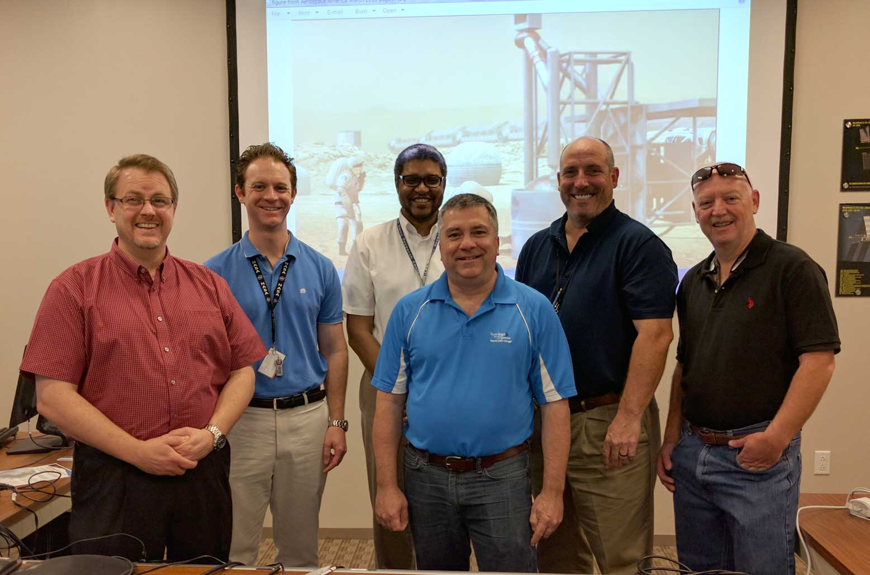
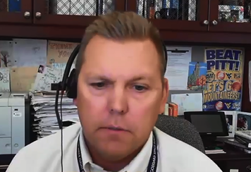
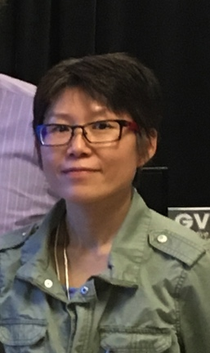
Team 1 – Modeling to Mars
GSFC IV&V – Ken Vorndran SSC – Eric Ross
ARC – Scott Miller JSC – Kris Lee
MSFC – Bobby Powell
LaRC – Robert Moses, Nipa Phojanamongkolkij

Slide 21
Team 1 Accomplishments
Numerous models for a Mars campaign and a mission to take In-Situ Resource Utilization cargo to the Mars surface
  Models can be reused and are in a model library
16 model based systems engineering products for technical reviews
  Program SRR and SDR
  Mission MCR and SRR
Agile systems engineering approach
  Collaboration – how to work on the same project with multiple modelers
Sensitivity analyses at the campaign level for two factors
  Mass limits for a particular launch
  Slips or delays in launch dates

Slide 22
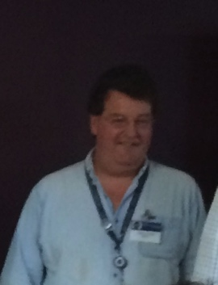
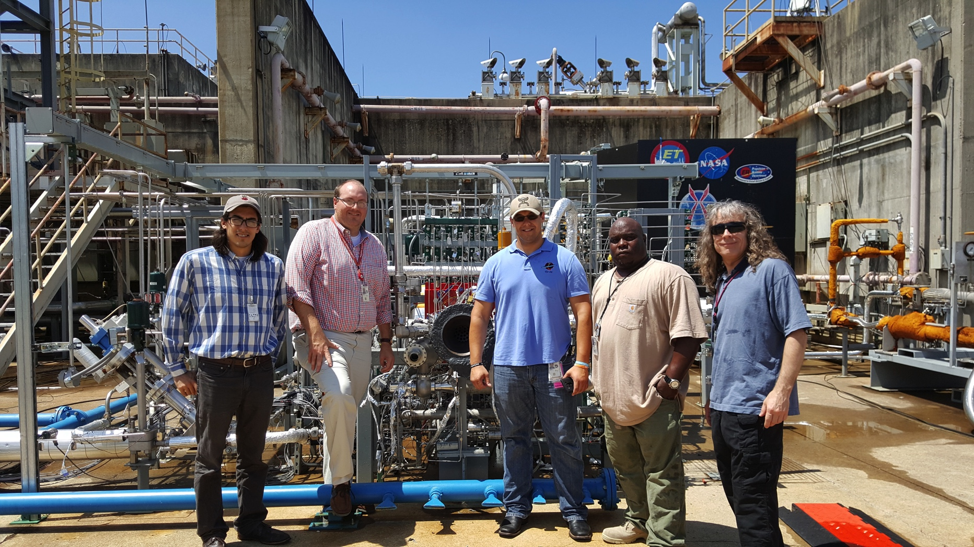
Team 2 – Additive Manufacturing and Re-tooling Engineering
MSFC – Graham Nelson, Randy Brackins
GRC – Bryan Fraser GSFC – James Sturm
JPL – Kevin Bonanne JSC – Ernesto Prado

Slide 23
Team 2 Accomplishments
Rocket engine design process enhancements
  Engine power balance data import and store in SysML
Model with top-level engine requirements and physical architecture
  Automatic verifications during design trade studies
  Mass and cost rollup calculations for demonstration of trade study automation
Auto‐generate up‐to‐date requirements and performance specifications for component leads
  Concurrent design process enabled by additive manufacturing
  Shift to “test-fail-fix”

Slide 24
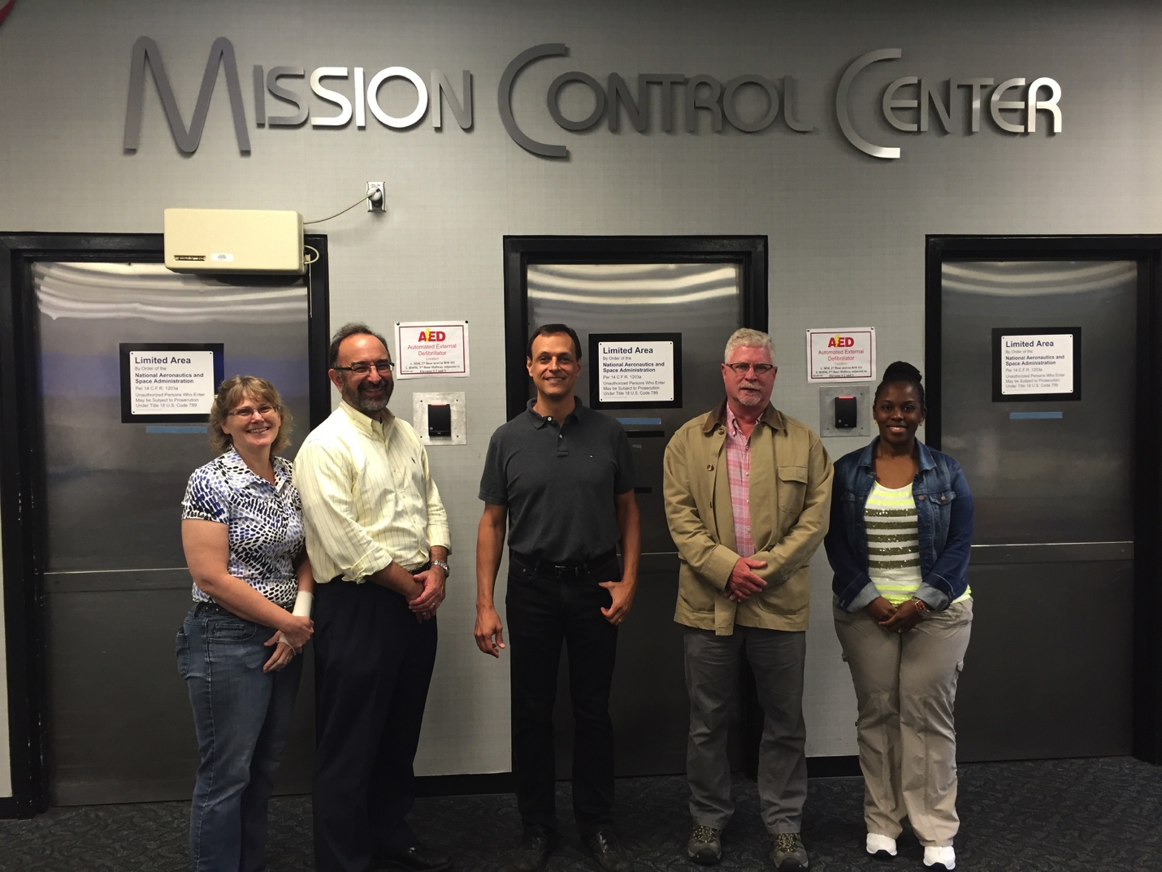
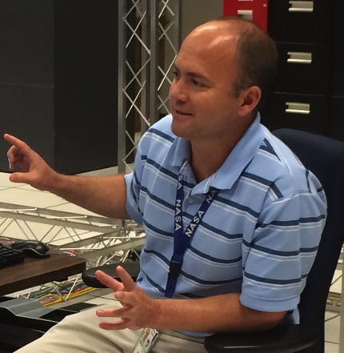
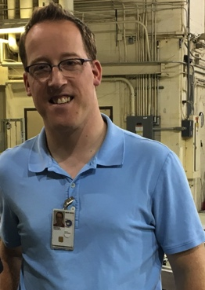
Team 3 – Mission Element
JSC – Bill Othon, Ron Maglothin GRC – Edith Parrott
KSC – Emilio Valencia LaRC – Trevor Grondin
MSFC – Paul Gill, Phil Hall, LaVeda Jackson

Slide 25
Team 3 Accomplishments
Re-usable libraries and patterns for a Mars Lander
  Final descent and landing operations and requirements
  Lander system, command and data handling, power, structures, and guidance, navigation and control components and interfaces
System model interactions with other engineering disciplines
  CAD and Dynamics Simulation (Trick)
Model organization for collaboration and control
  Isolate subsystem development and allow engineers more control over technical areas

Slide 26
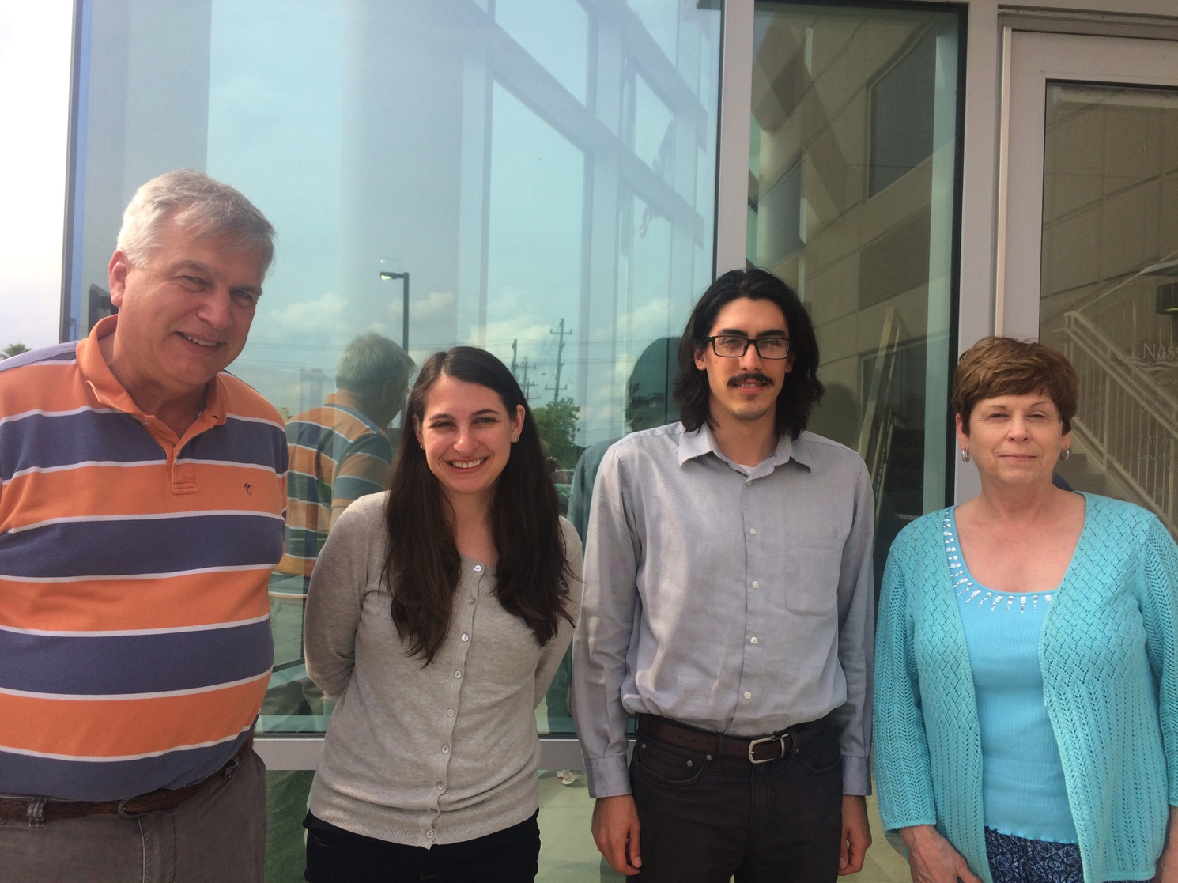
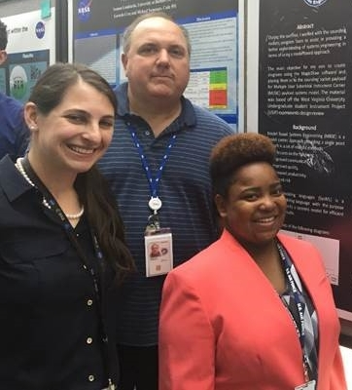
Team 4 – Sounding Rocket
Mission Flow Shadowing
GSFC – Jessica Knizhnik, Ed Amatucci, Denise McGarity (student)
JPL – Kevin Bonanne GSFC WFF – David Kotsifakis
SSC – Rebecca Deschamp

Slide 27
Team 4 Accomplishments
System model of Multiple User Suborbital Instrument Carrier (MUSIC) sounding rocket mission
  Design Review requirements from SRPO
  MUSIC mission information
  Generic, reusable, and reconfigurable component library
Immediate value to Sounding Rocket Program Office
  Identified missing and implied requirements and events
  Examination of current operating processes and information transfer
Department of Defense partner
  Program model of SRPO, project lifecycle, and measures of success
  Track cost, schedule, risk, and technical performance before and after MBSE implementation

Slide 28
Knowledge Capture Meeting
Capture lessons learned and recommended next steps
Session Title | Discussion Areas
Lessons Learned about this Pathfinder | What to continue or change for a follow-on and what focus areas of interest should be continued or changed
How to Do Systems Engineering with MBSE | What changes to NASA processes or NPR "shall" statements needed to be made and if any areas were ready to convert from document-centric to model-centric
Learning to Model | Types of training, mentors, on-the-job training, aids, and examples
NASA Infrastructure | Collaboration environment, access to software and licenses, and access to knowledge
MBSE with Other Areas | Configuration management, fault management, project management, and physics based models
Acceptance of MBSE | Acceptance of MBSE with line management, project management, systems engineering peers, peers in other disciplines, and review boards
Open Discussion | What to do about MBSE at the Agency Level

Slide 29
Knowledge Capture Summary
NASA Cloud for MBSE
  Solved many issues and had a successful expansion of the number and types of software licenses
  Higher number of users than before
Lessons Learned about this Pathfinder
  Focus was on learning how to model a system, not necessarily doing SE
  Suggestions for follow-on work
    Model more of the life-cycle of a product
    Link models from different teams
    Embed expert on each team
SE Processes with MBSE
  Too early to standardize on a specific toolset
  General acceptance of SysML for MBSE
  Start the adoption now, thoughtful and incremental

Slide 30
Knowledge Capture Summary
Learning to Model
  Teams experience ranged from novices to experts
  A lot to learn – language, tool chain, team work processes
Infrastructure
  Recommend a NASA-wide MBSE wiki to facilitate communication and socialization => glossary, best practices, etc.
  Continue to grow the cloud => more access and more users
  Establish a pilot team to SE the MBSE ecosystem
MBSE with other areas
  Involves data transformation, presentation, analysis, levels of detail
  Data as the “single source of truth”
  Recommend develop profiles with NASA Standards
Acceptance of MBSE
  Scattered use at centers with small successes, not a cohesive story
  Identify a champion at each Center to tie stories together
  Stakeholder analysis to drive implementation priorities

Slide 31
Agency-level Recommended Next Steps
Demonstrate the value of MBSE
  Focus on real NASA missions
  Produce real products
Gain the interest of projects and external partners
  DoD for mission flow shadowing
  Software vendor collaborations
Community of Practice with online collaboration space and libraries
  Agency resource for the Centers
  Handbooks, training, and seminars for getting started
Architect the NASA ecosystem for MBSE
  Establish how systems engineers will do their jobs
  Software tools used; what are needed; identify solutions for future NASA needs
Guidance on using MBSE with NASA SE processes
  Technical milestone review products
  Design and requirement compliance

Slide 32
MBSE Pathfinder Part 2 Plans and Schedule
Solicitation sent out by Jon Holladay to EMB members on 10/19
  Solicit participants for 2017; nominations due by 11/4
  Up to five topic areas
  Work plans more focused than for 2016
    Implement lessons learned
    Focus on the development of SE products across the life-cycle and integration with various analytical tools
  Georgia Tech ASDL students will participate
Tentative Schedule
  Kickoff in mid-November
  Training for new participants in December
  Advanced training for prior participants
  Part 2 ends 9/27/2017

Slide 33

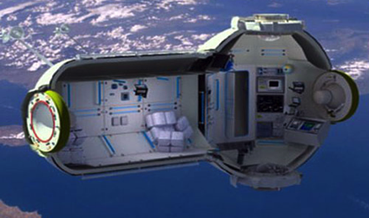
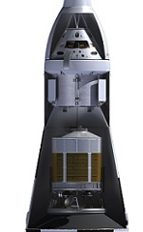

Potential Product and Work Activities
  LOX or methane farm development trades
  Characterization of components
  Concept of operations
  Space system requirements decomposition
  System level optimization trades
  Engine requirements to include analysis & test V&V
  Configuration Management of design
  Flow from CAD to additive manufacturing
  Testing and additive manufacturing
  PAF requirements with loads analysis and IDD generation
  Configuration Management of design
  Flow from CAD to composite manufacturing
  Testing and composite manufacturing
  Addition of discipline analysis to existing MBSE mission models
  Includes both programmatic and technical (DoD partnering)
  20+ Flights per year for shadowing and validation

Slide 34
Anticipated Challenge and Focus Areas
Eco-System and Clean-up Examples
  Common patterns and terminology for users
  Virtual Community of Practice
  Handbook for new users
  Awareness of potential new tools and plug-ins
  Four teams have good model baselines for systems of interest
    Models may require adjustment to common patterns and structure
    We need to also consider product and work breakdown structures
    New team (PAF) has an existing and mature requirement document
Application Examples
  Integration and configuration control of models
    Requirements
    Analysis (ROCETS, Loads, etc.)
    Repetitive Trades
    CAD
    CAM
    Test, Validation and Verification
  Visualization of Models
  Production of traditional artifacts from models

Slide 35
MBSE Pathfinder Summary
Technical
  All teams accomplished a significant amount of system modeling work
  Participants used many different approaches, tools, and processes
  Participants identified learning along the way
Organizational
  People were primarily from engineering, but not necessarily systems engineering
  Multiple levels were involved – Centers, NESC, HQ OCE
Cultural
  People on each team were from multiple Centers and disciplines, and had varying levels of experience
  Teams worked virtually for 8 months with 3 face-to-face meetings
  Two teams each had an additional face-to-face meeting

Slide 36
Impact
Benefits to NASA
  Trained and experienced cohort of 30+ people – smart buyers
  Go-to resource for Agency and Centers, national and international
  Increase or revival of Center working and learning groups
    Over 600 NASA people directly touched
Outstanding example of empowered teams – how did this happen?
  Management support from all levels
  Focus on quick, real-world experiences
  Active involvement of experienced and expert personnel

Slide 37
Conclusion
MBSE Pathfinder was very successful in 2016
  Provided significant number of lessons-learned for next steps
  Systems-of-interest were selected from NASA missions
  Virtual environment represented the modern workplace
  Established a strong collaborative community
Continuation into 2017 will maintain the momentum
The MBSE Pathfinder demonstrated to NASA how people from many different organizations and Centers can work effectively across boundaries and cultural differences

Slide 38
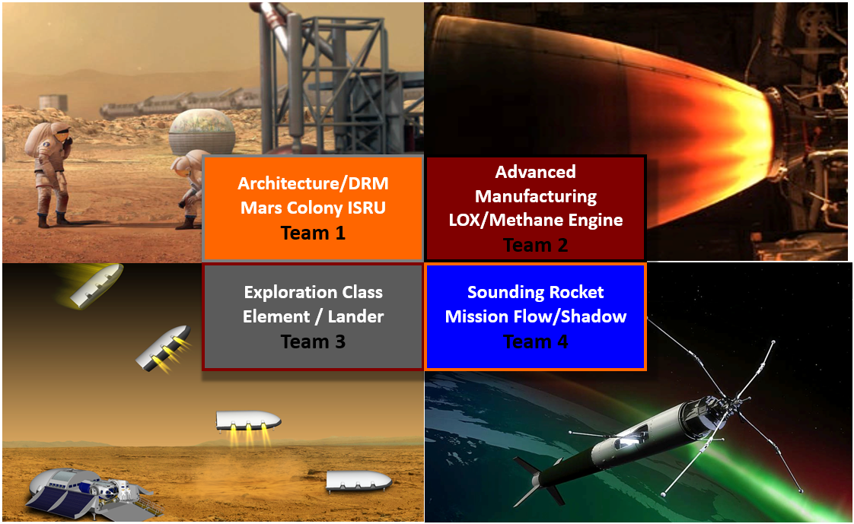
Questions?
Visit http://nescacademy.nasa.gov to view previous webcasts in this series.

