Slide 1
Unit 14
Synthesizing a Time History to Satisfy a Power Spectral Density using Random Vibration

Slide 2
Synthesis Purposes
A time history can be synthesized to satisfy a PSD
A PSD does not have a unique time history because the PSD discards phase angle
Vibration control computers do this for the purpose of shaker table tests
The synthesized time history can also be used for a modal transient analysis in a finite element model
This is useful for stress and fatigue calculations

Slide 3
Random Vibration Test
The Control Computer synthesizes a time history to satisfy a PSD specification.

Slide 4
Synthesis Steps
Step | Description
1 | Generate a white noise time history
2 | Take the FFT
3 | Scale the FFT amplitude per the PSD for each frequency
4 | The time history is the inverse FFT
5 | Use integration, polynomial trend removal, and differentiation so that corresponding mean velocity and mean displacement are both zero
6 | Scale the time history so that its GRMS value matches the specification’s overall GRMS value
7 | Take a PSD of the synthesized time history to verify that it matches the PSD specification

Slide 5
NAVMAT P-9492
PSD Overall Level = 6.06 GRMS
Accel
(G^2/Hz)
Frequency (Hz) | Accel (G^2/Hz)
20 | 0.01
80 | 0.04
350 | 0.04
2000 | 0.007
Frequency (Hz)

Slide 6
Time History Synthesis
vibrationdata > Power Spectral Density > Time History Synthesis from White Noise
Input file: navmat_spec.psd
Duration = 60 sec
Row 8, df = 2.13 Hz, dof = 256
Save Acceleration time history as: input_th
Save Acceleration PSD as: input_psd

Slide 7
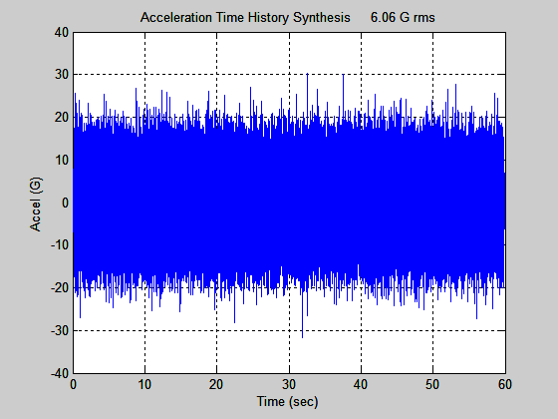
Base Input
Matlab array: input_th

Slide 8
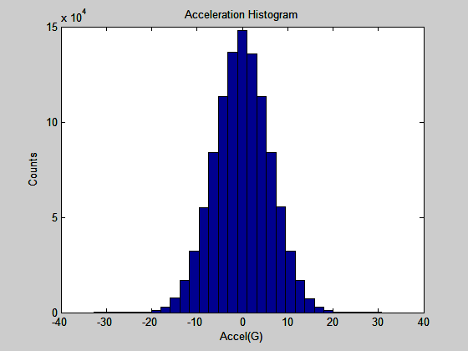
Base Input

Slide 9
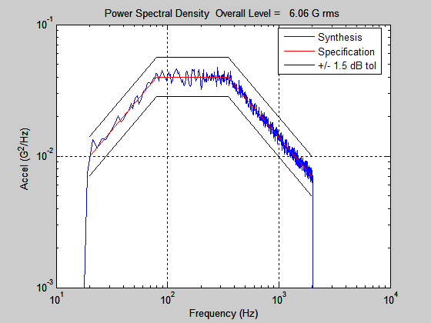
Base Input
Matlab array: input_psd

Slide 10
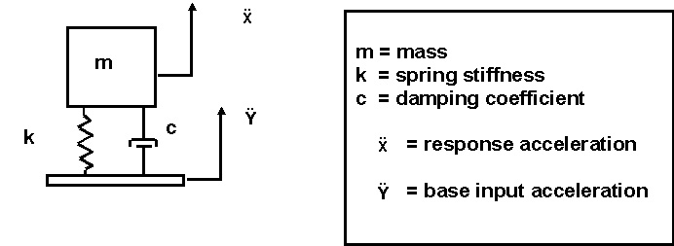
SDOF System Subject to Base Excitation
NESC Academy
The natural frequency is
Example:
fn = 200 Hz, Q=10

Slide 11
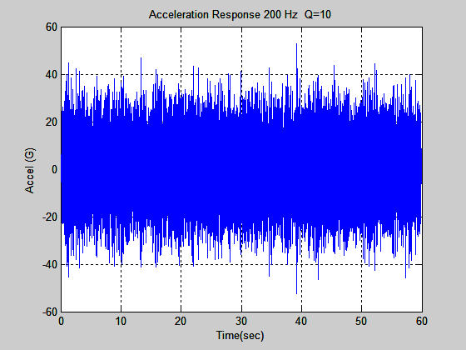
Acceleration
Response (G)
max= 52.69
min= -52.56
RMS= 11.24
crest factor= 4.69
Relative
Displacement (in)
max= 0.01279
min=-0.01282
RMS=0.002735
The theoretical crest factor from the Rayleigh distribution = 4.58
Matlab array: response_th

Slide 12
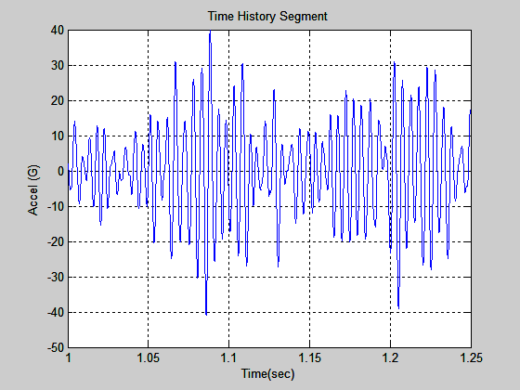
Response
fn=200, Q=10
The response is narrowband random.
There are approximately 50 positive peaks over the 0.25 second duration, corresponding to 200 Hz.

Slide 13
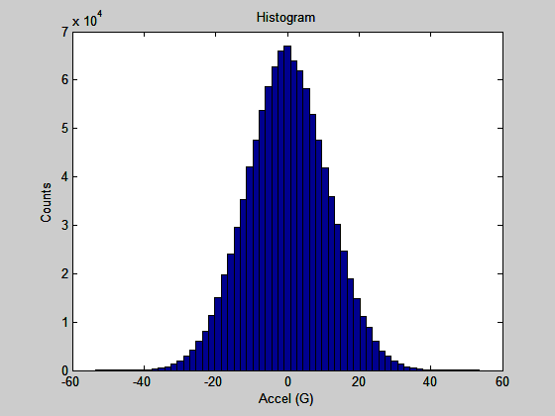
Response fn=200, Q=10

Slide 14
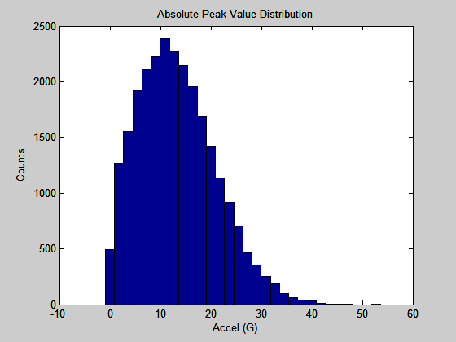
PSD SDOF Response fn=200 Hz Q=10
Rayleigh Distribution

Slide 15
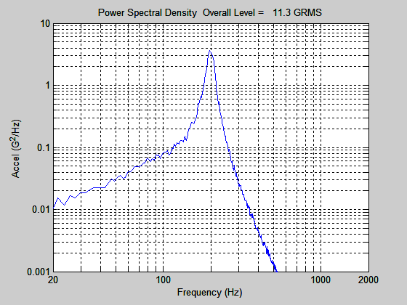
Response fn=200, Q=10
Matlab array: response_psd
Peak is ~ 100 x Input at 200 Hz.
Q^2 =100.
Only works for SDOF system response.
Row 8, df = 2.13 Hz, dof = 254

Slide 16
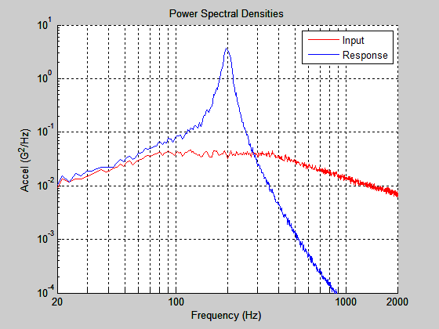
Response fn=200, Q=10

Slide 17
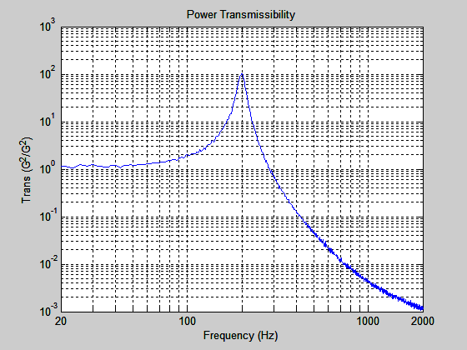
Matlab array: trans

Slide 18
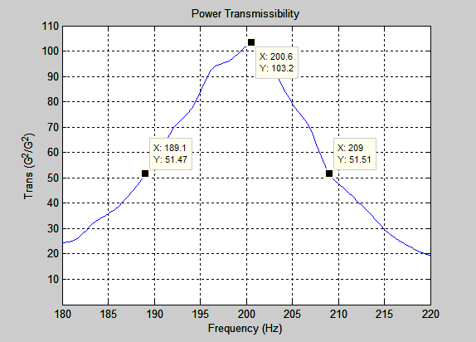
3 dB Bandwidth ≅ 20 Hz

Slide 19
Half Power Bandwidth & Curve-fit
Q = fn / Δf
fn = natural frequency
Δf = frequency bandwidth for -3 dB points
Q = 200 Hz / 20 Hz = 10
Now perform a curve-fit using the parameters shown on the next slide.

Slide 20
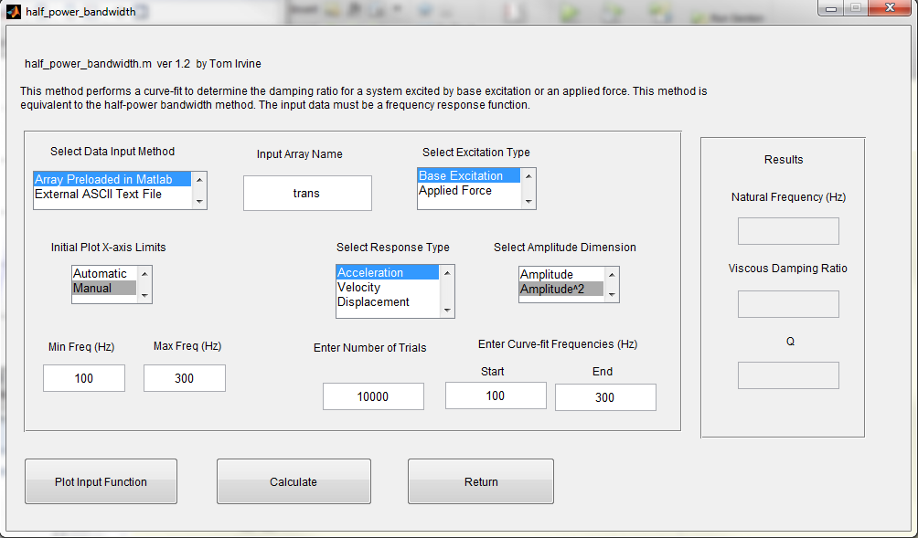

Slide 21


