Slide 1
Unit 23
Response to Classical Pulse Excitation

Slide 2

Classical Pulse Introduction
Vehicles, packages, avionics components and other systems may be subjected to base input shock pulses in the field
The components must be designed and tested accordingly
This units covers classical pulses which include:
  Half-sine
  Sawtooth
  Rectangular
  etc

Slide 3
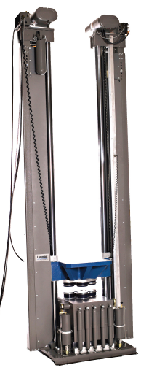
Shock Test Machine
Classical pulse shock testing has traditionally been performed on a drop tower
The component is mounted on a platform which is raised to a certain height
The platform is then released and travels downward to the base
The base has pneumatic pistons to control the impact of the platform against the base
In addition, the platform and base both have cushions for the model shown
The pulse type, amplitude, and duration are determined by the initial height, cushions, and the pressure in the pistons
platform
base

Slide 4
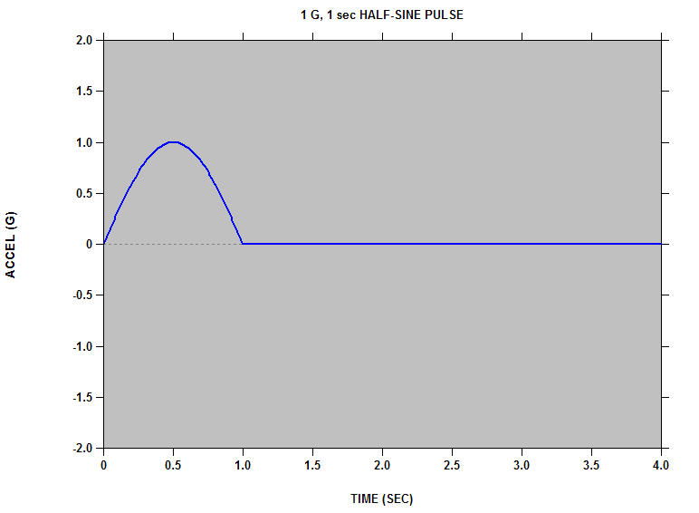
Half-sine Base Input
1 G, 1 sec HALF-SINE PULSE
Accel (G)
Time (sec)

Slide 5
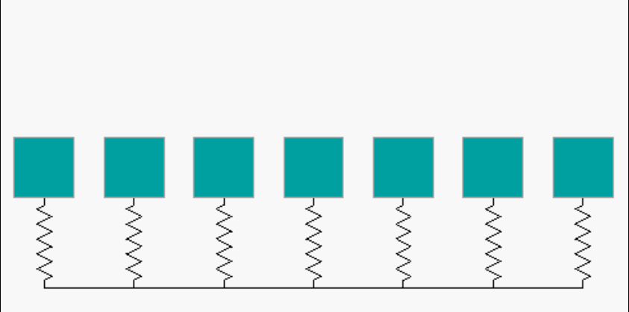
Systems at Rest
Soft
Hard
Natural Frequencies (Hz):
0.063 0.125 0.25 0.50 1.0 2.0 4.0
Each system has an amplification factor of Q=10

Slide 6
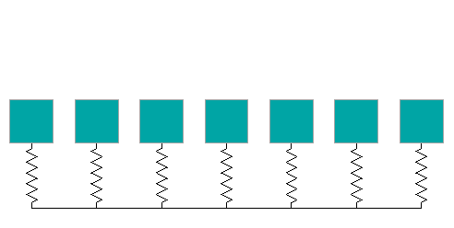
Click to begin animation. Then wait.

Slide 7
Systems at Rest
Soft
Hard
Natural Frequencies (Hz):
0.063 0.125 0.25 0.50 1.0 2.0 4.0

Slide 8
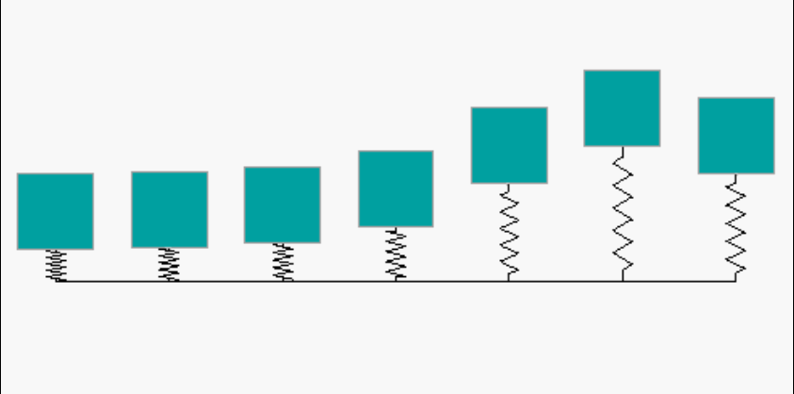
Responses at Peak Base Input
Soft
Hard
Soft system has high spring relative deflection, but its mass remains nearly stationary
Hard system has low spring relative deflection, and its mass tracks the input with near unity gain

Slide 9
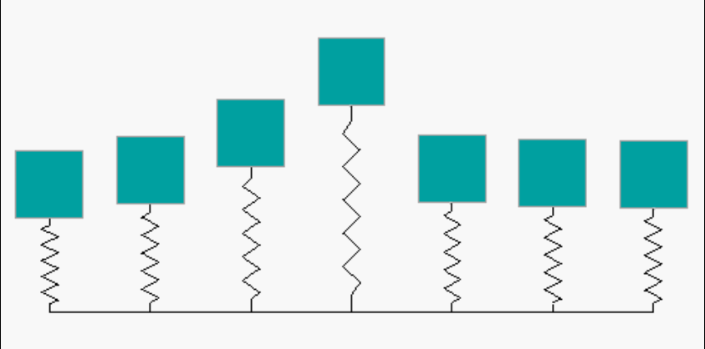
Responses Near End of Base Input
Soft
Hard
Middle system has high deflection for both mass and spring

Slide 10
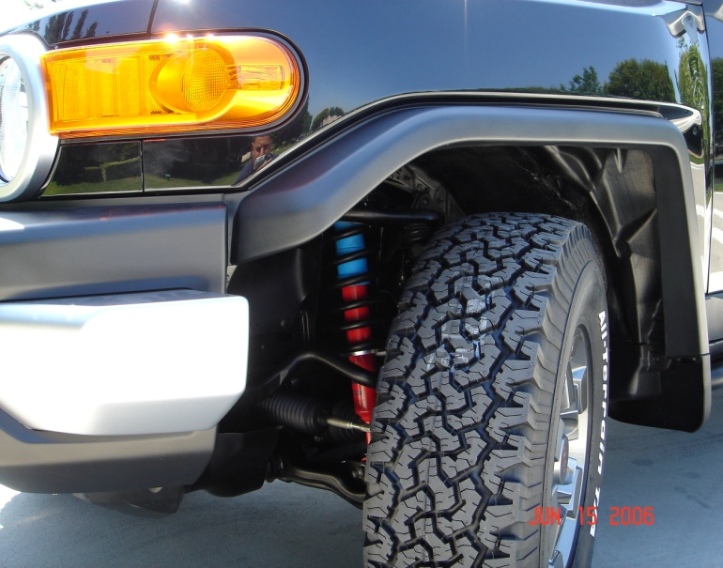
Soft Mounted Systems
Soft System Examples:
Automobiles isolated via shock absorbers
Avionics components mounted via isolators
It is usually a good idea to mount systems via soft springs.
But the springs must be able to withstand the relative displacement without bottoming-out.

Slide 11
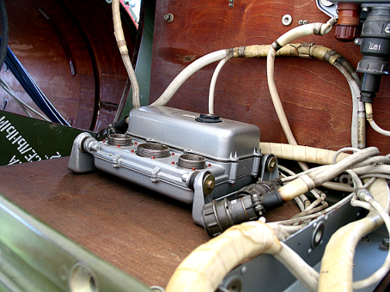
Isolated avionics component, SCUD-B missile.
Public display in Huntsville, Alabama, May 15, 2010
Isolator Bushing

Slide 12
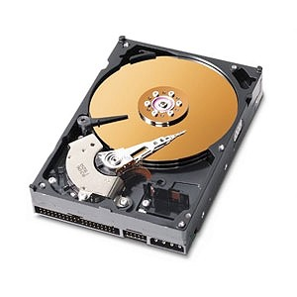
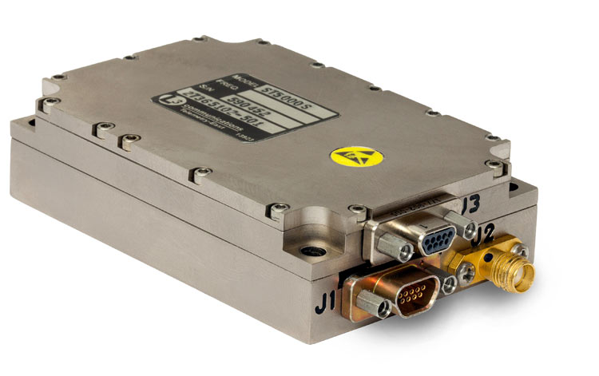
But some systems must be hardmounted
Consider a C-band transponder or telemetry transmitter that generates heat
It may be hardmounted to a metallic bulkhead which acts as a heat sink
Other components must be hardmounted in order to maintain optical or mechanical alignment
Some components like hard drives have servo-control systems, and hardmounting may be necessary for proper operation

Slide 13
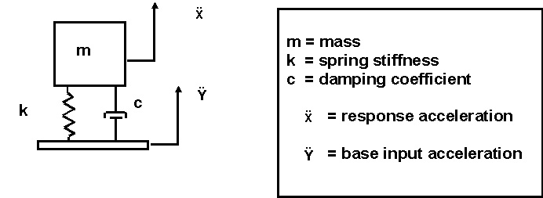
SDOF System

Slide 14
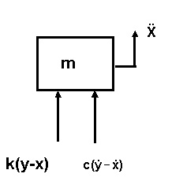
Free Body Diagram
Summation of forces in the vertical direction
Let z = x - y. The variable z is thus the relative displacement.
Substituting the relative displacement yields

Slide 15
Derivation
By convention,
 | is the natural frequency (rad/sec)
ξ | is the damping ratio
Substituting the convention terms into equation,
15
This is a second-order, linear, non-homogenous, ordinary differential equation with constant coefficients.

Slide 16
Derivation (cont.)
For a half-sine pulse
Solve for the relative displacement z using Laplace transforms.
Then, the absolute acceleration is

Slide 17
SDOF Example
A spring-mass system is subjected to:
10 G, 0.010 sec, half-sine base input
The natural frequency is an independent variable
The amplification factor is Q=10
Will the peak response be
> 10 G, = 10 G, or < 10 G ?
Will the peak response occur during the input pulse or afterward?
Calculate the time history response for natural frequencies = 10, 80, 500 Hz

Slide 18
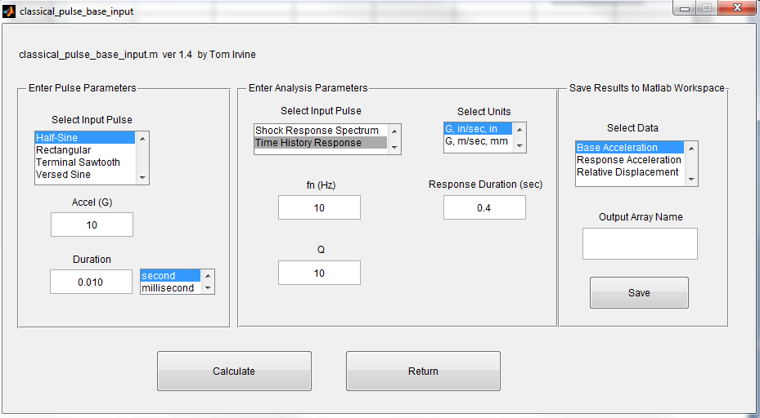
SDOF Response to Half-Sine Base Input
>> vibrationdata > Miscellaneous > Shock > SDOF Response: Classical Base Input > Time History Response

Slide 19
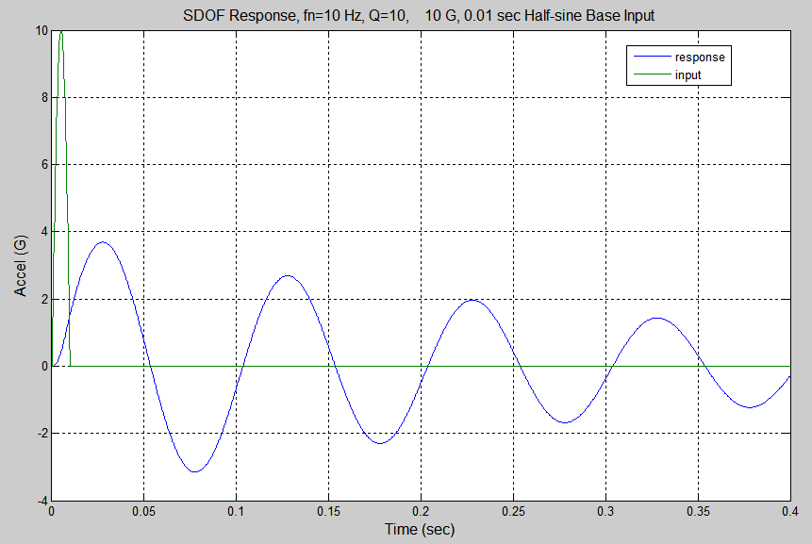
maximum acceleration = 3.69 G
minimum acceleration = -3.15 G

Slide 20
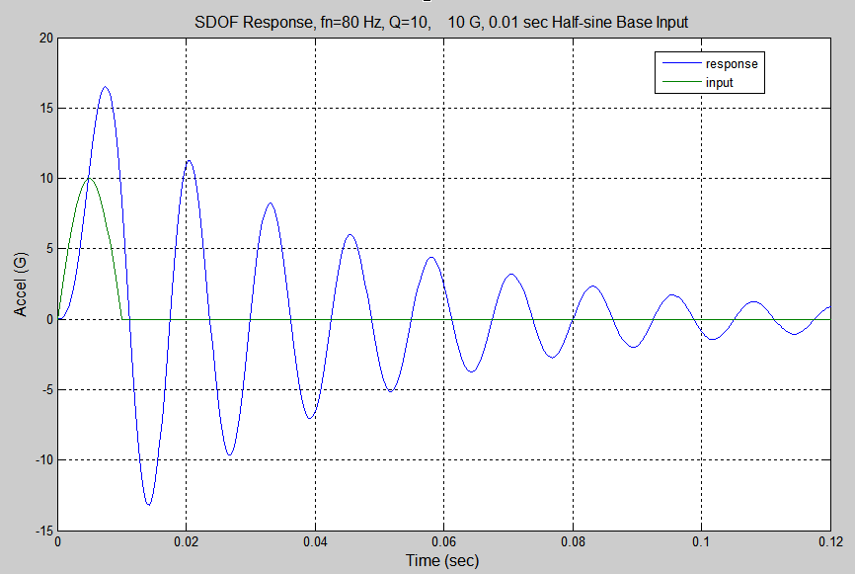
maximum acceleration = 16.51 G
minimum acceleration = -13.18 G

Slide 21
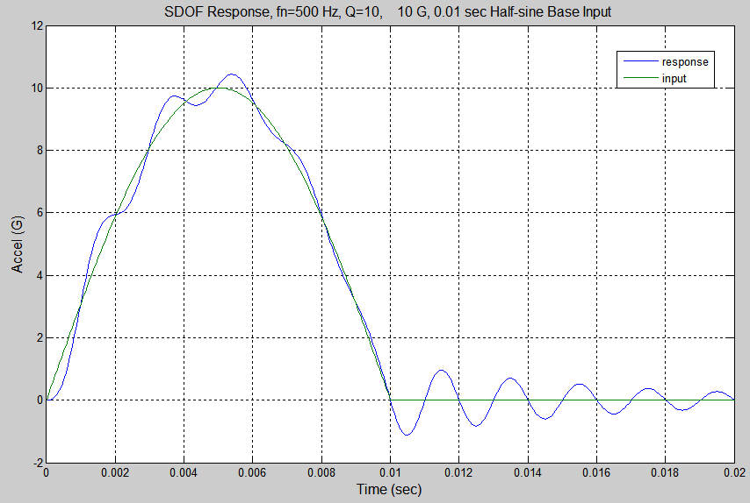
maximum acceleration = 10.43 G
minimum acceleration = -1.129 G

Slide 22
Summary of Three Cases
A spring-mass system is subjected to:
10 G, 0.010 sec, half-sine base input
Shock Response Spectrum Q=10
Natural Frequency (Hz) | Peak Positive Accel (G) | Peak Negative Accel (G)
10 | 3.69 | 3.15
80 | 16.5 | 13.2
500 | 10.4 | 1.1
Note that the Peak Negative is in terms of absolute value.

Slide 23
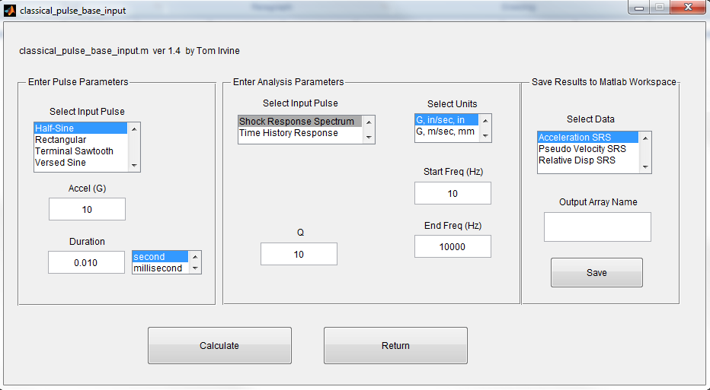
Half-Sine Pulse SRS
>> vibrationdata > Miscellaneous > Shock > SDOF Response: Classical Base Input > Shock Response Spectrum

Slide 24
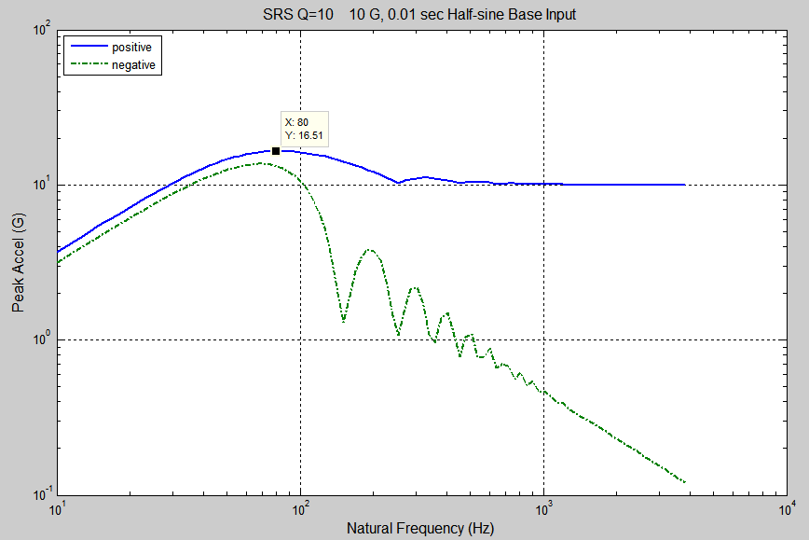
SRS Q=10 10 G, 0.01 sec Half-sine Base Input
X: 80 Hz
Y: 16.51 G
Natural Frequency (Hz)

Slide 25
Homework
Repeat the examples for the half-sine pulse
Also, do this for a 10 G, 10 msec terminal sawtooth pulse

