Slide 1
Unit 28
Multi-degree-of-freedom System
Shock Response Spectrum

Slide 2
Introduction
The SRS can be extended to multi-degree-of-freedom systems
There are two options
Modal transient analysis using synthesized waveform
Approximation techniques using participation factors and normal modes

Slide 3
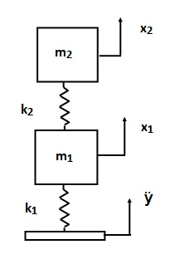
Two-dof System Subjected to Base Excitation
Damping will be applied as modal damping

Slide 4
Free-Body Diagrams
k₂ ( x₂ - x₁ )
x₂
m₂
x₁
m₁
k₂ (x₂-x₁)
k₁ ( x₁ - y )

Slide 5
Equation of Motion
Assemble the equations in matrix form
The equations are coupled via the stiffness matrix

Slide 6
Relative Displacement Substitution
Define relative displacement terms as follows
This works for some simple systems. Enforced acceleration method is required for other systems.
The resulting equation of motion is

Slide 7
General Form
where

Slide 8
Decoupling
Decouple equation of motion using eigenvalues and eigenvectors
The natural frequencies are calculated from the eigenvalues
The eigenvectors are the “normal modes”
Details given in accompanying reference papers

Slide 9
Proposed Solution
Seek a harmonic solution for the homogeneous problem of the form
where
= the natural frequency (rad/sec)
= modal coordinate vector or eigenvector

Slide 10
Solution Development
The solution and its derivatives are
Substitute into the homogeneous equation of motion

Slide 11
Generalized Eigenvalue Problem
Eigenvalues are calculated via
where
K is the stiffness matrix
M is the mass matrix
is the natural frequency (rad/sec)
There is a natural frequency for each degree-of-freedom

Slide 12
Generalized Eigenvalue Problem (cont)
Calculate eigenvectors
The eigenvectors describe the relative displacement of the degrees-of-freedom for each mode
The overall motion of the system is a superposition of the individual modes for the case of free vibration
There is a corresponding mode shape for each natural frequency

Slide 13
Eigenvector Relationships
Form matrix from eigenvectors
Mass-normalize the eigenvectors such that
(identity matrix)
Then
(diagonal matrix of eigenvalues)

Slide 14
Decouple Equation of Motion
Define a modal displacement coordinate
Substitute into the equation of motion
Premultiply by
Orthogonality relationships yields

Slide 15
Modified Equation of Motion
The equation of motion becomes
Now add damping matrix
is the modal damping for mode i

Slide 16
Candidate Solution Methods, Time Domain
Runge-Kutta - becomes numerically unstable for “stiff” systems
Newmark-Beta - reasonably good – favorite of Structural Dynamics textbooks
Digital recursive filtering relationship - best choice but requires constant time step

Slide 17
Digital Recursive Filtering Relationship
The digital recursive filtering relationship is the same as that given in Webinar 17, SDOF Response to Applied Force - please review
The solution in physical coordinates is then

Slide 18
Participation Factors
Participation factors and effective modal mass values can be calculated from the eigenvectors and mass matrix
These factors represent how “excitable” each mode is
Might cover in a future Webinar, but for now please read:
T. Irvine, Effective Modal Mass & Modal Participation Factors, Revision F, Vibrationdata, 2012

Slide 19
Participation Factors
Participation factors and effective modal mass values can be calculated from the eigenvectors and mass matrix
These factors represent how “excitable” each mode is
Might cover in a future Webinar, but for now please read:
T. Irvine, Effective Modal Mass & Modal Participation Factors, Revision F, Vibrationdata, 2012

Slide 20
Participation Factors
is the participation factor for mode i
For the two-dof example in this unit

Slide 21
MDOF Estimation for SRS
ABSSUM – absolute sum method
SRSS – square-root-of-the-sum-of-the-squares
NRL – Naval Research Laboratory method

Slide 22
ABSSUM Method
Conservative assumption that all modal peaks occur simultaneously
Pick D values directly off of Relative Displacement SRS curve
where is the mass-normalized eigenvector coefficient for coordinate i and mode j
These equations are valid for both relative displacement and absolute acceleration.

Slide 23
SRSS Method
Pick D values directly off of Relative Displacement SRS curve
These equations are valid for both relative displacement and absolute acceleration.

Slide 24
Example: Avionics Component & Base Plate
m₂ = 5 lbm
Q=10 for both modes
k₂ = 4.6e+04 lbf/in
Perform
normal modes
Transmissibility analysis
m₁ = 2 lbm
k₁ = 4.6e+04 lbf/in

Slide 25
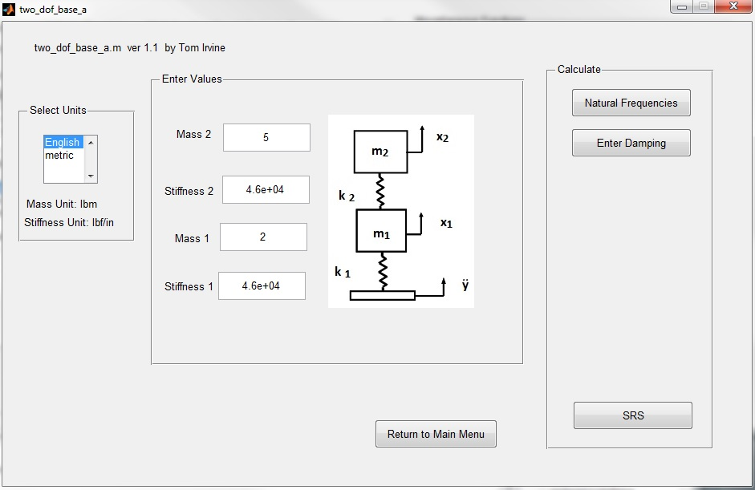
vibrationdata > Structural Dynamics > Spring-Mass Systems > Two-DOF System Base Excitation

Slide 26
Normal Modes Results
>> vibrationdata
Natural Participation Effective
Mode Frequency Factor Modal Mass
1 201.3 Hz 0.1311 0.0172
2 706.5 Hz 0.03063 0.0009382
modal mass sum = 0.01813 lbf sec^2/in (7.0 lbm)
mass matrix
0.0052 0
0 0.0130
stiffness matrix
92000 -46000
-46000 46000
ModeShapes =
4.5606 13.1225
8.2994 -2.8844

Slide 27
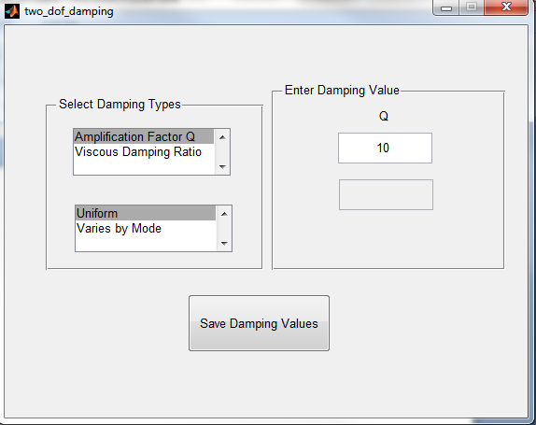
Enter Damping

Slide 28
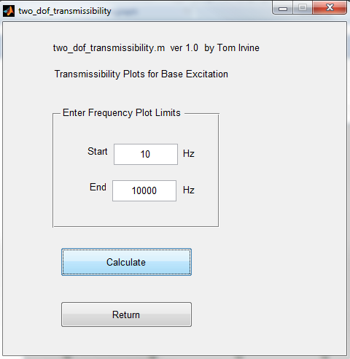
Transmissibility Analysis

Slide 29
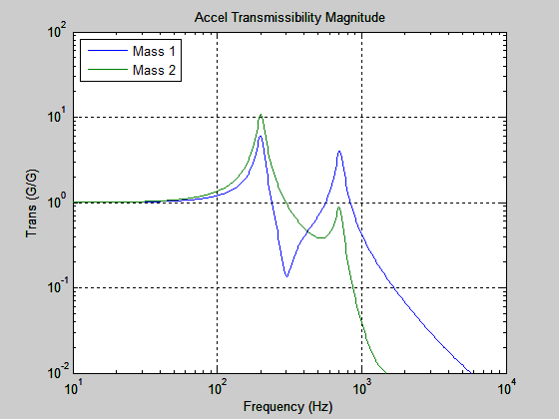
Acceleration Transmissibility

Slide 30
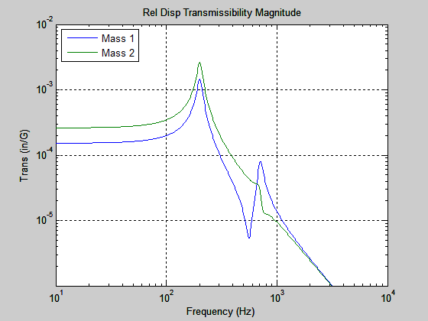
Relative Displacement Transmissibility
Relative displacement response is dominated by first mode.

Slide 31
SRS Base Input to Two-dof System
SRS Q=10
Perform:
Modal Transient using Synthesized Time History
SRS Approximation
Natural Frequency (Hz) | Peak Accel (G)
10 | 10
2000 | 2000
10,000 | 2000
srs_spec =[10 10; 2000 2000; 10000 2000]

Slide 32
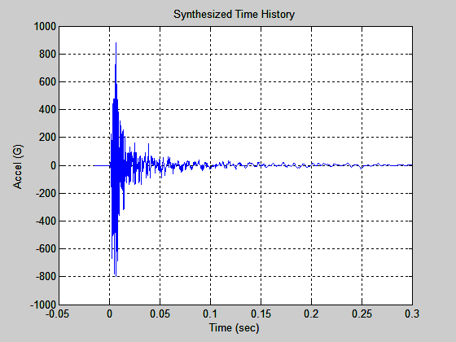
Modal Transient Method, Synthesis
File: srs2000G_accel.txt

Slide 33
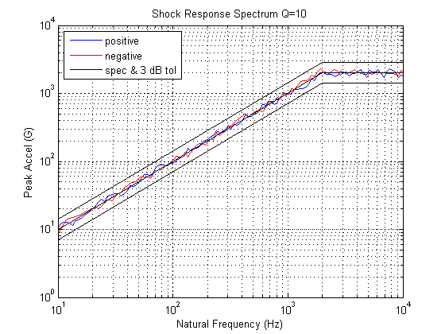
Modal Transient Method, Synthesis (cont)

Slide 34
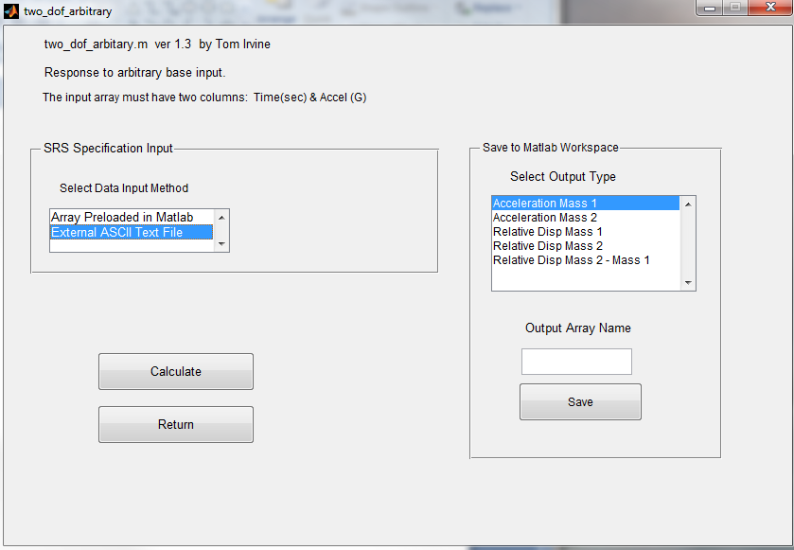
External File: srs2000G_accel.txt

Slide 35
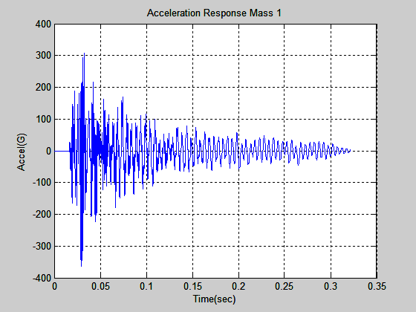
Modal Transient Response Mass 1

Slide 36
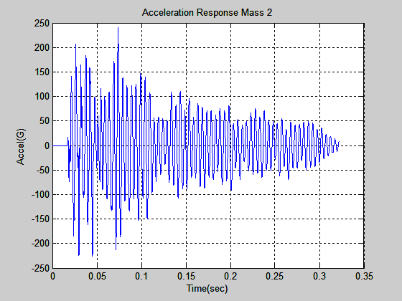
Modal Transient Response Mass 2

Slide 37
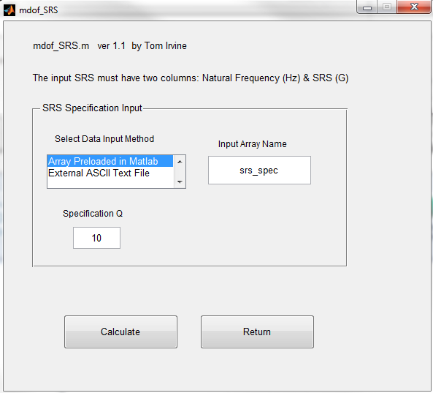
SRS Approximation for Two-dof Example

Slide 38
Comparison
Peak Accel (G)
Mass | Modal Transient | SRSS | ABSSUM
1 | 365 | 309 | 404
2 | 241 | 228 | 282
Both modes participate in acceleration response.

Slide 39
Comparison (cont)
Peak Rel Disp (in)
Mass | Modal Transient | SRSS | ABSSUM
1 | 0.029 | 0.030 | 0.034
2 | 0.055 | 0.053 | 0.054
Relative displacement results are closer because response is dominated by first mode.

