Slide 1

Unit 31
Rectangular & Circular Plate
Shock & Vibration
By Tom Irvine
Dynamic Concepts, Inc.

Slide 2
Introduction
This unit will continue plate bending shock & vibration
Plates modeled as continuous systems
(Finite element analysis for plates will be covered in a future unit)
First perform normal modes analysis
Next Plates will be subjected to base excitation (enforced acceleration)
Also consider stress-velocity relationship for plates

Slide 3
Rayleigh’s Method
Exact natural frequencies and mode shape solutions can be found for certain boundary condition cases, such as rectangular plate simply-supported on all sides
The Rayleigh method is used in other cases to determine the natural frequency and mode shape of a structure
Rayleigh method is
where
KE = kinetic energy
PE = potential energy

Slide 4
Rayleigh’s Method (cont)
Rayleigh's method requires an assumed displacement function
The method thus reduces the dynamic system to a single-degree-of-freedom system.
The assumed displacement function introduces additional constraints which increase the stiffness of the system
Rayleigh's method yields an upper limit of the true fundamental frequency
So form a number of candidate trial displacement functions each of which satisfies the boundary conditions
Select the winner as the function which yields the lowest natural frequency

Slide 5
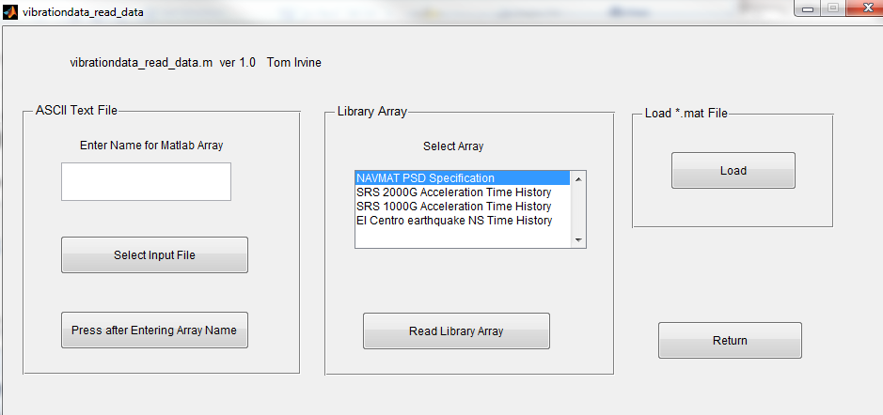
Read Input Arrays
vibrationdata > Import Data to Matlab
Read in Library Arrays: NAVMAT PSD Specification & SRS 1000G Acceleration Time History

Slide 6
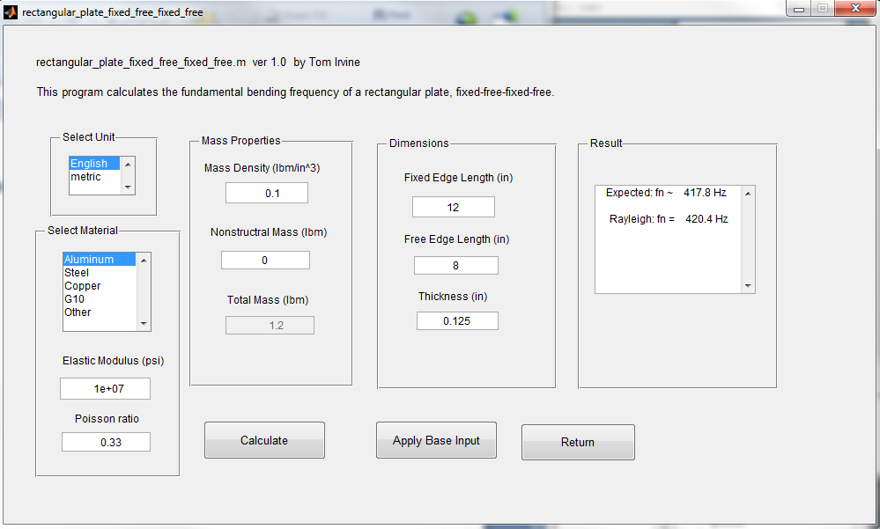
Rectangular Plate 12 x 8 x 0.125 inch
vibrationdata > structural dynamics > Plates, Rectangular & Circular >
Rectangular Fixed-Free-Fixed-Free

Slide 7
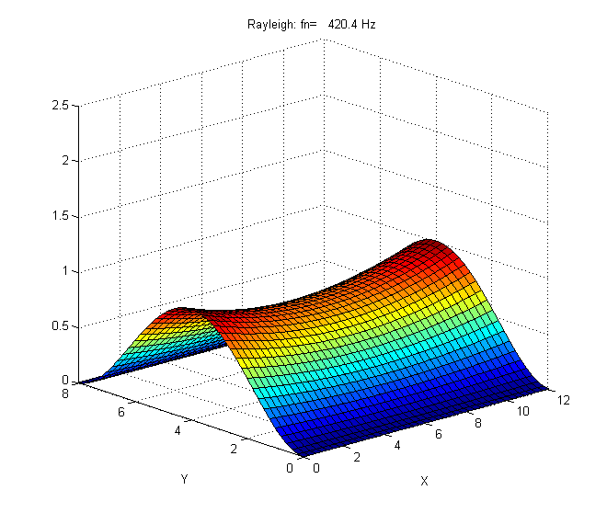
Fundamental Mode Shape

Slide 8
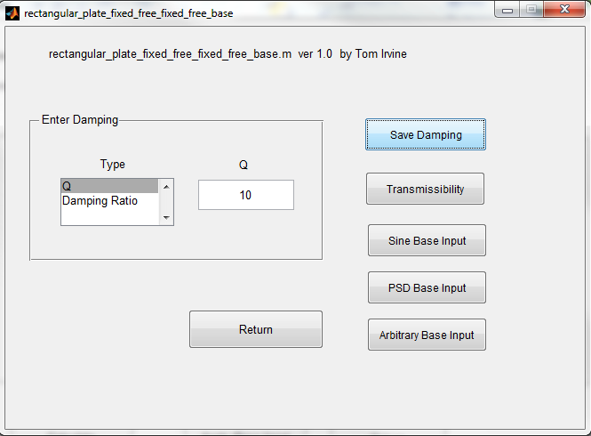
Enter Damping Q=10

Slide 9
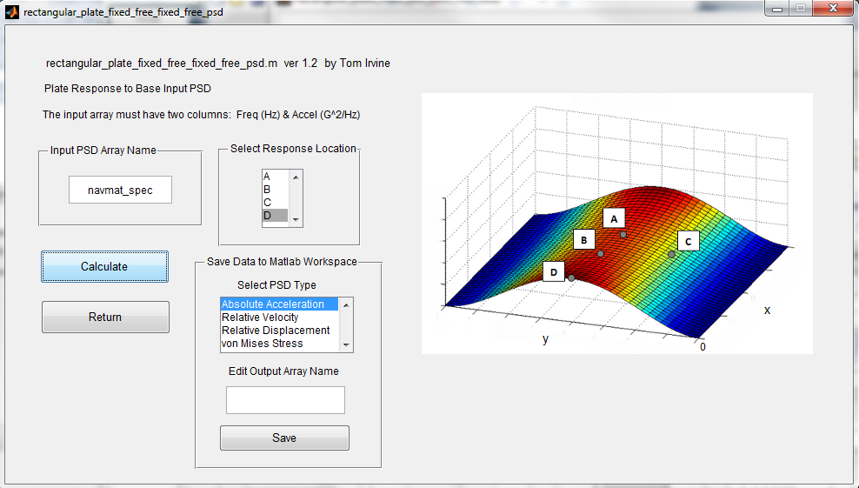
PSD Base Input

Slide 10
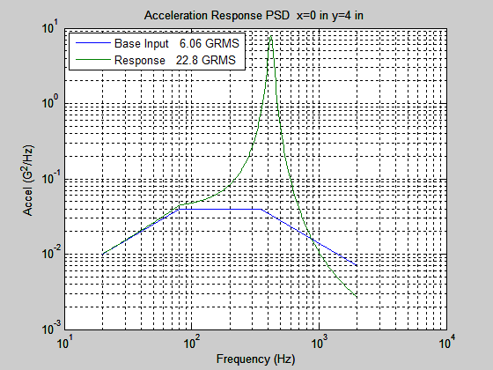
Acceleration PSD

Slide 11
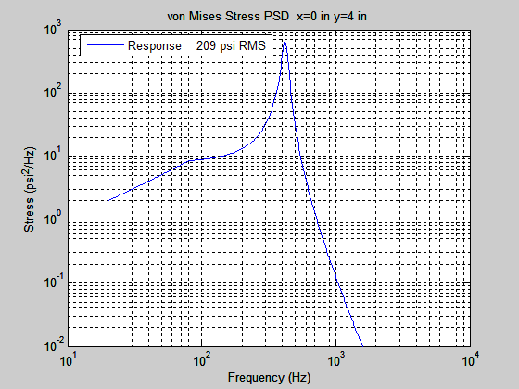
von Mises Stress

Slide 12
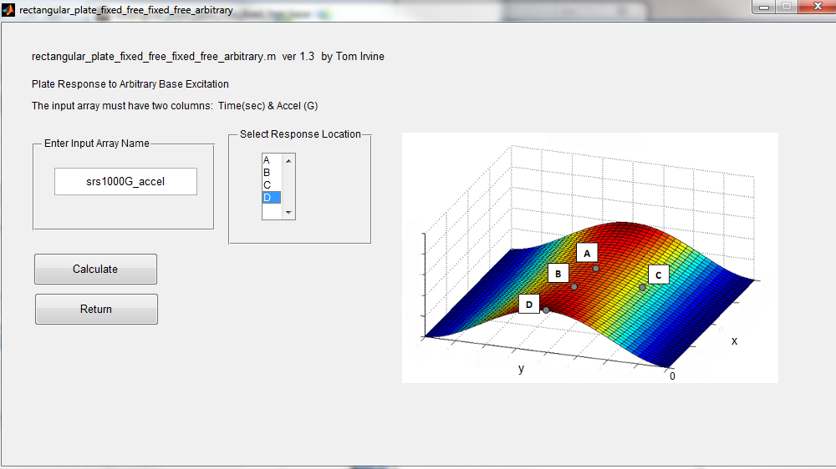
Shock Input

Slide 13
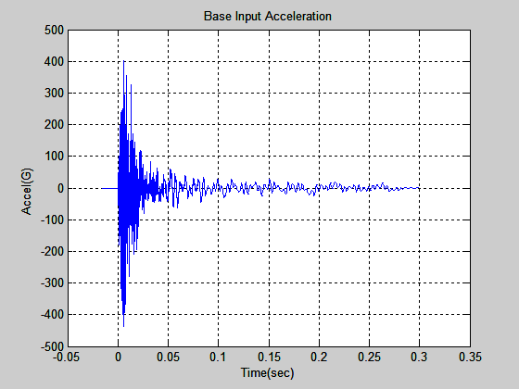
Base Excitation

Slide 14
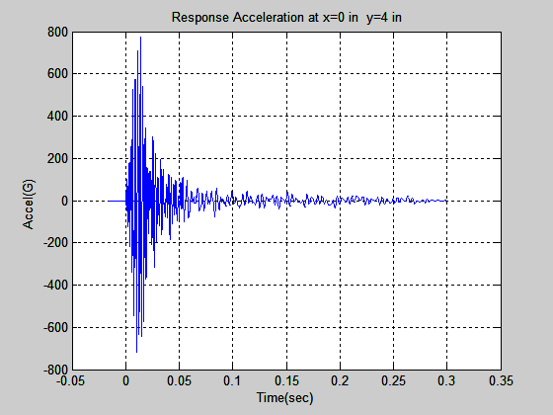
Acceleration

Slide 15
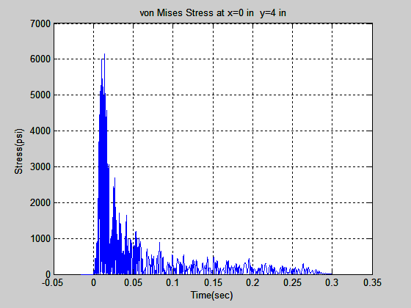
von Mises Stress

Slide 16
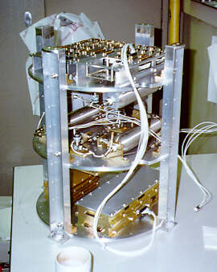
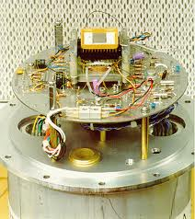
Circular Bulkhead & Avionics Example in Sounding Rockets
USC
Penn State

Slide 17
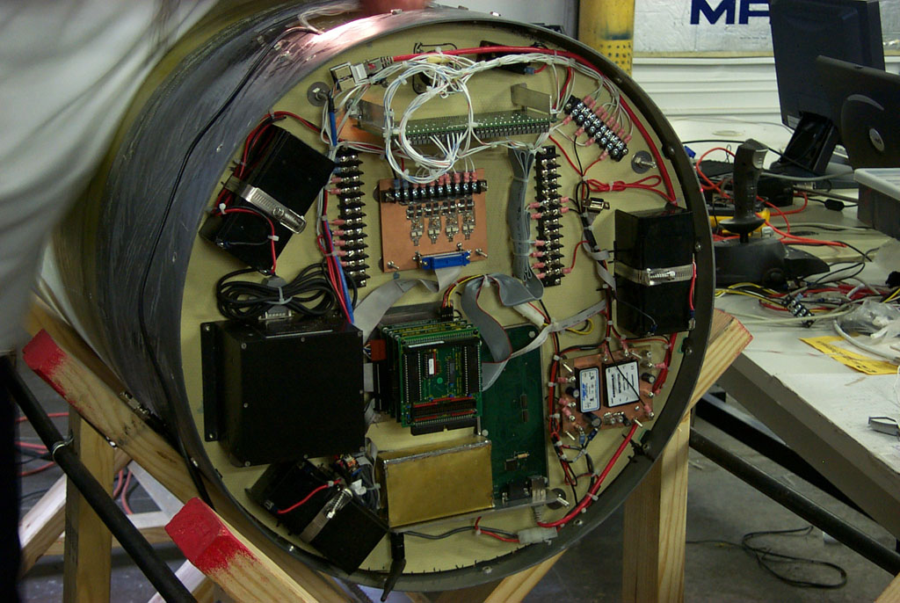
Circular Bulkhead & Avionics Example in Sounding Rockets (cont)
Armadillo Aerospace

Slide 18
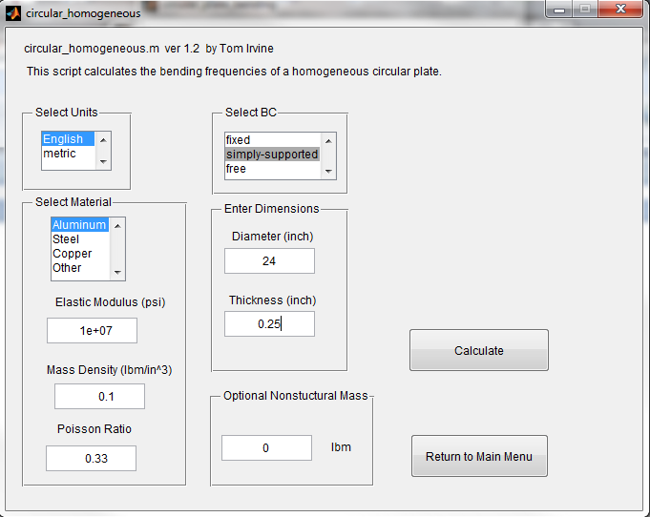
Circular Homogeneous Plate, Simply-Supported
vibrationdata > Structural Dynamics > Plates, Rectangular & Circular > Circular Plate > Homogeneous

Slide 19
Natural Frequency Results
Natural
Frequency
(Hz) n k C D root PF EMM
82.66 0 0 1.94266 0.034570 2.2314 0.8414 0.7079
231.35 1 0 2.48732 0.005247 3.7330 0.0000 0.0000
425.80 2 0 2.94619 0.001304 5.0644 0.0000 0.0000
493.98 0 1 2.94018 -0.000544 5.4549 -0.3487 0.1216
663.90 3 0 3.35390 0.000398 6.3239 0.0000 0.0000
805.36 1 1 3.33275 -0.000101 6.9651 0.0000 0.0000
944.19 4 0 3.72713 0.000137 7.5416 0.0000 0.0000
1164.57 2 1 3.68529 -0.000024 8.3756 0.0000 0.0000
1231.62 0 2 3.68427 0.000014 8.6133 0.2243 0.0503
1265.61 5 0 4.07501 0.000051 8.7313 0.0000 0.0000
1570.16 3 1 4.00968 -0.000007 9.7253 0.0000 0.0000
1627.36 6 0 4.40318 0.000020 9.9009 0.0000 0.0000
1706.69 1 2 4.00498 0.000003 10.1393 0.0000 0.0000
2020.93 4 1 4.31290 -0.000002 11.0333 0.0000 0.0000
2028.85 7 0 4.71539 0.000008 11.0549 0.0000 0.0000
2230.02 2 2 4.30231 0.000001 11.5901 0.0000 0.0000
2296.77 0 3 4.30199 -0.000000 11.7622 -0.1656 0.0274
n = nodal diameters
k = nodal circles
PF = participation factor
EMM = effective modal mass ratio

Slide 20
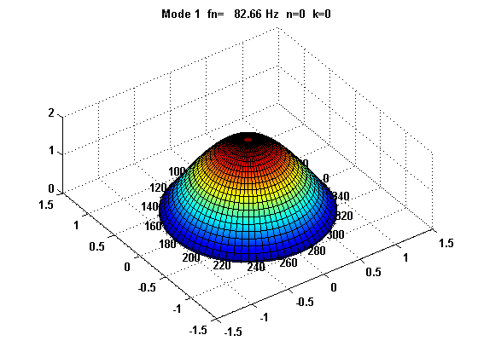
Mode 1

Slide 21
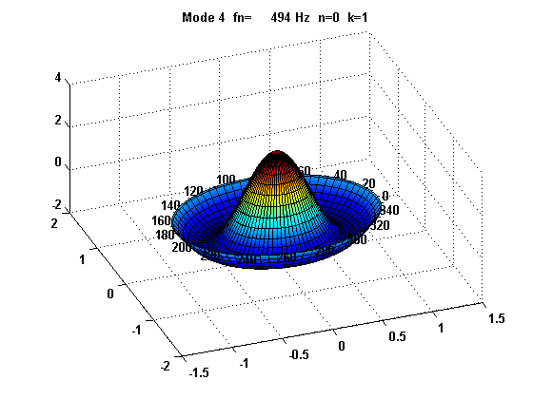
Mode 4

Slide 22
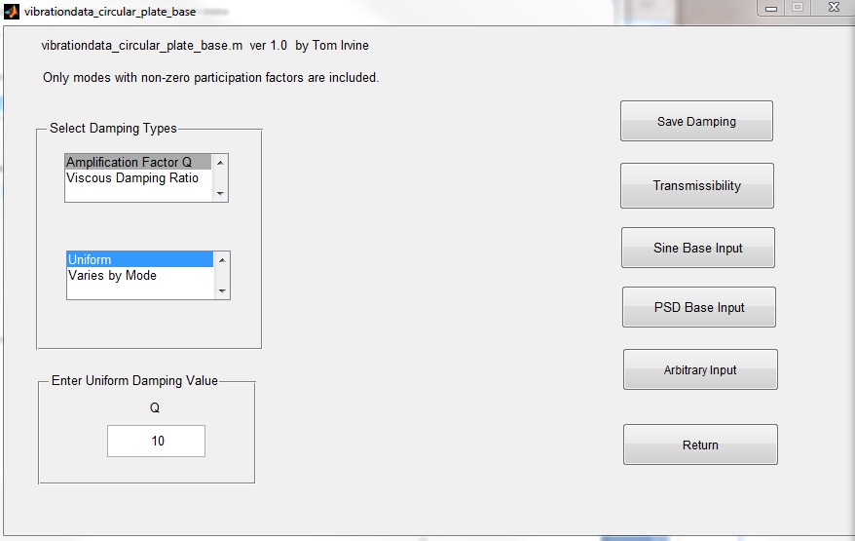
Enter Uniform Damping Q=10

Slide 23
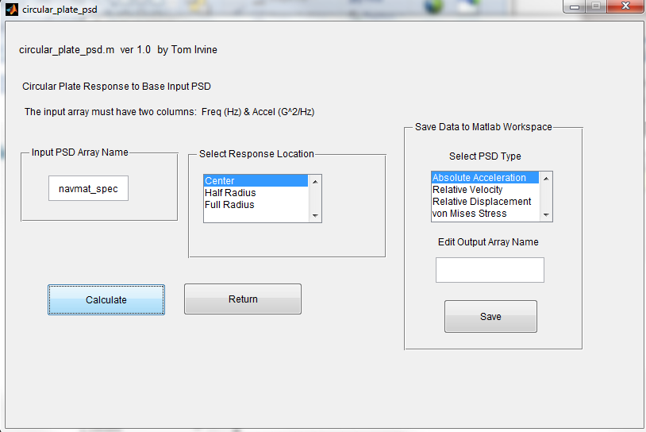
PSD Base Input

Slide 24
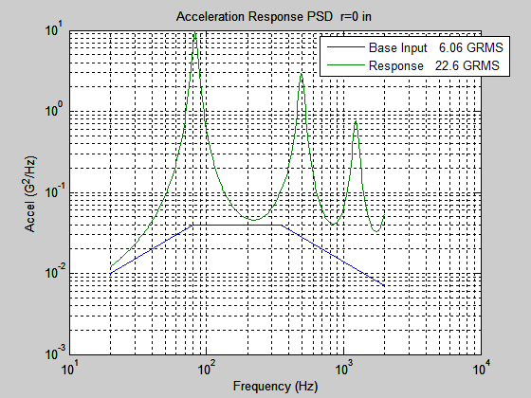
Acceleration

Slide 25
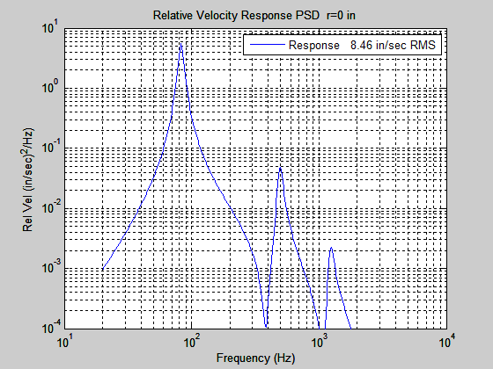
Relative Velocity

Slide 26
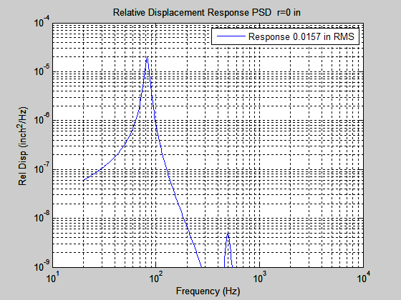
Relative Displacement

Slide 27
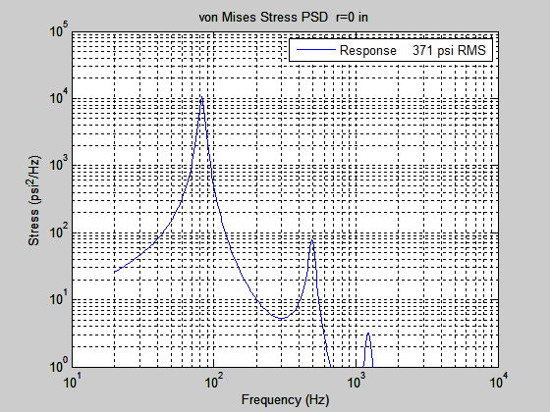
von Mises Stress

Slide 28
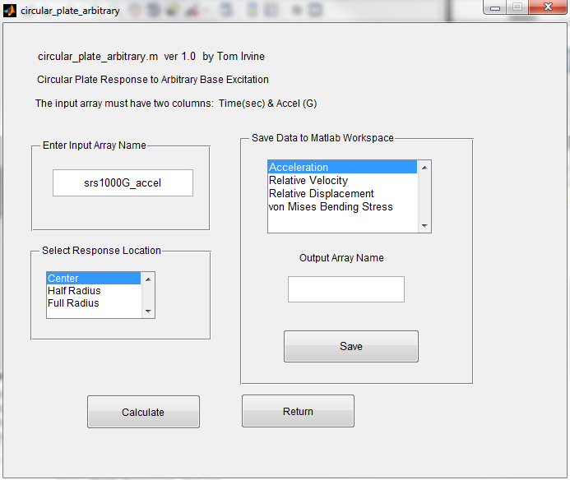
Arbitrary Input

Slide 29
Base Input

Slide 30
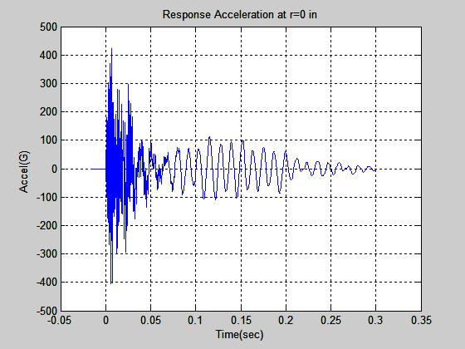
Acceleration

Slide 31
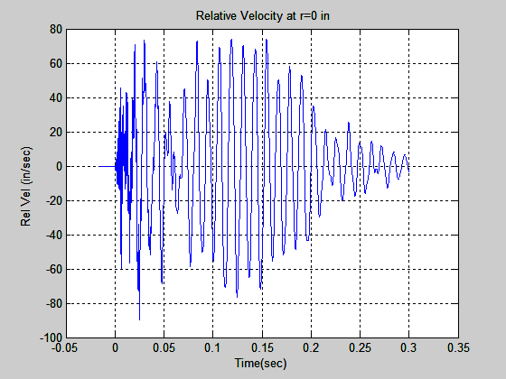
Relative Velocity

Slide 32
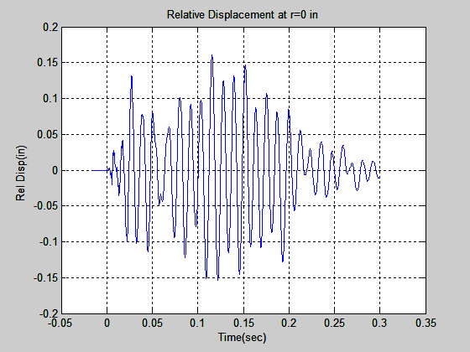
Relative Displacement

Slide 33
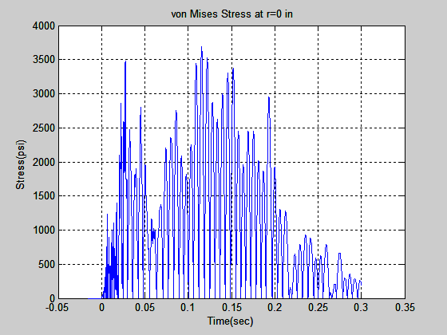
von Mises Stress

Slide 34
Shock Summary
Peak Response Values at Center
Acceleration = 423.2 G
Relative Velocity = 89.9 in/sec
Relative Displacement = 0.1609 in
von Mises Stress = 3687 psi
Peak Response Values at Half-Radius
Acceleration = 102.5 G
Relative Velocity = 53.1 in/sec
Relative Displacement = 0.111 in
von Mises Stress = 4125 psi

