Slide 1
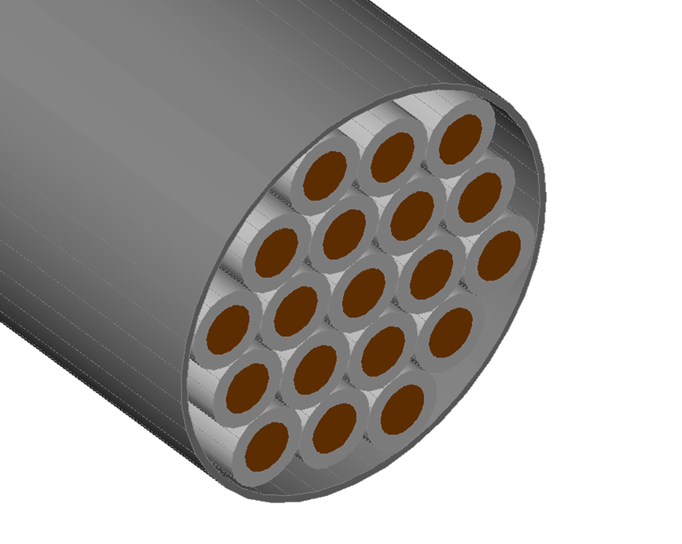
Wire and Wire Bundle Thermal Analysis
Steven L. Rickman
NASA Technical Fellow for Passive Thermal
NASA Engineering and Safety Center

Slide 2
Introduction
Wires and wire bundles are used extensively throughout aerospace vehicles to carry power to components throughout the vehicle or system;
Wires exhibit resistance to electrical current flowing through them;
The flow of current through a resistive wire gives rise to power dissipation in the form of heat;
As a result, a temperature rise in the wire is observed.

Slide 3
Introduction
Current flow through wires is limited, by design so as to not exceed the use temperature of the wire -- violating the maximum use temperature of a wire may damage the external insulation jacket and lead to other problems such as short circuits;
The problem is compounded when wires are grouped into bundles:
Heat transfer path is more complex;
Infinite number of possible combinations of wire quantity, gauge, configurations, bundle loading, etc.

Slide 4
Introduction
Wire and wire bundle design requires derating to ensure temperature limits aren't violated.
Ampacity, a term for amperage capacity, is a measure of the current carrying capability of a wire or a collection of wires in a bundle.

Slide 5
Introduction
Standard practice for cable derating within NASA programs has its roots in test data collected by the US military, the aviation industry, the Society for Automotive Engineers (SAE), and at NASA centers and traces back to the 1940s.
Resulting wire harness derating procedure still included significant conservatism [refs. 2-4].
Need to standardize a simple procedure that completely enveloped the envisioned use case and resulted in a capable design.

Slide 6
Introduction
Variables such as total harness loading (i.e., load distribution), ambient temperature, cable construction, conductor alloys, insulation types, etc. are assumed to be consistent with the test conditions in the wire derating studies and formed the basis for the derating curves.
Changes to these assumptions can have a significant effect on the ampacity of conductors within the harness allowing for larger margin than what is predicted by the curves.

Slide 7
Introduction
Pursuing development and use of a generalized thermal model that considers key aspects of the harness design and use case that the current derating procedure does not fully consider such as insulation type and thickness, varying ambient temperatures, different conductor materials, various bundle loading configurations, mixed wire sizes and types in bundles, and more accurate vacuum prediction.

Slide 8
Roadmap for this Lesson
To give the student an appreciation of the heat transfer within wires and wire bundles, this lesson focuses on:
Development of a single wire thermal model;
Extension of the single wire model into that of a wire bundle;
and finally…
Monte Carlo analysis is discussed allowing exploration of problem sensitivity to multiple variables.

Slide 9
Course Outline
Previous Work
Assumptions
Single Wire Thermal Model
External Convection for the Single Wire Thermal Model
Wire Bundle Thermal Model
Example: Wire Bundle Thermal Analysis
Monte Carlo Analysis and Example
Concluding Remarks
Acknowledgements
List of Symbols
References

Slide 10
Previous Work
The problem of wire and wire bundle analysis has been studied by van Benthem et al [ref. 5] and Ilgevičius and Liess [ref. 6].
Reference 5 focuses on thermal analysis of wire bundle configurations and highlights the complexity of the analysis by noting the numerous parameters involved.
Reference 6 discusses thermal analysis of wires using a finite volume method and highlights the complexities involved with variable parameters and considered non-linear thermal conduction, convection and radiation as well as temperature varying electrical resistance in a single wire.

Slide 11
Assumptions
For a single wire, heating arises due to resistive dissipation from current flow through the conductor;
Heat leaves the wire through:
Radiation and convection (if an atmosphere is present) after conducting to the insulation surface;
Conduction heat transfer to the terminations at either end of the wire;
Conduction arising from wire mounting is ignored in this analysis.

Slide 12
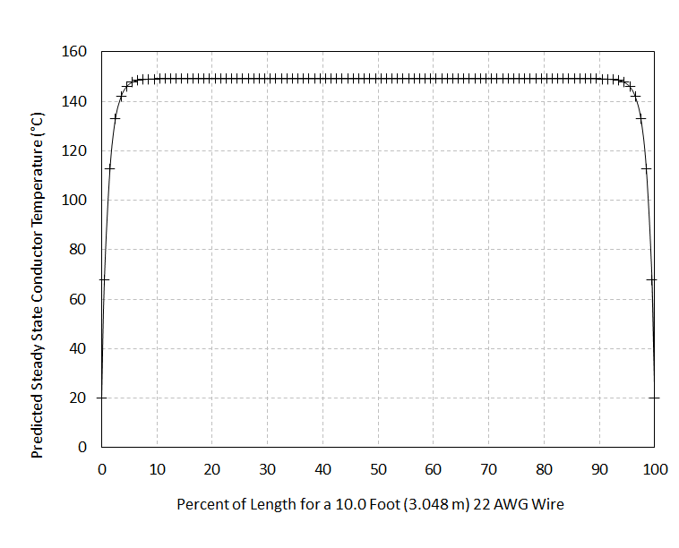
Assumptions
Wire/wire bundle cross section of interest is far from the wire/bundle terminations.
Heat transfer is from within the wire/bundle and to the wire jacket/bundle external surface.
Leads to a local two-dimensional steady sate analysis.
Temperature Profile
Percent of Length for 10.0 Foot (3.048 m) 22 AWG Wire

Slide 13
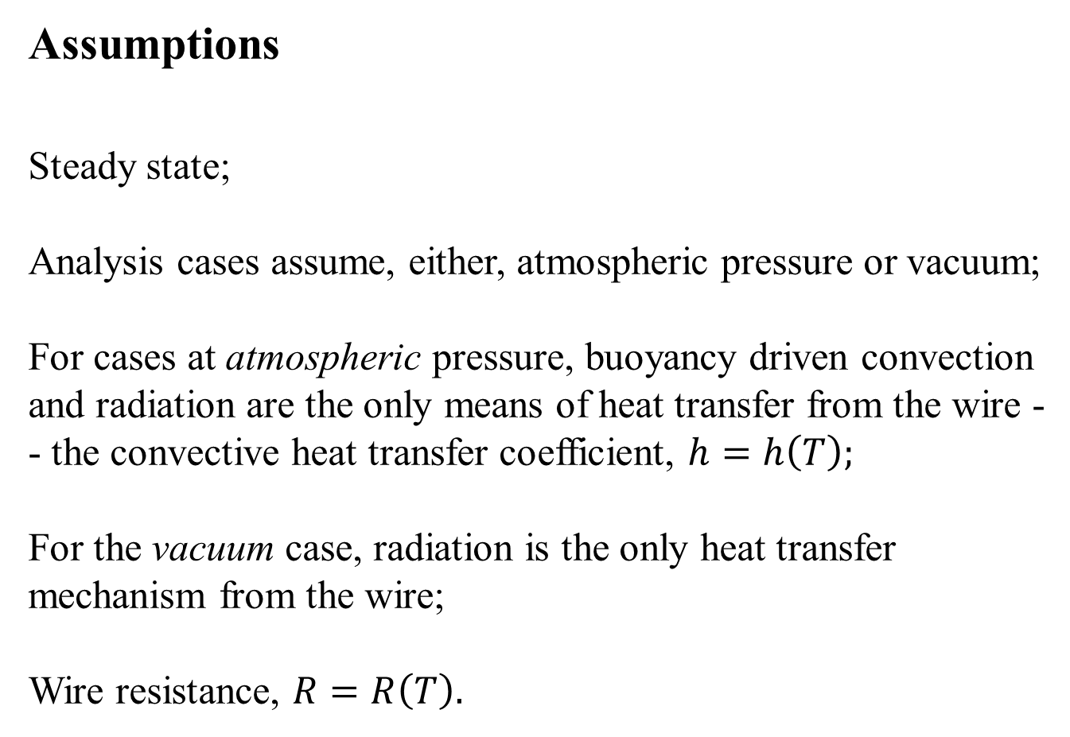
Assumptions
Steady state;
Analysis cases assume, either, atmospheric pressure or vacuum;
For cases at atmospheric pressure, buoyancy driven convection and radiation are the only means of heat transfer from the wire -- the convective heat transfer coefficient, $h=h\left(T\right);$
For the vacuum case, radiation is the only heat transfer mechanism from the wire;
Wire resistance, $R=R\left(T\right).$

Slide 14
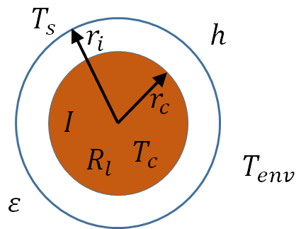

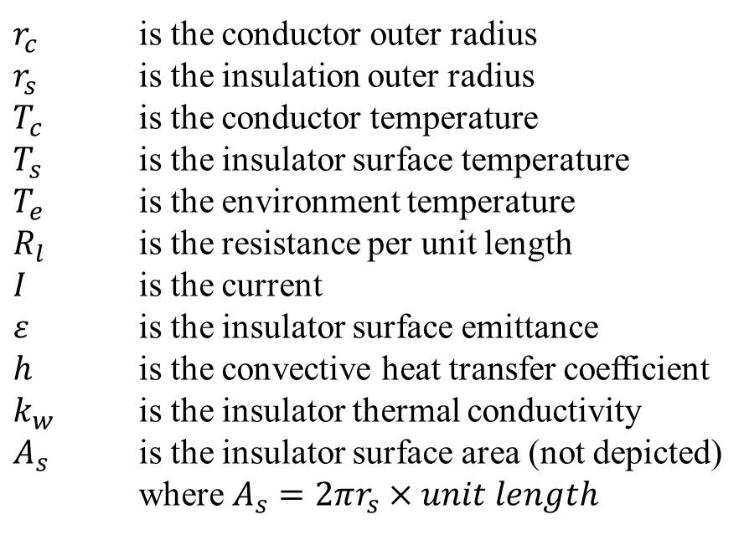


Single Wire Model
If we focus on a 2-dimensional slice through the wire that is sufficiently far from either end, we can neglect the conduction losses from the ends;
This assumption greatly simplifies the formulation of a steady state heat balance equation for the wire.
$r_{c}$ is the conductor outer radius
$r_{s}$ is the insulation outer radius
$T_{c}$ is the conductor temperature
$T_{s}$ is the insulator surface temperature
$T_{e}$ is the environment temperature
$R_{l}$ is the resistance per unit length
$I$ is the current
$ε$ is the insulator surface emittance
$h$ is the convective heat transfer coefficient
$k_{w}$ is the insulator thermal conductivity
$A_{s}$ is the insulator surface area (not depicted)
where $A_{s}=2πr_{s}×unit length$
$$T_{e}$$
$$k_{w}$$
Single Wire Cross-Section
Conductor
Jacket

Slide 15



Single Wire Model
For a two-dimensional cross section through a current carrying wire, the steady state heat balance is given by:
where…
and…
$${\dot{Q}}_{gen}={\dot{Q}}_{out}$$
$${\dot{Q}}_{out}=εA_{s}σ\left(T_{s}^{4}−T_{e}^{4}\right)+hA_{s}\left(T_{s}−T_{e}\right)$$
$${\dot{Q}}_{gen}=I^{2}R$$

Slide 16
Single Wire Model
But resistance varies with conductor temperature by the relationship:
And the steady state heat balance can be written as:
$$R=R\left(T_{c}\right)=R_{l}L\left[1+α\left(T_{c}−T_{0}\right)\right]$$
$$I^{2}R_{l}\left[1+α\left(T_{c}−T_{0}\right)\right]=2πr_{s}\left[εσ\left(T_{s}^{4}−T_{e}^{4}\right)+f_{h}h\left({r_{s},T}_{s}\right)\left(T_{s}−T_{e}\right)\right]$$

Slide 17
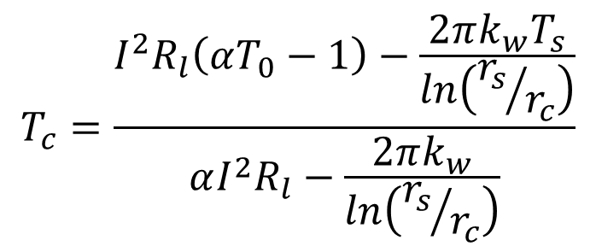
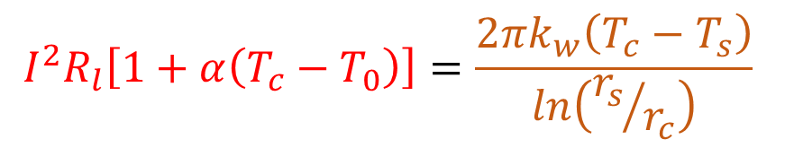
Single Wire Model
Through the two-dimensional cross section, the heat generated within the wire must travel through the wire insulation to be dissipated at the surface:
Rearranging yields:
$$I^{2}R_{l}\left[1+α\left(T_{c}−T_{0}\right)\right]=\frac{2πk_{w}\left(T_{c}−T_{s}\right)}{ln\left({r_{s}}/{r_{c}}\right)}$$
$$T_{c}=\frac{I^{2}R_{l}\left(αT_{0}−1\right)−\frac{2πk_{w}T_{s}}{ln\left({r_{s}}/{r_{c}}\right)}}{αI^{2}R_{l}−\frac{2πk_{w}}{ln\left({r_{s}}/{r_{c}}\right)}}$$

Slide 18
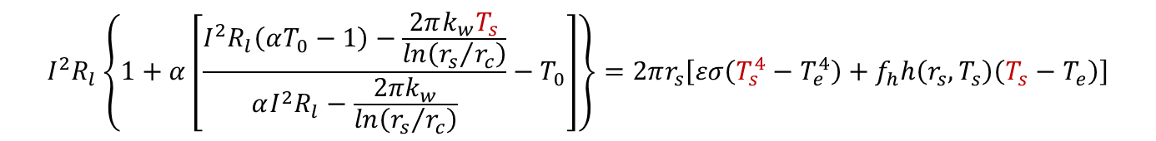
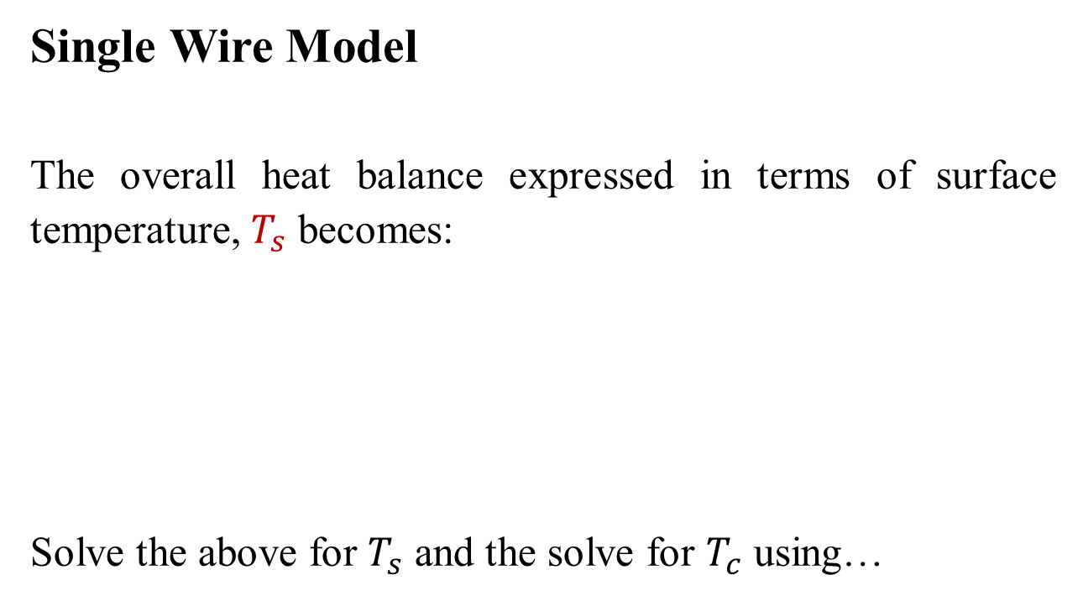
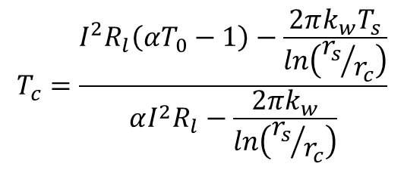
Single Wire Model
The overall heat balance expressed in terms of surface temperature, $T_{s}$ becomes:
Solve the above for $T_{s}$ and the solve for $T_{c}$ using…
$$I^{2}R_{l}\left\{1+α\left[\frac{I^{2}R_{l}\left(αT_{0}−1\right)−\frac{2πk_{w}T_{s}}{ln\left({r_{s}}/{r_{c}}\right)}}{αI^{2}R_{l}−\frac{2πk_{w}}{ln\left({r_{s}}/{r_{c}}\right)}}−T_{0}\right]\right\}=2πr_{s}\left[εσ\left(T_{s}^{4}−T_{e}^{4}\right)+f_{h}h\left({r_{s},T}_{s}\right)\left(T_{s}−T_{e}\right)\right]$$
$$T_{c}=\frac{I^{2}R_{l}\left(αT_{0}−1\right)−\frac{2πk_{w}T_{s}}{ln\left({r_{s}}/{r_{c}}\right)}}{αI^{2}R_{l}−\frac{2πk_{w}}{ln\left({r_{s}}/{r_{c}}\right)}}$$

Slide 19
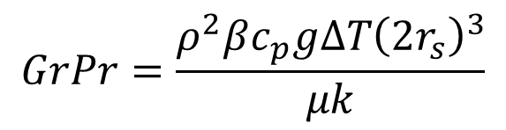
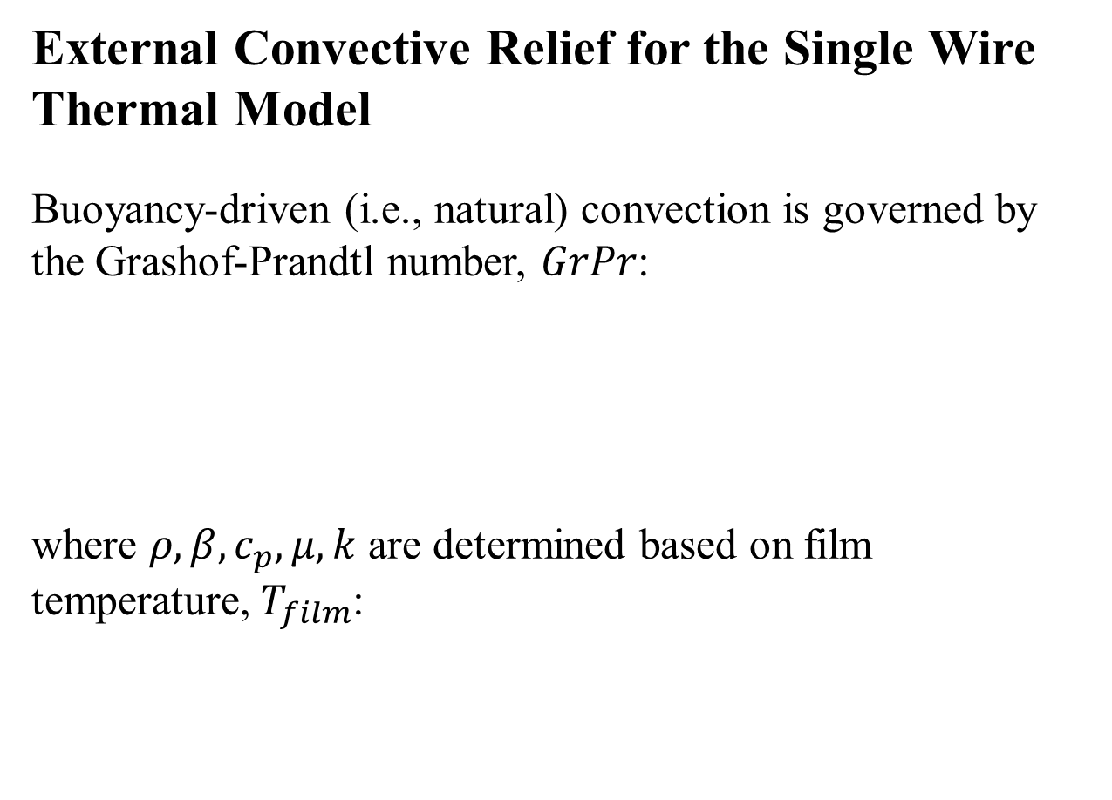
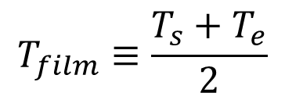
External Convective Relief for the Single Wire Thermal Model
Buoyancy-driven (i.e., natural) convection is governed by the Grashof-Prandtl number, $GrPr$:
where $ρ, β, c_{p},μ, k$ are determined based on film temperature, $T_{film}$:
$$GrPr=\frac{ρ^{2}βc_{p}gΔT{\left(2r_{s}\right)}^{3}}{μk}$$
$$T_{film}≡\frac{T_{s}+T_{e}}{2}$$

Slide 20
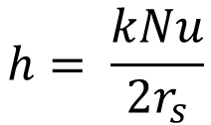
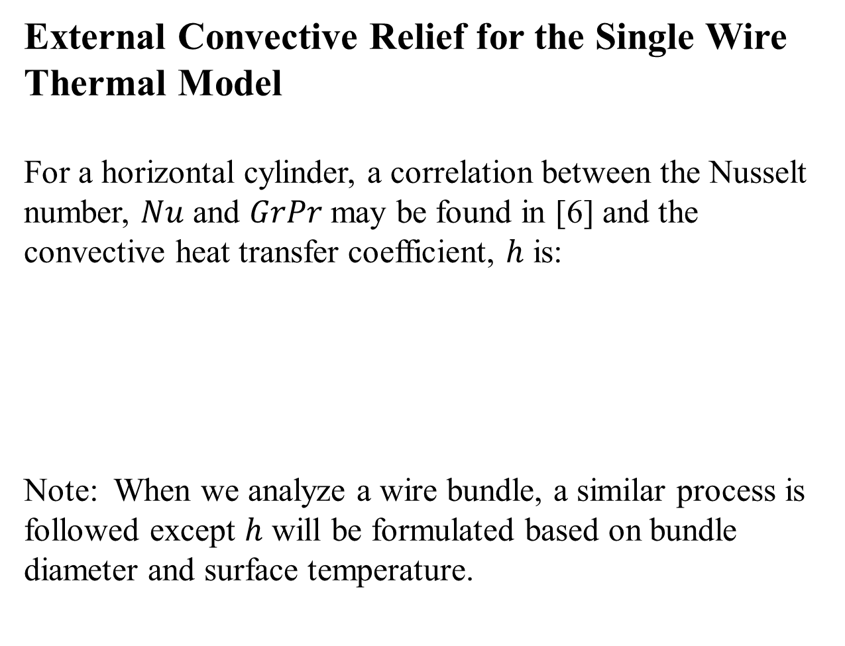
External Convective Relief for the Single Wire Thermal Model
For a horizontal cylinder, a correlation between the Nusselt number, $Nu$ and $GrPr$ may be found in [6] and the convective heat transfer coefficient, $h$ is:
Note: When we analyze a wire bundle, a similar process is followed except $h$ will be formulated based on bundle diameter and surface temperature.
$$h= \frac{kNu}{2r_{s}}$$

Slide 21
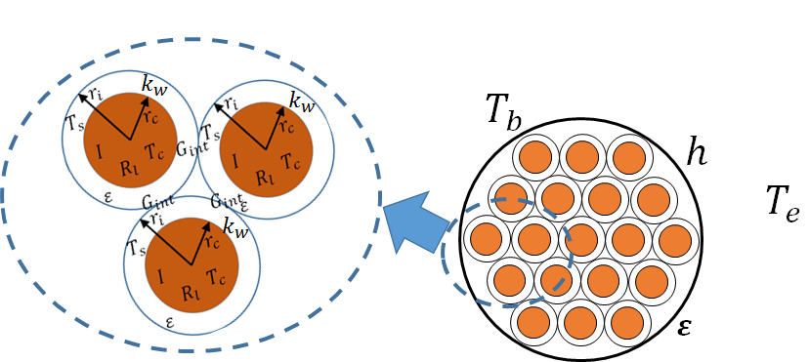
Extension to the Wire Bundle Thermal Model
The single wire thermal model derivation can be extended to describe heat transfer in a wire bundle by noting:
Wires in a bundle can radiate and conduct to adjacent wires.
External convection and radiation are from the bundle surface.

Slide 22
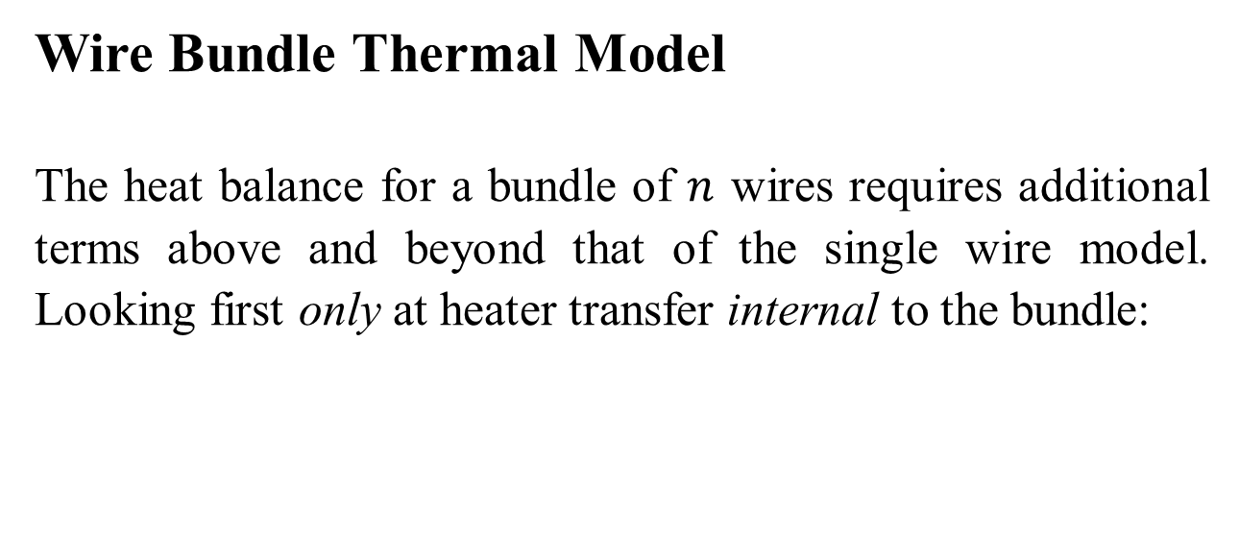



Wire Bundle Thermal Model
The heat balance for a bundle of $n$ wires requires additional terms above and beyond that of the single wire model. Looking first only at heater transfer internal to the bundle:
$${\left(I^{2}R_{l}\right)}_{i}\left\{1+α_{i}\left[{\left(T_{c}\right)}_{i}−T_{0}\right]\right\}=\sum_{j=1}^{n}{C_{ij}\left\{2π{\left(r_{s}\right)}_{i}ε_{i}B_{ij}σ\left[{\left(T_{s}^{4}\right)}_{i}−{\left(T_{s}^{4}\right)}_{j}\right]+{\left(G_{int}\right)}_{ij}\left[{\left(T_{s}\right)}_{i}−{\left(T_{s}\right)}_{j}\right]\right\}}$$
$$C_{ij}$$
=1 for adjacent wires i and j, = 0 otherwise
Radiation conductance between adjacent wires
Interface conductance between adjacent wires
$$2π{\left(r_{s}\right)}_{i}ε_{i}B_{ij}σ$$
$${\left(G_{int}\right)}_{ij}$$

Slide 23
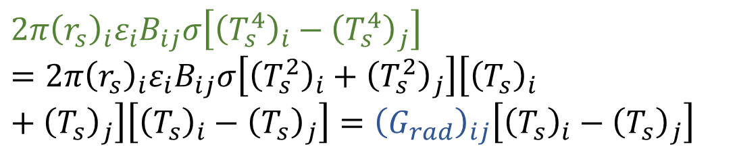

Wire Bundle Thermal Model
Let's look at the radiation term more closely…
Radiation between adjacent wires is non-linear but can be linearized:
where…
$$2π{\left(r_{s}\right)}_{i}ε_{i}B_{ij}σ\left[{\left(T_{s}^{4}\right)}_{i}−{\left(T_{s}^{4}\right)}_{j}\right]$$
$$2π{\left(r_{s}\right)}_{i}ε_{i}B_{ij}σ\left[{\left(T_{s}^{4}\right)}_{i}−{\left(T_{s}^{4}\right)}_{j}\right]=2π{\left(r_{s}\right)}_{i}ε_{i}B_{ij}σ\left[{\left(T_{s}^{2}\right)}_{i}+{\left(T_{s}^{2}\right)}_{j}\right]\left[{\left(T_{s}\right)}_{i}+{\left(T_{s}\right)}_{j}\right]\left[{\left(T_{s}\right)}_{i}−{\left(T_{s}\right)}_{j}\right]={\left(G_{rad}\right)}_{ij}\left[{\left(T_{s}\right)}_{i}−{\left(T_{s}\right)}_{j}\right]$$
$${\left(G_{rad}\right)}_{ij}=2π{\left(r_{s}\right)}_{i}ε_{i}B_{ij}σ\left[{\left(T_{s}^{2}\right)}_{i}+{\left(T_{s}^{2}\right)}_{j}\right]\left[{\left(T_{s}\right)}_{i}+{\left(T_{s}\right)}_{j}\right]$$

Slide 24
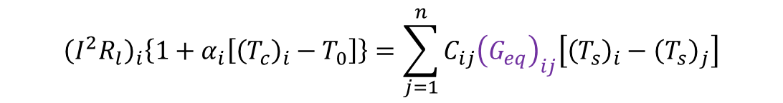
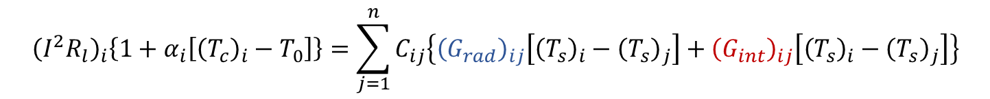

Wire Bundle Thermal Model
Looking once again at the internal heat balance…
and with the radiation linearized, we can combine it with the interface conductance term to obtain:
So we have:
$${\left(I^{2}R_{l}\right)}_{i}\left\{1+α_{i}\left[{\left(T_{c}\right)}_{i}−T_{0}\right]\right\}=\sum_{j=1}^{n}{C_{ij}\left\{{\left(G_{rad}\right)}_{ij}\left[{\left(T_{s}\right)}_{i}−{\left(T_{s}\right)}_{j}\right]+{\left(G_{int}\right)}_{ij}\left[{\left(T_{s}\right)}_{i}−{\left(T_{s}\right)}_{j}\right]\right\}}$$
$${\left(G_{eq}\right)}_{ij}={\left(G_{rad}\right)}_{ij}{+\left(G_{int}\right)}_{ij}$$
$${\left(I^{2}R_{l}\right)}_{i}\left\{1+α_{i}\left[{\left(T_{c}\right)}_{i}−T_{0}\right]\right\}=\sum_{j=1}^{n}{C_{ij}{\left(G_{eq}\right)}_{ij}\left[{\left(T_{s}\right)}_{i}−{\left(T_{s}\right)}_{j}\right]}$$

Slide 25
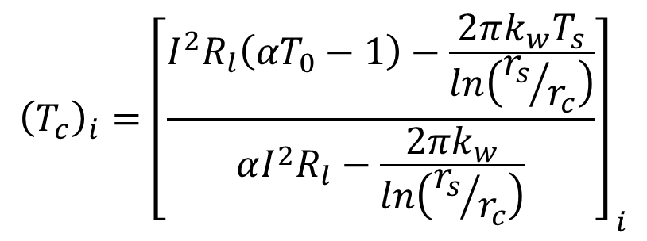
Wire Bundle Thermal Model
Similar to single wire model, the conductor temperature may be determined for each wire element once the surface temperatures are known:
$${\left(T_{c}\right)}_{i}={\left[\frac{I^{2}R_{l}\left({αT}_{0}−1\right)−\frac{2πk_{w}T_{s}}{ln\left({r_{s}}/{r_{c}}\right)}}{αI^{2}R_{l}−\frac{2πk_{w}}{ln\left({r_{s}}/{r_{c}}\right)}}\right]}_{ i}$$

Slide 26
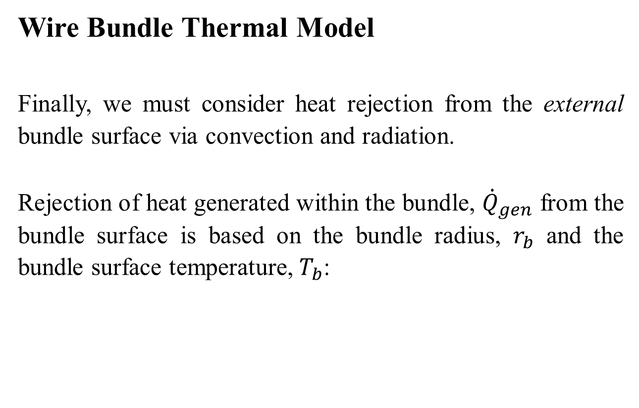
Wire Bundle Thermal Model
Finally, we must consider heat rejection from the external bundle surface via convection and radiation.
Rejection of heat generated within the bundle, ${\dot{Q}}_{gen}$ from the bundle surface is based on the bundle radius, $r_{b}$ and the bundle surface temperature, $T_{b}$:
$${\dot{Q}}_{gen}=2πr_{b}\left[εσ\left(T_{b}^{4}−T_{e}^{4}\right)+f_{h}h\left({r_{b},T}_{b}\right)\left(T_{b}−T_{e}\right)\right]$$

Slide 27
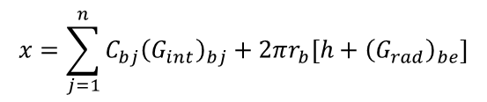
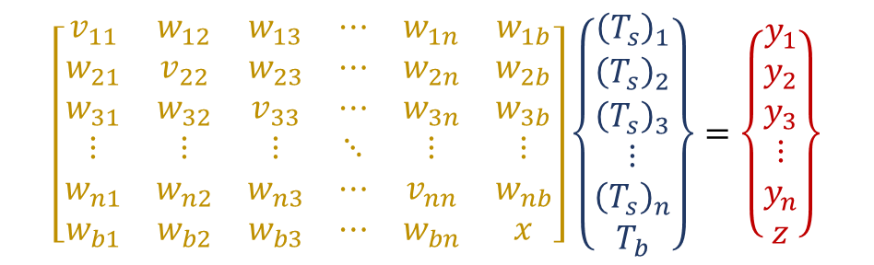

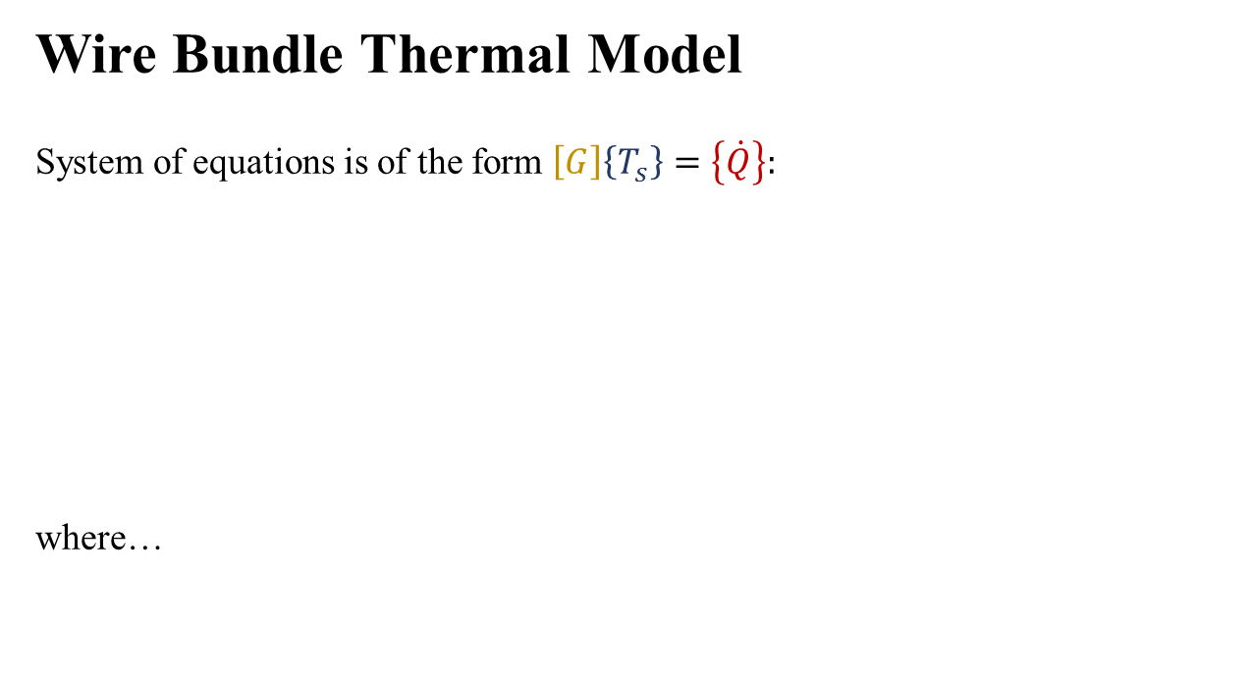
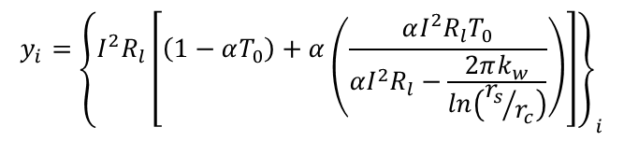

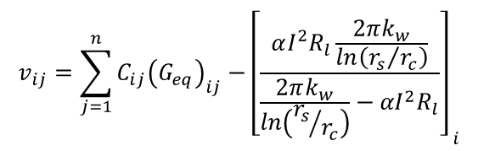
Wire Bundle Thermal Model
System of equations is of the form $\left[G\right]\left\{T_{s}\right\}=\left\{\dot{Q}\right\}:$
where…
$$\left[\begin{matrix}v_{11} & w_{12} & w_{13} & ⋯ & w_{1n} & w_{1b} \\ w_{21} & v_{22} & w_{23} & ⋯ & w_{2n} & w_{2b} \\ w_{31} & w_{32} & v_{33} & ⋯ & w_{3n} & w_{3b} \\ ⋮ & ⋮ & ⋮ & ⋱ & ⋮ & ⋮ \\ w_{n1} & w_{n2} & w_{n3} & ⋯ & v_{nn} & w_{nb} \\ w_{b1} & w_{b2} & w_{b3} & ⋯ & w_{bn} & x\end{matrix}\right]\left\{\begin{matrix}{\left(T_{s}\right)}_{1} \\ {\left(T_{s}\right)}_{2} \\ {\left(T_{s}\right)}_{3} \\ ⋮ \\ {\left(T_{s}\right)}_{n} \\ T_{b}\end{matrix}\right\}=\left\{\begin{matrix}y_{1} \\ y_{2} \\ y_{3} \\ ⋮ \\ y_{n} \\ z\end{matrix}\right\}$$
$$v_{ij}=\sum_{j=1}^{n}{{C_{ij}\left(G_{eq}\right)}_{ij}}−{\left[\frac{αI^{2}R_{l}\frac{2πk_{w}}{ln\left({r_{s}}/{r_{c}}\right)}}{\frac{2πk_{w}}{ln\left({r_{s}}/{r_{c}}\right)}−{αI}^{2}R_{l}}\right]}_{ i}$$
$$y_{i}={\left\{I^{2}R_{l}\left[\left(1−αT_{0}\right)+α\left(\frac{αI^{2}R_{l}T_{0}}{αI^{2}R_{l}−\frac{2πk_{w}}{ln\left({r_{s}}/{r_{c}}\right)}}\right)\right]\right\}}_{i}$$
$$w_{ij}=−C_{ij}{\left(G_{eq}\right)}_{ij}$$
$$z=2πr_{b}\left[h+{\left(G_{rad}\right)}_{be}\right]T_{e}$$
$$x=\sum_{j=1}^{n}{C_{bj}{\left(G_{int}\right)}_{bj}}+2πr_{b}\left[h+{\left(G_{rad}\right)}_{be}\right]$$

Slide 28
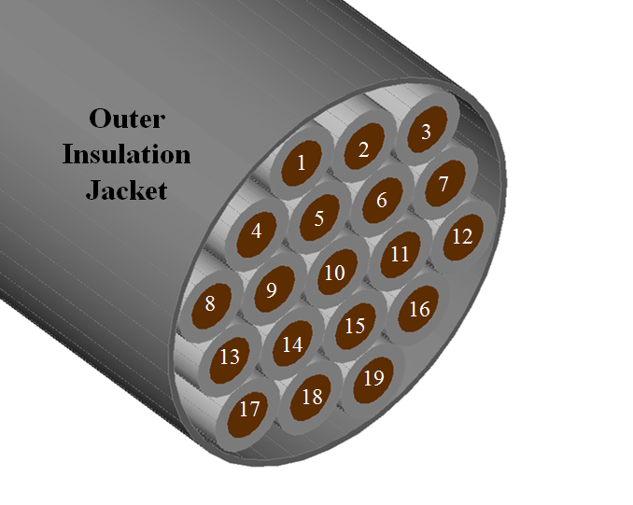
Example: Wire Bundle Thermal Analysis Configuration Schematic
Smart short element
Optical fiber element
Smart short element
Optical fiber element
Note: All other elements carry background current

Slide 29
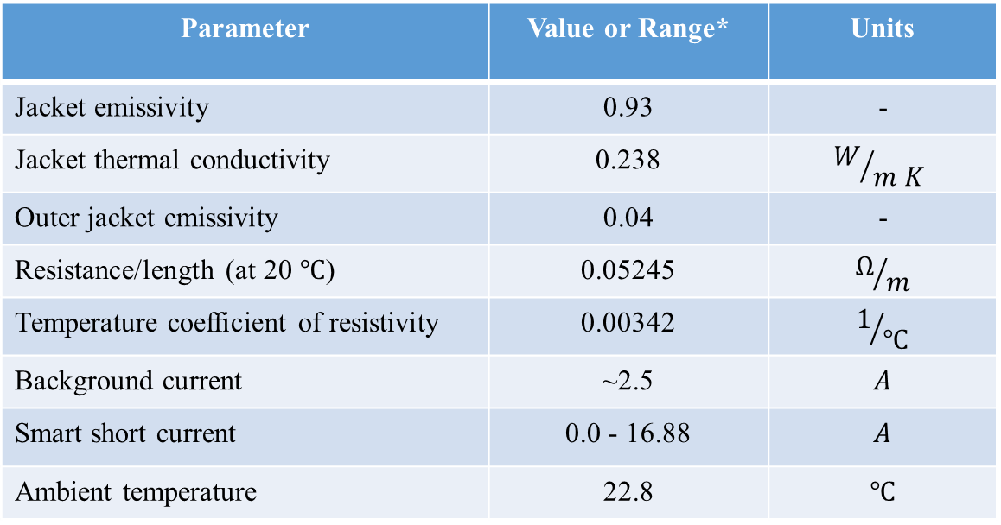
Example: Wire Bundle Thermal Analysis
Wires are 22 AWG, ETFE jacketed
*May differ from actual or specification values
Parameter | Value or Range* | Units
Jacket emissivity | 0.93 | -
Jacket thermal conductivity | 0.238 | $$W/{m K}$$
Outer jacket emissivity | 0.04 | -
Resistance/length (at 20 $℃$) | 0.05245 | $$Ω/m$$
Temperature coefficient of resistivity | 0.00342 | $$1/℃$$
Background current | ~2.5 | $$A$$
Smart short current | 0.0 - 16.88 | $$A$$
Ambient temperature | 22.8 | $$℃$$

Slide 30
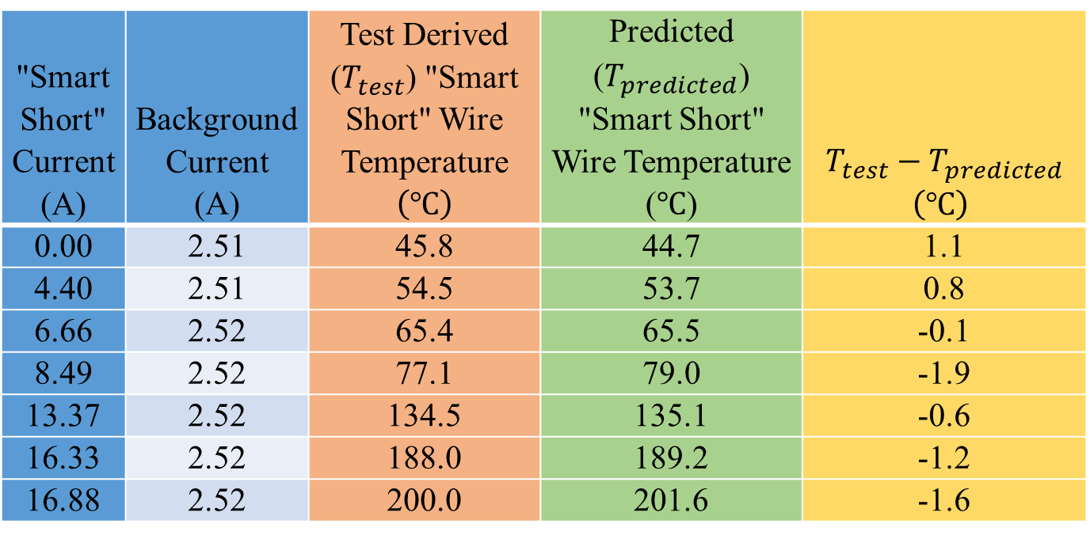
Example: Comparison of Wire Bundle Thermal Model to Ambient Test Data
"Smart Short" Current (A) | Background Current (A) | Test Derived ($T_{test}$) "Smart Short" Wire Temperature $\left(℃\right)$ | Predicted ($T_{predicted}$) "Smart Short" Wire Temperature ($℃$) | $$T_{test}−T_{predicted}$$ $\left(℃\right)$
0.00 | 2.51 | 45.8 | 44.7 | 1.1
4.40 | 2.51 | 54.5 | 53.7 | 0.8
6.66 | 2.52 | 65.4 | 65.5 | -0.1
8.49 | 2.52 | 77.1 | 79.0 | -1.9
13.37 | 2.52 | 134.5 | 135.1 | -0.6
16.33 | 2.52 | 188.0 | 189.2 | -1.2
16.88 | 2.52 | 200.0 | 201.6 | -1.6

Slide 31
Bundle Interface Conductance
Interface conductance between wires was adjusted to allow correlation -- a constant value was assumed here;
Unreasonable to assume that individual wire jacket to wire jacket interface conductances are known;
The value used throughout is representative of the average interface wire jacket to wire jacket interface conductance within the bundle;
Representative of the heat transfer path from the innermost wires of interest to the bundle surface.

Slide 32
Interface Conductance
Subsequent testing on a different configuration suggests the wire jacket to wire jacket interface conductance may be a function of the bundle bulk average temperature.
Hypothesis: A bundle of wires, constrained by, either, an outer jacket or tie wraps, expands as it temperature rises resulting in increased wire jacket to wire jacket interface conductance.
Further discussion is beyond the scope of this lesson but is discussed in [8].

Slide 33
Monte Carlo Analysis
Previous analysis assumed perfect knowledge of the parameters of interest;
Some parameters used in the analysis may not be known with a high degree of certainty (e.g., wire jacket-to-wire jacket interface thermal conductance);
Monte Carlo analysis capability may be employed to understand the sensitivity of the solution to uncertainties in one or more of the analysis parameters.

Slide 34
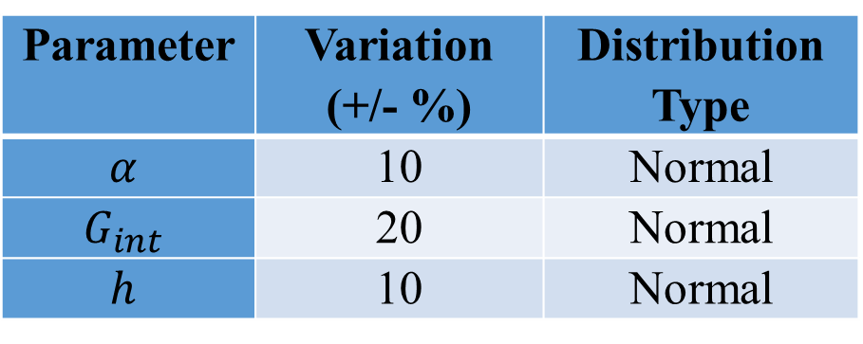
Example: Monte Carlo Analysis
As a demonstration of capability, Monte Carlo analysis was performed using the parameter variations for three key variables.
Parameter | Variation (+/- %) | Distribution Type
$$α$$ | 10 | Normal
$$G_{int}$$ | 20 | Normal
$$h$$ | 10 | Normal

Slide 35
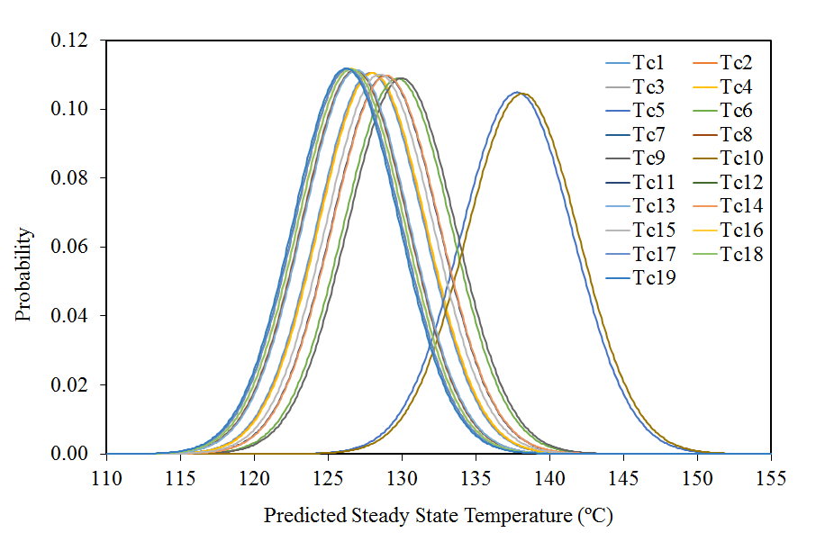
Example: Temperature Distributions Resulting from
Monte Carlo Analysis
Conductors carrying background current
Conductors carrying smart short current

Slide 36
Monte Carlo Analysis
In practice, the bundle of interest would be modeled for the conditions of interest;
A Monte Carlo analysis would be performed to assess the sensitivity of the solution to uncertainty in a variety of model parameters;
A successful design is attained when the predicted wire and insulation temperatures plus margins associated with parameter uncertainties are below the wire temperature limits.

Slide 37
Concluding Remarks
An analytical approach for wire bundle thermal analysis has been presented;
The governing heat transfer equations have been derived;
Implementation of the system of equations for solution of the wire bundle problem has been demonstrated and a means for assessing the sensitivity due to uncertainty in key analysis parameters has been investigated;
It is envisioned that the implementation of such models may be useful in assessing wire bundle ampacity for configurations not addressed in published standards.

Slide 38
Acknowledgements
The material for this short course was derived from Reference 1. Dr. Christopher J. Iannello is acknowledged as the co-author of that paper.
The technical was performed with the sponsorship of the NASA Engineering and Safety Center under the technical leadership of Dr. Robert Kichak of AS and D, Inc.
The authors acknowledge the test support provided by Mr. Thad Johnson, Mr. Lawrence Ludwig, Mrs. Tamara Dodge, Mr. Dan Ciarlariello and Mr. Lawrence Batterson of the NASA – Kennedy Space Center.

Slide 39
Acknowledgements
Ruth Amundsen and Chris Kostyk of the NESC Passive Thermal Technical Discipline Team are acknowledged for their review of the draft lesson and their valuable comments.

Slide 40
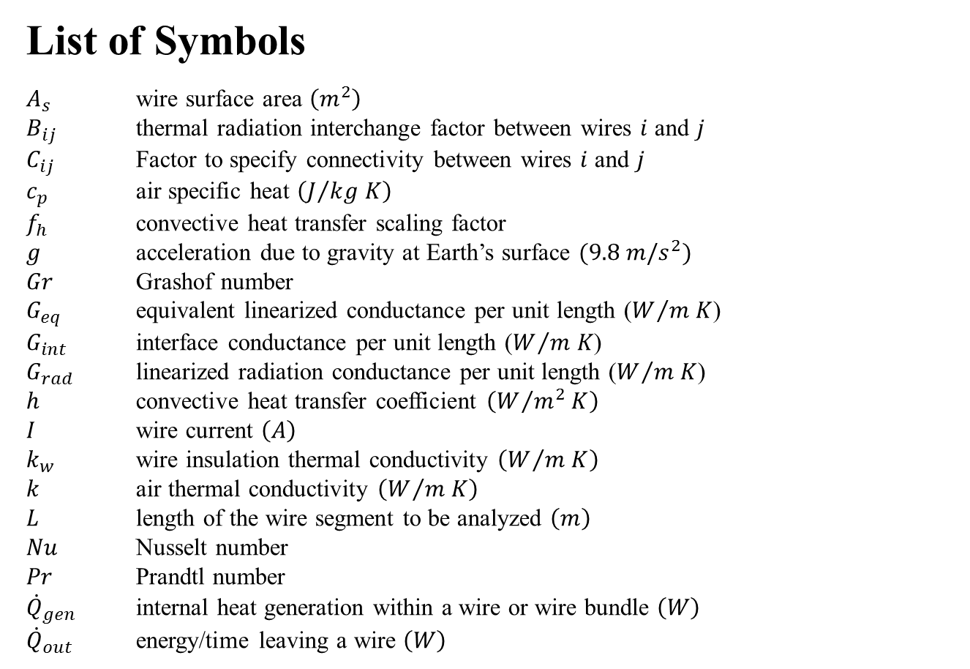
List of Symbols
$A_{s}$ wire surface area $\left(m^{2}\right)$
$B_{ij}$ thermal radiation interchange factor between wires $i$ and $j$
$C_{ij}$ Factor to specify connectivity between wires $i$ and $j$
$c_{p}$ air specific heat $\left(J/{kg K}\right)$
$f_{h}$ convective heat transfer scaling factor
$g$ acceleration due to gravity at Earth’s surface $(9.8 m/s^{2})$
$Gr$ Grashof number
$G_{eq}$ equivalent linearized conductance per unit length ($W/{m K}$)
$G_{int}$ interface conductance per unit length ($W/{m K}$)
$G_{rad}$ linearized radiation conductance per unit length ($W/{m K}$)
$h$ convective heat transfer coefficient $\left(W/{m^{2} K}\right)$
$I$ wire current $\left(A\right)$
$k_{w}$ wire insulation thermal conductivity $\left(W/{m K}\right)$
$k$ air thermal conductivity $\left(W/{m K}\right)$
$L$ length of the wire segment to be analyzed $\left(m\right)$
$Nu$ Nusselt number
$Pr$ Prandtl number
${\dot{Q}}_{gen}$ internal heat generation within a wire or wire bundle $\left(W\right)$
${\dot{Q}}_{out}$ energy/time leaving a wire $\left(W\right)$

Slide 41
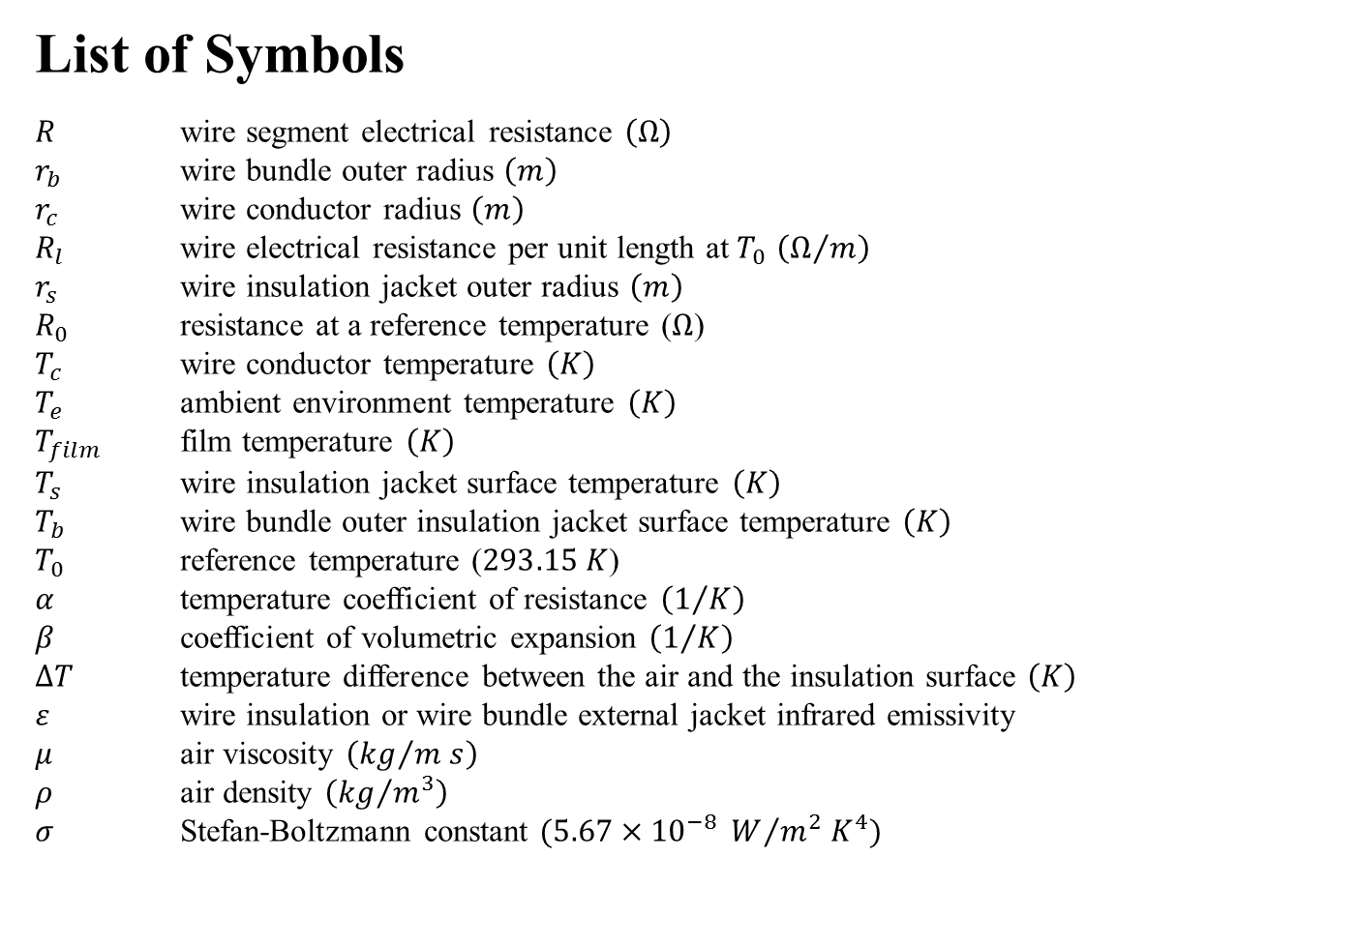
List of Symbols
$R$ wire segment electrical resistance $\left(Ω\right)$
$r_{b}$ wire bundle outer radius $\left(m\right)$
$r_{c}$ wire conductor radius $\left(m\right)$
$R_{l}$ wire electrical resistance per unit length at $T_{0}$ $\left(Ω/m\right)$
$r_{s}$ wire insulation jacket outer radius $\left(m\right)$
$R_{0}$ resistance at a reference temperature ($Ω$)
$T_{c}$ wire conductor temperature $\left(K\right)$
$T_{e}$ ambient environment temperature $\left(K\right)$
$T_{film}$ film temperature $\left(K\right)$
$T_{s}$ wire insulation jacket surface temperature $\left(K\right)$
$T_{b}$ wire bundle outer insulation jacket surface temperature $\left(K\right)$
$T_{0}$ reference temperature ($293.15 K$)
$α$ temperature coefficient of resistance $\left(1/K\right)$
$β$ coefficient of volumetric expansion $\left(1/K\right)$
$ΔT$ temperature difference between the air and the insulation surface $\left(K\right)$
$ε$ wire insulation or wire bundle external jacket infrared emissivity
$μ$ air viscosity $\left({kg}/{m s}\right)$
$ρ$ air density $\left({kg}/{m^{3}}\right)$
$σ$ Stefan-Boltzmann constant $(5.67×{10}^{−8} W/{m^{2} K^{4}})$

Slide 42
References
S. L. Rickman and C. J. Iannello, Heat Transfer Analysis in Wire Bundles for Aerospace Vehicles, in WIT Transactions on Engineering Sciences, Heat Transfer 2016, Wessex Institute, UK, 2016, vol. 106, pp. 53-63.
Cornelius, R.S., A History of the Development of New Current Ratings for Aerospace Wire, RayChem Report, circa 1978.
Wire Size Determination for Aerospace Applications, Report No. 88-220, Eagle Engineering/LMESCO under Contract to NASA (NAS-17900), December 1, 1988.

Slide 43
References
Wire/Cable Selection, Report No. 2ITA017, McDonnell Douglas Space Systems Company, May 10, 1990.
van Benthem, R.C., de Grave, W., Doctor, F., Taylor, S.,Nuyten, K., & Dit Routier, P.A.J., Thermal Analysis of Wiring Bundles for Weight Reduction and Improved Safety, AIAA 2011-5111, National Aerospace Laboratory (NLR), Netherlands, International Conference on Environmental Systems, July 2011.

Slide 44
References
A. Ilgevičius, H. D. Liess, Thermal Analysis of Electrical Wires by Finite Volume Method, ISSN 1392 – 1215 Elektronika ir Elektrotechnika. 2003. Nr. 4(46).
J. P. Holman, Heat Transfer, 5th Edition, McGraw-Hill Book Company, New York, pp. 274-277, 1981.
S. L. Rickman, C. J. Iannello, and K. Shariff, Improvements to Wire Bundle Thermal Modeling for Ampacity Determination, in Proceedings of the 3rd World Congress on Mechanical, Chemical, and Material Engineering (MCM'17), Avestia, Canada, 2017, pp. HTFF 102-1 - 102-7.

