Slide 1
Fundamentals of EMC
Wrap-Up
John McCloskey
NASA/GSFC Chief EMC Engineer
Code 565
Building 23, room E203
301-286-5498
John.C.McCloskey@nasa.gov

Slide 2
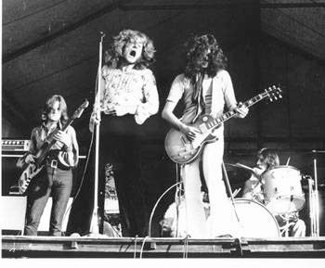
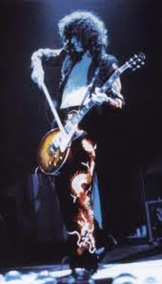
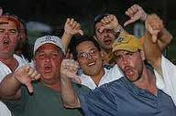
Course Final Exam
Who are the electronics and EMC engineers in this picture?
  Explain your answer
EMI Problem
Scientist
Systems Engineer
Electronics/ EMC Engineer
Electronics/ EMC Engineer
Managers (in front row)

Slide 3
Wrap-Up
Electromagnetics is here to stay
  Remember the d/dt terms
  As frequencies continue to increase, electromagnetic effects will continue to increase with them
Do you know where your currents are flowing?
  Do not confuse “current return path” with “ground”
  Provide intended return path by design
  Let nature do the work (i.e. let inductance work for you)
Treat “electrically long” (comparable to λ) lines as transmission lines
Watch for unintended dipoles/monopoles
Shielding, shielding, shielding
Terminations, terminations, terminations
Early diagnostic testing
  Common Mode Conducted Emissions (CMCE)
  Common Mode Conducted Susceptibility (CMCS)
  In your development lab, long before bringing your equipment to EMI lab
A few $ of prevention are worth a few $100 k of cure
Many resources available

Slide 4
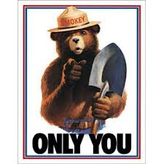
Wrap-Up (cont.)
CAN PREVENT EMC PROBLEMS

Slide 5
Wrap-Up
Discussion
Questions
Etc.

