Slide 1


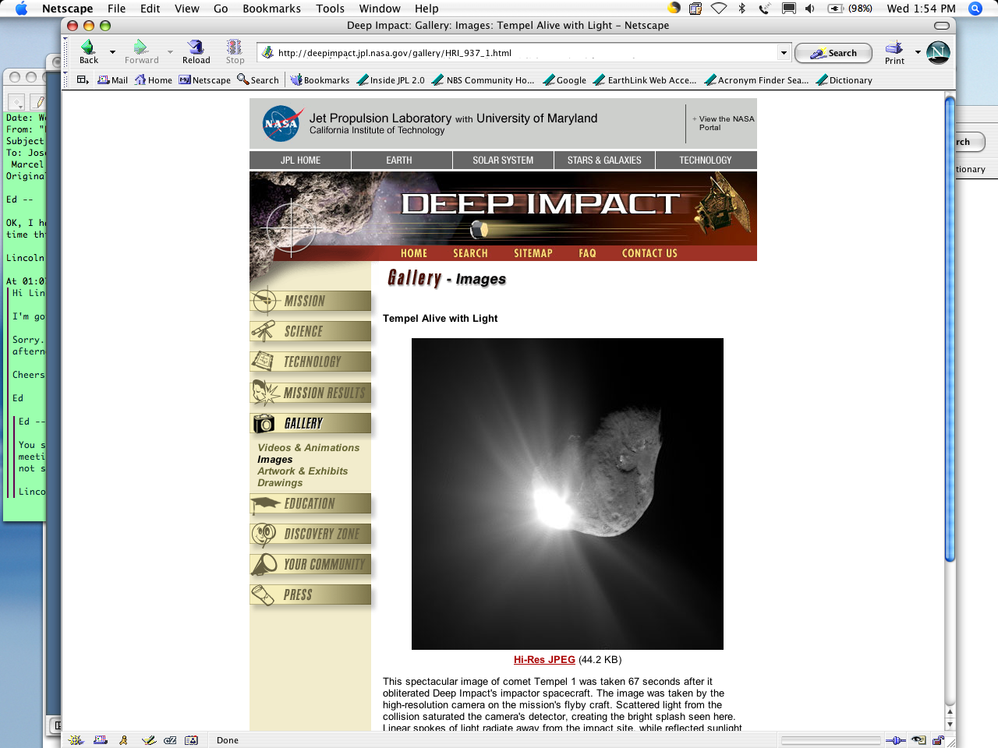
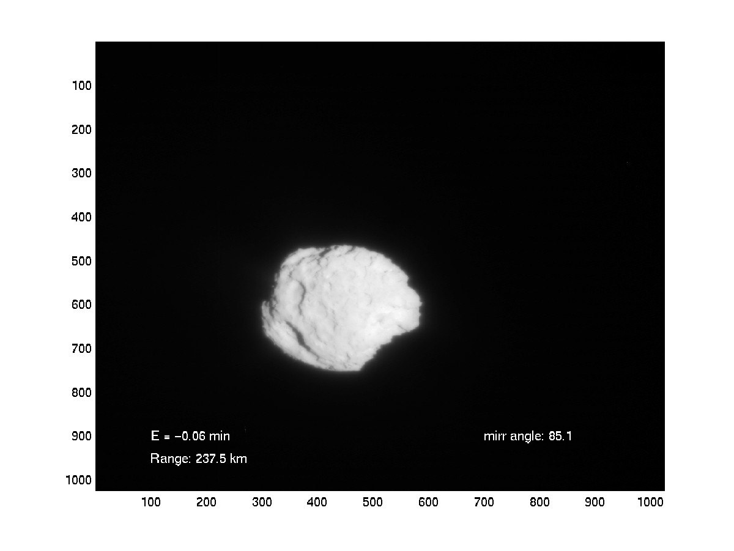

NESC Academy Webcast
Autonomous Navigation For Deep Space Missions
Dr. Shyam Bhaskaran, NASA Jet Propulsion Laboratory, California Institute of Technology
©2015, California Institute of Technology, government sponsorship acknowledged
Moderated by Neil Dennehy
Technical Fellow for Guidance, Navigation, & Control
NASA Engineering & Safety Center

Slide 2
Agenda
Brief introduction to deep space navigation
Brief introduction to optical navigation
Overview of Autonomous Navigation (AutoNav)
Examples of AutoNav use
Some thoughts on enhancements and future uses of AutoNav

Slide 3
Background on Deep Space Navigation
Spacecraft have visited 8 planets, 3 dwarf planets (Vesta, Ceres, Pluto), asteroids and comets
Navigation (determining where the spacecraft is at any given time, controlling its path to achieve desired targets), performed using ground-in-the-loop techniques.
Data for orbit determination includes a combination of:
  2-way Doppler, which measures line-of-sight velocity from spacecraft to tracking station
  2-way range, which measures line-of-sight range from spacecraft to tracking station
  Delta-Differential One-way Range (Delta-DOR), which provides plane-of-sky angular measurement
  Optical images of natural bodies taken by onboard camera (OpNav), which measures angle between spacecraft and body against an inertial reference

Slide 4
Background on Deep Space Navigation
Data received and processed on the ground
Orbit determination (OD) computed using linearized least squares filter
  Observed tracking data are differenced with predicted values based on reference trajectory (residuals)
  Adjust parameters of orbit (position, velocity, other constants) using least squares to minimize sum-of-squares of residuals until convergence
At desired times, maneuvers are computed to correct trajectory errors, and commands sent to execute maneuvers on spacecraft
For deep space, data are received using one of three Deep Space Network complexes (Goldstone, CA, Canberra, Australia, and Madrid, Spain)
  DSN is a heavily used resource
Current capabilities can achieve highly accurate results, for example:
  km level targeting accuracies for satellite flybys on Cassini mission
  10s of km landing ellipses on Mars
Still need to keep increasing performance for future missions, and alleviate pressure on DSN use

Slide 5
Drawbacks to Ground-based Navigation
Long round-trip light time (many minutes to many hours), depending on where the spacecraft is in Solar System
Time needed to process the data by analysts
  Orbit determination and maneuver calculations
  Analyze results
  Convene meetings to make decisions and implement decisions
  Generate sequence commands and uplink them to spacecraft
Lag time between the last navigation update and implementing maneuvers can typically take 8 or more hours to over a week. As a result:
  Loss of some science, for example, to precisely point instruments at a target cannot use latest navigation knowledge
  Loss for mission parameters, such as increased use of fuel as the orbit information has become stale during turnaround time to implement maneuvers

Slide 6
Onboard Autonomous Navigation
A self-contained, onboard, autonomous navigation system can:
  Eliminate delays due to round-trip light time
  Eliminate the human factors in ground-based processing
  Reduce turnaround time from navigation update to minutes, down to seconds
  React to late-breaking data
A framework and computational elements of an autonomous navigation system has been developed, called AutoNav
  Originally developed as one of the technologies for the Deep Space 1 mission, launched in 1998
  Subsequently used on three other spacecraft, for four different missions
  Primary use has been on comet missions to track comets during flybys, and impact one comet

Slide 7
AutoNav Data
In principle, can use same data as ground-based navigation (radiometric and optical)
  Radiometric data requires other information, such as media calibrations, for Earth-based data, or location of other spacecraft for spacecraft-to-spacecraft data
More straightforward to use entirely self-contained data, so current AutoNav based on using optical data only (OpNav)
  Passive optical data uses onboard camera to image celestial bodies
  Bodies can be distant point sources (“unresolved”), distant resolved bodies, or bodies which partially or completely fill the camera FOV, in which case terrain-relative navigation techniques can be employed
  Raw images reduced to sample/line coordinates of sub-pixel centers of stars and target object (“centerfinding”)

Slide 8
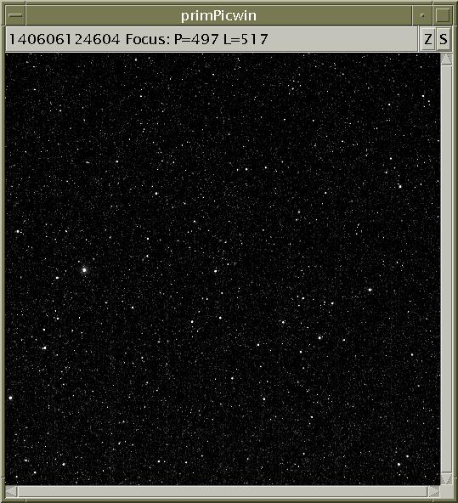
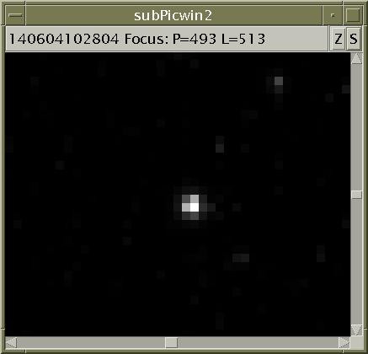
OpNav Types – Unresolved Body
Comet Churyumov-Gerasimenko
Gaussian Pointspread – Centerfind Using Gaussian Fit
Stars

Slide 9
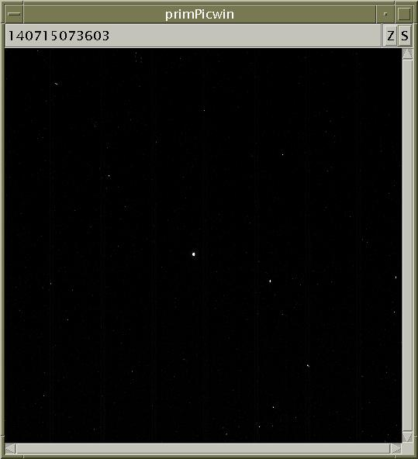
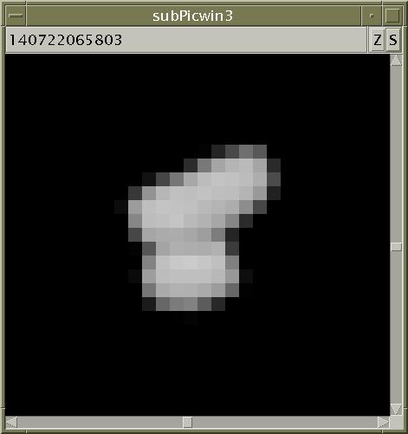
Opnav Types – Resolved Body
Comet Churyumov-Gerasimenko
For unknown shape, centerfind using brightness moment algorithm

Slide 10
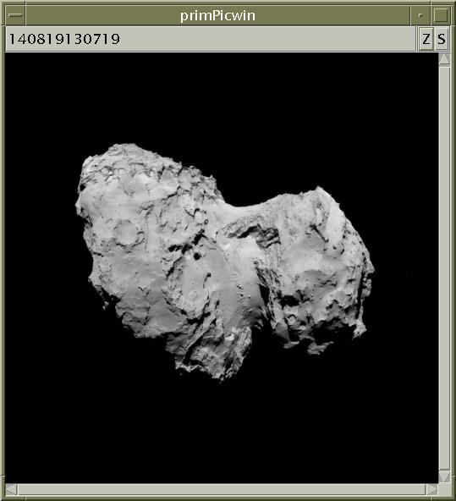
Opnav Types – Extended Body
Use terrain-relative landmark tracking techniques
Stars may or may not be visible

Slide 11
OpNav Basics
OpNav works on the basis of parallax
Apparent shift of body in camera FOV from its predicted location to where it actually is can be due to one of two things
  Either the body or the spacecraft is not where it was predicted to be
  The direction the camera was pointing was not where it was predicted to be
We can eliminate the 2nd source *if* there are stars in the camera FOV
  Stars are, for all practical purposes, at an infinite distance, so there is no discernible parallax due caused by the star or spacecraft position
  Can use stars in FOV to adjust the inertial pointing knowledge to eliminate it as a source of error
    1 star – can solve for Right Ascension and Declination of pointing
    2 or more stars – can also solve for the “twist” – rotation around camera boresight
  Refer to this as “stellar referenced” OpNav
If stars are not available, then the RA/DEC/TWIST parameter must also be solved for in the filter, degrading the accuracy of the solution

Slide 12
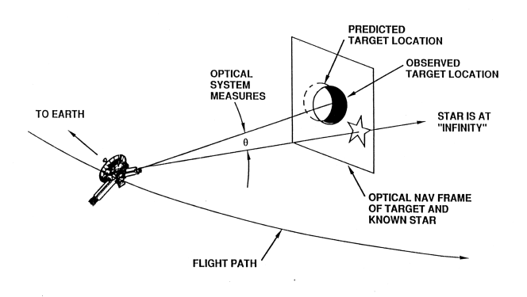
OpNav – Distant Objects
For distant, unresolved objects
  Center-of-figure of the body is found using a centroiding method
  Background stars provide inertial reference frame
For distant, resolved objects
  Center-of-figure found using various cross-correlation or limb-finding methods
  Background stars provide inertial reference frame
Centroid location provides line-of-sight vector to that body in the star-based inertial reference frame (angular measurement)
Time series of LOS vectors can be input to a least-squares filter to estimate spacecraft position and velocity

Slide 13
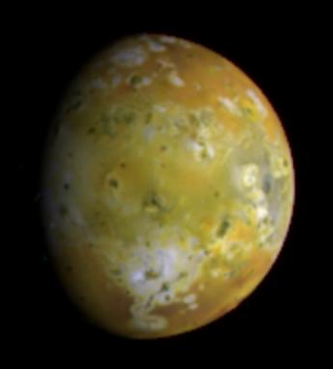
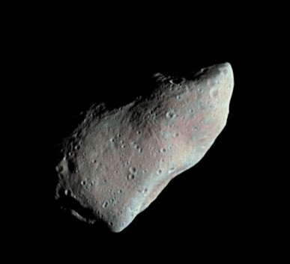
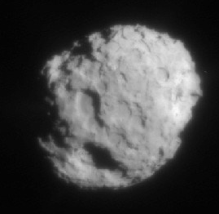
A Brief History of Stellar-referenced OpNav
1976: Viking orbiters demonstrated optical navigation using Phobos and Deimos.
1978-1989: Voyager requires optical navigation to meet mission objectives at Jupiter, Saturn, Uranus and Neptune.
1991-1996: Galileo Mission utilizes optical navigation to capture images of Gaspra and Ida, and to accurately achieve orbit and satellite tours.
1996-1998: Deep Space 1 optical navigation used in cruise flight in 1999, and approach to comet Borrelly
1997-2001: NEAR optical navigation used for flyby of Mathilde and approach to Eros
2002-present: Cassini optical navigation extensively used for satellite tour
2004: Stardust optical navigation used for approach to comet Wild 2
2005: Deep Impact optical navigation used for approach to comet 2006: MRO performs demonstration navigation with the Mars Optical Navigation Camera (ONC).
2008-2014: Rosetta used optical navigation for flybys of asteroids Leutetia and Steins, and approach to comet Churumov-Gerasimenko
2011 – 2015: Dawn used optical navigation for approach to Vesta and Ceres
2014 – 2015: New Horizons Pluto used optical navigation, imaging Pluto, Charon, Nix and Hydra on approach to the Pluto system
Voyager 1 at Jupiter, 1980
Galileo at Gaspra, 1991
Stardust at Wild 2, 2004

Slide 14
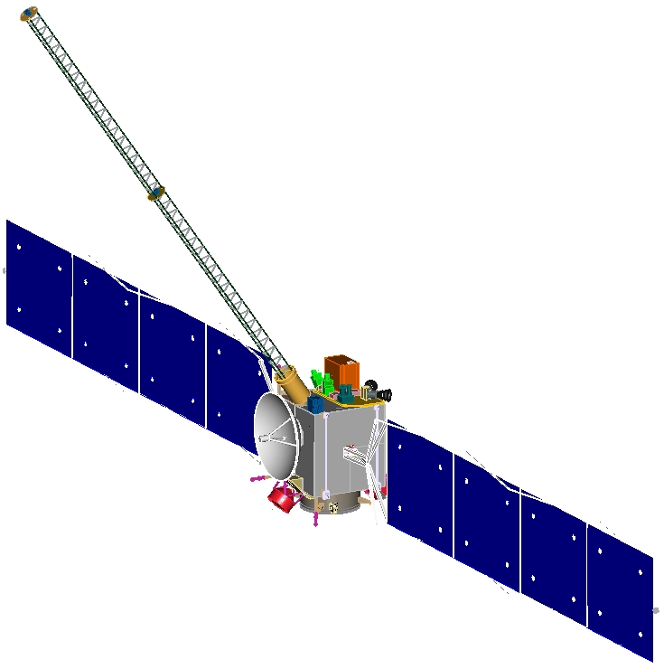
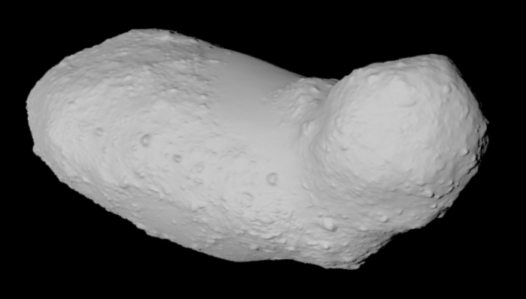
OpNav – Terrain Relative Navigation
Step 1: From a high orbit, or a previous mission, perform a survey to develop a set of landmark models and control network.
Step 2: Using the landmark network, images of the surface produce high precision OpNav data
Step 3: Data from individual images is combined in a navigation filter with other data (e.g. radiometric or LIDAR observations) to estimate s/c position.

Slide 15
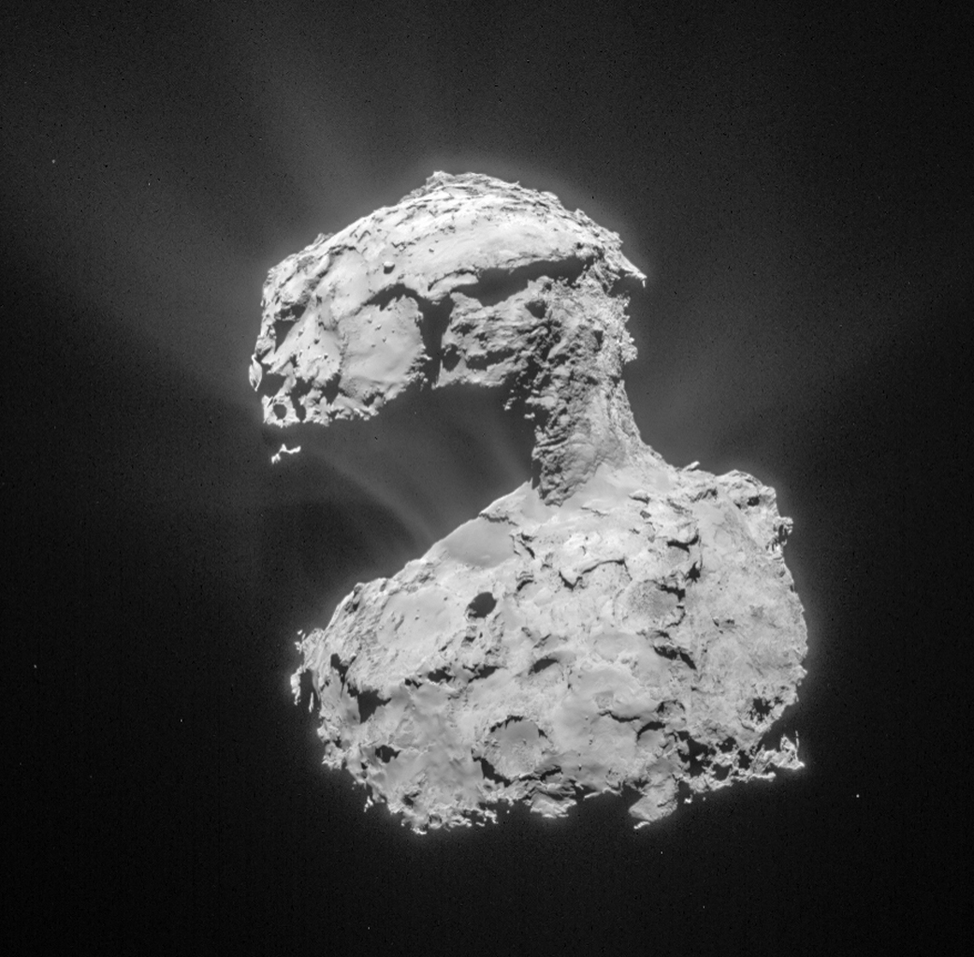
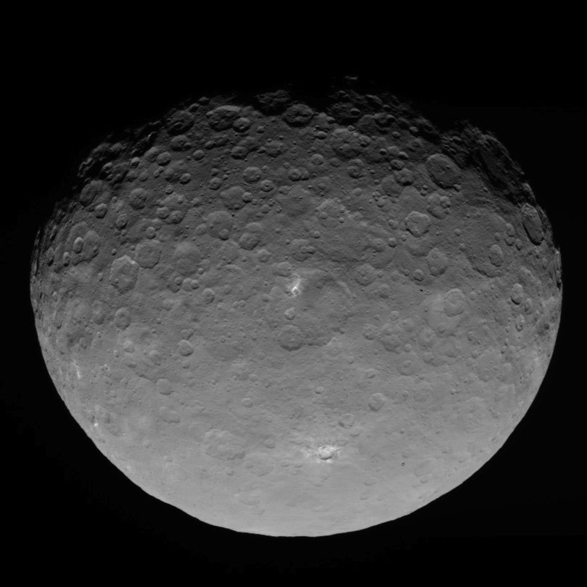
A Brief History of Terrain-Relative OpNav
2000-2001: NEAR orbital operations at Eros - 1st use of landmark based optical navigation at small bodies
2005: Hayabusa demonstrated the first use of stereo-photoclinometry (SPC) to derive a detailed shape model which can be used for terrain-relative navigation
2011-2015: Dawn used SPC extensively during Vesta and Ceres orbital operations
2015: Rosetta used SPC during proximity operations around comet Churumov-Gerasimenko
2018: OSIRIS-REx (future) will use SPC for proximity operations around Bennu
Rosetta at Churumov-Gersimenko, 2014
Dawn at Ceres, 2015

Slide 16
AutoNav Overview
All ground-based OpNav techniques transferred to spacecraft and automated
  While ground-based navigation uses OpNavs only in limited situations, current AutoNav system capable of using OpNav techniques throughout mission phase
Involves 3 steps – (1) image processing, (2) orbit determination, and (3) maneuver planning and execution
  Image processing automatically identifies stars and body in camera FOV and performs centerfinding
  OD filter combines images and other s/c ancillary information (such as thrusting, attitude knowledge, etc) to get complete s/c state
  Maneuvers computed at pre-specified times to retarget s/c to reference trajectory
System must be robust enough to automatically detect errors and respond to different situations

Slide 17
AutoNav Concept
Target asteroid/comet
Earth orbit
LOS Vector n
Main belt asteroids provide good beacon sources
Ephemerides are reasonably well known
Lots of asteroids to chose from
LOS Vector 2
LOS Vector 3
LOS Vector 1
LOS Vector 1
LOS Vector 2
Beacon asteroid
Beacon asteroid
Interplanetary cruise scenario
Technique used on DS1
Small body flyby scenario
Technique used on DS1, Stardust, DI

Slide 18
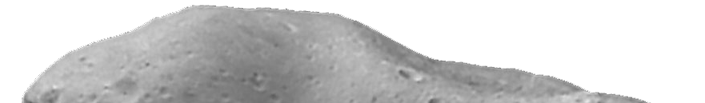
AutoNav Concept
Satellite
LOS Vector 1
LOS Vector 3
Planet
Landmark locations in body-fixed frame known from SPC shape model
Knowledge of bodies pole orientation and spin rate provide inertial reference
Satellite
LOS Vector 1
LOS Vector 2
Small body orbiting and/or landing
scenario
Approach and/or tour of planetary system containing
satellites

Slide 19
AutoNav Overview (cont.)
Orbit determination
  Numerical integration of dynamic equations of motion/ force modeling
    Ground navigation uses very high fidelity models of forces acting on spacecraft since radiometric data is very accurate, and processing speed not an issue
    Onboard computers not as fast, and rapid turnaround is important, so force models not as detailed
      Include central and 3rd body point mass gravitational accelerations, simple solar pressure model, impulsive Delta-V. Onboard thruster activity accumulated by IMUs also included in integration
      Low-thrust (e.g., ion propulsion system) modeled as linear polynomials
  Least-squares estimation
    Difference observed values of data against predicted values (based on predicted spacecraft trajectory) to get residuals
    Perform least squares fit - adjust parameters of trajectory to minimize the residuals until only random noise remains
    Result is reconstruction of past spacecraft trajectory, which can also be propagated into future to get predicted path

Slide 20
AutoNav Overview (cont.)
Maneuver planning and execution
  If predicted path based on latest OD does not meet mission requirements, maneuvers must be implemented to correct course
  Current AutoNav can control low-thrust (ion propulsion system) or standard impulsive delta-v (chemical systems)
  Low-thrust
    Long burns (many hours to many days), controlled by adjusting linear polynomials representing thrust direction, and duration of burn
    Adjustments are linear corrections to pre-planned directions and duration
  Impulsive delta-v
    3 parameters of impulse (cartesian components of delta-v) adjusted to control 3 targeting parameters (cartesian or B-plane target location)
    targeting parameters in linear regime around reference trajectory
  Full optimization and/or redesign of reference trajectorytypically not necessary

Slide 21
AutoNav Overview (cont.)
Data editing
  AutoNav performs same functions as ground navigation process, but must be done robustly
    Large outliers in data set, whether random or systematic, would seriously corrupt OD solution if not removed
    Editing on ground done by human in-the-loop – provides very good filter for bad data, especially systematic errors
  Optical data used by AutoNav is relatively sparse (e.g., 1 data point every 15-60 sec)
  Onboard process is to store a series of data, then analyze it statistically for outliers
    If not enough data accumulated, OD update is not performed
    Philosophy is that it is better to stay with a known, stale solution, rather than update orbit with potentially bad data
  Parameters for editing outliers mission specific and decided on from results of many hundreds of Monte Carlo simulation runs

Slide 22
Error Sources
Inertial direction of LOS vectors
  If stars are not in camera FOV, then inertial pointing of camera boresight will be a large error source and must be estimated in the filter.
Observed target/landmark inertial location
  For distant beacon asteroids, error in their ephemeris will corrupt s/c location estimation. Similarly, errors in the locations of landmarks will also corrupt the estimate
  For purely target-centered flybys where the s/c inertial location in space is not relevant, this is not an issue
Spacecraft non-gravitational forces
  Onboard estimates all s/c non-grav forces (maneuvers, momentum wheel desaturations, attitude control firings) from IMUs is typically not very accurate
Centerfinding ability
  Mismodeling of point source point spread, smearing due to exposure duration, ability to pinpoint landmark

Slide 23
Mission Results
5 missions using 4 different spacecraft have used AutoNav during the mission
  Deep Space 1 (cruise and flyby of comet Borrelly)
  Stardust (flyby of asteroid Annefrank and comet Wild 2)
  Deep Impact (Impactor and Flyby spacecraft imaging for comet Tempel 1)
  EPOXI (flyby of comet Hartley 2)
  Stardust NExT (flyby of comet Tempel 1)
Flyby mission parameters
Mission/Target | Flyby Radius (km) | Flyby Velocity (km/s) | Approach Phase (deg)
DS1/Borrelly | 2171 | 16.6 | 65
STARDUST/Annefrank | 3076 | 7.2 | 150
STARDUST/Wild 2 | 237 | 6.1 | 72
DI/Tempel 1 | 500/0 | 10.2 | 62
EPOXI/Hartley 2 | 694 | 12.3 | 86
STARDUST NExT/Tempel 1 | 182 | 10.9 | 82

Slide 24
Deep Space 1
1st mission in NASA’s New Millennium Program
  Goal was to test advanced technologies as part of a demonstration mission
  DS1 had 12 technologies, among which included:
    AutoNav
    Ion propulsion system
    Miniature Integrated Camera and Spectrometer (MICAS)
Mission overview
  Launch on October 1998
  Fly by asteroid Braille on July 1999
  Sole onboard star-tracker used to provide s/c attitude fails on August 1999. Results in long period where spacecraft in safe-mode while mission was redesigned to use MICAS camera as substitute star tracker. Long hibernation period results in dropping planned comet Wilson-Harrington flyby
  Flyby of comet Borrelly on September 2001

Slide 25
Deep Space 1 (cont.)
Original plan was to have AutoNav control interplanetary cruise and asteroid/comet flybys
Initial results from camera images, however, showed several unforeseen issues with MICAS
  Images heavily corrupted by stray light
  Sensitivity of camera not as good as expected
  Camera distortions unusual and difficult to model
Much of AutoNav software had to be reprogrammed to accommodate camera issues and so validation of cruise results delayed until June 1999, 8 months after launch and only 2 months before Braille encounter
Results in late June and early July indicated that orbit estimates as good as can be expected, but not as good as pre-flight analysis predicted, due to lingering camera performance issues
Maneuver planning and execution occurred as planned,
  OD had to be “seeded” from the ground in certain cases due to degraded perfomance

Slide 26
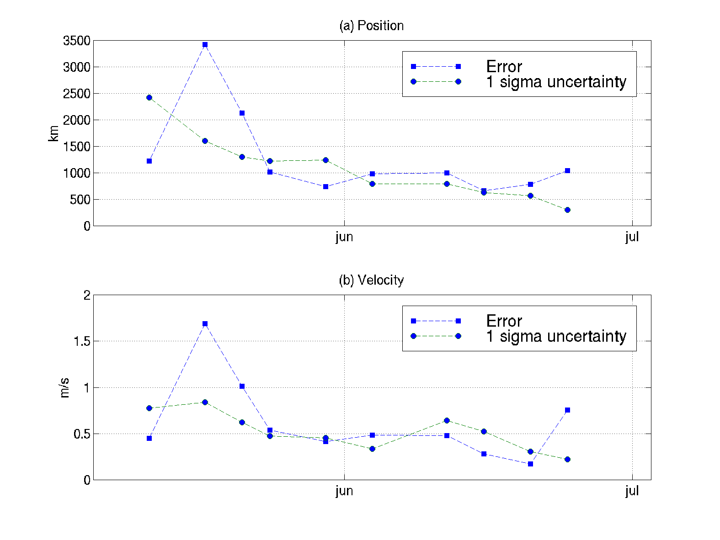
Deep Space 1 (cont.)

Slide 27
Deep Space 1 (cont.)
Encounter with Braille failed due to cosmic ray spoofing of AutoNav
  Resulted in redesign of system with more robust error rejection
Following Braille encounter, AutoNav in control of cruise navigation until August star tracker failure. Since AutoNav required attitude information from star tracker, had to fly remainder of cruise using ground-based navigation
Borrelly encounter on September 23, 2001
  Lessons from Braille encounter applied, and new software uploaded by June 2001
  Flyby tracking initiated 32 minutes prior to closest approach
  AutoNav performed successfully, tracking Borrelly until E- 2.5 min, when slew rate exceeded spacecraft capability
  Nucleus captured in 46 out of 52 image shuttered, resulting in best image at 46 m resolution on surface

Slide 28
Stardust
4th mission of NASA’s low cost, PI led Discovery Program
Primary goal of mission was to fly through coma of comet Wild 2 and return samples to Earth. Second goal was to capture high resolution images of comet nucleus during flyby
Launch on February 1999
Opportunistic flyby of asteroid Annefrank on November 2002
  Provided engineering test case of spacecraft operations at flyby, including test of AutoNav
Wild 2 flyby on January 2004
Sample returned successfully to Earth in January 2006
Cruise, comet approach, and Earth return all done using standard ground-based radiometric and optical navigation techniques

Slide 29
Stardust (cont.)
Annefrank
  High phase (150 deg) approach phase resulted in no ground-updates to target relative position at initiation of AutoNav
  AutoNav started at E-20 min and tracked asteroid through encounter
  Successful test increased confidence for Wild 2 encounter
Wild 2 encounter
  AutoNav initialized at E-30 min with ground-based target-relative information accurate to 5 km crosstrack, 2000 km (or, equivalently, 50 seconds) in downtrack direction
  Data accumulated for 20 min, 1st OD update at E-10 min.
  AutoNav initiated roll at E-4 min to align camera boresight rotation plane with flyby plane
  End result successfully centered comet for approach, flyby, and departure

Slide 30
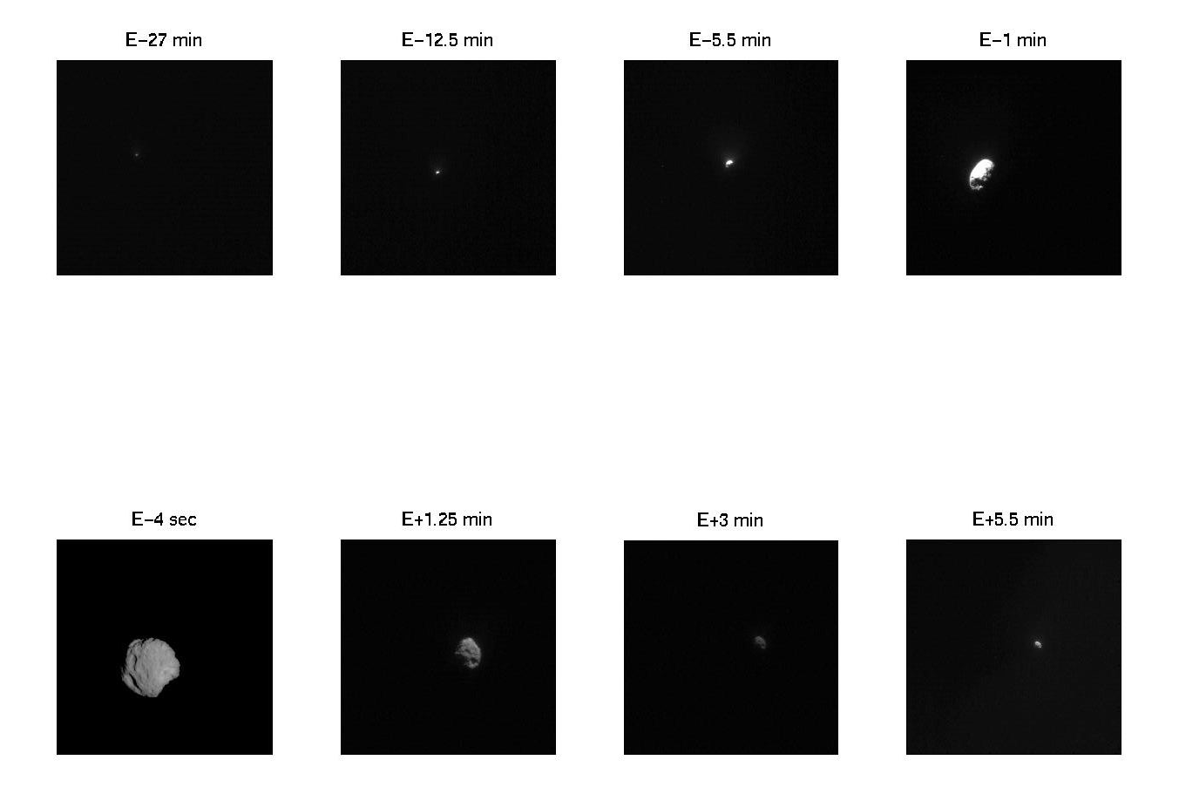
Stardust (cont.)

Slide 31
Deep Impact
DI was the eight mission in NASA’s Discovery Program
Goal of mission was to impact the comet Tempel 1 with one spacecraft while imaging the impact event with another
Flyby/Impactor combo launched on January 12, 2005
Cruise for 6 months
  Cruise and approach to comet performed using standard ground-based radiometric an optical navigation techniques
Impactor released from Flyby spacecraft at E-1 day. Flyby performs burn to slow down so that the impact can be observed prior to passing through closest approach
Modified DS1 version of AutoNav used on both Impactor and Flyby
  Impactor needed maneuver implementation to autonomous guide itself to impact site
  Flyby version kept identical to Impactor version to minimize and simplify testing

Slide 32
Deep Impact (cont.)

Slide 33
Deep Impact (cont.)
Impactor AutoNav
  Initiated at E-2 hours with pre-release target-relative navigation knowledge
  Images taken at 15 sec intervals
  Data accumulated for 10 min, the 1st OD update
  Maneuvers times pre-planned at E-90, 35, and 12.5 min. Delta-V vector computed and implemented onboard
  Image processing used “scene analysis” to direct spacecraft to impact site that was both lit, and biased towards the limb where the Flyby spacecraft made its overflight
Flyby AutoNav
  Initiated at E-2 hours with post-release navigation knowledge
  Used same image and OD cadence as Impactor, but no maneuvers performed
  Used knowledge of expected impact time to update time of rapid image sequencing start to capture event

Slide 34
Deep Impact (cont.)

Slide 35
EPOXI and Stardust NExT
EPOXI was the follow-on mission for DI, selected as Discovery Mission of Opportunity in August 2007
  Healthy Flyby spacecraft following Tempel 1 encounter sent to encounter comet Hartley 2
  Following 3 year cruise with 4 Earth flybys, rendezvous with Hartley 2 occurred on November 4, 2010
  Goal was to image Hartley 2 using visible and IR detectors
Stardust NExT was the follow-on mission for Stardust, also selected as Discovery Mission of Opportunity in August 2007
  Stardust main spacecraft healthy after release of sample canister probe to Earth
  Crater created by DI was not able to be imaged due to dust from the Impactor obscuring view, strong desire to see what crater was formed
  Stardust sent to comet Tempel 1, marking 1st time a comet was imaged from 2 different spacecraft at 2 different times
  Goal was to image crater location, and any more of Tempel 1 that was feasible

Slide 36
EPOXI and Stardust NExT (cont.)
EPOXI AutoNav
  DI software used unchanged.
  Desire to image comet through approach, flyby, and departure resulted in some new twists due to interaction with attitude control system knowledge and errors (DI stopped imaging about 70 sec prior to closest approach)
  Encounter imaging was successful, but leftover data from DI resulted in unforeseen offpoint at closest approach
    Resulted in discovery of large particles being ejected from nucleus
Stardust NExT AutoNav
  Stardust software used unchanged
  Desire for high resolution images resulted in decision to flyby at altitude that was limit of spacecraft’s capability to track
  AutoNav successfully tracked, although closest image slightly clipped

Slide 37
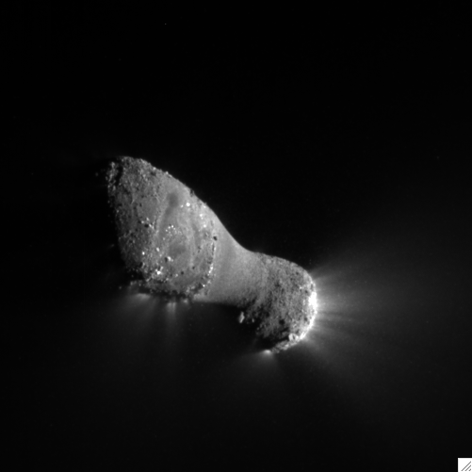
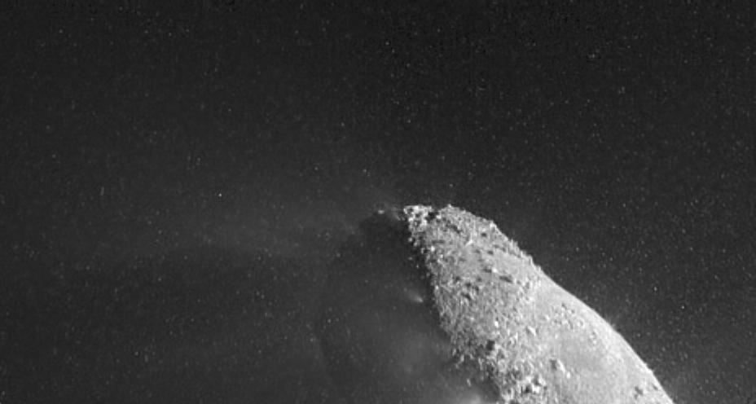
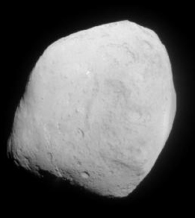
EPOXI and Stardust NExT (cont.)

Slide 38
Potential Future Uses of AutoNav
Asteroid deflection – terminal guidance for high speed impact already demonstrated. Enhancements would allow for greater variability in approach velocity and target sizes
Gravity tractoring – maintaining hover location using low-thrust to pull asteroid using s/c gravity
Small body/Lunar pinpoint landing – numerical simulations indicate AutoNav capable of delivering lander to less than 3 m accuracies for small bodies and 20 m for the moon
Aerobraking – maintain safe aerobraking corridor at Mars
Outer plane satellite tour – rapid turnaround navigation could take advantage of delta-v and mission time savings in complex dynamical environment
CubeSat, NanoSats, etc. – multiple, small s/c exploration of solar system would severely tax DSN assets. Some type of AutoNav required to reduce navigation tracking time

Slide 39
Investments in Technology Needed for Future AutoNav
Gimbal mounted cameras
  Would reduce need to slew entire s/c to image objects. Allows for separation of s/c attitude maintenance and need for pointing
Miniaturization of camera systems
  Smaller cameras for lower mass, needed for notional CubeSats or other small s/c.
  Small aperture limitation for getting enough signal-to-noise for proper image processing
Enhanced image processing techniques
  Would reduce/eliminate false detections and centroiding errors
Potential addition of other data types
  Lidar, radar altimetry
  One-way radiometric from the Earth or space assets
  Two-way radiometric from the Earth or space assets

Slide 40
Investments in Technology Needed for Future AutoNav
“AutoNav in a box” would:
  Provide single piece of hardware that combines narrow-angle camera for navigation with wide-angle camera and IMUs for attitude control, and processor for AutoNav computations
  Provide GPS-like functionality for most deep space applications (cruise, approach, orbit and landing)
Combination of AutoNav with AI enabled spacecraft would enable more autonomous spacecraft that can make decisions on its own

Slide 41
References
Bhaskaran, S., et al, “Orbit Determination Performance Evaluation of the Deep Space 1 Autonomous Navigation System”, AAS 98-193, AAS/AIAA Spaceflight Mechanics Meeting, Monterey, CA, February 1998.
Bhaskaran. S., et al, “Small Body Landings Using Autonomous Onboard Optical Navigation”, Journal of the Astronautical Sciences, Vol. 58, No. 3, 2012.
Gaskell, R. H., et al, “Characterizing and navigating small bodies with imaging data,” AIAA Meteoritics and Planetary Science, Vol. 43, 2008, pp. 1049-1061.
Kubitschek, D. G., et al, “Deep Impact Autonomous Navigation: The Trials of Targeting the Unknown”, AAS 06-081, AAS Guidance and Control Conference, Breckenridge, CO, February 2006.
Owen, W. M., “Methods of Optical Navigation,” AIAA/AAS Spaceflight Mechanics Conference, AAS 11-215, New Orleans, LA, February 2011.
Riedel, J. E., et al, “Configuring the Deep Impact AutoNav System for Lunar, Comet and Mars Landing, AIAA 2008-6940, AIAA/AAS Astrodynamics Specialist Conference, Honolulu, Hawaii, August 2008.
Tapley, B. D., Schutz, B. E., Born, G. H., Statistical Orbit Determination, Elsevier Academic Press, San Diego, CA, 2004.

Slide 42
NESC Academy Webcast
Questions?
Upcoming GNC Webcast:
Autonomous Spacecraft Navigation Using
Above-the-Constellation GPS Signals
Luke Winternitz
Wednesday, December 9th, 2015
2PM Eastern

