Slide 1


Human Factors Discovered:
Stories from the Front Lines
Randy Mumaw
San Jose State University Research Foundation
[NASA Ames Research Center]
May 8, 2018
Available for on-demand viewing
https://nescacademy.nasa.gov
Moderated by Dr. Jon Holbrook

Slide 2
The Path to Here
Ph.D. cognitive psychology
University of Pittsburgh / Learning Research & Development Center
Human Resources Research Organization (HumRRO)
Westinghouse Electric / R&D Center
Boeing Commercial Airplane
San Jose State University /
NASA Ames Research Center
ATC Training
Nuclear Power Plant Control Room Operators
Commercial Transport Pilots
Ask a question using the button below

Slide 3
Central Ideas
Humans operating complex, socio-technical systems strive to develop a system understanding deeper than the interface and procedures support.
System indications may not support a clear understanding of system state; indications can be fragmented, and the operator is responsible for integrating data (sometimes with little help).
System designers make inappropriately generous assumptions about the average operator’s ability to make sense of the system.

Slide 4
Understanding System State: Monitoring and Procedure Use
Illustration: Monitoring as Problem-Solving
AECB (Canada): How do NPP operators monitor the plant?
Method: Ethnographic; 288 hrs of observation

Slide 5
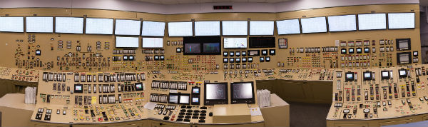
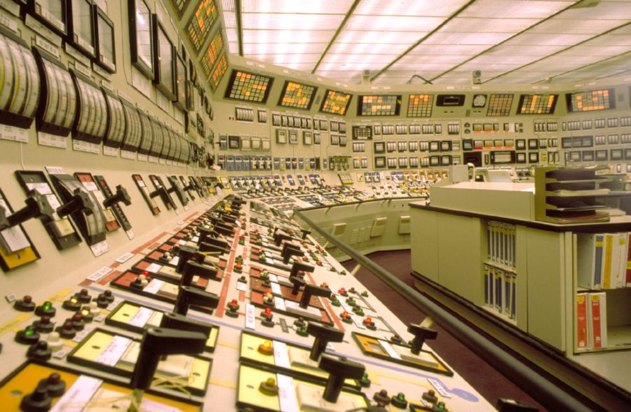
Single-sensor; single-indicator architecture
There is a burden on the operator to
- allocate attention appropriately
- add context
- understand system state
- identify developing problems
What does monitoring look like?

Slide 6
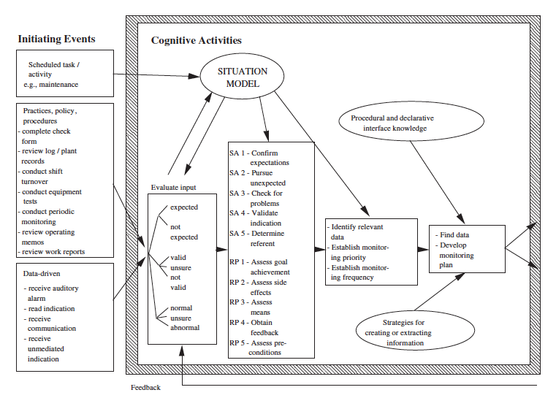
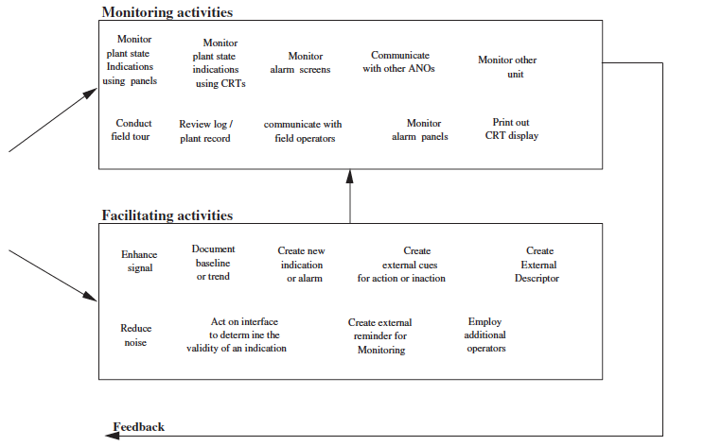
Model of Monitoring
Create a new alarm:
- There is an existing alarm on a tank level to ensure level is sufficient (> 75%)
- When shutting down the tank, you need to drain to 50% (takes hours)
- Change the setpoint to 55% and then focus on task,
Scheduled
Task
Monitor
alarms
Relevant data
and timing
Monitoring
plan
Create
a new alarm
Obtain
feedback
Vicente, K.J., Mumaw, R.J., & Roth, E.M. (2004). Operator monitoring in a complex dynamic work environment: A qualitative cognitive model based on field observations. Theoretical Issues in Ergonomic Science, 5(5), 359-384.

Slide 7
Model of Monitoring
Increase sensitivity:
- When refueling occurs, there is a need to monitor temperature changes,
which can be small
- Standard display-based charts make it hard to detect
- Increase sensitivity: halve range; stack charts
Scheduled
Task
Monitor
indications
Confirm
expectations
Relevant data
and timing
Monitoring
plan
Enhance
signal
Ask a question using the button below

Slide 8
Model of Monitoring
Establish baseline or trend:
- Some parameters are more variable and there is value in knowing their
behavior over a longer period of time
- Grab a recording of values from earlier in the day to understand
behavior over a longer duration
Monitor
indications
Periodic
monitoring
Expected?
Determine
referent
Relevant data
Monitoring
plan
Document
behavior
Normal?

Slide 9
Take-Aways
The older technology makes visible these active monitoring strategies
- changing saliency
- managing tasks / workload
- reducing uncertainty
Operators are “finishing the design”; creating information that the interface designer failed to provide
Cognition is distributed to the interface
- reminders and alerts
- [spatial dedication]
How do we create opportunities for finishing the design with new technologies?

Slide 10
Understanding System State: Monitoring and Procedure Use
Illustration: Procedure Use
Nuclear Reg Comm: Cognitive inputs to procedure use
Method: Human in the loop simulation
Malicious Procedural Compliance

Slide 11
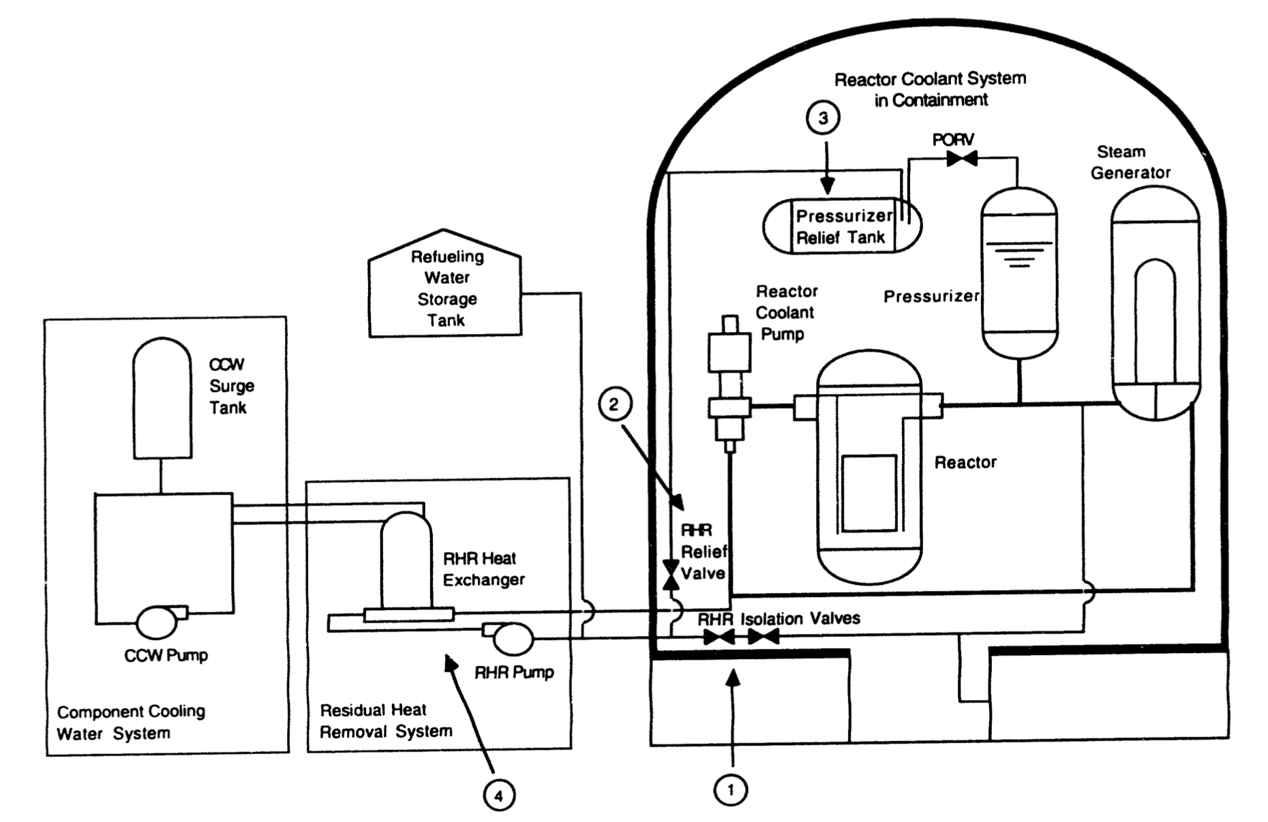
Procedure Use for a Cognitively Demanding Fault
Problem: Reactor coolant leak in an unusual place (distributed symptoms);
Solution requires a transition between separate Emergency Operating Procedures (EOPs)
Key EOP step: if Steam Generator (SG) pressure NOT stable or increasing return to step 1
[and, SG pressure is decreasing]
Key to solving:
- a focus on other inputs to SG pressure (use of schematics)
- understood that the point of the step was to determine if the SG was faulted
- awareness that they were stuck in a procedural loop
Roth, E.M., Mumaw, R.J., & Lewis, P.M. (1994). An empirical investigation of operator performance in cognitively demanding simulated emergencies. (NUREG/CR-6208). Washington, DC: Nuclear Regulatory Commission.
Notes:
ISLOCA event: basically a hard to detect leak
There is a procedure for identifying and isolating this type of leak
Generally, the emergency operating procedures (EOPs) use early symptoms to guide to a traditional LOCA
Plant 1 transition to correct procedure: no explicit step; just a step that says: try to identify and isolate leak
Plant 2 transition to correct procedure: explicit step but either that step can’t be reached or criteria for transition was not met at the right time
So, crews, to solve problem, had to work outside of EOPs
example Crew G: got to step that could transition them; criterion is If Steam Generator pressure NOT stable or increasing,
then return to step 1 (continue loop and never get to needed Procedure); IF increasing, then go to other proc.
Although the pressures are all decreasing, they focus on the other factors that are influencing steam generator pressure and
also they understood the point of the step (faulted steam generator vs a cooldown), and they understood the structure of the EOPs and knew that they would be stuck in this loop
Another group looked at how key components are related (sources of input) (through schematics)

Slide 12
Take-Aways
For both situation assessment and response planning, operators supported their procedure use through extra-procedural actions, such as developing a coherent account of symptoms.
Some crews chose (appropriately) not to take safety actions that were recommended by the EOPs.
Successful crews had knowledge of the structure of the EOPs and the objectives of different procedures.
Designers need to acknowledge and support Knowledge-Based performance

Slide 13
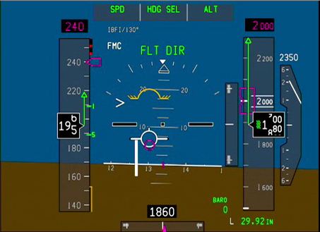
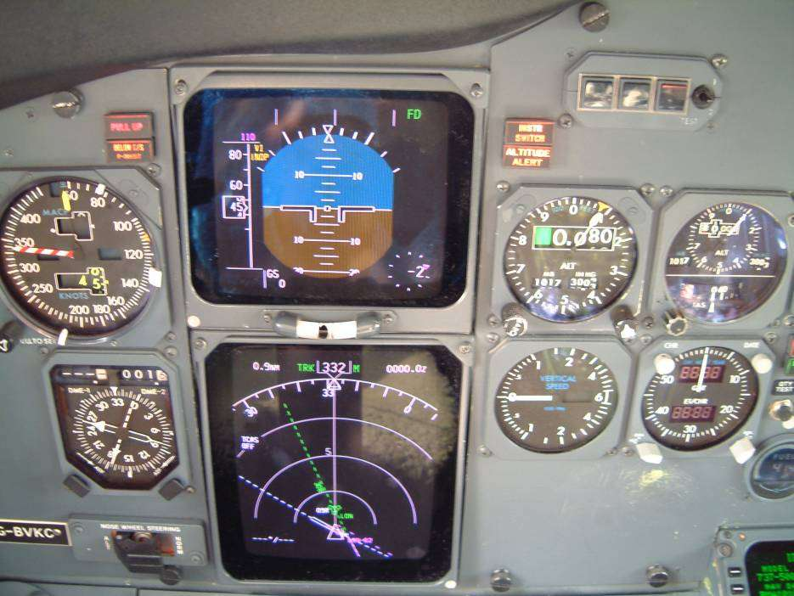
Incoherence of System Indications
Airplanes have a more compact, more modern interface;
Airplanes are (generally) less about diagnosing system faults and more about continuing safe flight and landing;
However, they can present a pretty incoherent or fragmented picture of airplane state.
Let’s look at how the following are presented:
- Unreliable airspeed
- Engine indications
- Cabin altitude (Helios)
Ask a question using the button below

Slide 14
High-Altitude Pitot Icing
Scen 1: Fail L+C+R pitots
FDE: Event 1
(first 30 seconds)
PFD:
Capt IAS ↓ 125
Stdby IAS ↓ 125
FO IAS ↓ 125
ND:
Capt TAS ↓ 231
FO TAS ↓ 231
Capt wind ↑ 250 kts
FO wind ↑ 250 kts
Starting point
End point, indicated
accurate indications
erroneous indications

Slide 15
High-Altitude Pitot Icing
Scen 1: Fail L+C+R
FDE: Event 1
(after 30 seconds)
MCP:
Flashing A – a/s
window (alpha floor)
Eng Ind:
N1 ↑ 98%
ND:
Capt GS ↑
FO GS ↑
PFD:
Amber flashing box
on IAS (CA and FO)
Starting point
End point, indicated
End point, actual
TLs:
advancing
Increased aero noise
accurate indications
erroneous indications

Slide 16
High-Altitude Pitot Icing
Scen 1: Fail L+C+R
FDE: Event 1
(first 50 seconds)
ND:
CAPT + FO TAS ↓ <100
CAPT + FO GS ↑ >500
Capt wind ↑ 300 kts
FO wind ↑ 300 kts
TLs:
Advancing
PFD:
Capt IAS ↓ 30
Stdby IAS ↓ 30
FO IAS ↓ 30
Starting point
End point, indicated
accurate indications
erroneous indications

Slide 17
High-Altitude Pitot Icing
Scen 1: Fail L+C+R
FDE: Event 2
(after 50 seconds, @ approx. 55kts)
OVHD PANEL:
THR ASYM COMP AUTO → OFF
MASTER WARNING
EICAS:
AUTOPILOT DISC
[] FLIGHT CONTROL MODE
AUTO SPEEDBRAKE
NO AUTOLAND
THRUST ASYM COMP
PFD:
CAPT + FO pitch bars disappear
CAPT + FO CMD disappears
CAPT + FO M → GS
ND:
TAS + wind disappears
Starting point
End point, indicated
End point, actual
Beeper (MC)
Siren (A/P DISC)
accurate indications
erroneous indications

Slide 18
IAS Behavior and Relevant Alerts
airplane 1
airplane 2
airplane 3
airplane 4
X
Capt
Ctr
FO
IAS Dis
X
Capt
Ctr
FO
IAS Dis
X
Capt
Ctr
FO
none
X
Capt
Ctr
FO
none
X
Capt
Ctr
FO
IAS Dis
X
Capt
Ctr
FO
IAS Dis
X
Capt
Ctr
FO
none
X
Capt
Ctr
FO
none
Single
X
Capt
Ctr
FO
none
X
Capt
Ctr
FO
none
X
Capt
Ctr
FO
none
X
Capt
Ctr
FO
none
X
X
Capt
Ctr
FO
IAS Dis
X
X
Capt
Ctr
FO
IAS Dis
X
X
Capt
Ctr
FO
NADS
X
X
Capt
Ctr
FO
NADS
X
X
Capt
Ctr
FO
IAS Dis
X
X
Capt
Ctr
FO
IAS Dis
X
X
Capt
Ctr
FO
NASD
X
X
Capt
Ctr
FO
NASD
Sequential
Simul
Simul
Simul
Simul
X
X
Capt
Ctr
FO
IAS Dis
X
X
Capt
Ctr
FO
none
X
X
Capt
Ctr
FO
NADS
X
X
Capt
Ctr
FO
none
X
X
Capt
Ctr
FO
IAS Dis
X
X
Capt
Ctr
FO
none
X
X
Capt
Ctr
FO
NASD
X
X
Capt
Ctr
FO
ASU
X
X
X
Capt
Ctr
FO
none
X
X
X
Capt
Ctr
FO
none
X
X
X
Capt
Ctr
FO
none
X
X
X
Capt
Ctr
FO
ASU
Simultaneous
Ctr = Ctr + Stby
IAS Dis – IAS DISAGREE
NADS – NAV AIR DATA SYS
ASU – AIRSPEED UNRELIABLE
NASD – NAV AIRSPEED DATA
Accurate IAS
AOA SPD

Slide 19
Take-Aways
The burden is on the pilot to integrate across seemingly contradictory indications; no clear, direct indication of fault
There is no indication of data validity; airspeed indications look “normal”
Some progress has been made in this area: AoA-based speed
Ask a question using the button below

Slide 20
Engine Indications
Single-sensor; single-indicator . . . again
Important engine states must be inferred
- engine surge
- engine damage / severe engine damage
- significant degradation or vibration
Confusion about which engine is affected
Primary Indications
Secondary Indications
The Regs require all of these parameters

Slide 21
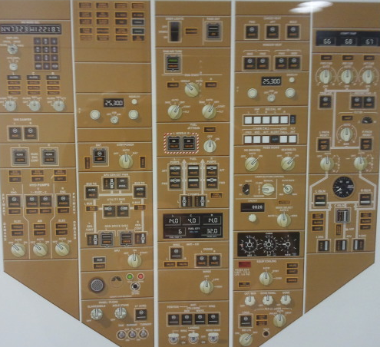
Flight Deck Effects: Engine Icing
Overhead Panel Lights ON
- Pack Off (1)
- Eng Bleed (2)
- Gen Off (3)
- Utility Bus (4)
- Center Fuel Tank Pumps (5)
- C2 Hyd Pump (6)
- Eng Anti-ice Valve (7)
1
Appropriate Action:
Engine Fail non-normal checklist
6
4
5
2
3
7
ND:
- Weather activity
MASTER CAUTION
LIGHT AND BEEPER
EICAS:
L GEN OFF
L UTIL BUS OFF
R UTIL BUS OFF
L ENG BLEED OFF
L ENG ANTI-ICE
L ENG PACK OFF
Engine Indications:
- Decreasing on failed engine;
increasing on good engine for
N1, N2, EGT, FF, Oil Press

Slide 22
Centralized alerting
• Operating State (Engine Availability)
- engine running
- engine not running
- failed
- shut down
- engine starting (and status)
• Non-Normal State
- which engine is affected?
- what is the required action?
- reduce throttle
- shut down engine
- why? what condition is present?
Basic Thrust
Parameter
Engine
Indication
Deviation that
caused the
condition is revealed
Sikora, J. & Mumaw, R. (2004). Making engine displays more meaningful to flight crews. Proceedings of the International Conference on Human-Computer Interaction in Aeronautics, Toulouse, France.

Slide 23
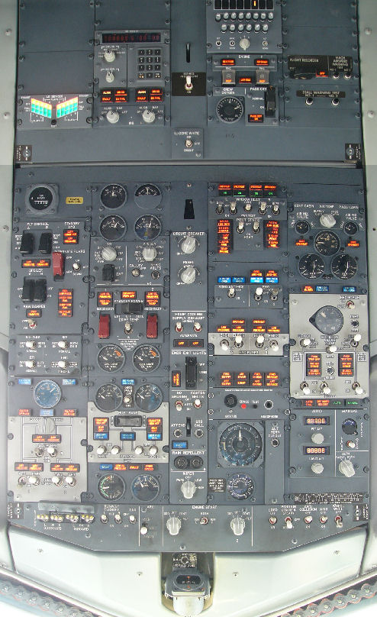
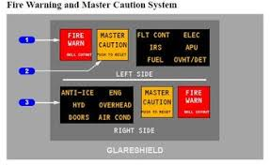
Helios 522 Accident
1 Pressurization was inadvertently set to MANUAL, preventing
the airplane from pressurizing
2 At 12,000, Cabin Altitude Horn sounds (same horn as TO Config)
3 At 17,000, two messages appeared on Overhead Panel:
- Equipment Cooling
- PASS OXY ON
4 Single light on “6 pack” points
to indicate there an alert
5 Equipment Cooling is near the front of the panel; PASS OXY ON
is further back
6 Airplane continues to climb; Crew incapacitated due to O2 loss
Front

Slide 24
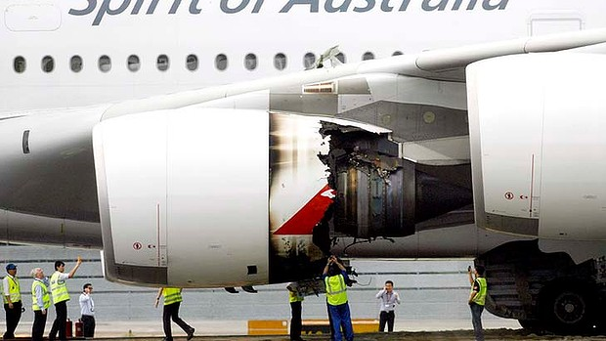
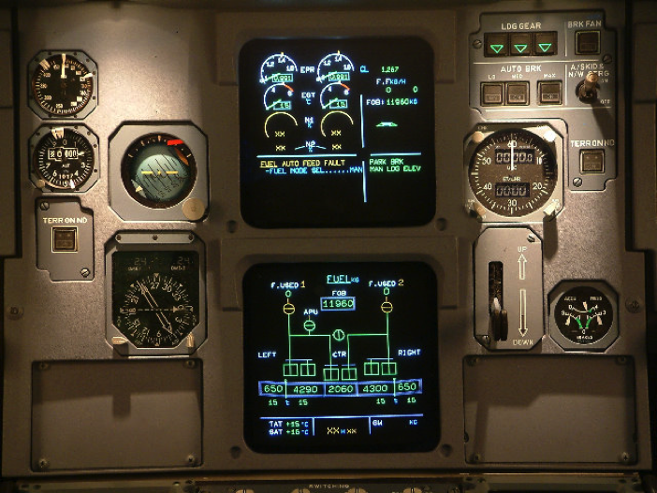
Explosion of Alert Messages
Qantas A380 Uncontained Engine Failure
QF 32; Singapore to Sydney; 469 people on board
4 minutes after Take-off, engine no. 2 bursts, severely damaging other equipment
43 ECAM messages in first 60 seconds; many additional later (> 80 total)
50 minutes to sort through the non-normal checklists (NNCs)
“It was hard to work out a list of what had failed; it was getting to be too much to follow. So we inverted our logic: Instead of worrying about what failed, I said ‘Let’s look at what’s working.’” A380 Captain

Slide 25
Appropriate Solutions?
The burden is on the pilot to integrate across low-level indications
What should we provide operators?
for NPP . . . . fault diagnosis and pointer to actions to contain/repair
Commercial aviation . . . .
- operational limitations
- guidance for continued safe flight and landing
Ask a question using the button below

Slide 26
New Approach for Managing Non-normals
Airplane
system
failure
Mission
Compatibility
Changes to
Operational Limitations
(phase of flight)
Airplane
Capabilities
Maneuver
Envelope
Diversion
Decision
Making
(if needed)
Mumaw, R.J., Feary, M., Fucke, L., Stewart, M., Ritprasert, R., Popovici, A., & Deshmukh, R. (2018). Managing complex airplane system failures through a structured assessment of airplane capabilities. NASA/TM-2018-291775. Moffett Field, CA: NASA Ames Research Center.

Slide 27
What is a Capability?
Airplane System Components
Hydraulic system
Thrust Reverser
Battery
Air conditioning pack
Airplane system components have failed
Airplane Capabilities
Range / Endurance
Stopping Distance (on runway)
Ability to perform a specific approach
Ability to enter RVSM airspace
Maneuver envelope
What can I do?
Where can I go?

Slide 28
Initial Ideas about Airplane Capabilities
Can I Take–off?
Can I reach my planned destination?
Can I land?
Envelope
Resources
Electric Power
Hydraulic Power
Pneumatic Power
Equipment Cooling
Engines (state)
Navigation
Communication
Autoflight
Surveillance
Cabin/Cargo Environment
Ice Protection
Fire Detection & Extinguishing
Airspace Access
Approach Access
Landing Distance
Runway Directional Control
Fuel Supply
Ask a question using the button below

Slide 29
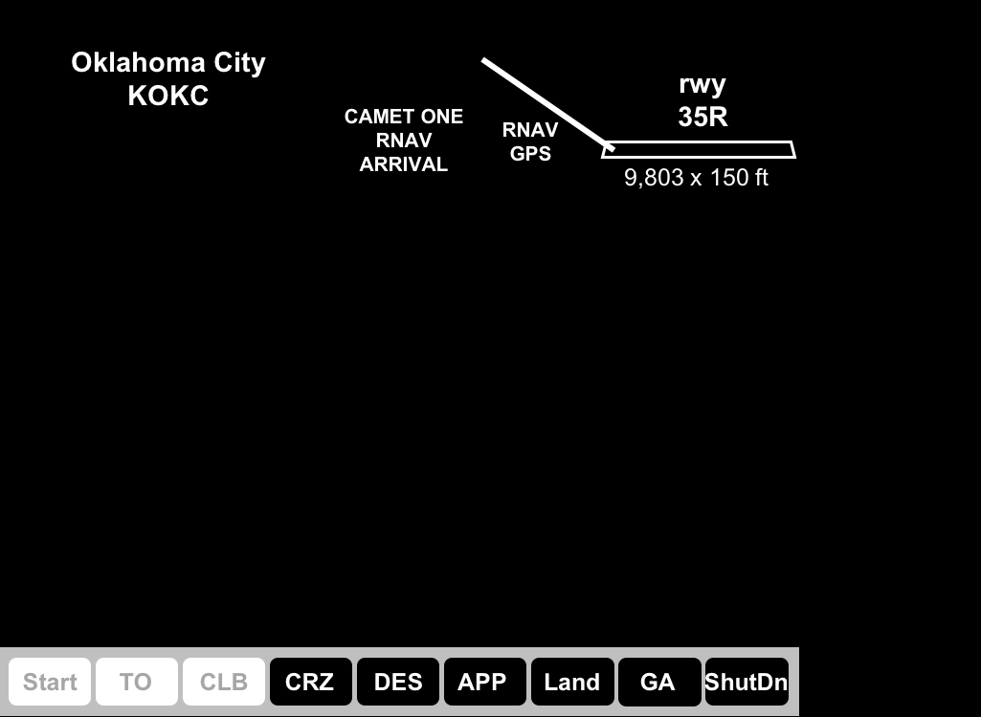
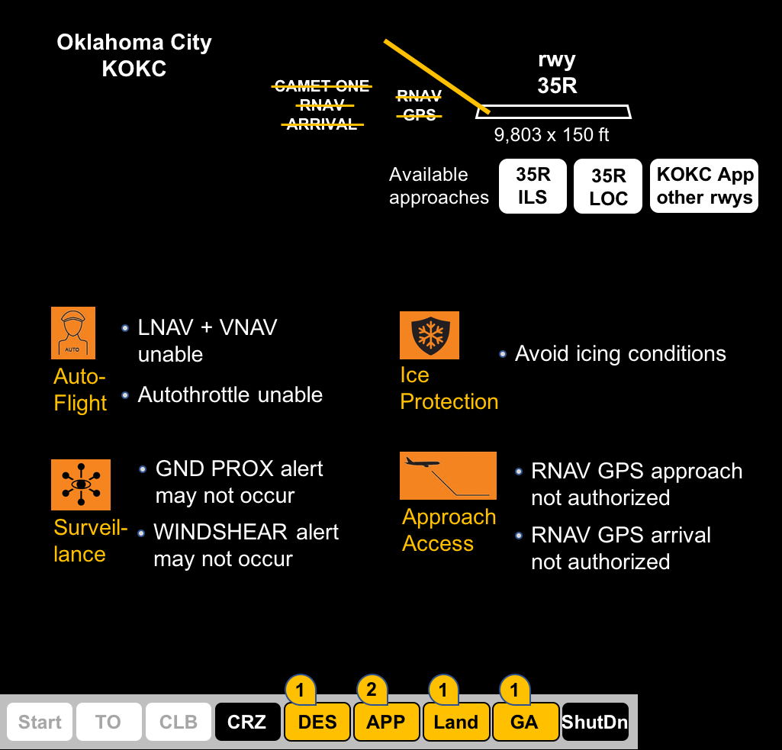
After an AC Bus Failure
Enroute to OKC, in Cruise.

Slide 30
Determining Influence on Performance
How can we go from potentially confusing flight deck effects to determine how well pilots should be able to perform a task?
Context is response to a non-normal situation, such as a system failure that requires a flight crew response for continued safe flight and landing

Slide 31
Analysis Framework: Rasmussen Model
Trained priorities place action behind other activities.
The required action(s) cannot be initiated immediately, and there is no persistent reminder for the flight crew about those action(s).
Prioritize
Action violated routinely without negative safety consequences.
Only the symptoms of the event can be observed,
no explanation is given.
Intentional
Deviation
Taking the action will have considerable consequences
associated with cost or the potential for injury.
Indications can be (at least partially) explained
by automatic system action.
Understand
Select Action(s)
Checklist to be executed is an un-annunciated checklist.
Normal indication, non-normal in this context.
Detect
Execute
Pilot must compare to internal standard / non-normal event does not
manifest in an indication and can only be felt by the pilot.
Feedback
Execution requires complex coordination between controls.
Error Detection
Action to be taken breaks familiar pattern of actions.
Error Recovery
Ask a question using the button below

Slide 32
Reliability: Performance Helps and Hinders
Detect
DET-2 – Critical indicator is available only to one crewmember and is unlikely to be picked up by another.
DET-5 – Normal indication, non-normal in this context.
DET-6 – Other automation or system action occurs to obscure or mask primary event.
DET-8 – Pilot must compare to internal standard
Understand
EXP-4 – Only the symptoms of the event can be observed, no explanation is given.
EXP-11 – Indications can be (at least partially) explained by automatic system action.
EXP-13 – Indications appear in multiple systems and require knowledge of system inter-connections to integrate into a coherent explanation.
Select Action
SEL-5 – Checklist to be executed is an un-annunciated checklist.
SEL-10 – No action guidance is provided
Prioritize Action
PRI-7 – The required action(s) cannot be initiated immediately, and there is no persistent reminder for the flight crew about those action(s).
Intentional Deviation
DEV-6 – There is significant uncertainty or unknown risk associated with taking the action (e.g. the action is not reversible).
DEV-7 – Criterion for taking action is ambiguous or difficult to determine or requires judgment call.
DEV-9 – Taking the action may lead to reduced availability of safety systems, equipment, or instruments.
Execute
EXE-10 – Controls are not placed near important indicators that determine execution.
EXE-19 – Execution requires a difficult coordination between crew members.
EXE-23 – Execution requires closed-loop monitoring of the actions effects
Error Detection; Error Recovery

Slide 33
Help/Hinder Analysis
Select
Action
Intentional
Deviation
Detect
Understand
Prioritize
Execute
Indications part of standard scan
Actions are compatible
System action masks engine failure
Interface gives clear understanding
Attention directed somewhere else
Delay in actions triggers warning
Overwhelmed by secondary indications
No perceived negative consequences
Possible explanation: other event
Controls clearly marked
Indications require knowledge to integrate
Near indicators
Requires flight crew coordination
Actions different
No guidance
Actions break pattern
Interface establishes priority
Requires cont control
Training establishes priority
Physically demanding
Needed to continue operating
Requires complex
coordination
Requires closed-loop
monitoring
Difficult conditions
Relevant HELP factor
Relevant HINDER factor

Slide 34
Help/Hinder Analysis
Select
Action
Intentional
Deviation
Detect
Understand
Prioritize
Execute
Crew attention likely on EICAS
Formal checklist exists
EICAS part of standard scan
Controls are near indicators
Multiple messages/indications point to same conclusion
Controls clearly marked
Condition statement explains event
Control appearance changed
Checklist condition matches FD effects
Indication directly points to checklist
Priorities established by indications
Actions not related to situation
Checklist gives understanding of action’s effects
Uncertainty or risk with taking action
Action may lead to reduced availability
Action may have costly consequences
Perception action can be delayed
Delaying may resolve problem
Relevant HELP factor
Relevant HINDER factor

Slide 35
FD Cue Analysis Take-Aways
Offers a thorough review of how well the flight deck effects and procedures support identifying and performing the appropriate actions.
Does not assign an error probability but a back door to quantitative analysis.
Unlike HRA, allows for consideration of wrong diagnosis and intentional deviations
Provides essential function of identifying design weaknesses.
Ask a question using the button below

Slide 36
Big Picture Take-Aways
In complex, engineered systems, there is a legacy of SS-SI that has slowly evolved over the years ( . . . except for engines).
System operators strive to push beyond the system interface (finish the design) and the procedures to understand system state (or operational consequences).
A close look at several cases shows that the flight deck effects presented to pilots can place a large burden on the flight crew. We need to change the language of the interface to be more compatible with operations.
We should be designing an interface that:
- presents system state and operational objectives more clearly
- supports both RB and KB performance
Ask a question using the button below

Slide 37

Thanks for your time!
Questions?
Available for on-demand viewing
https://nescacademy.nasa.gov

Slide 38
Back-Up

Slide 39
The Role of HF in the Operation of Complex Systems
Operator Selection
and Training
Flight deck
interface
System
Document / Analyze /
Understand
Operational
procedures
Design
Operator
training
System Performance
Develop
Operate System
Operator Performance
Evaluate
Non-normal Events
Human Performance
Human Reliability
Certify
Assess Risk
What fails? How? Why?
What saves the day?
Improving Operator
Performance /
Reduce Burden
Feedback
to Design
Unexpected Tech Uses
Risk Management
Operating Environment
(including changes)
Economic Drivers
HF Principles
Knowledge of Users

Slide 40
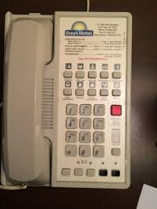
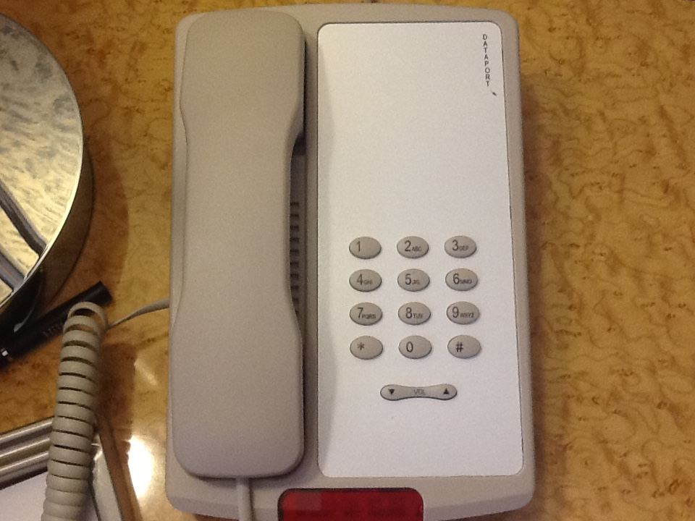

Slide 41
Humans (system users/operators) are adaptive:
you can give them a system/training/procedures but
they will not do what you expect them to do
Support skilled performance; Anticipate and manage
weaknesses. What is skilled perf?
How well can you manage human behavior?
What are the cues in the environment?
How much can we expect humans to reliably not follow cues
- Helios, as an example
- invalid airspeed has no cue
Finishing the design work (and insights into monitoring)
- activities observed; focus on monitoring
- monitoring as problem solving (more observable)
- transition from old to new: display management/overview
CREW as a tool to identify cues
- Air France 447 and unreliable airspeed
- HX bypass valve; assumptions about pilot
Procedures: prescription vs decision aid
- malicious procedural compliance
- Emilie’s work in NPP: actions to support 2 objec
- Av cases in which you had to do something other
than follow EICAS
- unreliable airspeed
- 6 EICAS messages but ENG FAIL
- KB perf happens; need to support it
- can move to ACM here (inherent problems with strings
of actions tied to individual failures)
CREW as effective tool in looking at human reliability
- backing off of assigning a value
- allows you to look at errors of commission (BIG)
Importance of quant tools and measures
(engineering world)
Example of Training Time
- how to predict training time
- TTM, # rules,
SO, expectation to follow procedure . . . . but
how well does interface support that procedure
Tool for SD ???
Intrinsic →
Extrinsic

Slide 42
Seeing HF through Operations
Finishing the design /
Understanding cues for performance
Procedures: prescription or decision aid
Managing non-normals / developing an
operational language
Assessing Human reliability
(in an engineering world)
Dedicated displays vs flexible workstation
and the need for an overview display
Ever-expanding set of evaluation issues
(deeper understanding of crew
performance and failures)
Markers of learnability (TTM, etc)
Autoflight solutions
- Air France 447 → unreliable airspeed → testing of CREW
- CREW Heat exchange bypass valve
- ANA 737 → no alerting on automation failure → automation issue / added an alert
- Flash Air et al → search for SD → work with TNO to build a model
- CAST ASA JSAT → alerting? → alerting analysis
- 1996 FAA report → mode confusion → SAFM and evaluation → Plan B display
- mis-diagnose → presentation of non-normals → airplane capabilities
- SAMG → data certainty → unreliable airspeed → change in indications (787 case)
- something on procedures? Boeing upgrade? Emilie’s study / Kim’s story
- the Canadian monitoring work? Kim’s story and finishing the design
- ASIAS use for understanding HP; didn’t really work
- role of the interface & expanding how we evaluate it
→ expectations feeding into design
- reduce burden on the operator / flight crew (from SS-SI)
- assessing risk
- documenting human performance (errors . . . safety?)
- a toolbox of analysis tools (“human error” as a starting point)
(maybe mention the idea of “failures in training”)
- managing non-normals (prevalence of system components)

