Slide 1
Neil Dennehy cornelius.j.dennehy@nasa.gov
Welcome…
The Evolution of Guidance, Navigation, and Control in Mars Entry, Descent, and Landing
Miguel San Martin, JPL

Slide 2
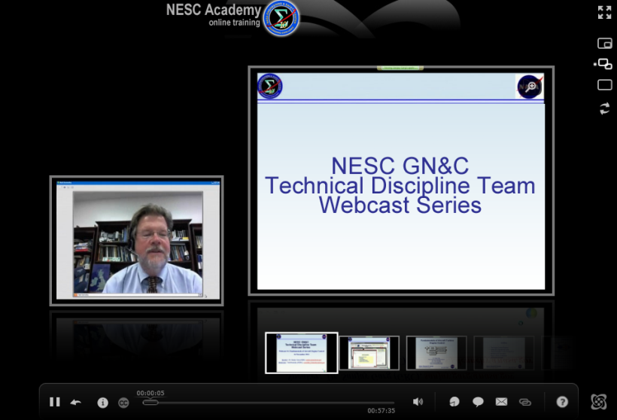

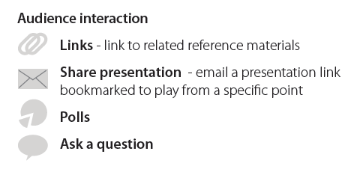


Slide 3
The Evolution of Guidance, Navigation, and Control in Mars Entry, Descent, and Landing
Miguel San Martin
Jet Propulsion Laboratory, California Institute of Technology
NASA Engineering and Safety Center
May 15, 2013
(c) 2013 California Institute of Technology. Government sponsorship acknowledged.

Slide 4
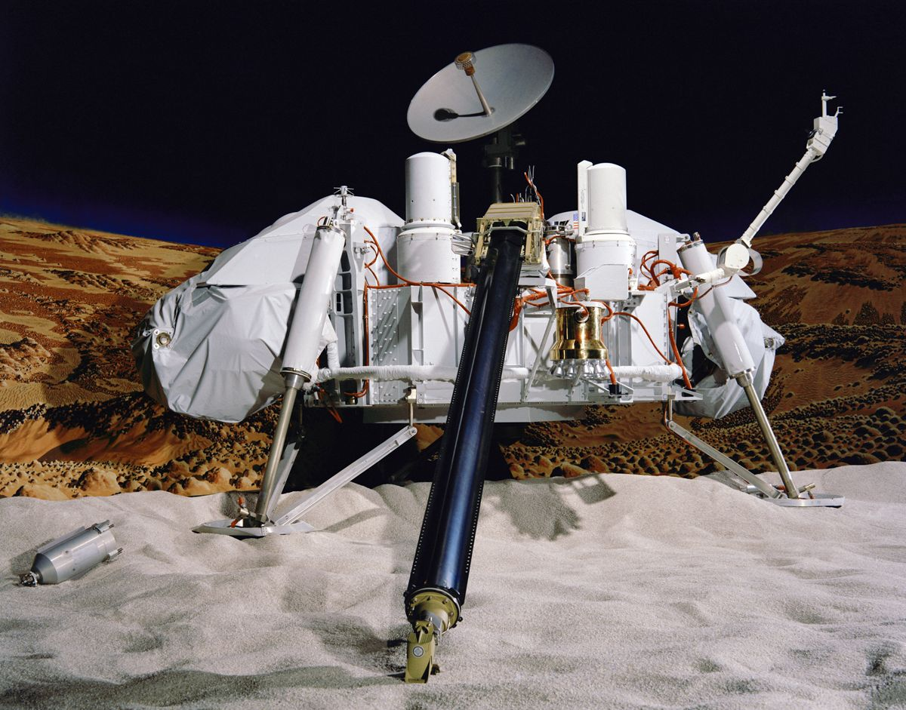
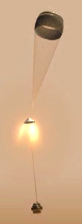
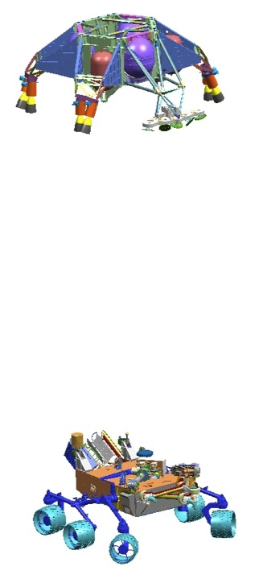
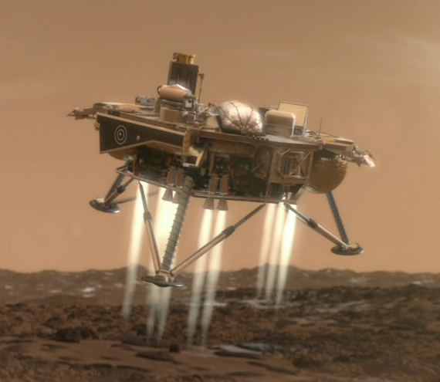
Mars Landers
Viking, 1976
MSL, 2012
MPF, 1997
MER, 2004
Phoenix, 2008

Slide 5
EDL Performance Metrics

Slide 6
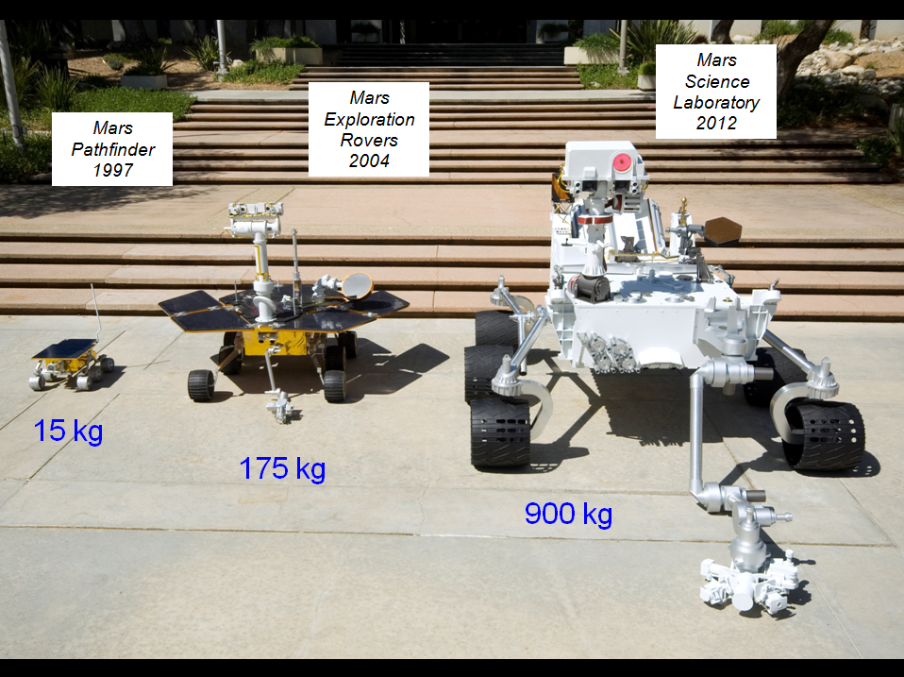

Slide 7
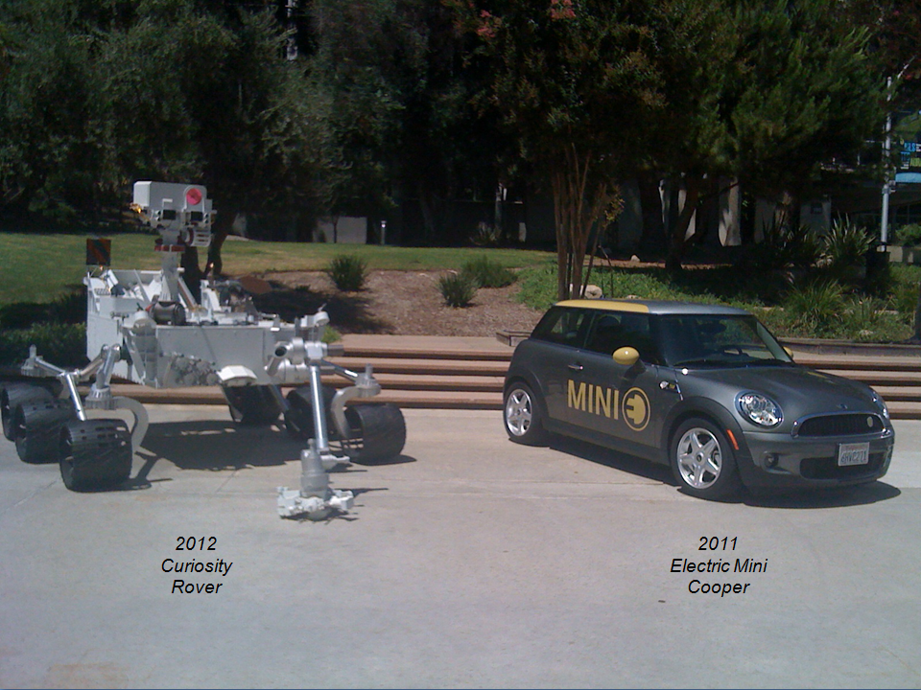

Slide 8
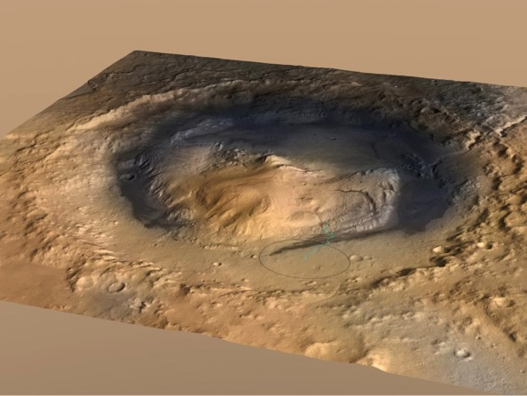
MSL/Curiosity Landing Ellipse in Gale Crater
Gale Crater

Slide 9
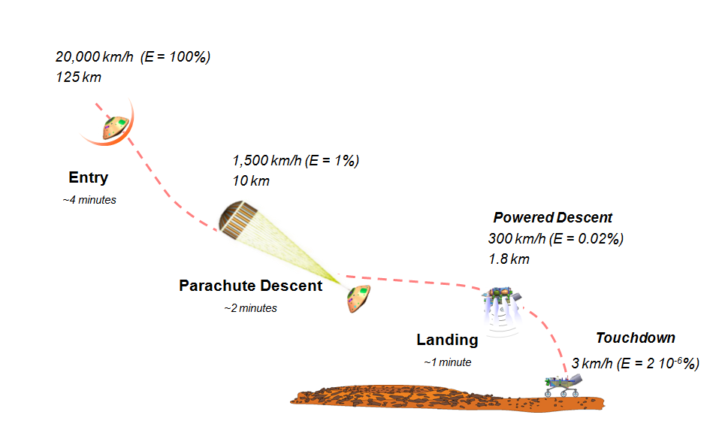
Entry, Descent, and Landing Phases
Notes:
Trade discussion focused on touchdown system – draws the most attention

Slide 10
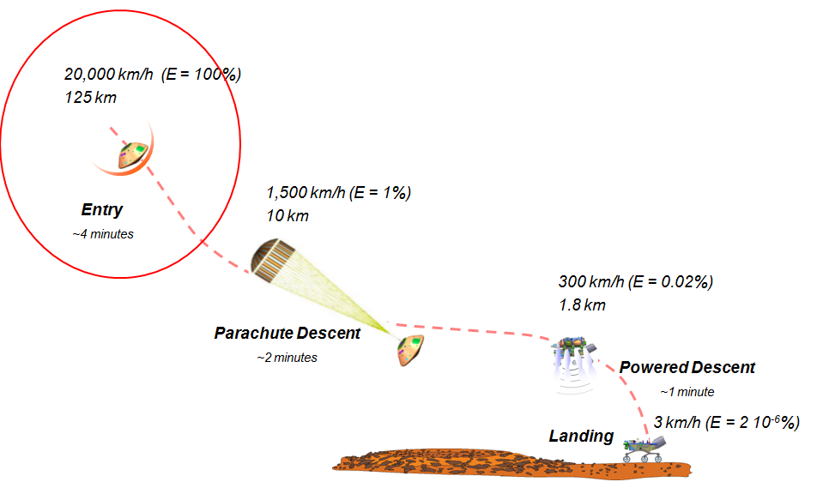
Entry, Descent, and Landing Phases
Notes:
Trade discussion focused on touchdown system – draws the most attention

Slide 11
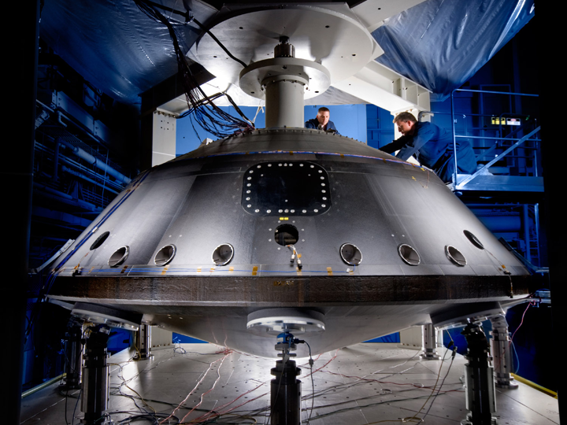
MSL Aeroshell

Slide 12
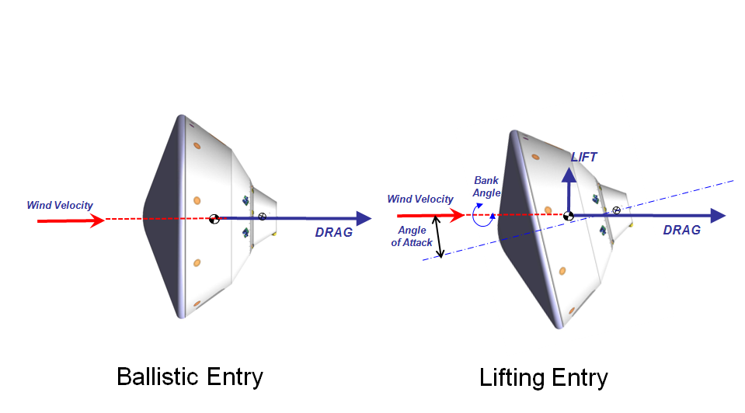
Ballistic vs. Lifting Entry

Slide 13
Entry Phase EDL/GN&C Architectures

Slide 14
Apollo Range Entry Guidance
-Initial Position State @ T0
-Target Coordinates
Inertial
Propagation
&
Drag and L/D
Estimation
&
Target
Computations
Initial
Attitude State
from
Cruise ACS
Range
Predictor
Lift
Command
Generator
Bank
Command
Generator
Commanded
Bank Angle
Reference Trajectory
IMU
Chute
Deploy
Trigger
Deploy Chute Flag

Slide 15
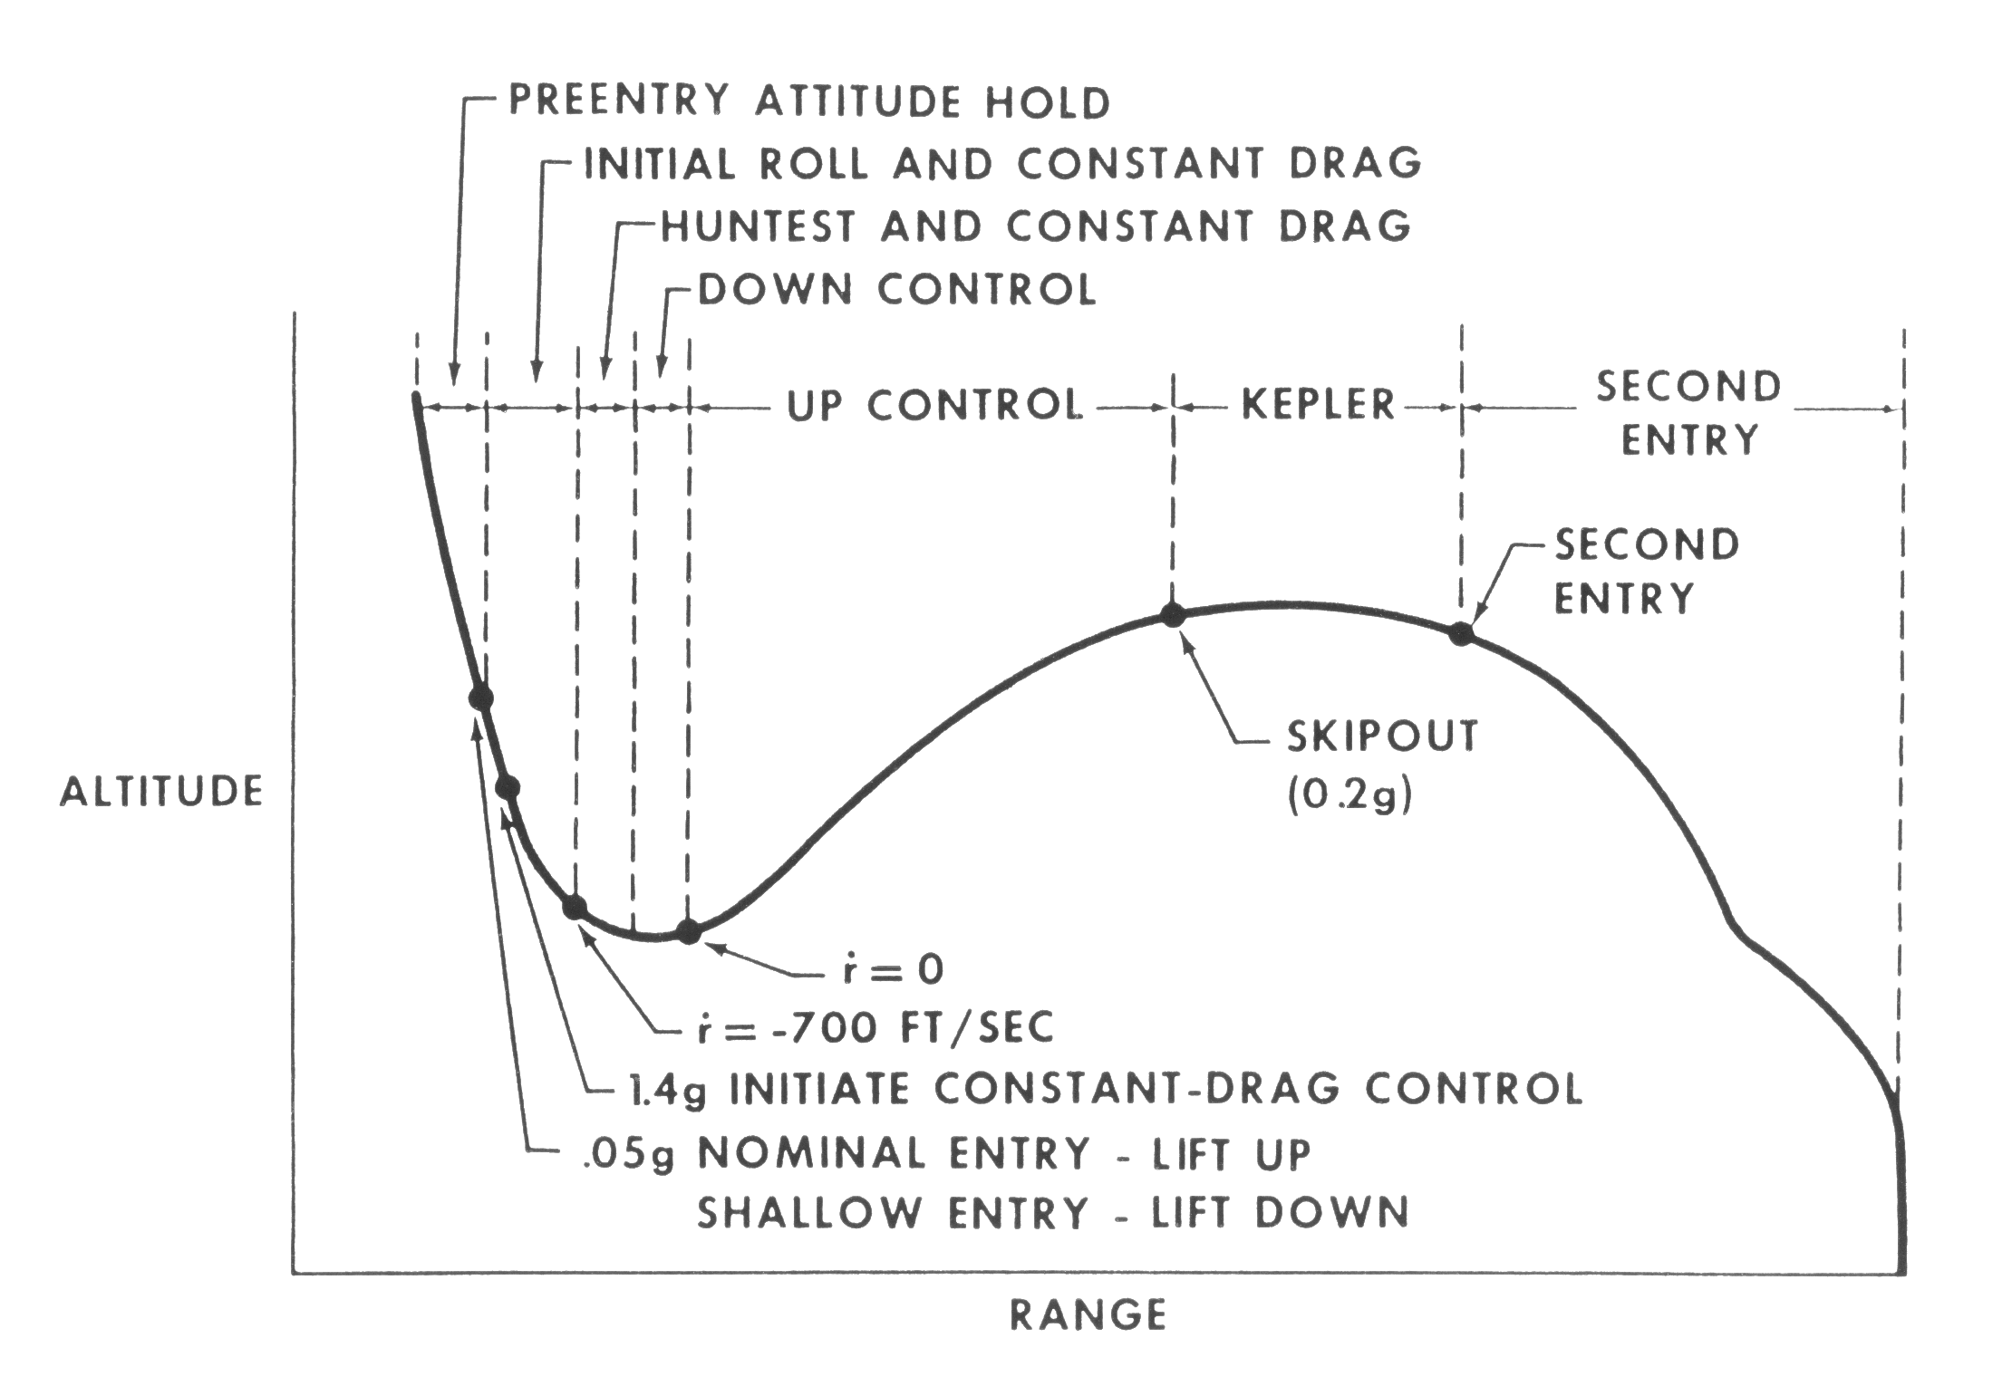
Ranging control Implementation
Heritage Apollo Entry profile
Second entry phase guidance equations:
Predicted range:
Vertical L/D command:
Only the second entry phase logic is used for Mars.
K₃ is an “L/D over-control” gain to adjust the level of aggressiveness in the convergence of predicted range to the actual range.
Bank angle command:
K2ROLL is the bank direction flag (+/- 1)

Slide 16
Lateral control
Cross-range control is accomplished by bank reversals which are performed at corridor limits on the target out-of-plane central angle (LATANG).
  Reversal triggers are quadratic functions of relative velocity.
  A tighter dead-band is used prior to the first reversal to protect low L/D dispersed cases.
  A minimum bank angle command of 15 deg is reserved in the direction toward the target.
Ranging control effectiveness becomes significantly diminished at low velocities, but heading control effectiveness is maintained at lower velocities.
  Bank angle commands are switched to a heading alignment controller for Vrel<1100 m/sec, to null final cross-range errors with proportional control.

Slide 17
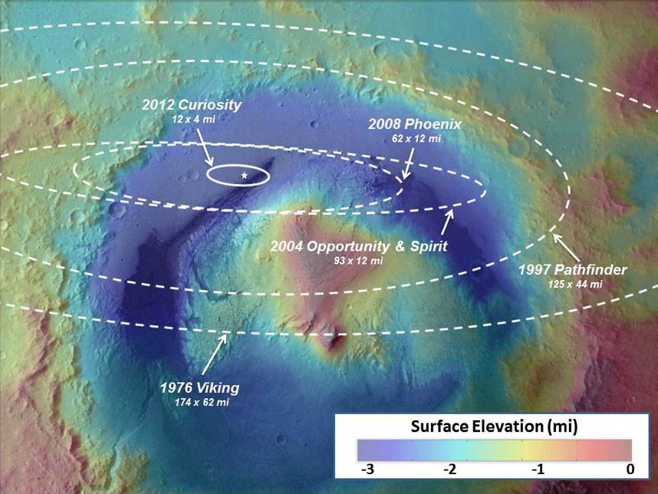

Slide 18
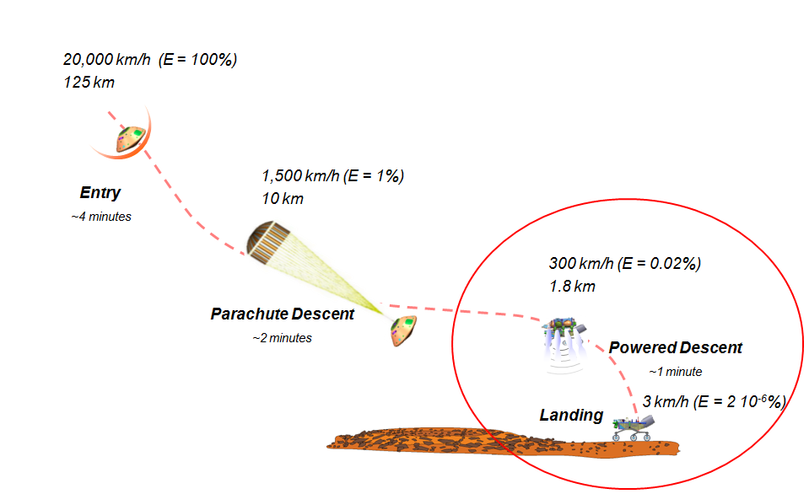
Entry, Descent, and Landing Phases
Notes:
Trade discussion focused on touchdown system – draws the most attention

Slide 19
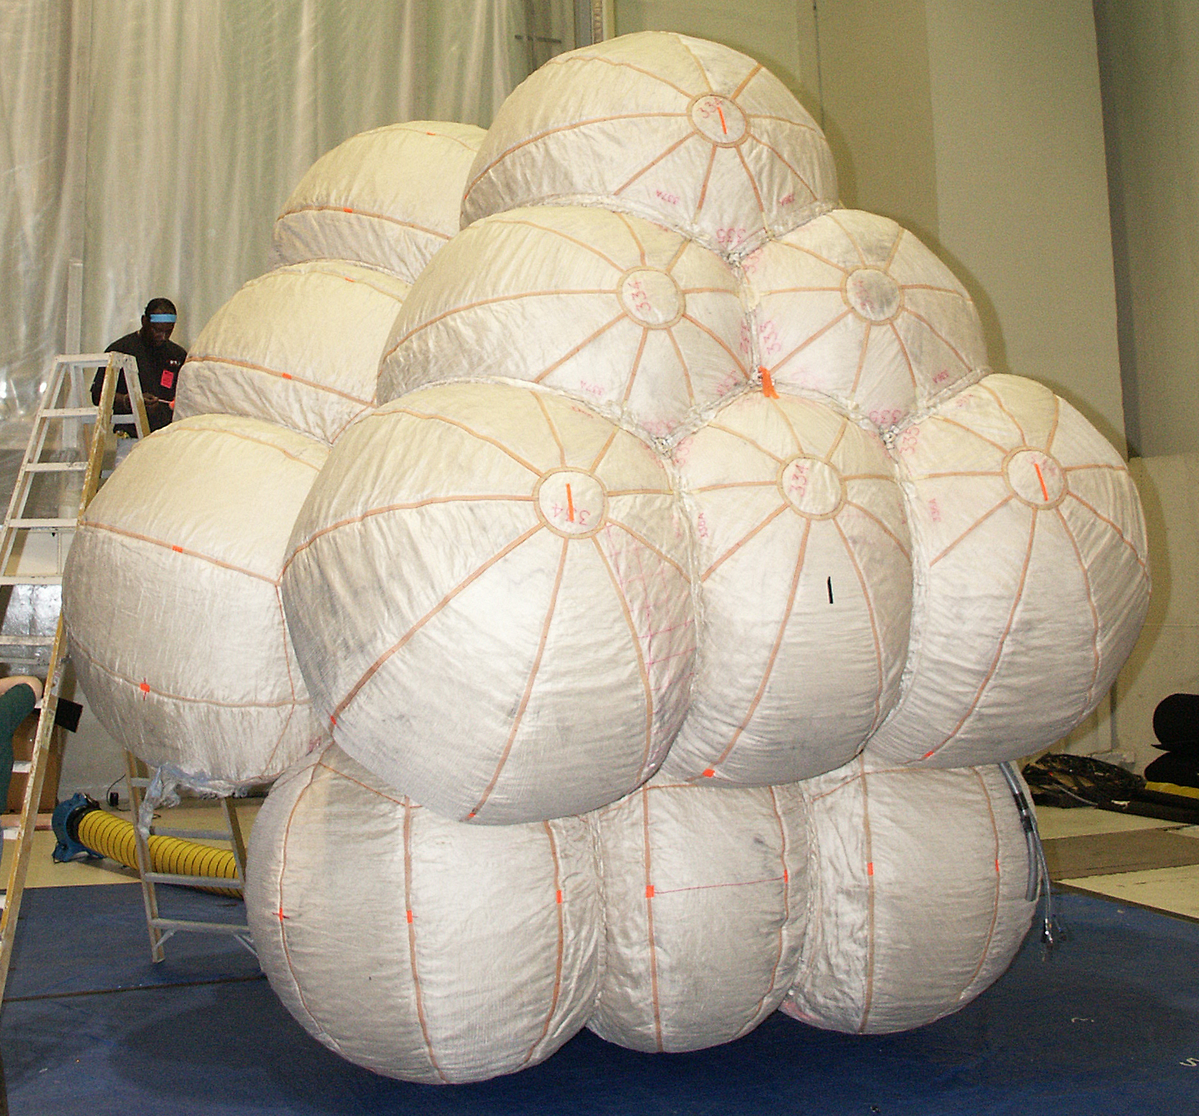
History of Mars Touchdown Velocities

Slide 20
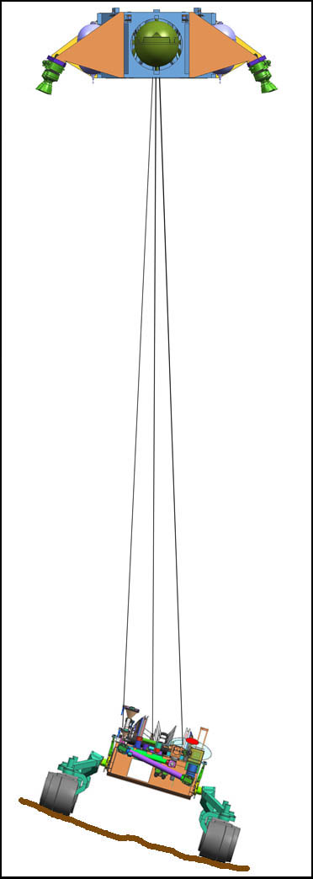
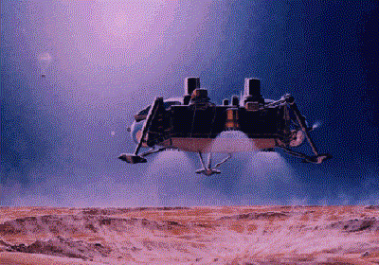
Motivation Behind The SkyCrane
+
=
Towchdown Velocity:
Vv = 2.4 m/sec
Vh < 1.4 m/sec
Touchdown Velocity:
Vv = 12m/sec
Vh < 16m/sec
Towchdown Velocity:
Vv = 0.75 m/sec
Vh < 0.5 m/sec
Robust to rocks
Robust to local slopes
Proven but hard rover egress
Sensitive to winds
Difficult to scale up
Robust to winds
Dedicated Touchdown Detection
Sensitive to local slopes
Sensitive to rocks
Difficult rover egress
Robust to winds
Robust to local slopes
Robust to rocks
Simple touchdown detection
No rover egress problem

Slide 21
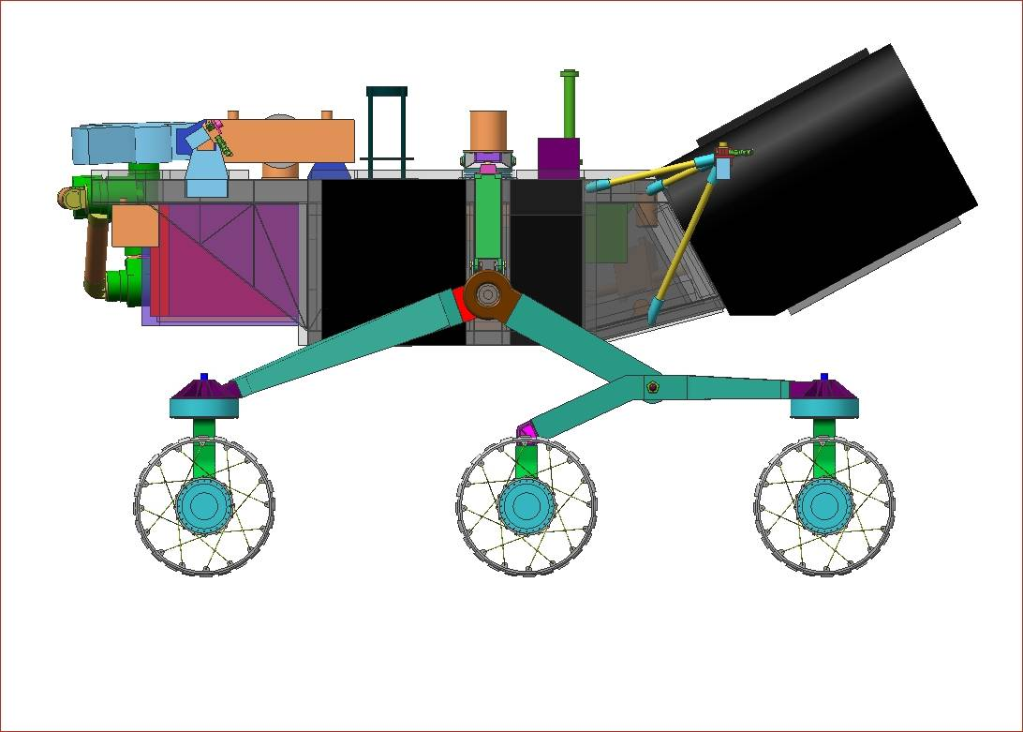
Control Design Design for Robustness
Robust stability is achieved by phase stabilization of appendage modes (pendulum and bridle-axial modes)
  Make the control system behave as springs and dashpots
    Collocated sensing (IMU) and control (MLE)
      16 Hz structure
    High sampling rate and a single sample delay
      64 Hz sample rate
    High bandwidth sensing and control
      IMU bandwidth > 30 Hz
      MLE bandwidth > 15 Hz
    Attitude Control (Inner Loop) Bandwidth
      ~ 1Hz
    All modes below 5 Hz are phase stabilized
      Fuel slosh modes < 2 Hz
      Bridle mode axial 0.4 to 1 Hz
      Pendulum mode < 0.2 Hz
      System robust to uncertainty in mode
        Frequency
        Damping
Structural modes are gain-stabilized
  8th order roll-off filter
1.0 Hz spring,
0.7 damping
~1000 kg mass
0.2 Hz spring,
0.7 damping
0.75 m/sec
Pendulum Mode: 0.1Hz
Axial Mode: 0.9 to 1.5Hz
0 DB
-180 deg

Slide 22
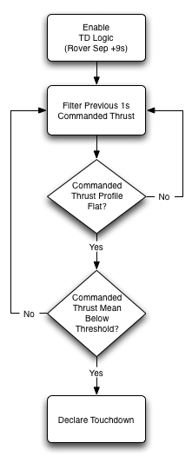
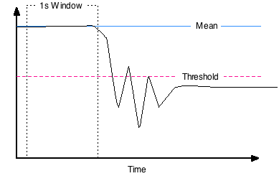
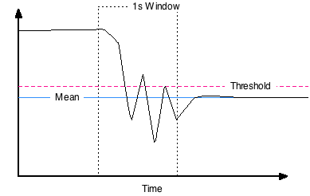
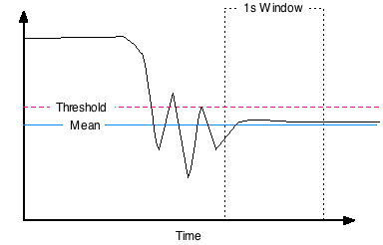
SkyCrane Touchdown Detection
Flat, mean above threshold
Throttle
Non-flat, mean below threshold
Throttle
Flat, mean below threshold
Throttle

Slide 23
Decoupled Delivery System from Payload
Decoupled Design, Development, & Testing

Slide 24
Verification & Validation
Easy to Analyze
Easy to Test

Slide 25
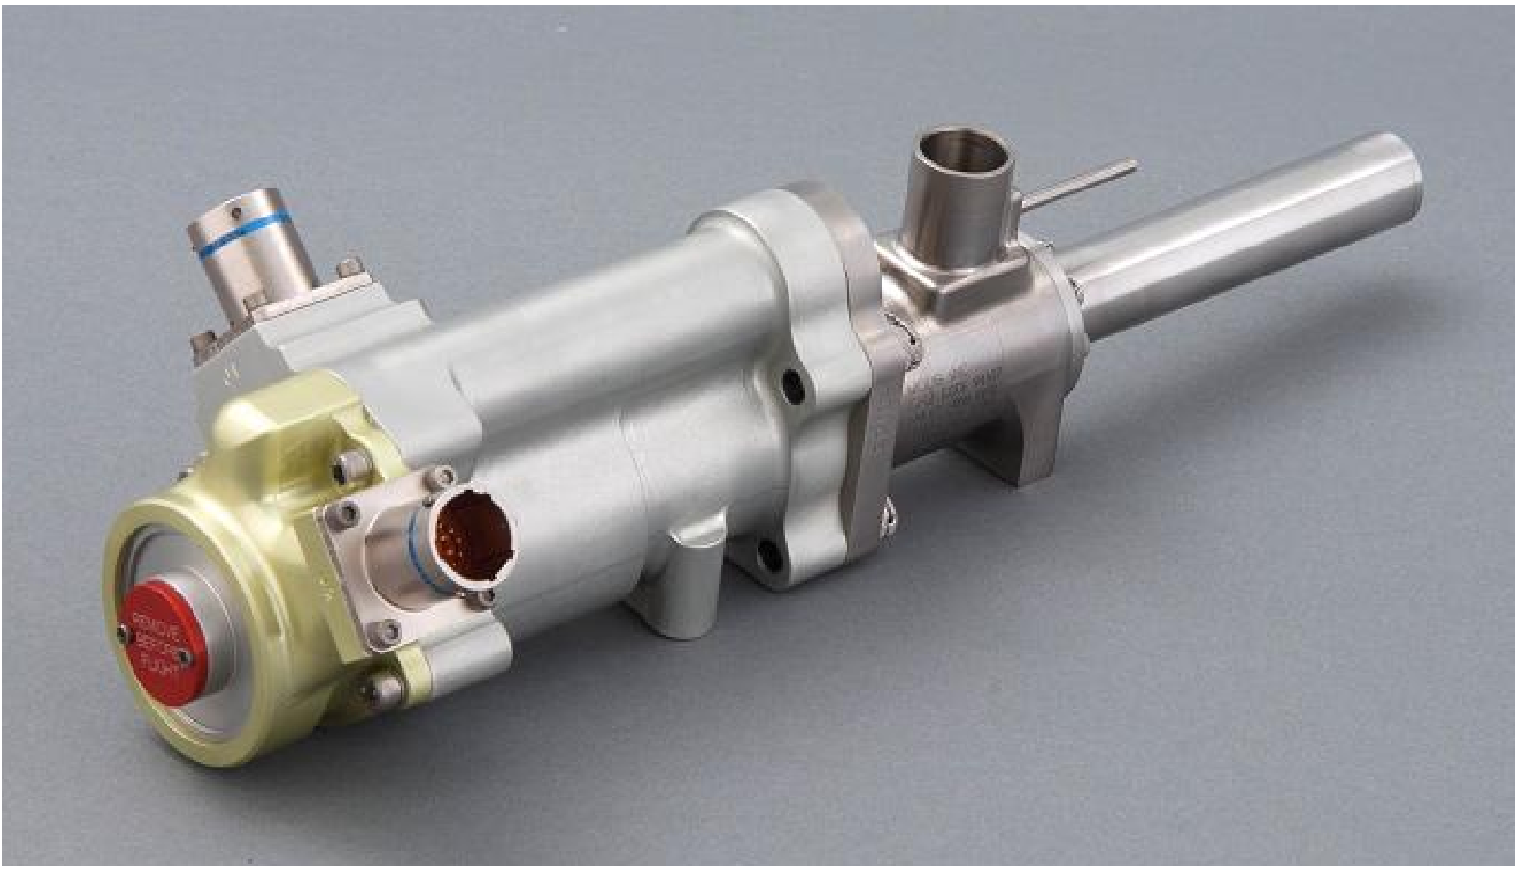
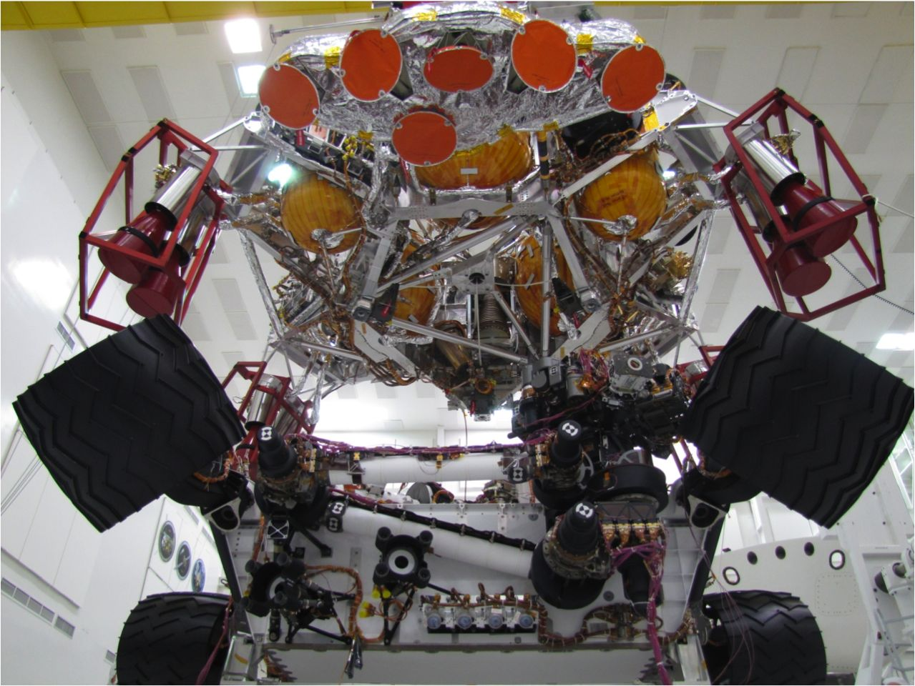
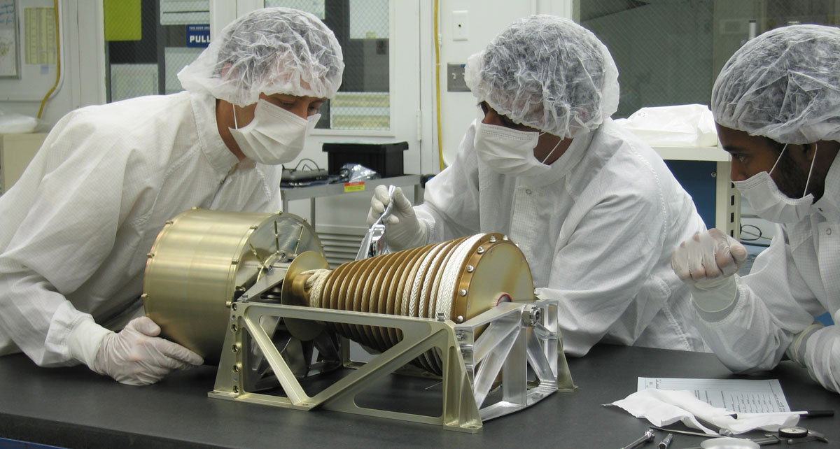
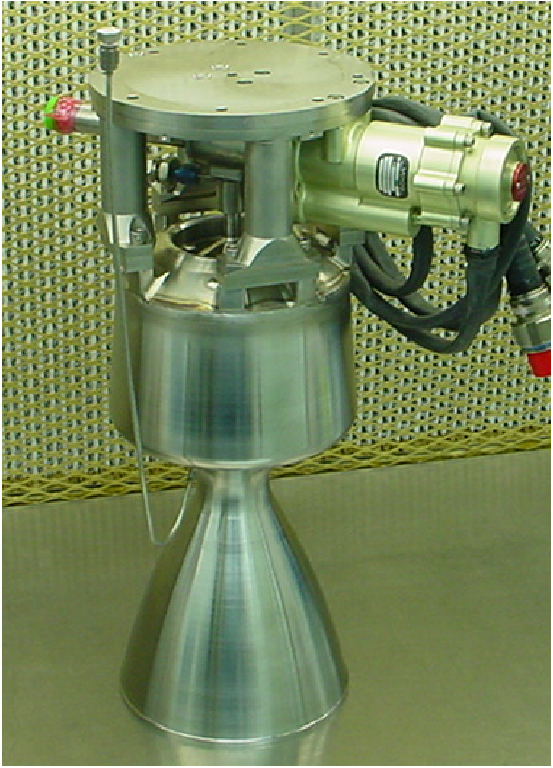
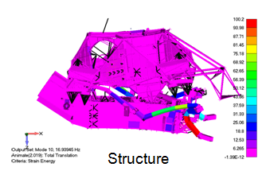
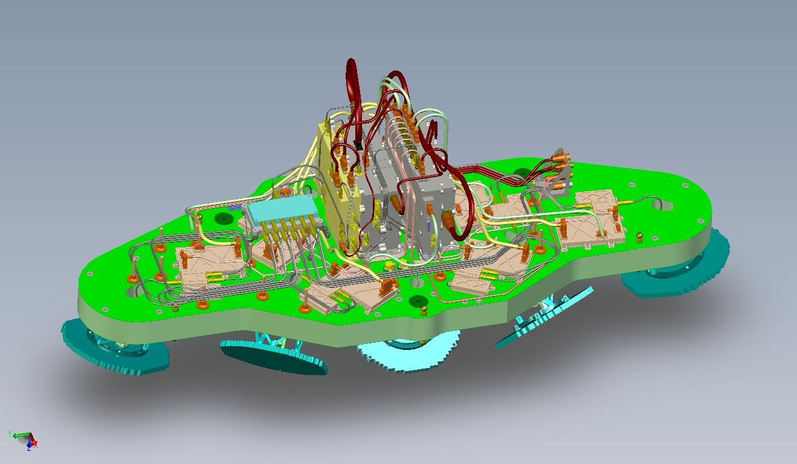
Key EDL/GN&C Developments/Challenges
BUD/Bridle
Terminal Descent Landing Sensor (TDS)
Mars Landing Engine (MLE)
Structure

Slide 26
Terminal Descent Testbed (TDT)

Slide 27
Terminal Descent Testbed (TDT)

Slide 28
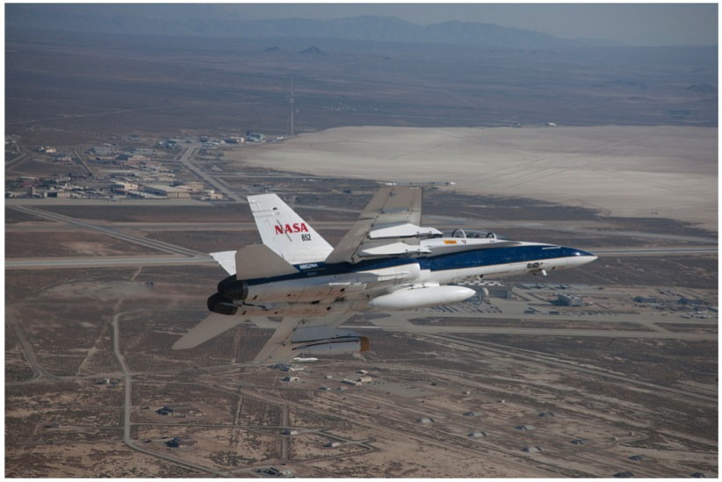
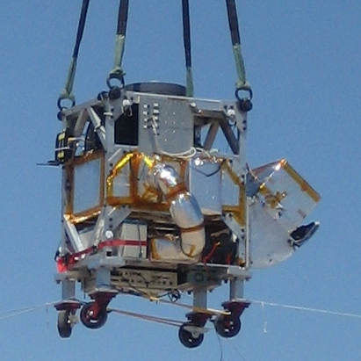
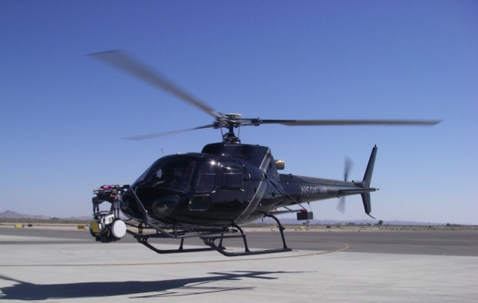
TDS Field Test Venues
China Lake Echo Towers
NASA Dryden Flight Research Center F/A-18
Eurocopter AS350 AStar Helicopter

Slide 29
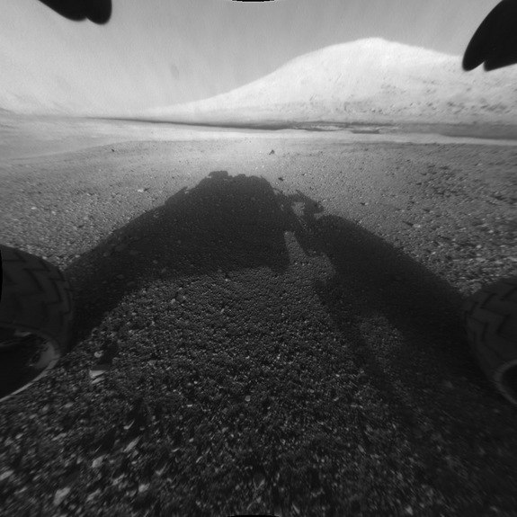
It Worked!!!

Slide 30
2.2 km actual
x

Slide 31
Conclusions
Mars has provided a challenging destination that has resulted in the development of multiple EDL/GN&C architectures with different cost, risk, and performance
Low cost solutions were successfully developed such as the MPF/MER airbag landers and the Phoenix soft-lander
In order to meet the large improvement in landing accuracy and delivered payload, MSL enlisted GN&C early in the design cycle and developed the appropriate sensor and actuators required for the task
  SkyCrane: Tightly integrated mechanical/GN&C design. GN&C is part of the Touchdown system
Future improvements in EDL performance (Hazard Detection & Avoidance, Pinpoint Landing) will require the development of new, and maybe costly, GN&C sensors and actuators, and new ways of testing the full end-to-end system

Slide 32
Questions???

Slide 33
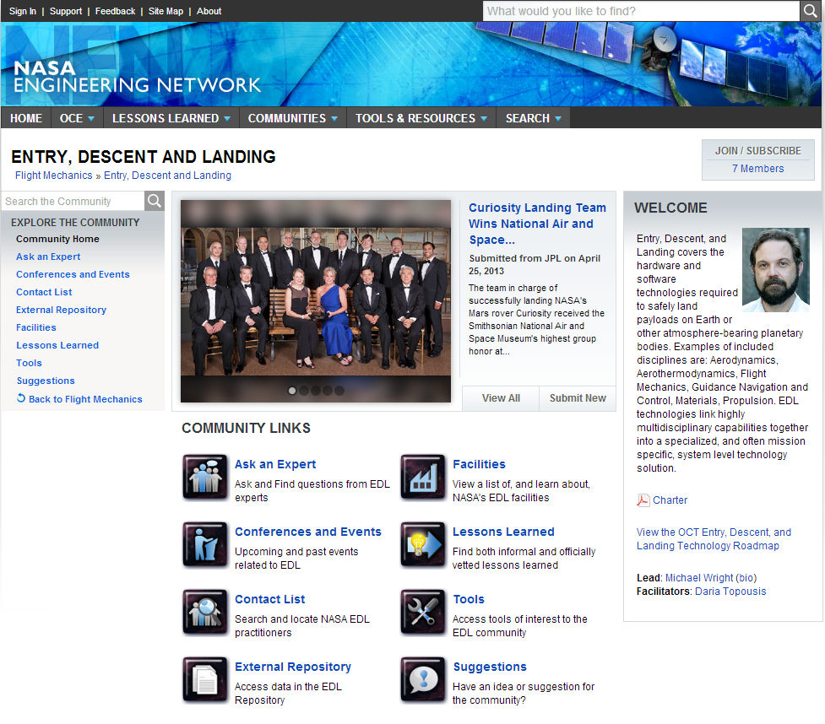
Join the EDL Community of Practice
One of the Communities at nen.nasa.gov
Supported by NASA OCE and OCT
Enables communication
between the centers and institutions supporting multi-disciplinary EDL-related activities.
It provides inputs and recommendations on issues related to current and future EDL
technology investments and technology requirements.

Slide 34
Thank you for
attending…
Fundamentals of Numerical Methods for GN&C Modeling & Simulation
July 17th, 2PM EDT
Timothy Crain

