Slide 1
Unit 18
Force Vibration Response Spectrum

Slide 2
Introduction
SDOF systems may be subjected to an applied force
Modal testing, impact or steady-state force
Wind, fluid, or gas pressure
Acoustic pressure field
Rotating or reciprocating parts
  Rotating imbalance
  Shaft misalignment
  Bearings
  Blade passing frequencies
  Electromagnetic force, magnetostriction

Slide 3
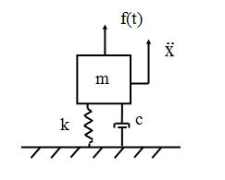
SDOF System, Applied Force
m | = | mass
c | = | viscous damping coefficient
k | = | stiffness
x | = | displacement of the mass
f(t) | = | applied force
Governing equation of motion

Slide 4
Rayleigh Peak Response Formula
Consider a single-degree-of-freedom system with the index n.
The maximum response can be estimated by the following equations.
Maximum Peak
fn | is the natural frequency
T | is the duration
ln | is the natural logarithm function
 | is the standard deviation of the oscillator response

Slide 5
Steady-State Response to Sine Force
The normalized displacement is
where F is the applied force magnitude
The natural frequency fn is
f is the applied force frequency
fn is the natural frequency

Slide 6
Steady-State Response to Sine Force (cont)
The transmitted force to ground ratio is
,
where
F_{t} is the transmitted force magnitude
F is the applied force magnitude
The transmitted force ratio is the same as that for the acceleration response to base excitation.

Slide 7
Control by Frequency Domain
Low Freq | Resonance | High Freq
Stiffness | Damping | Mass

Slide 9
Exercise
vibrationdata > Miscellaneous Functions >
SDOF Response: Steady-State Sine Force or Acceleration Input
Practice some sample calculations for applied force using your own parameters.
Try resonant excitation and then +/- one octave separation between the excitation and natural frequencies.

Slide 10
SDOF Response to Force PSD, Miles Equation
The overall displacement x is
where
m | is the mass
k | is the stiffness
ξ | is viscous damping ratio
A | is the amplitude of the force PSD in dimensions of [force^2 / Hz] at the natural frequency
Miles equation assumes that the PSD is white noise from 0 to infinity Hz.

Slide 11
Miles Equation, Velocity & Acceleration
The overall velocity is
An accelerance FRF curve is shown for a sample system in the next slide
The normalized accelerance converges to 1 as the excitation frequency becomes much larger than the natural frequency
The acceleration response would be infinitely high for a white noise force excitation which extended up to an infinitely high frequency
A Miles equation for the acceleration response to a white noise applied force cannot be derived

Slide 12
Miles Equation, Acceleration

Slide 13
SDOF Response to Force PSD, General Method
Displacement
Velocity

Slide 14
SDOF Response to Force PSD, General Method
Acceleration
Transmitted Force

Slide 15
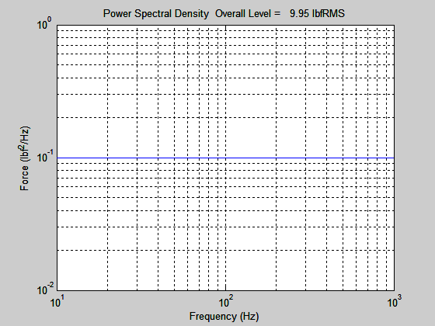
Force PSD
Frequency (Hz) | Force (lbf^2/Hz)
10 | 0.1
1000 | 0.1
Duration = 60 sec
The same PSD was used for the time domain calculation in Webinar 17.

Slide 16
SDOF Example
Apply the Force PSD on the previous slide to the SDOF system.
Duration = 60 seconds (but only affects peak value)
Mass = 20 lbm, Q=10,
Natural Frequency = independent variable

Slide 17
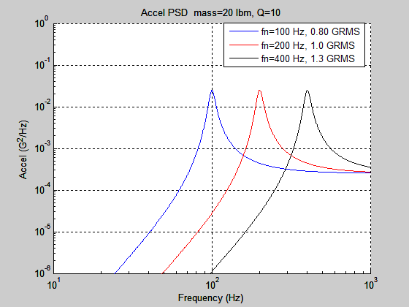
SDOF Response to Force PSD, Acceleration
Response at 400 Hz agrees with time domain result in previous webinar unit.
fn (Hz) | Accel (GRMS)
100 | 0.80
200 | 1.0
400 | 1.3
vibrationdata > Power Spectral Density > Force > SDOF Response to Force PSD

Slide 18
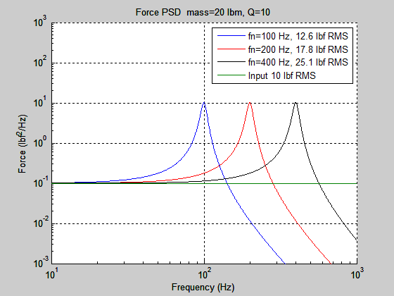
SDOF Response to Force PSD, Transmitted Force

Slide 19
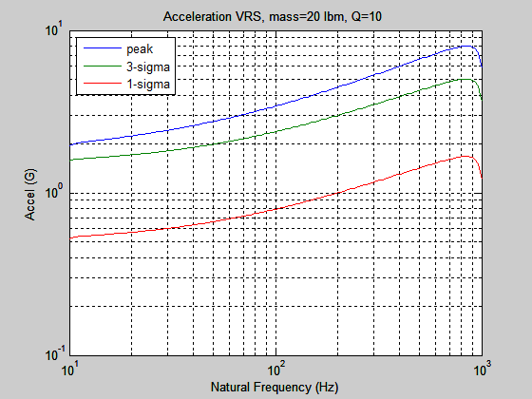
Acceleration VRS
fn (Hz) | Accel (GRMS)
100 | 0.80
200 | 1.0
400 | 1.3
vibrationdata > Power Spectral Density > Force > Vibration Response Spectrum (VRS)

Slide 20
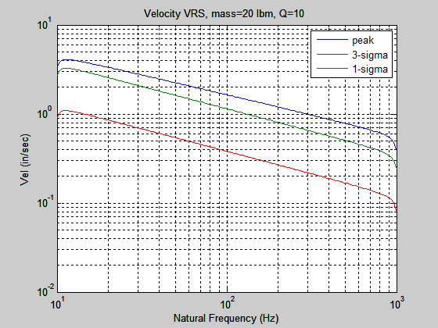
Velocity VRS

Slide 21
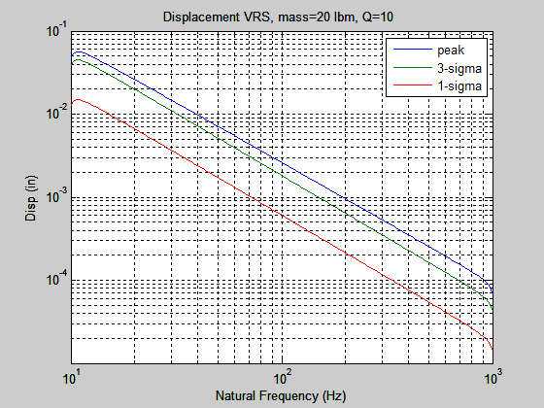
Displacement VRS

Slide 22
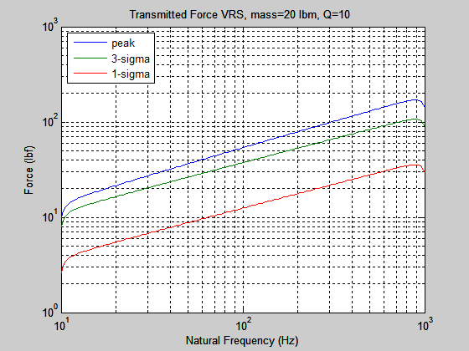
Transmitted Force VRS

Slide 23
Homework
Repeat the examples in the presentation using the Matlab scripts

