Slide 1
Pyrotechnic Shock Response

Slide 2
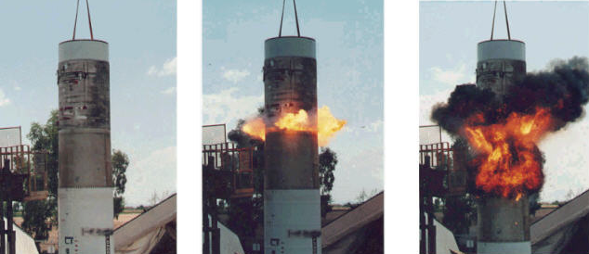
Stage Separation Ground Test
Linear Shaped Charge
But fire and smoke would not occur in near-vacuum of space
Plasma jet would occur instead

Slide 3
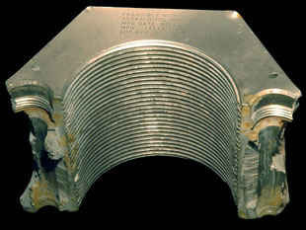
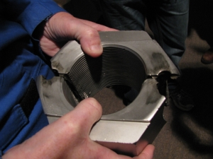
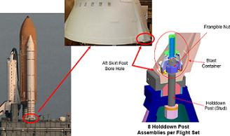
Space Shuttle, Solid Rocket Booster, Frangible Nuts
Frangible Nut
Aft Skirt Foot
Blast Container
Aft Skirt Foot
Hold Down Post Stud
4 Hold Down Post Assemblies per Each SRB

Slide 4
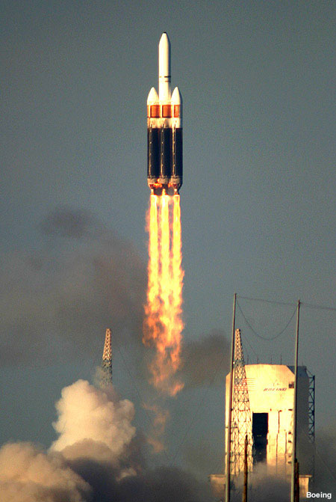
Delta IV Heavy Launch
The following video shows a Delta IV Heavy launch, with attention given to pyrotechnic events.
Click on the box on the next slide.

Slide 5

Delta IV Heavy Launch (click on box)

Slide 6
Pyrotechnic Shock Fields
Near Field - near source – shock is dominated by high-frequency wave motion
Mid Field - shock is composed of both wave motion and structural modes
Far Field - lower frequency response from structural modes
Avoid mounting avionics component near pyrotechnic device!

Slide 7
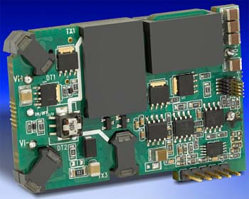
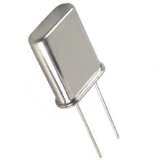
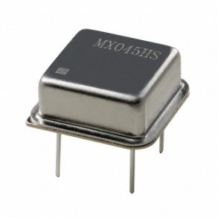
Pyrotechnic Shock Failures
Crystal oscillators can shatter.
Large components such as DC-DC converters can detached from circuit boards.

Slide 8
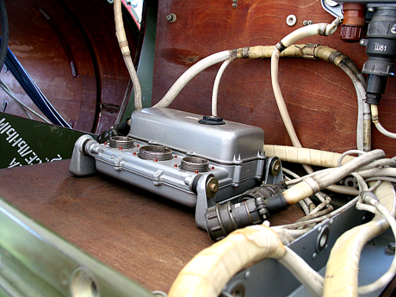
Shock Isolation, Elastomeric
Isolated avionics component, SCUD-B missile.
Public display in Huntsville, Alabama, May 15, 2010
The isolators break metal-to-metal contact
Isolator Bushing

Slide 9
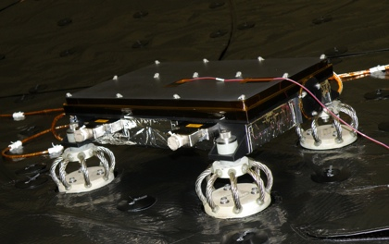
Shock Isolation, Wire Rope
NASA/JPL
Mars Science Laboratory
Sensor Support Electronics mounted on vibration isolators

Slide 10
Pyrotechnic Events
Avionics components must be designed and tested to withstand pyrotechnic shock from:
Separation Events
Strap-on Boosters
Stage separation
Fairing Separation
Payload Separation
Ignition Events
Solid Motor
Liquid Engine

Slide 11
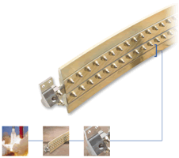
Frangible Joint
The key components of a Frangible Joint:
Mild Detonating Fuse (MDF)
Explosive confinement tube
Separable structural element
Initiation manifolds
Attachment hardware

Slide 12
Sample SRS Specification
Frangible Joint, 26.25 grain/ft, Source Shock
SRS Q=10
fn (Hz) | Peak (G)
100 | 100
4200 | 16,000
10,000 | 16,000
Used for design and test purposes

Slide 13
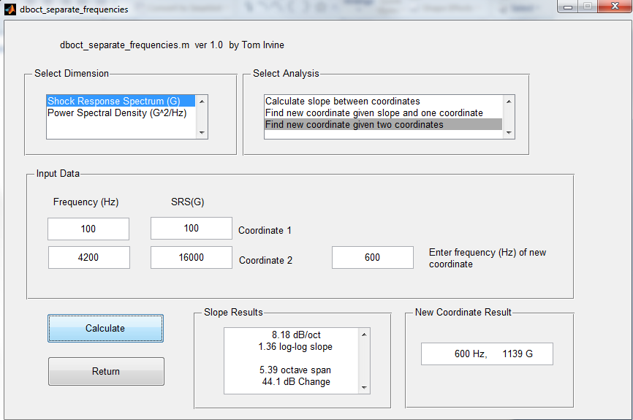
Interpolate the specification at 600 Hz.

Slide 14
Pyrotechnic Shock Ramps
Measured pyrotechnic shock are expected to have a ramp between 6 and 12 dB/octave

Slide 15
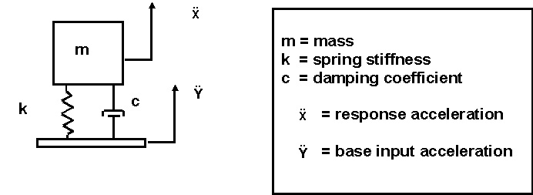
SDOF System

Slide 16
Smallwood Digital Recursive Filtering Relationship

Slide 17
Sample Rate & Aliasing
For measuring pyrotechnic shock energy . . .
Sample rate should be at least 10X the maximum SRS frequency
Example: Sample Rate > 100 KHz for SRS up to 10 KHz
Rule-of-thumb: At least ten points are needed to represent one period of a sine function in the time domain
Analog anti-aliasing filter is vital, with cut-off frequency below the Nyquist frequency
Review Webinar 10 for further details

Slide 18
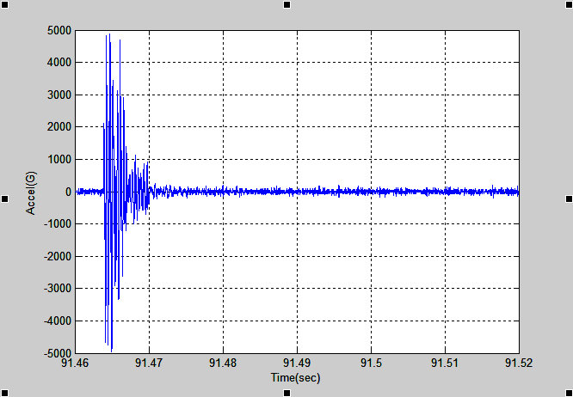
Flight Accelerometer Data, Re-entry Vehicle Separation Event
Source: Linear Shaped Charge. Filename: rv_separation.dat
Measurement location was near-field.

Slide 19
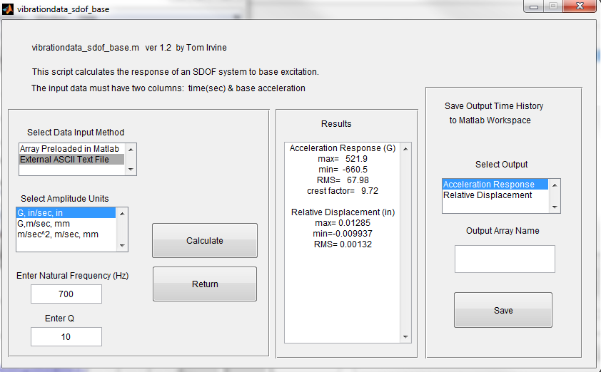
Apply rv_separation.dat as base input to SDOF (fn=700 Hz, Q=10)

Slide 20
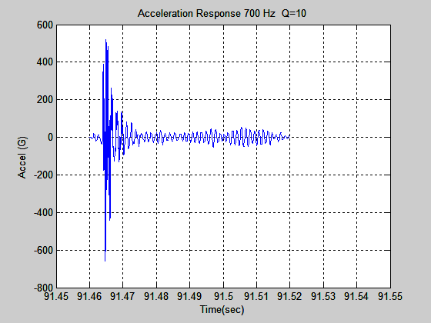
Flight Accelerometer Data, SDOF Response
Absolute Peak is 661 G.

Slide 21
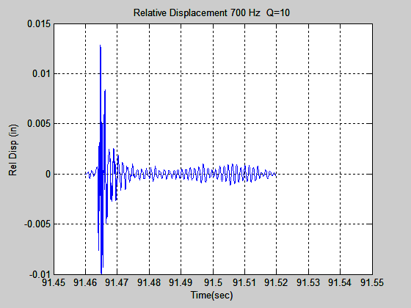
Flight Accelerometer Data, SDOF Response (cont)
Absolute Peak is 0.013 inch

Slide 22
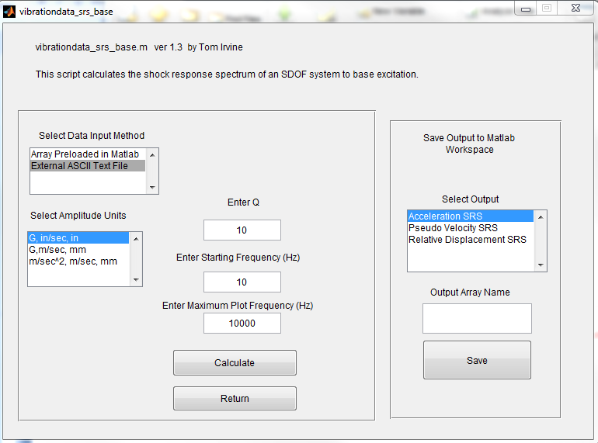
Filename: rv_separation.dat

Slide 23
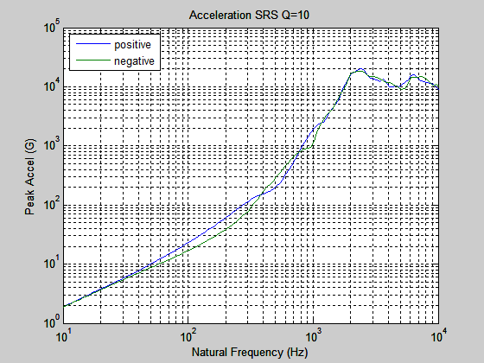
Flight Accelerometer Data SRS
(700 Hz, 660 G)

Slide 24
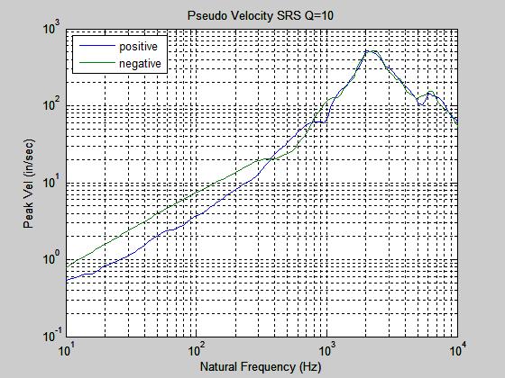
Flight Accelerometer Data SRS (cont)
Peak pseudo velocity is 500 in/sec
Severe!

Slide 25
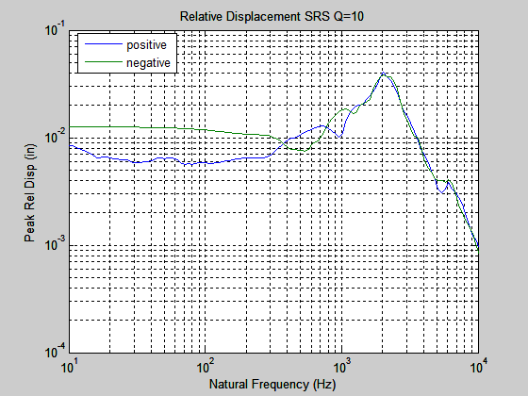
Flight Accelerometer Data SRS (cont)

Slide 26
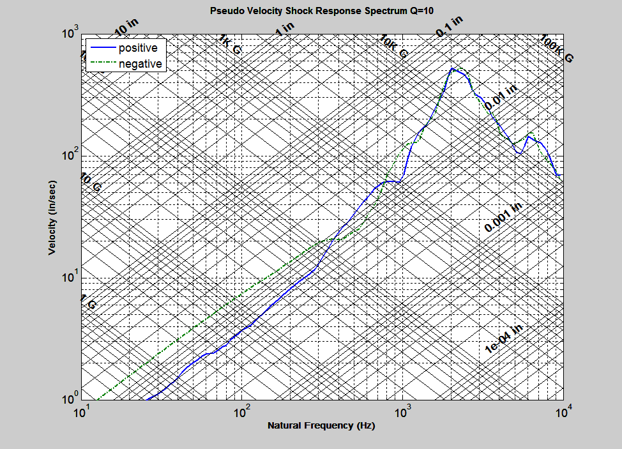
Flight Accelerometer Data SRS (cont)

Slide 27
Historical Velocity Severity Threshold
For electronic equipment . . .
An empirical rule-of-thumb in MIL-STD-810E states that a shock response spectrum is considered severe only if one of its components exceeds the level
Threshold = [ 0.8 (G/Hz) * Natural Frequency (Hz) ]
For example, the severity threshold at 100 Hz would be 80 G
This rule is effectively a velocity criterion.
MIL-STD-810E states that it is based on unpublished observations that military-quality equipment does not tend to exhibit shock failures below a shock response spectrum velocity of 100 inches/sec (254 cm/sec)
The above equation actually corresponds to 50 inches/sec
It thus has a built-in 6 dB margin of conservatism

