Slide 1
Pyrotechnic Shock Response
Part 2
Aliasing
Spurious Trend Removal

Slide 2
Introduction
Analog anti-aliasing filters must be used for shock measurement, otherwise . . .
Aliasing can cause up to 20 dB error in SRS plots
But a massive amount of ultra-high-frequency energy is required for this to happen
Example: near-field measurement of linear shaped charge
Has happened in laboratory component shock tests where detonation cord is used!

Slide 3
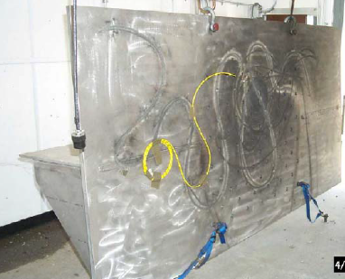
Shock Test Fixture, Back Side
Textile explosive cord with a core load of 50 gr/ft (PETN explosive)
Up to 50 ft of Detonating Cord has been used, that equals 0.36 pounds
Maximum frequency of shock energy is unknown
Test component is mounted on other side of plate
Near-field shock environment

Slide 4
Case History
Subtle Riddle . . .
A test lab was perform a shock test with a certain sample rate
The customer asked the test conductor to increase the sample rate
The test conductor said “Oh no, then we would have to increase the length of the detonation cord”
Explanation . . .
Increasing the sample rate gives more accurate results
The test lab did NOT used anti-aliasing filters
High-frequency energy was reflected down to lower frequencies
The SRS result appeared to be within specified tolerances
In reality component was being under-tested
This error affected many components which had been tested over the years

Slide 5
Numerical Experiment to Demonstrate Aliasing
Table 1. SRS Specification Q=10
Natural Frequency (Hz) | Peak Accel (G)
100 | 10
2000 | 1000
250K | 1000
A typical SRS Specification has its upper frequency < 10 KHz
The level in Table 1 is for educational purposes only

Slide 6
The top time history is synthesized to satisfy the spec in Table 1
The bottom time history was decimated by a factor of 32 with no lowpass filtering
Simulates potential aliasing

Slide 7
Close-up View

Slide 8
Shock Response Spectra
Decimated curve has some small aliasing error
But not really a problem

Slide 9
Example 2
Table 2. SRS Q=10
Natural Frequency (Hz) | Peak Accel (G)
100 | 10
2000 | 1000
250K | 50000
Repeat previous example but vastly increase acceleration at last breakpoint
Intended to simulate near-field pyrotechnic shock

Slide 10
The top time history is synthesized to satisfy the spec in Table 2
The bottom time history was decimated by a factor of 32 with no lowpass filtering
Simulates potential aliasing

Slide 11
Example 2, Close-up View
Aliasing occurs in the Decimated time history
Spurious low-frequency energy emerges

Slide 12
Example 2, SRS
The Decimated SRS is approximately 10 to 20 dB higher than the Original SRS
The source of the error is aliasing!

Slide 13
Spurious Trends in Pyrotechnic Shock Data
Numerous problems can affect the quality of accelerometer data during pyrotechnic shock events (aside from aliasing)
A baseline shift, or zero shift, in the acceleration time history is perhaps the most common error source
Anthony Chu noted that this shift can be of either polarity and of unpredictable amplitude and duration
He has identified six causes of zero shift:
a. Overstressing of sensing elements
b. Physical movement of sensor parts
c. Cable noise
d. Base strain induced errors
e. Inadequate low-frequency response
f. Overloading of signal conditioner.

Slide 14
Spurious Trends, continued
Accelerometer resonant ringing is a special example
This is a particular problem if the accelerometer has a piezoelectric crystal as its sensing element
A piezoelectric accelerometer may have an amplification factor Q > 30 at resonance
This resonance may be excited by high-frequency pyrotechnic shock energy
Resonant ringing causes higher element stresses than expected

Slide 15
Spurious Trends (Continued)
Chu notes that this may cause the signal conditioner to overload, as follows:
When a signal conditioner attempts to process this signal, one of its stages is driven into saturation
Not only does this clipping distort the in-band signals momentarily, but the overload can partially discharge capacitors in the amplifier, causing a long time-constant transient
This overload causes zero shift in the acceleration time history
This shift distorts the low-frequency portion of the shock response spectrum

Slide 16
Evaluate Quality of Shock Data
Acceleration time history should oscillate somewhat symmetrically about the zero baseline
Integrated velocity should also oscillate about the zero baseline
Positive & negative SRS curves should be similar
SRS positive & negative curves should each have initial slopes from 6 to 12 dB/octave
Otherwise editing is needed

Slide 17
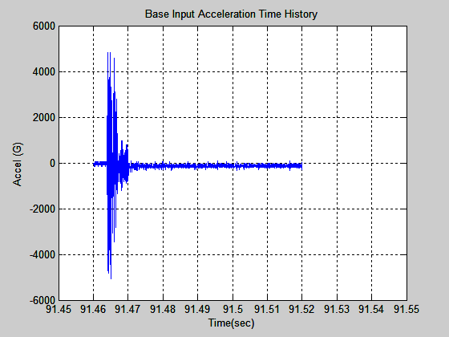
RV Separation Raw Acceleration Data
Shift is about -100 G
The data in the previous unit was cleaned up. The raw data is shown above.

Slide 18
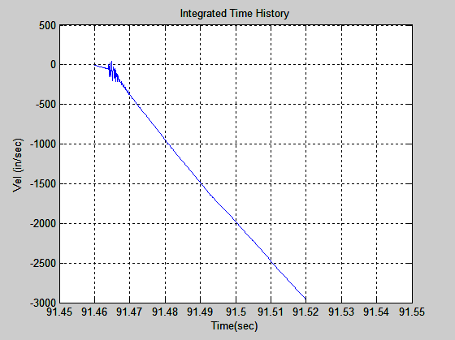
RV Separation Raw Velocity
Ski slope effect!

Slide 19
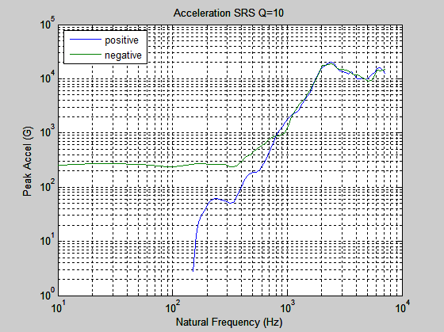
SRS of Raw Data
Warning sign:
Positive & negative SRS curves diverge below 800 Hz

Slide 20

Data Surgery

Slide 21
Spurious Trend Removal
There is no one right way!
Data is too precious to discard, especially flight data
Goal is to obtain plausible estimate of the acceleration time history & SRS
So document whatever method that you use
Show before and after plots
Possible “cleaning” methods include polynomial trend removal and high pass filtering
In some cases spurious EMP spikes must be manually edited
Possible EMI from pyrotechnic charge initiation current into accelerometer signals
So “turn-the-crank” methods may not be effective

Slide 22
Mean Filter
A mean filtering method is demonstrated in this unit
The mean filter is a simple sliding-window filter that replaces the center value in the window with the average (mean) of all the values in the window
The mean filter is intended as a lowpass filter which smoothes the data
It may also be used as an indirect highpass filter by subtracting the mean filtered signal from the raw data
The indirect mean highpass filtering method is useful for cleaning pyrotechnic shock data
As an aside, mean filtering is commonly used to smooth optical images

Slide 23
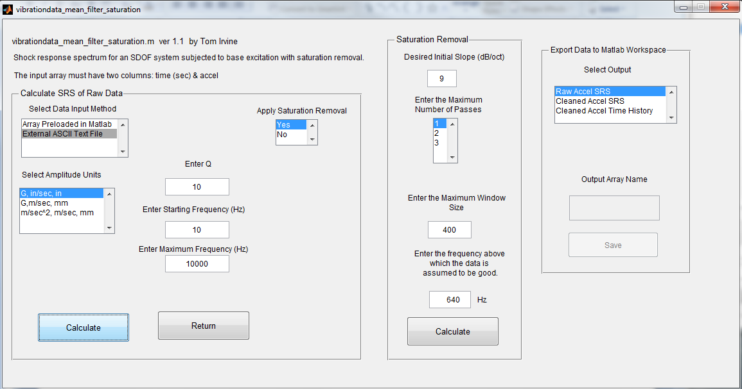
vibrationdata > Time History > Shock Saturation Removal
Input ASCII File: rv_separation_raw.txt

Slide 24
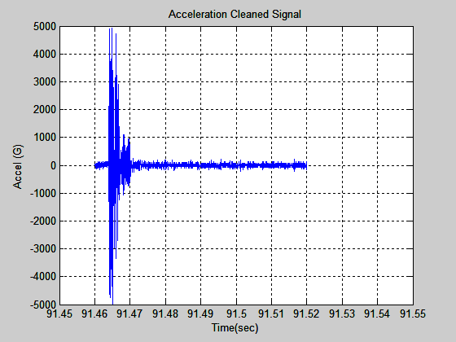
Cleaned Time History
Plausible!
All types of filtering and trend removals tend to cause some pre-shock distortion

Slide 25
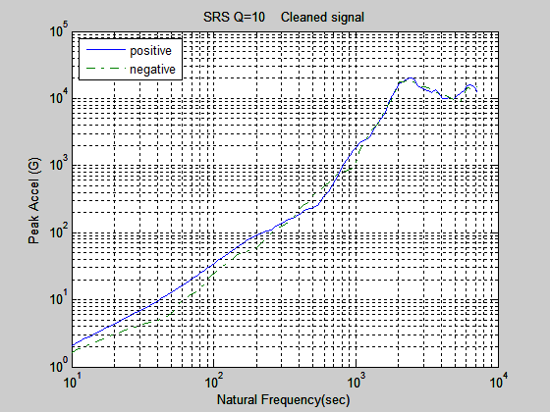
Cleaned SRS

Slide 26
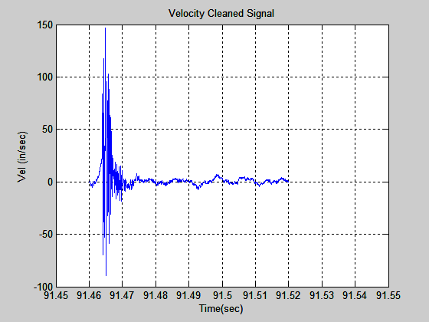
Cleaned Velocity
Mostly Plausible
Some pre-shock distortion

