Slide 1
Unit 27
SRS Synthesis
1. Wavelets
2. Damped Sinusoids

Slide 2
Wavelet Synthesis
Goal:
Synthesis acceleration time history that can be used for a shaker test or for a numerical simulation

Slide 3
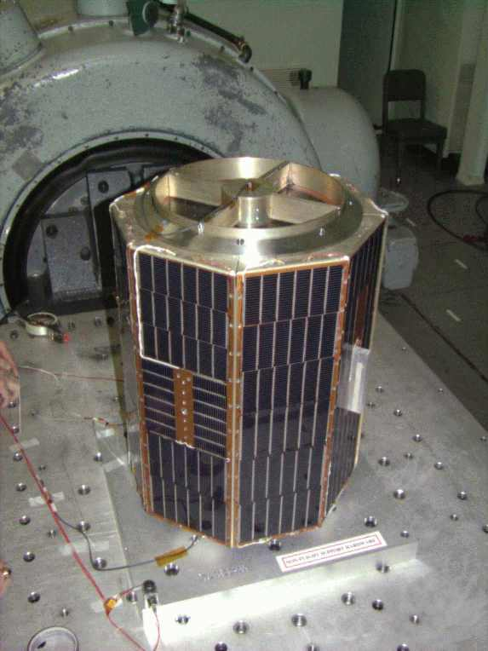
Shaker Shock
A shock test may be performed on a shaker if the shaker’s frequency and amplitude capabilities are sufficient
A time history must be synthesized to meet the SRS specification
Typically damped sines or wavelets
The net velocity and net displacement must be zero

Slide 4
Wavelets & Damped Sines
    A series of wavelets can be synthesized to satisfy an SRS specification for shaker shock
    Wavelets have zero net displacement and zero net velocity
    Damped sines require compensation pulse
    Assume control computer accepts ASCII text time history file for shock test in following examples

Slide 5
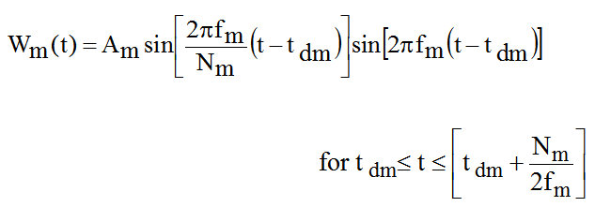
Wavelet Equation
W_{m} (t) = acceleration at time t for wavelet m
A_{m} = acceleration amplitude f _{m} = frequency t _{dm} = delay
N_{m} = number of half-sines, odd integer > 3

Slide 6
Typical Wavelet

Slide 7
SRS Specification
MIL-STD-810E, Method 516.4, Crash Hazard for Ground Equipment
SRS Q=10
Synthesize a series of wavelets as a base input time history.
Goals:
Satisfy the SRS specification.
Minimize the displacement, velocity and acceleration of the base input.
Natural Frequency (Hz) | Peak Accel (G)
10 | 9.4
80 | 75
2000 | 75
>> srs_spec=[ 10 9.4 ; 80 75 ; 2000 75 ]

Slide 8
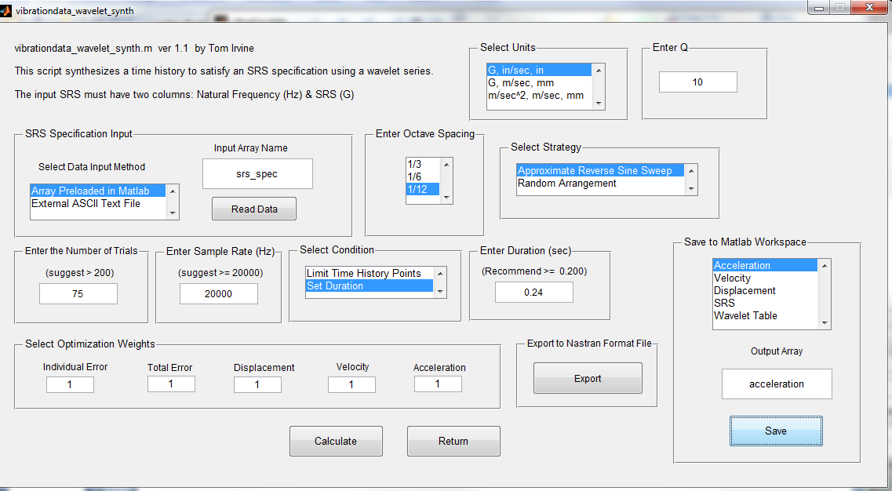

Slide 9
Synthesis Steps
Step | Description
1 | Generate a random amplitude, delay, and half-sine number for each wavelet. Constrain the half-sine number to be odd. These parameters form a wavelet table.
2 | Synthesize an acceleration time history from the wavelet table.
3 | Calculate the shock response spectrum of the synthesis.
4 | Compare the shock response spectrum of the synthesis to the specification. Form a scale factor for each frequency.
5 | Scale the wavelet amplitudes.

Slide 10
Synthesis Steps (cont.)
Step | Description
6 | Generate a revised acceleration time history.
7 | Repeat steps 3 through 6 until the SRS error is minimized or an iteration limit is reached.
8 | Calculate the final shock response spectrum error. Also calculate the peak acceleration values. Integrate the signal to obtain velocity, and then again to obtain displacement. Calculate the peak velocity and displacement values.
9 | Repeat steps 1 through 8 many times.
10 | Choose the waveform which gives the lowest combination of SRS error, acceleration, velocity and displacement.

Slide 11
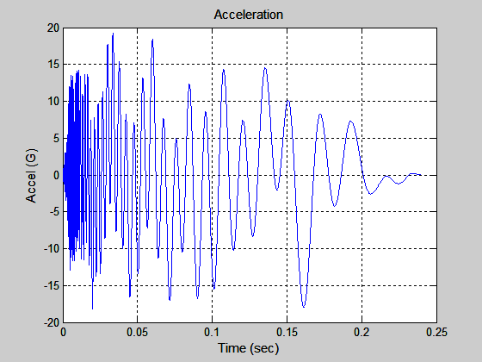
Wavelet, Synthesized Acceleration
Optimum case = 57
Peak Accel = 19.2 G
Peak Velox = 32.9 in/sec
Peak Disp = 0.67 inch
Max Error = 1.56 dB

Slide 12
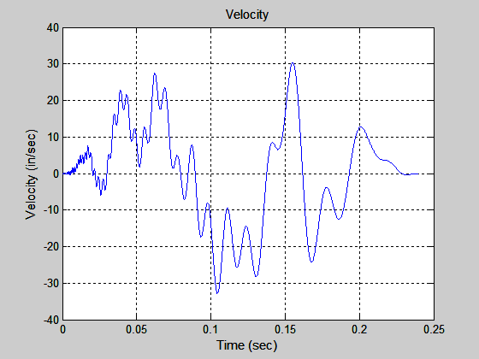
Wavelet, Synthesized Velocity

Slide 13
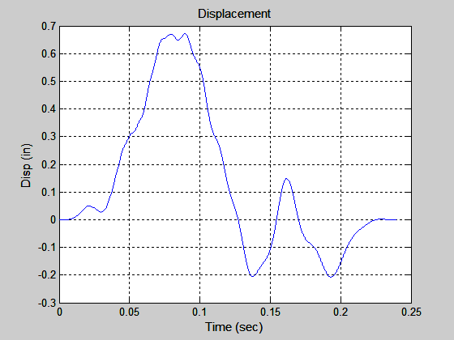
Wavelet, Synthesized Displacement

Slide 14
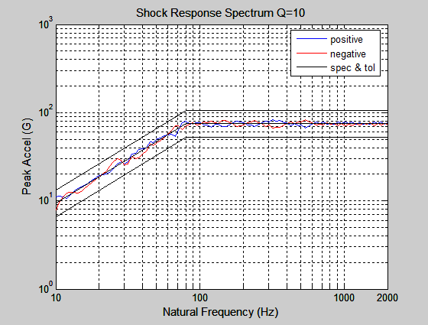
Wavelet, Synthesized Acceleration SRS

Slide 15
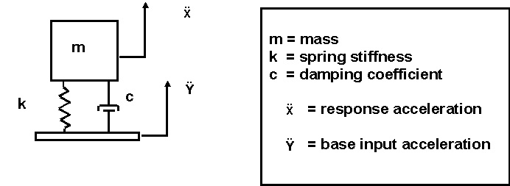
SDOF Modal Transient
Assume a circuit board with fn = 400 Hz, Q=10
Apply the reconstructed acceleration time history as a base input.
Use arbit.m

Slide 16
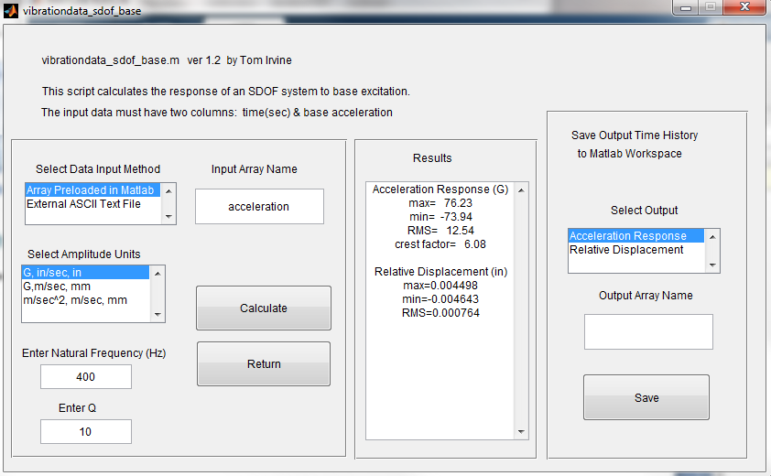

Slide 17
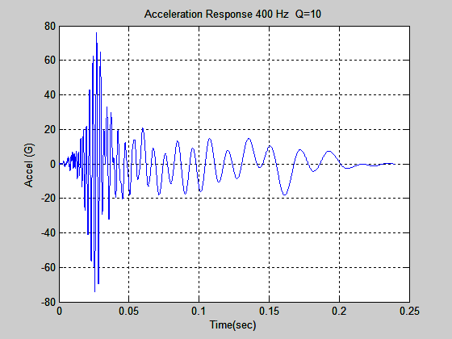
SDOF Response to Wavelet Series
Acceleration Response (G)
max= 76.23
min= -73.94
RMS= 12.54
crest factor= 6.08
Relative Displacement (in)
max=0.004498
min=-0.004643
RMS=0.000764
Use acceleration time history for shaker test or analysis

Slide 18
Damped Sine Synthesis
Goal:
Synthesis acceleration time history to simulate a pyrotechnic shock for a numerical analysis

Slide 19
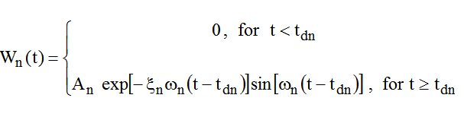

Damped Sinusoids
Synthesize a series of damped sinusoids to satisfy the SRS.
Individual damped-sinusoid
Series of damped-sinusoids

Slide 20
Typical Damped Sinusoid

Slide 21
Specification
SRS Q=10
Natural Frequency (Hz) | Peak Accel (G)
100 | 100
2000 | 2000
10,000 | 2000
Specification is undefined < 100 Hz
But component may have a low natural frequency
So extrapolated slope to, say, 20 Hz for this example
New starting coordinate (20 Hz, 20 G)
>> srs_spec=[20 20; 2000 2000; 10000 2000]

Slide 22
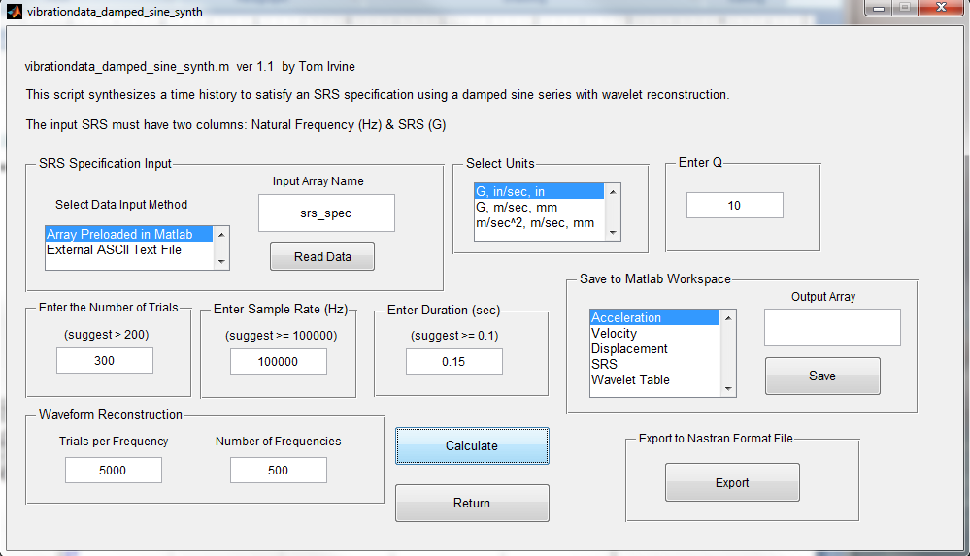

Slide 23
Synthesis Steps
Step | Description
1 | Generate random values for the following for each damped sinusoid: amplitude, damping ratio and delay. The natural frequencies are taken in one-twelfth octave steps.
2 | Synthesize an acceleration time history from the randomly generated parameters.
3 | Calculate the shock response spectrum of the synthesis
4 | Compare the shock response spectrum of the synthesis to the specification. Form a scale factor for each frequency.
5 | Scale the amplitudes of the damped sine components

Slide 24
Synthesis Steps (cont.)
Step | Description
6 | Generate a revised acceleration time history
7 | Repeat steps 3 through 6 as the inner loop until the SRS error diverges
8 | Repeat steps 1 through 7 as the outer loop until an iteration limit is reached
9 | Choose the waveform which meets the specified SRS with the least error
10 | Perform wavelet reconstruction of the acceleration time history so that velocity and displacement will each have net values of zero

Slide 25
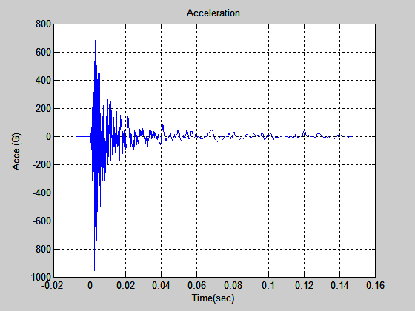
Synthesized Acceleration

Slide 26
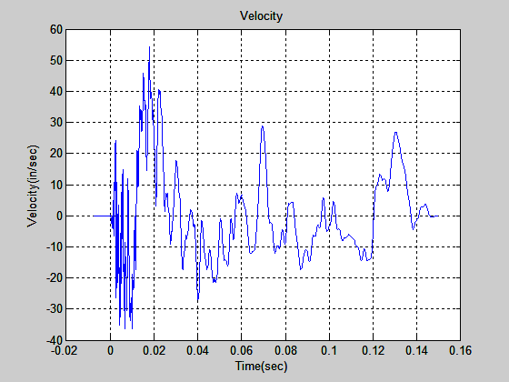
Synthesized Velocity

Slide 27
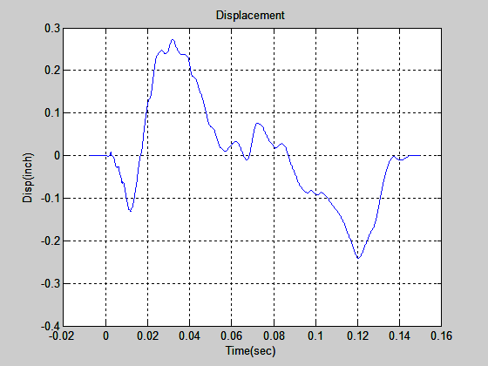
Synthesized Displacement

Slide 28
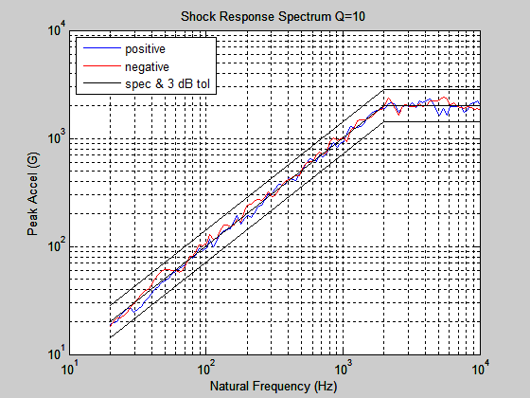
Synthesized Shock Response Spectrum

Slide 29
SDOF Modal Transient
Assume a circuit board with fn = 600 Hz, Q=10
Apply the reconstructed acceleration time history as a base input.

Slide 30
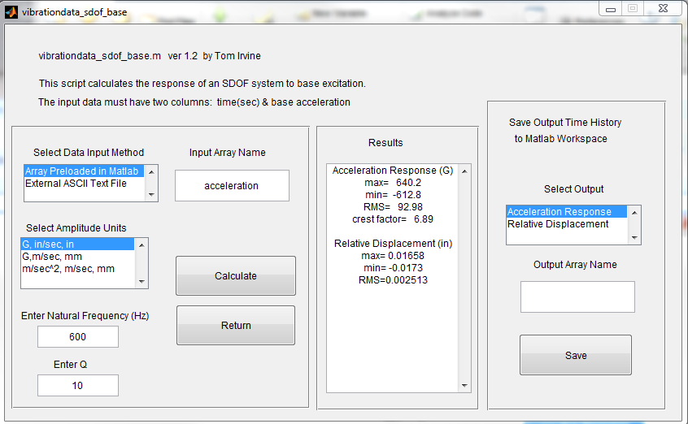
SDOF Response Acceleration
Absolute peak is 640 G. Specification is 600 G at 600 Hz.

Slide 31
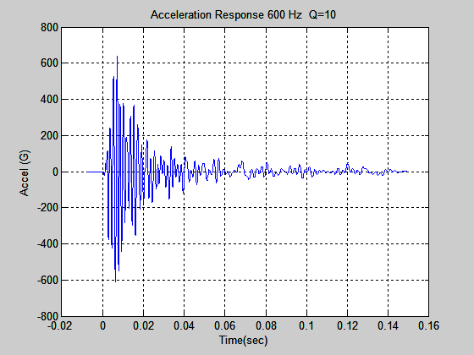
SDOF Response Acceleration
Absolute peak is 640 G. Specification is 600 G at 600 Hz.

Slide 32
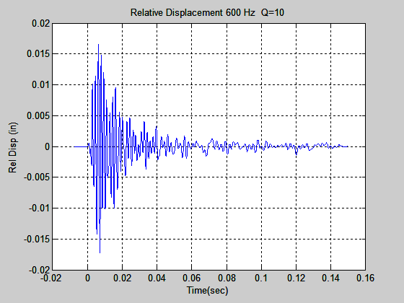
SDOF Response Relative Displacement
Absolute Peak is 0.017 inch

Slide 33
Peak Amplitudes
Absolute peak acceleration is 640 G.
Absolute peak relative displacement is 0.017 inch.
For SRS calculations for an SDOF system . . . .
Acceleration / ω_{n}² ≈ Relative Displacement
[ 640G ][ 386 in/sec^2/G] / [ 2 π (600 Hz) ]^2 = 0.017 inch

