Slide 1
Unit 34
Rainflow Cycle Counting for
Continuous Beams
By Tom Irvine

Slide 2

Rainflow Fatigue Cycles
Endo & Matsuishi 1968 developed the Rainflow Counting method by relating stress reversal cycles to streams of rainwater flowing down a Pagoda.
ASTM E 1049-85 (2005) Rainflow Counting Method
Goju-no-to Pagoda, Miyajima Island, Japan

Slide 3
S-N Curve
For N>1538 and S < 39.7
log₁₀ (S) = -0.108 log₁₀ (N) +1.95
log₁₀ (N) = -9.25 log₁₀ (S) + 17.99
The curve can be roughly divided into two segments
The first is the low-cycle fatigue portion from 1 to 1000 cycles, which is concave as viewed from the origin
The second portion is the high-cycle curve beginning at 1000, which is convex as viewed from the origin
The stress level for one-half cycle is the ultimate stress limit

Slide 4
Base Input PSD
Base Input PSD, 6.1 GRMS
Frequency (Hz) | Accel (G^2/Hz)
20 | 0.0053
150 | 0.04
600 | 0.04
2000 | 0.0036
Now consider that the beam assembly is subjected to the MIL-STD-1540B ATP random vibration base input level. The duration is 3 minutes.

Slide 5
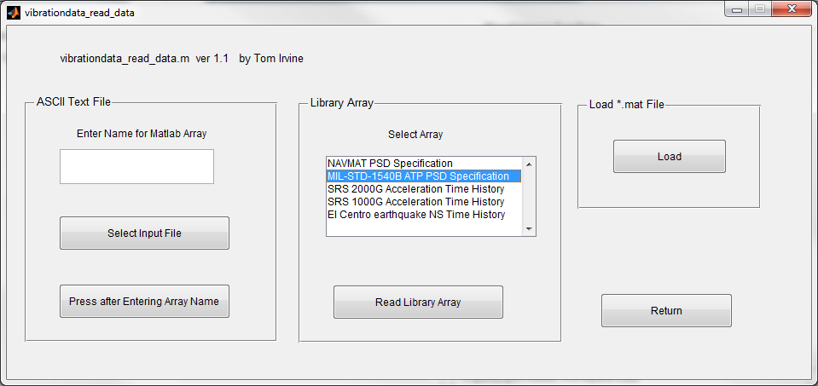
Base Input PSD
The PSD on the previous slide is library array: MIL-STD1540B ATP PSD

Slide 6
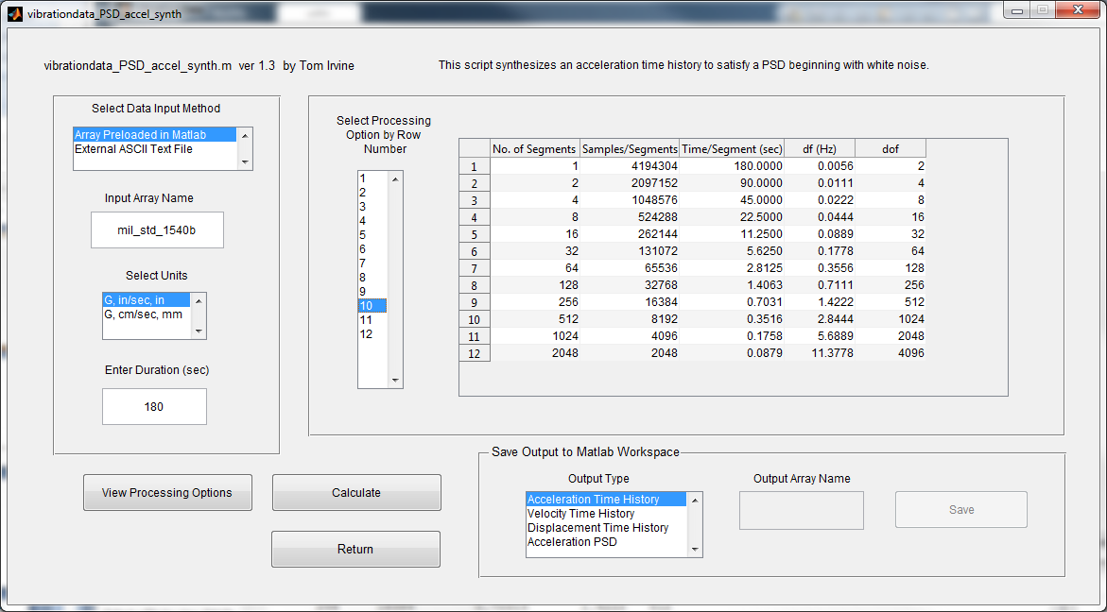
Time History Synthesis

Slide 7
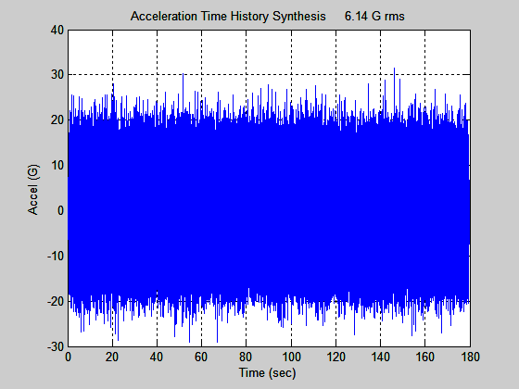
Base Input Time History
Save Time History as: synth
An acceleration time history is synthesized to satisfy the PSD specification
The corresponding histogram has a normal distribution, but the plot is omitted for brevity
Note that the synthesized time history is not unique

Slide 8
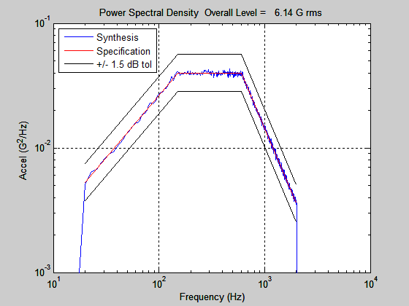
PSD Verification

Slide 9
Continuous Beam Subjected to Base Excitation
EI, ρ
Cross-Section | Rectangular
Boundary Conditions | Fixed-Free
Material | Aluminum
L
Width | = | 2.0 in
Thickness | = | 0.25 in
Length | = | 8 in
Elastic Modulus | = | 1.0e+07 lbf/in^2
Area Moment of Inertia | = | 0.0026 in^4
Mass per Volume | = | 0.1 lbm/in^3
Mass per Length | = | 0.05 lbm/in
Viscous Damping Ratio | = | 0.05 for all modes
y(x, t)
w(t)

Slide 10
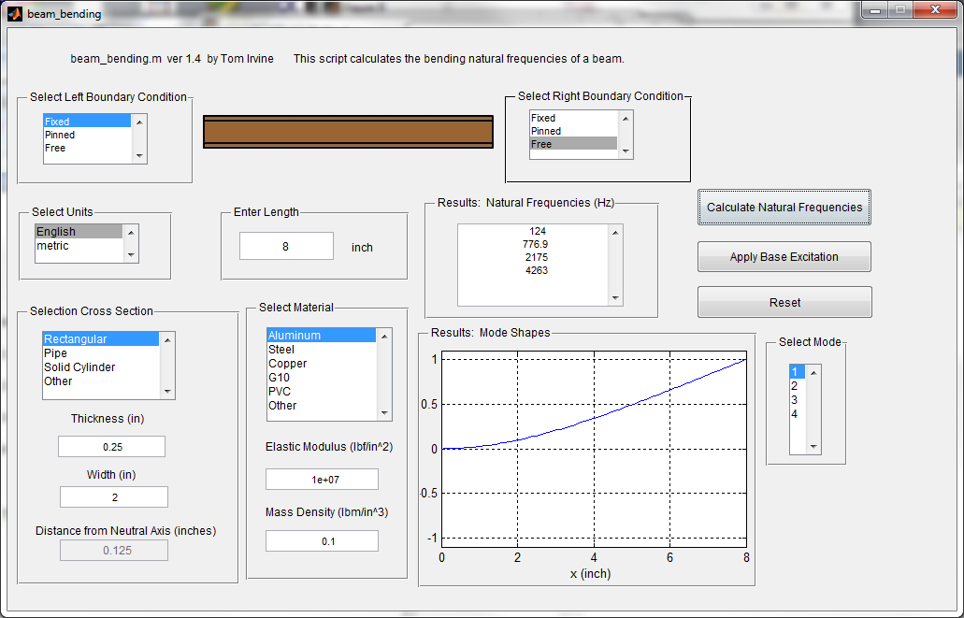
vibrationdata > Structural Dynamics > Beam Bending > General Beam Bending

Slide 11
Continuous Beam Natural Frequencies
Natural Participation Effective
Mode Frequency Factor Modal Mass
1 124 Hz 0.02521 0.0006353
2 776.9 Hz 0.01397 0.0001951
3 2175 Hz 0.00819 6.708e-05
4 4263 Hz 0.005856 3.429e-05
modal mass sum = 0.0009318 lbf sec^2/in = 0.36 lbm

Slide 12
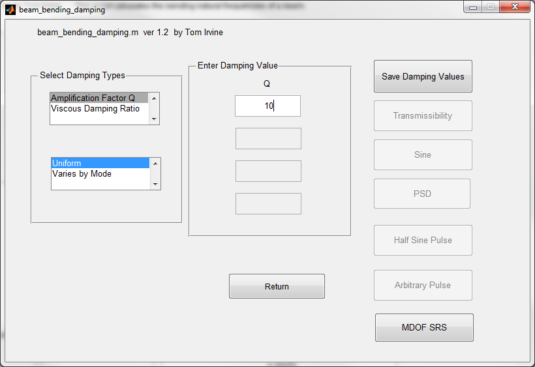
Press Apply Base Input in Previous Dialog and then enter Q=10 and Save Damping Values

Slide 13
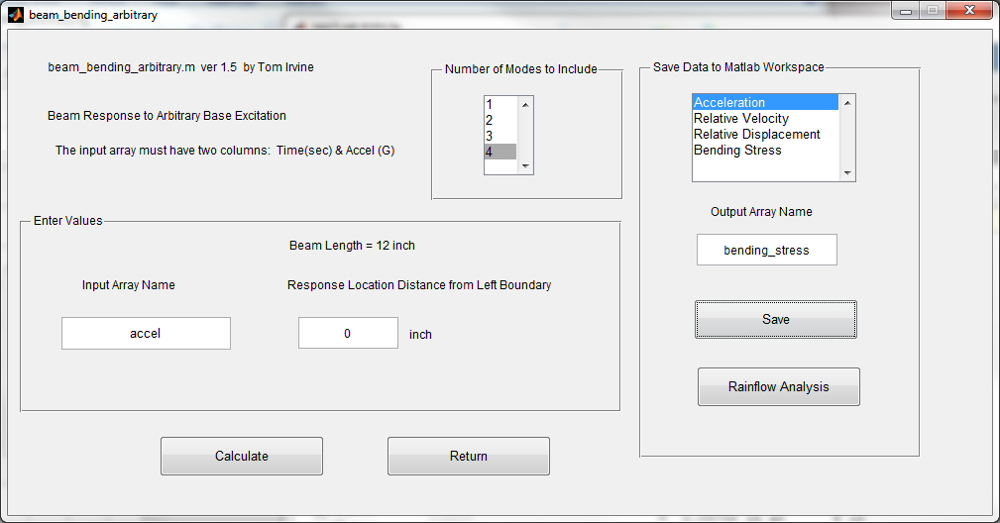
Apply Arbitrary Base Input Pulse. Include 4 Modes. Save Bending Stress and go to Rainflow Analysis.

Slide 14
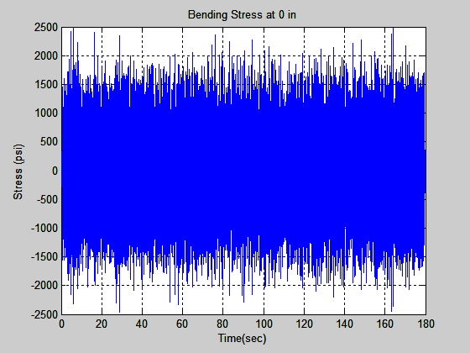
Bending Stress at Fixed End

Slide 15
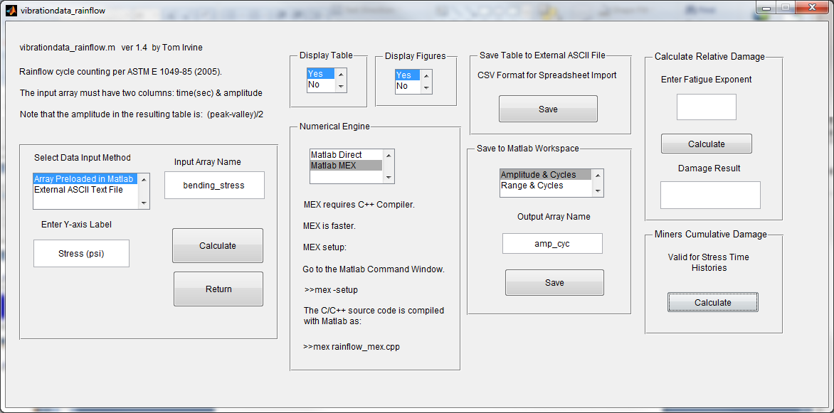
Bending Stress at Fixed End, Rainflow

Slide 16
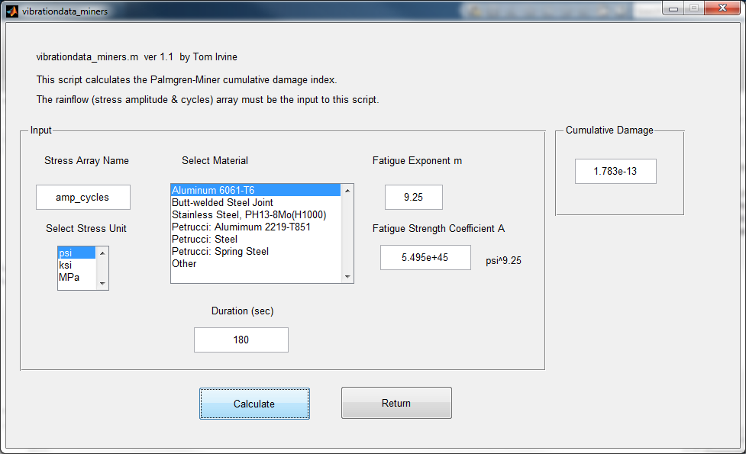

Slide 17
Cantilever Beam, Fixed Boundary, Fatigue Damage Results for Various Input Levels, 180 second Duration, Stress Concentration Factor = 1
Input Overall Level (GRMS) | Input Margin (dB) | Response Stress Std Dev (ksi) | R
6.1 | 0 | 0.542 | 1.783e-13
12.2 | 6 | 1.08 | 1.09E-10
24.2 | 12 | 2.16 | 6.61E-08
48.4 | 18 | 4.3 | 4.02E-05
Cumulative Fatigue Results
The beam could withstand 36 days at +18 dB level based on R=0.7
( (0.7/4.02e-05)*180 sec) / (86400 sec / days) = 36 days

Slide 18
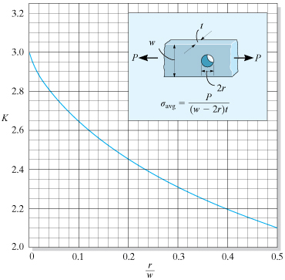
Consider Potential Stress Concentration Factor for Local Stress

Slide 19
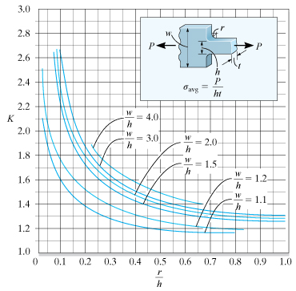
Consider Potential Stress Concentration Factor for Local Stress (cont)

Slide 20
Stress Concentration Factor Notes
A good, fine-mesh finite element model can predict stress concentration factors.
But fine-mesh FEA models are time-consuming to run for modal transient analysis.
More about FEA in future Webinars…

Slide 21
Cantilever Beam, Fixed Boundary, Fatigue Damage Results for Various Input Levels, 180 second Duration
Input Overall Level (GRMS) | Response Stress Std Dev (ksi) | R for K=1 | R for K=3
6.1 | 0.542 | 1.783e-13 | 4.62E-09
12.2 | 1.08 | 1.09E-10 | 2.82E-06
24.2 | 2.16 | 6.61E-08 | 1.71E-03
48.4 | 4.3 | 4.02E-05 | 1.04
Cumulative Fatigue Results
Two Stress Concentration Cases K
The K=3 factor causes the damage R to go up by 3^9.25,
where 9.25 is the fatigue exponent

Slide 22
Frequency Domain Fatigue Methods
Rainflow can also be calculated approximately from a stress response PSD using any of these methods:
Narrowband
Alpha 0.75
Benasciutti
Dirlik
Ortiz Chen
Lutes Larsen (Single Moment)
Wirsching Light
Zhao Baker

Slide 23
Spectral Moments
The eight frequency domain methods on the previous slides are based on spectral moments.
The nth spectral moment for a PSD is
where
f | is frequency
G(f) | is the one-sided PSD
Additional formulas are given in the fatigue papers at the Vibrationdata blog: http://vibrationdata.wordpress.com/

Slide 24
Spectral Moments (cont)
The expected peak rate E[P]
The eight frequency domain methods “mix and match” spectral moments to estimate fatigue damage.
Additional formulas are given in the fatigue papers at the Vibrationdata blog:
http://vibrationdata.wordpress.com/

Slide 25
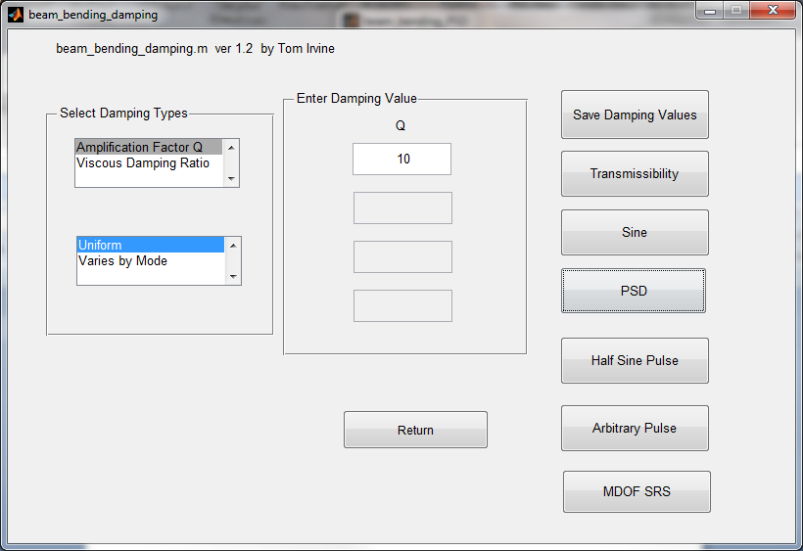
Return to Previous Beam Example, Select PSD

Slide 26
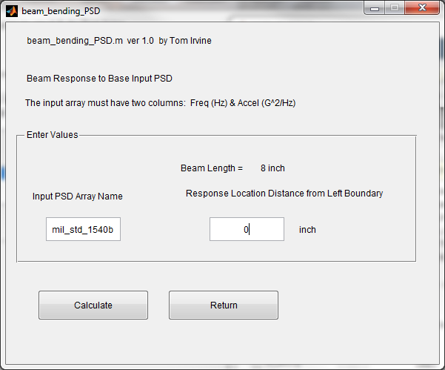
Apply mil_std_1540b PSD. Calculate stress at fixed boundary.

Slide 27
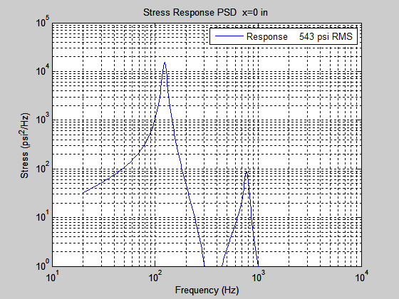
Bending Stress PSD at fixed boundary
Overall level is the same as that from the time domain analysis.

Slide 28
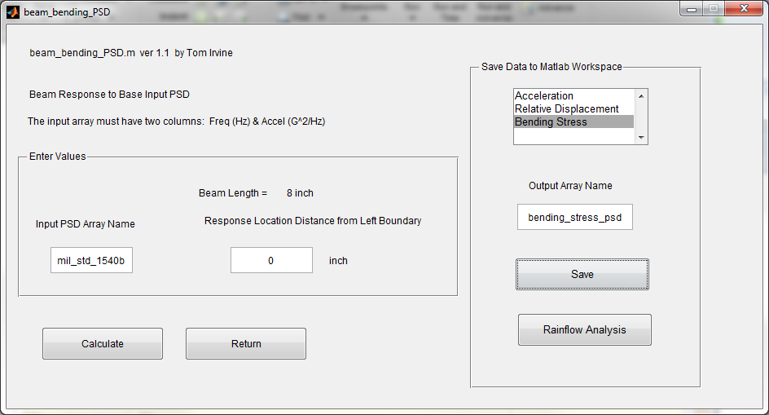
Save Bending Stress PSD and to Rainflow Analysis.

Slide 29
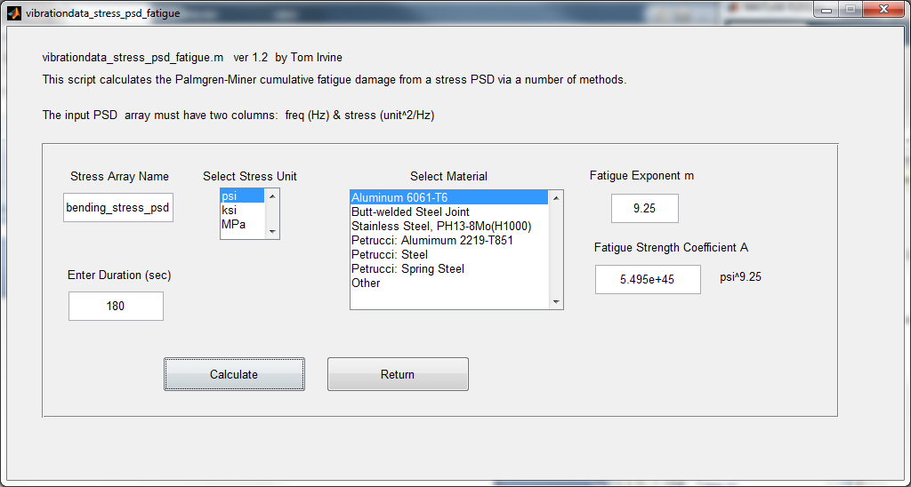

Slide 30
Rate of Zero Crossings = 186.4 per sec
Rate of Peaks = 608.5 per sec
Irregularity Factor alpha = 0.3063
Spectral Width Parameter = 0.9519
Vanmarckes Parameter = 0.475
Lambda Values
Wirsching Light = 0.6208
Ortiz Chen = 1.097
Lutes & Larsen = 0.7027
Cumulative Damage Damage Rate A*rate
(1/sec) ((psi^9.25)/sec)
Narrowband DNB = 1.9e-13, 1.0573e-15, 5.8100e+30
Dirlik DDK = 1.26e-13, 7.0141e-16, 3.8543e+30
Alpha 0.75 DAL = 1.53e-13, 8.4808e-16, 4.6602e+30
Ortiz Chen DOC = 2.09e-13, 1.1602e-15, 6.3754e+30
Zhao Baker DZB = 1.12e-13, 6.2029e-16, 3.4085e+30
Lutes Larsen DLL = 1.34e-13, 7.4303e-16, 4.0829e+30
Wirsching Light DWL = 1.18e-13, 6.5634e-16, 3.6066e+30
Benasciutti Tovo DBT = 1.48e-13, 8.2304e-16, 4.5226e+30
Average of DAL,DOC,DLL,DBT,DZB,DDK
average=1.469e-13

Slide 31
Bending Stress Damage Comparison
Stress concentration factor = 1
Method | Time History Synthesis | PSD Average
Damage R | 1.78e-13 | 1.47e-13

