Slide 1
Webinar 37
Acoustic Fatigue
By Tom Irvine

Slide 2
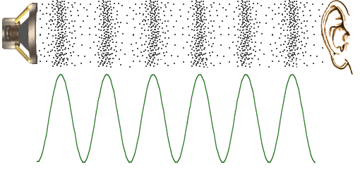
Sound Waves
Sound waves propagate longitudinally

Slide 3
Sound Pressure Level Formula
The overall sound pressure OASPL is
dB
where P _{rms} is the pressure RMS
The equivalent reference for air in terms of English units is :
P_{ref} ≈ 2.9(10 ⁻⁹) psi rms

Slide 4
Sound Pressure Level Formula (cont)
The sound pressure in a frequency band is
dB
where f _{c} is the band center frequency

Slide 5
Band Limits
Sound pressure levels are typically represented in terms of one-third octave format
These are “proportional bandwidths” where the bandwidth increases with frequency
Each band has three frequency parameters
f _{l} - lower frequency limit
f _{c} - center frequency
f _{u} - upper frequency limit

Slide 6
Band Limits (cont)
The formulas relating these parameters for one-third octave band is
Furthermore, consider the respective center frequencies of two adjacent bands.

Slide 7
One-Third Octave Bands
In practice, these formulas are applied in an approximate manner
An example of a one-third octave band spectrum is
Band | Lower Freq (Hz) | Center Freq (Hz) | Upper Freq (Hz)
1 | 89 | 100 | 112
2 | 112 | 125 | 140
3 | 140 | 160 | 180
4 | 180 | 200 | 224

Slide 8
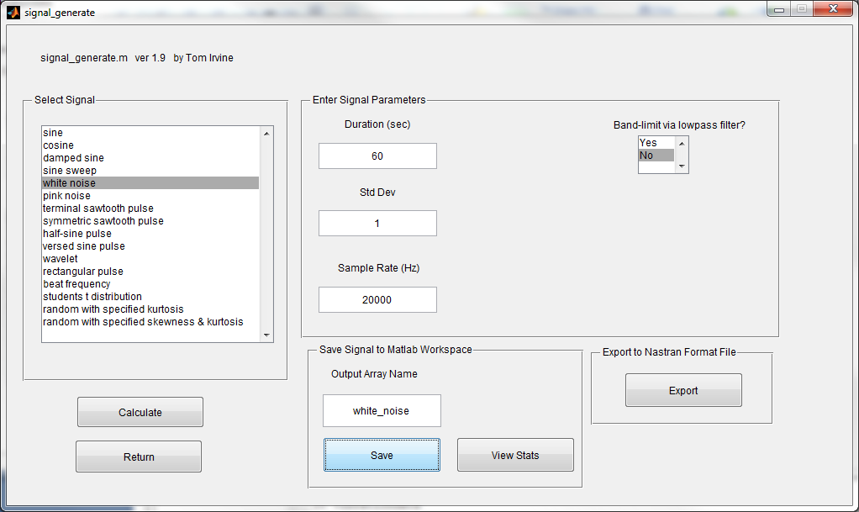
Generate white noise pressure time history, 60 sec, std dev = 1 psi, sr=20000 Hz
Objective

Slide 9
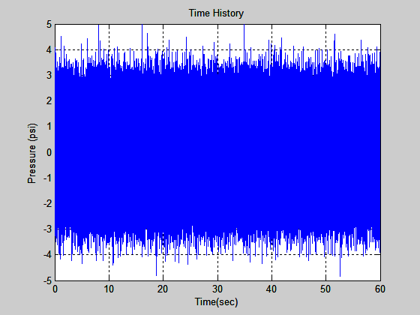
White Noise Pressure Time History

Slide 10
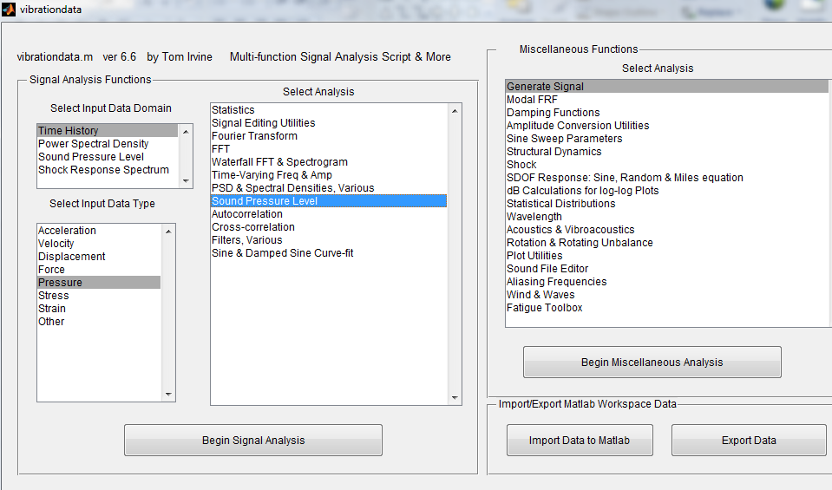
Calculate SPL for the white noise pressure time history
Objective

Slide 11
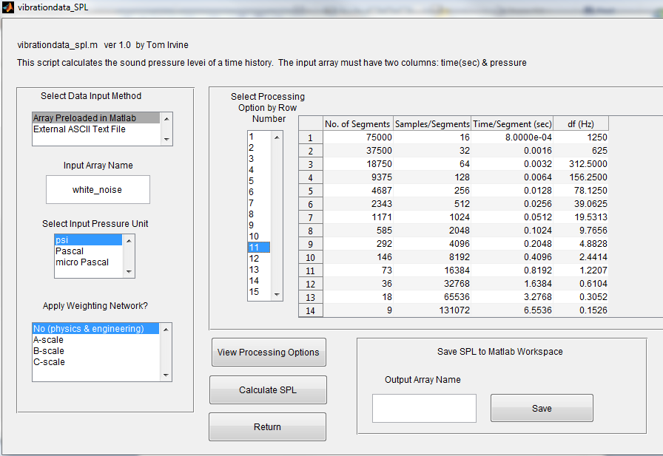

Slide 12
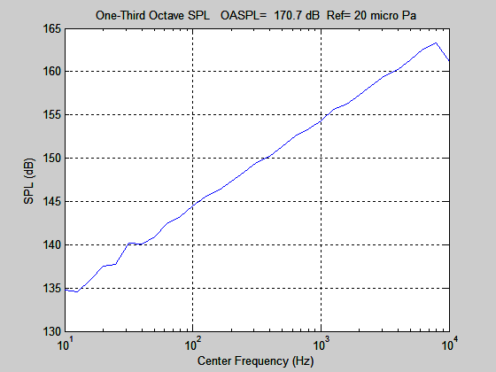
White Noise SPL
Slope is
3 dB/octave

Slide 13
Typical dB Levels
Source | SPL (dB) |  | Source | SPL (dB)
Large Rocket (nearby) | 180 to 194 |  | Subway Train | 100
Jet Aircraft, Artillery Fire | 150 |  | Heavy Truck, Niagra Falls | 90
Shotgun Blast | 145 |  | Noisy Office or Restaurant | 80
Propeller Aircraft | 140 |  | Busy Traffic, Normal Radio | 70
Pneumatic Riveter, Jackhammer, Pain Threshold | 130 |  | Normal Conversation, Dishwasher | 60
Rock Concert, Thunder, Car Horn | 120 |  | Quiet Office | 50
Construction Noise | 110 |  | Library | 40

Slide 14
Analysis Example
Use frequency domain damage methods to assess acoustic fatigue damage
Demonstrated for a rectangular plate subjected to a uniform acoustic pressure field
Consider a baffled plate with dimensions 18 x 16 x 0.063 inches
The material is aluminum 6061-T6
The plate is simply-supported on all four edges
Assume 3% damping for all modes ( Q=16.67 )

Slide 15
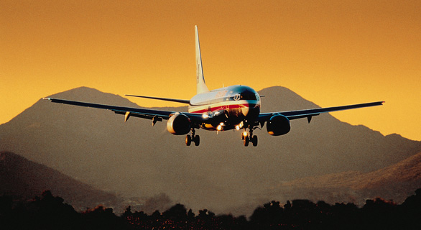
Typical Boeing 737
The plate will be subjected to flight levels from a 737 aircraft external fuselage.

Slide 16
Applied Pressure
The plate is subjected to the Boeing 737 Aft Mach 0.78 sound pressure level
Assume that the pressure is uniformly distributed across the plate
The sound pressure level and its corresponding power spectral density are shown in the following figures
Calculate the stress and cumulative fatigue damage at the center of the plate with a stress concentration factor of 3
Determine the time until failure at the nominal level and at 6 dB increments

Slide 17
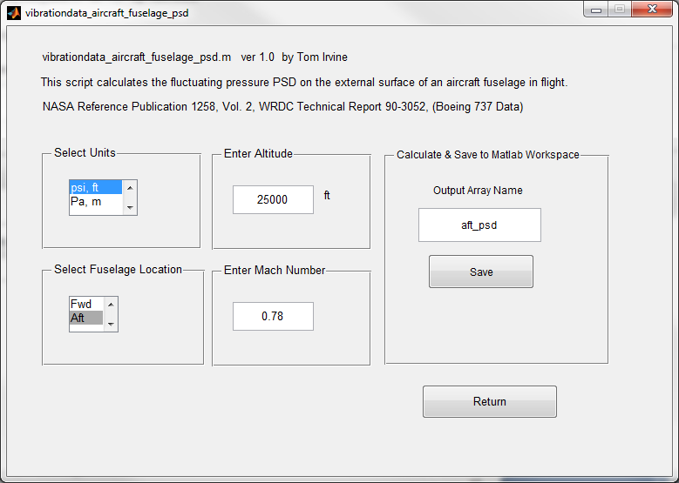
Boeing 737 Mach 0.78 , Equivalent PSD, Aft External Fuselage
vibrationdata > vibrationdata_read_data > PSD Library Array >
Aircraft External Fuselage Pressure PSD in Flight

Slide 18
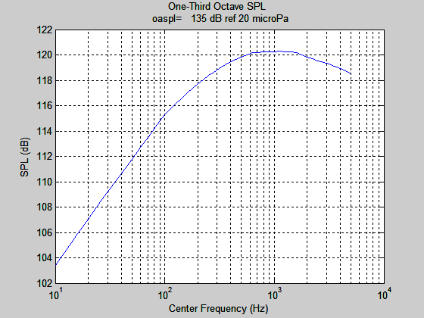
Boeing 737 Mach 0.78 , SPL, Aft External Fuselage

Slide 19
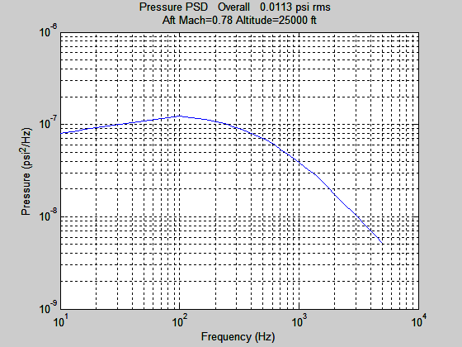
Boeing 737 Mach 0.78 Pressure PSD, Aft External Fuselage

Slide 20
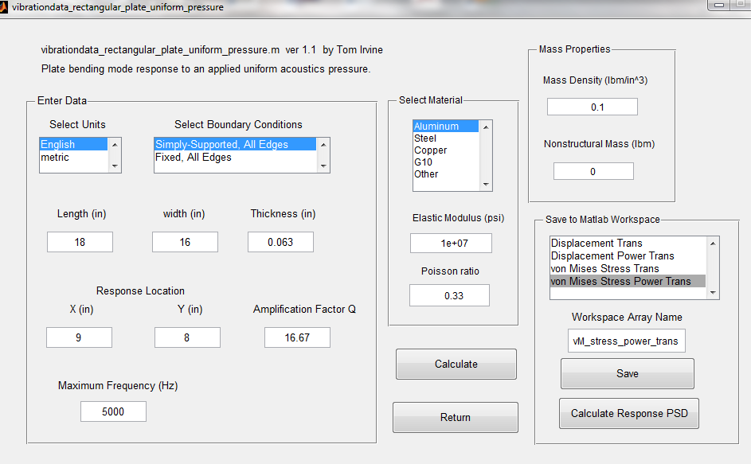
vibrationdata > Acoustics & Vibroacoustics > Vibroacoustics > Rectangular Plate Subjected to Uniform Acoustic Pressure Field

Slide 21
Rectangular Plate Natural Frequencies
fn(Hz) m n PF EMM ratio
41.576 1 1 0.05557 0.657
96.628 2 1 -0 0
111.25 1 2 -0 0
166.3 2 2 0 0
188.38 3 1 0.01852 0.073
227.38 1 3 0.01852 0.073
258.06 3 2 -0 0
282.43 2 3 -0 0
316.84 4 1 -0 0
374.18 3 3 0.006175 0.008111
386.51 4 2 0 0
389.95 1 4 -0 0
445.01 2 4 0 0
482 5 1 0.01111 0.02628
502.64 4 3 -0 0
536.76 3 4 -0 0

Slide 22
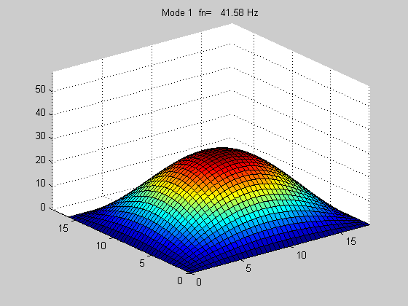
Fundamental Bending Mode

Slide 23
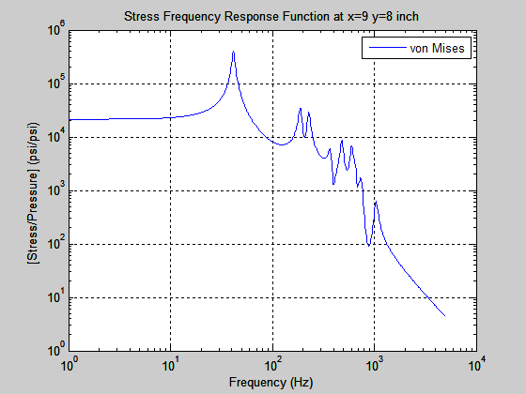
Center of
the Plate
The stress concentration factor is applied separately by multiply the magnitude by 3.
The magnitude is then squared prior to multiplying by the force PSD.

Slide 24
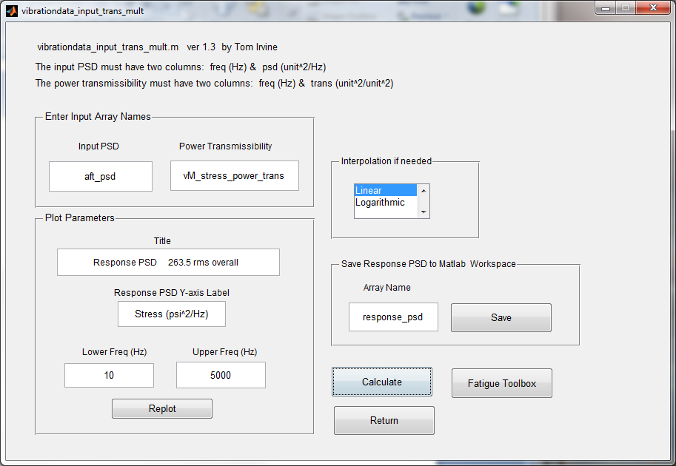

Slide 25
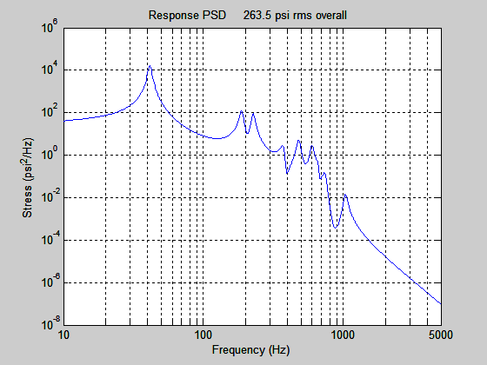
Center of the Plate Stress Response PSD
Press “Calculate Response PSD” on previous dialog.

Slide 26
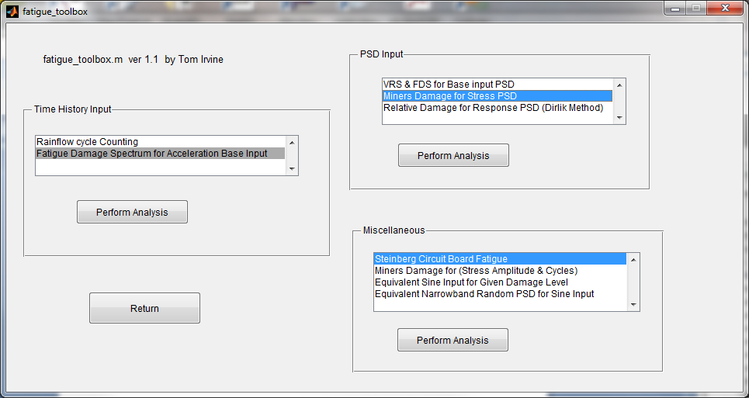
Fatigue Toolbox

Slide 27
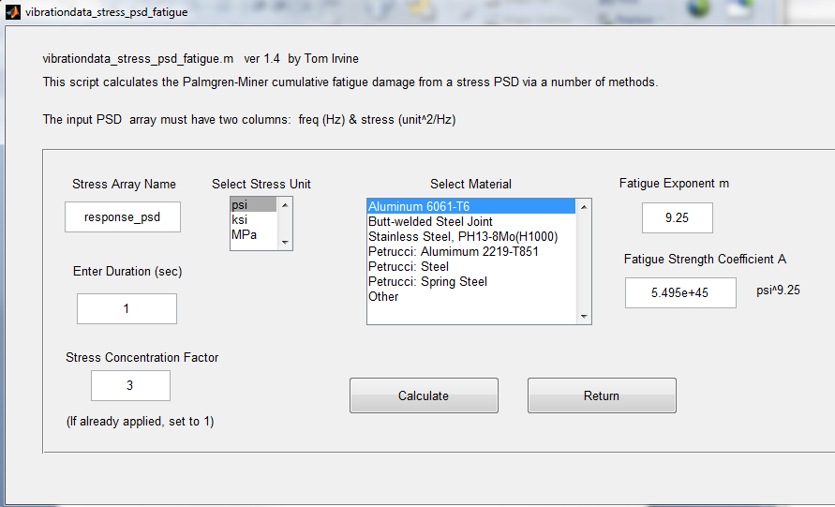
Fatigue Calculation
Set duration = 1 sec, because only fatigue rate is needed. Stress Concentration =3

Slide 28
Damage Results
Cumulative Damage, Simply-Supported Rectangular Plate, Center, Stress Concentration=3
Margin | Stress* | Damage Rate | Time to Failure
(dB) | (psi rms) | (1/sec) | (sec) | (Days)
0 | 263.5 | 9.53E-15 | 7.35E+13 | 8.50E+08
6 | 527 | 5.80E-12 | 1.21E+11 | 1.40E+06
12 | 1054 | 3.53E-09 | 1.98E+08 | 2290
18 | 2108 | 2.15E-06 | 3.25E+05 | 3.77
* Prior to accounting for stress concentration factor

Slide 29
Pressurization Cycles
Aircraft fuselages undergo repetitive cycles of differential pressure with each flight
The difference between the cabin and the external ambient pressure is about 6 or 7 psi at an altitude of 36,000 feet
Note that cabin pressure at high altitudes is maintained at about 75% of sea level pressure, which corresponds to the air pressure at 8000 ft
This is done by pumping air into the cabin
Note that there is some variation in these numbers depending on the aircraft model
Pressurization cycles along with vibration, corrosion, and thermal cycling can cause fatigue cracks to form and propagate

Slide 30
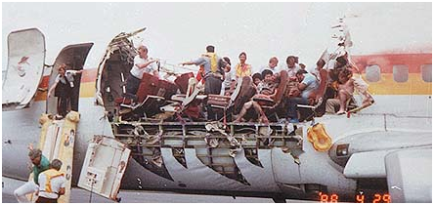
Aloha Airlines Flight 243
Aloha Airlines Flight 243 between Hilo and Honolulu in Hawaii suffered extensive damage after an explosive decompression in flight, on April 28, 1988
The aircraft was a Boeing 737-297. It was able to land safely at Kahului Airport on Maui.
There was one fatality — a flight attendant was swept overboard
Fatigue cracks occurred due to disbanding of cold bonded lap joints and hot bonded tear joints in the fuselage panels.
This caused the rivets to be over-stressed
A large number of small cracks in the fuselage may have joined to form a large crack
Corrosion was also a related factor

