Slide 1
Unit 41
Vibrationdata
PSD Special Topics
Band-Splitting
Time-Level Equivalence
PSD Synthesis using Sine Series

Slide 2
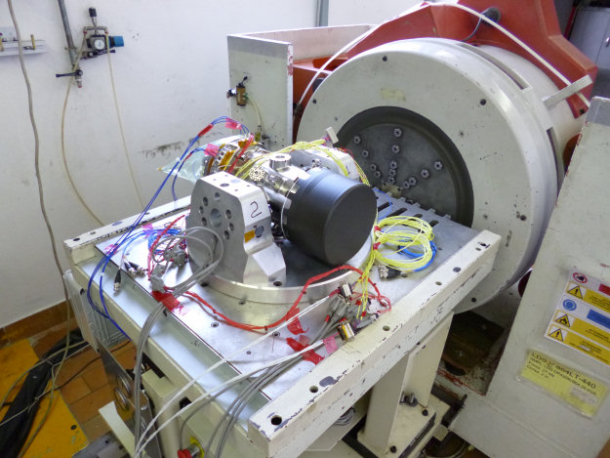
Introduction
Vibrationdata
Inertial Sensor Vibration Test

Slide 3

Some Tribal Knowledge
Vibrationdata
Some power spectral density test specifications are too high in amplitude for a given shaker system
Band-splitting can be cautiously used in these cases
Reference: Test Methods and Control, Martin Marietta, 1989

Slide 4
Guidelines
Vibrationdata
The preferred test method for selection of the band separation shall be to start at the lowest test frequency and extend the first Split Band to the highest energy/frequency level attainable
Start Band 2 at the end of Band 1, etc.
No more than 4 Bands are allowed
The resultant band selection shall be evaluated to assure reasonability, to avoid splitting at known resonances, etc.
Efforts should be made to minimize the number of bands, and to make the actual test bands approximately of equal energy content

Slide 5
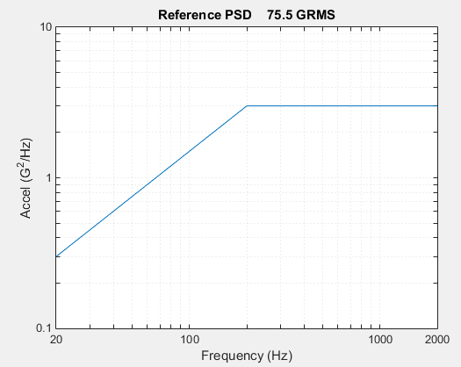
PSD Spec, High-level
Vibrationdata
spec=[20 0.3 ; 200 3 ; 2000 3 ]

Slide 6
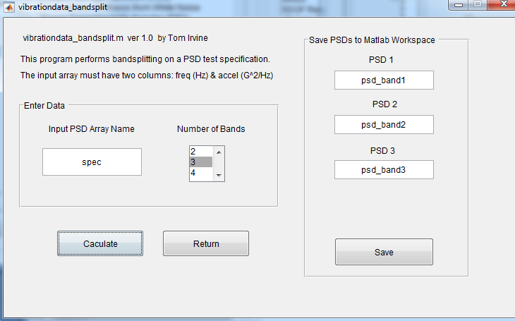
split into three bands with equal GRMS levels
vibrationdata > power spectral density > PSD Band-splitting

Slide 7
PSD 1 43.6 GRMS
Freq (Hz) | Accel (G^2/Hz)
20 | 0.3
200 | 3
734.5 | 3
PSD 2 43.6 GRMS
Freq (Hz) | Accel (G^2/Hz)
734.5 | 3
1368 | 3
PSD 3 43.5 GRMS
Freq (Hz) | Accel (G^2/Hz)
1368 | 3
2000 | 3

Slide 8
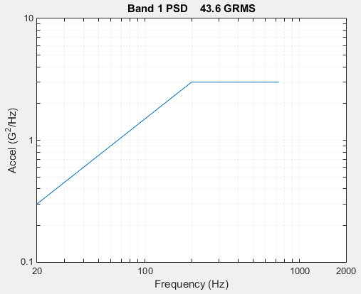
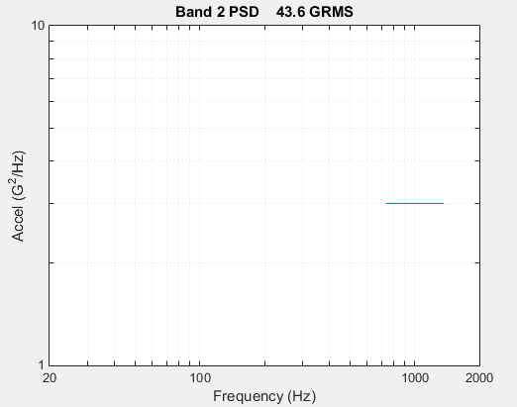
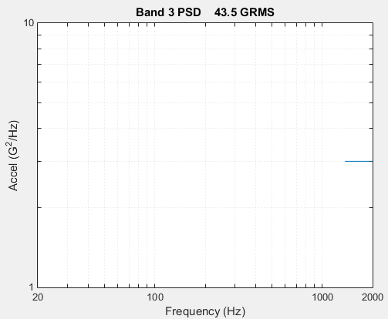

Slide 9
Time-Level Equivalence Scaling
Vibrationdata
A component will be subjected to a certain PSD for 2000 hours in its field environment
2000 hours is too long for a shaker table test
Goal is to test the component at a higher level for shorter duration
Scaling justification will be in terms of fatigue damage

Slide 10
Equivalence Formula
Vibrationdata
Steinberg fatigue-type formula
Assume linearity
where
T₁ | reference time
T₂ | new time
G₁ | reference GRMS level
G₂ | new GRMS level
b | fatigue exponent

Slide 11
Fatigue Exponent
Vibrationdata
Steinberg b=6.4 for electronic boxes
Martin-Marietta
Smaller b is more conservative for scaling to higher level at shorter duration
Item | b
Electrical Black Boxes | 4.0
Stainless Steel Feed Lines and Bellows | 5.3
Hydraulic Actuators | 5.3
Electrical Connectors | 5.0
Ordnance | 5.3

Slide 12
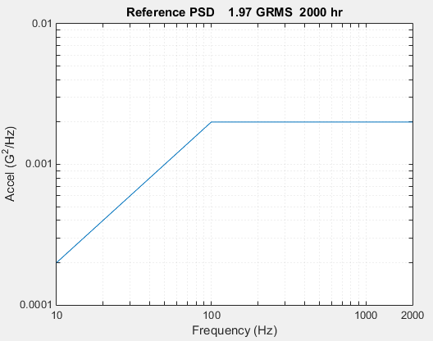
Increase level for
1 hour test
psd_ref=[10 0.0002; 100 0.002; 2000 0.002]

Slide 13
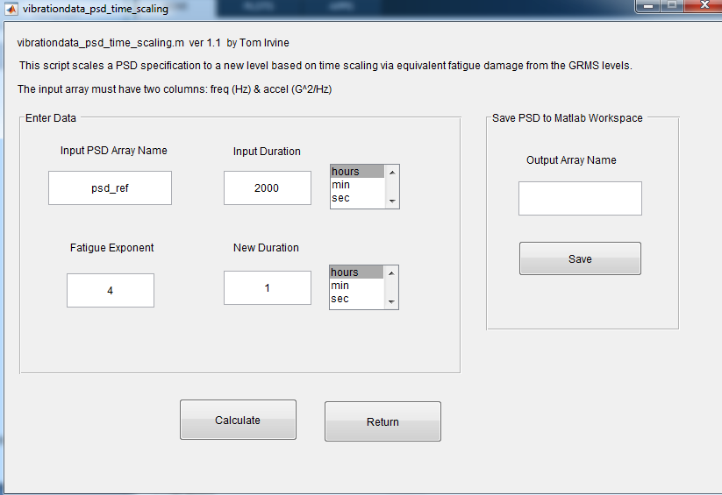
vibrationdata > Power Spectral Density > PSD Specification Time Scaling
Fatigue exponent b=4

Slide 14
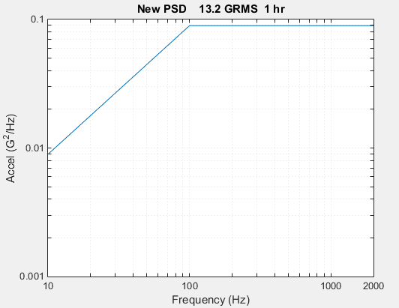
New Level with 16.5 dB increase
Vibrationdata
New PSD
Freq (Hz) | Accel (G^2/Hz
10 | 0.0089
100 | 0.089
2000 | 0.089

Slide 15
PSD Synthesis using Sine Series
Vibrationdata
A time history for a PSD can be synthesized from a series of sinusoids
The resulting “pseudo random” time history is deterministic but simulates a random event
This method is simpler to understand than beginning with white noise
The sine method allows for finer control than the white noise method
The sine method might be more appropriate for short random burst with narrow bandwidth
In contrast, the white noise method is appropriate for general purpose

Slide 16
PSD Synthesis using Sine Series, Steps
Vibrationdata
Step | Description
1 | Select number of sine frequencies f _{i} and frequency spacing Δf_{i}
2 | Choose the phase angles ϕ _{i} , typically random
3 | Calculate the peak amplitudes A _{i} from the PSD unit^2/Hz values P _{i}
4 | Sum components with sampling rate > 10 x highest PSD frequency

Slide 17
PSD Synthesis Steps (cont)
Vibrationdata
Step | Description
5 | Take a histogram which should resemble a normal distribution
6 | Calculate kurtosis should be approximately 3.0
7 | Calculate PSD of Y(t) and compare with specification

Slide 18
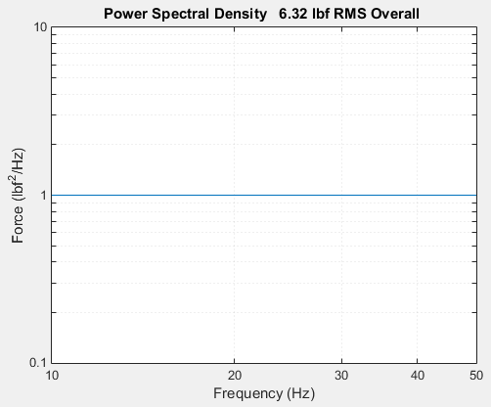
Force PSD
Vibrationdata
force_psd = [10 1; 50 1] duration = 20 seconds

Slide 19
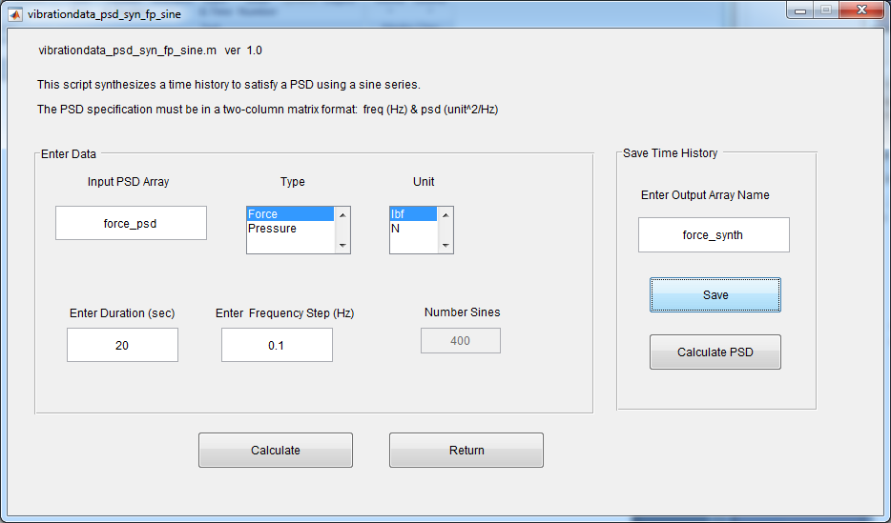
Power Spectral Density > Force > Time History Synthesis from Sine Series
Experiment with different frequency steps

Slide 20
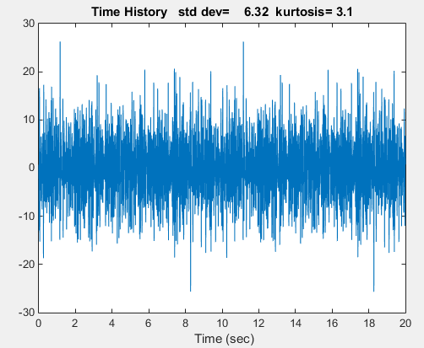
Synthesized Time History from Sinusoids
Vibrationdata
Note the repeating pattern

Slide 21
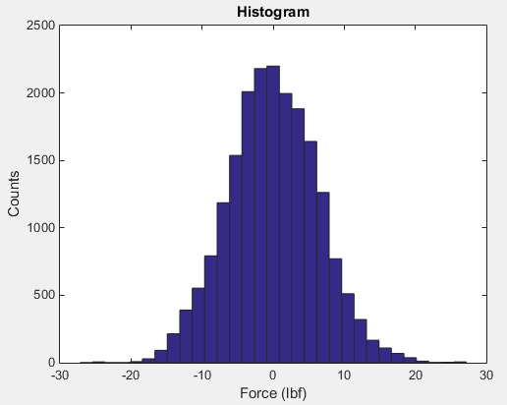
Corresponding Histogram
Vibrationdata

Slide 22
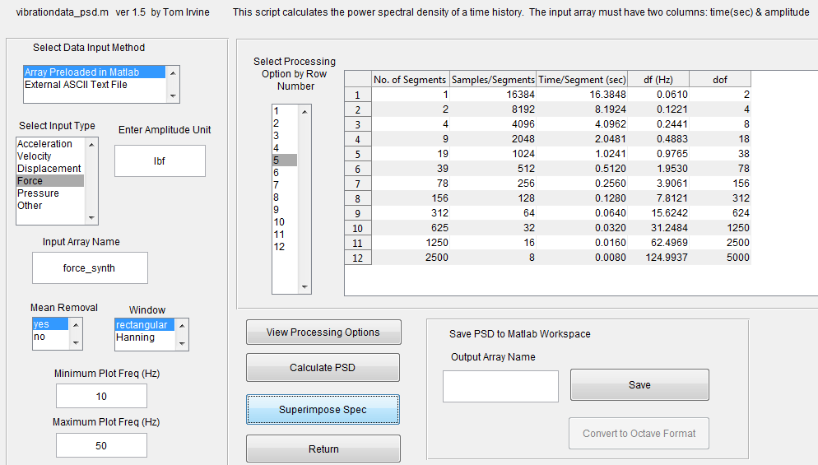

Slide 23
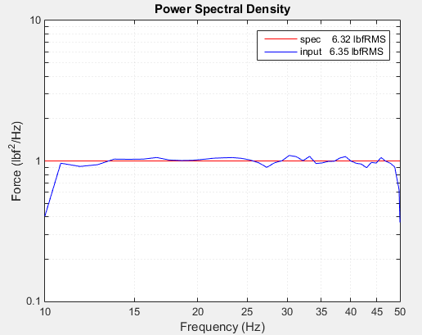
Resulting PSD Comparison
Vibrationdata

Slide 24
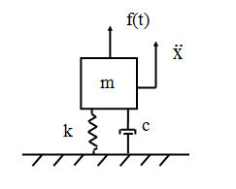
SDOF System Subjected to an Applied Force
Vibrationdata
m | = | mass
c | = | viscous damping coefficient
k | = | stiffness
x | = | displacement of the mass
f(t) | = | applied force
Apply synthesized force to SDOF System:
20 Hz, Q=10, mass= 2lbm

Slide 25
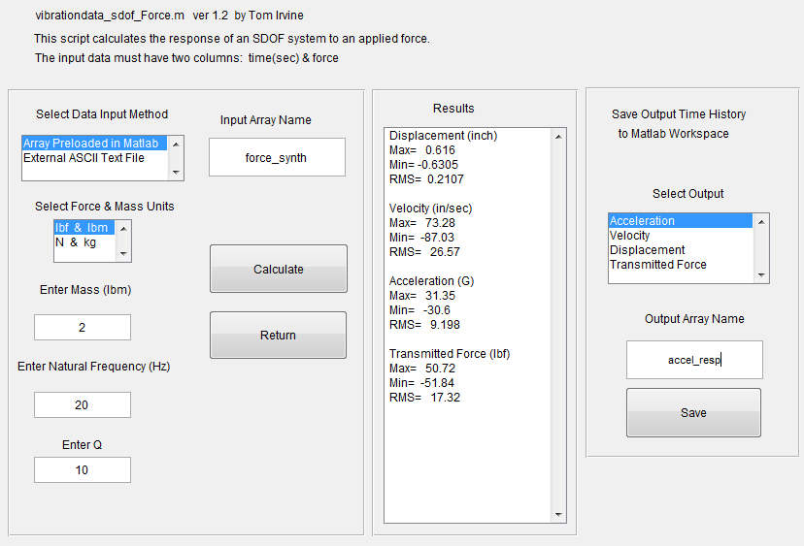
vibrationdata > Time History > Force > SDOF Response to Applied Force

Slide 26
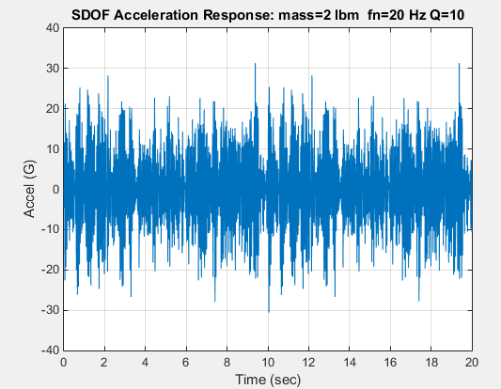
SDOF Response, Time History
Vibrationdata

Slide 27
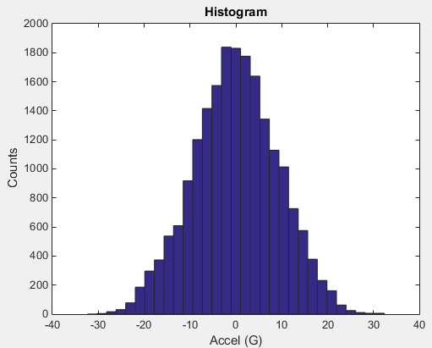
SDOF Response, Histogram
Vibrationdata

