Slide 1
Unit 42
Vibrationdata
Shock Special Topics
Accidental Drop Shock
Half-Sine Shock on Drop Tower
Half-Sine Shock on Shaker Table
Waveform Reconstructions via Wavelets

Slide 2

The Drop Seen Around the World
Vibrationdata
First person to buy an iPhone 6 drops It on live TV, Perth, Australia, Sep 18, 2014

Slide 3
Introduction
Vibrationdata
Drop shock is a very messy, nonlinear problem with potential plastic deformation, cracking, etc.
Making test measurements is probably more effective than analysis
The orientation of the item as it strikes the ground is one of several challenges for both measurement and analysis
But we can do some very simple modeling as a first approximation

Slide 4
Assumptions
Vibrationdata
The object can be modeled as a single-degree-of-freedom system subjected to initial velocity
The object is dropped from rest
There is no energy dissipation
The collision is perfectly elastic
The object remains attached to the floor via the spring after initial contact
The object freely vibrates at its natural frequency after contact
The system has a linear response

Slide 5
SDOF Model
Vibrationdata
x
m
k
x
m
k
Dropped from rest at initial height
Attaches to ground upon initial contact
where m is mass, and k is stiffness

Slide 6
Some High School Physics
Vibrationdata
The initial velocity of the object as it strikes the ground can be found by equating the change in kinetic energy with the change in potential energy:
where is the drop height above the ground, and g is gravity acceleration
Next, solve the undamped, free vibration problem with the initial velocity given above. Also, initial displacement is zero.

Slide 7
Solve Equation of Motion for Peak Responses
Vibrationdata
The resulting displacement is
The velocity is
The acceleration is

Slide 8
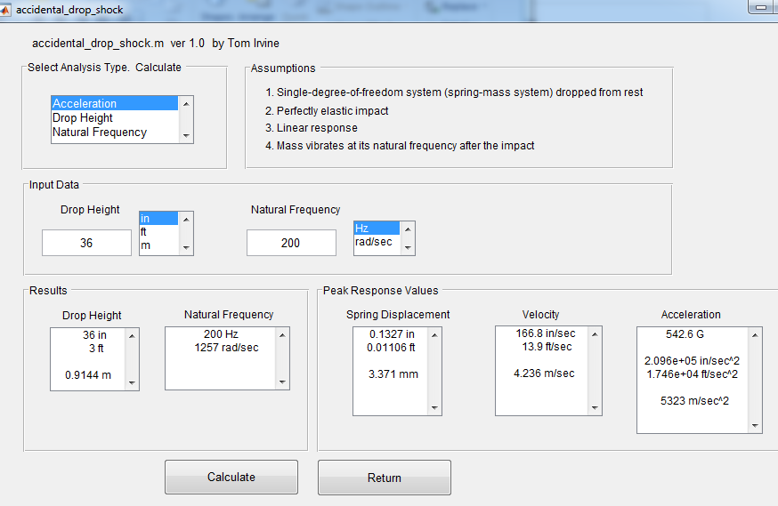
Miscellaneous > Shock > Accidental Drop Shock

Slide 9
Peak Response Values
Vibrationdata
Drop height = 36 inches
Natural Freq (Hz) | Displacement (in) | Velocity (in/sec) | Acceleration (G)
200 | 0.133 | 167 | 543
600 | 0.044 | 167 | 1630
1000 | 0.027 | 167 | 2710
100 in/sec is “severity threshold” per some references
Drop height of 13 inches yields 100 in/sec
See Webinar 29, Gaberson’s papers, MIL-STD-810E, etc.

Slide 10
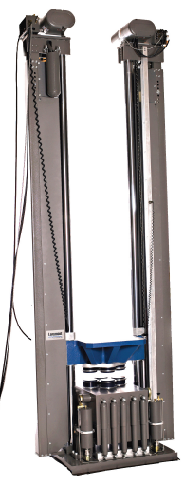
Shock Testing
Classical pulse shock testing has traditionally been performed on a drop tower
The component is mounted on a platform which is raised to a certain height
The platform is then released and travels downward to the base
The base has pneumatic pistons to control the impact of the platform against the base
In addition, the platform and base both have cushions for the model shown
The pulse type, amplitude, and duration are determined by the initial height, cushions, and the pressure in the pistons
platform
base

Slide 11
Half-Sine Shock Concerns
Vibrationdata
Consider total velocity change, net velocity and displacements
Drop Towers can ideally be configured for 0% to 100% rebound

Slide 12
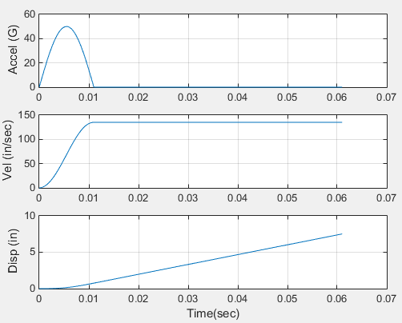
50 G, 11 msec Half-Sine Pulse
Vibrationdata
Assumes zero initial velocity and zero initial displacement

Slide 13
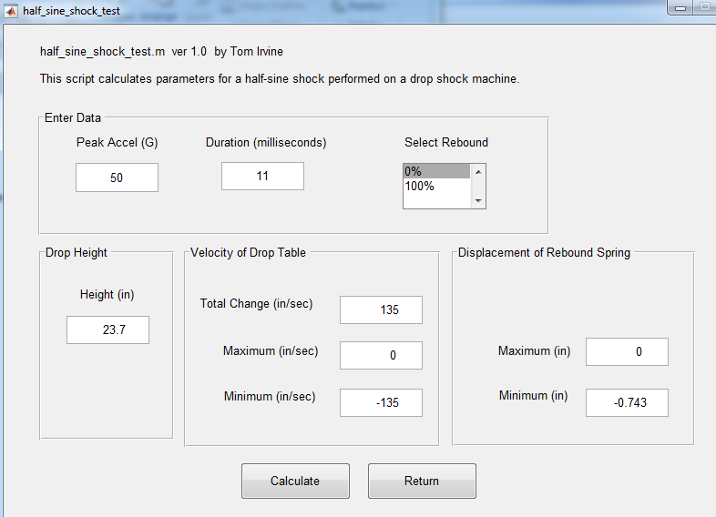
Miscellaneous > Shock > Half-Sine Shock Text

Slide 14
50 G, 11 msec, Half-Sine Pulse
Vibrationdata
Rebound | Peak Velocity (in/sec) | Peak Displacement (in)
0% | 135 | 0.74
100% | 67.6 | 0.24
Total velocity change is 135 in/sec in either case
(area under the acceleration half-sine curve)

Slide 15
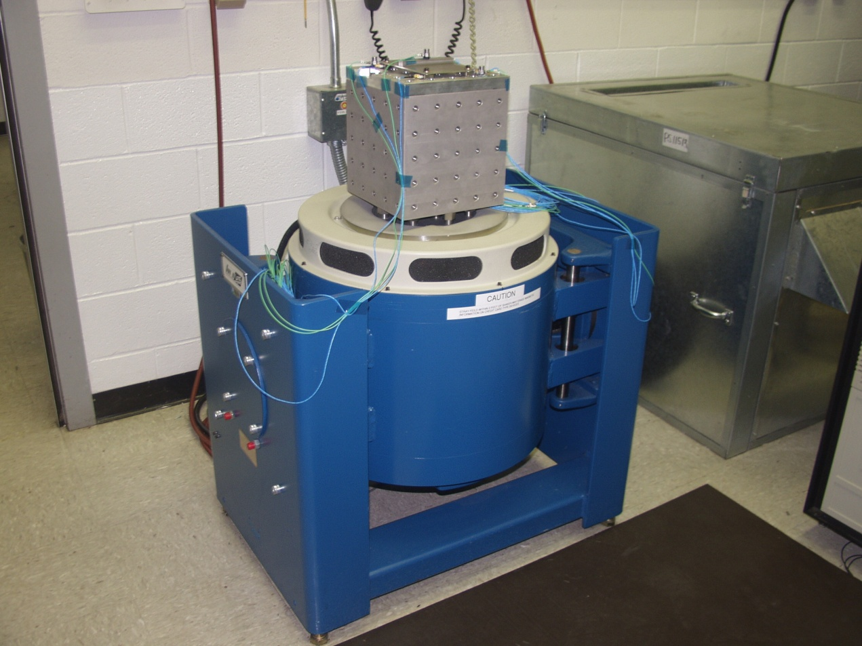
Half-Sine Shock on Shaker Table
Vibrationdata
Must have:
zero net velocity
zero net displacement

Slide 16
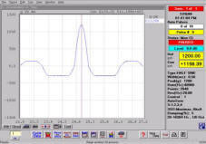
Use Pre and Post-Pulses
to Control Velocity and Displacement
Vibrationdata
Image from vendor (poor quality but still instructive)

Slide 17
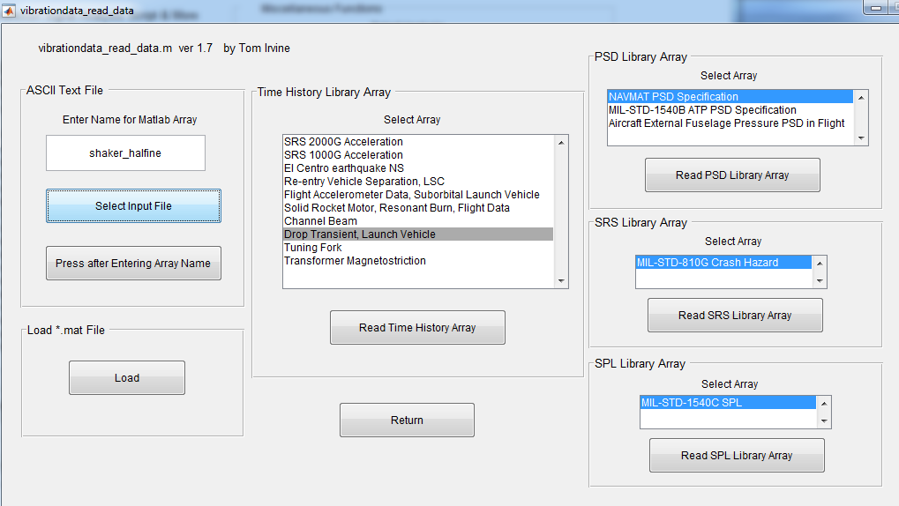
Read ASCII File: shaker_halfsine.txt

Slide 18
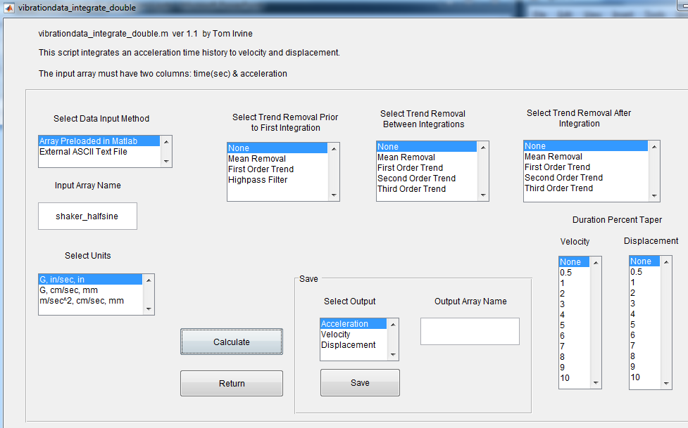
vibrationdata > Integrate or Differentiate > Double Integrate Acceleration to Displacement

Slide 19
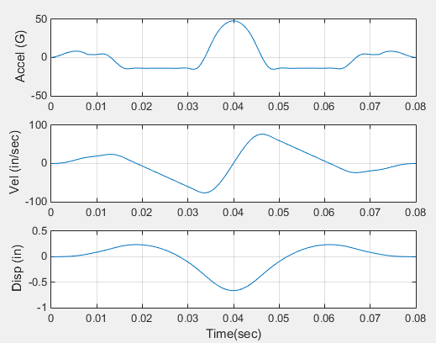
Goal: 50 G, 11 msec, Half-Sine Shock for Shaker Test
Max & Min
(48.1 G, -15.2 G)
(76.7 in/sec, -76.7 in/sec)
(0.24 in, -0.66 in)

Slide 20
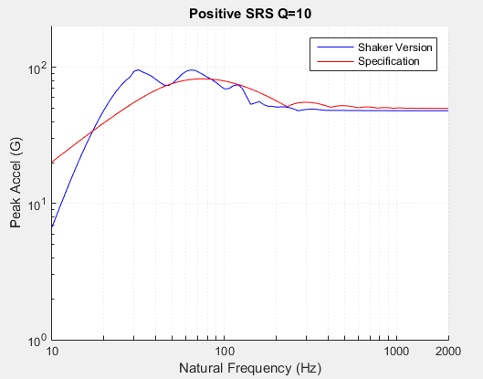
SRS Comparison
Vibrationdata

Slide 21
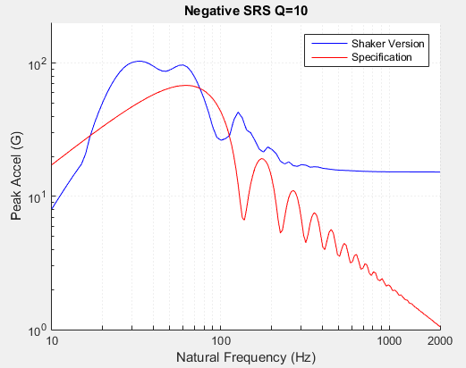
SRS Comparison (cont)
Vibrationdata

Slide 22
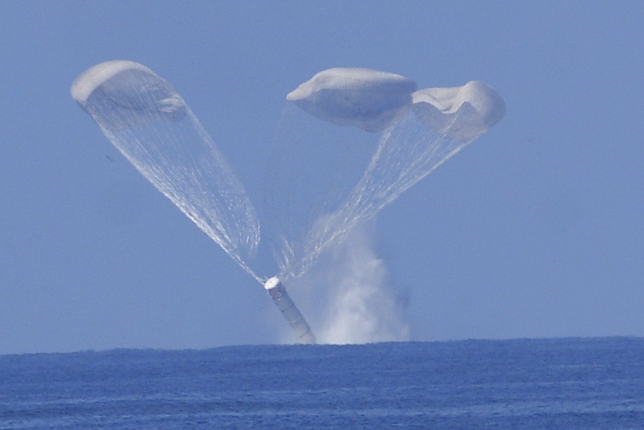
Vibrationdata
Shuttle Solid Rocket Booster Splashdown

Slide 23
Vibrationdata
Shuttle Solid Rocket Booster Splashdown
IEA boxes were recovered and flown on other missions
IEA boxes thus needed to withstand multiple splashdown shock events
Use flight accelerometer data to derive splashdown “time replication” shock test for the IEA electronic box to be performed on shaker table

Slide 24
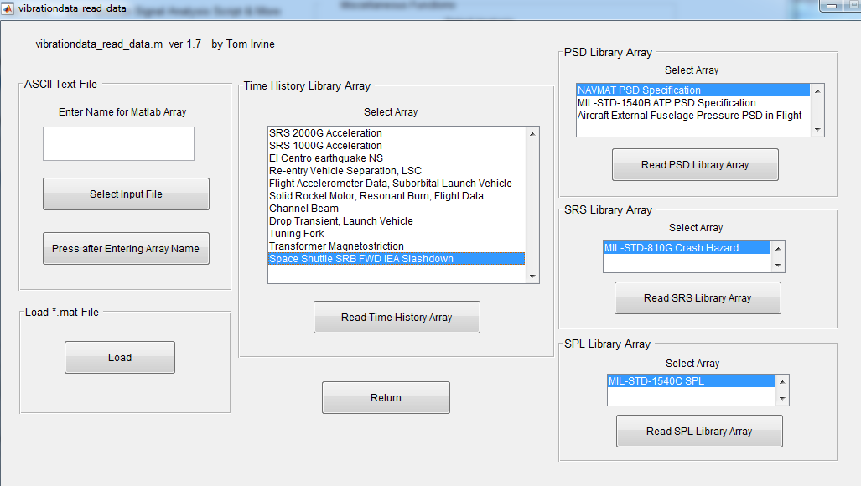
Import Shuttle Flight Accelerometer Data
Vibrationdata

Slide 25
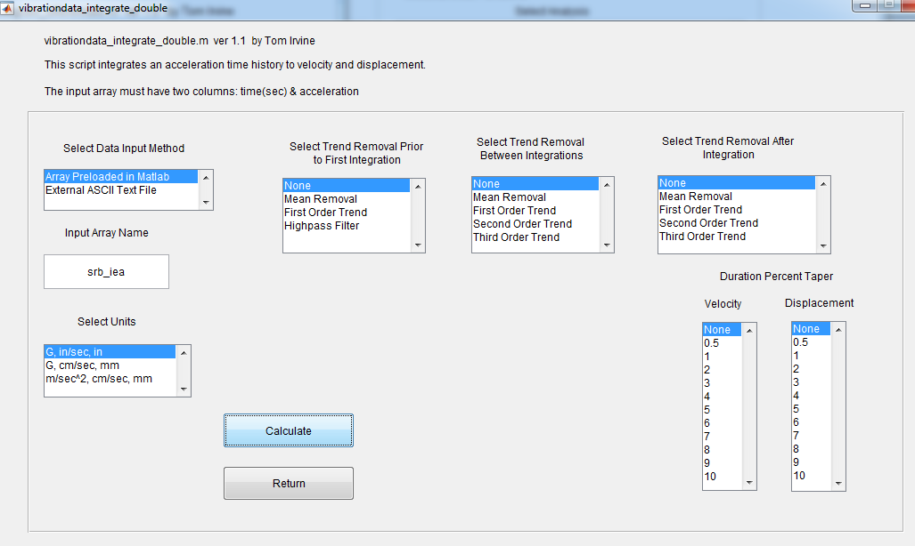
Integrate to Velocity & Displacement

Slide 26
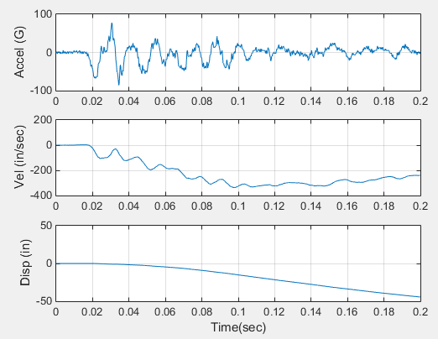
SRB IEA Shock Data
Vibrationdata

Slide 27
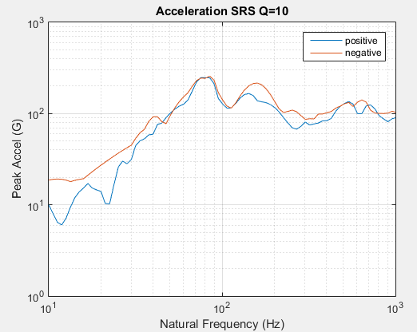
Time History > Shock Response Specturm

Slide 28
Wavelet Modeling
Vibrationdata
There are several approaches to rendering the measured acceleration waveform suitable for a shaker test
Use wavelet reconstruction for “elegance”
Previously used wavelet reconstruction for damped sine synthesis in Webinar 27
The quality of the measured data is a concern due to the:
velocity and displacement drift in the time domain
differences between positive & negative SRS curves
So do not expect “exact replication”
The following method can also be used for correcting or filtering signal by removing saturation effects, etc.

Slide 29
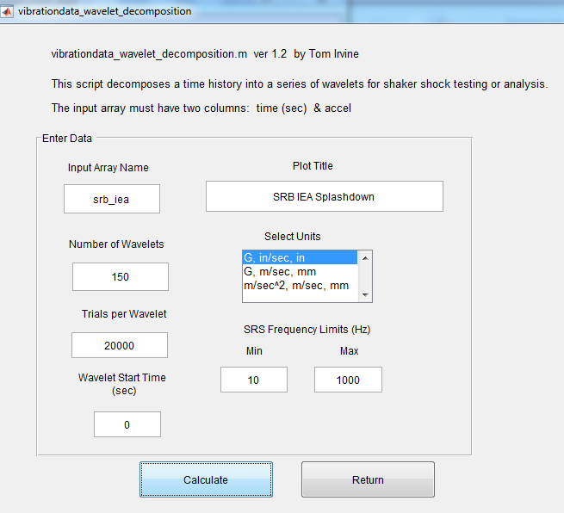
Time History > Wavelet Reconstruction > Decompose Time History into Wavelet Table

Slide 30
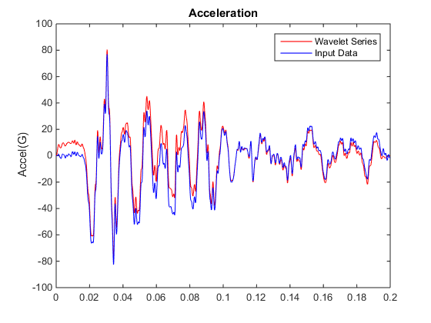
Acceleration Comparison
Vibrationdata

Slide 31
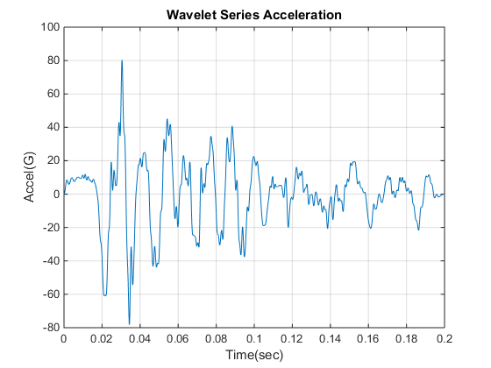
Acceleration
Vibrationdata

Slide 32
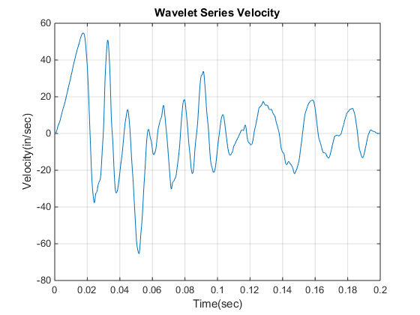
Velocity
Vibrationdata

Slide 33
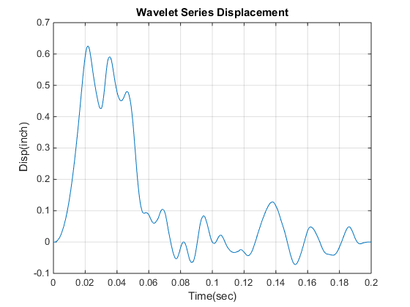
Displacement
Vibrationdata

Slide 34
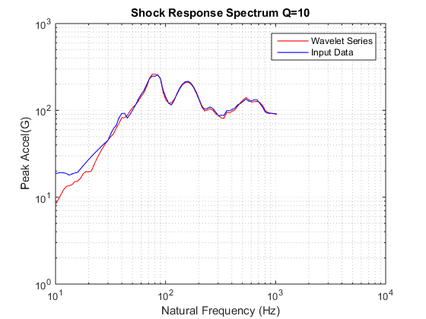
Shock Response Spectrum
Vibrationdata

