Slide 1





Antimonide Based Infrared Detectors and Focal Plane Arrays for NASA Applications
Sanjay Krishna
Professor and George R Smith Chair in Engineering,
Department of Electrical and Computer Engineering
The Ohio State University
Email: krishna.53@osu.edu
https://kind.engineering.osu.edu
NASA Webinar
May 15th 2018
https://discovery.osu.edu/

Slide 2
Outline
Motivation and Application Need
  Mid-infrared Imaging and Sensing
  Driving Application Need for NASA
Technology Background
  Antimonide Based Semiconductors
  Historical Perspective of Superlattices
  Physics of Superlattices
Engineering Band-diagrams and Band-structures
  Band-diagram Engineering: Unipolar Barrier Detectors
  Band-structure Engineering: Superlattice Avalanche Photodiodes
Technology Status and Future Directions
  Job security for Physicists, Chemists, Material Scientists and Engineers!!!

Slide 3
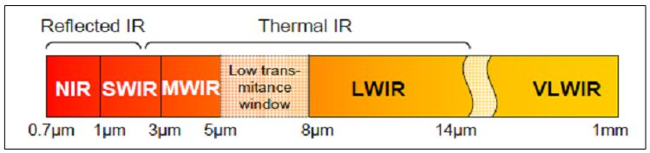
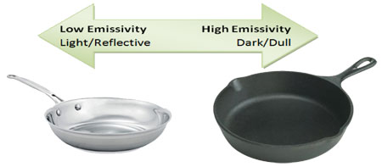
Reflective and Thermal Infrared
Infrared is generally considered to span the wavelength between 0.7μm-25μm*
25μm
The wavelength range between 1.7μm-25μm is referred to as Mid-Infrared*
* Various research communities use different semantics

Slide 4
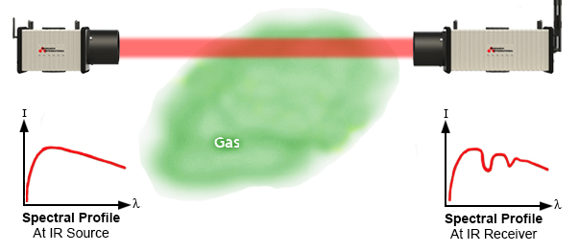
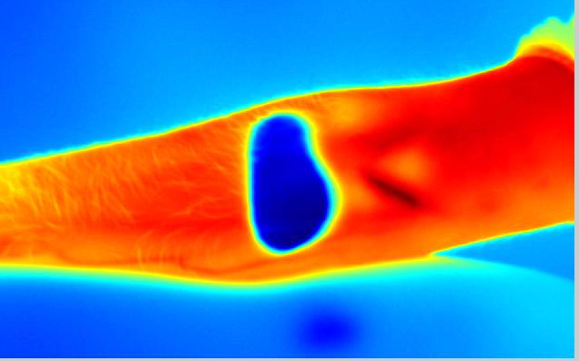

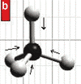
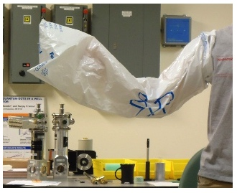
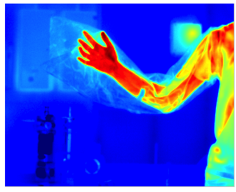
Mid-Infrared Sensing and Imaging
Three scientific phenomenology enabled in the infrared
Stand-off Chemical Sensing
Thermal Imaging
Absorption Finger Print
Modified from http://www.resrchintl.com/Gas_Detection.html
Seeing Through Objects
Various applications exploit these phenomenology

Slide 5
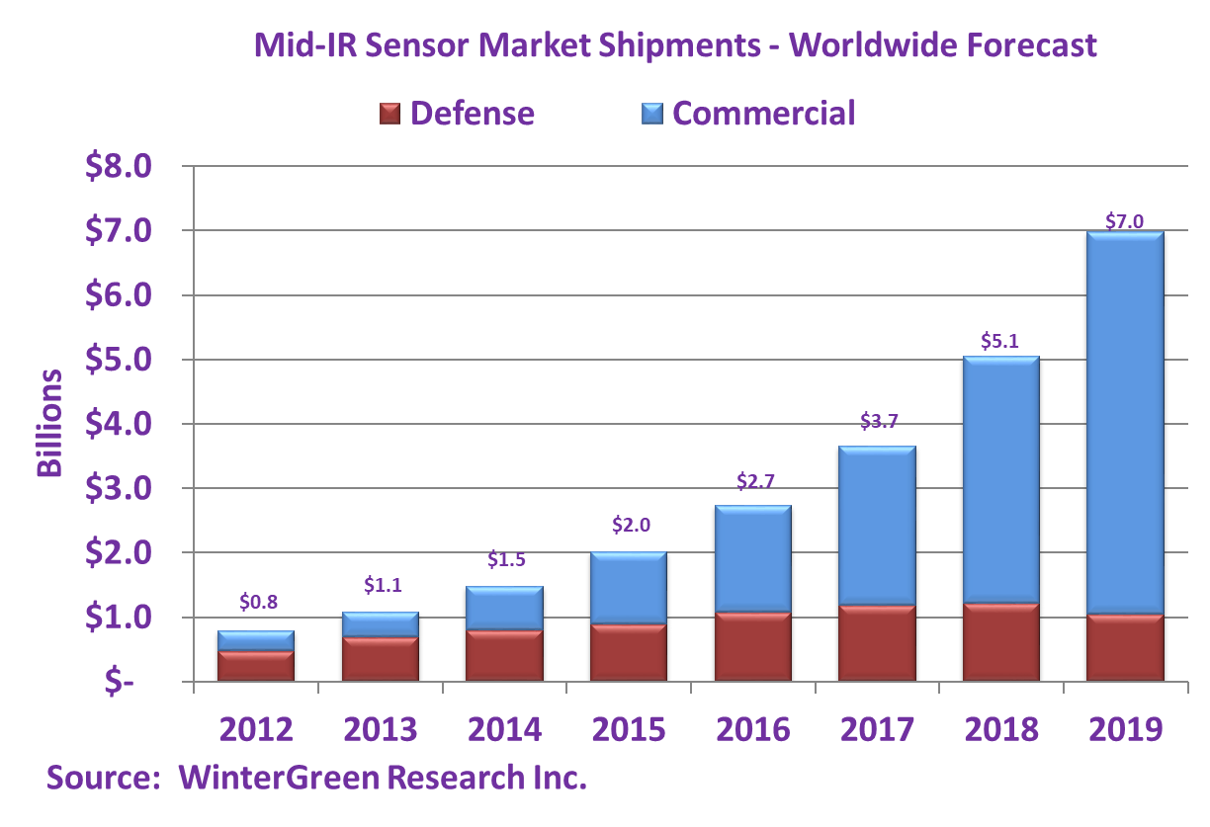
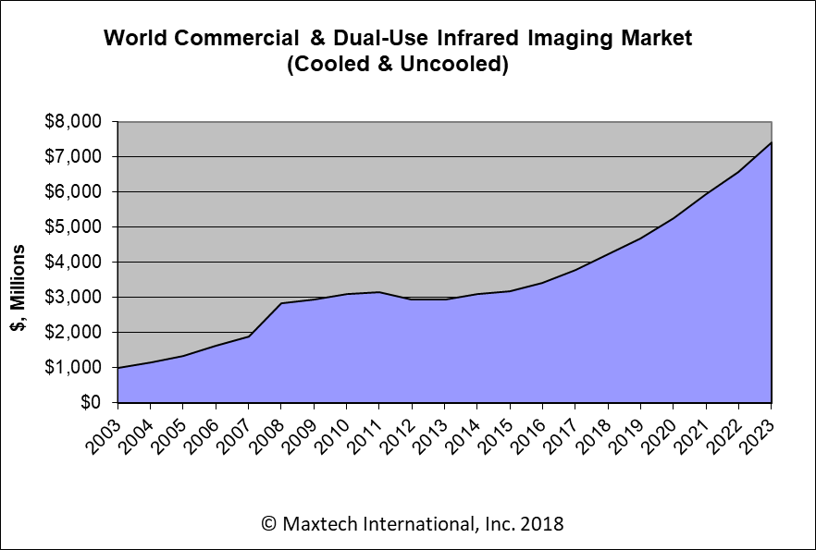
Growth in Mid-Infrared Sensing Market
Key Messages:
IR Sensing and imaging are fast growing multi-billion dollar markets
Significant growth expected in the commercial market
DoD/NASA could benefit from innovations in the commercial sector

Slide 6
NASA Applications
Earth Science Applications
Space-Based Lidar
Weather, gas detection, pollution monitoring, ocean and ice changes, deforestation, forest fires, soil moisture, geology, plant health etc
CubeSat Infrared Atmospheric Sounder (CIRAS)
Hyperspectral Thermal Emission Spectrometer (HyTES)
SLI-T: Long Wavelength Infrared FPA for Land Imaging
https://www.jpl.nasa.gov/cubesat/missions/ciras.php

Slide 7
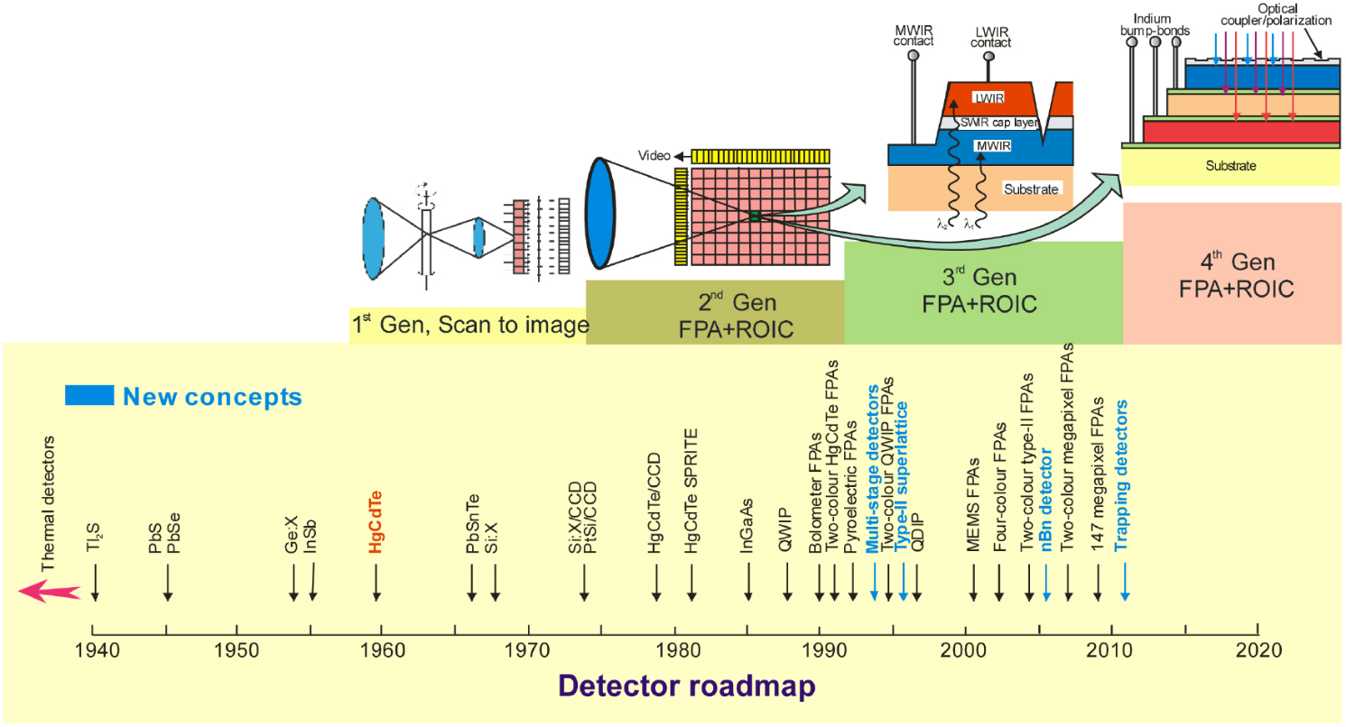
History of Infrared Detectors
A Rogalski et al 2016 Rep. Prog. Phys. 79 046501 doi:10.1088/0034-4885/79/4/046501

Slide 8
Outline
Motivation and Application Need
  Mid-infrared Imaging and Sensing
  Driving Application Need for NASA
Technology Background
  Antimonide Based Semiconductors
  Historical Perspective of Superlattices
  Physics of Superlattices
Engineering Band-diagrams and Band-structures
  Band-diagram Engineering: Unipolar Barrier Detectors
  Band-structure Engineering: Superlattice Avalanche Photodiodes
Technology Status and Future Directions
  Job security for Physicists, Chemists, Material Scientists and Engineers!!!

Slide 9
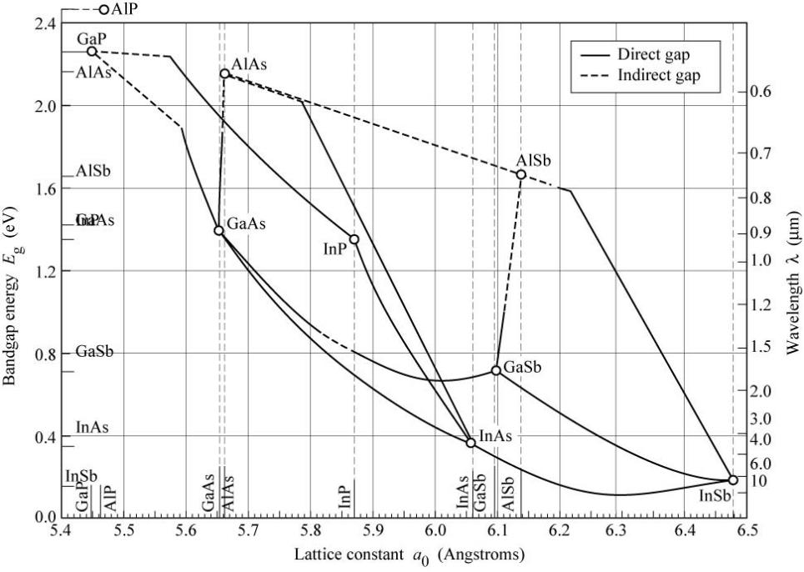
6.1 Å Semiconductor Materials
Two application drivers:
High Speed, Low Power Electronic Devices (Field effect transistors, Resonant Tunneling Diodes etc)
Mid-Infrared Photonic Devices (Infrared lasers and detectors)
Kroemer, The 6.1A family (InAs,GaSb, AlSb) and its heterostructures: A selective review, Phyisica E 20, (2004)

Slide 10
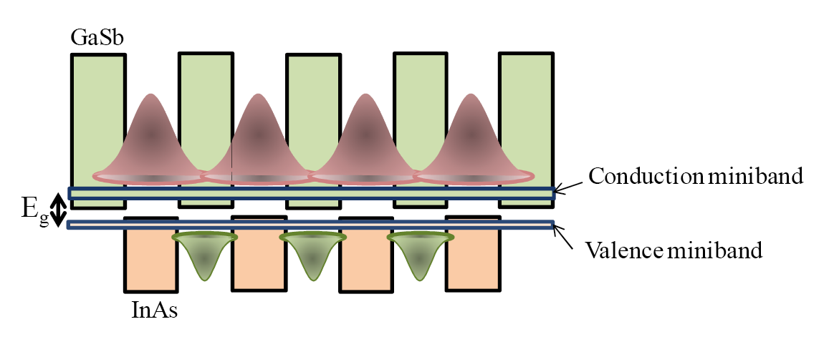
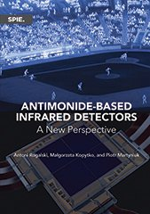
InAs/(In)GaSb Type-II Superlattices (T2SL)
Key Historical Papers: Sai-Halasz, G. A., Tsu, R., and Esaki, L. (APL 1977): “A new semiconductor superlattice”
Frensley and Kroemer (1977); Schulman and McGill (MCT superlattice, APL, 1979); Smith and Mailhiot (InAs/InGaSb strained layer superlattces, JAP, 1987); Osbourn (InAsSb SLS, JAP 1982/JVSTB 1984)
Super-lattice
Good Review Articles and Recent References:

Slide 11
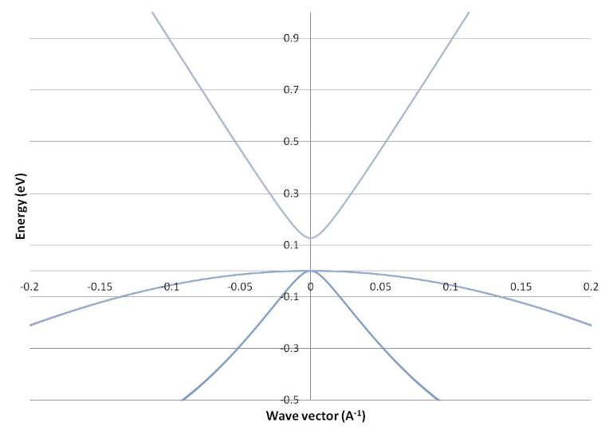
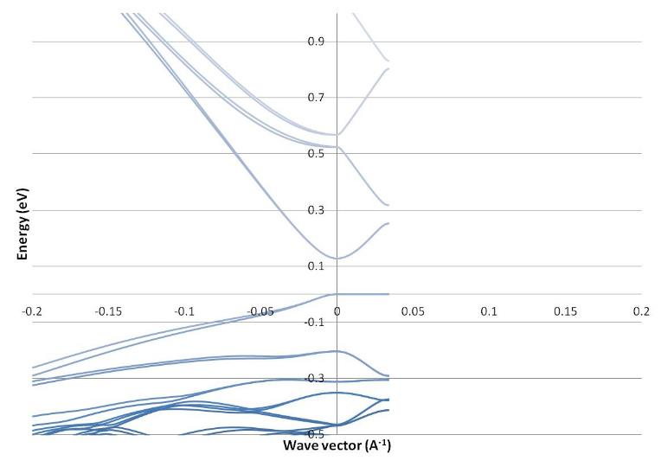
Physics of Bulk and Superlattice Bandstructures
Hg_{0.77}Cd_{0.23}Te
73.2 Å InAs/
19.7 Å InAs_{0.55}Sb_{0.45}
<− In-plane
Growth-axis −>
T=77 K
  Key Differences:
  Anisotropy in bandstructure and transport
  Reduced k-vector due to periodicity of superlattice
  Additional degrees of freedom for iso-gap structures
Smith, D. L., and C. Mailhiot. "Theory of semiconductor superlattice electronic structure." Reviews of Modern Physics 62, no. 1 (1990): 173.
  Modeling by Chris Grein, UIC

Slide 12
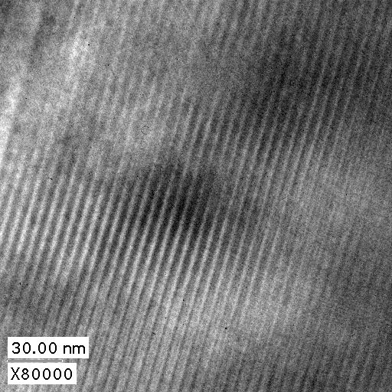
From Theory to Practice: Materials Development
Growth by Solid Source Molecular Beam Epitaxy by Dr. Ron Kaspi
42 Å
STM by Michael Weimer (Texas A & M)
TEM by Paul Rotella (UNM)

Slide 13
Outline
Motivation and Application Need
  Mid-infrared Imaging and Sensing
  Driving Application Need for NASA
Technology Background
  Antimonide Based Semiconductors
  Historical Perspective of Superlattices
  Physics of Superlattices
Engineering Superlattice Band-diagrams and Band-structures
  Band-diagram Engineering: Unipolar Barrier Detectors
  Band-structure Engineering: Superlattice Avalanche Photodiodes
Technology Status and Future Directions
  Job security for Physicists, Chemists, Material Scientists and Engineers!!!

Slide 14
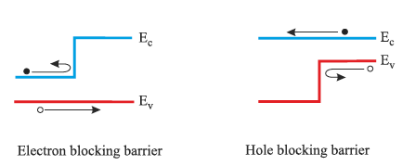
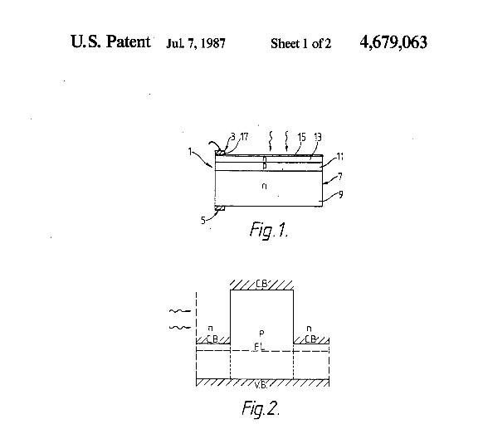
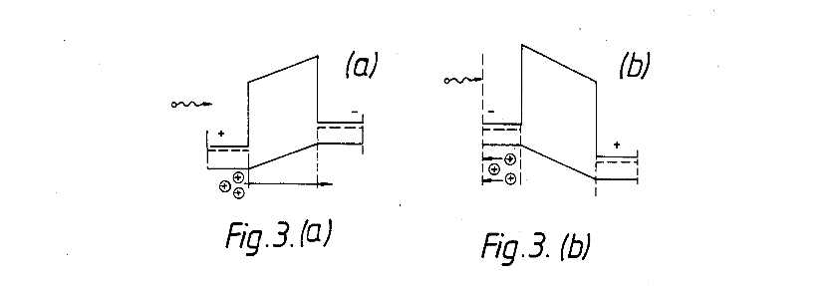
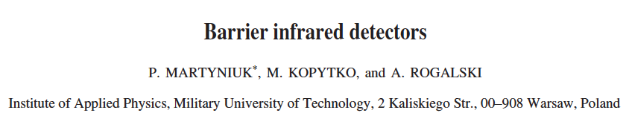
Unipolar Barrier Engineering
  A unipolar barrier* blocks one type of carrier and allows the transport of the other carrier
  Anthony White, Infrared Detector Patent, 1987
*Term Coined by David Ting, JPL

Slide 15
Unipolar Barrier Detectors
2006
nBn (with InAs) [1]
W-structure [2]
2007
nBn
(with T2SL) [3]
M-structure [4]
2008
2009
CBIRD [6]
2010
pBiBn [7]
2011
pBp [10]
2012
Interband Cascade (ICIP) [9]
N-structure [11]
XBn
[5]
2014
nBn [13]
2016
Ga-free W-nBn [14]
Ga-free nBn [12]
pBn [8]
2018
HOT nBn [15]
Reduction in dark current by use of current blocking layers
[1] Maimon and Wicks, Appl. Phys. Lett. 89, 151109, 2006
[2] Vurgaftman et al, Appl. Phys. Lett. 89, 121114, 2006
[3] Rodriguez et al, Appl. Phys. Lett. 91, 043514, 2007
[4] Nguyen et al, Appl. Phys. Lett. 91, 163511, 2007
[5] Klipstein, Proc. SPIE 6940, Infr. Tech. Appl., 2008
[6] Ting et al, Appl. Phys. Lett. 98, 023508, 2009
[7] Gautam et al, Appl. Phys. Lett. 96, 231107, 2010
[8] Hood et al, J. Electron Mat., 39.7 (2010): 1001-1006.
[9] Yang et al, Journal of Applied Physics 107.5 (2010): 054514
[10] Plis et al, IEEE Photonics Journal 3, 234, 2011
[11] Salihoglu et al, Appl. Phys. Lett. 101, 073505, 2012
[12] Kim et al, Applied Physics Letters 101.16 (2012): 161114.
[13] Soibel et al, Appl. Phys. Lett., 105, 023512, 2014
[14] Olson et al, Applied Physics Letters 108.25 (2016): 252104
[15] Soibel et. Al, Appl. Phys. Lett. 112, 041105 (2018).
Notes:
Philip Klipstein ""XBn " barrier photodetectors for high sensitivity and high operating temperature infrared sensors", Proc. SPIE 6940, Infrared Technology and Applications XXXIV, 69402U (April 23, 2008); doi:10.1117/12.778848;
Klipstein, Proc. SPIE 6940, Infrared Technology and Applications, 2008

Slide 16
nBn Detector: The Concept
Modeled Band diagram for nBn structure
Metal
50 nm N-Contact
Growth direction
100 nm Unipolar Barrier
3 μm N-Absorber
500 nm N-Contact
Metal
Log I
Diff
T₂ > T₁
I₂ < I₁
Standard diode
I₁
nBn
G-R
Higher T_{op}with the same performance
I₂
Better performance at the same T_{op}
T₂
T₁
1/T
S. Maimon and G. W. Wicks, Appl. Phys. Lett. 89, 151109 (2006)

Slide 17
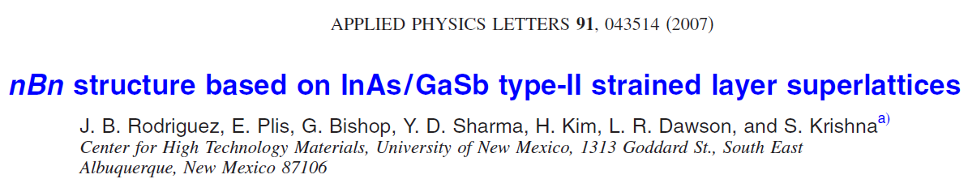
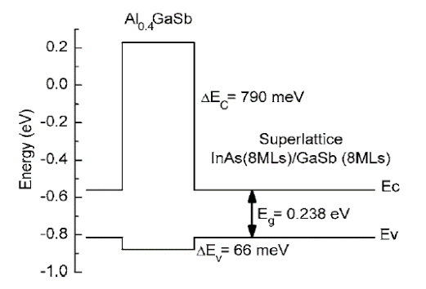
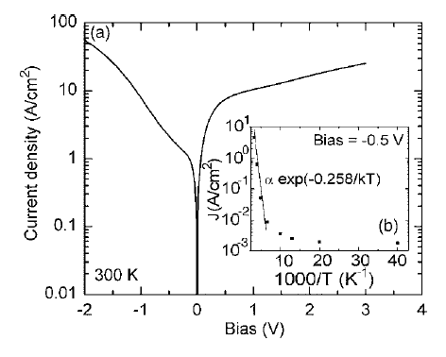
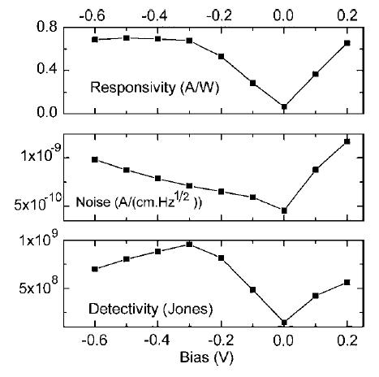
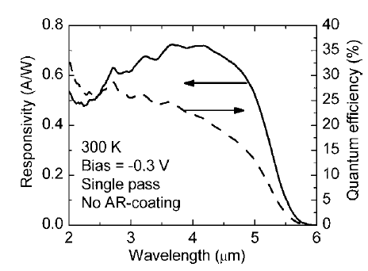
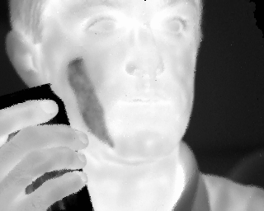
InAs/GaSb Superlattices based Detectors and FPAs
T=77K
320x256
f4 optics, NETD=23.8mK
Kim et al, Appl. Phys. Lett. 92, 183502 (2008)

Slide 18
2 Color nBn Superlattice Detectors
Dual-color detection using nBn based T2SL detectors
Barrier
Barrier
N-SLS
(λ₁)
N-SLS
(λ₂)
N-SLS
(λ₂)
N-SLS
(λ₁)
V_{bias}
V_{bias}
Khoshakhlagh et al, (APL,263504, 2007)

Slide 19


Dual Color (LW/LW) pBp Detectors
Barrier
LWIR2
LWIR1
Top
Bottom
p
P+ InAs/GaSb Contact
p- InAs/GaSb “Red” LWIR Abs. (4µm)
B
p- InAs/AlSb Barrier
The detector was designed to operate with λ_{50%, blue} = 9.5 µm and λ_{50%, red} 11.5 µm
p
p- InAs/GaSb “Blue” LWIR Abs. (4µm)
P+ InAs/GaSb Contact
P+ GaSb
Notes:
Double Check

Slide 20
Band-Structure Engineering
Potential benefits of superlattices over bulk alloys:
E_{g}=Δ -type resonance can be engineered into either conduction or valence band, giving rise to engineered impact ionization coefficients (β/α<<1 or β/α >>1) or reduced Auger recombination
E_{g} and Δ are independently adjustable ⇒ resonance can occur at desired wavelength in broad spectral range: SWIR to VLWIR
Resonant band has high density of states ⇒ can benefit from resonance even in high fields
Large growth-axis effective masses ⇒ lower dark currents
Superlattice Based Avalanche Photodiodes:
β/α enhancement in AlAs/GaAs (Mon and Hess, 1982)
Bandstructure engineering can only be done in superlattices and quantum confined materials

Slide 21
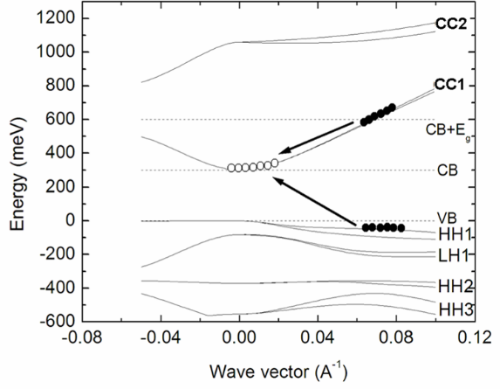
Engineering Impact Ionization in Superlattices
ElectronAPD
Hole APD
Banerjee, K., Ghosh. S, Mallick.S, Plis E, Krishna S. and Grein C "Midwave infrared InAs/GaSb strained layer superlattice hole avalanche photodiode." Applied Physics Letters 94, no. 20 (2009): 201107.
Mallick, S., Banerjee, K., Ghosh, S., Plis, E., Rodriguez, J. B., Krishna, S., & Grein, C. (2007). Ultralow noise midwave infrared InAs–GaSb strain layer superlattice avalanche photodiode. Applied Physics Letters, 91(24), 241111.

Slide 22



Impact Ionization and Avalanche photodiode (APDs)
Excess noise

Slide 23


Design of Low Noise APD
For a desired gain value.
noise
Output
Random process
noise
Internal gain
Excess noise
Figure of Merits
Multiplication
(M)
Stochastic process
Excess noise
factor (F) or k value
$α$ : electron ionization coefficient
$β$ : hole ionization coefficient
Notes:
We need to get a good materials which has low-k value and high multiplication.
k value depends on a material that we will use.
This excess noise is Inevitable because in order to use APD we need a internal gain which create excess noise!
Unfortunately, the excess noise can degrade the S/N ratio

Slide 24
Outline
Motivation and Application Need
  Mid-infrared Imaging and Sensing
  Driving Application Need for NASA
Technology Background
  Antimonide Based Semiconductors
  Historical Perspective of Superlattices
  Physics of Superlattices
Engineering Superlattice Band-diagrams and Band-structures
  Band-diagram Engineering: Unipolar Barrier Detectors
  Band-structure Engineering: Superlattice Avalanche Photodiodes
Technology Status and Future Directions
  Job security for Physicists, Chemists, Material Scientists and Engineers!!!

Slide 25



State of Superlattice Technology
Thanks to US DoD investments, Significant Advances Made in the T2SL Technology (Especially in MWIR )
Antimonide Superlattice Technology (2018)
Space
DoD
Technology Readiness Level
Customer Requirement*
Commercial
DoD Vista Push
Wavelength
Ting et al. IR Tech and Applications XLIII. Vol. 10177 2017.
Vurgaftman, I., et al APL 108.22 (2016): 222101.
Ariyawansa, Gamini, et al. APL 108.2 (2016): 022106.
B. V. Olson et al, Phys. Rev. Appl. 7, 24016 (2017).
Sundaram, M. SPIE Proc. XLIII, 10177-33, 2017
Razeghi et al Optics letters 43, no. 3 (2018): 591-594.
* Customers have different product requirements with varying price points

Slide 26
Scientific Challenges for Superlattices
Key drift-diffusion parameters for vertical transport are not fully understood
    Effect of localization, Sb segregation, interfacial roughness, hole-mixing, on minority carrier diffusion length and vertical mobility
Passivation of p-type superlattice material
Behavior of hot carriers at edge of Brillouin Zone
Reduction of noise to achieve high operating temperature long wave infrared
Reduced modulation transfer function (MTF – array contrast) in small pixel, high fill factor, large format nBn format focal plane array (FPA) – due to lateral collection

Slide 27
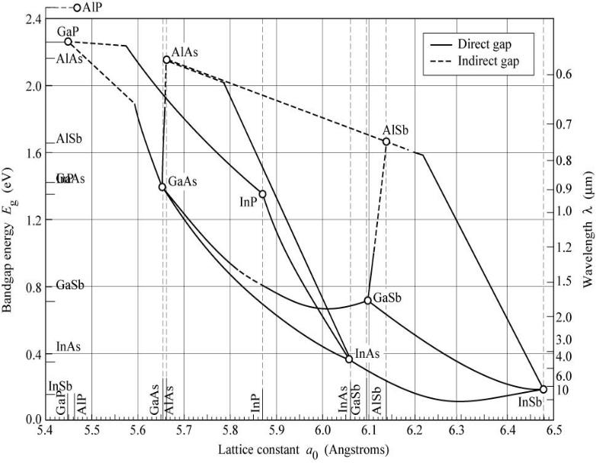
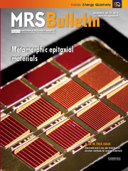
New Materials Platform: 6.3 Å Metamorphic Antimonides
LWIR (8 -14 μm):
Wavelength range with the most available thermal imaging cameras.
According to Planck’s law, terrestrial targets emit mainly in the LWIR.
a_{e}
LWIR
InAs_{1-x}Sb_{x}
Epitaxy layer
a_{s}
Starting substrate
Lattice constant vs. wavelength in III-V semiconductors
Available substrate
Lattice constant a_{s} < a_{e}
Requires virtual substrate of same lattice constant
Svensson, S. P., et al Physical Review B 86, no. 24 (2012): 245205
Dahiya et al, JVSTB, 2018.

Slide 28
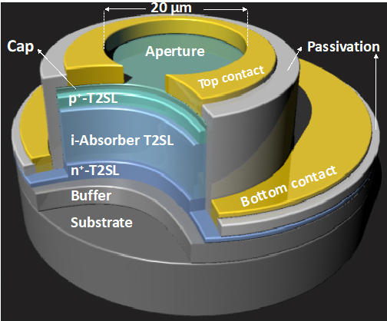
Field Programmable Avalanche Photodiodes
Objective: Replace two detectors with a single field programmable detector
Singh et al, IEEE JST AEORS, 2018

Slide 29
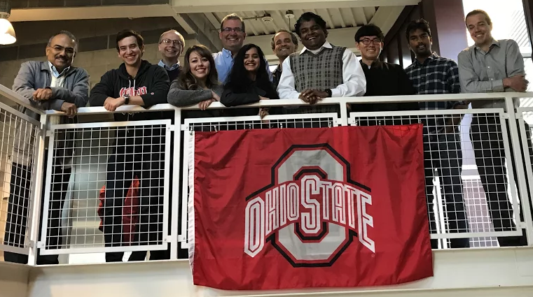
Krishna INfrared Detector (KIND) Laboratory
Senior Researchers
Graduate Students
Dr. Chris Ball (Res. Scientist)
Dr. TJ Ronningen (Sr. Researcher)
Dr. Alireza Kazemi (Postdoc)
Dave Hollingshead (Res. Engg)
Sen Mathews (Res. Scientist)
Teressa Specht (PhD)
Vinita Dahiya (PhD)
Seung Hyun Lee (PhD)
Sri Harsha Kondati (PhD)
Lilian Acosta (PhD)*
Zahra Taghipour (PhD)*
Undergraduate Students
https://kind.engineering.osu.edu/
Spring 2018
Brett Ringel
Rudy Fink
Aashita Kawatra
Quentin Shu
Funding Agencies
, HEL-JTO, DARPA/AFRL , MDA,
Collaborators
Past Group Members
Grassman/Ringel/Rajan/Carlin/ Rodriguez-Saona/Heremans/Myers (OSU)
Grein (UIC)/Campbell (Uva)
Grbic (Michigan)
Maria (NC State)
Schehing/Reyner/Ariyawansa/Duran (AFRL-RY)
Cowan/Steenbergen/Morath(AFRLRV))
SK Infrared LLC
Lee/Kim (KRISS)
Raytheon Vision Systems
Research Faculty/Postdocs (8): Dr. A.Amout (Emcore), Dr. P. Dowd (ASU), Dr. J. Brown (Micron), Dr. J.B. Rodriguez (Montpellier), Dr. T. Vandervelde, (Tufts); Dr. M. Naydenkov (Lightspin); Dr. Y.D. Sharma (OSI); Dr. J.O. Kim (KRISS); Dr. Plis (Assurance); Dr. Winckel (SNL); Dr. Tian, Dr. Klein (SNL);
PhDs (26): Dr. Winckel, (UNM); Dr. Zhu, (DC); Dr. Plis, UNM; Dr. Attaluri, Lehigh Univ.; Dr. Newmann, Emcore; Dr. Andrews, NRL; Dr. Wilcox NRL, Dr. Khoshakhlagh (JPL), Dr. Kim (UCB), Dr. Shenoi (RPI), Dr. Ramirez (Skinfrared), Dr. Shao (Purdue); Dr. Barve (UCSB); Dr. Gautam (UCSB); Dr. Jang (AFRL/RY), Dr. Myers (Skinfrared); Dr. Kutty; Dr. Fiorante (Universidade de São Paulo); Dr. F. Santiago (SNL); Dr. Brianna Klein (UNM);. Dr. Sebastian Godoy (Concepcion); Dr.Montoya (Duke); Dr. Schuler-Sandy (UNM); Dr. Kazemi (OSU); Dr. Zarmiri (UW) Dr. Cowan (AFRL);
M.S. (16) : C. Kadlec (SNL), M. Malone T. Specht, K. Knobel (AFRL), J. Oberling, A. Scott (AFRL), N. W. Bernstein (LANL), J. Shelton, (SNL), G. Bishop (SNL), E. Varley (SNL), D. Jepson (AFRL); M. Lenz, (SNL), K. Posani (Qualcomm), C. Wilcox, (NRL), S. Annamalai (Triquint), M. Serna (Oxford), S.Raghavan
www.krishnairlab.com
* At UNM

