Slide 1


Multi-Output Autoregressive (MOAR) Aerodynamic Modeling For Flutter Prediction
Ron Efrati, Prof. Daniella Raveh
Technion – Israel Institute of Technology
AePW4 Meeting, September 12

Slide 2
Introduction
Focus on Reduced Order Models (ROMs) for the transonic unsteady aerodynamics
Time domain may require less data for model identification than frequency domain ROMs
Time domain model identification with MOAR modeling has been successfully implemented given time history of aeroelastic response in many flow conditions
Computational effort may be drastically reduced if the model identification process is implemented solely on the unsteady aerodynamics model

Slide 3
Outline
MOAR modeling
  Formulation
  Unsteady aerodynamic modeling
Aeroelastic coupling in state-space
BSCW airfoil section test case
  Preliminary results
  Validation

Slide 4
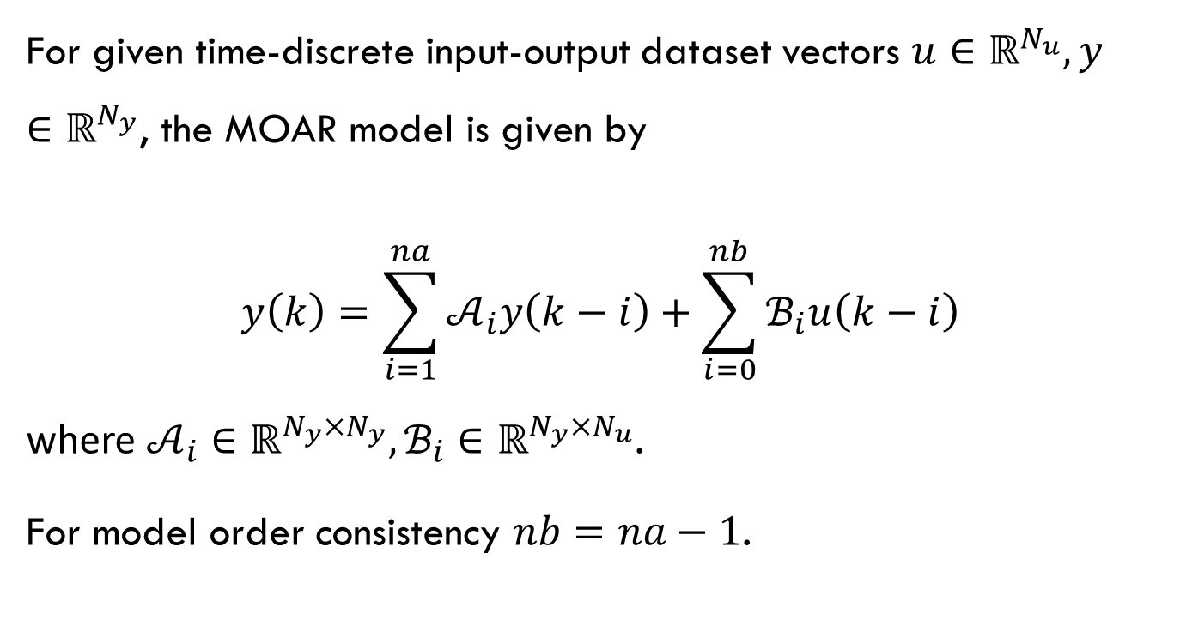
MOAR Model Formulation
For given time-discrete input-output dataset vectors $u∈ℝ^{N_{u}},y∈ℝ^{N_{y}}$, the MOAR model is given by
$$y\left(k\right)=\sum_{i=1}^{na}{𝒜_{i}y\left(k−i\right)}+\sum_{i=0}^{nb}{ℬ_{i}u\left(k−i\right)}$$
where $𝒜_{i}∈ℝ^{N_{y}×N_{y}},ℬ_{i}∈ℝ^{N_{y}×N_{u}}$.
For model order consistency $nb=na−1$.

Slide 5
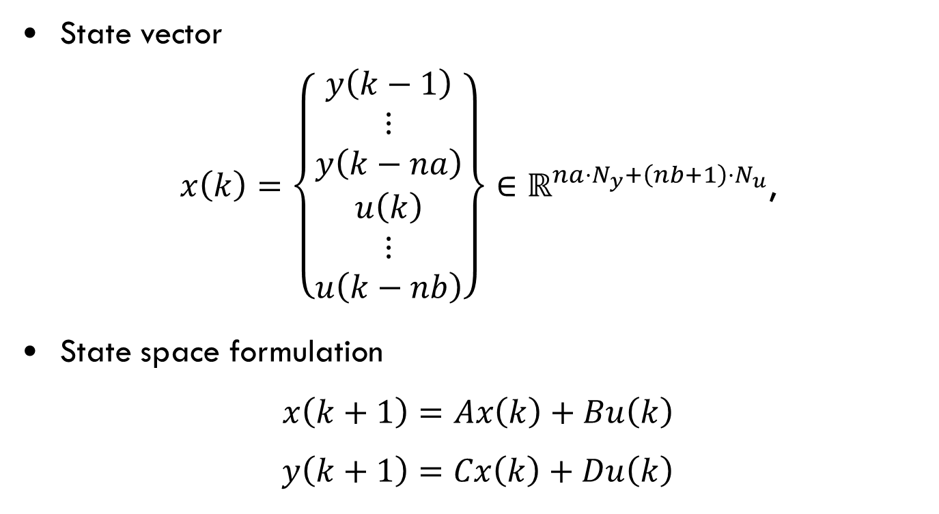
State Space Form
State vector
$x\left(k\right)=\left\{\begin{matrix}y\left(k−1\right) \\ ⋮ \\ y\left(k−na\right) \\ u\left(k\right) \\ ⋮ \\ u\left(k−nb\right)\end{matrix}\right\}∈ℝ^{na⋅N_{y}+\left(nb+1\right)⋅N_{u}}$,
State space formulation
$$x\left(k+1\right)=Ax\left(k\right)+Bu\left(k\right)$$
$y\left(k+1\right)=Cx\left(k\right)+Du\left(k\right)$

Slide 6

State Space Form
$$A=\left[\begin{matrix}𝒜_{1} & ⋯ & 𝒜_{na} & 0 & ℬ_{1} & ⋯ & ℬ_{nb} \\ I & ⋯ & 0 & 0 & 0 & ⋯ & 0 \\ & ⋱ & & ⋮ & ⋮ & & ⋮ \\ 0 & & I & 0 & 0 & ⋯ & 0\end{matrix}\right], B=\left[\begin{matrix}ℬ_{0} \\ 0 \\ ⋮ \\ I \\ ⋮ \\ 0\end{matrix}\right]$$
$$C=\left[\begin{matrix}𝒜_{1} & ⋯ & 𝒜_{na} & ℬ_{1} & ⋯ & ℬ_{nb}\end{matrix}\right]$$
$$D=ℬ_{0}$$
Stability requirement $\left|λ_{A}\right|<1$.

Slide 7
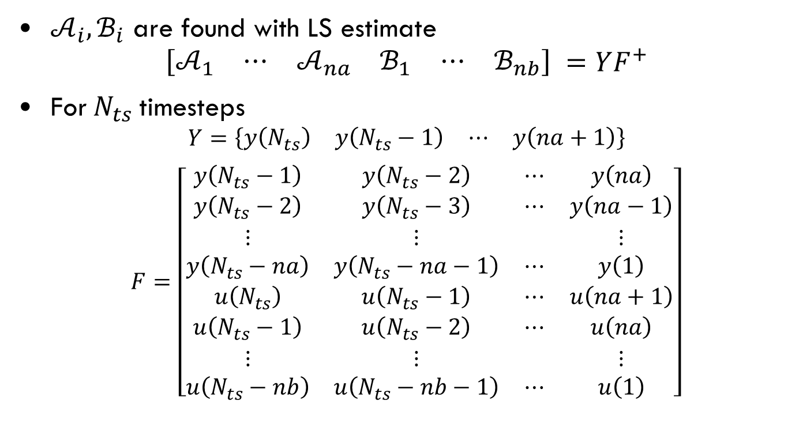
State Space Form
$𝒜_{i},ℬ_{i}$ are found with LS estimate
$$\left[\begin{matrix}𝒜_{1} & ⋯ & 𝒜_{na} & ℬ_{1} & ⋯ & ℬ_{nb}\end{matrix}\right] =YF^{+}$$
For $N_{ts}$ timesteps
$$Y=\left\{\begin{matrix}y\left(N_{ts}\right) & y\left(N_{ts}−1\right) & ⋯ & y\left(na+1\right)\end{matrix}\right\}$$
$F=\left[\begin{matrix}y\left(N_{ts}−1\right) & y\left(N_{ts}−2\right) & ⋯ & y\left(na\right) \\ y\left(N_{ts}−2\right) & y\left(N_{ts}−3\right) & ⋯ & y\left(na−1\right) \\ ⋮ & ⋮ & & ⋮ \\ y\left(N_{ts}−na\right) & y\left(N_{ts}−na−1\right) & ⋯ & y\left(1\right) \\ u\left(N_{ts}\right) & u\left(N_{ts}−1\right) & ⋯ & u\left(na+1\right) \\ u\left(N_{ts}−1\right) & u\left(N_{ts}−2\right) & ⋯ & u\left(na\right) \\ ⋮ & ⋮ & & ⋮ \\ u\left(N_{ts}−nb\right) & u\left(N_{ts}−nb−1\right) & ⋯ & u\left(1\right)\end{matrix}\right]$

Slide 8
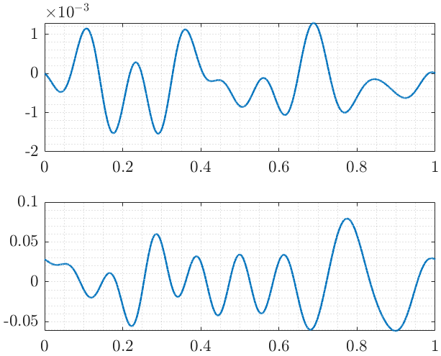
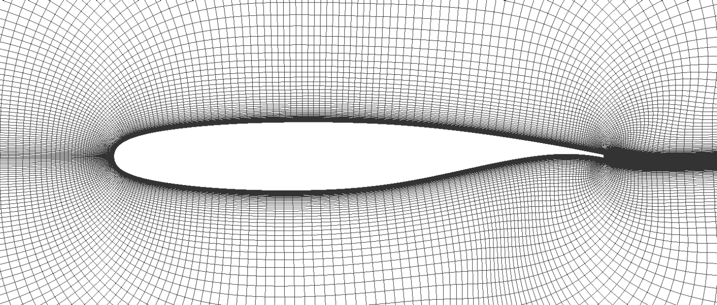
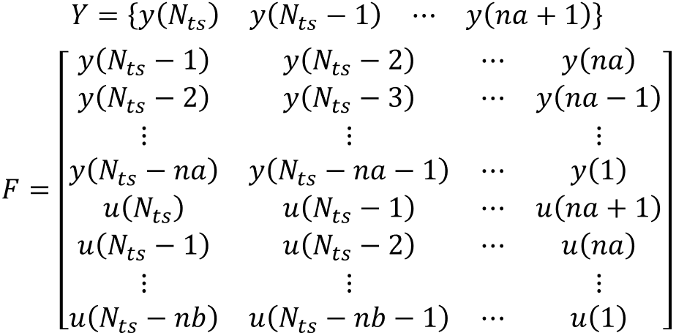
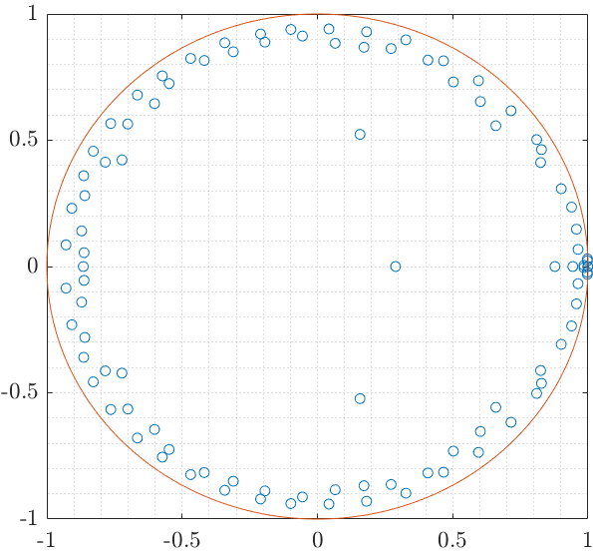


Procedure
Identification of 2DOF aerodynamic model
$$y\left(k\right)=q_{∞}^{−1}\left\{\begin{matrix}L\left(k\right) \\ M\left(k\right)\end{matrix}\right\}, u\left(k\right)=\left\{\begin{matrix}h\left(k\right) \\ θ\left(k\right)\end{matrix}\right\}$$
Prescribed Motion Time-History
SS MOAR Model
Stability Analysis
Aerodynamic Lift and Moment Computation

Slide 9
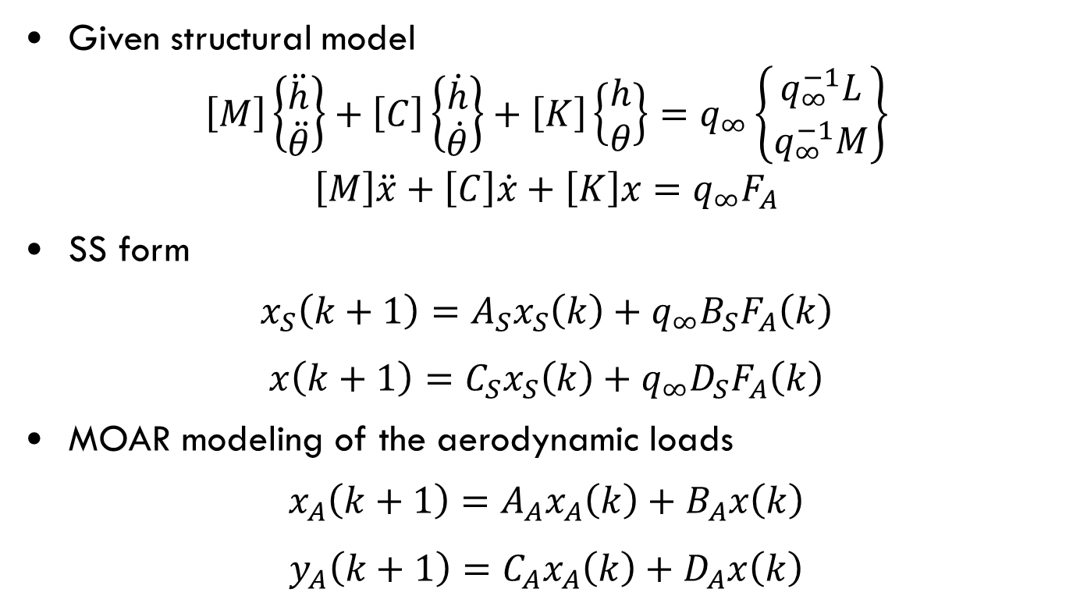
Aeroelastic Coupling
Given structural model
$$\left[M\right]\left\{\begin{matrix}\ddot{h} \\ \ddot{θ}\end{matrix}\right\}+\left[C\right]\left\{\begin{matrix}\dot{h} \\ \dot{θ}\end{matrix}\right\}+\left[K\right]\left\{\begin{matrix}h \\ θ\end{matrix}\right\}=q_{∞}\left\{\begin{matrix}q_{∞}^{−1}L \\ q_{∞}^{−1}M\end{matrix}\right\}$$
$$\left[M\right]\ddot{x}+\left[C\right]\dot{x}+\left[K\right]x=q_{∞}F_{A}$$
SS form
$$x_{S}\left(k+1\right)=A_{S}x_{S}\left(k\right)+q_{∞}B_{S}F_{A}\left(k\right)$$
$x\left(k+1\right)=C_{S}x_{S}\left(k\right)+q_{∞}D_{S}F_{A}\left(k\right)$
MOAR modeling of the aerodynamic loads
$$x_{A}\left(k+1\right)=A_{A}x_{A}\left(k\right)+B_{A}x\left(k\right)$$
$y_{A}\left(k+1\right)=C_{A}x_{A}\left(k\right)+D_{A}x\left(k\right)$

Slide 10
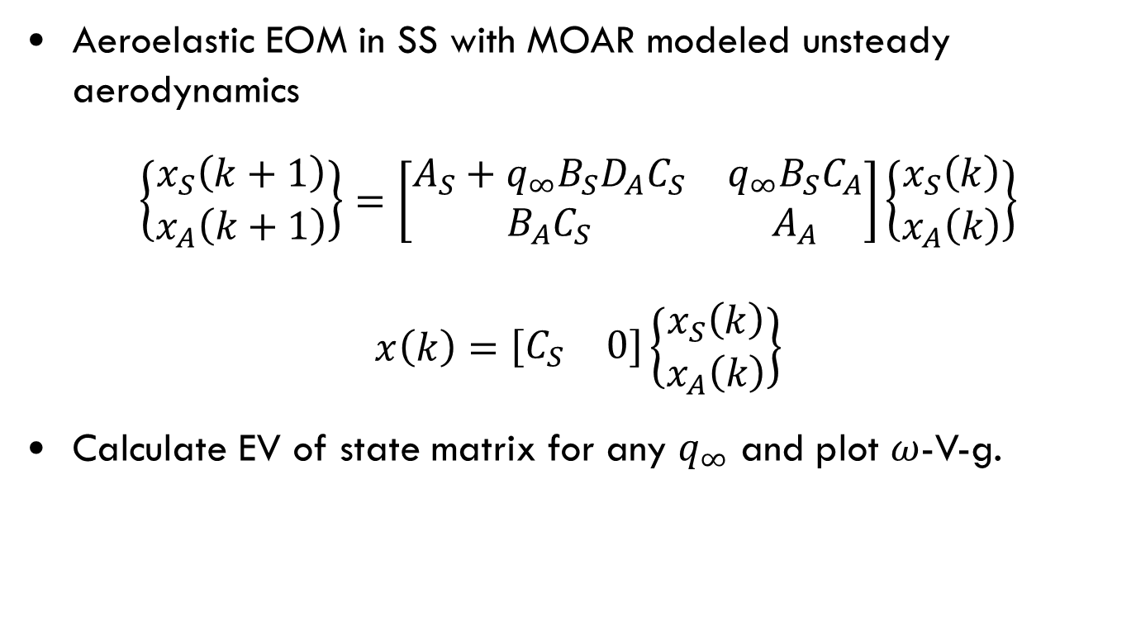
Aeroelastic Coupling
Aeroelastic EOM in SS with MOAR modeled unsteady aerodynamics
$$\left\{\begin{matrix}x_{S}\left(k+1\right) \\ x_{A}\left(k+1\right)\end{matrix}\right\}=\left[\begin{matrix}A_{S}+q_{∞}B_{S}D_{A}C_{S} & q_{∞}B_{S}C_{A} \\ B_{A}C_{S} & A_{A}\end{matrix}\right]\left\{\begin{matrix}x_{S}\left(k\right) \\ x_{A}\left(k\right)\end{matrix}\right\}$$
$$x\left(k\right)=\left[\begin{matrix}C_{S} & 0\end{matrix}\right]\left\{\begin{matrix}x_{S}\left(k\right) \\ x_{A}\left(k\right)\end{matrix}\right\}$$
Calculate EV of state matrix for any $q_{∞}$ and plot $ω$-V-g.

Slide 11

BSCW Airfoil Section Test Case
Generate prescribed motion signals (filtered random signals)
  $Δt={10}^{−4}$seconds ($F_{S}={10}^{4}$ Hz)
  $N_{ts}={10}^{4}$ (Simulation time 1 second)
  Frequency resolution 1 Hz
  Frequency range 2 Hz – 10 Hz

Slide 12

BSCW Airfoil Section Test Case
Compute aerodynamic lift and moment
  EZAir code
  Structured RANS solver
  $k$-$ω$ SST

Slide 13

BSCW Airfoil Section Test Case
Plot Partial Auto-Correlation Function (PACF) to determine adequate AR order
  Represents the correlation between the signal with each of its lagged values, that is not accounted for shorter lags
  $na=50$ is sufficient for 2% confidence interval

Slide 14
BSCW Airfoil Section Test Case
Comparison between the MOAR model and exact CFD results

Slide 15
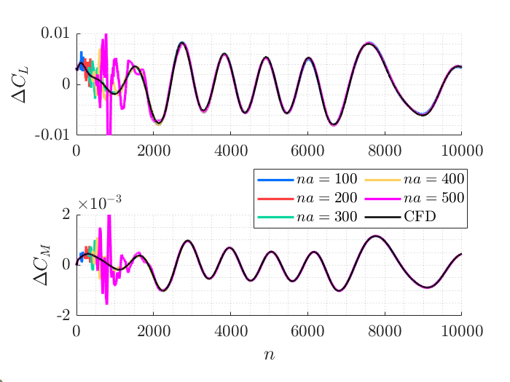
BSCW Airfoil Section Test Case
Large AR orders might introduce overfitting errors

Slide 16
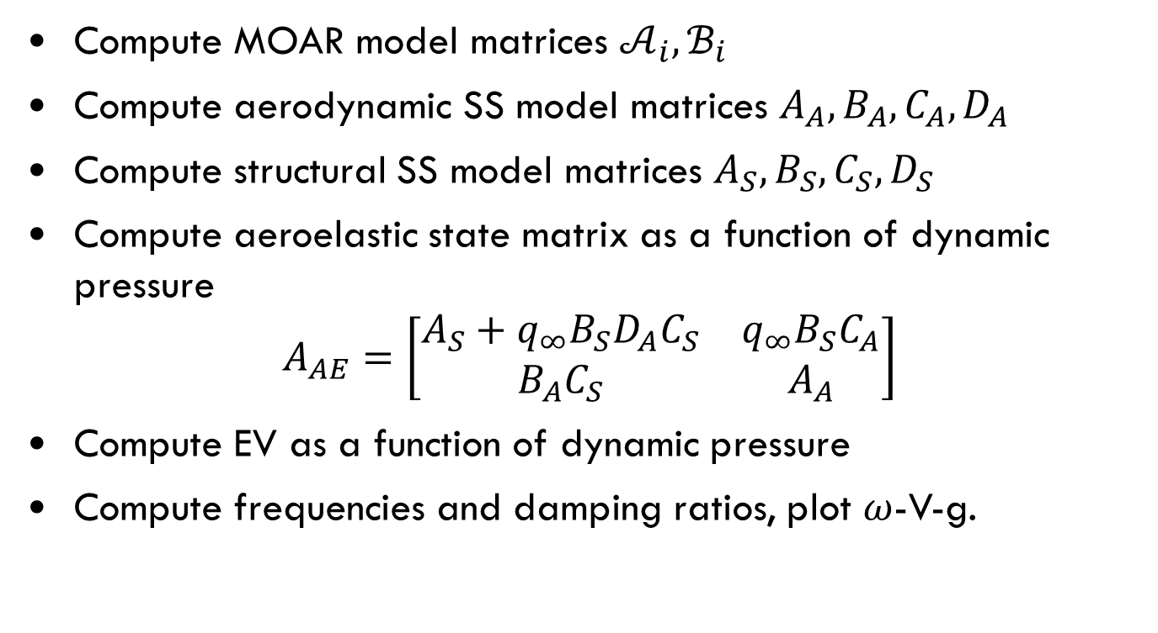
BSCW Airfoil Section Test Case
Compute MOAR model matrices $𝒜_{i},ℬ_{i}$
Compute aerodynamic SS model matrices $A_{A},B_{A},C_{A},D_{A}$
Compute structural SS model matrices $A_{S},B_{S},C_{S},D_{S}$
Compute aeroelastic state matrix as a function of dynamic pressure
$$A_{AE}=\left[\begin{matrix}A_{S}+q_{∞}B_{S}D_{A}C_{S} & q_{∞}B_{S}C_{A} \\ B_{A}C_{S} & A_{A}\end{matrix}\right]$$
Compute EV as a function of dynamic pressure
Compute frequencies and damping ratios, plot $ω$-V-g.

Slide 17

BSCW Airfoil Section Test Case
Mach 0.8, AoA $1^{∘}$

Slide 18

BSCW Airfoil Section Test Case
Mach 0.8, AoA $5^{∘}$

Slide 19
BSCW Airfoil Section Test Case
Mach 0.8, AoA sweep

Slide 20

BSCW Airfoil Section Test Case
AoA $1^{∘}$, Mach sweep

Slide 21

BSCW Airfoil Section Test Case
Validation with aeroelastic simulation at Mach 0.8, AoA $1^{∘}$

Slide 22
BSCW Airfoil Section Test Case
Validation with aeroelastic simulation at Mach 0.8, AoA $1^{∘}$

Slide 23

BSCW Airfoil Section Test Case
Validation with aeroelastic simulation at Mach 0.8, AoA $1^{∘}$
  3.5% error in flutter dynamic pressure obtained with MOAR model compared with aeroelastic URANS simulation

Slide 24
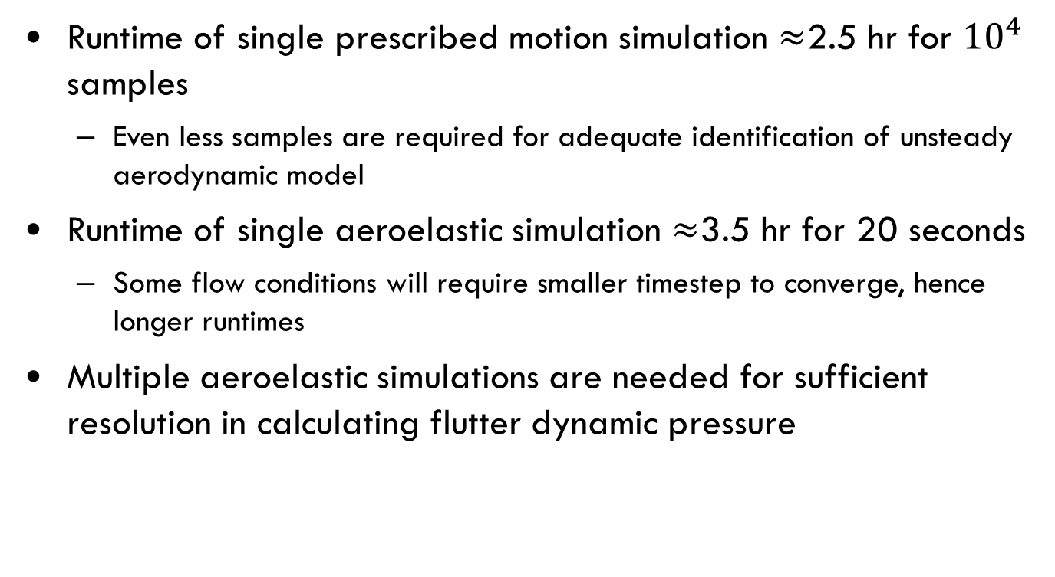
Computational Aspects
Runtime of single prescribed motion simulation $≈$2.5 hr for ${10}^{4}$ samples
  Even less samples are required for adequate identification of unsteady aerodynamic model
Runtime of single aeroelastic simulation $≈$3.5 hr for 20 seconds
  Some flow conditions will require smaller timestep to converge, hence longer runtimes
Multiple aeroelastic simulations are needed for sufficient resolution in calculating flutter dynamic pressure

Slide 25
Next Steps
Complete validation of AoA sweep
Analysis of the finite wing
Apply aerodynamic MOAR model at buffet conditions

